Slide 1
Windows Low-Level System Monitoring Data Collection

Slide 2
Outline
Overview and Status
Performance
Data to be provided
CDM Mapping
A Look from TA2 Perspective
Timeline

Slide 3
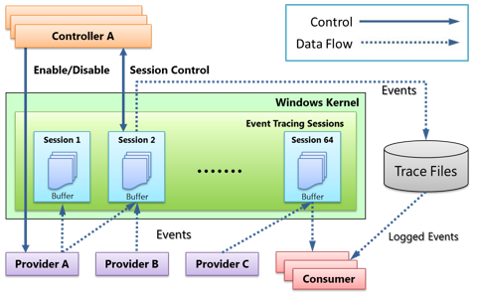
ETW Architecture
ETW has many trace providers (600+ in Win7, 1000+ in Win10)
NT Kernel Logger: Kernel logging
Microsoft-Windows-USB-UCX/Microsoft-Windows-USB-USBPORT: USB logging
Stackwalking with xperf (A tool which also uses ETW): Stack logging
Notes:
Data source -> ETW
Controller, provider, consumer / session provider
Controller enables provider
Consumer receiver data from ETW and parse
Session – consumer (real-time), only one session is real-time
Many ways of storing (
Tool on the end user: Control and parse; Use TA3 API to compress into AVRO files; data transmission protocol ()
USB logging

Slide 4
ETW Features
Robust: Immune to crash and hangs. In case of a system crash, it maintains a temporary log file
Lightweight: Highly optimized to monitor and logging. uses kernel-mode buffers. Log is written by a separate thread
Built-in: No additional tools need to be installed
Dynamic: Can be started, configured and stopped dynamically without rebooting the system

Slide 5
Challenges
Efficiency
The default ETW tdh library for parsing events can only achieve 2000-3000 events per second.
Solution: we manage to get the struct of each event class and parse more than 1,000,000 events per second.
Notes:
No multi-thread parsing / single-thread
Nt Kernal logger (21 providers, 105 events (30-40 classes)), manual check MSDN (DWORD type), parse fields based on the offset to the event base address
Consume the event (CPU is calling which kernel address)

Slide 6
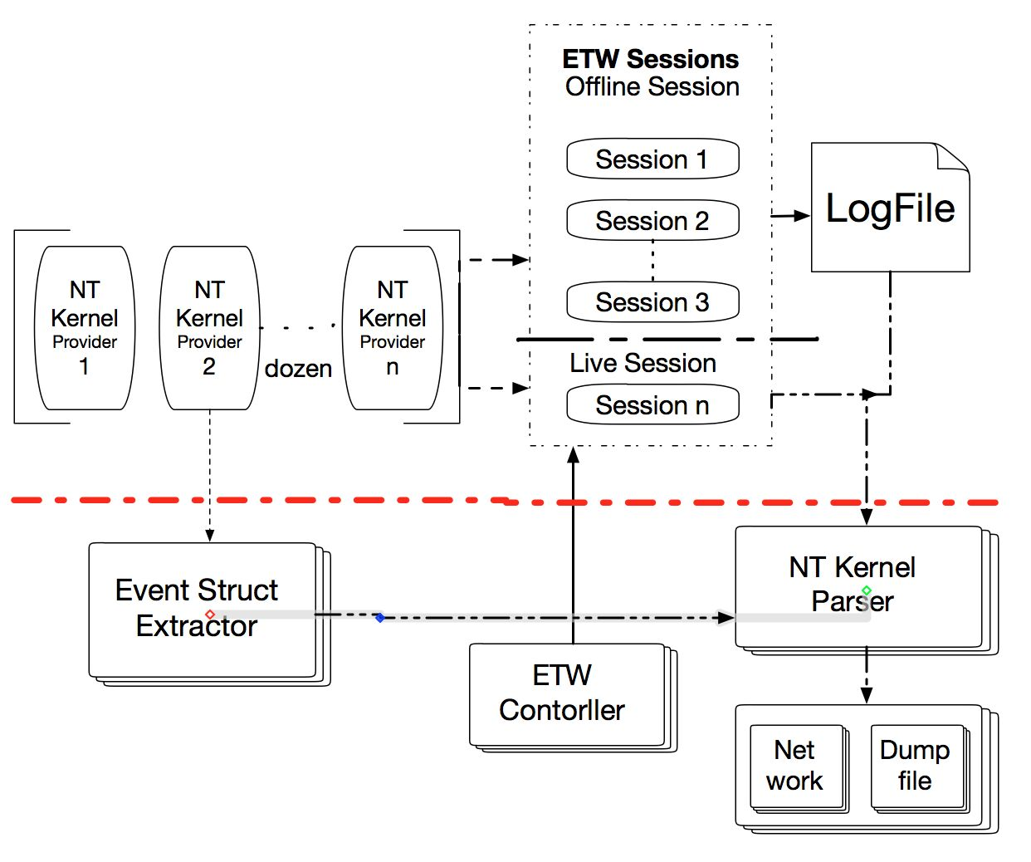
Our System
Notes:
Our effort
NT Kernel
Feature store (remove)
虚线、红圈圈

Slide 7
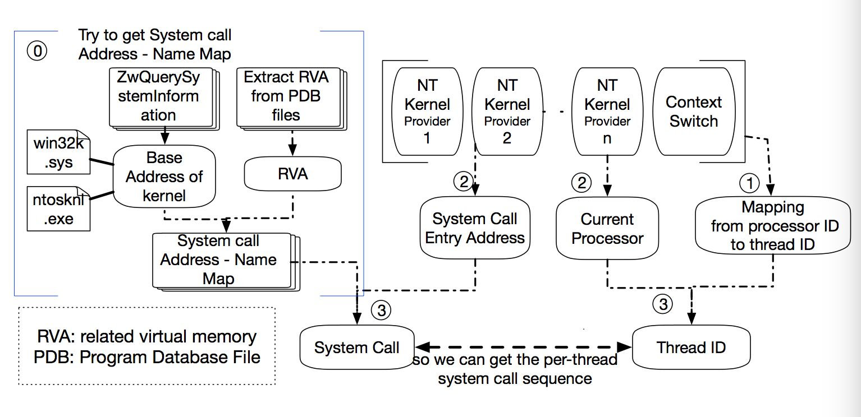
Thread-level System Call Data Collection
Notes:
NT Kernel
2/2 Which processor is calling which address
Context Switch
One processor is being used by which thread
A system call (actually API) of NTDLL.dll -> image message (NT Kernel is loaded, current loaded)
System calls stored in Windows Kernel (Win32k.sys, NTOSKNL.exe)
Output: which thread invokes which system call?

Slide 8
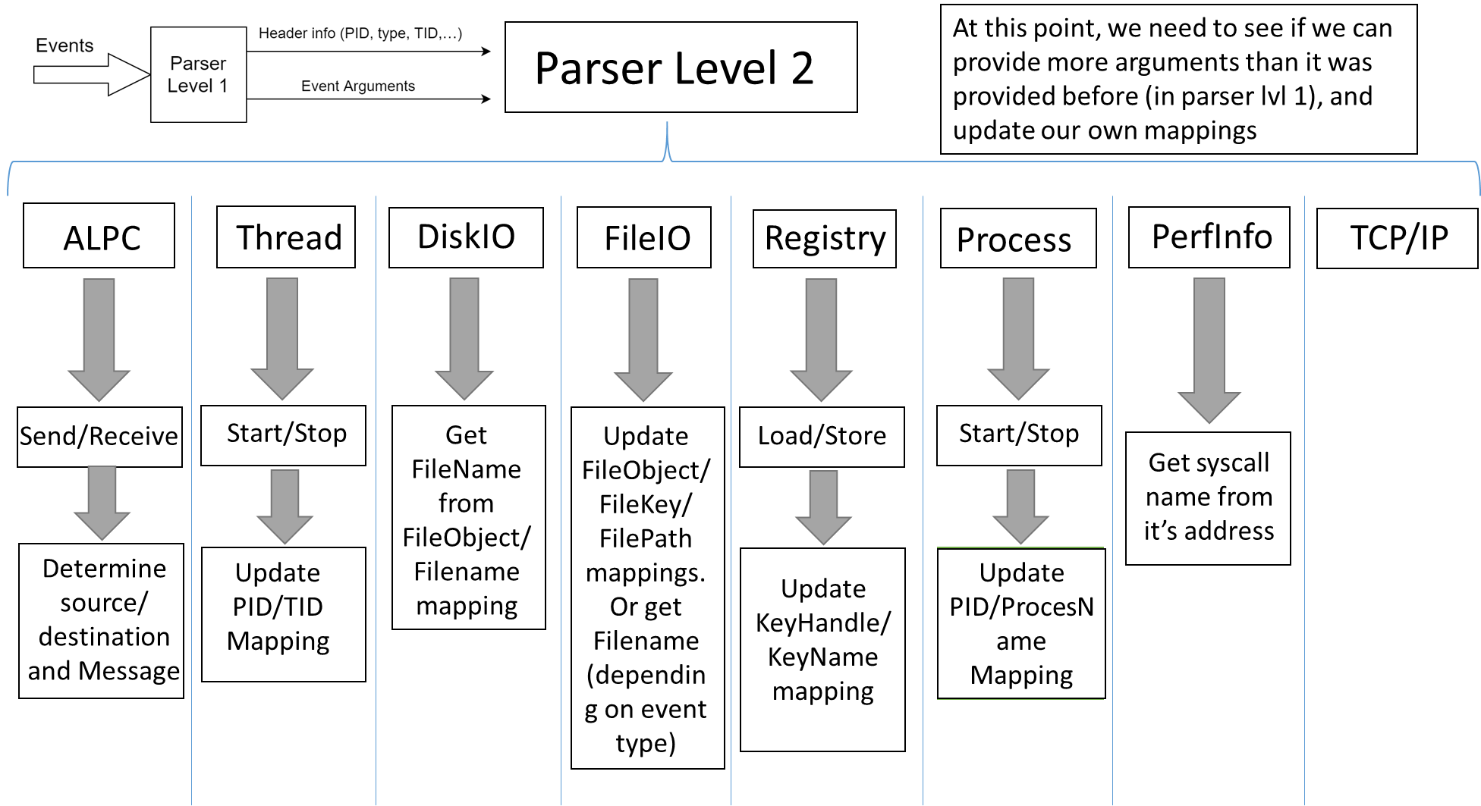

Slide 9
Deployment and Performance

Slide 10
Deployment and System Overhead
We have tested our system on server physical machines, including the PI’s desktop:
Computer Specification
CPU: Intel(R) Core(TM) i5-4590 CPU @ 3.30GHz
RAM: 8GB
Operation System: Windows 7 SP1 64 bit
Speed
Collecting + parsing + converting to cdm + writing to file
Full-Load, full kernel system call traces, >1.5M events/sec
Full-Load, security relevant system calls + mal behavior related system calls, 1M events/sec
System has been deployed and running on the TA3 VM
Notes:
(We only focus on the overhead of ETW parser, except CDM translater and Kafka producer.
Idle Run: When computers are idle with few tasks
Full-Load: CPU-intensive and memory-intensive tasks (Watching video, program compiling (STMQ test program))
Increment in CPU/Memory

Slide 11
Data Provided

Slide 12
1: Windows Event Data from NT Kernel Logger
Category | Operations
Process | start, end
Thread | start, end
File | name, create, delete, enumeration, notification, set, rename, query, read, write, cleanup, close, flush
Registry | create, delete, enumerate
Image | load, unload, free
Network | accept, connect, disconnect, receive, reconnect, retransmit, send, fail, copy
ALPC | send, receive, wait, unwait
Notes:
There are many interested providers in the NT Kernel Logger session, such as the process, thread, image load, system call, and so on. Some of us allow us to provide thread-level system call data.

Slide 13
Windows Event Data Example
• Machine-readable (JSON-based) format
CDM Event
{ "uuid": 0xf5bcec9c0dde4075b42b01d96e3db4f8,
"type": EVENT_SENDMSG,
"subject": 0x5e9e3cf923844de3af58fe7c582d32d9,
"name": "ALPC_Send",
"timestampNanos": 131600704759045323,
"predicteObject": 0x6b644bdec2f148a8adbbc11fed72cdaa,
“properties”: {“MessageID”: 0x892AC9DD}
"CDMVersion": 18
“InstrumentationSource”: SOURCE_WINDOWS_MARPLE
...
}

Slide 14
2: System Call Data Provided, by Category (Examples)
102 selected, important system calls
Category | System Call Examples
Process | NtCreateUserProcess NtOpenProcess NtOpenProcessToken NtOpenProcessTokenEx NtQueryInformationProcess NtSetInformationProcess
File | NtOpenFile NtReadFile NtWriteFile NtCreateFile NtCreateNamedPipeFile NtQueryAttributesFile NtQueryInformationFile NtQueryVolumeInformationFile
Registry | NtOpenKey NtQueryKey NtOpenKeyEx NtEnumerateKey NtQueryValueKey NtEnumerateValueKey
Network | NtDeviceIoControlFile
Memory | NtAllocateVirtualMemory NtWriteVirtualMemory NtQueryVirtualMemory NtProtectVirtualMemory NtFreeVirtualMemory
GUI | NtGdiFlush NtGdiBitBlt NtGdiOpenDCW NtGdiStretchBlt
Keyboard | NtUserGetKeyState NtUserGetAsyncKeyState NtUserGetKeyboardState
Mouse | NtUserSetCursor NtUserDestroyCursor NtUserGetCursorFrameInfo
Clipboard | NtGdiIntersectClipRect NtUserSetClipboardViewer NtUserOpenClipboard NtGdiGetAppClipBox

Slide 15
System Call Represented in CDM
CDM Event
{ "uuid": 0x82dcf375a1d84696b6f6e4ef83596fbf,
"type": EVENT_OTHER,
"subject": 0xc702fe2a1f4240a9b2bc681f70f08b5e,
"name": “System Call",
"timestampNanos": 131606384769726357,
“properties”: {“SystemCallName”: NtFreeVirtualMemory}
"CDMVersion": 18
“InstrumentationSource”: SOURCE_WINDOWS_MARPLE
...
}

Slide 16
CDM Mapping

Slide 17
CDM Mapping: Windows Event + System Calls
ETW Events | CDM Records
Process Start | EVENT_EXECUTE
Registry Create Key | EVENT_CREATE_OBJECT
Registry Delete Key | EVENT_OTHER (delete)
Registry Enumerate Key | EVENT_OTHER (enumerate)
Image load/unload | EVENT_LOADLIBRARY
Image Virtual Free | EVENT_UMOUNT
TCP/IP Connect | EVENT_CONNECT
TCP/IP Accept | EVENT_ACCEPT
TCP/IP Disconnect | EVENT_CLOSE (disconnect)
TCP/IP Receive | EVENT_RECVMSG
TCP/IP Send | EVENT_SENDMSG
File Create | EVENT_CREATE_OBJECT
File Rename | EVENT_RENAME
File Read | EVENT_READ
File Write | EVENT_WRITE
File Delete | EVENT_UPDATE (delete)
File Close | EVENT_CLOSE
Selected System Calls (102) | EVENT_OTHER
Notes:
(1309 vs 102)
ALPC: Inter process communication (IPC)
System call entry address
VAMAP: Enables the map and unmap (excluding image files) event type (only appear starting from Win8

Slide 18
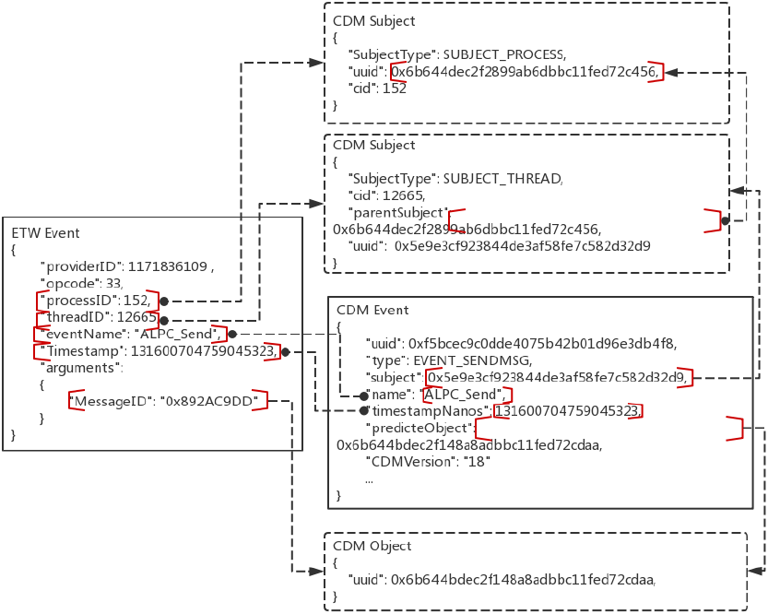
Produce a CDM Event: 1/2
1 ETW Event → N CDM Records
Notes:
Mismatch between ETW events and CDM events ->bridge the gap?
How to process records - such as aggregations and correlating events
Correlate ETW Events:

Slide 19
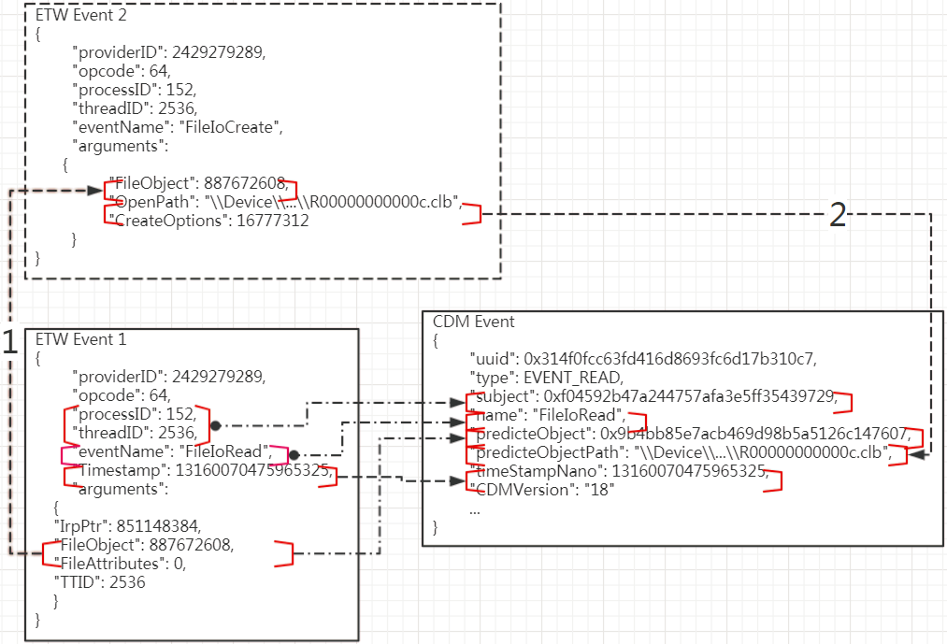
Produce a CDM Event: 2/2
N ETW Events → 1 CDM Record

Slide 20
A Look from TA2 Perspective: Policy Enforcement Detection Forensics (Attack Graph Construction)

Slide 21
Policy Enforcement Support
Policy 1: Originating User
Policy 2: Block suspect server communication
Policy 3: Block automated scripts
Policy 4: Block uploads with network data

Slide 22
Policy 1: Originating User
--Block if the user originating the process that sent the HTTP request is in a specific group
----------------------------------
We provide user/group information for a process.
101.227.143.109
firefox.exe
Steve
Group
Notes:
QQ.exe send some data to remote ip 101.227.143.109, and we can confirm that QQ.exe belongs to userid 8213960, if we have group info, we can decide whether block this connection or not.

Slide 23
Policy 2: Block suspect server communication
--Block if the process that sent the HTTP request ever communicated with a specific remote server
We provide process, TCP/IP events, socket information, timestamp.
Notes:
We can confirm that QQ.exe connect remote ip 101.227.143.109 through tracking. If this IP address is suspicious ,we can block following IP connection.

Slide 24
Policy 3: Block automated scripts
--Block if no portion of the request originated from a definite User Interface action. Define a user interface action as some subset of
---- Keyboard typing
---- GUI actions such as clicking on a menu bar item or desktop icon
---- Cut-and-paste from the clipboard
We provide system call data, related to keyboard, GUI, and clipboard.
TA2 could decide if such low-level system call data provides sufficient semantics for them to determine a specific user interface action.

Slide 25
Policy 4: Block uploads with network data
--Policy 4: Block uploads with network data
--Block uploads that contain data downloaded from a network connection
We provide the thread-level file I/O, TCP/IP events information.
We cannot provide quite fine-grained data for TA2 to determine the provenance of some portion of a file.

Slide 26
A Look from TA2 Perspective: Policy Enforcement Detection Forensics (Attack Graph Construction)

Slide 27
Effective for Malware Detection
TA2 Uses our trace for detection of malicious points.
TA1 Steaming Execution Traces
Finite Automata
Predefined Malicious Behaviors
Malicious Point Detected
Notes:
SID: Security ID (user, group, privilege, …) -> unwanted TCP/IP access
Windows assign a SID to
Policy 2: TCP/IP, DNS (ip address)
Policy 3: Keyboard typing / Keyboard action –based human interaction ()
(Keyboard input, menu …)
Policy 4:
Need fine-grained taint information (part of the file from Internet will be blocked to be sent out)

Slide 28
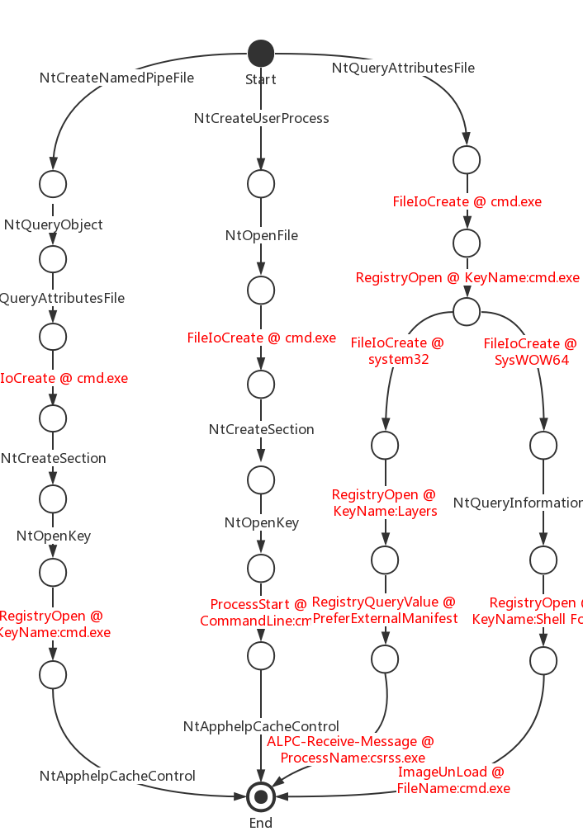
Eligible for Malware Detection
Example scenario: Remote Shell
Our mixed data of Windows Events and System calls could be used for typical APT behavior detection.
Notes:
SID: Security ID (user, group, privilege, …) -> unwanted TCP/IP access
Windows assign a SID to
Policy 2: TCP/IP, DNS (ip address)
Policy 3: Keyboard typing / Keyboard action –based human interaction ()
(Keyboard input, menu …)
Policy 4:
Need fine-grained taint information (part of the file from Internet will be blocked to be sent out)

Slide 29
A Look from TA2 Perspective: Policy Enforcement Detection Forensics (Attack Graph Construction)

Slide 30
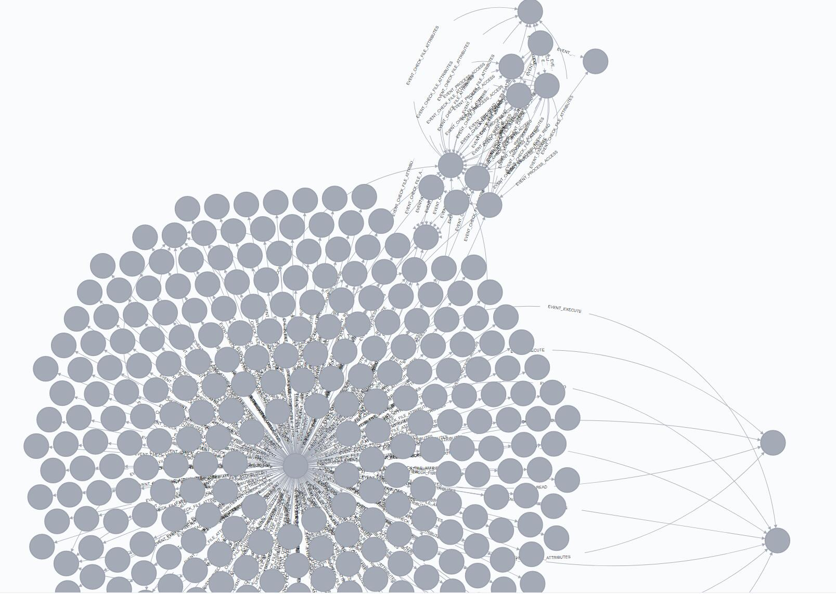
Goal
APT Detection Analytics
Malicious IP
Malicious point
IoC
When and
Where
to get into the system
More malicious behavior
In system
Malicious
Point
Firefox
backward
tracking
forward
tracking

Slide 31
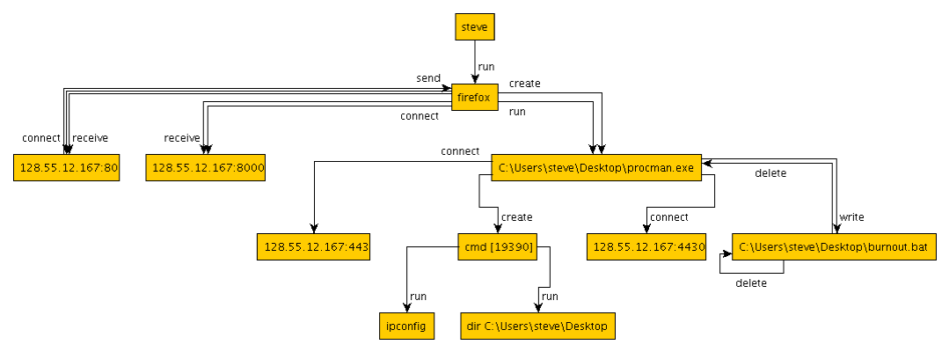
Expected Output
Ground-truth
attack graph
Our graph
Firefox
C:\Users\steve\Desktop\procman.exe

Slide 32
One challenge —— Hub Process
IP1
IP2
IP3
read
read
read
When we track the attack back to the File3, how can we know which IP the file come from？
Program
(without data-flow, this is a black box)
write
write
write
execute
File1
Malicious File3
File2
malicious behaviors

Slide 33
Scenario —— Pandex-like Browser exploit attack
Firefox: 44.0.2 version
Exploit: CVE-2016-1960
IP1
IP2
10.214.148.224:34568
IP2
IP1
10.214.148.224:34568
read
read
read
read
read
read
Firefox Process(pid:17120)
Firefox Process(pid:17120)
Other threads
payload
thread
with thread-level traces
Other threads
payload
thread
write
write
write
execute
write
write
write
execute
File1
malicious.exe
File1
malicious.exe
File2
File2
The firefox was exploited and load the payload in memory. Then payload downloaded malicious.exe form 10.214.148.222:80
With thread-level traces, it is intuitively that malicious.exe came from 10.214.148.222:80

Slide 34
First Scenario —— Pandex-like Browser exploit attack
When visiting serveral websites, all thread traffics are in the same thread
When Firefox was exploited and the payload connect back to the C&C server(10.214.148.224)

Slide 35
Can we get thread-level traces?
ETW can directly provide thread id for the following events:
File operations
Process/Thread operations
Registry operations
…
One challenge is how to provide network operation with thread id.
We find that NdisEtwProvdier can provide these information
HTTP
GET www.malware.com
TCP
DstPort:80
IPV4
Destination = 10.2.3.4
Ethemet
MAC = 6C-0B-84-3C-4B-OE
NdisEtwProvider Event
ProcessId = 1002
ThreadId = 4396

Slide 36
Comparison with FiveDirections
 | MARPLE | 5D
System Call | √ | ×
Call Stack | not now | ×
Thread Information | √ | √
User Level Events | × | √
Real-time Parsing | √ | ?
Notes: 5D is mainly user-level data, has to be saved to logs before reading from it.
We read directly from providers, have no disk access (save resource, small load on the system).
Notes:
5D is mainly user-level data,
Marple: we have no disk access (save resource, small load on the system), real-time data output
NT Keylogger session is the only real-time

Slide 37
Timeline

Slide 38
Timeline
First release provided to TA3 BBN on Dec. 19;
Second release provided to TA3 yesterday;
Benign CDM traces to be released soon;
On the track to meet the Feb. 5 deadline and involve in Engagement 3 in March.

Slide 39
The End

Slide 40
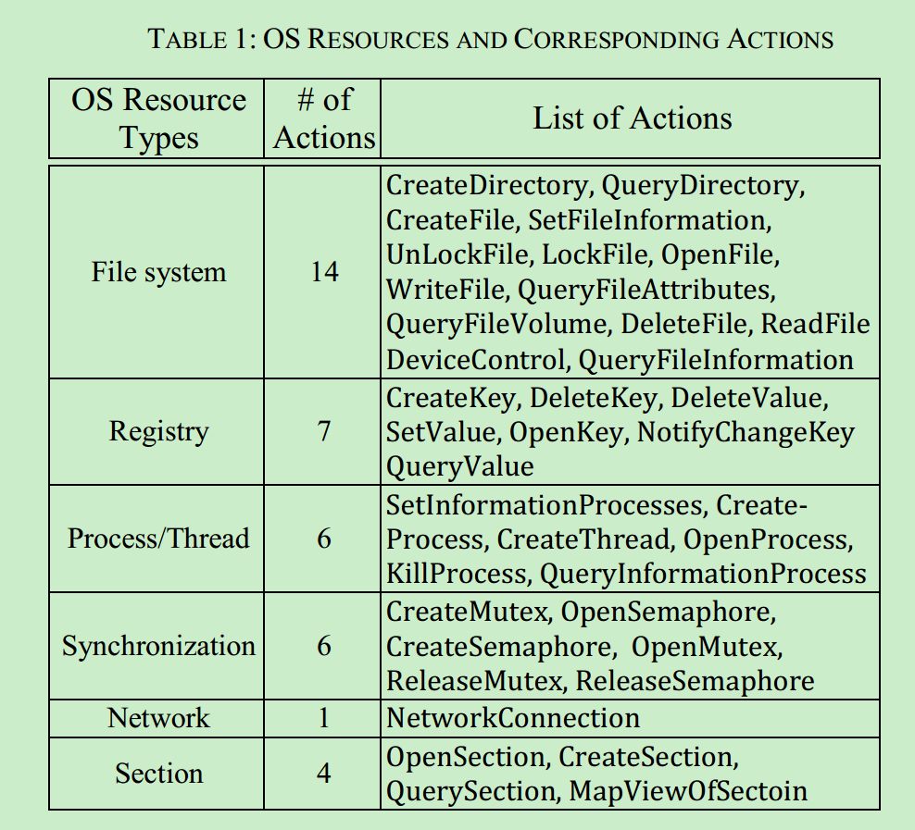
Challenges & Solutions – cont’d
We correlate events to extract the parameters for most security-related system calls.
Notes:
Reconstruction -> construction / restoration
Although we cannot uncover the parameters for all system calls, we are able to uncover the parameters for most security-related system calls.
By checking MSDN and other public forums, we could uncover a set of security-related system calls.

Slide 41
Behavioral Study of General Malware

Slide 42
Interesting points – Syscall with Stack
Syscall is so low-level that one high-level API can invoke tens of APIs which invoke hundred of syscalls
NtQuerySystemInformation
NtQuerySystemInformation
NtQuerySystemInformation
NtWaitForSingleObject
NtReleaseMutant
…
NtQueryKey
NtQueryKey
NtOpenKeyEx
NtAllocateVirtualMemory
NtCreateMutant
gdiplus.dll@GdipSaveImageToStream

Slide 43
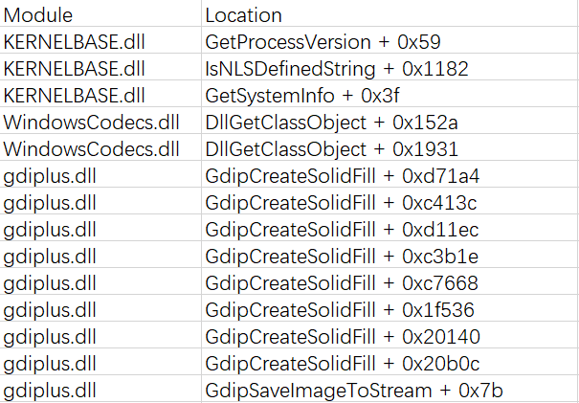
Interesting points – Syscall with Stack
Stack trace can fill the semantic gap between syscalls and APIs
The stack trace of NtQuerySystemInformation:
NtQuerySystemInformation
NtQuerySystemInformation
NtQuerySystemInformation
NtWaitForSingleObject
NtReleaseMutant
…
NtQueryKey
NtQueryKey
NtOpenKeyEx
NtAllocateVirtualMemory
NtCreateMutant

Slide 44
Interesting points – Syscall with Stack
Using syscalls to infer the behavior of malware
NtUserGetDC
NtGdiGetDeviceCaps
NtGdiGetDeviceCaps
NtGdiCreateCompatibleDC
NtGdiCreateCompatibleBitmap
NtGdiSelectBitmap
NtGdiStretchBlt
Screen Capture

Slide 45
Interesting points – Syscall with Stack
It seems that this methods works well, but ...
Benign applications also capture screen, such as Window built-in Snippingtool.exe
These syscalls could occur together occasionally in benign application without capturing screen because the diverse nature of syscalls

Slide 46
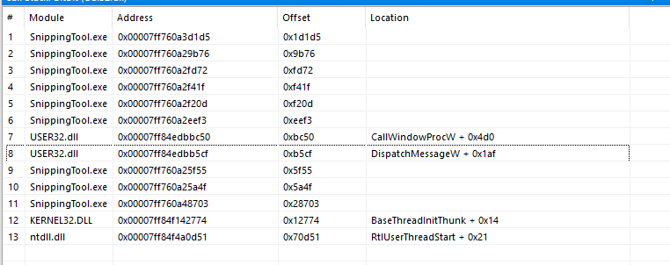
Interesting points – Syscall with Stack
Benign program usually receive human actions message (mouse click) and invoke DispatchMessage API to do the corresponding functions, such as capture the screen.
Thus the core syscall of screen capture should invoked by DispatchMessage and we can get this info from the stack trace.

Slide 47
Interesting points – Syscall with Stack
Although the core syscall of screen capture can occur together occasionally , these syscalls usually invoked by system native dlls.
The stack of GdiBitBlt from notepad. We can see that this API is invoked by system dll USER32.dll
The stack of GdiBitBlt from malware. We can see that this API is invoked by the malware itself.

Slide 48
One challenge —— Hub Process
IP1
IP2
IP3
read
read
read
When we track the attack back to the File3, how can we know which IP the file come from？
Program
(without data-flow, this is a black box)
write
write
write
execute
File1
Malicious File3
File2
malicious behaviors

Slide 49
First Scenario —— Pandex-like Browser exploit attack
IP1
IP2
215.25.80.123:80
IP2
IP1
215.25.80.123:80
read
read
read
read
read
read
Firefox Process
Firefox Process
browser
kernel
drakon
thread
with thread-level traces
browser
kernel
drakon
thread
write
write
write
execute
write
write
write
execute
File1
spd.exe
File1
spd.exe
File2
File2
The firefox was exploited and load the payload(drakon) in memory. Then drakon downloaded spd.exe form 215.25.80.123:80
With thread-level traces, it is intuitively that spd.exe came from 215.25.80.123:80

Slide 50
Can we get thread-level traces?
ETW can directly provide thread id for the following events:
File operations
Process/Thread operations
Registry operations
…
One challenge is how to provide network operation with thread id.
We find that NdisEtwProvdier can provide these information
HTTP
GET www.malware.com
TCP
DstPort:80
IPV4
Destination = 10.2.3.4
Ethemet
MAC = 6C-0B-84-3C-4B-OE
NdisEtwProvider Event
ProcessId = 1002
ThreadId = 4396

Slide 51
Second Scenario —— Malicious File Download
IP1
IP2
IP3
Using IDM(Internet Download Manager) to download three files simultaneously.
IDM
File1
File2
File3

Slide 52
Second Scenario —— Malicious File Download
IP1
IP2
IP3
Using thread we can connect each IP to a corresponding file for the popular downloader IDM(Internet Download Manager)
But for browsers ...
IDM
File1
File2
File3
Thread1
Thread2
Thread3

Slide 53
Thread-level traces are not enough
IP1
IP2
IP3
This is a simplified model for latest Firefox version. All network connections are in the same thread(Thread1) and Thread2 is responsible for writing file.
Thread 1
Thread 2
File1
File3
File2

Slide 54
Infer the provenance
When visiting website, the browser will receive a part of data and write(cache) it to the disk, and repeat this process until file is downloaded completely.
Although some IP and files are mixed and can not judge the connection between file and IP, we can still see a lot of pure traces which can infer the provenance.
Network connections and File writing are mixed together

Slide 55
Other info we can use to infer provenance
Any popular browsers will create a Zone:identifier for each downloaded file. This identifier is used to tell other programs this file is downloaded from untrusted Internet.
When visiting website, browsers will immediately cache the content, save icon, query some registries.
The size of data TCP Receive should be close to the size of daa File Write.
If a socket connecting to IP1 is disconnected before File2 is written, it is highly impossible that File2 is downloaded from IP1.

