Slide 1

PrivacyShield: Real-time Monitoring and Detection of Android Privacy Leakage
Review and Discussion
Yan Chen
Lab of Internet and Security Technology
Northwestern University
President, NetShield LLC

Slide 2
My Research
PhD. In Computer Science from UC Berkeley, 2003.
Associate Prof. of EECS Dept at Northwestern
Director of Lab for Internet and Security Technology
DOE Early CAREER Award, 2005
DOD Young Investigator Award, 2007
Microsoft Trustworthy Computing Award, 2004 & 2005
Over 80 publications with more than 5700 citations, H-index 30 (Google Scholar)

Slide 3
Origin of PrivacyShield (1)
Multi-year investigation of security and privacy in Android smartphones
Security
  Systematic evaluation of state-of-the-art Android anti-malware against transformation attacks
  Apps evaluated included AVG, Symantec, Lookout, ESET, Dr. Web, Kaspersky, Trend Micro, ESTSoft (ALYac), Zoner, Webroot, and many others
  Results: Found that all the studied tools found vulnerable to common transformations

Slide 4
Origin of PrivacyShield (2)
Privacy
  Systematic evaluation of leakage of private data from Android apps
  Studied 3,968 apps from Android Market (Google Play)
  Results: Found that 25% of Google Play apps leak data
    946 leak some info
    844 leak phone identifiers
    212 leak geographic location
  Leaks to a number of ad and analytics domains
No solutions that are truly effective

Slide 5
















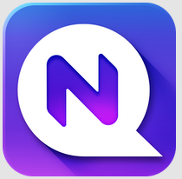


Recognition
Interest from vendors
5

Slide 6
Overview of Our Solutions
AppsPlayground (ACM CODASPY’13)
  Automatic, large-scale dynamic analysis of Android apps
DroidChamelon (ACM ASIACCS’13)
  Evaluation of latest Android anti-malware tools
→AutoCog
  Check whether sensitive permissions requested by app are consistent with its natural-language description
  Reveal suspicious sensitive permissions
  Alpha version released
→PrivacyShield
  Solves the problem of private data leakage
  Does not modify the Android platform
  Alpha version release in progress

Slide 7
The Privacy Problem
Apps regularly leak private info for ad targeting and tracking
Users can (sometimes) control access to secure information, but can’t control leakage
  Example 1: an app might access location to provide a legitimate service to the user, but then secretly share this information with advertisers and analytics services
    True for even very popular apps
    An example: Booking.com (> 5M downloads)
  Example 2: malware apps may steal private data
    TapSnake malware: A GPS spy in the garb of a game
Existing privacy apps only control permissions, not the flow of private data
No existing techniques to access whether the behavior of app oversteps user expectation

Slide 8
PrivacyShield Solution
Principles
  Give the user visibility and control over private data flow
  Real-time monitoring
Download
Instrument
Reinstall
Run
Alert User
Unmodified Android Middleware
And Libraries

Slide 9
Two Business Markets
Enterprise market: Mobile Data Management (MDM)
Consumer market: privacy protection apps

Slide 10
Mobile Data Management (MDM)
Bring Your Own Device (BYOD)
  The current trend in mobile device management
  The IT administrator has limited control over devices now
Supporting 3rd party apps
  Employees need them for personal use
  Enterprises may use them to improve productivity
  Chat, dropbox, backup apps…

Slide 11
MDM Challenges
How do apps handle data that they access
  Does it remain within the device or the enterprise?
  Is it leaked out to unknown third parties?
  Can an employee upload confidential data to a remote server
  No current solution addresses these concerns
PrivacyShield addresses these challenges

Slide 12
PrivacyShield for MDM
Sophisticated app wrapping to track privacy leaks in real time
Ability to configure global and per-app policies with respect to data handling
A unified view across all devices and apps for the IT administrators

Slide 13
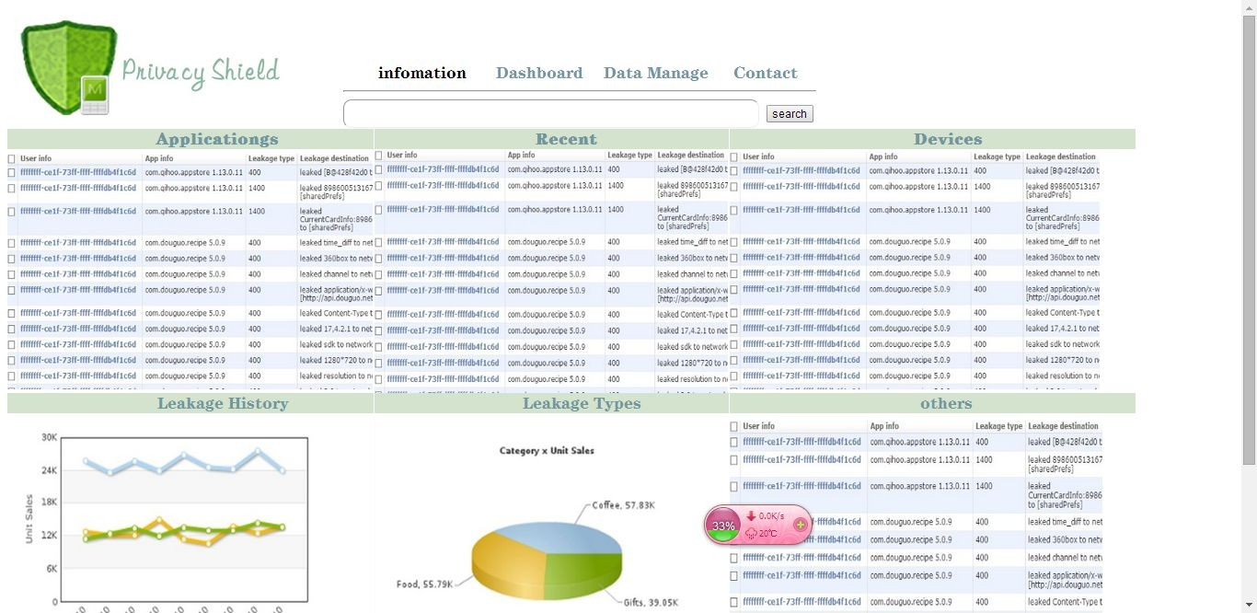
PrivacyShield Dashboard

Slide 14
More Comparison with Existing MDM
Examples that existing MDM products (e.g., Airwatch) fail:
  A chat application has access to contacts to provide its services but should not send them to anywhere outside the enterprise
  A backup service should back up files and documents only to a location within the enterprise and should not leak them out

Slide 15
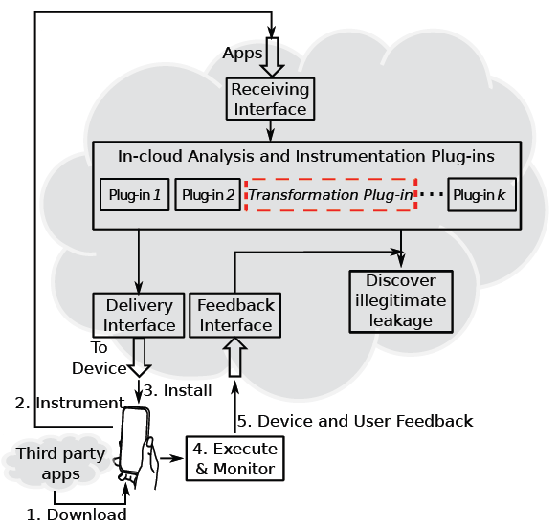
PrivacyShield for Consumers
By vendor or 3rd party service

Slide 16
Competitive Landscape
Segment | Approach | Example vendors
Security | Anti-virus; Privacy settings audit | AVG, BitDefender, think Android, MyPermissions, Xeudoxus, Pdroid, Trend, Lamian, PlaceMask, and others
Personal Privacy | Privacy settings audit; File “Locking” | AVG, NQMobile, Armor, Avast, Lookout, Mapwarebytes, McAfee, Trend Micro, Kaspersky, MyMobile, TrustGo, and others
Enterprise Mobile Device Management | Anti-virus; Separate user and enterprise data; Containerize apps | Samsung, Blackberry, Airwatch, Citrix, MobileIron, Symantec, McAfee, Divide, Touchdown, Kaspersky, and others
We believe PrivacyShield offers a distinct and more complete solution to data leakage
None of them except PrivacyShield can protect against the aforementioned leakage

Slide 17
Questions
Is the problem of private data leakage recognized?
How is the solution different or similar to what's already out there?
Any ideas on marketing PrivacyShield to individuals or enterprises?
Any suggestions of others who would be interested to learn about PrivacyShield?

Slide 18
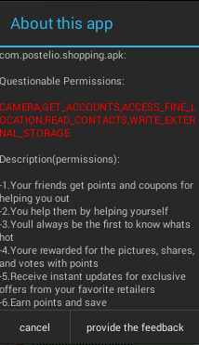

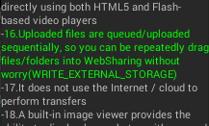
AutoCog Usage
End user: understand if an application is over-privileged and risky to use.
Developer: receive an early feedback on the quality of description of revealing security-related aspects of the applications
18

Slide 19
AutoCog Solution

