Slide 1
Policy Enforcement on 5D Dataset

Slide 2
Goal
Policy 1: Originating User
Policy 2: Block suspect server communication
Policy 3: Block automated scripts
Policy 4: Block uploads with network data

Slide 3
Policy 1: Originating User
--Block if the user originating the process that sent the HTTP request is in a specific group
----------------------------------
EVENT_CONNECT
Subject UUID | ……
Object UUID | ……
Time Stamp | 2015-08-17 12:10:22
Socket object
UUID | ……
Local Port | 49750
Remote IP | 194.90.181.242
Remote Port | 80
Subject Process
UUID | ……
Cmdline | C:\Users\steve\Documents\Mozilla Firefox\firefox.exe http://www.hbo.com
Principal UUID | ……
Principal
UUID | ……
Name | Steve
194.90.181.242
Firefox.exe
steve
Group?
Notes:
Firefox.exe connect IP address 194.90.181.242
We can confirm that user steve execute firefox.exe through tracking, so if there is group info, we can decide whether block this IP connection or not.

Slide 4
Policy 2: Block suspect server communication
--Block if the process that sent the HTTP request ever communicated with a specific remote server
EVENT_CONNECT
Subject UUID | ……
Object UUID | ……
Time Stamp | 2015-08-18 19:16:36
Socket object
UUID | ……
Local Port | 51720
Remote IP | 69.20.49.234
Remote Port | 80
Subject Process
UUID | ……
Cmdline | C:\Users\steve\Documents\Mozilla Firefox\firefox.exe http://www.hbo.com
Socket object
UUID | ……
Local Port | 51949
Remote IP | 12.182.252.160
Remote Port | 80
EVENT_CONNECT
Subject UUID | ……
Object UUID | ……
Time Stamp | 2015-08-18 19:49:39
Notes:
We can confirm that Firefox.exe connect IP address 69.20.49.234 at 19:16:36 through tracking. If this IP address is suspicious ,we can block following IP connection, such as 12.182.252.160.

Slide 5
Policy 3: Block automated scripts
--Block if no portion of the request originated from a definite User Interface action.Define a user interface action as some subset of
---- Keyboard typing
---- GUI actions such as clicking on a menu bar item or desktop icon
---- Cut-and-paste from the clipboard
In 5D dataset, we don’t have these info as following:
1) Keyboard info
2) GUI actions info
3) cut-and paste info
So we cannot make it.

Slide 6
Policy 4: Block uploads with network data
--Policy 4: Block uploads with network data
--Block uploads that contain data downloaded from a network connection
We need more fine-grained info in this policy.
For example:
We should not block this request.
But we may block this request
if we don’t get data information in this file.
Download
Data downloaded from network
Data not downloaded from network but sent by a process
Send
Notes:
if a process save some data in a file, and send some other information in this file to a remote IP, we must analyze this file.

Slide 7
Policy 4: Block uploads with network data
--Policy 4: Block uploads with network data
--Block uploads that contain data downloaded from a network connection
EVENT_ACCEPT
Subject UUID | ……
Object UUID | ……
Socket object
UUID | ……
Local Port | 58532
Remote IP | 127.0.0.1
Remote Port | 58531
Subject Process
UUID | ……
Cmdline | C:\Users\steve\Documents\Mozilla Firefox\firefox.exe http://www.hbo.com
EVENT_CONNECT
Subject UUID | ……
Object UUID | ……
Socket object
UUID | ……
Local Port | 61811
Remote IP | 194.90.181.242
Remote Port | 80
Notes:
In 5D data, we can only confirm that one process receive some data , and may send these data to a remote IP. That is , we cannot confirm that these data that are sent to a remote IP are downloaded from a network connection.

Slide 8
Policy Enforcement on MARPLE TA1 Dataset

Slide 9
Policy 1: Originating User
--Block if the user originating the process that sent the HTTP request is in a specific group
----------------------------------
TcpIpSendIPV4
Subject UUID | ……
Object UUID | ……
Socket object
UUID | ……
Local IP | 210.32.142.206
Local Port | 8962
Remote IP | 101.227.143.109
Remote Port | 20480
Subject Process
UUID | ……
Name | QQ.exe
Principal UUID | ……
Principal
UUID | ……
Userid | 8213960
Username | Chunlin
101.227.143.109
QQ.exe
8213960
Group?
Notes:
QQ.exe send some data to remote ip 101.227.143.109, and we can confirm that QQ.exe belongs to userid 8213960, if we have group info, we can decide whether block this connection or not.

Slide 10
Policy 2: Block suspect server communication
--Block if the process that sent the HTTP request ever communicated with a specific remote server
Socket object
UUID | ……
Local IP | 210.32.142.206
Local Port | 8962
Remote IP | 101.227.143.109
Remote Port | 20480
TcpIpSendIPV4
Subject UUID | ……
Object UUID | ……
Subject Process
UUID | ……
Name | QQ.exe
TcpIpSendIPV4
Subject UUID | ……
Object UUID | ……
Socket object
UUID | ……
Local IP | 210.32.142.206
Local Port | 8962
Remote IP | 101.227.143.109
Remote Port | 20480
Notes:
We can confirm that QQ.exe connect remote ip 101.227.143.109 through tracking. If this IP address is suspicious ,we can block following IP connection.

Slide 11
Policy 3: Block automated scripts
--Block if no portion of the request originated from a definite User Interface action.Define a user interface action as some subset of
---- Keyboard typing
---- GUI actions such as clicking on a menu bar item or desktop icon
---- Cut-and-paste from the clipboard
Now in ETW dataset, we don’t have these info as following:
1) Keyboard info
2) GUI actions info
3) cut-and paste info
So we cannot make it now.

Slide 12
Policy 4: Block uploads with network data
--Policy 4: Block uploads with network data
--Block uploads that contain data downloaded from a network connection
We also need more fine-grained info in this policy in ETW dataset, it is too difficult.

Slide 13
Policy 4: Block uploads with network data
--Policy 4: Block uploads with network data
--Block uploads that contain data downloaded from a network connection
Socket object
UUID | ……
Local IP | 192.168.172.133
Local Port | 18172
Remote IP | 183.61.38.175
Remote Port | 20480
FileIoRecvIPV4
Subject UUID | ……
Object UUID | ……
FileIoWrite
Subject UUID | ……
Object UUID | ……
File object
UUID | ……
Name | \Device\HarddiskVolume1\Users\admin\AppData\Local\Microsoft\windows\Temporary Internet Files\Low\MSIMGSIZ.DAT
Subject Process
UUID | ……
Name | Iexplore.exe
FileIoRead
Subject UUID | ……
Object UUID | ……
Socket object
UUID | ……
Local IP | 192.168.172.133
Local Port | 19964
Remote IP | 183.61.38.175
Remote Port | 20480
TcpIpSendIPV4
Subject UUID | ……
Object UUID | ……
Notes:
In ETW dataset, we can only confirm that one file is written by a process, such as iexplore.exe .After writing this file, iexplore.exe read it, and may send some data belong to this file to a remote IP, but we cannot confirm that whether the data that is sent by iexplore.exe is from the file or not.

Slide 14
Automatic Attack Graph Pruning

Slide 15
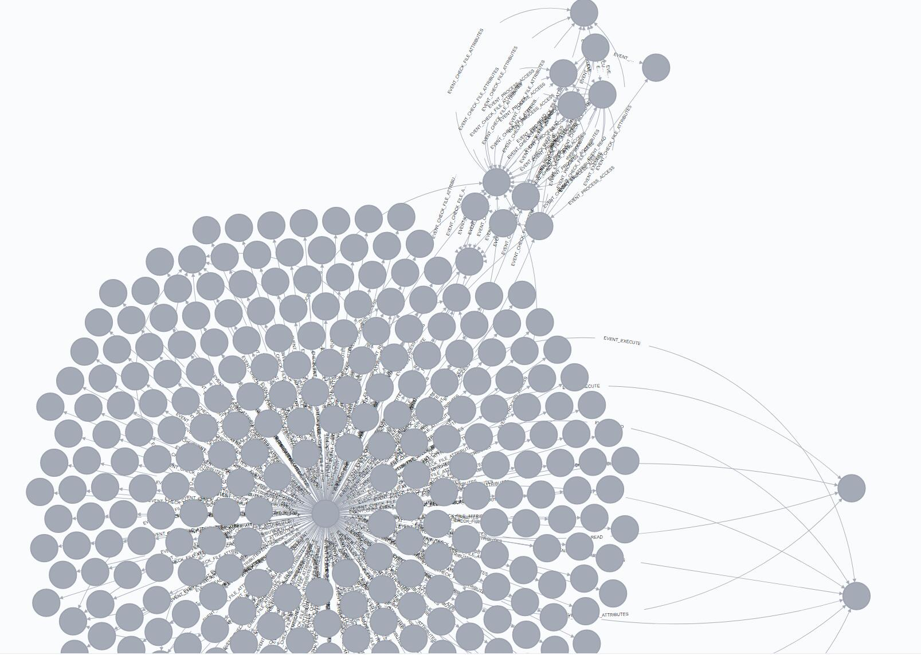
Goal
APT Detection Analytics
Malicious IP
Malicious point
IoC
When and
Where
to get into the system
More malicious behavior
In system
Malicious
Point
Firefox
backward
tracking
forward
tracking

Slide 16
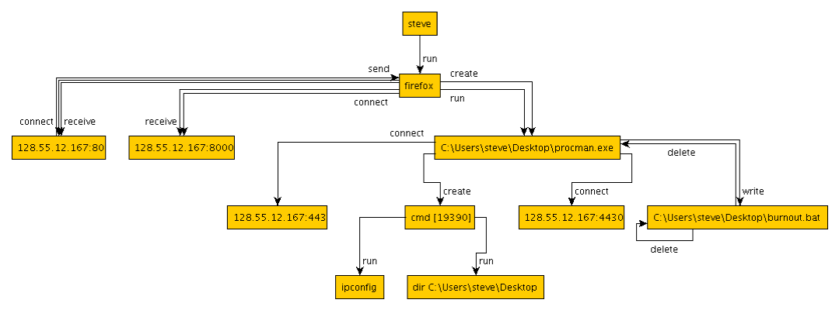
Expected Output
Ground-truth
attack graph
Our graph
Firefox
C:\Users\steve\Desktop\procman.exe

Slide 17
Reduction ratio and Related data
 | File size | File size after pruning | The amount of node | The amount of node after pruning | Reduction ratio
Bovia | 15248KB | 12KB | 17595 | 68 | 99.6%
Pandex | 1125099KB | 13KB | 392610 | 66 | 99.98%
Pandex-injection | 390240 KB | 7KB | 271022 | 55 | 99.98%

Slide 18
Illustration based on 5D Data
Rules
One or more
malicious
points
5D data
Set
Attack graph

Slide 19
An Example Attack Scenario
Time 0: firefox.exe creates spd.exe
Time 1: firefox.exe reads malgunmc.ttf
Time 2: firefox.exe execute spd.exe
Time 3: spd.exe writes imgD3.tmp
Time 4: firefox.exe writes a.log
Time 5: firefox.exe reads other read-only files
Time 6: firefox.exe creates profile.exe
Time 7: firefox.exe reads A.dll
Time 8: profile.exe reads imgD3.tmp
Time 9: profile.exe writes to 212.36.52.109:80
Time 10: profile.exe reads a.log
Time 11: firefox.exe creates process A
Time 12: Administrator knows the connected IP is malicious (blacklisted)
…
5
firefox.exe
1
malgunmc.ttf
0
2
7
11
spd.exe
3
4
A.dll
Process A
imgD3.tmp
6
a.log
8
10
profile.exe
9
212.36.52.109:80

Slide 20
Rule 1: Only Consider the Events Happening before Attack
Time 0: firefox.exe creates spd.exe
Time 1: firefox.exe reads malgunmc.ttf
Time 2: firefox.exe execute spd.exe
Time 3: spd.exe writes imgD3.tmp
Time 4: firefox.exe writes a.log
Time 5: firefox.exe reads other read-only files
Time 6: firefox.exe creates profile.exe
Time 7: firefox.exe reads A.dll
Time 8: profile.exe reads imgD3.tmp
Time 9: profile.exe writes to 212.36.52.109:80
Time 10: profile.exe reads a.log
Time 11: firefox.exe creates process A
Time 12: Administrator knows the connected IP is malicious (blacklisted)
…
5
firefox.exe
1
malgunmc.ttf
0
2
7
11
spd.exe
3
4
A.dll
Process A
imgD3.tmp
6
a.log
10
8
profile.exe
9
212.36.52.109:80
Notes:
follows the attack back in time

Slide 21
Rule 2: Only Keep Certain Events for Benign Process
Time 0: firefox.exe creates spd.exe
Time 1: firefox.exe reads malgunmc.ttf
Time 2: firefox.exe execute spd.exe
Time 3: spd.exe writes imgD3.tmp
Time 4: firefox.exe writes a.log
Time 5: firefox.exe reads other read-only files
Time 6: firefox.exe creates profile.exe
Time 7: firefox.exe reads A.dll
Time 8: profile.exe reads imgD3.tmp
Time 9: profile.exe writes to 212.36.52.109:80
Time 10: profile.exe reads a.log
Time 11: firefox.exe creates process A
Time 12: Administrator knows the connected IP is malicious (blacklisted)
…
5
firefox.exe
1
malgunmc.ttf
0
2
7
11
spd.exe
3
4
A.dll
Process A
imgD3.tmp
6
a.log
8
10
profile.exe
9
212.36.52.109:80

Slide 22
Rule 2: Only Keep Certain Events for Benign Process
Time 0: firefox.exe creates spd.exe
Time 1: firefox.exe reads malgunmc.ttf
Time 2: firefox.exe execute spd.exe
Time 3: spd.exe writes imgD3.tmp
Time 4: firefox.exe writes a.log
Time 5: firefox.exe reads other read-only files
Time 6: firefox.exe creates profile.exe
Time 7: firefox.exe reads A.dll
Time 8: profile.exe reads imgD3.tmp
Time 9: profile.exe writes to 212.36.52.109:80
Time 10: profile.exe reads a.log
Time 11: firefox.exe creates process A
Time 12: Administrator knows the connected IP is malicious (blacklisted)
Certain Events
1）benign process execute other process
2）events that may cause benign process receive
some command，such as TCP, read file and so on

Slide 23
Rule 3: Ignore Read-only and Certainly-unimportant Files
Time 0: firefox.exe creates spd.exe
Time 1: firefox.exe reads malgunmc.ttf
Time 2: firefox.exe execute spd.exe
Time 3: spd.exe writes imgD3.tmp
Time 4: firefox.exe writes a.log
Time 5: firefox.exe reads other read-only files
Time 6: firefox.exe creates profile.exe
Time 7: firefox.exe reads A.dll
Time 8: profile.exe reads imgD3.tmp
Time 9: profile.exe writes to 212.36.52.109:80
Time 10: profile.exe reads a.log
Time 11: firefox.exe creates process A
Time 12: Administrator knows the connected IP is malicious (blacklisted)
…
5
firefox.exe
1
malgunmc.ttf
0
2
7
11
spd.exe
3
4
A.dll
Process A
imgD3.tmp
6
a.log
10
8
profile.exe
9
212.36.52.109:80

Slide 24
Rule 3: Ignore Read-only and Certainly-unimportant Files
Time 0: firefox.exe creates spd.exe
Time 1: firefox.exe reads malgunmc.ttf
Time 2: firefox.exe execute spd.exe
Time 3: spd.exe writes imgD3.tmp
Time 4: firefox.exe writes a.log
Time 5: firefox.exe reads other read-only files
Time 6: firefox.exe creates profile.exe
Time 7: firefox.exe reads A.dll
Time 8: profile.exe reads imgD3.tmp
Time 9: profile.exe writes to 212.36.52.109:80
Time 10: profile.exe reads a.log
Time 11: firefox.exe creates process A
Time 12: Administrator knows the connected IP is malicious (blacklisted)
Certainly unimportant Files
1、executable files that only executed by benign process
2、dll files that exist in system and never change

Slide 25
FCCE Integration
FCCE provides a complete data management solution
PHF detection relies on streaming data processing
Attack graph pruning relies on historical data queries
FCCE is scalable
No worries about memory size and large graphs
FCCE now has a REST API
Stateless query interface
Extensible for writing and specific query needs
Attack graph pruning is a good starting task to integrate FCCE and NWU’s modules

Slide 26
One challenge —— Hub Process
IP1
IP2
IP3
read
read
read
When we track the attack back to the File3, how can we know which IP the file come from？
Program
(without data-flow, this is a black box)
write
write
write
execute
File1
Malicious File3
File2
malicious behaviors

Slide 27
First Scenario —— Pandex-like Browser exploit attack
Firefox: 44.0.2 version
Exploit: CVE-2016-1960
IP1
IP2
10.214.148.224:34568
IP2
IP1
10.214.148.224:34568
read
read
read
read
read
read
Firefox Process(pid:17120)
Firefox Process(pid:17120)
Other threads
payload
thread
with thread-level traces
Other threads
payload
thread
write
write
write
execute
write
write
write
execute
File1
malicious.exe
File1
malicious.exe
File2
File2
The firefox was exploited and load the payload in memory. Then payload downloaded malicious.exe form 10.214.148.222:80
With thread-level traces, it is intuitively that malicious.exe came from 10.214.148.222:80

Slide 28
First Scenario —— Pandex-like Browser exploit attack
When visiting serveral websites, all thread traffics are in the same thread
When Firefox was exploited and the payload connect back to the C&C server(10.214.148.224)

Slide 29
Can we get thread-level traces?
ETW can directly provide thread id for the following events:
File operations
Process/Thread operations
Registry operations
…
One challenge is how to provide network operation with thread id.
We find that NdisEtwProvdier can provide these information
HTTP
GET www.malware.com
TCP
DstPort:80
IPV4
Destination = 10.2.3.4
Ethemet
MAC = 6C-0B-84-3C-4B-OE
NdisEtwProvider Event
ProcessId = 1002
ThreadId = 4396

Slide 30
The End

