Slide 1
SDNShield: Reconciliating Configurable Application Permissions for SDN App Markets
Yan Chen
Lab of Internet and Security Technology (LIST)
Northwestern University, USA
Joint work with Xitao Wen, Bo Yang Chengchen Hu, Yi Wang, Bin Liu, and Xiaolin Chen

Slide 2
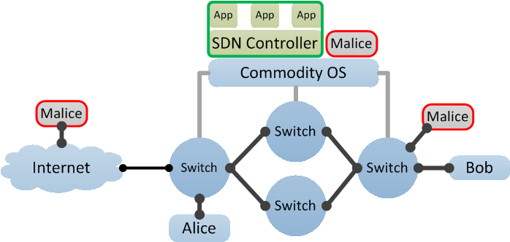
Motivation
SDN security concerns rank No.1 road blocker for SDN adoption*
Over-privilege problem in control plane
New Attack Surface:
Host-Controller Channel
Traditional Attack Surface:
DP-CP Channel
* http://searchsdn.techtarget.com/feature/Five-reasons-IT-pros-are-not-ready-for-SDN-investment

Slide 3
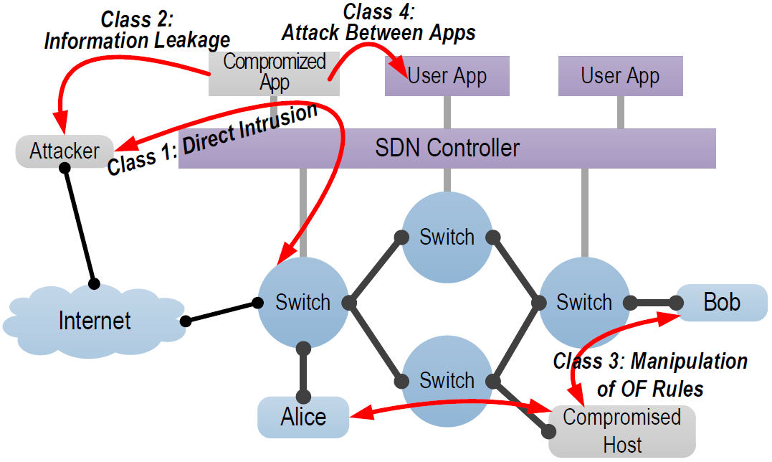
Threat Models
Exploit of existing benign-but-buggy apps
Distribution of malicious apps by attacker
Plenty of potential attacks

Slide 4
Approach
Policy-based Access Control on Apps
  Proactively eliminate apps’ over-privilege behaviors

Slide 5
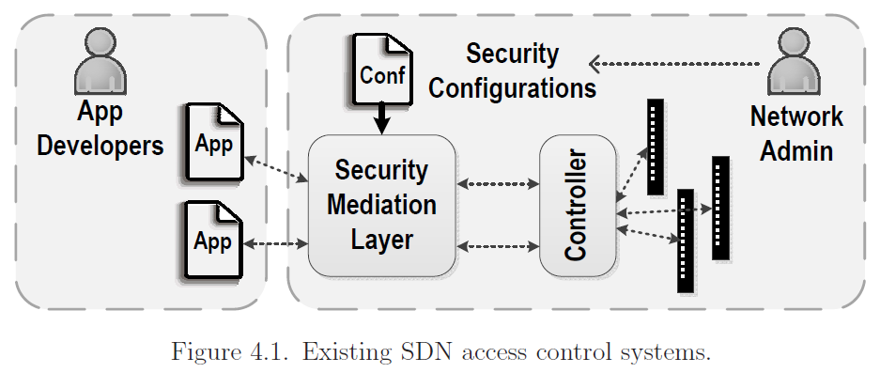
Existing SDN Security Systems
Cryptographic authentication
  Mainstream controller platforms
  No isolation
Android-like permissions
  SE-floodlight[NDSS15], FortNOX[HotSDN12]
  Too coarse grain
Strong & heavy isolation: Rosemary [CCS14]
Open Question: how to have the developer and network admins collaborate to enforce security policies on apps ?

Slide 6
Our Vision
Flexible permission abstractions
  App developers can express fine-grained permission requests.
Limited increase on management burden
  Administrators can easily refine app permissions with higher-level security policies.
Reliable and lightweight enforcement
  The controller needs a secure while efficient isolation architecture to enforce permissions.

Slide 7
Challenge
How to describe SDN app based permissions?
  Accurately describe the complex API behavior space
  Complicated logic is needed to depict inter-dimensional relations
How to reduce burden of admin on drafting security policy?
  Need to reconcile inputs from app developer and network admin
  Need a bridge to reshape app’s permission space with local security requirements
How to reliably enforce permissions?
  Runtime isolation
  Reference monitoring
SDNShield Permission Abstractions
SDNShield Security Policy Reconciliation
SDNShield Isolation Architecture

Slide 8
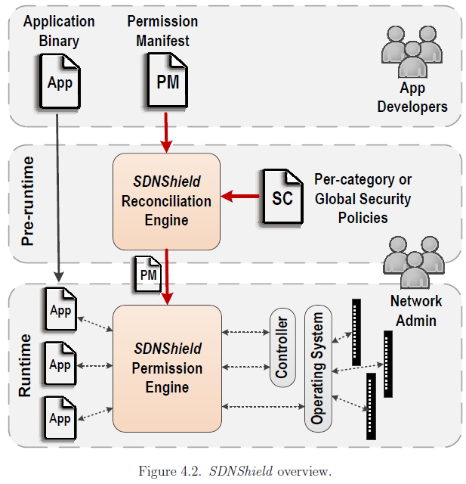
System Overview
Permission Manifest
  Describes per-app permission requirement
  Written in permission language
  Drafted by app developer
  Reviewed by controller vendor
Security Policy
  Describes security requirements of local environment
  Written in security policy language
  Provided by network admin

Slide 9
Roadmap
SDNShield System Design
SDNShield Implementation and Evaluations
Published in HotSDN2013 and DSN2016
Ongoing Extension to REST APIs and NFVs
Conclusions

Slide 10
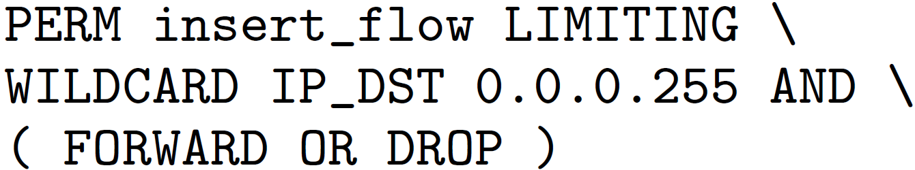
Permission Abstractions
Permission Token
Permission Filter

Slide 11
Permission Abstractions
Coarse-grained permission tokens
  Describe chunks of logical resources
  E.g., read_flow_table, insert_flow, visible_topology, send_pkt_out, etc.
Fine-grained permission filters
  Predicates on permission tokens connected with logic operators
  Flow filters: flow match, flow action, flow wildcard, flow ownership
  Topology filters: partitioning physical topology, virtual topology
  Priority filter, statistics filter, event filter, etc.

Slide 12
Security Policy Reconciliation
Goal: reduce administration burden on permission review
Security Policy Language
  Based on concepts that administrator are already familiar with
  Three major abstractions:
    Permission boundary
    Mutual exclusion
    Permission Customization
Algorithm-assisted reconciliation process
  Admin feeds customization conditions and local security policy
  Reconciliation engine finds policy violation and provides permission candidates

Slide 13
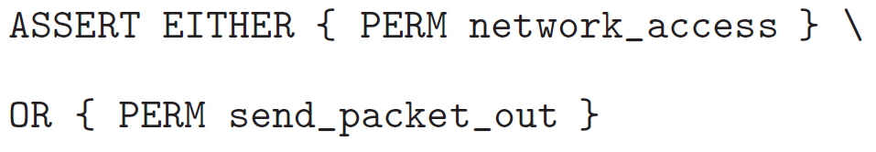
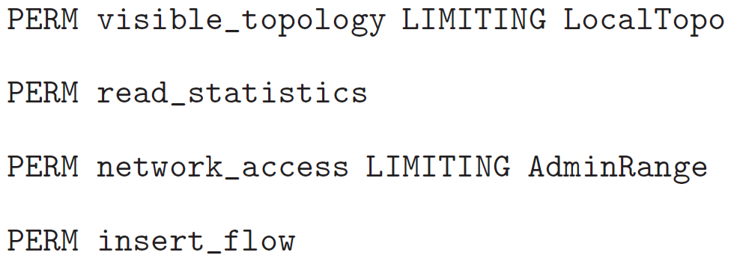
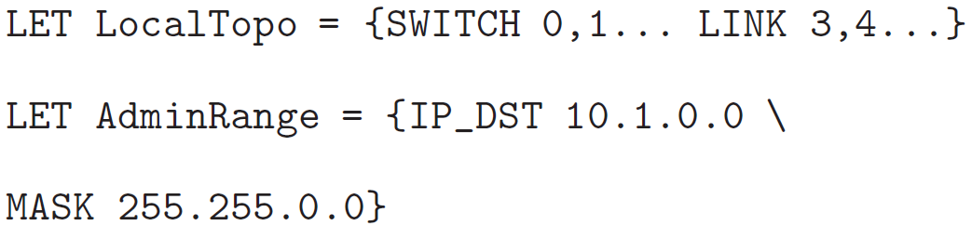
Security Policy Examples
Example 1:
Example 2:
permission manifest security policy

Slide 14
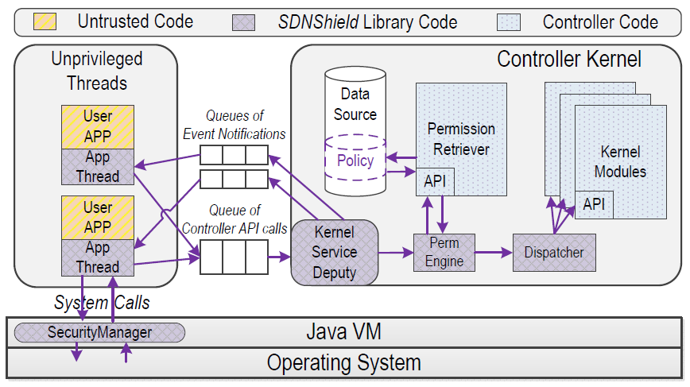
Isolation Architecture
Design Goals
  Execution and memory isolation
  Mediating syscalls
  Efficiency
  No modification to Apps
Design Choices
  Thread-level isolation
  Language-based reference monitoring (Java VM)

Slide 15
Implementation
Platform-independent reconciliation engine and permission engine
  Parses permission manifests and security policies
  Library for efficient permission checking
  23k lines of code in Java
Controller extensions
  Implemented on OpenDaylight and Floodlight
  Inter-thread communication and API wrapping
  App initiation process

Slide 16
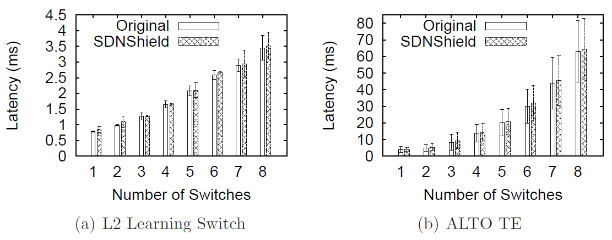
Evaluation
Latency impact
  Tested on two real apps
  Almost unnoticeable latency difference

Slide 17
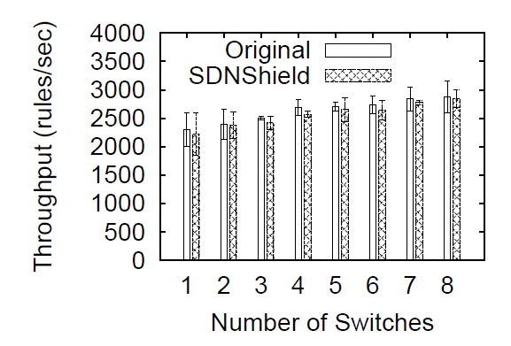
Evaluation
Throughput impact

Slide 18
Roadmap
SDNShield System Design
SDNShield Implementation and Evaluations
Ongoing Extension to REST APIs and NFVs
Conclusions

Slide 19
REST APIs
REST (REpresentational State Transfer)
  Resource-based: Each URI represents a resource.
  Client-Server: Client connects to Server via HTTP protocol
  HTTP verbs: POST-Create, GET-Select, PUT-Update, DELETE-Delete
Benefits
  Simple, flexible, unified, scalable
Example
HTTP Verb | URI | Description
POST | /v2.0/routers | Create a router
DELETE | /v2.0/routers/{router_id} | Delete a router
GET | /v2.0/routers | Query all routers

Slide 20



Motivation in REST API Access Control
Attacks outside controller remain
Trusted Apps with certain privileges are still dangerous
Hackers with access to trusted apps can attack underlay network
Abstraction of SAL APIs makes Access Control easier
Bunch of SAL APIs
Benign
Malicious
REST API
REST Access Control
Trusted Apps A
Trusted Apps B
Service Abstraction Layer
One Simple REST API
Notes:
Customers can use apps from trusted vendors only to prevent malicious exploits from apps inside controller
but attacks outside controller, e.g. exploit in REST API layer, remains.
Hackers with access to trusted apps can attack underlay network,
e.g. stealing underlay topology info from monitoring apps, manipulating traffic to let malicious traffic bypass IDS, DPI or FW in traffic optimization apps or even crashing the whole network by causing traffic jams in critical network devices
REST API is the abstraction of several SAL APIs, or a transaction of several sequential SAL APIs.
A malicious REST API call contains more illegal operations in SAL APIs, which makes easier to entirely block malicious operations.

Slide 21
Design for REST API Access Control
Based on Mapping between REST APIs & SAL APIs
REST API generally is an independent transaction
A transaction contains several sequential primitive API calls
REST API can be mapped into an API tree in time order
CreateNetwork
Data Center Scenario
“CreateNetwork” API
ReadDataStore
(Check if UUID exists)
Y
ReadDataStore
(Check if tenant exists)
N
Y
WriteDataStore
(Write tenant)
UpdateDataStore
(Update tenant)
ReadDataStore
(Check if subnets exist)
REST API
WriteDataStore
(Write network)
SAL API
Transaction
WriteFlow
(Write network)
SYS API

Slide 22
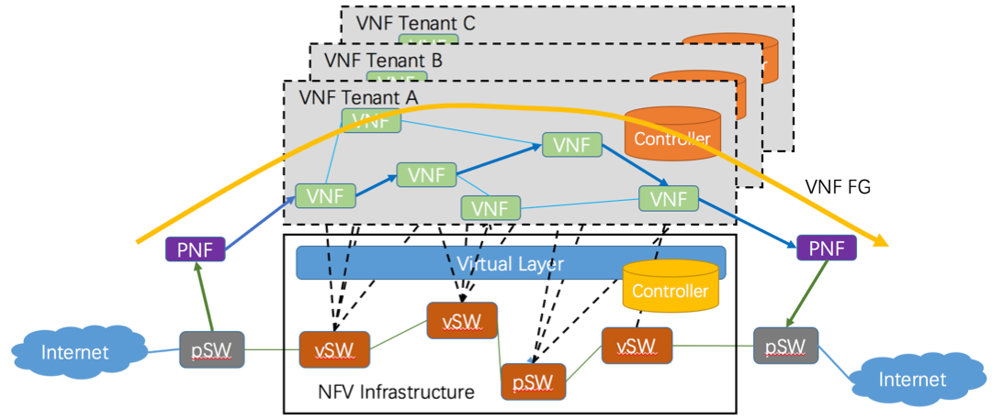
NFV Scenarios
Network functions are virtualized in cloud based platform.
Controllers are responsible for leading traffic through a series of network functions, thus providing network services.
NFVI providers can even provide controllers for tenants to manipulate their traffic on providers’ infrastructure.
More important role in network
But very limited security work done

Slide 23
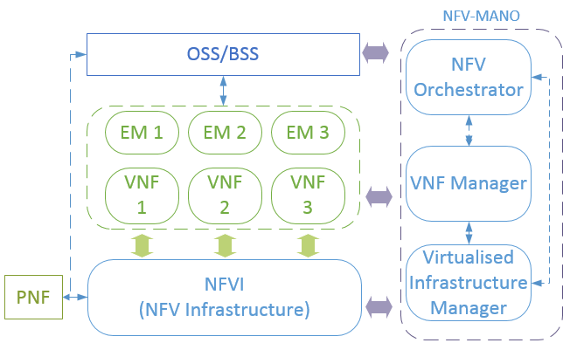
Extending SDNShield to NFVs
App-Controller Interaction
  Multiple controllers locate in different layer, each with specific role
  Cross-layer interactions between Apps and Controllers
SDNShield in NFV
  Controller is vital for NFV, (REST) interactions are frequent and complex
  How to have efficient and effective access control for NFVs
Controller
5
4
App
4
3
2
1
3
1
2
Notes:
OSS/BSS operation/business support systems
EM: Element management
Reference: http://www.etsi.org/deliver/etsi_gs/nfv/001_099/002/01.02.01_60/gs_nfv002v010201p.pdf

Slide 24
Conclusions
A novel and flexible permission control system for SDN applications
Fine-grained permission abstractions
Limited increase on administration burden
Extending SDNShield to REST APIs and NFVs
http://list.cs.northwestern.edu/sdn

Slide 25
Comparison
 | Control-plane or Data-plane | Allow App Cooperation? | Protection beyond Flow Conflict | Protection beyond CP/DP Channel?
FortNOX/FRESCO | CP | Yes | No | No
FlowVisor | CP | No | Yes | No
AvantGuard | DP | N/A | N/A | N/A
SDNShield | CP | Yes | Yes | Yes

Slide 26
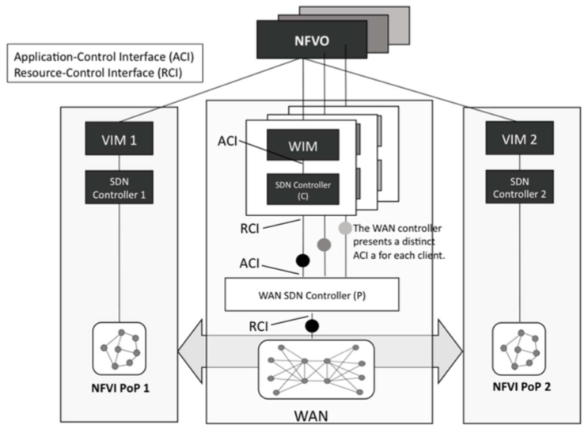
NFV Scenarios
Network functions are virtualized in cloud based platform.
Controllers are responsible for leading traffic through a series of network functions, thus providing network services.
NFVI providers can even provide controllers for tenants to manipulate their traffic on providers’ infrastructure.
More important role in network
But limited security works done

