Slide 1
Mobile Device Security
Group Magic:
Michael Gong
Jake Kreider
Chris Lugo
Kwame Osafoh
MSIT 458 – Information Security
October 30, 2010

Slide 2
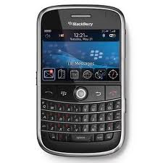
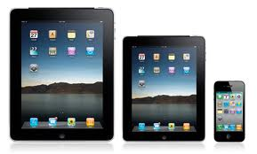
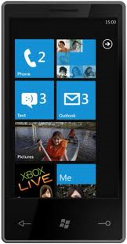
Background
Mobility continues to become an increasingly vital component of our everyday lives
Prevalence of 3G/4G cellular services enable being connected at all times to the corporate and social networks
Employers continue to seek new ways to capitalize on being connected with their employees
Employees want a simple but feature rich platform
Employees want the freedom and simplicity to use a device of their choosing
Mobile interaction between user and company systems must be seamless
Mobility without compromising security

Slide 3
Problem Statement
With the explosive growth of smartphones, tablets and mobile devices, companies must find a means of providing access to their internal systems and information to their mobile workforce securely and seamlessly.

Slide 4
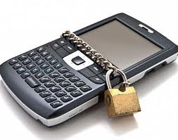
Security Threat: Confidentiality
Proper device access
Device theft/loss
Data loss / information leakage
Ownership rights
End-user right to privacy
Struggle with information accessibility

Slide 5
Security Threat: Availability
Always-on accessibility
Disparate technologies / carrier agreements
Malware/virus detection & prevention
High availability / resiliency across platforms
Adherence to company-wide information security policies

