Slide 1


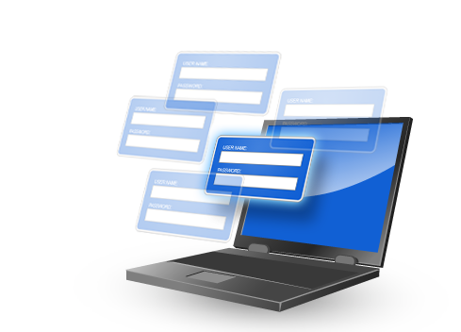
Single Sign-on Integration (SSI)
Information Security Project
[ Part 3/3 ]
****
password123
Login >
Login Successful !!!
For Professor Yan Chen;
By Team Triad [ Naveed | Radu | Moniza ]
Notes:
MSIT 458 – Information Security Class
Prepared by Team Triad:
Naveed Asem
Radu Bulgaru
Moniza Shaikh

Slide 2
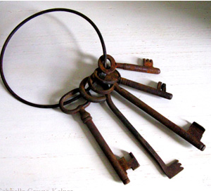
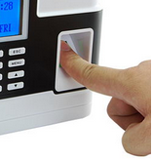




AGENDA
[1] Current Solution: Issues/ pros/ cons
[2] Proposed Solution
1 Project Overview
2 Technical Analysis
[3] Implementation
[4] Analysis: Cost/ Risk
[5] Impact: Business/ Legal consequences
[6] Adoption: Corporation/ Industry
3 Business Analysis
[1]
Current: issues/pros/cons
[2]
Proposed
Solution
[3]
Implementation
[4]
Cost/Risk
[5]
Impact: Business/Legal
[6]
Adoption: Corp/Industry
Notes:
Presentation Time = 30 sec
Part 3: Then please analyze the pros and cons on the existing work, and propose a solution to the problem you formulated, by either adopting Current Solutions, or propose something new. Please be specific on how you will implement or have implemented the solutions (down to the product level), the cost/risk analysis, feasibility analysis, business/legal consequence, how this solution will fit different corporate context, like industry, education, government, etc. Each group is expected to give a final project presentation towards the end of the quarter. The presentation is expected to be 20 minutes plus 3 minutes Q&A. But we can have Q&A mingled w/ the presentation, i.e., each team has 23 minutes, including the switch time.
1) Current Solution
2) Proposed Solution
3) Solution Implementation
4) Detailed Analysis
5) Implementation Impact
6) Solution Approach

Slide 3
Next Topic …
Project
Overview
Technical
Analysis
Business
Analysis
[1]
Current: issues/pros/cons
[2]
Proposed
Solution
[3]
Implementation
[4]
Cost/Risk
[5]
Impact: Business/Legal
[6]
Adoption: Corp/Industry
[1] Current Solution: Shortcomings, Pros, Cons
[2] Proposed Solution
Notes:
Total Presentation Time For This Section = 4 minutes

Slide 4


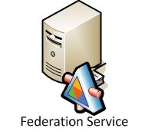

1) Current Solution
  Problem Statement:
  Our Company has SSO Infrastructure
  Also has silo applications using AD for sign-on
  We need to integrate silo apps into SSO
Portal
-OR-
SSO
Current Infrastructure
Authentication
& Authorization
Notes:
Presentation Time: 1 minute, 30 sec
Current Solution - Shortcomings
Our company already has SSO infrastructure in-place. We currently use Active Directory Federation Service (ADFS) and also have SharePoint as a front-end portal that utilizes ADFS, with ability to connect to other SSO frameworks.
We also have applications that are silo-ed with authentication that is not integrated with the enterprise security model.
We would like to integrate our silo applications into the enterprise SSO so users don’t have to log-in multiple times to access our systems.
We haven’t already integrated because not many people see value in Integration. Most important reason is that there is no enterprise standard that requires integration with SSO.

Slide 5

1) Current Solution
  Pros & Cons
  PROS:
    Easier to understand
    Faster site performance
    No single point of authentication failure
  CONS:
    Need to remember additional passwords
    Users spend more time logging in
    Wasted infrastructure resources
    Less Secure
Notes:
Presentation Time: 1 minute
Pros of current system:
Easier to understand – Mostly because you don’t have to understand external SSO system and sign-on process is easy to understand (and therefore weaker and less secure)
Faster site performance – As you will see later on, a SSO process typically takes several redirects at first to establish
No single point of authentication failure – Depends on SSO architecture. If SSO implemented correctly then this is not valid.
Cons of current system:
Users have to remember additional passwords; Even though users are already authenticated via SSO, they will be challenged again with a SSO screen.
Users spend more time, in general, in logging in.
SSO infrastructure is expensive and not using it is waste of resources.
Less Secure – Different silo apps may follow different methods of authentication.

Slide 6


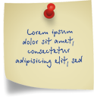




Current Solution: Jack’s Story …
SSO
CRM
ERP
Custom
HR
Meet Jack!
Jack uses 5 different websites
Jack has to remember 5 different passwords
VERY…
FRAZZLED!!!
This makes Jack …
Notes:
Presentation Time: 30 seconds
Jack has access to five different applications that all require log-on.
He must log-on to each one of these applications separately.
Jack needs to remember five different passwords

Slide 7


Proposed Solution …
SSO
CRM
SSO
ERM
Custom
HR
Get rid of keys & passwords except 1
Integrate apps with existing SSO
Jack has to remember 1 password
That makes Jack very HAPPY !!!
Notes:
Presentation Time: 30 seconds
Proposed Solution –
Integrate all separate applications into a single sign-on application so Jack only has to remember just one password to have one key to open all application locks.
We build on technical details in the next section.

Slide 8
Next Topic …
Project
Overview
Technical
Analysis
Business
Analysis
[1]
Current: issues/pros/cons
[2]
Proposed
Solution
[3]
Implementation
[4]
Cost/Risk/ Selection
[5]
Impact: Business/Legal
[6]
Adoption: Corp/Industry
[3] Solution Implementation
Notes:
Total Presentation Time For This Section = 6 minutes 30 sec

Slide 9
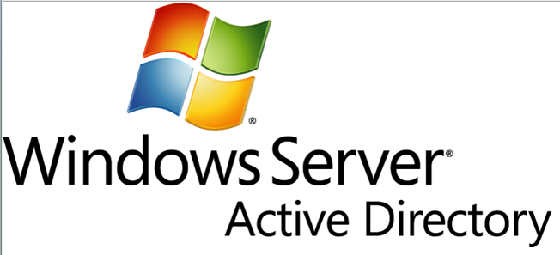
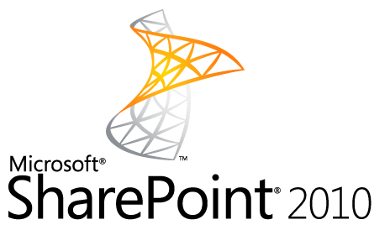

3) Solution Implementation
  Existing SSO Technology
Active Directory 2008 R2
SharePoint 2010
Question:
Which one to use?
Lets first analyze them both …
Notes:
Presentation Time = 15 sec
Existing SSO technology
Lets begin with looking at what existing SSO technologies exist in-house.
We have two SSO technologies: Active Directory 2008 R2 and SharePoint 2010

Slide 10
3) Solution Implementation
  SSO Overview & Integration Steps
Active Directory
Overview
Integration Steps
SharePoint
Overview
Integration Steps
Active Directory 101
AD Integration
SharePoint 101
SP Integration
Notes:
Presentation Time = 15 sec
Let’s talk about …
integration overview
and
steps involved in the integration process

Slide 11


Active Directory 101
AD Integration
SharePoint 101
SP Integration
Active
Directory
Main Features
+
Federation & Unity (ADFS)
Directory Service (LDAP)
Server Management (ADSM)
Group Policy (GP)
Notes:
Presentation Time = 1 min 30 sec
Presentation Help:
In this slide, we will review main features of Active Directory at a very high-level
ADFS - AD’s most prominent feature is ADFS which is used for SSO support for Internet, Intranet, and Extranet clients. It is also used to synchronize authentication cross platforms
LDAP - holds users and groups information.
ADSM - provides features such as password policy enforcement
GP - Several group policy features.
-- FOR REFERENCE --
Following is a breakdown of each feature mentioned in the slide. THIS IS JUST FOR REFERENCE – I don’t think you should present this level of detail or people will get bored.
ADFS: It is used to allow single sign-on (SSO
.) capabilities to web applications hosted by multiple organizations without the need to configure an Active Directory trust relationship between them. This task is performed by using AD FS servers to separate the process of authentication (proving who a user is) from that of authorization (specifying what a user can do). AD FS allows this sepa- ration by configuring account partners to authenticate users and groups, and then pro- viding claims to resource partners that control the actual access to resources.
Lightweight Directory Services:
LDAP Users & Groups
LDAP Synchronization & Replication
Authentication
Centralized directory mgmt
AD Server Management
Fine-Grained Password Policies
Global Names Zone
Restart-able AD Services
Audit Object Changes
Group Policy (GP):
GP Delivery & Enforcement
GP Central Store
Synchronizing multiple GP Objects
GP Logging (Audit, App, Reports)
Active Directory Federation Services (ADFS)
SSO for Internet, Intranet, Extranet
http://www.isaca.org/Groups/Professional-English/windows-server/GroupDocuments/Windows%20Server%202008%20Active%20Directory%20Components.pdf
http://msdn.microsoft.com/en-us/library/ms808915.aspx

Slide 12
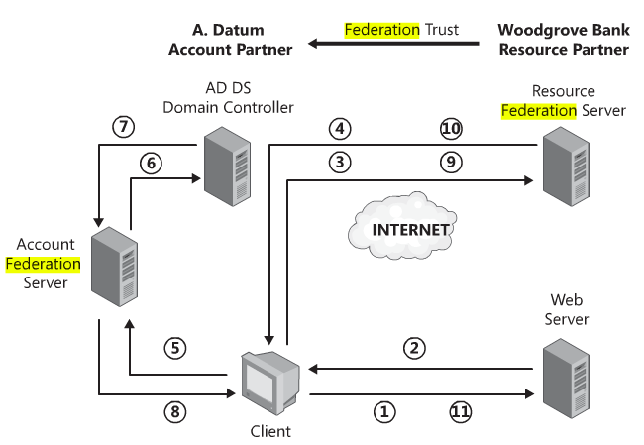
Active Directory 101
AD Integration
SharePoint 101
SP Integration
  SSO Scenario with AD: Client accessing internet
11 Step process to establish SSO connection.
Next Discussion:
Integrating our silo apps (at Web Server) to work with AD’s SSO
Requires custom code/configuration at Web Server.
Reference:
Book: Windows Server® 2008 Active Directory® Resource Kit
By Stan Riemer; Conan Kezema; Mike Mulcare ; Byron Wright; Microsoft Active Directory
Notes:
Presentation Time =1 min 30 sec
Presentation Help:
This diagram shows a Client (user at Datum) trying to access an application at Server (Woodgrove Bank)
11 step complex process, with a lot of redirects. Requires authentication and building trust with different entities.
Requires web server to have claim-aware applications (covered in next slide)
-- FOR REFERENCE --
FOLLOWING CONTENT IS NOT FOR PRESENTATION BUT PERSONAL REFERENCE (In case we get questions asked):
Details of all 11 steps:
1. A user at A. Datum uses a Web browser to make a request over HTTPS to access an application running on the Web server at Woodgrove Bank.
2. The AD FS Web Agent installed on the Web server intercepts the request and checks to see if the client has presented a cookie legitimizing the request. If the user has not yet authenticated, the client will not have this cookie. In this case, the AD FS Web Agent uses a HTTP 302 redirect message to redirect the client to the resource federation server hosted at Woodgrove Bank. The AD FS Web Agent is not aware of the federation trust, so it must redirect the client request to the federation server.
3. The client sends an HTTPS request to the resource federation server. The resource Federation Service must now determine where the account is held for this use—this is known as the home realm discovery. Based on the federation trust configuration, which includes information such as the UPN or e-mail address, the resource federation server will determine that the home realm is A. Datum.
4. The client is redirected again, this time to the account federation server at A. Datum.
5. The client sends an HTTPS request to the account Federation Service.
6. The user is authenticated by using Windows integrated authentication or by providing credentials when prompted by the federation server.
7. AD DS authenticates the user and sends the success message back to the federation server, along with other information about the user stored in the directory (attributes, group memberships, and so on), which will be used to generate the user’s claims.
8. The claims data is placed in a digitally signed security token and given to the client as an authentication cookie, with a further redirect back to the resource Federation Service.
9. The client sends the security token to the resource Federation Service, which validates that the security token comes from a trusted partner. If it did, the federation server will issue a home realm cookie so that future requests will not have to go through the home realm discovery process again, until the cookie expires.
10. If successful, the federation server creates and signs a new token of its own to issue
11. SSO session established and user authenticated !!!

Slide 13
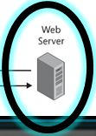
Active Directory 101
AD Integration
SharePoint 101
SP Integration
  STEPS: Integrating apps to AD SSO
  Step 1) Enable Federation on Web Server
  Step 2) Enable Reading SAML token
  Step 3) Verify Authentication from SAML token
  Step 4) Obtain Trust Policy from AzMan
  Step 5) Retrieve Claims
  Step 6) Make Authorizing Decisions
A LOT of custom code & configuration
Notes:
Presentation Time = 30 sec
Presentation Help:
Just mention that this slide talks about steps needed to integrate claim-aware application to single-sign-on
Then skip over all 6 steps without going one by one and just mention that, “to summarize all these steps, integration requires a lot of CUSTOM CODE on application and CONFIGURATION on web server”
-- FOR REFERENCE --
You can find details of each one of these steps below. Note: This requires you to know web development to understand this code. This is using .NET deployed on IIS web server. There are similar steps for other web server integrations such as web logic and tomcat
Link: http://msdn.microsoft.com/en-us/library/bb897402.aspx

Slide 14
Active Directory 101
AD Integration
SharePoint 101
SP Integration
  SharePoint - Main Component
Standard
Portal
Search
Enterprise
BI
Core
Storage
Social
ECM - Enterprise Content Mgmt
Applications
Topology
Share Services
Base APIs
Security
BPM - Business Process Mgmt
People
Security
Integrated with SSO providers (such as AD)
Customize security
Separate admin portals
Reference:
Book: Essential SharePoint 2010: Overview, Governance, and Planning
Notes:
Presentation Time = 30 sec
PRESENTATION HELP:
Don’t go over these features but explain that SharePoint comes with a full set of features such as Portal, Cross site search, Content management, Business Intelligence deployment.
<CLICK>
SECURITY - One of these core features is SECURITY which is most important to our discussion.
SP security provides an integration with single sign on providers such as Active Directory
This security can be customized in SharePoint to provide additional features such as role based page authentication.
Admins have separate portal to provide better site management and administration
-- REFERENCE ONLY ---
Some useful text on Sharepoint to active directory security mapping/integration: SharePoint Groups can include Active Directory Groups and/or individual users. However, SharePoint Groups cannot include other SharePoint Groups. There are two types of SharePoint Groups: Default Groups and Custom Groups. The primary advantage of SharePoint Groups is in situations when you chose to deviate from the inherited security of a parent site and assign unique permissions to a site. In this case, SharePoint will create the appropriate groups for Owners, Members, and Visitors, and the admin- istrator can manage security by assigning membership for these groups.
Very nice video on SP: http://www.amsimaging.com/microsoft-sharepoint/

Slide 15
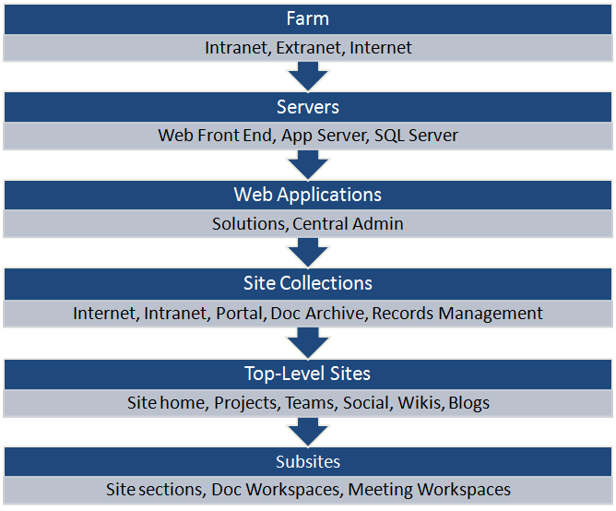
Active Directory 101
AD Integration
SharePoint 101
SP Integration
  SharePoint - Architecture
Next Discussion:
Integrating our silo applications into SP Site Collection
Notes:
Presentation Time = 30 sec
Now lets discuss the architecture of the components we reviewed in the last slide. SharePoint architecture consists of:
SharePoint farms,
which have servers,
which have web applications, and site collections.
<CLICK>
Our MAIN focus is how we can integrate an application into SharePoint Site Collection to leverage all these features. We will explore that in the next slide …
-- FOR REFERENCE --
Site layout - http://msdn.microsoft.com/en-us/library/ms473633.aspx
Farm Hierarchy - http://kjellsj.blogspot.com/2010/07/scalable-sharepoint-2010-farm-services.html
Microsoft Building Blocks - http://msdn.microsoft.com/en-us/library/ee534971(v=office.14).aspx

Slide 16
Active Directory 101
AD Integration
SharePoint 101
SP Integration
  STEPS: Integrating apps to SP (& SSO)
  Step 1) Move & Import app to SP Site
  Step 2) Update SP Configuration, DB connections
  Step 3) Configure app to attach SP master page
  Step 4) Update site roles if necessary
NOT many code or configuration changes
Notes:
Presentation Time = 30 sec
Once again, we will not go over each one of these steps but talk at high-level:
SharePoint Integration follows a 4 step process shown in this slide
All these steps require very minimal code change or configuration and its mostly plug and play.
Code change is required if you want to leverage additional SharePoint features.
-- FOR REFERENCE --
Integrating Applications to SharePoint
Copy the DLL of your custom application to sharepoint server; then import it using SharePoint designer (File -> Pages Tab -> Import files)
Update connection strings for your new application’s database
Specify a reference to SharePoint master page so our custom app can inherit all the relevant features of SharePoint
IF you are using AD authentication without any special roles then you don’t need to work on this step. However, more than often you will have some configuration on your app and you can define that in SharePoint for this site you just integrated into SharePoint.

Slide 17


SharePoint is preferred
But what does Microsoft recommend?
Active Directory 101
AD Integration
SharePoint 101
SP Integration
  COMPARISON: AD vs. SP
Active Directory
SharePoint
Require significant code changes
More complex integration
Does not require SP for SSI
Easier to integrate
Easier to configure
Added features
Can integrate with other SSO providers
Notes:
Presentation Time = 30 sec
Lets summarize our technical analysis of comparing integration options of AD and SP.
AD:
- More code changes
- Complex integration
+ Does not require SharePoint for Single Sing-on Integration
SP:
+ Easier to integrate & configure
+ Added features
+ Ability to integrate with other SSO providers

Slide 18

Once again,
SharePoint is preferred
for our scenario
3) Solution Implementation
  Microsoft Recommendation for SSI
Active Directory 2008 R2
SharePoint 2010
Integrate third-party/ complex apps
Integrate apps when unable to integrate with SharePoint
    Integrate Custom/simple apps
    Integrate apps with SharePoint whenever possible
Rule of Thumb
Reference:
Microsoft Press Book: “Microsoft SharePoint Foundation 2010”
Authors: Penelope Coventry, Troy Lanphier, Johnathan Lightfoot, Thomas Resing, Michael Doyle
Notes:
Presentation Time = 30 sec
If running out of time, say:
Microsoft recommends using SharePoint when possible.
If not running out of time, details below:
SharePoint Integration:
Integrate custom/simple apps such as SSRS reports or web forms
Integrate with SharePoint whenever possible for all custom and simple applications.
Active Directory Integration:
Integrate with third-party complex applications that do not fit into SharePoint architecture.
Integrate with Active Directory when unable to integrate with SharePoint.
Once again, SharePoint is preferred for our scenario of integrating a simple silo app to SSO

Slide 19
Next Topic …
Project
Overview
Technical
Analysis
Business
Analysis
[1]
Current: issues/pros/cons
[2]
Proposed
Solution
[3]
Implementation
[4]
Cost/Risk
[5]
Impact: Business/Legal
[6]
Adoption: Corp/Industry
[4] Cost/ Risk Analysis
[5] Business/ Legal Consequences
[6] Corporations/ Industry adoption of SSI
Notes:
Total Presentation Time For This Section = 6 minutes

Slide 20
Cost of Single Sign-on Integration
  Total Cost of Ownership (TCO)
  Work Breakdown Structure (WBS) as follows:
Software/
Hardware Cost
SW Costs
HW Costs
Develop/Integrate
Dev/Support Cost
Support/Repair
Deploy/Maintenance
Incremental Cost, 3yrs
License renewal
Dev/Support
Training
Training Cost
Developer Training
Notes:
Presentation Time = 30 sec
NOTE: We don’t need to dive into detail in this slide as they are covered in the next slide. Perhaps only mention the main 4 areas
Slide Presentation:
We will start by reviewing the total cost of ownership.
We broke down total cost of ownership into granular elements using work breakdown structure. These pieces are:
Software/hardware cost
Development/support cost
Training cost
Incremental cost for 3 years
-- FOR REFERENCE --
WBS structure is used to effectively break down and estimate cost of implementation in granular pieces and then computing cost by aggregating cost of each grain.
Next slide shows detailed TCO calculation

Slide 21
TCO for 3 years:
SharePoint = $-29,423
Active Directory = $ 51,000
SharePoint is preferred
Software & Hardware Cost
Decommissioning server when integrating with SP.
Dev/Support Cost
Less work with SharePoint Integration.
Training Cost
Slightly more training cost for AD.
Incremental Cost
More support required for AD.
Reference:
[1] Formula: (#3/52*#1)*#2
[2] Formula: (#3/52*#1/2)*#2
Notes:
Presentation Time = 1 min, 30 sec
Presentation Help:
Let’s not go over each line item. Just mention main areas and some prominent points listed in the slide (and below in detail):
Software & Hardware Cost:
Most prominent point is that with SharePoint we get to decommission our existing server as our application is deployed on SharePoint server.
Development/Support Cost:
Development/support cost is low for SharePoint due to lower SSI complexity
Training Cost:
# of days for training is higher for custom code
Incremental Cost:
This comprises of developer support cost, training cost, Dev/support cost
--- REFERENCE ---
50k cost savings is typical for a production grade server. What typically adds up to make this cost is database server license, software license, backups storage, tape backups, database backups, licensing costs, third-party support costs, internal resource support cost, license renewals, etc.

Slide 22

Risk Analysis
Risk of Implementing SSI
Investing in Microsoft technology stack
Availability of resources
Slower Performance
System outage affects all applications
Notes:
Presentation Time = 30 sec
At this point, Mention that we will now focus on SharePoint as it is a preferred solution
Risk Points:
Investing in Microsoft Technology Stack is an SSI risk because if the enterprise strategy changes to go with a different enterprise content management (ECM) provider, then that would require additional work/rework.
Availability of skilled resources to implement SharePoint is more scarce than custom development.
Typically establishing SSO connection requires several redirects and slows the performance of authentication.
If there is a system outage on SharePoint or AD, that would affect all applications deployed using SSO. However, this is a less risk if system is architected correctly.

Slide 23


Feasibility Analysis
What makes Implementing SSI, a feasible solution?
Cost savings
Well documented integration
Leadership support
Simple integration options
Notes:
Presentation Time = 30 sec
Following factors make the Single Sign-on Integration, a highly feasible (Possible) solution:
Cost savings – no need to maintain extra hardware or support personnel.
Documentation - Integrating application to SSO is typically very well documented and thousands of companies are already doing it.
Leadership Support – Leadership team typically supports projects that bring conformity and consistency.
Simple Integration Options - SharePoint provides very easy and simple integration options

Slide 24


Business & Legal Consequences
Easier authentication
Single & easy user management
Cross site integration
Single business portal
Simplifies legal requirement
Notes:
Presentation Time = 45 sec
Now we are going to focus on Business consequences of implementing a Single Sign-on Integration project utilizing SharePoint
BUSINESS:
Easier authentication – Business can focus more on business and being profitable and less on hassle of logging into sites and remembering passwords
Easy user management – Single place to manage all users that makes it much easier and clear to manage users.
Cross site integration - By integrating application into SSO such as SharePoint, you can also achieve cross site integration and leverage some common features (such as centralized document management).
Single business portal – Single business portal allows easy content navigation and increase productivity and collaboration.
LEGAL:
Using SharePoint also simplifies legal requirement - Some features of SP such as automated data archival, document management, and asset management help organization achieve compliance (such as SOX compliance)

Slide 25
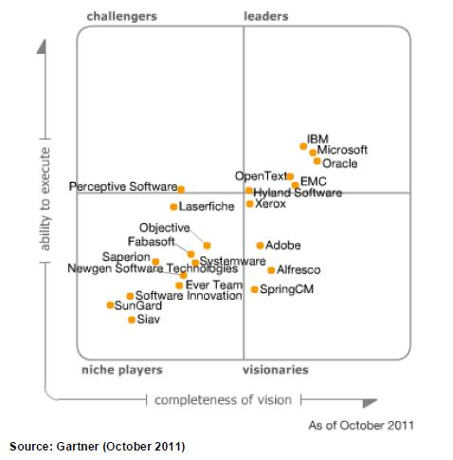
Solution Adoption
By Corporations/Industries
Silo apps exist in all major corporations regardless of industry.
Wide solution adoption potential.
SharePoint is industry leader and already well adopted by organizations around the world.
Notes:
Presentation Time = 1 min
Silo apps exist in all major corporations regardless of industry, so it is a wide spread issue.
Greater solution adoption potential – Since the solution is for a wide spread problem, its adoption will be wide spread as well.
SharePoint is already well adopted by organizations around the world.
-- REFERENCE –
Gartner Report –
http://ecmroad.wordpress.com/2011/10/21/gartner-magic-quadrant-for-ecm-2011/

Slide 26

Q&A
Thank you,
[ TEAM TRIAD ]
Moniza | Radu | Naveed
Notes:
Presentation Time = 3 min

