Slide 1
Information Security in Real Business (Part 2)
October 20th , 2012
Team Tiger

Slide 2
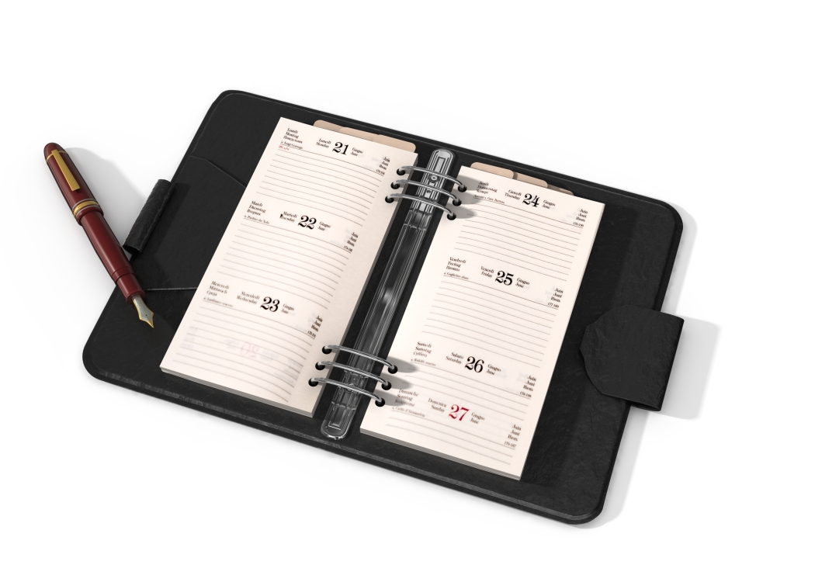
Agenda
Information Security in Real Business
Objective
Security and Business Issue
Principles of Data Protection and Business Requirements
Why it is important?
Industry Research
Q & A / Feedback
Vote of Thanks

Slide 3
Objective
To complete and present Part 2 of Project “Information Security in Real Business:
From Part 1 the (at least) four issues, pick the most interesting one to your group and the one which should not been very well solved (or the one being solved, i.e., an ongoing project) in your corporate/organizations.
Formulate a security problem and do some research on the related work. Please show why this problem is a general one that comes across multiple industry/education/government sectors.
Each group is expected to give a presentation (5-10 minutes) to seek synergy and early feedback from other students and the instructor in week 5.

Slide 4
Security (Issue)
Team Tiger Group MSIT Northwestern Engineering

Slide 5
Business Issue
Cornerstone: Availability
Business Issue: Confidential Information / Data Protection Issues, involving loss of Confidential Customer data in a “Outsourced Environment”
Our computer networks, computers and software, if left unsecured, can pose a substantial risk to our confidential information. As Company Associates, we must do everything possible to protect Company information systems from unauthorized access.

Slide 6
Principles of Data Protection
Identify the type of information you need to store and why
Consider data protection principles into account when storing
customer data.
There are eight principles of data protection. These state that data must be:
Fairly and lawfully processed
Used for limited purposes
Adequate, relevant, not excessive
Accurate
Not kept longer than necessary
Processed in accordance with the data subject's (i.e., the customer) rights
Secure
Not transferred to countries without adequate protection
A more comprehensive definition of these principles is on website of the Information Commissioner's Office.

Slide 7
Business Requirements
Managing Sensitive Data initiative
Complying with law, regulations, contracts, policies, guidelines and procedures in protecting data and its appropriate use
Protecting individual privacy and reducing the potential for identity theft
Education and awareness
Data Stewardship and Data Governance
Privacy and Confidentiality Policy for Institutional Data
Access principles, guidelines and procedures
Guidelines for managing research data
We have legal and ethical responsibilities to protect the privacy and confidentiality of institutional data.

Slide 8
Why it is Important
As Company Associates, we sometimes have access to client and/or Company information that is not generally known to the public and provides the Company or our clients with a business advantage. This confidential information includes, but is not limited to:
Strategic and business plans,
Financial, sales or pricing information,
Customer lists and data,
Vendor terms with suppliers,
System code or designs, tools,
Methodologies and promotional plans,
Proprietary computer systems, and
Copyrights or trademarks on certain brand names.
Our stockholders and clients rely on us to protect this important business information from unlawful or inadvertent disclosure.
Our ability to protect the confidentiality of this information is critical to our ability to obtain and retain customers. Unauthorized or premature disclosure could have a serious financial impact on the Company and our clients and may subject the Company and our Associates to liability, including penalties for insider trading.

Slide 9
Industry Research
A data breach occurs when there is a loss or theft of, or other
unauthorized access to, data containing sensitive personal
information that results in the potential compromise of the
confidentiality or integrity of data.
The first state data security breach notification law was enacted in
California in 2002. In response to state security breach notification
laws enacted thereafter in numerous jurisdictions, over 2,676 data
breaches and computer intrusions involving 535 million records
containing sensitive personal information have been disclosed by the
nation’s largest data brokers, businesses, retailers, educational
institutions, government and military agencies, healthcare providers,
financial institutions, nonprofit organizations, utility companies, and
Internet businesses.
Source: Federal Information Security and Security Breach Notification Laws
Data Security Breach Notification Laws by Gina Stevens, Legislative Attorney (April 10, 2012)
http://www.fas.org/sgp/crs/misc/R42475.pdf

Slide 10
Industry Data on data breaches
Year | What | How | Organization
2005 | personal information of 163,000 persons | Security breach | ChoicePoint
2006 | the personal data of 26.5 million veterans was breached | employee’s hard drive was stolen from his home | VA State
2007 | 46.2 million credit and debit cards | breach of its computer network by unauthorized individuals | TJX Companies
2008 | 4 million debit and credit card numbers | computer systems were illegally accessed while the cards were being authorized for purchase | the Hannaford supermarket chain
2009 | 130 million records from credit card processor | security breach | Heartland Payment Systems Inc. of Princeton, N.J
2011 | patient data 20,000 emergency room patients | security breach | Stanford Hospital in California
2011 | Data Breaches | Unsecured Cloud Computing | Epsilon, Sony, and Amazon data breaches.
2011 | compromising customer names and e-mail addresses | Database Hacked | E-mail marketing company Epsilon
2011 | certain PlayStation Network and Qriocity service user account information was compromised | an illegal and unauthorized intrusion into its network | Sony
According to the Federal Trade Commission (FTC), identity theft is the most common complaint from consumers in all 50 states. Between January and December 2010, the Consumer Sentinel Network (CSN ), a database of consumer complaints, received more than 1.3 million consumer complaints. Identity theft tops the list accounting for 19% of the complaints.
Federal Trade Commission, “Consumer Sentinel Network Data Book for January—December 2010,” March 2011, at http://www.ftc.gov/sentinel/reports/sentinel-annual-reports/sentinel-cy2010.pdf

Slide 11
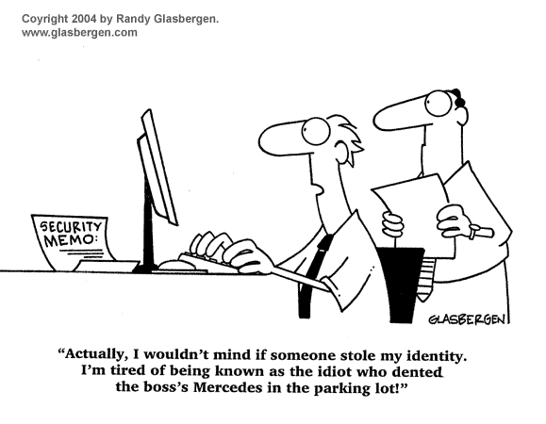

Slide 12
Q & A Feedback - Manu Arora - Syed Ashfaq

