Slide 1
Email Encryption
Team 2.0
Nayan Thakkar, Eddie Gallon, David Kotar,
Bruce Malone and Pamela Dorman

Slide 2
Requirements for Solution
Support for:
Mid size company "X" with ~250 employees
Windows network with Exchange 2010 w/350 mailboxes
4 locations with centralized infrastructure
Email hosted in-house at single location
Goals:
HIPAA Compliance.
Protect sensitive information.
Secure emails.
Solution:
ZixCorp Gateway

Slide 3
Feature Comparisons
 | IronPort | Sophos UTM | McAfee Email Encryption | ZixCorp Gateway
Email Encryption | yes | yes | yes | yes
Policy Based | yes | yes | yes | yes
Legal Compliance | yes | yes | yes | yes

Slide 4
Cost Comparison
Cisco C170 - supports < 2000 users
CAPEX - $2,035 OPEX - (~15% CAPEX) - $305 /yr
TCO over 5 years - $3560
Sophos Virtual Email Appliance - Supports < 1000 users
CAPEX - $1,995 OPEX - (~ 15% CAPEX) - $299/yr
TCO over 5 years - $3490

Slide 5
Cost Comparison
McAfee Email Gateway EG4000 - sized for our needs
CAPEX - $1995.00 OPEX - (~15% CAPEX) - $299/yr
TCO over 5 years - $3490
ZixCorp - supports < 2000 users
CAPEX - NONE OPEX - $1000/yr
TCO over 5 years - $5000

Slide 6
Recommended Solution
Zixcorp Gateway
Reasoning
No upfront CAPEX
Solid relationship with Vendor
Competitive in price and features
Meets our needs
Feasibility
ZixCorp implemented at Fortune 100 companies
Satisfied Customers
Company financially viable - (NASDAQ - ZIXI)
ZixCorp invested in product

Slide 7
Implementation Analysis
Easy to implement- 2 week install time
Hardware:
Dell 1U physical rack-mountable or
VMWare environment
Internal Infrastructure Modifications
Firewall (open port 80, 443, 25, 53 for DNS)
DNS (MX, A, PTR)
Easy flash cutover / fallback
Operational Owner - Network Security Group
Maintenance- 24x7 support contract

Slide 8
Risk Analysis & Compliance
Business Risks:
Non-compliance with HIPPA policy.
Up to $250,000 per incident
Up to 5 years in prison for some violations.
Fines.
Compliance Goals:
Encrypted emails.
Protect sensitive information.
Notes:
PCI violations can also result in financial losses, i.e. suspension of merchant license.

Slide 9
Transparent Email Encryption
Fully transparent email encryption services
Between ZixGateway customers, email is encrypted without any extra steps. It’s completely transparent to the sender and receiver---not even a password is required to decrypt.
Extends transparent experience with safe and secure notification using TLS
Ease of use
Enterprise Mobility support
Notes:
What is TLS:
Transport Layer Security (TLS) is a protocol that ensures privacy between communicating applications and their users on the Internet. When a server and client communicate, TLS ensures that no third party may eavesdrop or tamper with any message. TLS is the successor to the Secure Sockets Layer (SSL).
TLS is composed of two layers: the TLS Record Protocol and the TLS Handshake Protocol. The TLS Record Protocol provides connection security with some encryption method such as the Data Encryption Standard (DES). The TLS Record Protocol can also be used without encryption. The TLS Handshake Protocol allows the server and client to authenticate each other and to negotiate an encryption algorithm and cryptographic keys before data is exchanged.
The TLS protocol is based on Netscape's SSL 3.0 protocol; however, TLS and SSL are not interoperable. The TLS protocol does contain a mechanism that allows TLS implementation to back down to SSL 3.0. The most recent browser versions support TLS. The TLS Working Group, established in 1996, continues to work on the TLS protocol and related applications.
ZixCorp, the leader in email encryption services, has integrated transport layer security (TLS) delivery in the new release of ZixGateway®. Ideal for compliance and security officers, TLS email through ZixGateway reduces administration, enhances transparent delivery, provides guaranteed encrypted replies and enables reporting capabilities that do not exist with any other TLS email solution.
Enterprise Mobility Support
Enterprises should expect mobile support for email encryption to include:
Seamless email encryption as users navigate from desktop to mobile device
Optimized layouts designed to accommodate the user’s environment
Fully functional navigation maximized for the user’s screen
Maximum user convenience with no cumbersome steps
ZixMobility is unique in its support by:
Functioning across all mobile platforms with comprehensive support for the top three – AndroidTM, BlackBerry® and iPhone®
Enabling a "Remember Me" option for direct access to secure messages
Extending the life of secure emails
ZixMobility is fully deployed.

Slide 10
Policy-based Email Encryption
Policy Actions & Features
ZixGateway’s primary policy actions are:
Encrypt
Redirect
Block
Complimentary secondary actions include:
Sender notification email
Carbon copy to specified individual(s)
Outbound and/or inbound disclaimers
Other important features:
Users / Departmental policy
Managed by ZixGateway’s eGroups
Automated by LDAP integration
ZixGateway performs full content scanning of the subject line, message body and over 200 types of attachments
Notes:
ZixGateway’s primary policy actions are:
Encrypt
… to existing ZixGateway customers = transparent for recipient
… using ZixCorp’s Managed TLS = transparent for recipient
… to custom branded secure portal, ZixPort
Redirect
Block
Complimentary secondary actions include:
Sender notification email
Carbon copy to specified individual(s)
Outbound and/or inbound disclaimers
Other important features:
Users / Departmental policy
Managed by ZixGateway’s eGroups
Automated by LDAP integration
ZixGateway performs full content scanning of the subject line, message body and over 200 types of attachments

Slide 11
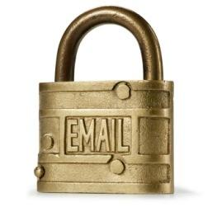
Policy-based Email Encryption
Email Security Policy:
Sender triggered actions
Actions by domain (sender/recipient) or message attribute
Content triggered action
Secured & Simplified TLS:
Managed TLS
Simplified TLS Configuration
Superior Branding & Reporting
Notes:
Company’s email security policy may consist of:
Sender triggered actions
Key word or phrase
ZixSelect - button in Outlook toolbar
Actions by domain (sender/recipient) or message attribute
Always encrypt to business partners
Encrypt all PDFs sent by a group of users
Block unauthorized users
Content triggered actions
Full content scanning provides an added safety net for customers
Avoids relying on sender only triggered encryption

Slide 12
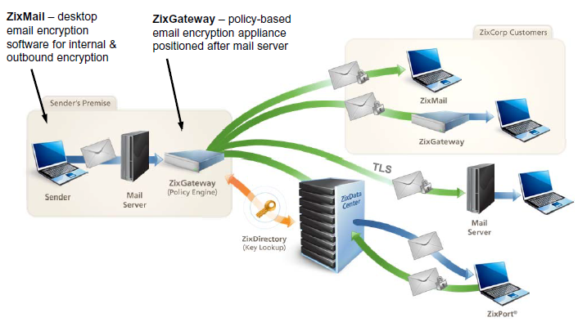
ZixCorp Outbound Email
Notes:
ZixCorp's Key Differentiator is its ZixDirectory
The ZixDirectory is …
global repository of encryption keys with over tens of millions of members & adding 100,000 new members a week
A unique approach to email encryption, leveraging a hosted
and SHARED key directory delivers:
Transparent email encryption between customers
No key management or key storage
Eliminates the most complicated and costly aspect of email encryption
Nothing new to build, manage or maintain
Hosted in the ZixData Center, state-of-the-art infrastructure
A $50 million facility with SysTrust/SOC3 certification, SOC2 accreditation
and PCI DSS Level 1 Version 2.0 compliance
99.99% availability with guaranteed Service Level Agreements

Slide 13
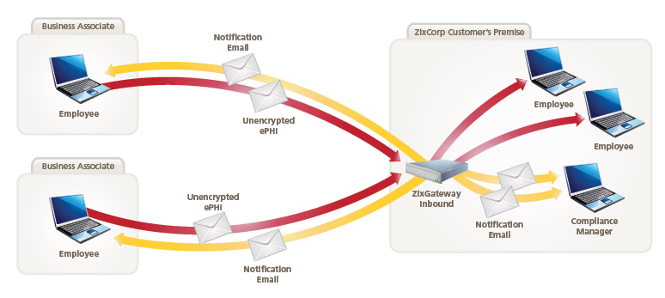
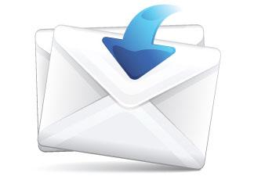
ZixCorp Inbound Email
Notes:
SAAS based with 100% subscription solution
Foundation for ZixDirectory®, ZixPort® and all central security monitoring services
RFID badge/biometric access/video surveillance
Proven >99.999% availability
Massive redundancy
3 ISPs
2 power grids plus battery/generator back-up
Network, service and database – no single point of failure
Hybrid chilled water and freon (back-up) cooling
Highly trained 24x7x365 operations center staff
Satellite fSAAS based with 100% subscription solution
Foundation for ZixDirectory®, ZixPort® and all central security monitoring services
RFID badge/biometric access/video surveillance
Proven >99.999% availability
Massive redundancy
3 ISPs
2 power grids plus battery/generator back-up
Network, service and database – no single point of failure
Hybrid chilled water and freon (back-up) cooling
Highly trained 24x7x365 operations center staff
Satellite facilities in U.S. and Europe for availability protection and geographic service distributionacilities in U.S. and Europe for availability protection and geographic service distribution

Slide 14
Adoption across different industries
Notes:
Zix has developed accurate models for Healthcare (HIPAA), Financial(GLBA) and considers may state encryption laws (CA, MA,NV and WA).
Zix also will update and customize solutions at no cost to customers. Such as for HIPPA Zix provides content filters such as Health Identifiers (OIDs, IDs), Health Terms, Social Security Numbers.
Zix Adoption:
· Five divisions of US Treasury
· All of the FFIEC US federal banking regulators (FDIC and OCC)
· 22 US state banking regulators
· More than 1,800 US financial institutions or 20% of all banks in the US
· More than 1,500 hospitals or 20% of all hospitals in US
· 32 Blue Cross Blue Shield organizations.
Individuals and businesses often use email to send passwords, financial data, and other sensitive information without understanding all the risks. In general, email messages are transmitted in plaintext over the internet without any form of encryption. Several states, including California and Massachusetts, have passed their own legislation requiring email encryption. The Federal government's Health Insurance Portability and Accountability Act (HIPAA) mandates that health care providers utilize reliable email encryption technology. Financial services firms also face regulation under the Sarbanes-Oxley Act (SOX). Imagine what would happen to your business if sensitive client information, credit card numbers or even health records contained in an email were intercepted.
Brokerage firms use email encryption for transmitting trade confirmations. Anytime a person places a buy or sell order, it is a requirement for brokerage firms to send a trade confirmation. These are typically sent thru postal mail, however, this process can take days, is an expensive process and contain sensitive information that could get lost or even intercepted. Through email encryption, brokerage firms can securely deliver the confirmations electronically.
The banking community also use email encryption to replace traditional methods of communicating such as postal mail, fax, overnight couriers and unsecured email. Sensitive information such as details on bank operations, customers name and account numbers are now encrypted and delivered securely internally, with customers.
More and more Industries are recognizing the importance of email encryption, especially as users continue to voice their privacy concerns. With the existing legislation in several states, presumably more states will follow, and the potential cost of intercepted data, it is important for businesses and individuals to protect confidential information by sending secure emails.

Slide 15
Conclusion & Next Steps
Conclusion
Goal - HIPAA compliance/ Protect Customer Information.
Need - Technology to protect our most vulnerable communication method, email.
Recommendation - ZixCorp Email Encryption.
Benefit - HIPAA Compliance, Customers protected, best solution at best price.
Next Steps
Recommendation Approval
Secure Funding for 1st Quarter 2013

