Slide 1


BYOD: Device Management
By:
Melissa Varghese
Nikhil Madhusudhana
Stella Stephens
Yang Shi

Slide 2
Outline
Problem Statement
Solutions - Virtualization
Cost Analysis
Legal Issue
Business Implementation
Questions

Slide 3
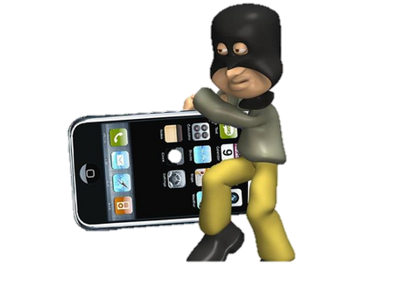
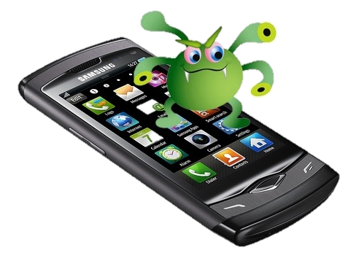
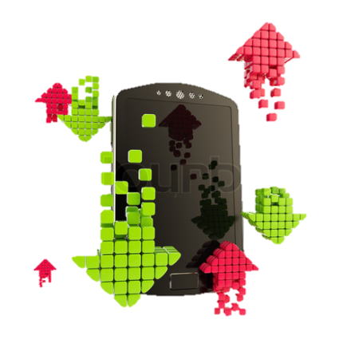
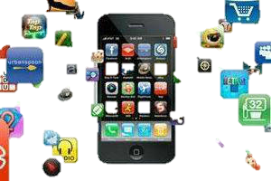
BYOD - The Risks
The sensitive data present on a device that is lost, stolen or in the possession of someone who leaves the company.
An infected personal device connecting to the corporate network.
Malicious apps downloaded by an user.
Theft of data via uploading to a personal device.

Slide 4
BYOD
44 percent of firms had a Bring Your Own Device (BYOD) policy in place in early 2012.
That number increased to 94 percent in 2013.
http://www.forbes.com

Slide 5
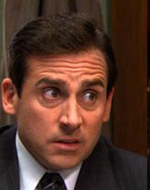
The Problem
Can we set dynamic, context-aware policies? We don’t want employees accessing Facebook at work!
Can we grant granular access to mobile apps? Can we segregate critical business apps from non-compliant or potentially malicious apps?
How can we prevent leakage of our sensitive business data via mobile devices?
Can we monitor and profile mobile network traffic and
user behavior?
BYOD.
Now What?

Slide 6
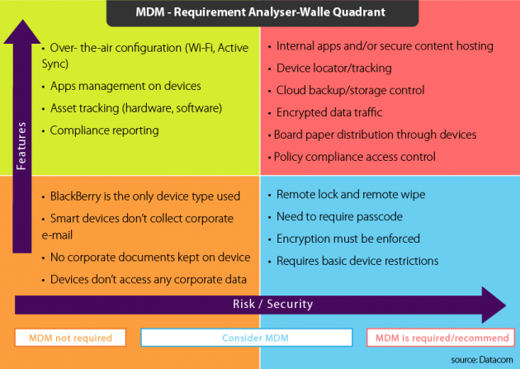


The Solution: MDM?

Slide 7
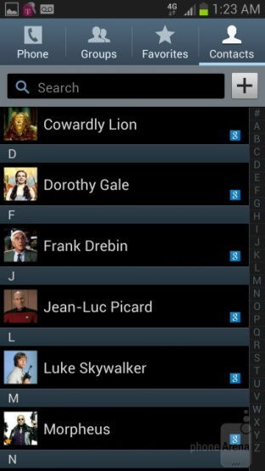
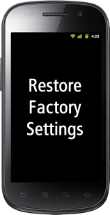


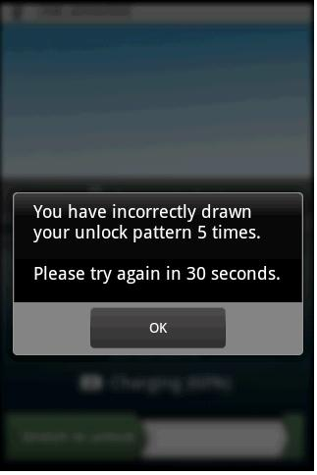

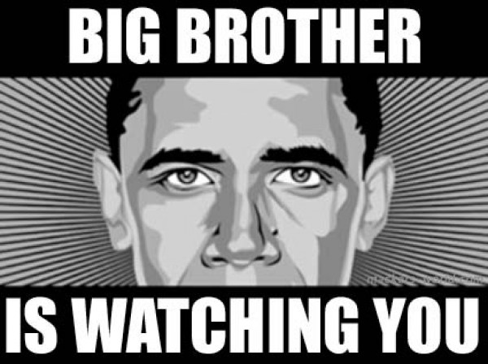
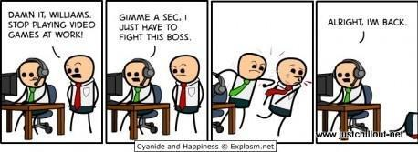
MDM Issue – All or Nothing

Slide 8
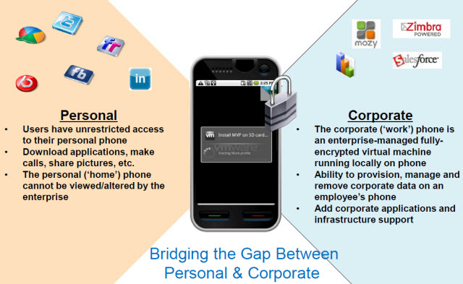
The Solution: Virtualization?
http://www.vmware.com/

Slide 9
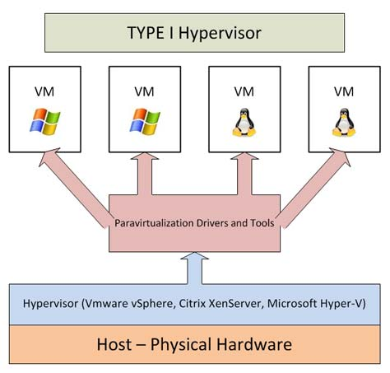
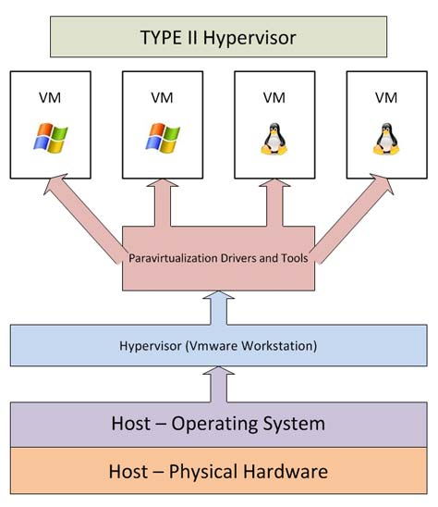
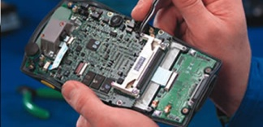


Client-Side Hypervisor
http://www.datacenterknowledge.com/

Slide 10
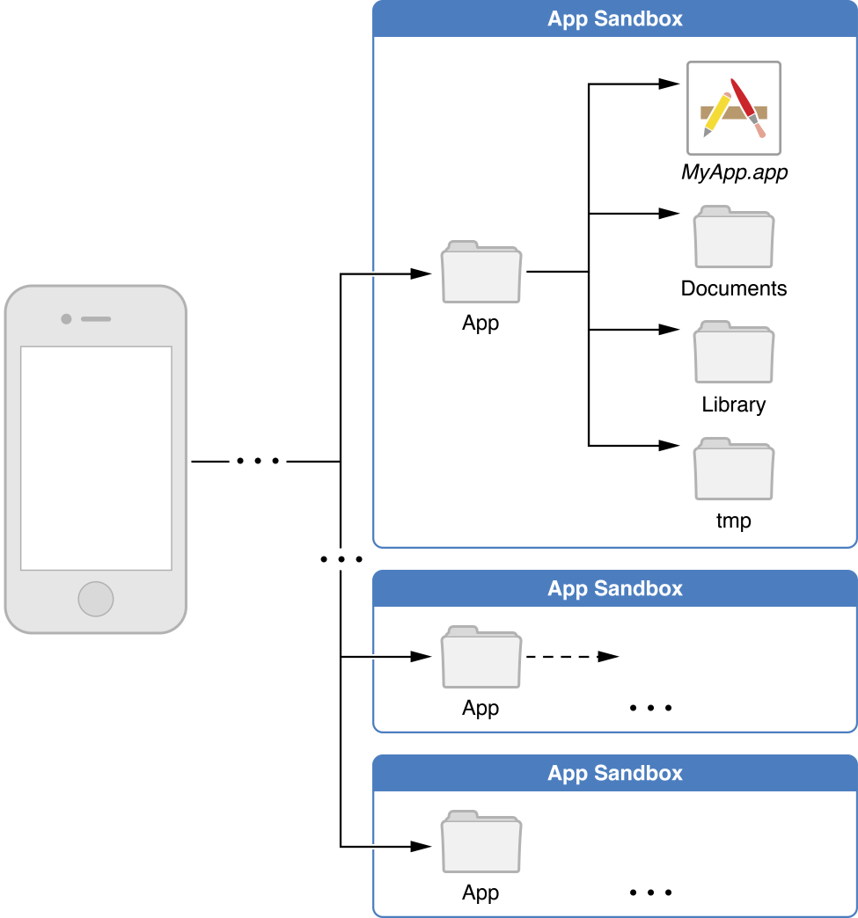

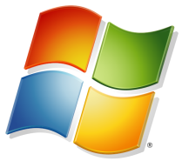


App Sandboxes/Containers
Performance
Scalability
https://developer.apple.com

Slide 11
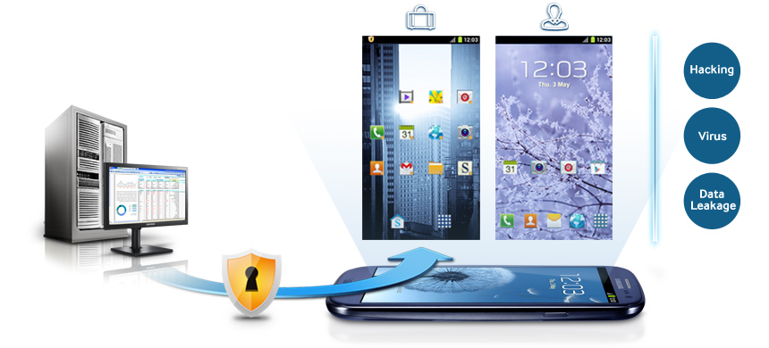
Secure Single App Containers
Single container support for:
User Authentication
App and Data Usage Policies
Stored and Network Data Encryption
Time and location-based access controls
Vendors:
Bitzer Mobile
Mocana (Mobile App Protection)
OpenPeak (Sector)
Symantec (App Center Enterprise)
https://developer.apple.com

Slide 12
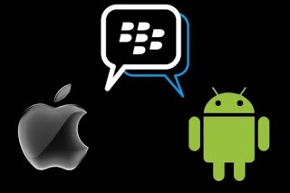
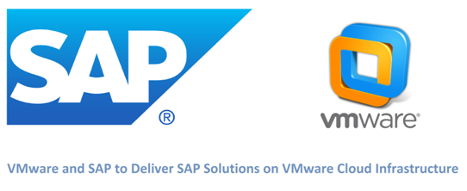
Virtualization in Mobile Devices
BlackBerry Technology
  BlackBerry Balance
AT&T
  Toggle
Samsung
  KNOX
VMware
  Horizon Mobile Secure Workplace
http://goo.gl/g6e29G
http://www.forbes.com

Slide 13
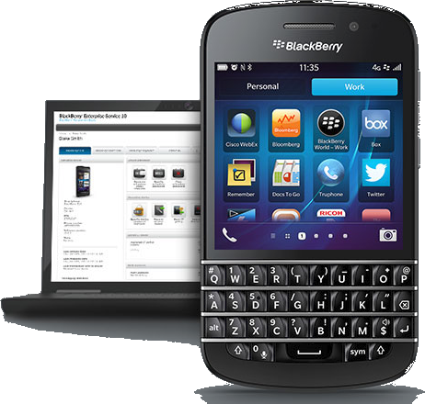
BlackBerry Enterprise Service
MDM for iOS, Android & Blackberry 10
Containment
BlackBerry Balance (BlackBerry 10 Only)
  Manage Work & Personal data
  Work Space fully encrypted
  Minimal training requirements
  Employee satisfaction improved
http://us.blackberry.com/

Slide 14

AT&T Toggle
Android & Apple iOS
Application on top of OS
Dual-persona
Cross-platform MDM features
Security
  Remote lock & wipe (Selective wipe)
  Lockdown features (Bluetooth, Wi-Fi, camera)
  Email control policy
  Real-time scanning (Android only)
AT&T Mobile Enterprise Management
  Application installed on device
www.business.att.com

Slide 15
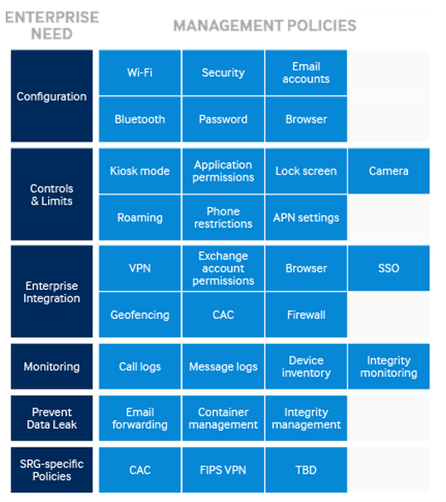
Samsung KNOX
Samsung Galaxy Devices
MDM
  Built-in IT Policies
  Active Directory Ready
  Single Sign-On Capability
KNOX application
Personal & Work Mode
Security
  VPN support
  On-Device Encryption
  Smart Card Authentication
  Device Theft Recovery
www.samsungknox.com

Slide 16
VMware Horizon Mobile
Partnered with SAP
Secure Workspace
  2 step Authentication to connect via Horizon View Client
Type 2 Hypervisor
VMware Horizon View
  Desktop appears across the devices

Slide 17
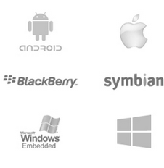
Other Strong Players
Airwatch
  Containerization of corporate email, browsing, content and applications
  Dual personas, multiuser mode
  Secure file synchronization and sharing, both on-premises and in the cloud
Citrix - XenMobile
  Strong, broad set of enterprise mobile integrated offerings in all the major MDM areas
  Deep understanding of enterprise application and mobility needs
  Long history of supporting mobile endpoints and remote access
  Secure containers for smartphones, tablets, Macs and PCs
  MDX App container (sandbox)
    Worx mobile applications
Source: Gartner (May 2013)

Slide 18
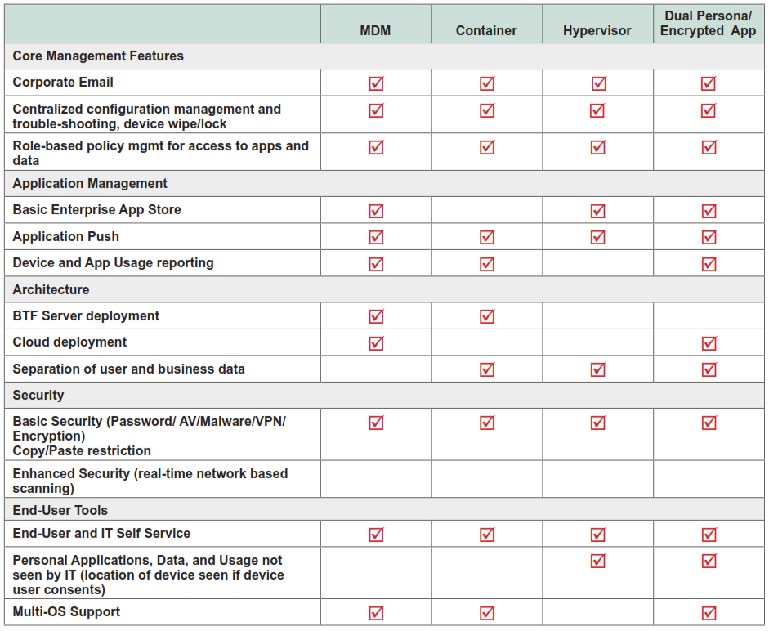
Comparison

Slide 19
Virtualization Cost Analysis
Vmware Horizon mobile
Pros-
Full encryption. Higher security than dual persona applications.
No application modification.
Runs Simultaneous instances of Android OS.
Cons-
Available only for android OS
Limited cellphone models.
Cost - $$$$$
Blackberry Balance
Pros-
Provides highly secure email.
Selective wipe of data and prevents corporate/personal data overlap.
IT can restrict server access.
Cons-
Only provides illusion of separation.
Does not scale well.
Cost- $$$$
AT & T toggle
Pros-
Quick to support new models, scalable to large population.
Easier to support new OS’s.
Rapid device certification and deployment.
Cons-
Slower to run than Hypervisors.
May still need addon security and MDM.
Cost - $$$

Slide 20
Device Monitoring
User Access Manager (UAM) provides user access, guest access management, device fingerprinting, and self-registration.
Endpoint Admission Defense (EAD) reduces network exposure and monitors
the endpoints.
Network Traffic Analyzer (NTA) provides traffic monitoring and capacity planning.
User Behavior Auditor (UBA) provides usage monitoring.
The other things we can monitor:
  All UDT Nodes
  All network connections
  All port details
Keystroke logger installed on devices

Slide 21
Legal Issue of BYOD
No specific BYOD laws.
Existing areas of law apply:
  Privacy law
  Labor law
  Laws relating to:
    Stored Communications
    Computer Fraud & Abuse
    Information Security & Privacy
Industries where laws are likely to apply BYOD even if not explicitly stated:
  Government
  Health Care
  Finance
  Electrical and Nuclear Power

Slide 22
Business Implementation

Slide 23
Business Implementation
School District
  Teachers: feature phone assigned
  Over 500 teachers
  All had personal phones
  Tablet for students
Healthcare
  Patient Data
  Dual Persona
AT&T Toggle
  iPhones or Android devices
  Cloud based managegement

Slide 24
Questions

