Slide 1
Northwestern University Network Security
Policy
&
Security Automation: Metrics and Big Data
Presented by Brandon Hoffman

Slide 2
Topics for Discussion What do you want to talk about?
IT Security in the Business
Policies, Standards, and Procedures
Security Reality and Automation
Measurement and Metrics in Security

Slide 3
The CISO Agenda
Business
Managing 3rd Party Risk (Outsourcers)
Culture / Awareness
Executive / Board Reporting
M&A
Metrics / Benchmarking
Business Continuity
Privacy / Security Breach
Strategy
Brand Protection & Enhancement
Disaster Recovery
Alignment with Business Goals / Objectives
High Availability
CISO
Regulatory
Compliance
Technology
Enablement
Linkage to Enterprise
Risk Mgmt
Identity Management
Mobile Computing
Top-Line Growth
Evolving Threats
Compliance / Internal Audit
Manage Risk
Staffing Support
Align/Optimize Spend
Vulnerability / Patch Management
Core Functions

Slide 4
Risk
IT Security performs a critical role in assessing risk in the organization.
Vulnerability Scanning
Penetration Testing
Industry Trends
IT Strategy
Familiarity/Participation with Audit and Compliance measures

Slide 5
Audit Support
In many cases, IT Security is heavily relied upon to perform in depth testing required by an audit organization. Security is enlisted by audit because:
Technical expertise
Familiarity with current issues from internal testing
Familiarity with Policies, Standards, and Procedures

Slide 6
Compliance
Compliance may relate to internal compliance or external compliance.
Internal compliance:
Policies and Standards
Security and Configuration baselines
Framework use – ISO, COBIT, ITIL, GAISP, NIST
Best Practices

Slide 7
Compliance cont’d
External compliance:
SOX (Sarbanes Oxley)
COSO Framework
HIPAA
PCI
Safe Harbor

Slide 8
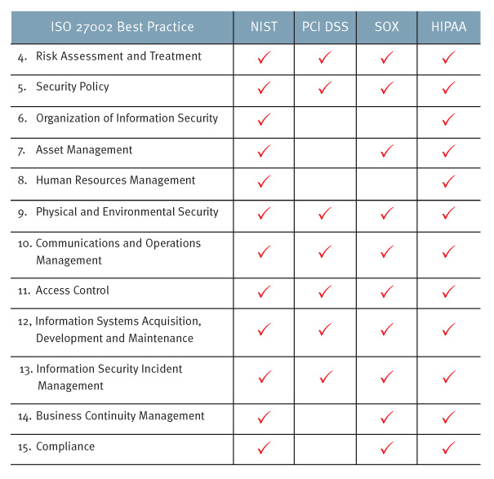
ISO Leading Practices
Source: www.rsa.com

Slide 9
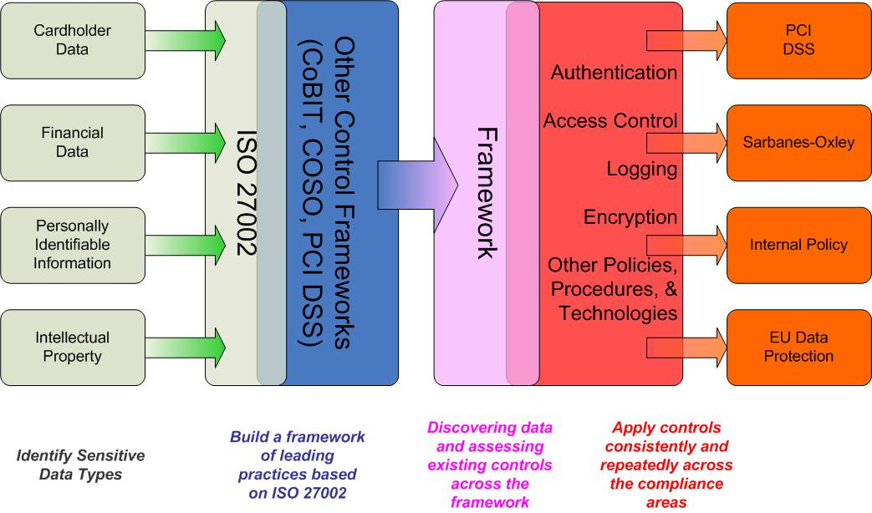
Compliance in Action
Source: www.rsa.com

Slide 10
Internal Policy
IT Security is regularly tasked with creation and enforcement of IT policies, standards, and procedures. Creation and enforcement of these documents require:
Understanding of audit roles and procedures
Familiarity with all systems, networks, and applications
Compliance considerations

Slide 11
Internal Policy cont’d
Definitions:
A Policy is a set of directional statements and requirements aiming to protect corporate values, assets and intelligence. Policies serve as the foundation for related standards, procedures and guidelines.
A Standard is a set of practices and benchmarks employed to comply with the requirements set forth in policies. A standard should always be a derivation of a policy, as it is the second step in the process of a company’s policy propagation.
A Procedure is a set of step-by-step instructions for implementing policy requirements and executing standard practices.

Slide 12
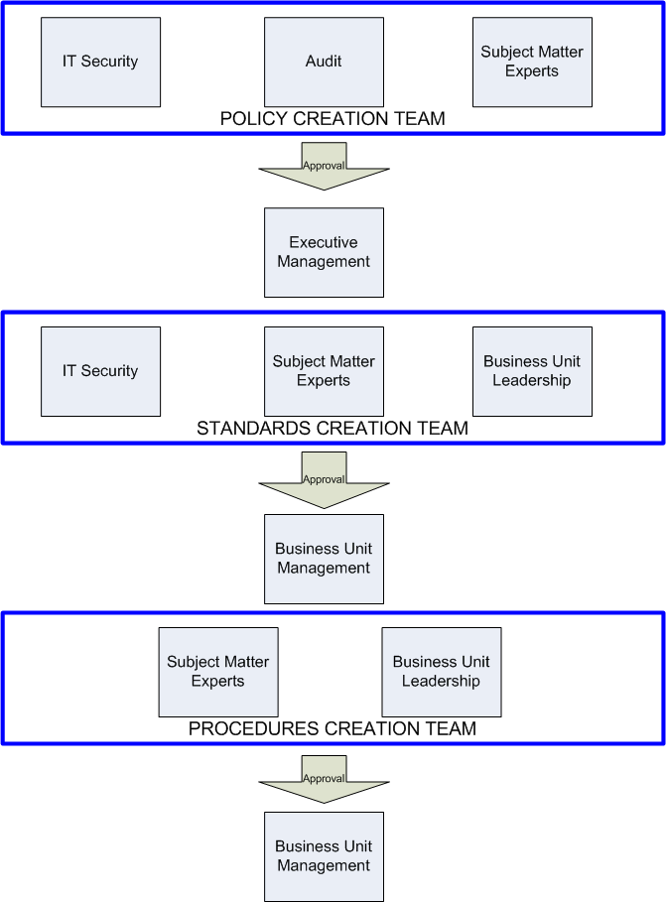
Internal Policy cont’d

Slide 13
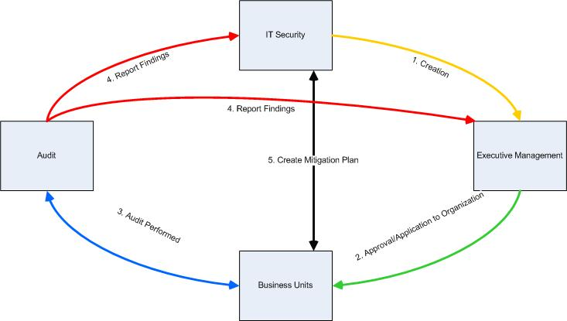
Internal Policy cont’d
Policy creation and enforcement cycle

Slide 14
Policy Business Case
A top 5 global food retailer has a massive IT/IS infrastructure and good governance….but no real policies!
Policies are the foundation for enforcing IT compliance and governance.
What policies were written for the client…

Slide 15
Policy Business Case cont’d
Policies written for IT Security:
Acceptable Use Policy
Information Classification & Ownership Policy
Risk Assessment & Mitigation Policy
Access Control Policy
Network Configuration and Communication Policy
Remote Access Policy
Business Continuity Policy
Incident Response Policy
Third Party Data Sharing Policy
System Implementation & Maintenance
Secure Application Development
Cryptography & Key Management
Mobile Computing
Physical & Environmental Security

Slide 16
Policy Business Case cont’d
Sample Policy

Slide 17
Translation to the Real World
Security policy can be written but is it applied??

Slide 18
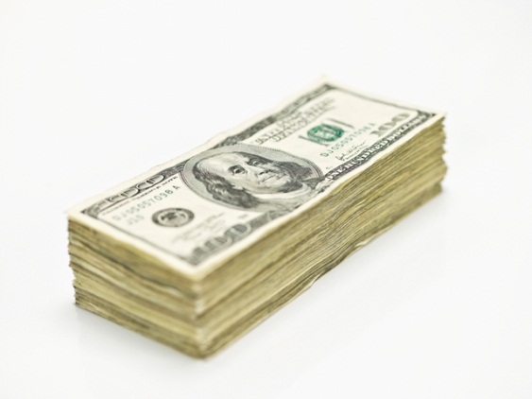
The reality of IT security
90% of Companies say they have been breached in the last 12 months*
Billions of $$$ in IT security spending

Slide 19
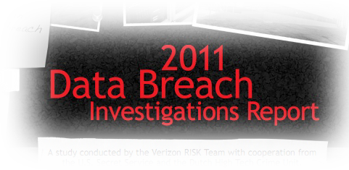
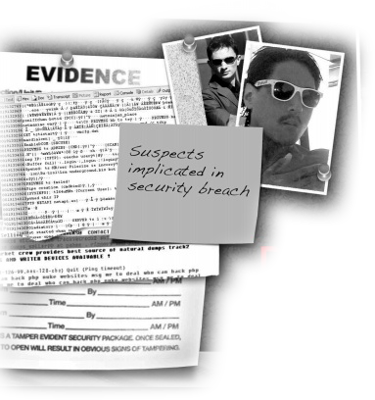
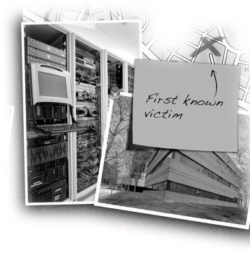
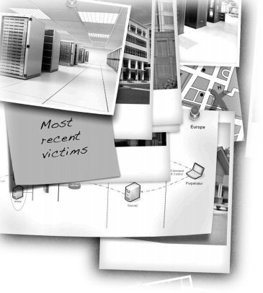
Why can’t we stop them?
Verizon has studied recent breaches
92% of attacks were not highly difficult
96% of attacks could have been avoided
Better yet, they found it just takes “consistent application of simple or intermediate controls”
How can that be?
Notes:
Is this really what the verizon DBIR says? Weren’t the majority of records stolen achieved using advanced techniques?

Slide 20
The paradox
Let’s review:
Bad guys are getting in
We’re spending billions
Simple controls work
What’s going wrong?

Slide 21
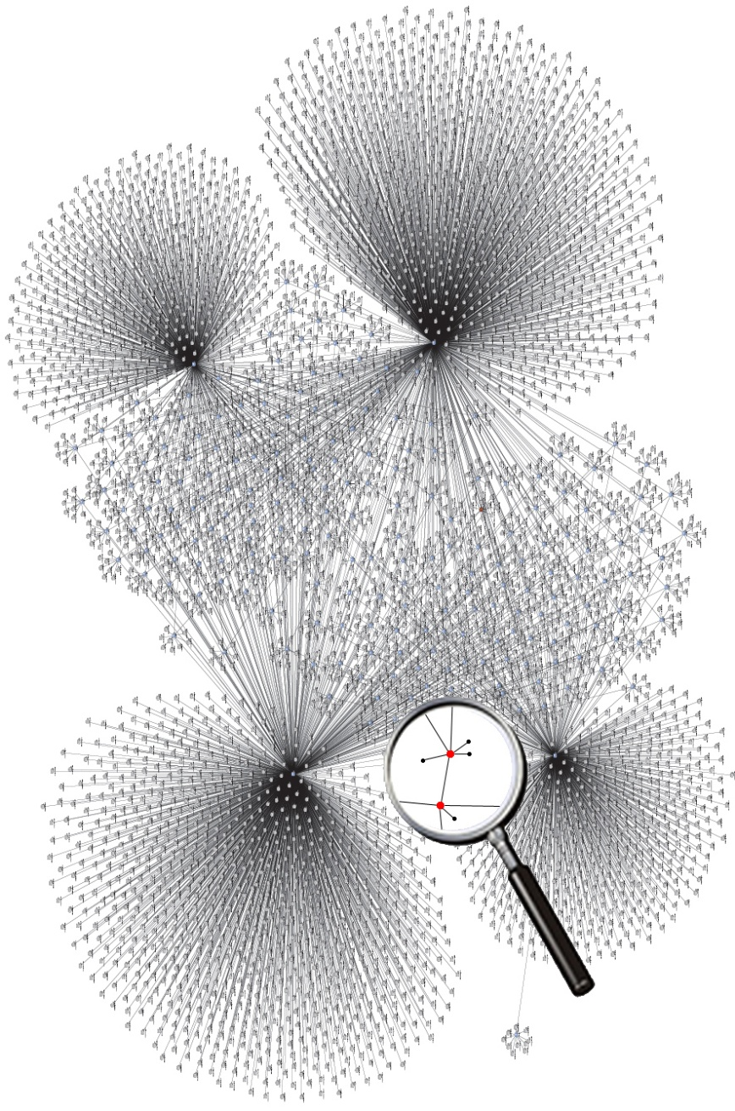
Complexity is the enemy
Verizon said “consistent” controls
In real networks, that’s hard
Complexity defeats us
Humans don’t handle complexity well
We set policy well
Human effort just doesn’t scale
Too many details
Too many interactions
Just how complex are real world infrastructures?

Slide 22
Here’s one real corporate network

Slide 23
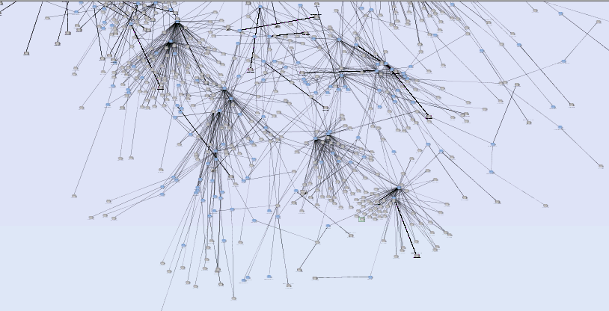
Zooming in a bit…

Slide 24
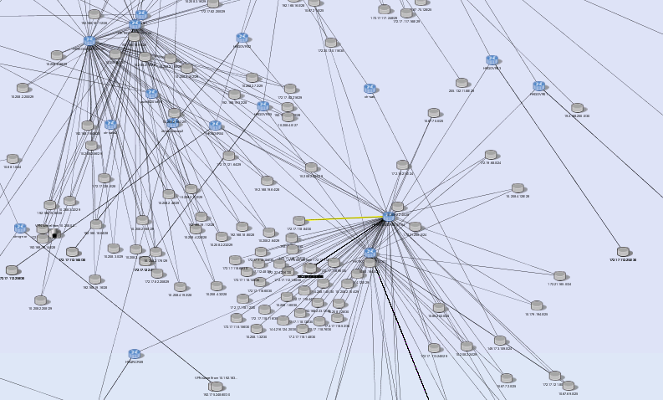
Here’s one “doorway” into the network

Slide 25
One small typo created a problem
One device with a single letter typo here

Slide 26
Where can you go from here?

Slide 27
Implications of simple typo
Technical details:
ACL as written:
ip access-list extended ACL-S61-534
permit ip any <8 servers>
permit ip any <8 more servers>
permit ip any host <1 server>
permit ip any host <1 more server>
ACL as applied:
interface serial 6/1.534
description Link To <outsiders>
ip access-group ACL-61-534 in
The access group lacks an S!
In English:
Good security rule, applied badly
Hard for a human to spot
Expected access: extremely limited
Actual access: wide open to a competitor/partner

Slide 28
Casualties of complexity abound
Financial Services
Before Automation: Brand new data center, emphasis on increased security
With Automation: Found error in 1 firewall of 8 that destroyed segmentation
Retail
Before Automation: Believed they had enterprise-wide scan coverage
With Automation: Identified major gap – firewall blocked scanning of DMZ
Bank
Before Automation: Built segmentation between development and 401(k) zones
With Automation: Found addresses added to development had full 401(k) access

Slide 29
The data challenge in security
We’ve got data
Lots of it
Making sense of it is hard
Skills shortage
Sheer scale
Data mountains need data mountaineers

Slide 30
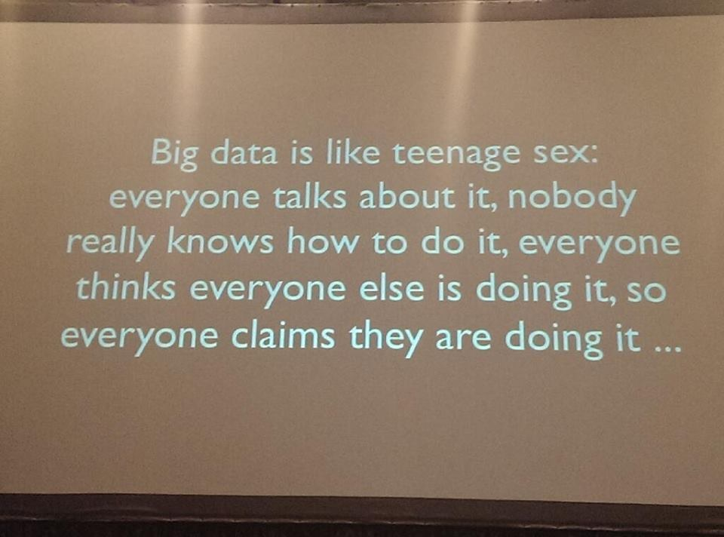
Big Data – hype vs reality

Slide 31
Borrowing other kids’ toys
Big Data works for business analytics
Why can’t we just use their tools?
They look for trends – we care about outliers
Response: can’t we just subtract the trend?
That gets you the noise

Slide 32
Solution: Security Metrics
Security is the absence of something
Can’t report how often you were NOT on the cover of WSJ

Slide 33
Don’t Measure Busy-ness
Many people start with process counting
These measure busyness
Not business
How do you show gains?
Just get busier?

Slide 34
Develop Management Metrics
Metrics close the control loop
Ops has availability
Security needs risk
Focus on outcomes
How easily could a breach occur?
How effective is our spend?
Are we making it harder to break in?
Availability
Operations
Risk
Security

Slide 35
Resources Required
Assets you need to protect
Everyone has some examples
PII, regulatory assets, IP, etc
Some truly “mission critical”
Financial, energy, government, military
Knowledge of vulnerabilities
Bad guys exploit them, so you scan
Counter-measures
It starts with the firewall

Slide 36
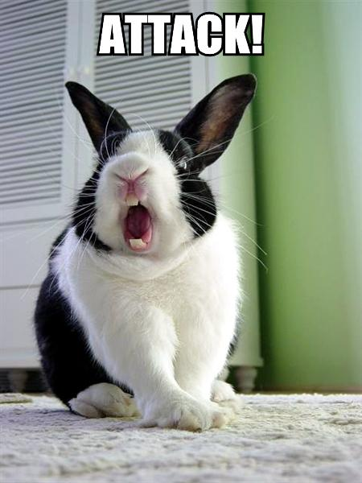
Be PROACTIVE
We want to know our defensive posture
That involves finding the weak points
Attack a model of the network
Measure ease of compromise
Use standards where possible

Slide 37
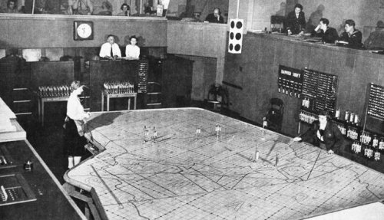
What now? Build the Security War Room
CORRELATE DATA FEEDS
DASHBOARDS
MODEL EVERYTHING

Slide 38
HOW? Start with your infrastructure
See it
Understand it
Test it
Improve it
Automate
Don’t just map – run war-games

Slide 39
Four major gears
Test
Elements
Measure Risk
Gather
& Map
Test
System

Slide 40
You cant manage what you can’t see:
Visualize your network
Validate configuration stores
Gather
& Map
Test elements individually and automate it:
Configuration hardening
Analyze access granted through elements as islands
Test
Elements
Test elements interacting:
Understand end to end access
Analyze vulnerability locations and exposure
Build and measure POLICY compliance
Test
System
Automate and report on findings:
Measure attack risk holistically (attack vectors)
Measure POLICY compliance across all systems
Report into metrics that matter (trends, outliers)
Measure Risk

Slide 41
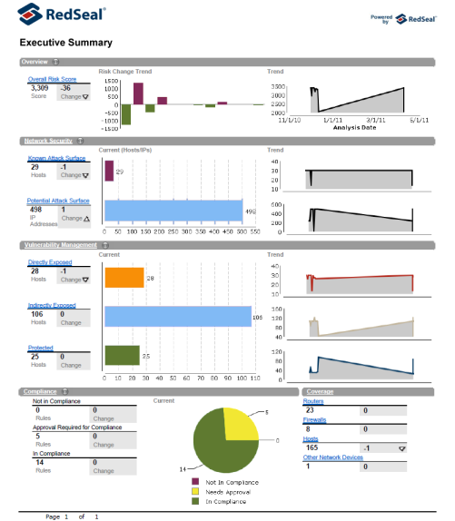
Outbound Proof
How easily can attackers get in?
How big is my attack surface?
How much is non-compliant?

Slide 42
Dashboards for Internal
Are investments working?
Where do we need to improve?

Slide 43
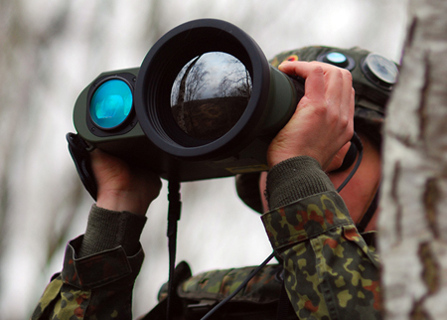
The need for proactive security intelligence
Security has to reinvent Big Data
“Pile it up and hope” won’t work
Humans need machines to help:
Continuously assess defenses
Correlate data
Visualize the the battlefield
Show the state of your network security
Demonstrate compliance with network security policy
Identify gaps and prioritize remediation based on risk

Slide 44
Metrics Conclusions
Defensive posture CAN be measured
This drives to better outcomes
Measure posture => improved posture
It helps the CFO “get it”
You can sleep better
Demonstrate effectiveness, not busyness

Slide 45
Recap
True security is about People, Process, and Technology
Application of simple controls (policy) is required for compliance AND success
Security is a “Big Data” problem
Without automation to reduce complexity, security remains a dream
Without effective metrics, security will never get the exposure or support needed from the top down

