Slide 1
Toward Energy-Efficient Computing
Nikos Hardavellas
PARAG@N – Parallel Architecture Group
Northwestern University

Slide 2
Energy is Shaping the IT Industry
#1 of Grand Challenges for Humanity in the Next 50 Years
[Smalley Institute for Nanoscale Research and Technology, Rice U.]
Computing worldwide: ~408 TWh in 2010 [Gartner]
Datacenter energy consumption in US ~150 TWh in 2011 [EPA]
  3.8% of domestic power generation, $15B
  CO₂-equiv. emissions ≈ Airline Industry (2%)
Carbon footprint of world’s data centers ≈ Czech Republic
Exascale @ 20MW: 200x lower energy/instr. (2nJ → 10pJ)
  3% of the output of an average nuclear plant!
10% annual growth on installed computers worldwide [Gartner]
Exponential increase in energy consumption

Slide 3
More Data → More Energy
SPEC, TPC datasets growth: faster than Moore
Same trends in scientific, personal computing
Large Hadron Collider
  March’11: 1.6PB data (Tier-1)
Large Synoptic Survey Telescope
  30 TB/night
  2x Sloan Digital Sky Surveys/day
    Sloan: more data than entire history of astronomy before it
Exponential increase in energy consumption

Slide 4
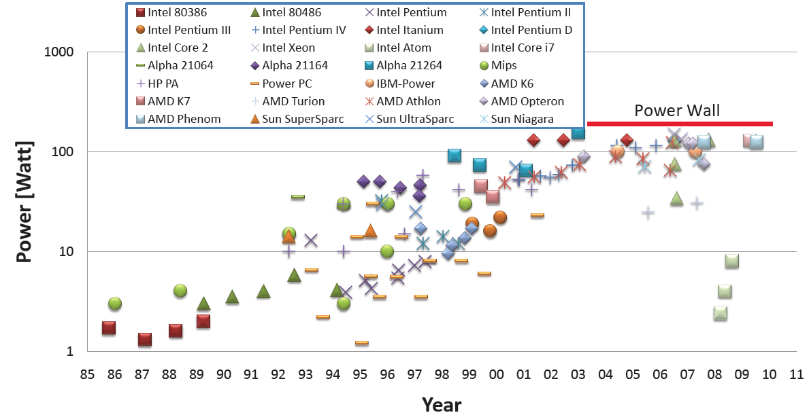
Technology Scaling Runs Out of Steam
Transistor counts increase exponentially, but…
Can no longer power the entire chip
(voltage, cooling do not scale)
Can no longer feed all cores
with data fast enough
(package pins do not scale)
Bandwidth
Wall
Power
Wall
Can no longer keep costs at bay
(process variation, defects)
Can fit 1000 cores on chip, but
only a handful will be running
Low Yield + Errors

Slide 5
Main Sources of Energy Overhead
Useful computation: 0.5pJ for an integer addition
Major energy overheads
  Data movement: 1000pJ across 400mm² chip, 16000pJ memory
    Elastic caches: adapt cache to workload’s demands
  Processing: 2000pJ to schedule the operation
    Seafire: specialized computing on dark silicon
  Circuits: up to 2x voltage guardbands
    Low voltages, process variation → timing errors
    Elastic fidelity: selectively trade accuracy for energy
Chips fundamentally limited by power : ~130W for forced air cooling
    Galaxy: optically-connected disintegrated processors
[calculations for 28nm, adapted from S. Keckler’s MICRO’11 keynote]

Slide 6
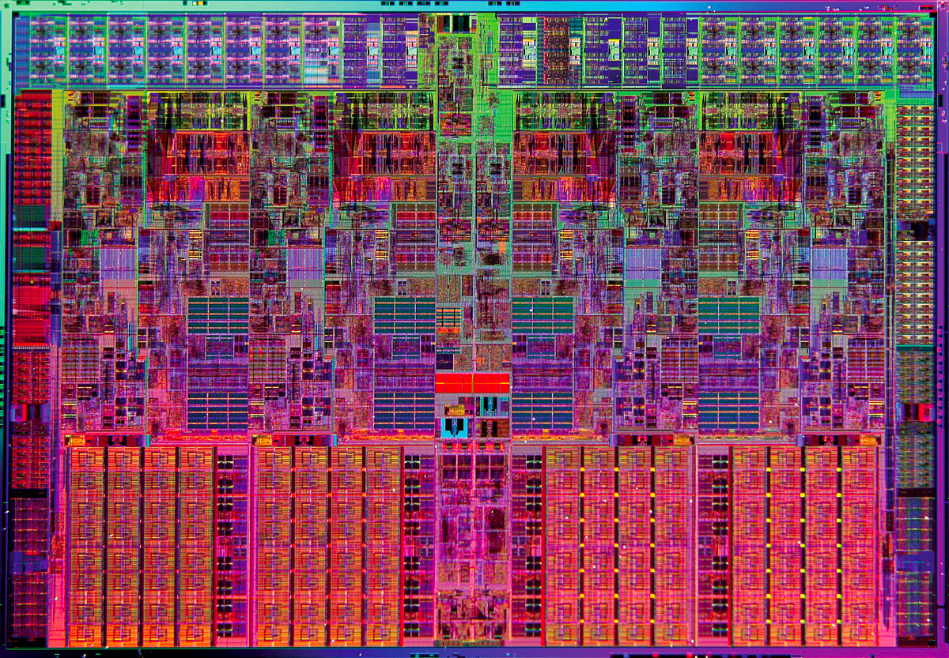
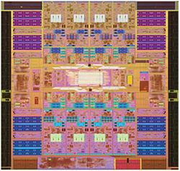
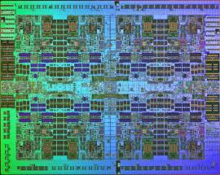
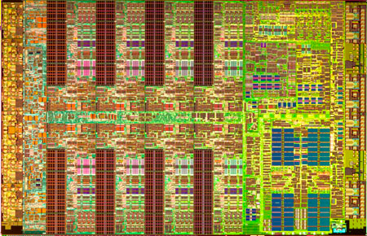
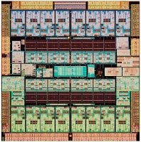
Overcoming Data Movement and Processing Overheads
Elastic caches: adapt cache to workload’s demands
  Significant energy on data movements and coherence requests
  Co-locate data, metadata, and computation
  Decouple address from placement location
    Capitalize on existing OS events → simplify hardware
    Cut on-chip interconnect traffic, minimize off-chip misses
Seafire: specialized computing on dark silicon
  Repurpose dark silicon to implement specialized cores
  Application cherry-picks a few cores, rest of chip is powered off
  Vast unused area → many specialized cores
  → likely to find good matches
  12x lower energy (conservative)

Slide 7


Overcoming Circuit Overheads and Pushing the Power Wall
    Elastic fidelity: selectively trade accuracy for energy
  We don’t always need 100% accuracy, but HW always provides it
  Language constructs specify required fidelity for code/data segments
  Steer computation to exec/storage units with appropriate fidelity and lower voltage
  35% lower energy
Galaxy: optically-connected disintegrated processors
  Split chip into chiplets, connect with optical fibers
  Spread in space → easy cooling → push away power wall
  Similarly for bandwidth, yield
  2-3x speedup over best alternative
  53% avg. lower Energy x Delay
  product over best alternative
10% errors
No errors

Slide 8
Outline
Overview
➔ Energy scalability for server chips
Where do we go from here?
  Short term: Elastic Caches
  Medium term: Specialized Computing on Dark Silicon
  Medium-Long term: Elastic Fidelity
  Long term: Optically-Connected Disintegrated Processors
Summary

Slide 9
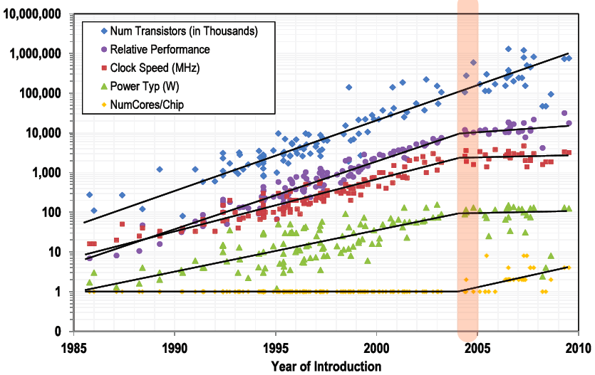
Performance Reality: The Free Ride is Over
???
[NRC]
Physical constraints limit chip scalability

Slide 10
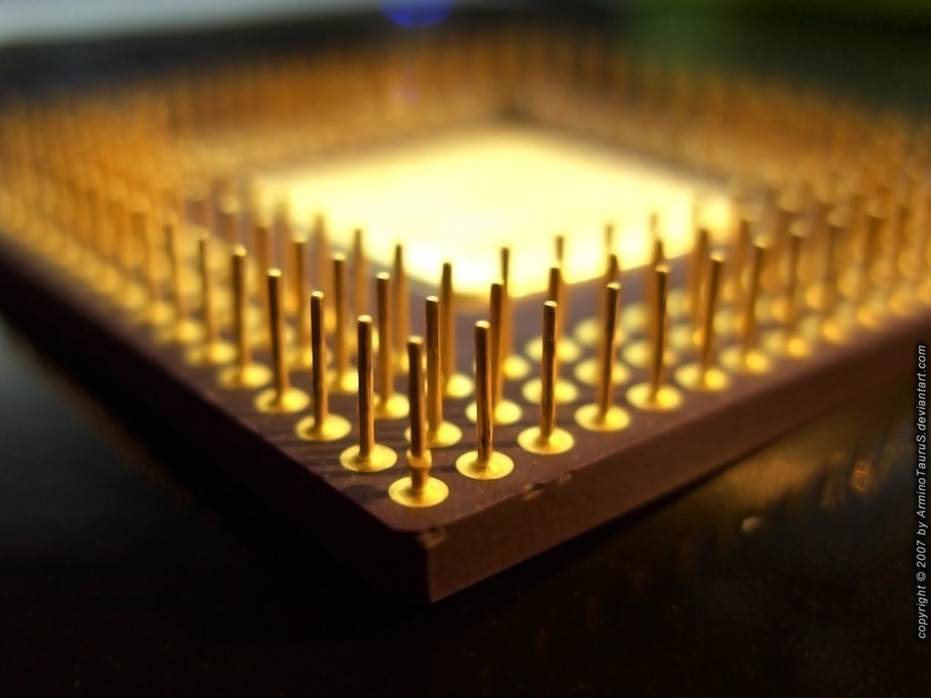
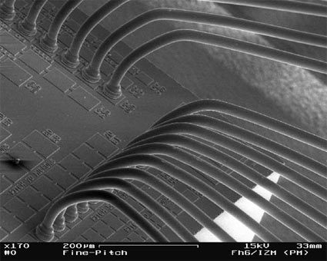
Pin Bandwidth Scaling
[TU Berlin]
Cannot feed cores with data fast enough to keep them busy

Slide 11
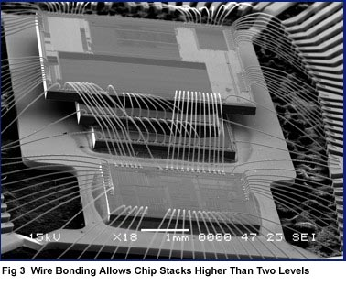
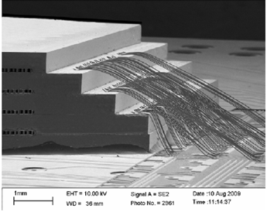
Breaking the Bandwidth Wall: 3D-die stacking
[Philips]
[Loh et al., ISCA’08]
[IBM]
Delivers TB/sec of bandwidth; use as large “in-package” cache
Notes:
So, enter 3D-die stacking. We can put memory on separate dies on top of the logic die with the cores. The memory can be treated as a huge cache which will have such a high hit rate that the pin bandwidth suffices. The connections within the chip are fast and power efficient, as the signal only has to travel a few microns across layers. The internal buses provide TB/s bandwidth in a very small area, easily matching the bandwidth most applications will require.

Slide 12
Voltage Scaling Has Slowed
  In last decade: 10x transistors but 30% lower voltage
  “Economic Meltdown of Moore’s Law” [Kenneth Brill, Uptime Institute]

Slide 13
Chip Power Scaling
[Azizi 2010]
Cooling does not scale! Chips are getting too hot!
Notes:
Because physics dictates the max power we can efficiently cool from the surface of a chip. We may be able to push the limit slightly up with liquid cooling, but to really solve the problem we need to drill tiny holes in the silicon and push microfluids through to increase the surface area that comes in contact with the liquid. This is tremendously difficult to do, and it complicates the chip routing because the tools will need to know the existence of voids and route metal wires around them. Even if we could push the cooling limit up orders of magnitude, we still run into the problem of power delivery. How are we going to deliver say 4KW into the chip, and reliably switch a transistor at a few mV? We may have major signal integrity problems here. It is like pushing an ocean wave through a pipe and placing individual droplets at certain locations.
The bottom line is that physics places a hard limit we cannot avoid. We can only try to be more efficient within that constraint.

Slide 14
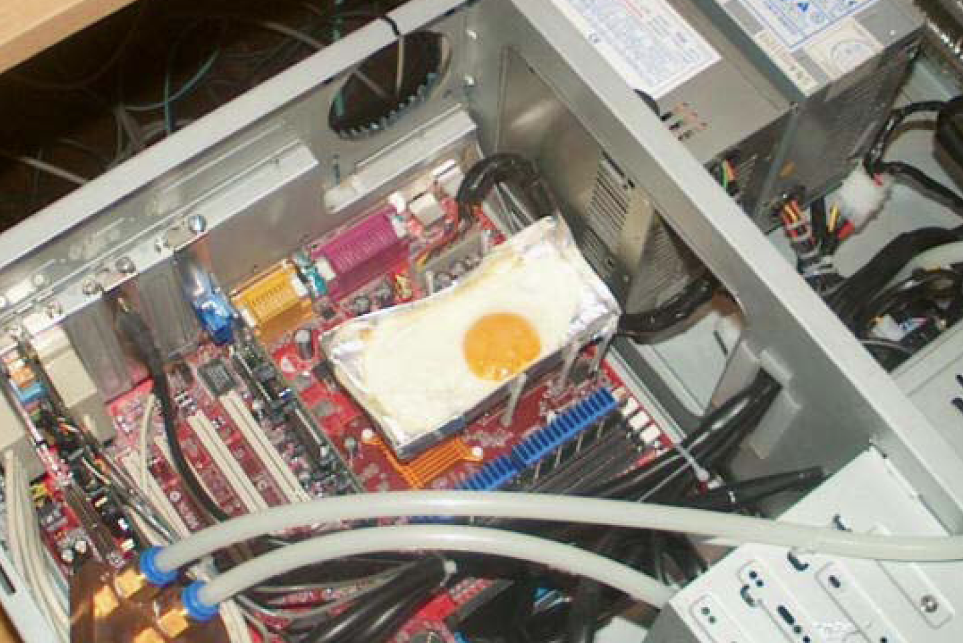
The New Cooking Sensation!
[Huang]

Slide 15
Where Does Server Energy Go?
Many sources of power consumption:
Infrastructure (power distribution, room cooling)
  State-of-the art data centers push PUE below 1.1
    Facebook Prineville: 1.07
    Yahoo! Chillerless Data Center: 1.08
  Less than 10% wasted on infrastructure
Servers [Fan, ISCA’07]
  Processor chips (37%)
  Memory (17%)
  Peripherals (29%)
  …

Slide 16
First-Order Analytical Modeling
[Hardavellas, IEEE Micro 2011] [Hardavellas, USENIX ;login: 2012]
Physical characteristics modeled after UltraSPARC T2, ARM11
Area: Cores + caches = 72% die, scaled across technologies
Power: ITRS projections of V_{dd}, V_{th}, C_{gate}, I_{sub}, W_{gate}, S₀
  Active: cores=f(GHz), cache=f(access rate), NoC=f(hops)
  Leakage: f(area), f(devices)
  Devices/ITRS: Bulk Planar CMOS, UTB-FD SOI, FinFETs, HP/LOP
Bandwidth:
  ITRS projections on I/O pins, off-chip clock, f(miss, GHz)
Performance: CPI model based on miss rate
  Parameters from real server workloads (DB2, Oracle, Apache)
  Cache miss rate model (validated), Amdahl & Myhrvold Laws
Notes:
A few things about the model

Slide 17
Caveats
First-order model
  The intent is to uncover trends relating the effects of technology-driven physical constraints to the performance of commercial workloads running on multicores
  The intent is NOT to offer absolute numbers
Performance model works well for workloads with low MLP
  Database (OLTP, DSS) and web workloads are mostly memory-latency-bound
Workloads are assumed parallel
  Scaling server workloads is reasonable
Notes:
This is a first-order model only, with the intent to uncover trends and not to offer absolute numbers.

Slide 18
Area vs. Power Envelope
Good news: can fit 100’s cores. Bad news: cannot power them all
Notes:
We fix the area and power budget, and calculate the area left over for cores and cache. We draw two lines: the yellow indicates the chip designs where the entire area if filled with cores and cache assuming infinite power; the black shows how many cores and cache we can power together, assuming max clock rate. Good news: can fit 100’s cores. Bad news: cannot power them all. The reason is that we run the chip at max speed, so we require the max supply voltage and so we consume max power. We can relax this requirement and scale the voltage and the frequency together.
DB2-TPCC, GPP, 20nm, conventional memory, HP transistors, 310mm die, 130W power, 10GHz max freq.

Slide 19
Pack More Slower Cores, Cheaper Cache
VFS
The reality of The Power Wall: a power-performance trade-off
Notes:
As the voltage scales down from right to left, we can power an increasingly large chip with more and more cores. However, the speed also scales down from right to left, changing the performance in the opposite direction as each one of the cores now becomes slower. This is the true nature of the power wall: it is a power/performance tradeoff. It is not clear which one is the best design point of all (best = peak performance). But we are not done yet. All these curves assume infinite bandwidth.
DB2-TPCC, GPP, 20nm, conventional memory, HP transistors, 310mm die, 130W power, 10GHz max freq.

Slide 20
Pin Bandwidth Constraint
VFS
Bandwidth constraint favors fewer + slower cores, more cache
Notes:
If we also add the bandwidth constraint, we see that as clock rates increase from top to bottom, we have the bandwidth to support fewer and fewer cores. The feasible designs are the ones below the bandwidth curve for some voltage, and to the left of the power curve for the same voltage. So, which one is the best design now?
DB2-TPCC, GPP, 20nm, conventional memory, HP transistors, 310mm die, 130W power, 10GHz max freq.

Slide 21
Example of Optimization Results
Power + BW: ~5x loss
BW:
~2x loss
  Jointly optimize parameters, subject to constraints, SW trends
  Design is first bandwidth-constrained, then power-constrained
Notes:
What we do with the model to answer this question is to calculate the performance of each design point, and plot it all in a graph. The yellow line assumes fixed 310mm2 area, but infinite bandwidth and power. The black line assumes a finite power, but the chip runs at the max clock rate. The grey line relaxes the clock rate and scales both the voltage and the frequency and plots the highest performance design of all for each cache size. This is equivalent to what VFS could achieve. The grey line assumes infinite bandwidth, We add the curve that shows the bandwidth constraint, and again plot for each cache size the max performance among all VFS’ed designs (blue). The pareto-frontier of the feasible designs is shown in red. The peak performance is achieved at the intersection of the bandwidth and power constraints.
TPCH, GPP, 20nm, 3D memory, HP transistors, 310mm die, 130W power, 10GHz max freq.

Slide 22
Performance Analysis of 3D-Stacked Multicores
Chip becomes power-constrained
Notes:
3D-memories effectively push the bandwidth wall beyond the power one, and chips become entirely power constrained.
TPCH, GPP, 20nm, 3D memory, HP transistors, 310mm die, 130W power, 10GHz max freq.

Slide 23
Core Counts for Peak-Performance Designs
Physical characteristics
modeled after
UltraSPARC T2 (GPP)
ARM11 (EMB)
  Designs for server workloads > 64-120 cores impractical
  B/W + dataset scaling push up cache sizes (cores area << die size)
Notes:
We run this analysis on all workloads across technologies, and we plot the number of cores that the highest-performance design has for each technology node. We show the results for both conventional cores (modeled after UlraSparc T2), and for low-power embedded ones (EMB) modeled after ARM11. We see that while we can feet 1000s of cores in a die, it makes sense to power only a few tens to low hundreds The power consumption of more cores will force the entire chip to run at a lower voltage, slowing down the entire chip and negatively impacting performance. Besides the relative low core counts, we also find that cache sizes grow enormously to mitigate the pin bandwidth wall.

Slide 24
Short-Term Scaling Implications
Caches are getting huge
Need cache architectures to deal with >> MB
Need to minimize data transfers
Elastic Caches
  Adapt behavior to executing workload to minimize transfers
  Reactive NUCA [Hardavellas, ISCA 2009][Hardavellas, IEEE Micro 2010]
  Dynamic Directories [Das, DATE 2012]
Need to push back the bandwidth wall!!!

Slide 25
Data Placement Determines Performance
core
core
core
core
core
core
core
core
L2
L2
L2
L2
L2
L2
L2
L2
core
core
core
core
core
core
core
core
cache
slice
L2
L2
L2
L2
L2
L2
L2
L2
core
core
core
core
core
core
core
core
core
core
L2
L2
L2
L2
L2
L2
L2
L2
core
core
core
core
core
core
core
core
core
core
L2
L2
L2
L2
L2
L2
L2
L2
Goal: place data on chip close to where they are used

Slide 26
Directory Placement Also…
core0
core 1
core 2
core 3
Core 4
core 5
core 6
core 7
L2
L2
L2
L2
L2
L2
L2
L2
x
L2
core 8
core 9
core 10
core 11
core 12
core 13
core 14
core 15
Dir
L2
L2
L2
L2
L2
L2
L2
L2
core 16
core 17
core 18
core 19
core 20
core 21
core 22
core 23
L2
L2
L2
L2
L2
L2
L2
L2
core 24
core 25
core 26
core 27
core 28
core 29
core 30
core 31
core 30
L2
L2
L2
L2
L2
L2
L2
L2
Off-chip access
x
Goal: co-locate directories with data

Slide 27
Elastic Caches: Cooperate With OS and TLB
Core accesses the page table for every access anyway (TLB)
  Pass information from the “directory” to the core
Utilize already existing SW/HW structures and events
TLB entry:
P/S
Dir/Ownr ID
VPageAddr
PhyPageAddr
1 bit
log₂(N)
Page Table entry:
P/S/T
Dir/Ownr ID
VPageAddr
PhyPageAddr
2 bits
log₂(N)
Page granularity allows simple + practical HW

Slide 28
Classification Mechanisms
Instructions classification: all accesses from L1-I (grain: block)
Data classification: private/shared at TLB miss (grain: OS page)
Page classification is accurate (<0.5% error)
On 1st access
On access by another core
Core i
core
Ld A
Ld A
core
Core j
TLB Miss
TLB Miss
L2
L2
OS
OS
A: Private to “i”
A: Private to “i”
A: Shared
Bookkeeping through OS page table and TLB

Slide 29
Elastic Caches
Data placement (R-NUCA) [Hardavellas, ISCA 2009]
[Hardavellas, IEEE-Micro Top Picks 2010]
  Up to 32% speedup (17% avg.)
  Within 5% on avg. from an ideal cache organization
  No need for HW coherence mechanisms at LLC
Directory placement (Dynamic Directories) [Das, DATE 2012]
  Up to 37% energy savings on interconnect (16% avg.)
  No performance penalty (up to 9% speedup)
Negligible hardware overhead
  logN+1 bits per TLB entry, simple logic

Slide 30
Outline - Main Sources of Energy Overhead
Useful computation: 0.5pJ for an integer addition
Major energy overheads
  Data movement: 1000pJ across 400mm² chip, 16000pJ memory
    Elastic caches: adapt cache to workload’s demands
  Processing: 2000pJ to schedule the operation
    Seafire: specialized computing on dark silicon
  Circuits: up to 2x voltage guardbands
    Low voltages, process variation → timing errors
    Elastic fidelity: selectively trade accuracy for energy
Chips fundamentally limited by power : ~130W for forced air cooling
    Galaxy: optically-connected disintegrated processors
[calculations for 28nm, adapted from S. Keckler’s MICRO’11 keynote]

Slide 31
Exponentially-Large Area Left Unutilized
Should we waste it?
Notes:
The dark silicon area grows exponentially in time, as shown by the trend line. Here we plot the die size of the peak-performance design for each workload, So instead of having a large chip and use it all (click), we are forced to power down the majority of it and use only a fraction of the available transistors (click). Independent estimates indicate that as soon as next year we’ll have 20% of a chip being dark silicon.

Slide 32
Repurpose Dark Silicon for Specialized Cores
[Hardavellas, IEEE Micro 2011]
[Hardavellas, USENIX ;login: 2012]
Don’t waste it; harness it instead!
  Use dark silicon to implement specialized cores
Applications cherry-pick few cores, rest of chip is powered off
Vast unused area → many cores → likely to find good matches
Notes:
Instead of wasting it, we advocate we should embrace dark silicon and use it to build specialized cores. Instead of powering up a small number of identical cores (click), the applications will cherry-pick the cores that most closely match their computational requirements. The vast and exponentially growing area of dark silicon allows us to implement a wide variety of specialized cores, increasing the likelihood that an application will find a good match.

Slide 33
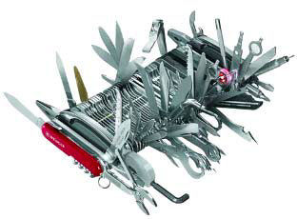

The New Core Design
[analogy by A. Chien]
From fat conventional cores, to a sea of specialized cores
Notes:
So, cores are moving from big beasts able to do everything but excelling at nothing, to a sea of specialized cores, each able to do only a small number of jobs but can do them really well.

Slide 34
Design for Dark Silicon
Sea of specialized cores, power up only what you need
Notes:
Instead of building multicores out of conventional cores, we build a sea of specialized ones, where the application powers up only what it needs, leaving the rest of the chip off to conserve energy.

Slide 35
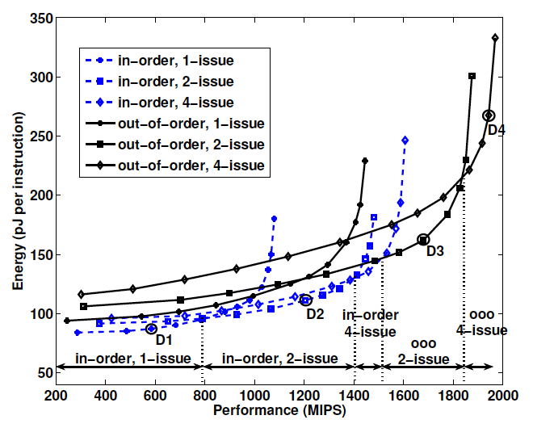
Core Energy Efficiency
[Azizi 2010]
Notes:
Why specialized cores are any better than conventional ones?

Slide 36
First-Order Core Specialization Model
Modeling of physically-constrained CMPs across technologies
Model of specialized cores based on ASIC implementation of H.264:
  Implementations on custom HW (ASICs), FPGAs, multicores (CMP)
  Wide range of computational motifs, extensively studied
 |  | Frames per sec | Energy per frame (mJ) | Performance gap of CMP vs. ASIC | Energy gap of CMP vs. ASIC
ASIC |  | 30 | 4
CMP | IME | 0.06 | 1179 | 525x | 707x
 | FME | 0.08 | 921 | 342x | 468x
 | Intra | 0.48 | 137 | 63x | 157x
 | CABAC | 1.82 | 39 | 17x | 261x
[Hameed, ISCA 2010]
12x LOWER ENERGY compared to best conventional alternative
Notes:
We build our specialized cores by looking at published numbers for H.264, a high-definition video encoder. We choose H.264 because it has been widely studied, and optimized implementations exist for pretty much anything, conventional multicores, FPGAs, ASICs, etc. H.264 has a wide range of computational motifs, from data parallel ones (motion estimation) to control intensive ones (CABAC segment). We model our specialized cores by looking at the worst case scenario: the control-intensive CABAC segment is the least hardware-friendly, due to the large number of changes in control flow (if-then-else statements). By running our models again, assuming our cores exhibit characteristics similar to an ASIC implementation of CABAC, we find that we can obtain a 12x reduction in energy compared to the best alternative!!!!

Slide 37
Outline - Main Sources of Energy Overhead
Useful computation: 0.5pJ for an integer addition
Major energy overheads
  Data movement: 1000pJ across 400mm² chip, 16000pJ memory
    Elastic caches: adapt cache to workload’s demands
  Processing: 2000pJ to schedule the operation
    Seafire: specialized computing on dark silicon
  Circuits: up to 2x voltage guardbands
    Low voltages, process variation → timing errors
    Elastic fidelity: selectively trade accuracy for energy
Chips fundamentally limited by power : ~130W for forced air cooling
    Galaxy: optically-connected disintegrated processors
[calculations for 28nm, adapted from S. Keckler’s MICRO’11 keynote]

Slide 38
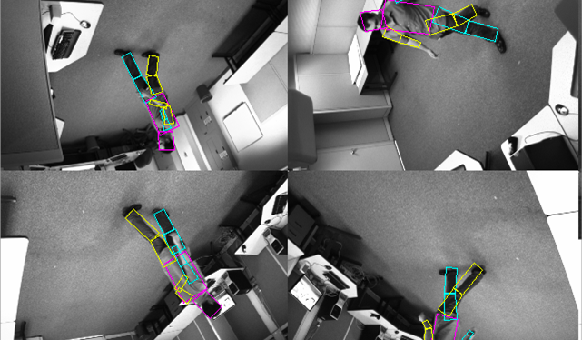
100% Fidelity May Not Always Be Necessary
Loop Perforation [Sidiroglou, FSE 2011]
Original

Slide 39
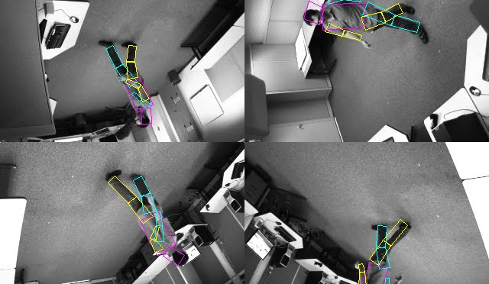
100% Fidelity May Not Always Be Necessary
Loop Perforation [Sidiroglou, FSE 2011]
15% distortion, 2.6x speedup

Slide 40
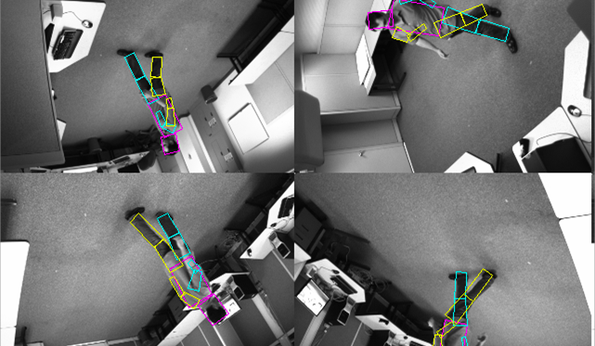
100% Fidelity May Not Always Be Necessary
Loop Perforation [Sidiroglou, FSE 2011]
3/8 cores fail

Slide 41
Trade-Off Accuracy for Energy
[Roy, CoRR arXiv 2011]
Elastic Fidelity
  We don’t always require 100% accuracy, but HW always provides it
  Audio, video, imaging, data mining, scientific kernels
  Language constructs specify required fidelity for code/data segments
  Steer computation to exec/storage units with appropriate fidelity
  Results: Up to 35% lower energy via elastic fidelity on ALUs & caches
    Turning off ECC: additional 15-85% from L2
original
10% error
allowed
Notes:
Conceptually, you can thing of a core as having a bunch of “accelerators” on the side, which in this case are just ALUs/FPUs/MULs/ etc. They have their own power rails, and we can selectively lower their voltage without affecting the voltage of the main core. The system will steer error-resilient computations to these ALUs to save energy. According to Prof. Friedman (U-Rochester) we can have ~100 different domains on a chip. Voltage changes will be very infrequent, so we can amortize the inefficiencies of the voltage shifters and regulators. Voltage shifters are needed so the low-Vdd ALUs can talk to the high-Vdd world. The frequency does not change (we let timing errors trickle in instead), so we don’t have to worry about meta-stability issues across frequency domains.

Slide 42
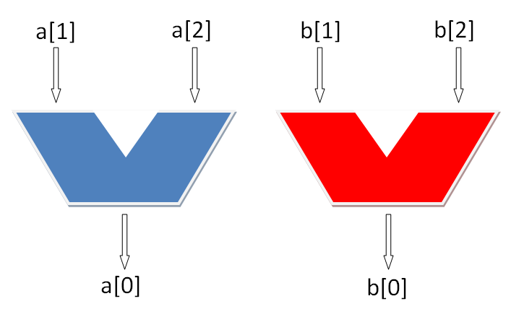
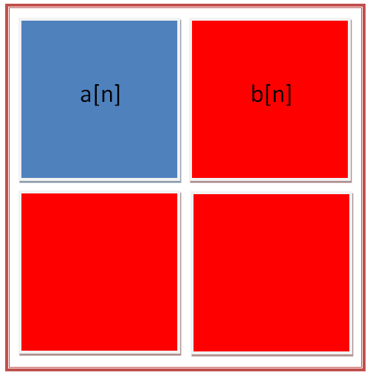
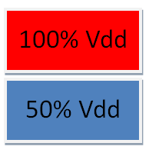
Simple Code Example
imprecise[25%] int a[N];
int b[N];
. . .
a[0] = a[1] + a[2];
b[0] = b[1] + b[2];
. . .
Execution units (e.g., ALUs)
Voltage legend (color-coded)
Data Storage (e.g., cache)

Slide 43
Estimating Resilience
Currently users specify error-resilience of data
QoS profilers can automate the fidelity mapping
  User-provided function to calculate output quality
  User-provided quality threshold
Profiler parses source code
  Identifies data structures & code segments
Software fault-injection wrappers determine error resilience

Slide 44
Outline - Main Sources of Energy Overhead
Useful computation: 0.5pJ for an integer addition
Major energy overheads
  Data movement: 1000pJ across 400mm² chip, 16000pJ memory
    Elastic caches: adapt cache to workload’s demands
  Processing: 2000pJ to schedule the operation
    Seafire: specialized computing on dark silicon
  Circuits: up to 2x voltage guardbands
    Low voltages, process variation → timing errors
    Elastic fidelity: selectively trade accuracy for energy
Chips fundamentally limited by power : ~130W for forced air cooling
    Galaxy: optically-connected disintegrated processors
[calculations for 28nm, adapted from S. Keckler’s MICRO’11 keynote]

Slide 45
Galaxy: Optically-Connected Disintegrated Processors
[Pan, WINDS 2010]
Split chip into chiplets, connect with optical fibers
  Fibers offer high bandwidth, low latency
Spread chiplets far apart to cool efficiently
  Thermal model: 10cm are enough for 5 chiplets (80 cores)
Mitigate bandwidth, power, yield
Notes:
All electrical, all optical interconnects, 0.6V 2.5GHz, Galaxy 1.2V 5GHz

Slide 46
Galaxy: Optically-Connected Disintegrated Processors
[Pan, WINDS 2010]
Split chip into chiplets, connect with optical fibers
  Fibers offer high bandwidth, low latency
Spread chiplets far apart to cool efficiently
  Thermal model: 10cm are enough for 5 chiplets (80 cores)
Mitigate bandwidth, power, yield
Notes:
All electrical, all optical interconnects, 0.6V 2.5GHz, Galaxy 1.2V 5GHz

Slide 47
Nanophotonic Components
resonant
detectors
Ge-doped
coupler
waveguide
off-chip
laser source
resonant modulators
Selective: couple optical energy of a specific wavelength

Slide 48
Modulation and Detection
10001011
11010101
  64 wavelengths DWDM
  3 ~ 5μm waveguide pitch
  10Gbps per link
10001011
11010101
~100 Gbps/μm bandwidth density !!! [Batten, HOTI 2008]

Slide 49
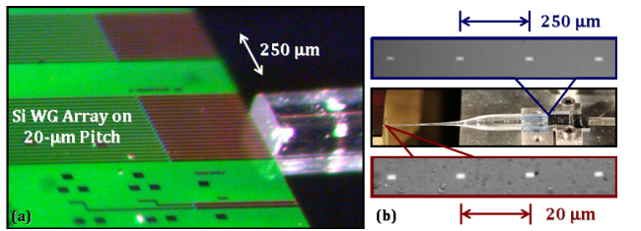
IBM Technology: Dense Off-Chip Coupling
Dense optical fiber array [Lee, OSA/OFC/NFOEC 2010]
<1dB loss, 8 Tbps/mm demonstrated
Tapered couplers solved bandwidth problem, demonstrated Tbps/mm

Slide 50
Galaxy Overall Architecture
2-3x speedup, 53% lower Energy x Delay product over best alt.
200mm² die, 64 routers/chiplet, 9 chiplets, 16cm fiber: > 1K cores

Slide 51
Conclusions
Physical constraints limit chip scaling and performance
Major energy overheads
  Data movement
    Elastic caches: adapt cache to workload’s demands
  Processing
    Seafire: specialized computing on dark silicon
  Circuits guardbands, process variation
    Elastic fidelity: selectively trade accuracy for energy
Pushing back the power and bandwidth walls
    Galaxy: optically-connected disintegrated processors
Need to innovate across software/hardware stack
  Devices, programmability, tools are a great challenge

Slide 52
Thank You!
Parallelism alone is not enough to ride Moore’s Law
Overview of our work at PARAG@N
  Elastic Caches: adapt cache to workload’s demands
  Seafire: specialized computing on dark silicon
  Elastic Fidelity: selectively trade-off accuracy for energy
  Galaxy: optically-connected disintegrated processors

