Slide 1
EECS 395/495
Algorithmic DNA Self-Assembly
General Introduction
Thursday, 4/4/2013
Ming-Yang Kao

Slide 2
Three Essential Ingredients
algorithms
DNAs
self-assembly

Slide 3
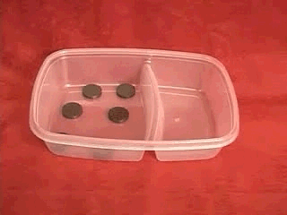
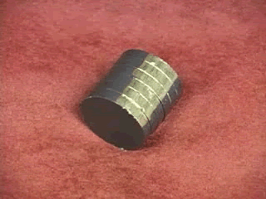
Example of Self-Assembly
[http://www.math.udel.edu/MECLAB, 2007]
Self-Assembly by Magnetic Forces

Slide 4
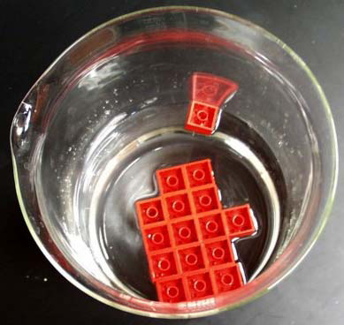
Example of Self-Assembly
[Campbell et al., 2007]
LEGO Bricks + Water + Capillary Forces

Slide 5
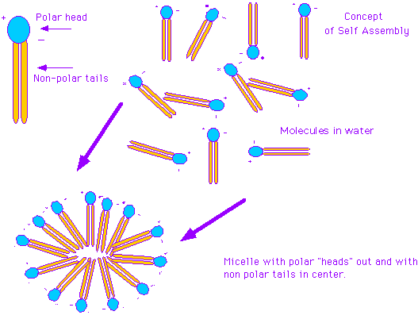
Example of Self-Assembly
[http://staff.jccc.net/pdecell/chemistry/selfassem.html]
proteins and molecules on cell membrane
Self-Assembly by Hydrophilic and Hydrophobic Interactions

Slide 6
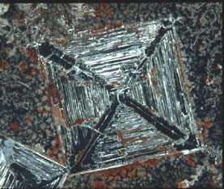
Example of Self-Assembly
[http://web.mit.edu/lms/www, Zhang, 2001]
Crystal Formation

Slide 7
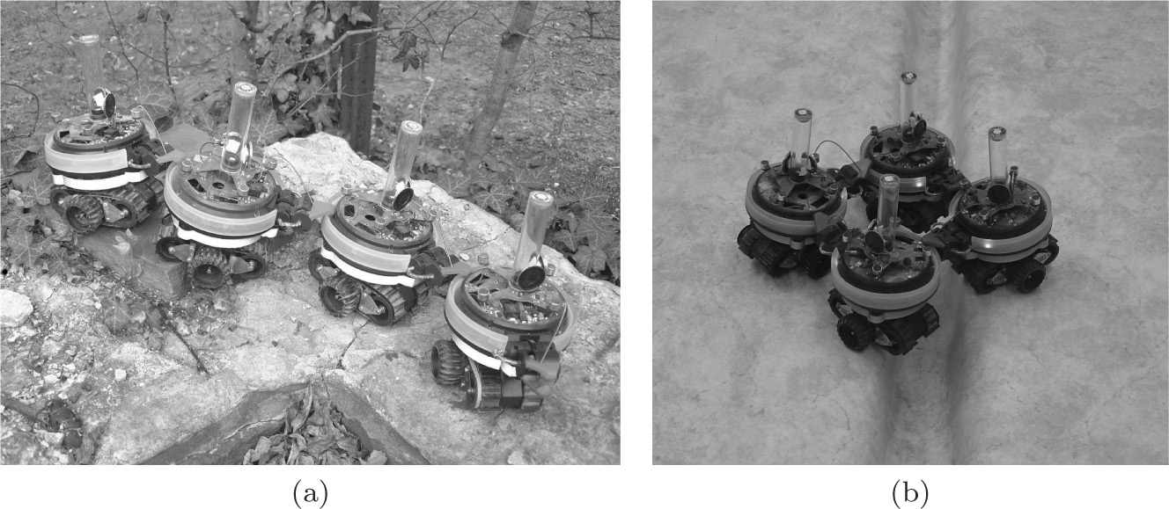
Example of Self-Assembly
[Tuci et al., 2006]
Robot Self-Assembly via Cellular Automata
A group of robots physically connected to each other that (a) moves on rough terrain and (b) passes over a gap during an experiment in a close arena with a flat terrain.

Slide 8
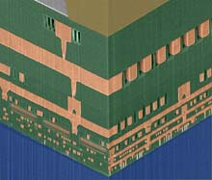
Example of Self-Assembly
[http://www.technologyreview.com/Biztech, 2007]
Insulation around Copper Wiring
This microprocessor cross section shows empty space in between the chip’s copper wiring. Wires are usually insulated with a glasslike material, but IBM has used self-assembly techniques, which can be employed in chip-making facilities, to create air gaps that insulate the wires. Credit: IBM

Slide 9
DNA-based
Self-Assembly + Algorithms
DNA – four bases A, C, G, T
paring of A/T and C/G ➔ self-assembly
two pairs ➔ two bits 0 and 1 ➔ encoding of programs and data ➔ algorithms
self-assembly ➔ executing algorithms ➔ guiding self-assembly

Slide 10
Algorithmic DNA Self-Assembly
Nano Technology
Using computation to build nanostructures
Computational Technology
Using nanostructures to perform computation

Slide 11
Algorithmic DNA Self-Assembly
Nano Technology
+
Computational Technology
1 dimensional self-assembly
e.g., 1990s’ DNA computing
2 dimensional self-assembly
this course’s focus
3 dimensional self-assembly
some progress recently

Slide 12
DNA Tiles -- Basic Unit of 2D Self-Assembly
TILE
G C A T C G
C G T A G C

Slide 13
Algorithmic DNA Self-Assembly
Program = Tiles + Lab Steps
Output = Shape + Pattern

Slide 14
Algorithmic DNA Self-Assembly
Input: the description of a shape (or pattern)
Output: a set of tiles and a sequence of lab steps to produce the shape (or pattern)
Computational Objectives:
minimize the # of different tiles (i.e., tile types)
minimize the range of temperatures
minimize the # different temperatures used
minimize the # of lab steps
minimize the complicatedness of steps
minimize the assembly time
minimize errors
others

Slide 15
Outline of This Discussion
Examples of DNA Tiles
Examples of DNA Self-Assemblies
Examples of DNA Nano Structures
A Basic Model

Slide 16
Outline of This Discussion
Examples of DNA Tiles
Examples of DNA Self-Assemblies
Examples of DNA Nano Structures
A Basic Model

Slide 17
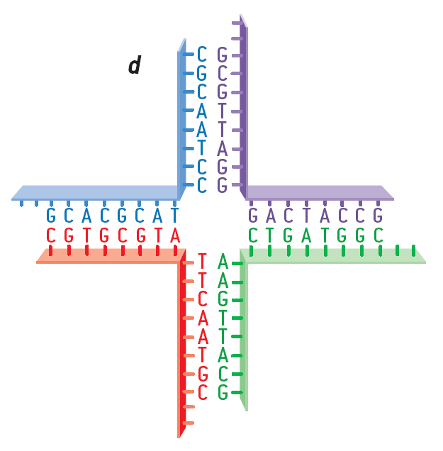
Examples of DNA Tiles
[Holliday, 1964]
exchange of genetic information in yeast
aaaa

Slide 18
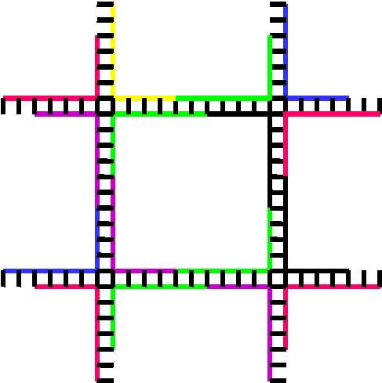
Examples of DNA Tiles
aaaa
TILE
aaaa

Slide 19
Examples of DNA Tiles
[Reif’s Group, Duke University]
T G C G
A C G C

Slide 20
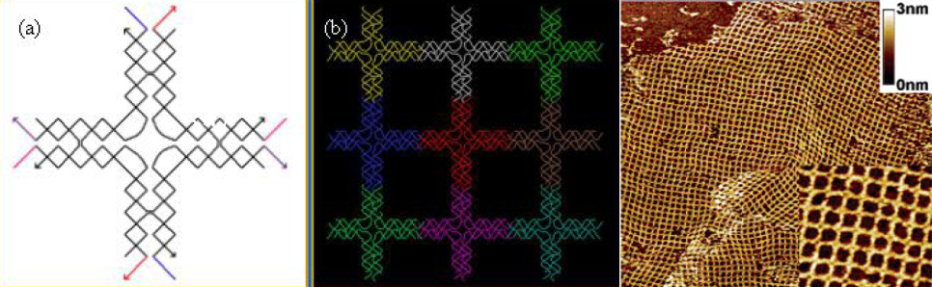
Examples of DNA Tiles
[Park, Pistol, Ahn, Reif, Lebeck, Dwyer, and LaBean, 2006]

Slide 21
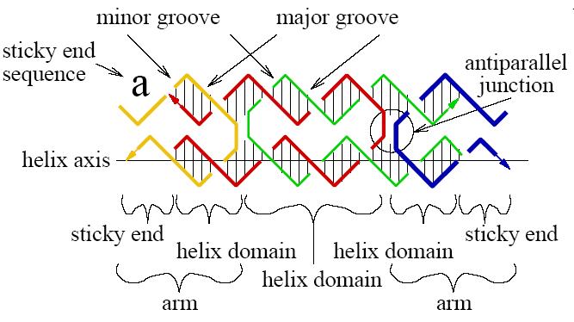
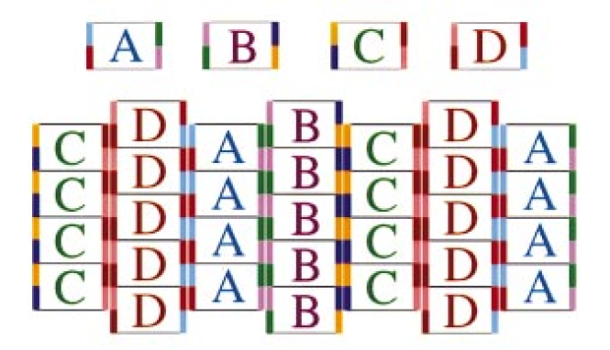
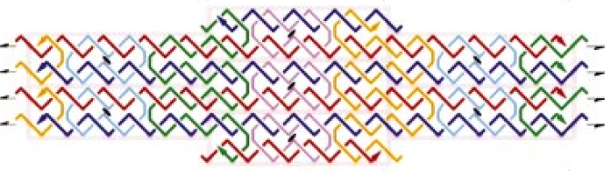
Examples of DNA Tiles
[Winfree’s Group, Cal Tech]

Slide 22
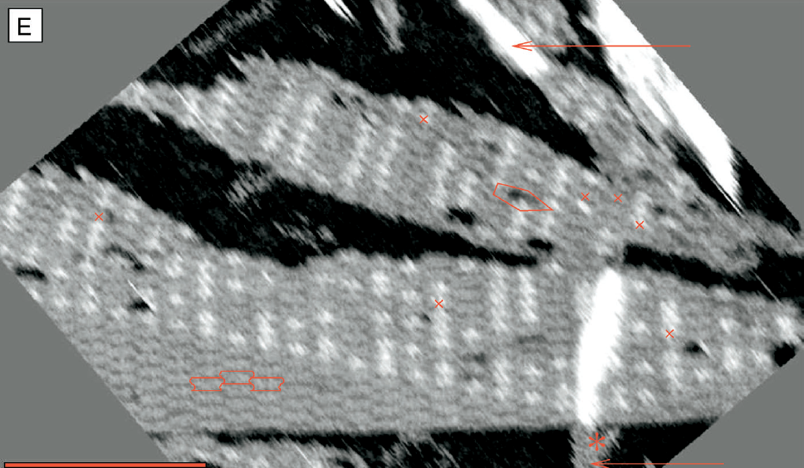
Examples of DNA Tiles
[Sierpinski Triangle, Rothemund, Papadakis, Winfree, 2004]

Slide 23
Self-Assembly for Binary Counters
[Winfree, 2000]

Slide 24
2D Self-Assembly for Turing Machines
[Winfree, Yang, and Seeman, 1998]

Slide 25
Self-Assembly for Circuit Patterns
[Cook, Rothemund, and Winfree, 2003]

Slide 26
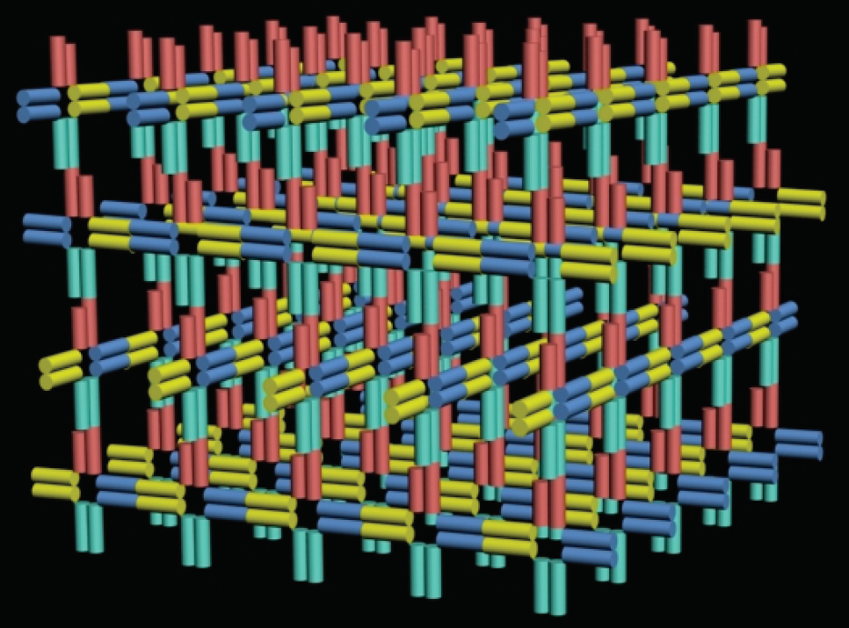
Example of 3D Self-Assembly
[Shaw, University of Southern California]

Slide 27
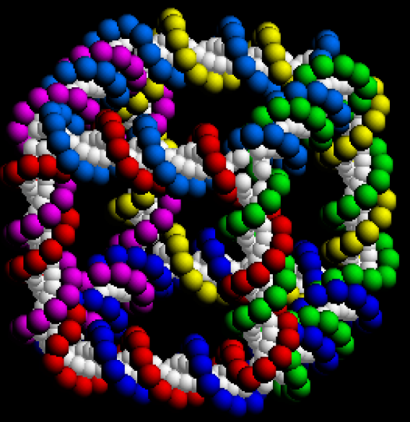
3D DNA Cube
[Seeman, New York University]

Slide 28
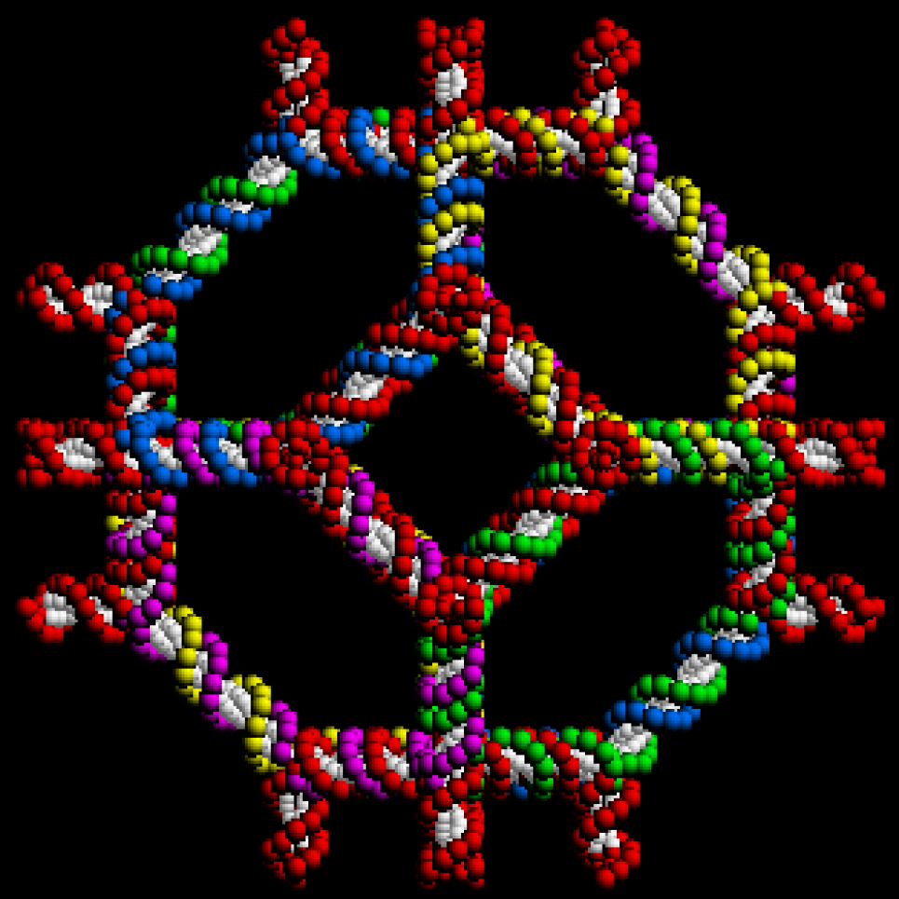
3D DNA Truncated Octahedron
[Seeman, New York University]

Slide 29
Clonable DNA Octahedron
[Shih, Quispe, Joyce, 2004]
one 1,669-mer + five 40-mers

Slide 30
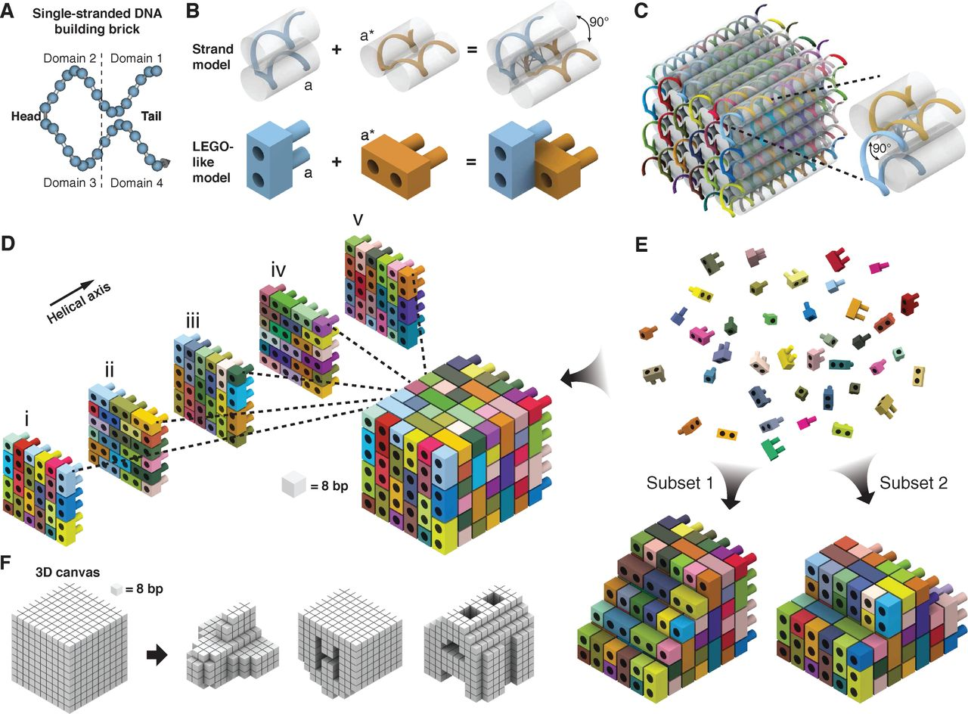

Fig. 1 Design of DNA brick structures analogous to structures built of LEGO® bricks.
Y Ke et al. Science 2012;338:1177-1183
Published by AAAS
Notes:
Design of DNA brick structures analogous to structures built of LEGO® bricks. (A) A 32-nt four-domain single-stranded DNA brick. Each domain is 8 nt in length. The connected domains 2 and 3 are “head” domains; domains 1 and 4 are “tail” domains. (B) Each two-brick assembly forms a 90° dihedral angle via hybridization of two complementary 8-nt domains “a” and “a*”. (C) A molecular model that shows the helical structure of a 6H by 6H by 48B cuboid 3D DNA structure. Each strand has a particular sequence, as indicated by a distinct color. The inset shows a pair of bricks. (D) A LEGO-like model of the 6H by 6H by 48B cuboid. Each brick has a particular sequence. The color use is consistent with (B). Half bricks are present on the boundary of each layer. (E) The 6H by 6H by 48B cuboid is self-assembled from DNA bricks. The bricks are not interchangeable during self-assembly because of the distinct sequence of each brick. Using the 6H by 6H by 48B as a 3D molecular canvas, a smaller shape can be designed by using a subset of the bricks. (F) 3D shapes designed from a 10 by 10 by 10–voxel 3D canvas; each voxel fits 8 bp (2.5 nm by 2.5 nm by 2.7 nm).

Slide 31
Linear Self-Assembly for Regular Languages
[Winfree, Yang, and Seeman, 1998]

Slide 32
Tree Self-Assembly for Context-Free Languages
[Winfree, Yang, and Seeman, 1998]

Slide 33
Outline of This Discussion
Examples of DNA Tiles
Examples of DNA Self-Assemblies
Examples of DNA Nano Structures
A Basic Model – the Abstract Tile Assembly Model

Slide 34
Typical Examples Used in This Discussion
N x N Squares
k x N rectangles
Counters

Slide 35
Standard Tile Model of DNA Self-Assembly
[Rothemund and Winfree, STOC 2000]
tile system: (T, s, G, t)
T: tile set
s: seed tile
G: glue function
t : temperature, positive integer

Slide 36
Example: Build a Square
S
a
b
G( , ) = 2
G( , ) = 2
G( , ) = 2
G( , ) = 2
G( , ) = 1
G( , ) = 1
G( , ) = 1
T =
x
c
d
positive strength between same glues
zero strength between distinct glues
start with the seed tile
add one tile at a time
bind if total strength is at least t
order must not affect final shape and pattern
temperature t = 2

Slide 37
Example: Build a Square
S
a
b
G( , ) = 2
G( , ) = 2
G( , ) = 2
G( , ) = 2
G( , ) = 1
G( , ) = 1
G( , ) = 1
T =
x
c
d
temperature t = 2
S

Slide 38
Example: Build a Square
S
a
b
G( , ) = 2
G( , ) = 2
G( , ) = 2
G( , ) = 2
G( , ) = 1
G( , ) = 1
G( , ) = 1
T =
x
c
d
temperature t = 2
S
a

Slide 39
Example: Build a Square
S
a
b
G( , ) = 2
G( , ) = 2
G( , ) = 2
G( , ) = 2
G( , ) = 1
G( , ) = 1
G( , ) = 1
T =
x
c
d
temperature t = 2
c
S
a

Slide 40
Example: Build a Square
S
a
b
G( , ) = 2
G( , ) = 2
G( , ) = 2
G( , ) = 2
G( , ) = 1
G( , ) = 1
G( , ) = 1
T =
x
c
d
d
temperature t = 2
c
S
a

Slide 41
Example: Build a Square
S
a
b
G( , ) = 2
G( , ) = 2
G( , ) = 2
G( , ) = 2
G( , ) = 1
G( , ) = 1
G( , ) = 1
T =
x
c
d
d
temperature t = 2
c
S
a
b

Slide 42
Example: Build a Square
S
a
b
G( , ) = 2
G( , ) = 2
G( , ) = 2
G( , ) = 2
G( , ) = 1
G( , ) = 1
G( , ) = 1
T =
x
c
d
d
temperature t = 2
c
x
S
a
b

Slide 43
Example: Build a Square
S
a
b
G( , ) = 2
G( , ) = 2
G( , ) = 2
G( , ) = 2
G( , ) = 1
G( , ) = 1
G( , ) = 1
T =
x
c
d
d
temperature t = 2
c
x
x
S
a
b

Slide 44
Example: Build a Square
S
a
b
G( , ) = 2
G( , ) = 2
G( , ) = 2
G( , ) = 2
G( , ) = 1
G( , ) = 1
G( , ) = 1
T =
x
c
d
d
x
temperature t = 2
c
x
x
S
a
b

Slide 45
Example: Build a Square
S
a
b
G( , ) = 2
G( , ) = 2
G( , ) = 2
G( , ) = 2
G( , ) = 1
G( , ) = 1
G( , ) = 1
T =
x
c
d
d
x
x
temperature t = 2
c
x
x
S
a
b

Slide 46
The End

