Slide 1
Digital Refocusing Using Incoherent Holography
Supplementary Material: Videos and High-resolution Images
[View in Full-Screen Slide Show Mode]
Paper ID: 27

Slide 2
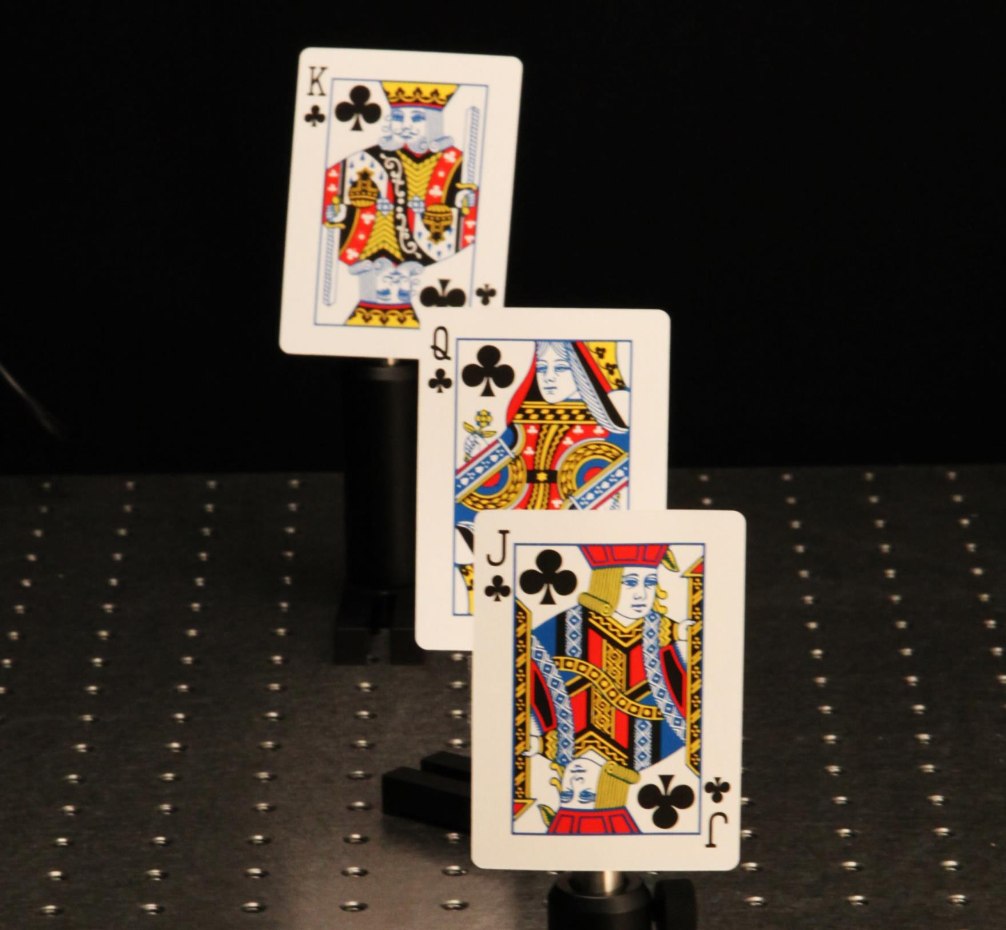
Playing Cards Scene

Slide 3
Refocusing Video
[Plays Automatically in Full Screen Mode]

Slide 4
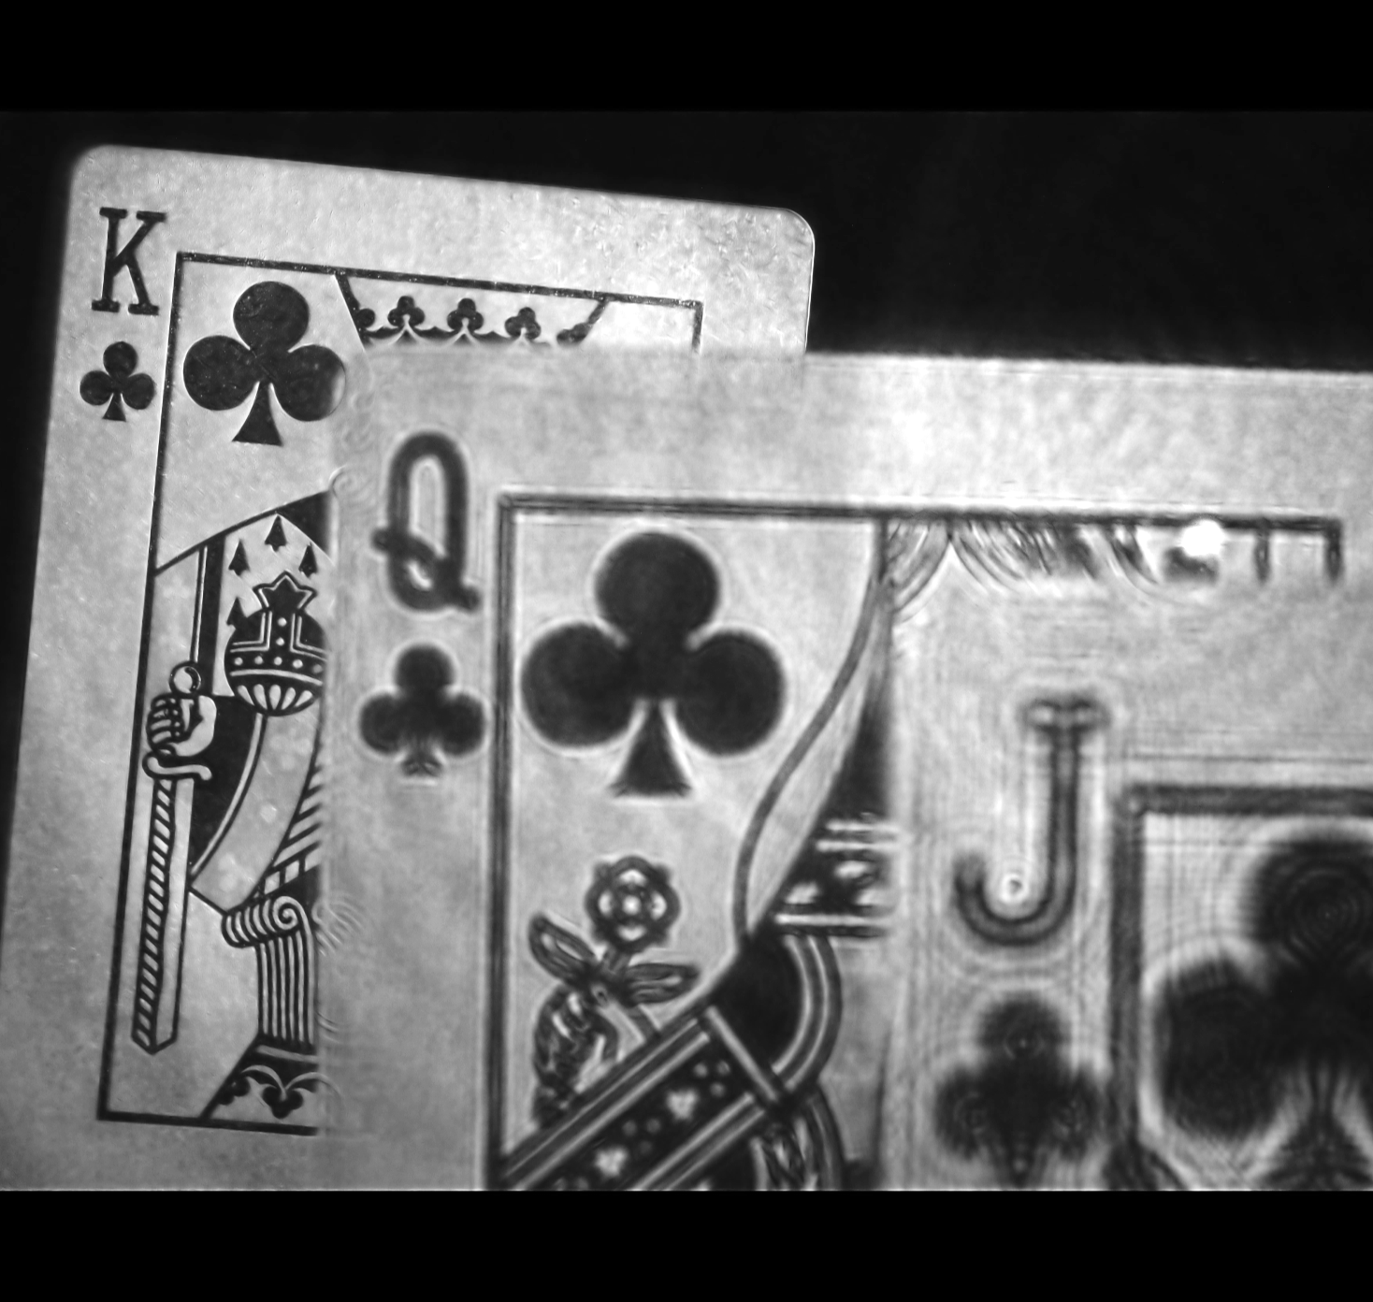
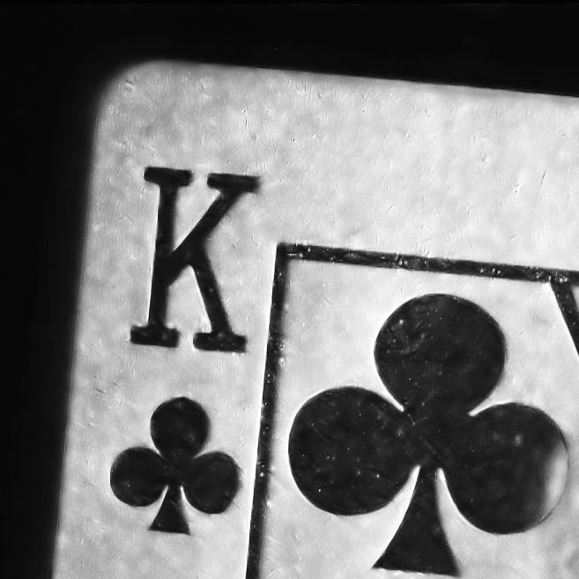
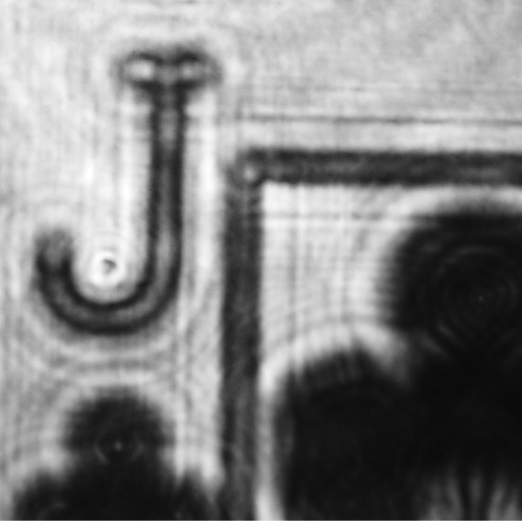
Recovered Hologram (Focused in Back)
(10Mpix resolution)

Slide 5
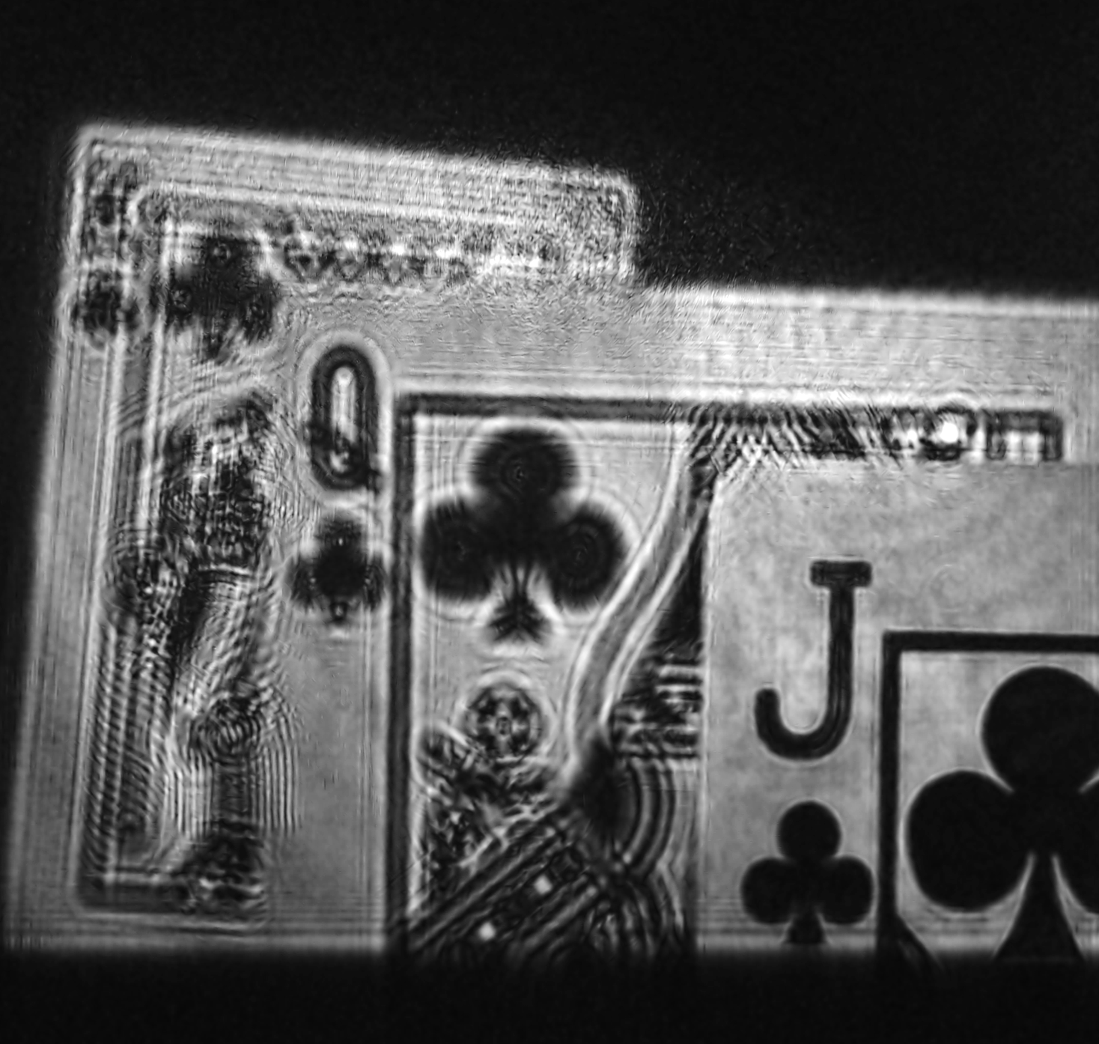
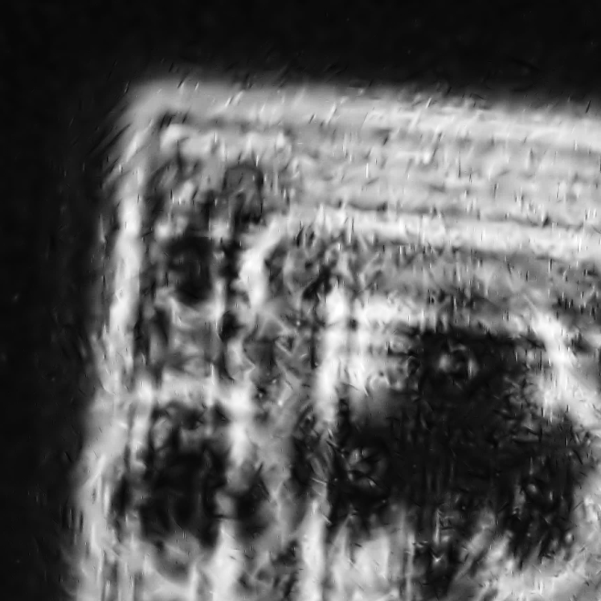
Digital Refocusing on Jack
(10Mpix resolution)

Slide 6
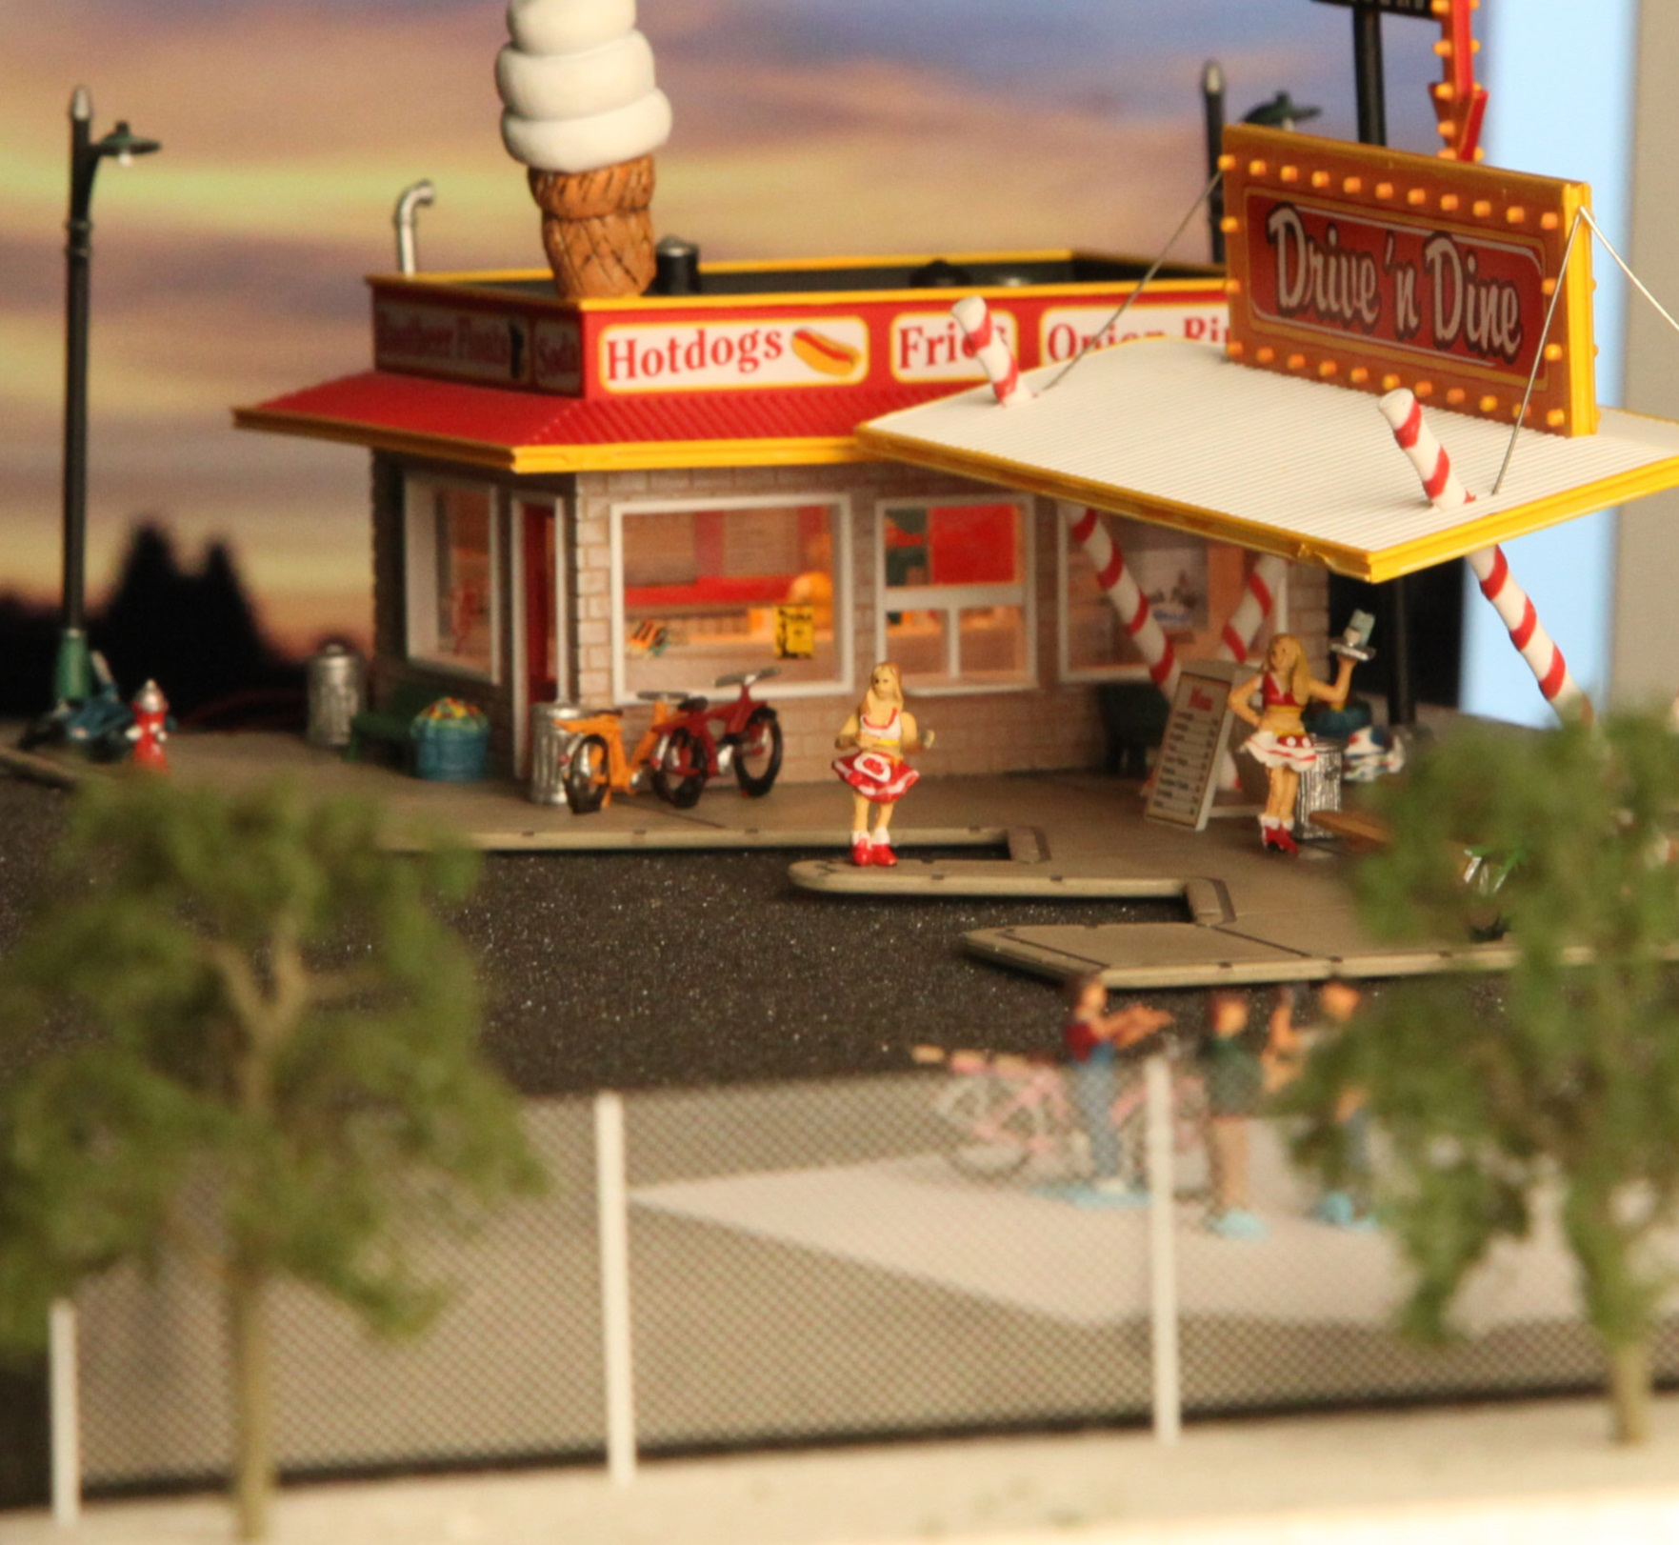
Miniature Diner Scene
Fence

Slide 7
Refocusing Video
[Plays Automatically in Full Screen Mode]

Slide 8
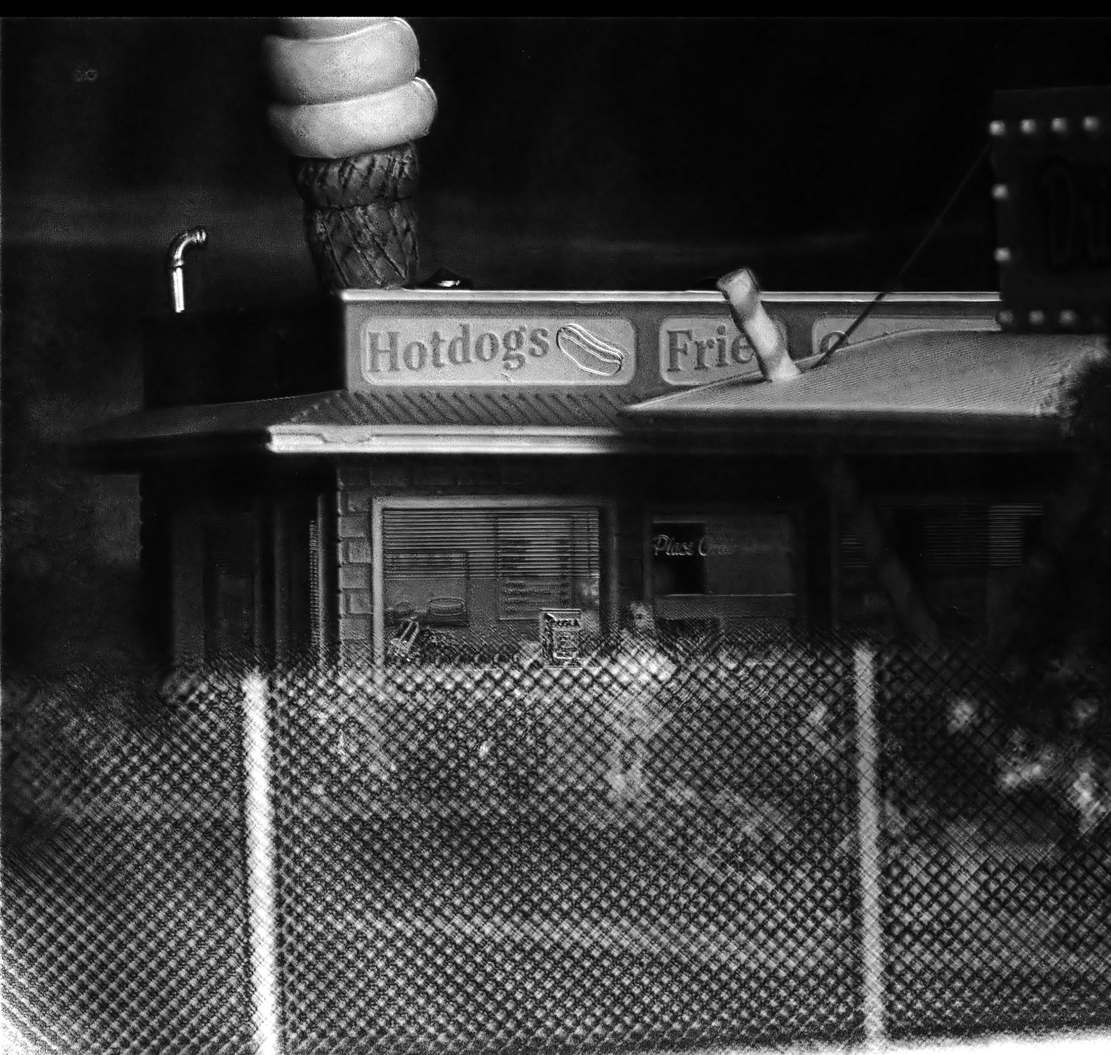
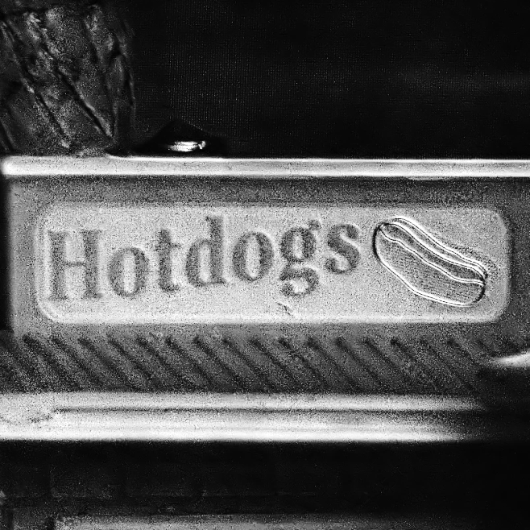
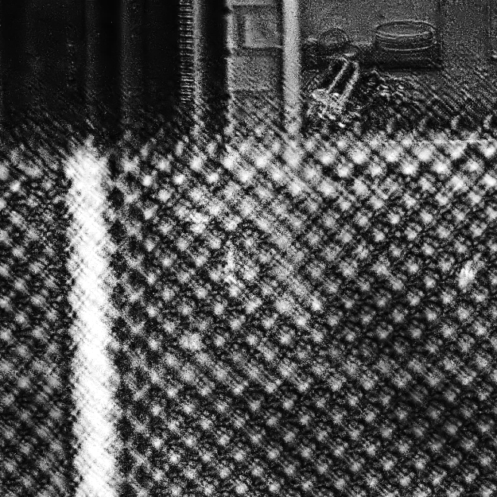
Recovered Hologram (Focused in Back)
(10Mpix resolution)

Slide 9
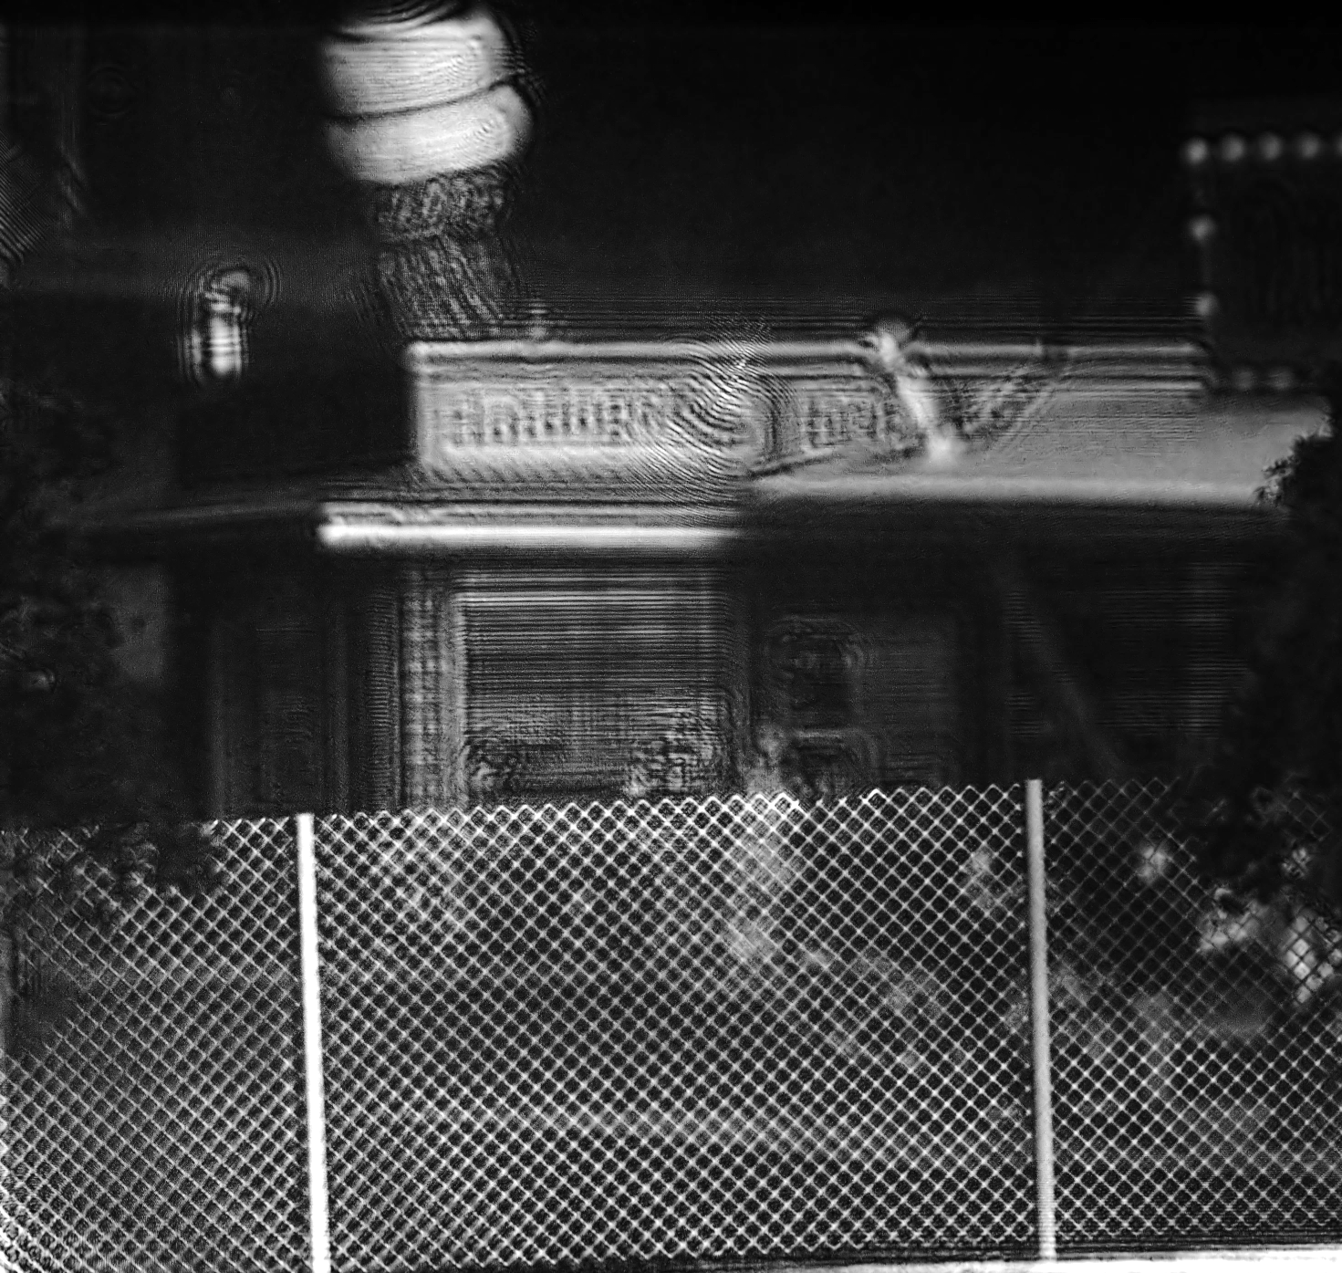
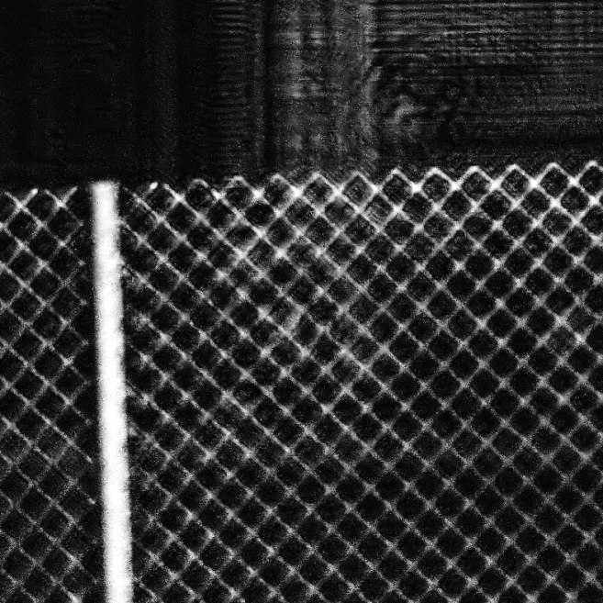
Digital Refocusing on Fence
(10Mpix resolution)

