Slide 1
从校园到职场
西北大学团契

Slide 2
1. 学习

Slide 3
PhD Students
If you already have an advisor
Try to get in research ASAP
Keep in mind that research is supposed to take your majority of time (i.e., > 50%), even when you are supported as TA or fellowship
Otherwise
Try to identify one ASAP
Two-way selection
Check out and take related courses

Slide 4
Master Students
Duration: better to take 15 months than 9 months
Especially if you want to find a job and get some working experience in US after graduation
Start to look for jobs once you settle down
Get right expectation
OK to start with a non-paid job
Use the career services of the university and the department

Slide 5
Add a bit of my own experience: Fellowship/church is your forever home
You will probably become too busy to come back to the fellowship/church
Sometimes you got to pause or face big challenges
Always come back when you feel you need a home – don’t be shy ☺

Slide 6
2. 生活

Slide 8
如何適應美國文化?
工作與學習: 直接與合適的溝通
住房與室友: 調適不同文化
購物與娛樂

Slide 9
尋找適合的群體
華人群體與其他種族
朋友與同事的界線
Mentor的重要性

Slide 10
教會與我
華人教會或美國教會?
教會中的人際關係

Slide 11
3. 新手

Slide 12
你以为学计算机将来是这样的

Slide 13
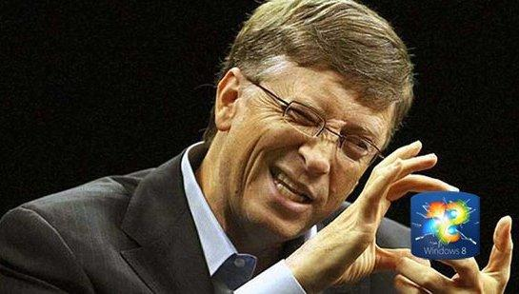
没毕业咱说不准也能变成这样

Slide 14
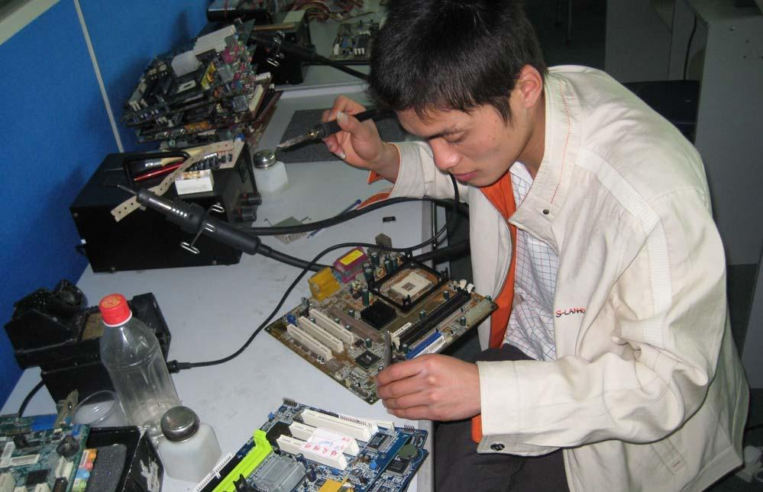
等你毕业后会发现，其实是这样

Slide 15
你以为学市场营销将来是这样的

Slide 16
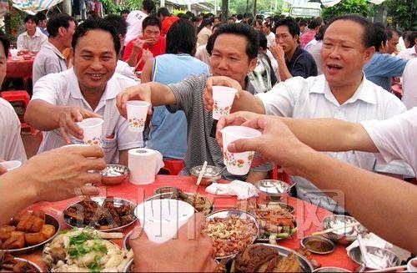
俗一点也是这样的

Slide 17
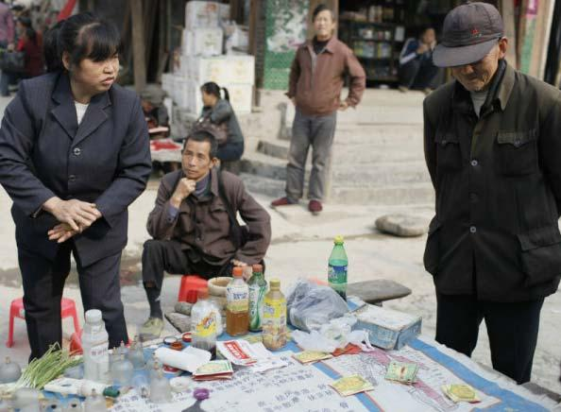
等你毕业后会发现，其实是这样

Slide 18
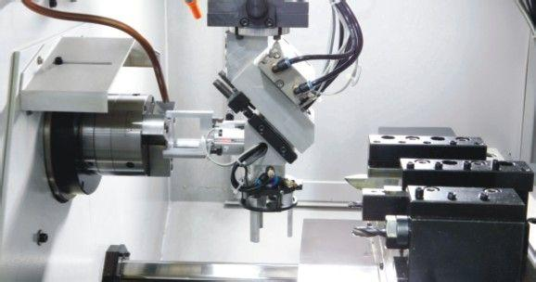
你以为学机械工程将来是这样的

Slide 19
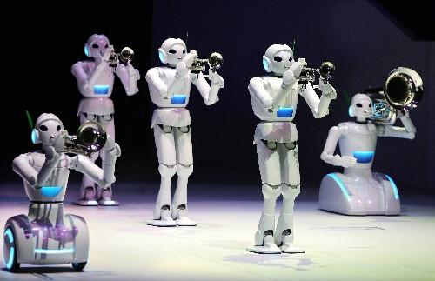
时不时还能倒腾出个这货陪你玩

Slide 20
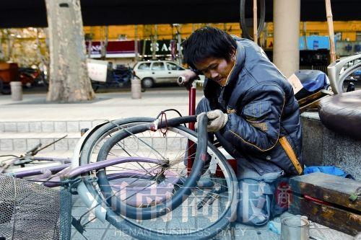
等你毕业后会发现，其实是这样

Slide 21
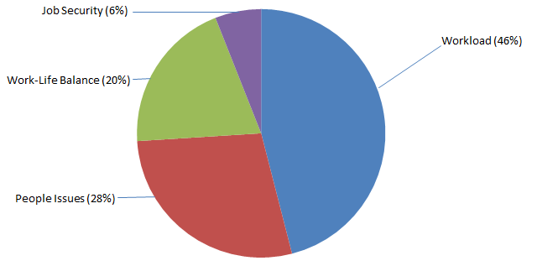
工作压力来源

Slide 22
工作压力
信息超载
多项任务
跨专业
目标不确定
要求紧迫
没有帮助
繁琐重复

Slide 23
对策
放下包袱，从零开始
不要忧虑，学习休息
扩展思路
目标合理吗？
谁能帮忙？
磨刀不误砍柴工？

Slide 24
人际关系
没有人愿意帮助新人
老板挑毛病
老板指示不清楚
老板不能保护你
老板奖罚不公
同事挑毛病
同事互相指责
同事抢功劳

Slide 25
对策
保持友善的态度
保持积极乐观的心态
结交有价值的朋友

Slide 26
4. 面试与老板

Slide 27
Top three qualification questions
1.Trustworthy 誠信
2.Flexible and fast learner 應變能力和快速学习
3.Leadership potential 領導力潛能

Slide 28
Trustworthy 誠信
–A story of 一个小聪明，毁了前程http://www.aiweibang.com/yuedu/caijing/1326536.html
–善人從他心裡所存的善就發出善來，惡人從他心裡所存的惡就發出惡來；因為心裡所充滿的，口裡就說出來 (路加福音 6:45) Luke 6:45
–Important of your value system 所以你的價值觀是非常的重要
•Be friend of Bible God because He will helps you to stay away from the following (箴言6:16-19) Proverb 6:16-19
1) 高 傲 的 眼 ， 2) 撒 谎 的 舌 ， 3)流 无 辜 人 血 的 手 ，4)图 谋 恶 计 的 心 5)飞 跑 行 恶 的 脚 ，6)吐 谎 言 的 假 见 证 7)并 弟 兄 中 布 散 分 争 的 人

Slide 29
應變能力和快速学习
•Ability to handle difficulty, changes, dealing with risks and ambiguity

Slide 30
Leadership potential 領導力潛能
•Vision-They have a clear, exciting idea of where they are going and what they are trying to accomplish and are excellent at strategic planning.
•Courage勇氣-courage means that you are willing to take risks in the achievement of your goals with no assurance of success.
•Integrity -Integrity requires that you always tell the truth, to all people, in every situation. Truthfulness is the foundation quality of the trust that is necessary for the success of any business
•Humility-It means that you are willing to admit you could be wrong, that you recognize you may not have all the answers. And it means that you give credit where credit is due.
•Strategic planning-ability to look ahead, to anticipate with some accuracy where the industry and the markets are going.
•Focus-is focused and concentrated on the most valuable use of their time is essential to the excellent performance of the enterprise
•Cooperation - Gain the cooperation of others by making a commitment to get along well with each key person every single day.

Slide 31
•First Impression
•Top 3 questions
–TELL ME ABOUT YOURSELF
–WHY SHOULD I HIRE YOU
–TELL ME ABOUT A CLASS THAT YOU HATE AND LIKE THE MOST

Slide 32
Top 1: Tell me about yourself
•People tend to meander through their whole resumes and mention personal or irrelevant information in answering--a serious no-no.
•You were/are known as
•Education -Last degree
•Core competencies
•Value system
•Keep your answer to a max of 3 min

Slide 33
Top 2: Why should I hire you?
•Do your homework on the position
•Illustrate why you are the most qualified candidates
•Idenitfy the skills and knowledge that are critical to the position
•Identify experiences from past that demonstrate those skills and knowledge

Slide 34
Top 3: A class you hate the most and a class you like the most
•What are they?
•After being knocked down how do you pick oneself up?
•Your ability to summary and communicate

Slide 35
Working with your boss
•Open communication
–Don’t wait until the last minute
•Aligning your goals
•Be supportive

