Slide 1
AppShield: A Virtual File System in Enterprise Mobility Management
Zhengyang Qu
Northwestern University, IL, US,
Notes:
She worked on this project mainly during her summer internship at northwestern university.

Slide 2
Outline
Introduction
System Design & Implementation
Evaluation
Conclusion & Discussion

Slide 3
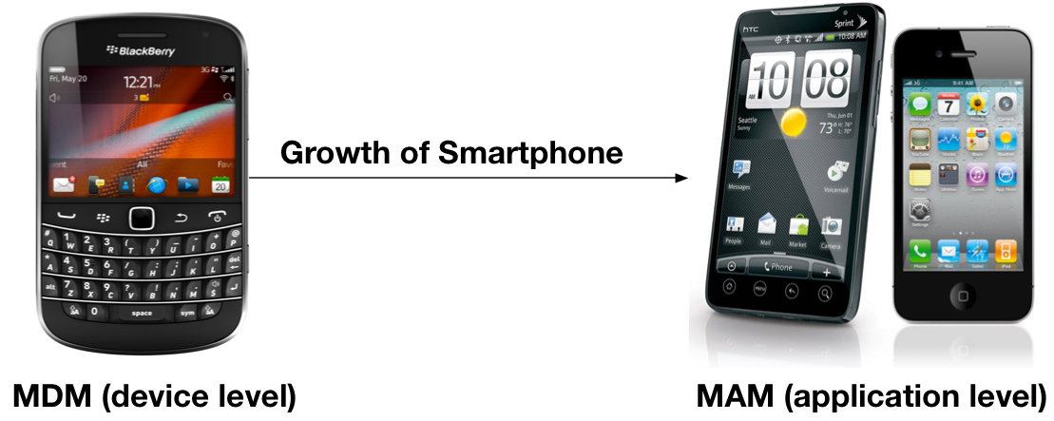
Background
Evolution of Enterprise Mobile Management (EMM)
  The rise of smartphone and growth of mobile app

Slide 4
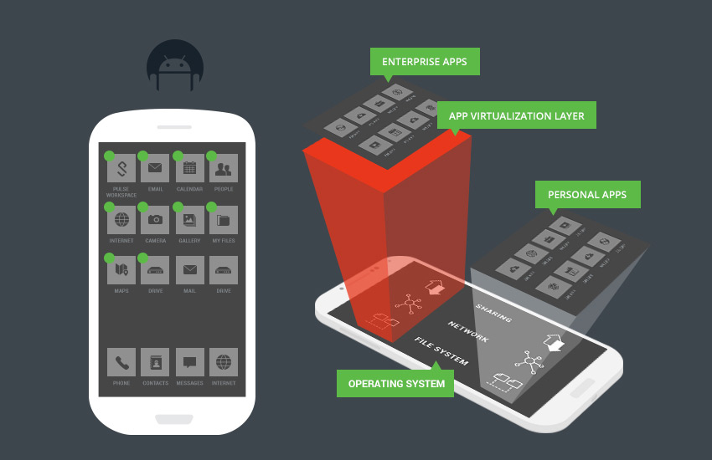
Tradeoff:
Productivity v.s. Security
Notes:
Example of choice of email client, doc editor

Slide 5
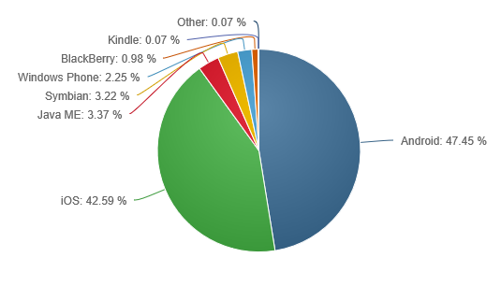
Android OS Popularity
Mobile OS Market Share, Jan 2015, by netmarketshare.com

Slide 6
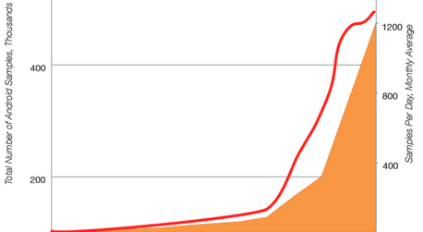
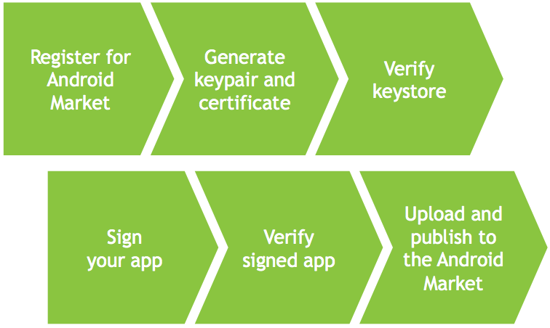
Android Malware/Spyware

Slide 7
Desired System
Generality
  Any application on mobile marketplaces → hardened business version
Data isolation/sharing
Complete mediation
  Stealthy channels: reflection, native code, dynamic load
Flexibility
  Dynamic & remote access policy update
Portability
  No modifications (dependencies) on OS
Cross-platform
  Proxy-based data access mechanism demo on iOS

Slide 8
Major Methods
 | Developer support | OS version dependency | Device dependency | App dependency | Generality
Application rewriting | No | No | No | Partial | Full
Software development kit (SDK) | Yes | Partial | No | No | Limited
Operating System modification | No | Yes | Yes | No | Full
Notes:
Application rewriting
Mocana
Work on all devices, NOT on all applications
SDK
Good
Work on all applications, NOT on all versions of OS
Extra developer support
OS Modification
Bring Android to work on Android Lollipop
Dependencies on OS versions or customization
Limitation of portability

Slide 9
Challenges
Lack of OS support
  Existing Android storage mechanism supports either data sharing or data isolation alone
Diversity of data access behavior
  Native code, Java reflection, Dynamic loading
Performance penalty
  Popular resource virtualization-based solutions have the scalability issue
Notes:
Lack of OS support,
Talk about internal storage and external storage here!

Slide 10
Outline
Introduction
System Design & Implementation
Evaluation
Conclusion & Discussion

Slide 11
Security Model
How to use:
  Shield the application to get the business version of application
  Applications on device are divided into two sets: business and personal

Slide 12
Android Segmentation

Slide 13
AppShield Design
Apps data exchange channels:
  File system
  Content provider
  Inter-process communication
Proxy-based data access mechanism
Privileged data leakage detection/prevention
Notes:
In the order of next few slides

Slide 14
AppShield Architecture
3
8
7
9
4
6
12
13
11
10
5
14
1
2

Slide 15
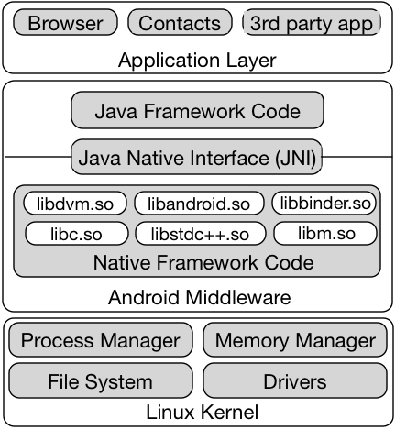
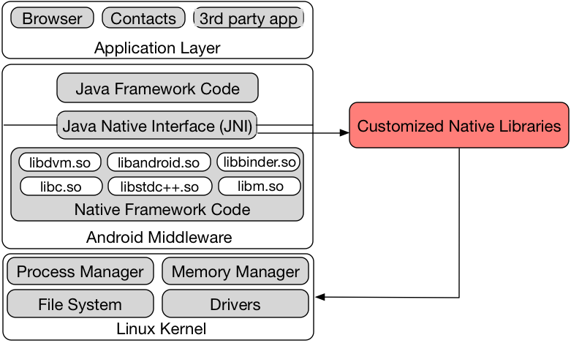
System Call Hooking

Slide 16
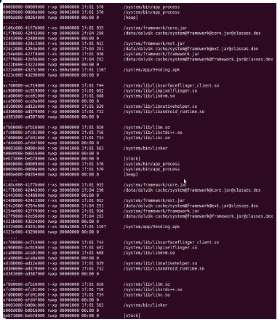
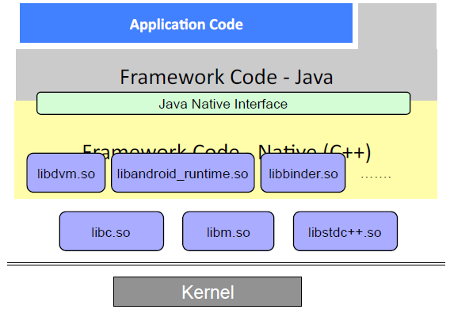
System call interposition

Slide 17
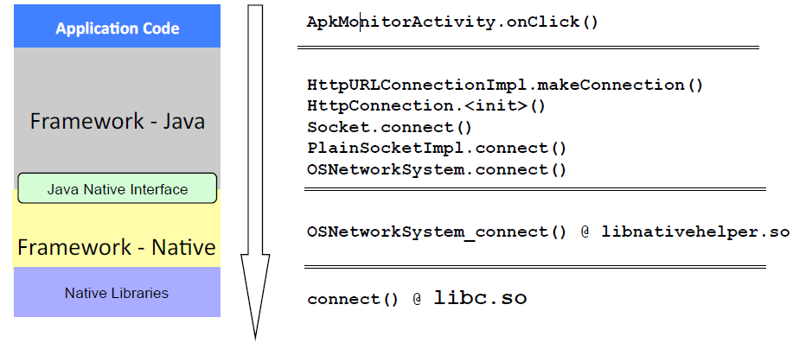
Example: Socket Connection

Slide 18
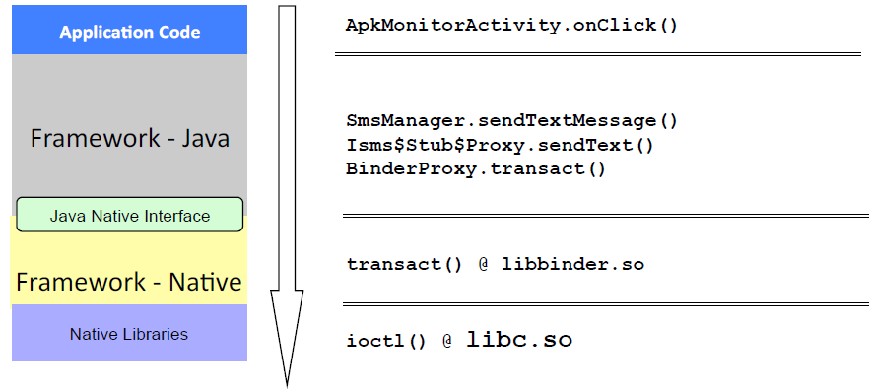
Example: Send SMS

Slide 19
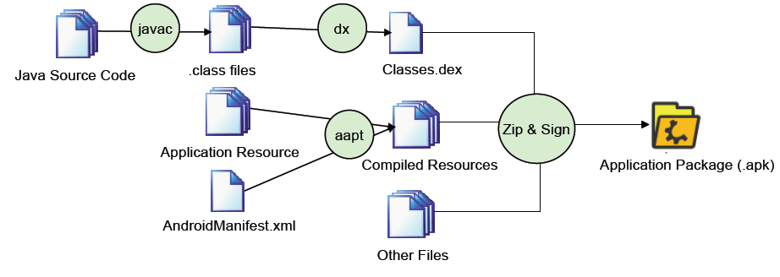
Application Rewriting
Framework
Android application project organization

Slide 20
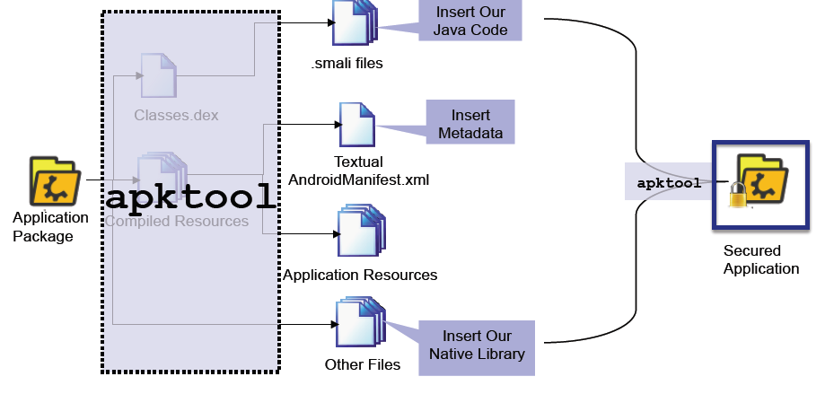
Application Rewriting Framework (cont’d)
Application reverse engineering
Notes:
Decompile the dex bytecode to a intermediate representation (IR) smali using open-source tool apktool
Modifiy the application for three parts
Native code for customized system calls and GOT entry overwriting
AndroManifest.xml delceare the parent class of the whole application, the preprocess service in the middle of zygote and the application
Premission declaration of content provider
Smali
Initial the communication with AppShield, popup UI notification
AppShield is deployed as a remote service and generates a random private key to sign each business application. When the application is installed, the client side AppShield keeps the mapping from the application name to the signature, which is used to dierentiate business applications and personal applications. Due to the physical isolation of signature generation and the one-to-one map-ping of original keys to new keys, it is computationally dicult for an attacker to create a malicious application with the same signature as that of a legitimate business application to launch the privilege escalation attack.

Slide 21
File System
open()
creat(), rename(), mkdir(), remove()
stat(), lstat()
Notes:
Open(), modify the file path with the one in the internal storage of AppShield, pass the flags and modes.
creat(), rename(), mkdir(), remove()
Replaces the le paths in the parameters of these system calls with the corresponding business file paths in its internal storage.
Stat(), lstat()
Get the file descriptor first and call the default system call fstat()

Slide 22
Content Provider
Manage the access to a structured set of data
Core: SQLite with schema
System content providers: contact, SMS, calendar
Process:
  Create mirror content provider
  Hook system call ioctl()
Notes:
AppShield duplicates the target content provider with the same schema and table definition in its private internal storage. AppShield guards the mirror content provider with a special permission.
Access to content provider relies on IPC. This is the main system call through which all binder IPCs are sent. By interposing on this system call, AppShield replaces the URIs to the original content provider with the URIs to the mirror content provider to redirect the data operation. Using context in this system call, AppShield could validate who initiates the operations on the content provider, and the PDP module could decide whether to allow the access. Malicious application thus cannot operate on the mirror content provider by the overwriting URI and permission declaration.

Slide 23
Data Sharing/isolation
Privileged data kept in internal storage, private access mode owned by AppShield
Data access by other applications go through public storage with the virtual file path
Business application’s access redirect to the true file → sharing
Personal application cannot access the private internal storage→ isolation

Slide 24

Data Sharing/isolation (cont’d)
No access to privileged data
AppShield
Personal Application
Access
Access
Business application
Business application

Slide 25
User Privacy Leakage
Detection/Prevention
Other system calls to hook
  Internet connects
    connect()
  Process management
    fork(), execvp()

Slide 26
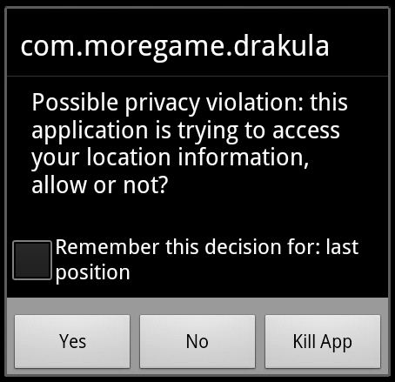
Privacies Guarded
Location
Contacts
Phone number
IMEI
IMSI
ICCID

Slide 27
Outline
Introduction
System Design & Implementation
Evaluation
  Need to add methodology
Conclusion & Discussion

Slide 28
Security Policy Enforcement
Manual operations on 50 apps
Total Apps | Succeed | Cannot be rewritten | Crash | Cannot isolate/share data
50 | 46 (92%) | 1 (2%) | 2 (4%) | 1 (2%)
Notes:
1 app cannot be rewritten because apktool crash when unpacking the app
2 applications crashed because the column NAME RAW CONTACT ID , introduced in the recent Android API 21, was not included in our mirror contact provider.
Our proxy-based data access mechanism failed on only one application, because it uses Java reection to invoke the onCreate() method as the application entry and therefore skips our preprocess service, which establishes the communication with AppShield and redirects system calls.

Slide 29
Reliability
Automatic test on 1000 apps (Monkey)
Total Apps | Succeed | Cannot be rewritten | Crashed
1000 | 953 (95.3%) | 12 (1.2%) | 35 (3.5%)
Notes:
12 applications failed during rewriting because their obfuscation crashed the reverse engineering tools smali/baksmali and apktool in unpacking, decoding, and repacking.
35 apps crashes
We ran their original versions and found 29 of them also crashed, which clearly were not caused by AppShield . To investigate the reasons why the remaining 6 rewritten applications crashed while their original versions did not, we just unpacked and repacked them without modifying their code or data, and found all of them still crashed after repacking. We hypothesize that they might use anti-repacking techniques, such as signature validation.

Slide 30
Latency
Micro-benchmark
  Android file system: time latency in fetching file descriptor 1000 times
  iOS file system: time latency in rendering contents of file to UI 1000 times
  Android content provider: time latency in getting cursor 1000 times
Marco-benchmark
  Manually operate the phone, wait the content rendered to UI, close the app, average latency in 5 operations

Slide 31
Latency Results
 | File System |  |  |  | Content Provider
 | Android |  | iOS |  | Android
 | Orig | AppShield | Orig | AppShield | Orig | AppShield
Micro-benchmark (ms) | 0.729 | 2.998 | 171.092 | 347.475 | 7.303 | 9.014
Marco-benchmark (s) | 1.472 | 1.524 | 1.643 | 1.753 | 1.068 | 1.194
Notes:
In the worst case, AppShield 's policy enforcement introduced a latency of 2.269ms on the Android le system, because acquiring each file descriptor involves one round of IPC with AppShield . As for rendering the le contents on the UI on iOS, AppShield introduced a latency of 176ms. AppShield introduces a latency of 1.711 when getting the cursor of content provider. Since IPC is the dominant factor in the latency and has a xed time cost, the relative latency decreases as the original le system operation takes longer.
AppShield introduced a latency of 52ms, 110ms, and 126ms in data operations on the Android le system, iOS le system, and Android content provider, respectively. Such latency is barely perceptible.

Slide 32
Memory Consumption & Code size increment
adb shell dumpsys meminfo <package_name|pid>
Notes:
AppShield's rewriting introduced less than 50% overhead in memory usage and code size in 90% applications. The average overhead is 8049.1KiB in memory usage and 121.2KiB in code size. Our system hooks into the low-level system calls, and the dynamic linking mechanism naturally supports our efficient memory utilization by avoiding code duplication. Moreover, we add our customized system calls, and the classes for communication with AppShield and UI notification just once rather than inlining them at every point where the original application accesses privileged data.

Slide 33
Outline
Introduction
System Design & Implementation
Evaluation
Conclusion & Discussion

Slide 34
Comparison
 | AirWatch | MOCANA | GOOD | Citrix | Android L | AppShield *
Method | SDK & App rewriting | App rewriting | SDK | SDK | OS modification | App rewriting
Data location | Internal Storage | Internal Storage | Internal Storage | Internal Storage | External Storage | Internal Storage
Isolation | Sandbox | Sandbox | Sandbox | Sandbox & Encryption | DAC | Sandbox
Data sharing among business apps | Online access required | Online access required | Online access required | Local shared | Local shared | Local shared
Access control and granularity | Static | Static | Coarse Dynamic | Static | Coarse Dynamic | File-level Dynamic

Slide 35
Discussion
Usage of anti-reverse engineering techniques crashes the application rewriting
  apktool
System call invoked not through the system libc by pass our mechanism
Notes:
The initial step of our rewriting mechanism is to unpack the APK le and decompile the dex bytecode to IR. Application developers sometimes use anti-reverse engineering techniques to crash decompilation tools to protect their intellectual property. However, our large scale evaluation shows that the percentage of these applications is still low.
Another limitation of our approach is that it depends on hooking on the dynamically-linked libc . Any system call invoked not through the system libc , such as by using a statically-linked libc in the application, will bypass our hooking mechanism. The chance of this happening, however, is very low, and can be detected statically.

Slide 36
Publication List
Zhengyang Qu, V. Rastogi, X. Zhang, Y. Chen, T. Zhu, Z. Chen, “AutoCog: Measuring the Description-to-permission Fidelity in Android Applications” in ACM CCS 2014 (114/585, 19.5%)
Zhengyang Qu, G. Guo, Z. Shao, V.Rastogi, Y. Chen, H. Chen, W. Hong, “AppShield: A Proxy-based Data Access Mechanism in Enterprise Mobility Management”, submitted to ESORICS 2015.

Slide 37
Thank you!
Questions?
http://list.cs.northwestern.edu/mobile/

Slide 38
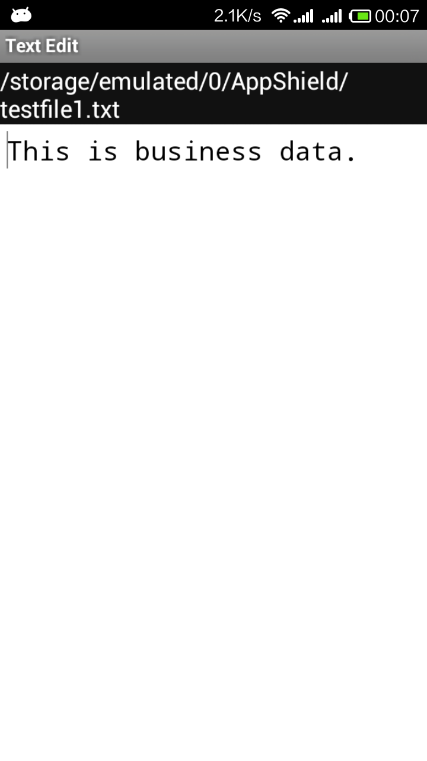
Demo
The shielded sample app TextEdit
The virtual file path “/storage/emulated/0/AppShield/testfile1.txt” in SD card
The file really accessed is in the internal storage

Slide 39
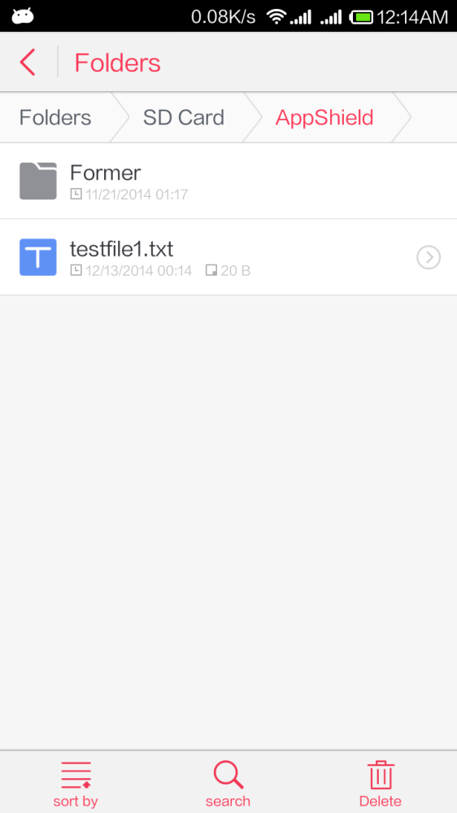
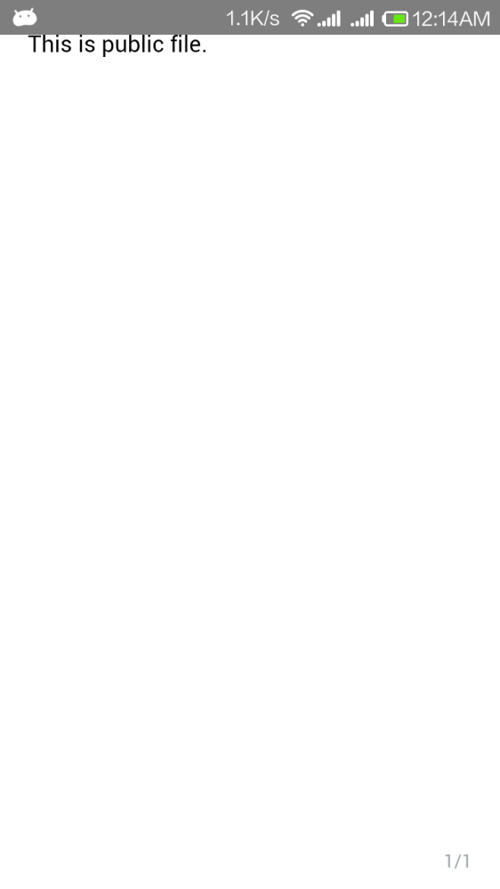
Demo
The personal application WPS could only access the fake file kept in SD card

Slide 40
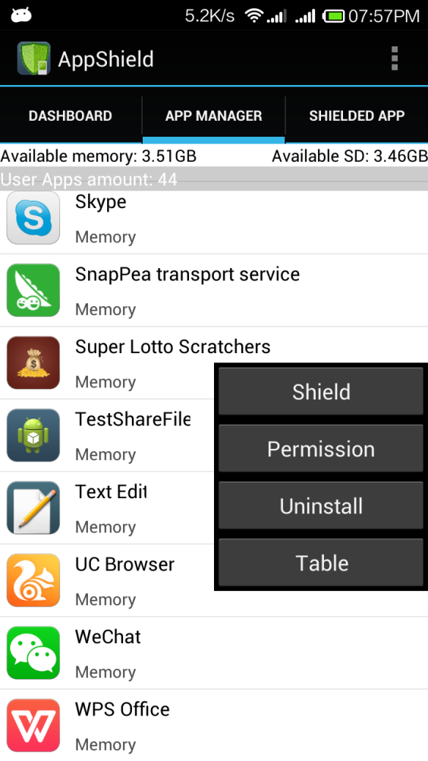
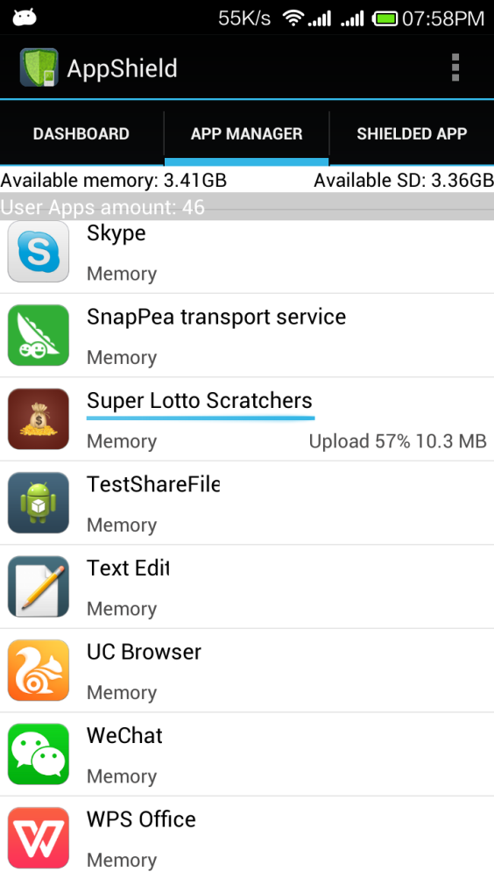

Demo
Select the application to be shield, and upload to our server

Slide 41
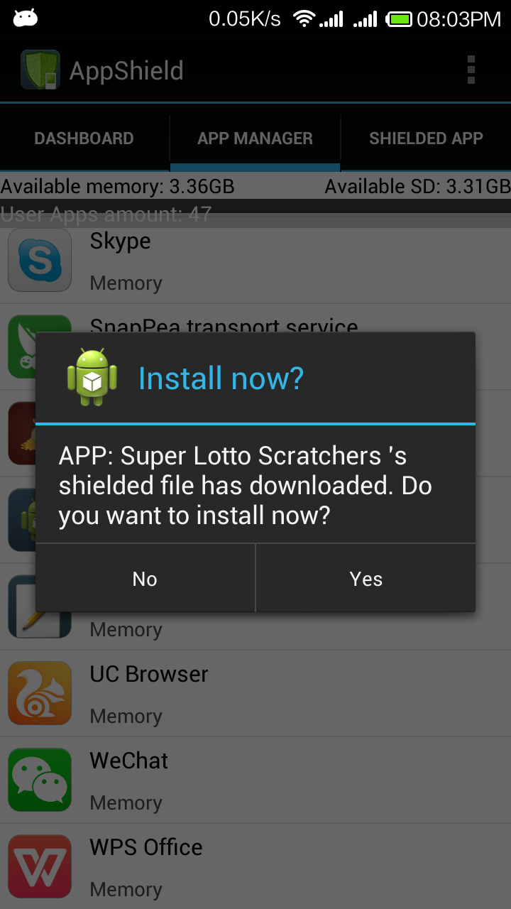
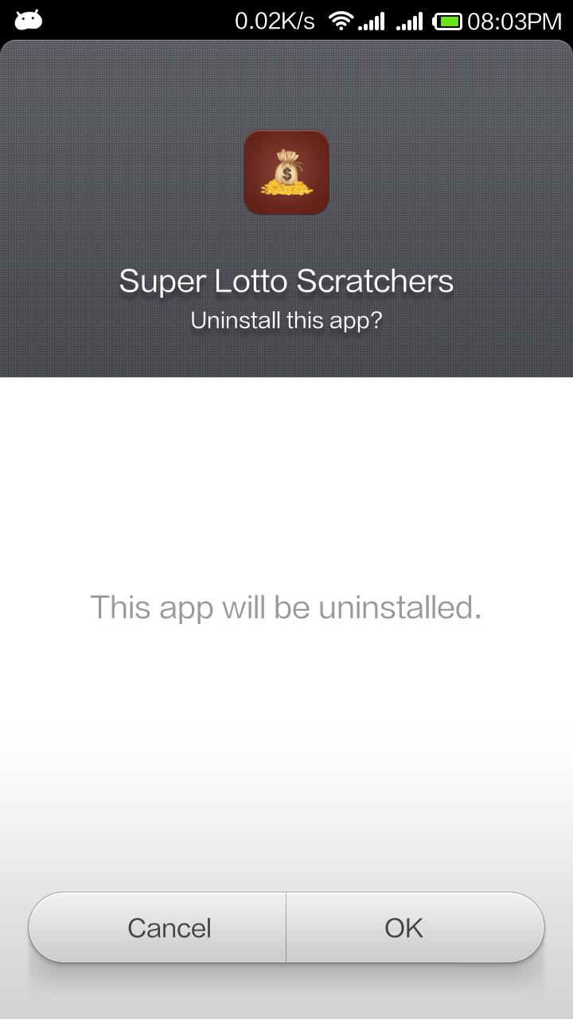
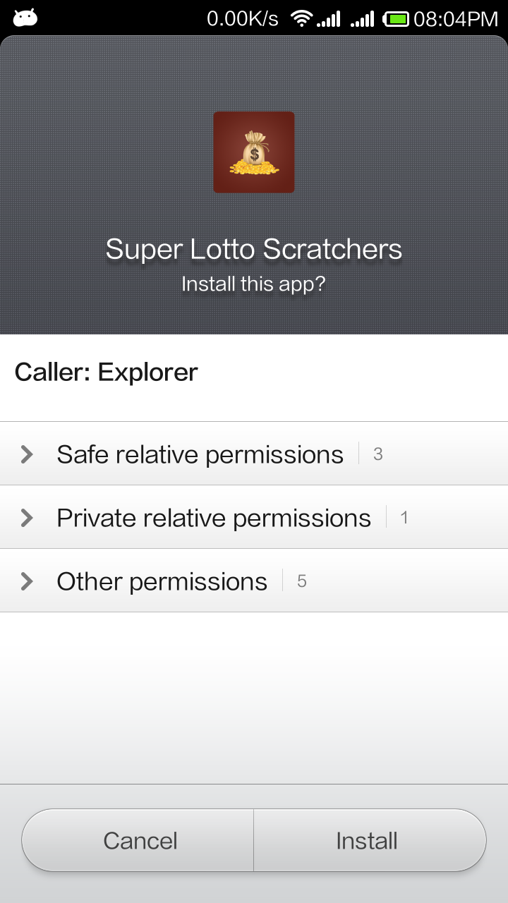
Demo
Replace the application with the shielded one

Slide 42
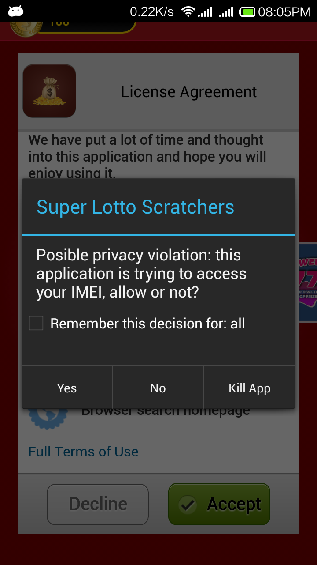
Demo
The business version of application monitors the behavior, and alert the user in enforcing the policy

Slide 43
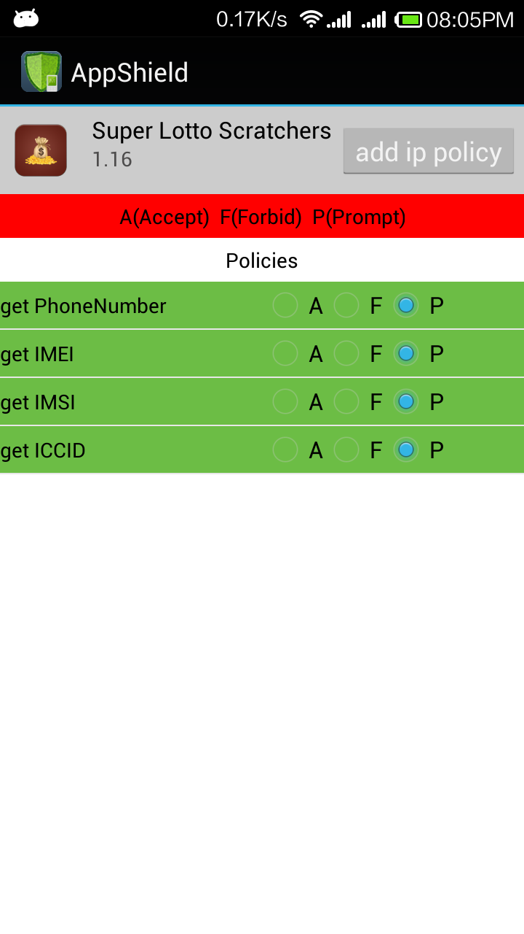
Security Policy
Decision on behavior: Allow (A), Forbid (F), Popup (P)
Could change both locally and remotely in runtime

