Slide 1
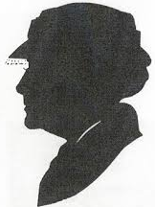
MARPLE: Mitigating APT Damage by Reasoning with Provenance in Large Enterprise Networks
October 11, 2017
Notes:
Miss Marple is the detective in Agatha Christie’s novels who ‘connects the dots’…

Slide 2
Agenda
Time | Topic | Presenter(s)
11:00am-11:05am | Arrival and Introduction | All
11:05am-11:10am | Overview of Site Visit Agenda | J.R. Rao
THE MARPLE APPROACH
11:10am-11:20am | MARPLE Post-Engagement Analysis | All
11:20am-11:30pm | Architecture Evolvement For Cross-Host Forensics | J.R. Rao
11:30am-12:15pm | Policy Enforcement: MARPLE Response System | Xiaokui Shu, R. Sekar, and Yan Chen
12:15pm-12:30pm | Lunch
12:30pm-12:50pm | A Faster and More Versatile τ-calculus and FCCE | Xiaokui Shu and Doug Schales
12:50pm-13:10pm | RiskDroid with Neural Nets | Heqing Huang
13:10pm-13:30pm | SLEUTH Development and Plans | R. Sekar
13:30pm-13:50pm | APT Story Teller | Venkat Venkatakrishnan
13:50pm-14:10pm | Automatic Attack Graph Pruning | Haitao Xu
14:10pm-14:40pm | Windows Monitoring and Graph Generation | Yan Chen
14:40pm-15:00pm | Discussion and Next Steps | All

Slide 3
Automatic Attack Graph Pruning

Slide 4
Goal
APT Detection Analytics
IoC
When and
Where
to get into the system
More malicious behavior
In system
Malicious
Point
backward
tracking
forward
tracking

Slide 5
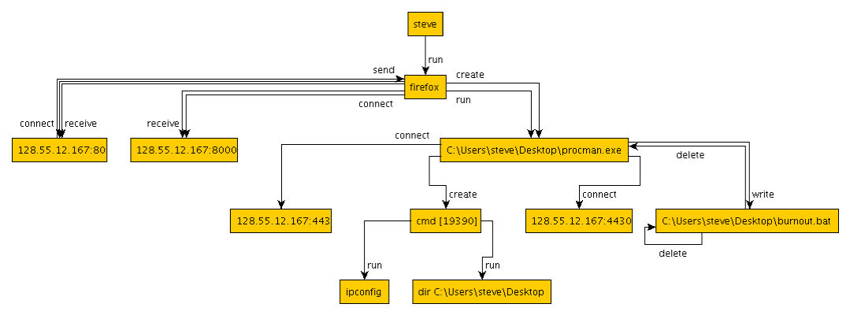
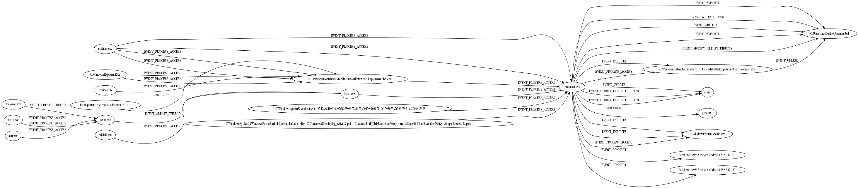
Expected Output
Ground-truth
attack graph
Our graph
Firefox
C:\Users\steve\Desktop\procman.exe

Slide 6
Illustration based on 5D Data
Rules
One or more
malicious
points
5D data
Set
Attack graph

Slide 7
Pruning Rules
1）Imposed on Subject/Object
  1.1 Deal with Hub process & injection
  1.2 Delete irrelevant nodes
  1.3 DLL files
  …
2）Based on Time stamp
  2.1 Time stamp in injection
  …
3） Imposed on Events
  3.1 Event_modify_file_attribute
  3.2 Event_check_file_attribute
  3.3 Event_read
  …

Slide 8
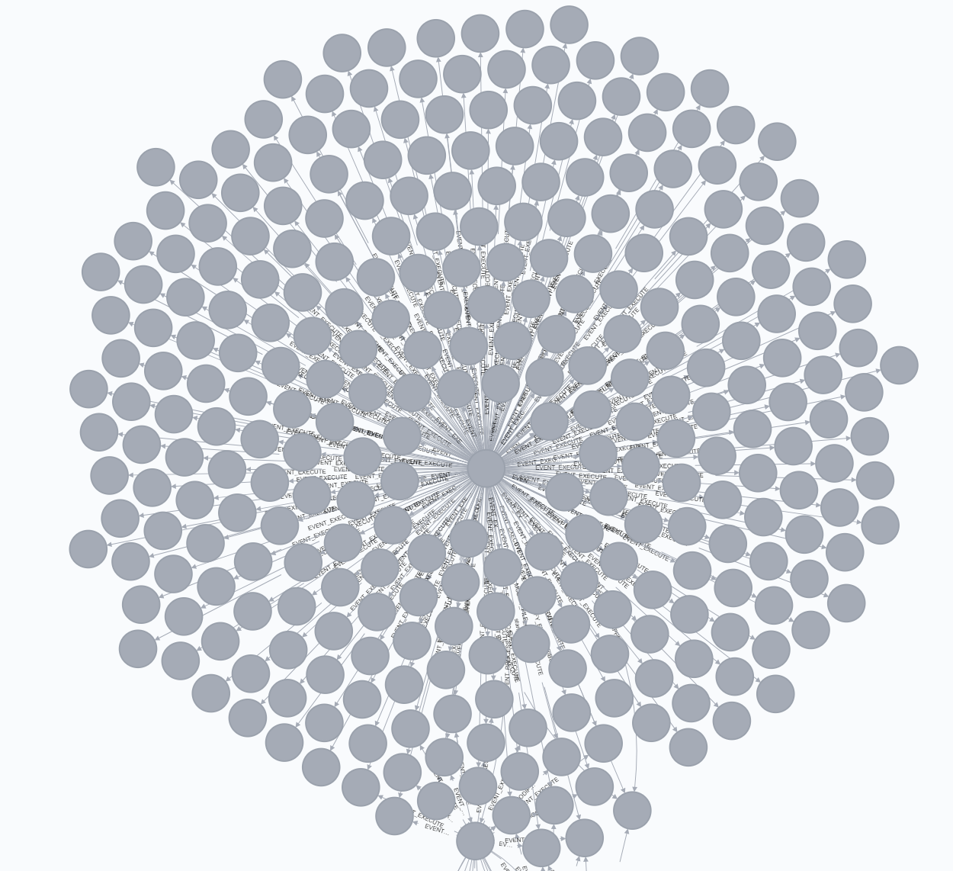
Rule 1.1: Deal with Hub Processes
Characteristic
  Benign process
  Involved in a lot of operations
  Difficult to prune
  …
Notes:
& injection processes

Slide 9
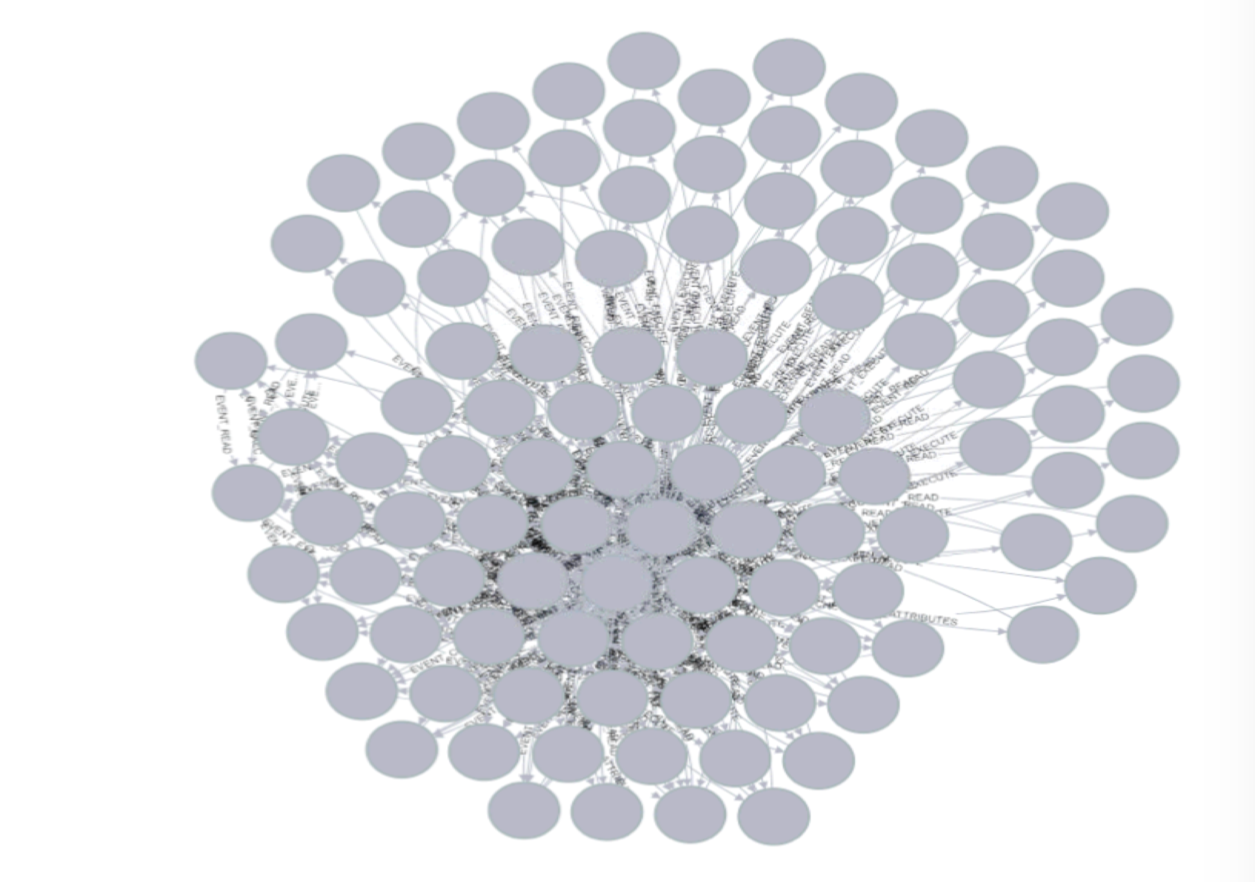
Rule 1.1: Hub processes vs Injection processes
Difference (?)
  Not malicious point
  Do malicious behavior through other malicious process
Firefox.exe execute
Limit time stamp
Notes:
Time window: 1 hour

Slide 10
Rule 1.1: Hub processes vs Injection processes - cont’d
Rules for identifying “injection” activity
  Event_create_thread
  Event_process_access
  Many Access such as:
PROCESS_QUERY_INFORMATION
PROCESS_QUERY_LIMITED_INFORMATION
PROCESS_CREATE_THREAD
PROCESS_VM_OPERATION
PROCESS_VM_READ
PROCESS_VM_WRITE

Slide 11
Rule 1.2: White List
Maybe hub process or injection
Explorer.exe
firefox.exe
Svchost.exe
Rundll32.exe
…

Slide 12
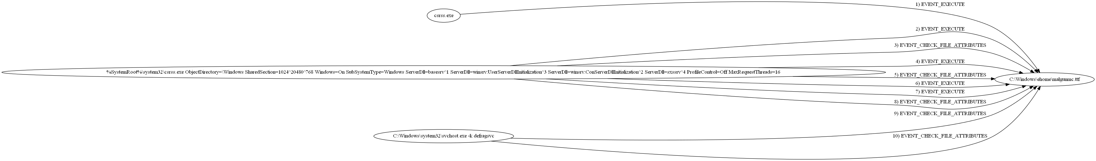
Rule 1.2: Delete Irrelevant Nodes
*.ttf(TTF) font file
*.ttc(TTC) font file
…

Slide 13
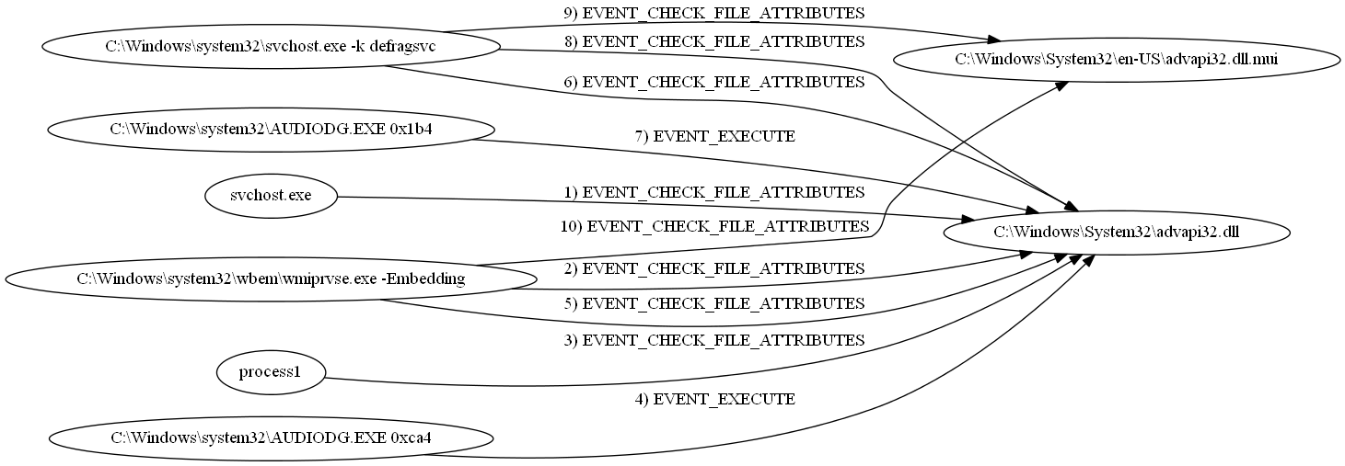
Rule 1.3: DLL Files
Characteristic
  Large amount
  Difficult to prune
  Shared with other process

Slide 14
Rule 1.3: DLL Files - cont’d
Rules
  No backward or forward tracking

Slide 15
Rule 2.1: Prune Nodes before Attacks
Rules
  Perform only forward tracking; No backward tracking
B
9:00 B inject D
D
10:00
A
7:00
C

Slide 16
Rule 3: Event_read, Event_check, modify_file_attribute
Characteristic
  Such events are not so suspicious like Event_write
  Important information but with large amount
Rules
  Perform only backward tracking; No forward tracking
B
D
Event_check_file_attributes
A
C

Slide 17
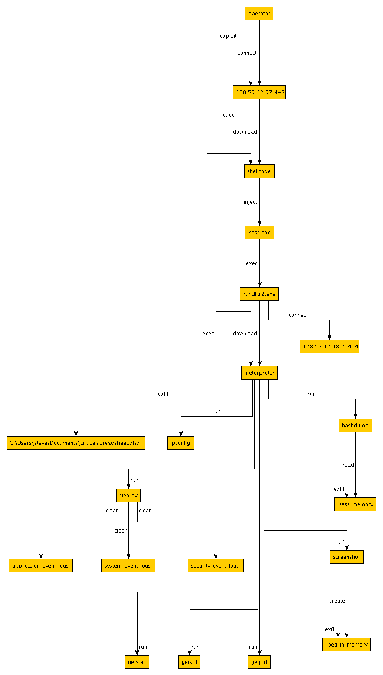
Data Issue: Data Loss in Pandex Injection Attack
  All the nodes are missing after “Meterpreter ”

Slide 18
FCCE Integration
FCCE provides a complete data management solution
  PHF detection relies on streaming data processing
  Attack graph pruning relies on historical data queries
FCCE is scalable
  No worries about memory size and large graphs
FCCE now has a REST API
  Stateless query interface
  Extensible for writing and specific query needs
Attack graph pruning is a good starting task to integrate FCCE and NWU’s modules

Slide 19
Windows Monitoring and Graph Generation

Slide 20
Outline
System Overview
Challenges and solutions
Components
    User-level parser
    Kernel logger parser
    CDM translator
Our Advantages
    Fine-grained (i.e., thread-level)
    System call
    Stack walk information
    Device information (e.g., USB Keylogging)
Deployment and Overhead
Notes:
Overview X
Feature store -> Kafka
Advantages
Stack information (useful for unit/PHF detection, implementation info related to system call/events) -> may cause overhead
Thread-level granularity (which thread invokes the event) (TCP/IP are only process-level)
-> System call information
Device information -> USB keylogging information

Slide 21
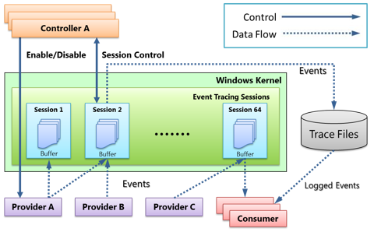
ETW Architecture
ETW has many trace providers (600+ in Win7, 1000+ in Win10)
  NT Kernel Logger: Kernel logging
  Microsoft-Windows-USB-UCX/Microsoft-Windows-USB-USBPORT: USB logging
  Stackwalking with xperf (A tool which also uses ETW): Stack logging
Notes:
Data source -> ETW
Controller, provider, consumer / session provider
Controller enables provider
Consumer receiver data from ETW and parse
Session – consumer (real-time), only one session is real-time
Many ways of storing (
Tool on the end user: Control and parse; Use TA3 API to compress into AVRO files; data transmission protocol ()
USB logging

Slide 22
Challenges
Efficiency
The default ETW tdh library for parsing events can only achieve 2000-3000 events per second.
  Solution: we manage to get the struct of each event class and are the first to parse more than 1,000,000 events per second.
System call parameter reconstruction
  ETW provides only the address of a system call.
  We need to do mapping from address to system call name.
Notes:
No multi-thread parsing / single-thread
Nt Kernal logger (21 providers, 105 events (30-40 classes)), manual check MSDN (DWORD type), parse fields based on the offset to the event base address
Consume the event (CPU is calling which kernel address)

Slide 23
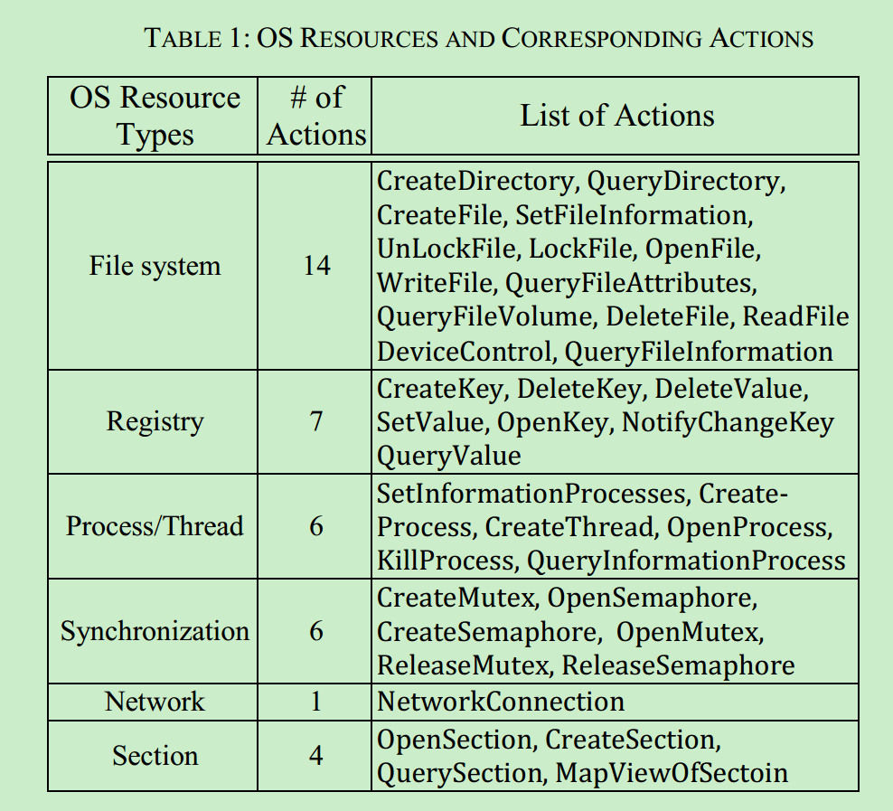
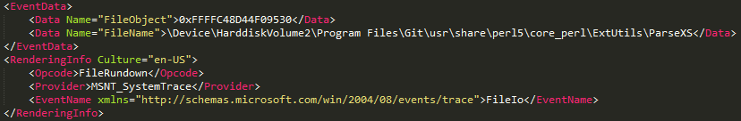
Challenges & Solutions – cont’d
System call parameter reconstruction：
The parameters of system calls are not directly provided via ETW.
We correlate events to extract the parameters for most security-related system calls.
Notes:
Reconstruction -> construction / restoration
Although we cannot uncover the parameters for all system calls, we are able to uncover the parameters for most security-related system calls.
By checking MSDN and other public forums, we could uncover a set of security-related system calls.

Slide 24
Existing Work on Windows Low-Level Data Collection
Non-ETW approaches
  SSDT and API Hooking (Affect the stability and reliability of the running system, limited usefulness in recent versions of Windows)
    SSDT: Overwriting of a kernel data structure
    API: Modification of running software to intercept function calls
  Run the system on QEMU (Efficiency problem ?)
  Monitor single processes (High Overhead)
ETW-based approaches
  [purdue] overhead is very high based on our measurements and other papers (100K+ events/sec)
  No parameter reconstruction

Slide 25
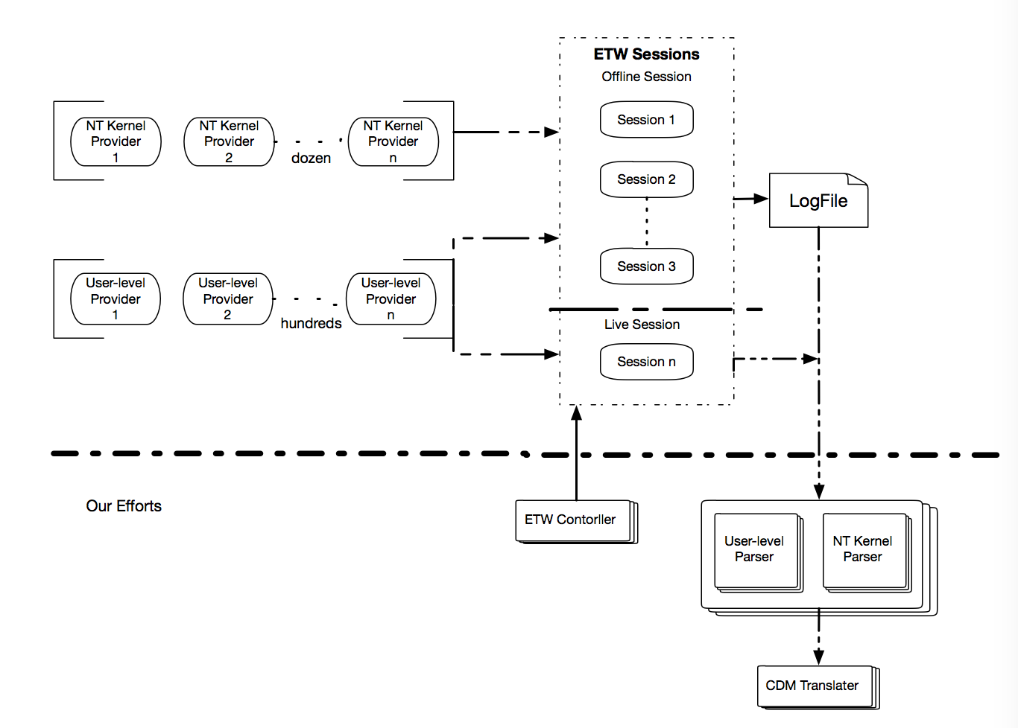
Our System
Four components
Notes:
Our effort
NT Kernel
Feature store (remove)
虚线、红圈圈

Slide 26
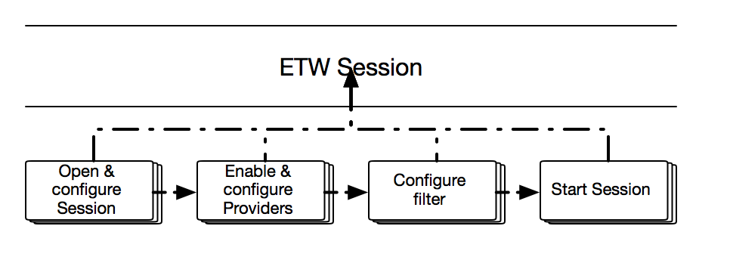
Component 1: ETW Controller
Notes:
Controller
First create a session, enable providers(generate data to session), filter the not-interested data (provider provides multiple kinds of data), (real-time, local disk) session

Slide 27
Component 2: NT Kernel Logger Parser
NT Kernel Logger Session is a special session which provides events from Windows kernel.
Contains 21 providers, and provides 105 events in total on Win7
Automatically correlate joint events to infer parameters of system calls.
  For example,
  1 event "FILE CREATE" + 1 event "SYSTEM CALL ENTRY "(NtCreateFile) = NtCreateFile + some of the parameters from the other event
Notes:
Each provider defines a class which has different members.
Filename, FileObject, KeyName,
Open a registry (kname, object, objectname),
Members -> Struct fields
Nt Kernal logger (21 providers, 105 events (30-40 classes)), manual check MSDN (DWORD type), parse fields based on the offset to the event base address
Combine/correlate several events to produce one CDM event! (send messageID, receive messageID, ALPC, advanced local procedure call mechanism)

Slide 28
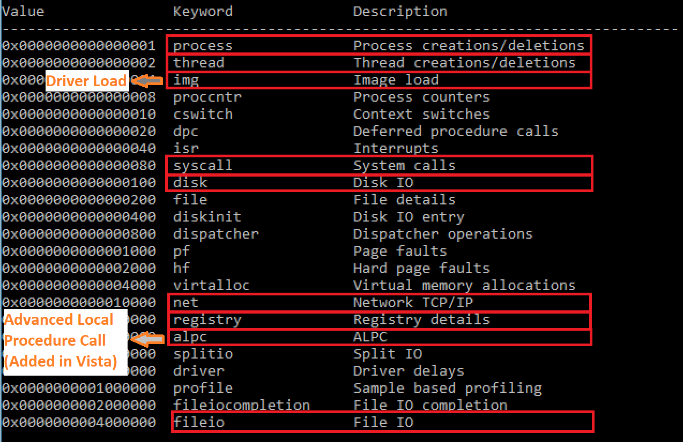
Component 2: NT Kernel Logger

Slide 29
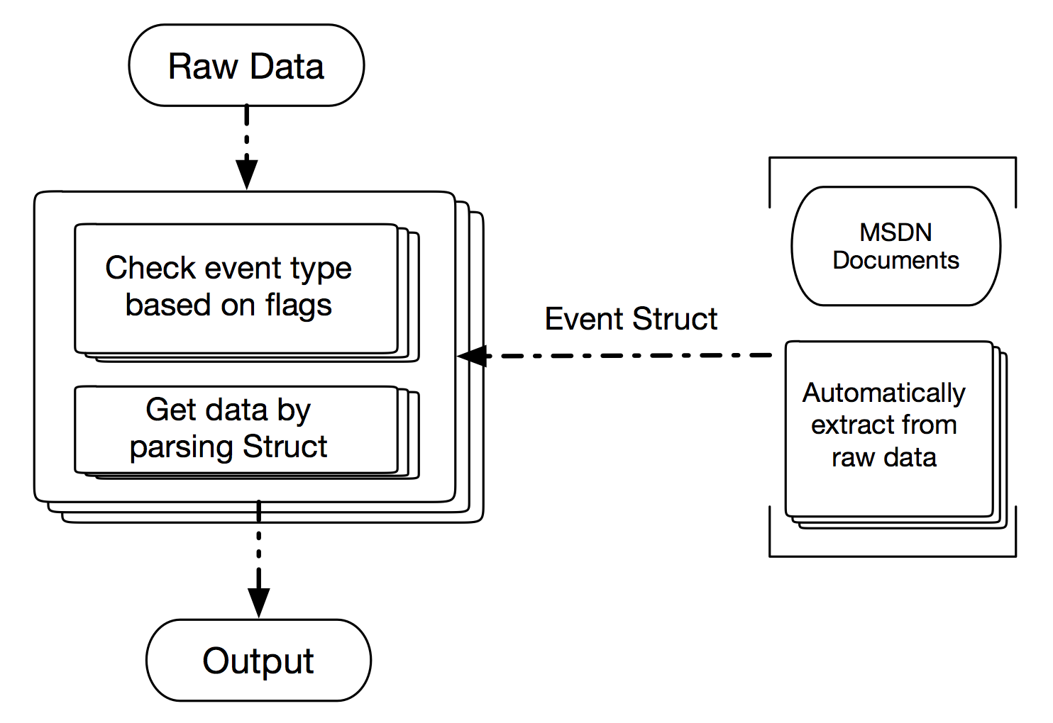
Component 2: NT Kernel Logger Parser – cont’d
Notes:
Filename, FileObject, KeyName,
Open a registry (kname, object, objectname),
Members -> Struct fields
Nt Kernal logger (21 providers, 105 events (30-40 classes)), manual check MSDN (DWORD type), parse fields based on the offset to the event base address
Combine/correlate several events to produce one CDM event! (send messageID, receive messageID, ALPC, advanced local procedure call mechanism)

Slide 30
Component 3: User-level parser – cont’d
    User-Level Events
    Windows Start
    Account(Login/Logout)
    File
    Registry
    Process
    Thread (Remote Thread Creation)
    Network (TCP/UDP, Bind to Port)
    Dynamic Library Load
    System and Security Log Clear
    WMI Queries
    USB related
    ……
Notes:
OS start
User login / logout
File read / write
TCP/UDP/IPv4/IPv6
Clear the log / tracks
WMI (Windows Management Instrumentation)

Slide 31
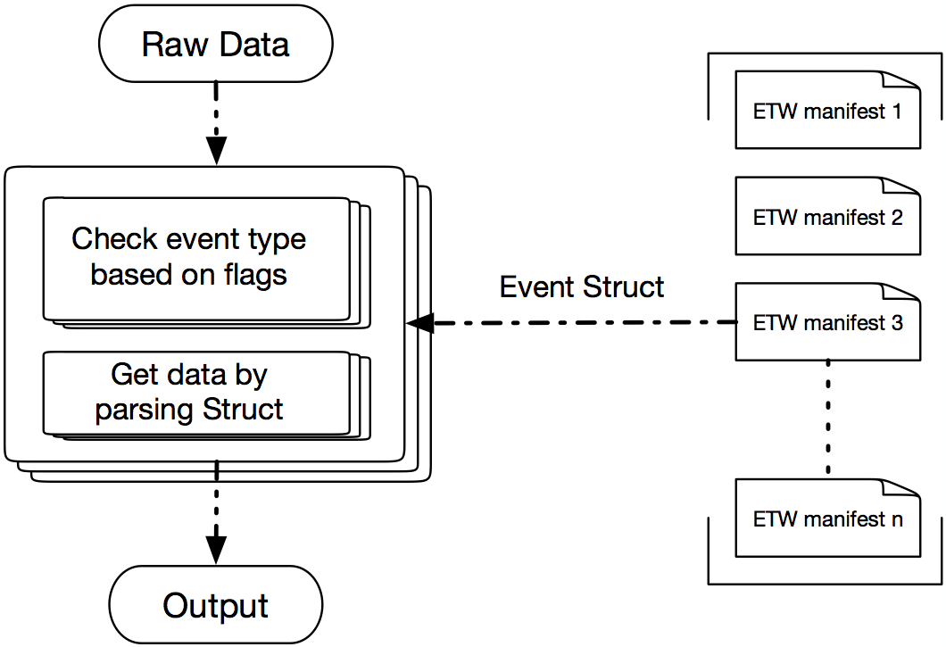
Component 3: User-level parser
Notes:
User-level event structure has been given by the “ETW manifest”.
Write file ()
Raw data -> by which provider (fileIO), opcode (34, write file) -> (who/when, operated object ) (who create the connection, if send data)

Slide 32
Component 4: CDM Translator
User Level (short list)
Kernel Level (short list)
ETW Events | CDM Records
Windows Start | Subject(SUBJECT_PROCESS), EVENT_BOOT
Account Login | EVENT_LOGIN
Registry Link | EVENT_LINK
Registry Read | EVENT_READ
File Read | EVENT_READ
File Read Attribute | EVENT_CHECK_FILE_ATTRIBUTES
Dynamic Library Load | EVENT_LOADLIBRARY, EVENT_UPDATE, FileObject(hash)
ETW Events | CDM Records
ALPC_SEND ALPC_REC | EVENT_SIGNAL
FILEIO::Name FILEIO::Create FILEIO::Read | EVENT_OPEN EVENT_READ EVENT_LSEEK
PageFault_V2:: VirtualAlloc | EVENT_OTHER
Thread::CSwitch PerfInfo::SyscallEnter | EVENT_OTHER
VAMAP | EVENT_MMAP
Image::Image_Load | EVENT_MMAP
TCPIP::RecvIPV4 | EVENT_RECVFROM EVENT_RECVMSG
Several ETW events may be combined together to produce one CDM record.
Notes:
ALPC: Inter process communication (IPC)
System call entry address
VAMAP: Enables the map and unmap (excluding image files) event type (only appear starting from Win8

Slide 33
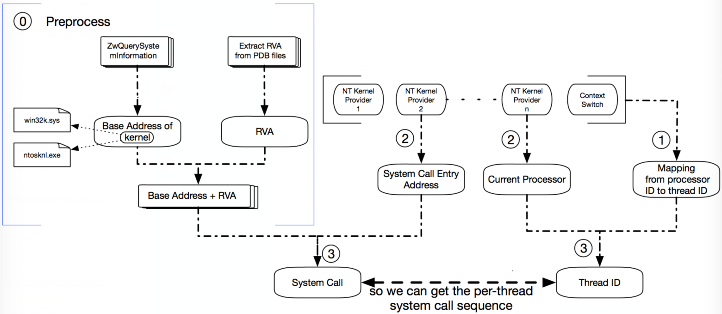
Advantage 1: Fine-grained System Call Collection
Notes:
NT Kernel
2/2 Which processor is calling which address
Context Switch
One processor is being used by which thread
A system call (actually API) of NTDLL.dll -> image message (NT Kernel is loaded, current loaded)
System calls stored in Windows Kernel (Win32k.sys, NTOSKNL.exe)
Output: which thread invokes which system call?

Slide 34
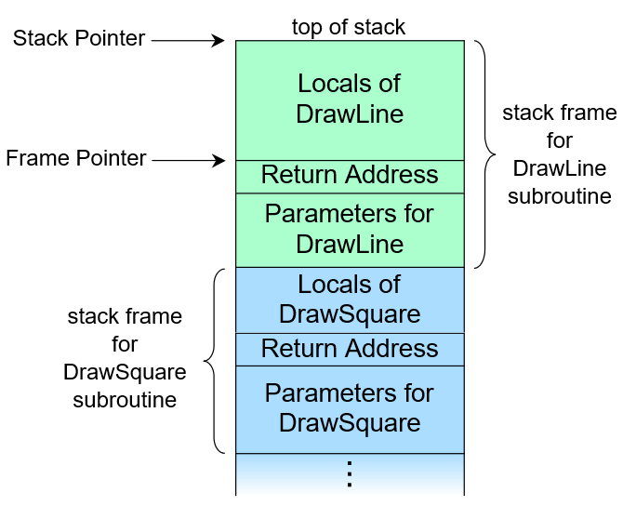
Advantage 2: Call Stack
Call stack: stack data structure that stores information about the active subroutines of a program.
Frames are stored in the call stack
If the frame sizes are not equal, stack pointers indicate frame pointers
Routines are popped out of the stack after they are finished
Return address is used to check where should the program go after it’s execution is finished

Slide 35
Advantage 2: Stack Logging

Slide 36
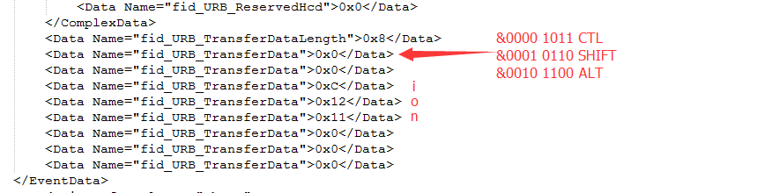
Advantage 2: USB Keylogging
Microsoft-Windows-USB-UCX (usb3.0, Win8 +)
Microsoft-Windows-USB-USBPORT (usb2.0, Win7 +)
Notes:
Which USB devices are generating the data
USB keyboard transferred data
Checking the raw data against FID protocol
We have the capability of capturing the keyboard input!!!

Slide 37
Deployment and System Overhead
We have tested our system on server physical machines:
    Computer Specification
    CPU:Intel(R) Core(TM) i5-4590 CPU @ 3.30GHz
    RAM: 8.GB
    Operation System : Windows 7 SP1 64 bit
ETW Parser Overhead:
    Idle-Run:1%-3% CPU , 34MB memory (increment)
    Full-Load: 8%-12% CPU, 50MB memory (increment)
System has been deployed and running on the TA3 VM
Notes:
(We only focus on the overhead of ETW parser, except CDM translater and Kafka producer.
Idle Run: When computers are idle with few tasks
Full-Load: CPU-intensive and memory-intensive tasks (Watching video, program compiling (STMQ test program))
Increment in CPU/Memory

Slide 38
Comparison with FiveDirections
 | MARPLE | 5D
System Call | √ | ×
Call Stack | √ | ×
Thread Information | √ | ×
User Level Events | √ | √
Real-time Parsing | √ | ×
Notes: 5D is mainly user-level data, has to be saved to logs before reading from it.
We read directly from providers, have no disk access (save resource, small load on the system).
Notes:
5D is mainly user-level data,
Marple: we have no disk access (save resource, small load on the system), real-time data output
NT Keylogger session is the only real-time

Slide 39
Policy Enforcement Scenario Support
    Policy 1: Originating User
    NT-Kernel-Logger::Process (SID)
    NT-Kernel-Logger::TCPIP
    _{Policy 2:}
    _{NT-Kernel-Logger::TCPIP}
    _{Microsoft-Windows-TCPIP}
    _{Microsoft-Windows-DNS-Client}
    _{Policy 3: keyboard}
      Microsoft-Windows-USB-UCX
      Microsoft-Windows-USB-USBPORT
    Policy 4:
    NT-Kernel-Logger::FileIo_Read
    offset size
Notes:
SID: Security ID (user, group, privilege, …) -> unwanted TCP/IP access
Windows assign a SID to
Policy 2: TCP/IP, DNS (ip address)
Policy 3: Keyboard typing / Keyboard action –based human interaction ()
(Keyboard input, menu …)
Policy 4:
Need fine-grained taint information (part of the file from Internet will be blocked to be sent out)

Slide 40
Policy Enforcement: MARPLE Response System

Slide 41
Policy Enforcement Architecture
TA1 server
MARPLE Policy Enforcement Response System
Apache
Customized HTTP Server
Enforcement Module
Task Dispatcher
Decision Combinator
BBN Kafka
SLEUTH traversal module
τ-calculus traversal module
TA1 client
Firefox
Monitor
FCCE

Slide 42
Policy Enforcement TA2 Requirement
Input
Policy ID
Client IP
Client Port
Server IP
Server Port
Timestamp
Output
202 Accepted Req
400 Bad Req
500 Error
200 Passed
400 Failed
MARPLE Policy Enforcement Response System
Customized HTTP Server
Task Dispatcher
Decision Combinator
Procedure
Locate the subject of the network object
Perform one or multi-step backtracking
Extract specific CDM information associated with subjects, e.g., user name
Yield binary answer with subgraph
Combining decisions
SLEUTH traversal module
τ-calculus traversal module
Data
Streaming CDM from TA1 client
FCCE

Slide 43
τ-calculus Development Plan For Policy Enforcement
Principal CDM records support
  Retrieve user/group information for Policy #1
  Realization: explicit node vs. implicit node vs. property
Functional, lazily evaluated, and customized traversal
  Current: a ~> b, following temporal and information flow
  Planned: a ~> b with f(x), f(x) is a function which specifies rules for traversals
  Functionality in examples: only follow EVENT_EXECUTE, exclude EVENT_MMAP, etc.
Compiler/Batcher
  Current: interactive shell that evaluate each command, e.g., MATCH, DUMP
  Planned: execution of pre-programmed scripts in batch
Policy enforcement wrapper
  Compare retrieved values and provide binary answer to our customized HTTP server

Slide 44
SLEUTH Development Plan For Policy Enforcement
Need input from SBU/UIC

Slide 45
Windows Backtracking Strategy Study (NWU)
NWU is preparing some examples of the 4 policies on Window
Issues such as no specific data will be mentioned when talking about the examples

Slide 46
Questions on Policies
Policy #1 (Originating user)
  Is multi-step traversal needed?
    We will handle sudo, but how about:
    User -> ssh -> run script -> service start daemon -> fork script -> fork browser -> send packet
Policy #2 (Block suspect server communication)
  Clear and feasible
Policy #3 (Block automated scripts)
  TA2 needs to search for UI events associated with the process
    Can we get the list of names of events or related objects?
    Can TA1s confirm the items (previous bullet) are in the data?
Policy #4 (Block uploads with network data)
  TA2 needs multi-step traversal
    We may need provenance information for hub processes, e.g., Firefox, Nginx
    Otherwise, hard to know if the file “/tmp/foo2.txt” read is associated with the out-going network traffic

Slide 47
The End

