Slide 1
Detection Approaches and E4 Findings
Yan Chen and Runqing Yang
Northwestern University

Slide 2
Our Findings Summary
Attacks were conducted by TA5.1 during 2 days: 13th (on MARPLE data), 19th (MARPLE - TRACE data)
On 13th: successfully detect several attacks in real-time.
Email phishing with two malicious executables downloaded and executed.
Powershell-based attack in which an obfuscated script is downloaded and executed.
Data leakage attack with high confidential documents are stole through VNC.
Notes:
9th: The powershell command downloaded a powershell script and executed it
11th: We did not have the elevate driver or process injection ready for engagement 3 and therefore could not use them on FiveDirections.
W1>nrudp 27.56.56.211 80
The attacker intended to leave the connection open for later but lost access when the netrecon UDP exfil failed.
27.56.56.211:80 -> 128.55.12.167:8027 netrecon udp
12th: the end to end attack was not fully tested and did not work as intended. The end result was that drakon did not successfully run, connect out, or self delete.
221.205.132.182:80 -> 128.55.12.167:8052 drakon (failed)
exploit www.allstate.com
Firefox: connection to 135.84.161.202:80

Slide 3
Our Findings Summary
Attacks were conducted by TA5.1 during 2 days: 13th (on MARPLE data), 19th (MARPLE - TRACE data)
On 19th:
Part of TA1 collectors was killed by an attacker through SSH.
Reconnaissance and Data Leakage. Host information is collected and exfiltrated through SSH.
Notes:
9th: The powershell command downloaded a powershell script and executed it
11th: We did not have the elevate driver or process injection ready for engagement 3 and therefore could not use them on FiveDirections.
W1>nrudp 27.56.56.211 80
The attacker intended to leave the connection open for later but lost access when the netrecon UDP exfil failed.
27.56.56.211:80 -> 128.55.12.167:8027 netrecon udp
12th: the end to end attack was not fully tested and did not work as intended. The end result was that drakon did not successfully run, connect out, or self delete.
221.205.132.182:80 -> 128.55.12.167:8052 drakon (failed)
exploit www.allstate.com
Firefox: connection to 135.84.161.202:80

Slide 4
Attack Campaign 1 (on Nov 13th )
Two suspicious executable files are downloaded and executed through phishing emails.
doit.exe and doit2.exe was downloaded and executed from thunderbird.exe.
Both processes sent and received msgs from 128.55.12.185 on port 31337.
Then attackers leverage Powershell to perform malicious actions.
A multi-layer obfuscated powershell script was downloaded and executed from 128.55.12.185.
Notes:
suspicious command session：
Survey the target on April 9th
Triple

Slide 5
Attack Graph for Campaign 1

Slide 6
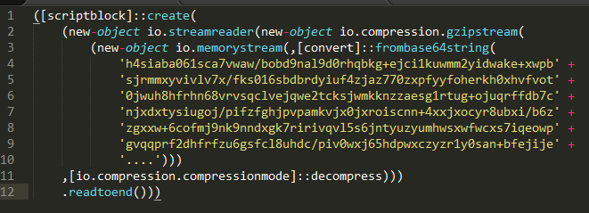
Attack Campaign 1 (on Nov 13th )
First layer obfuscated Powershell script:
The string embedded in first layer script was first decoded by base64 and then decompressed using Gzip.
Second layer obfuscated Powershell script:
The content decoded from the above string is still a base64 encoded string, which was executed by the attacker using the built-in EncodedCommand option of Powershell.
Notes:
suspicious command session：
Survey the target on April 9th
Triple

Slide 7
Attack Campaign 1 (on Nov 13th )
Third layer obfuscated Powershell script:
After decoding the second-layer string, we found that the content is still obfusucated using the same method (base64 + Gzip).
Reflective loading …
Notes:
suspicious command session：
Survey the target on April 9th
Triple

Slide 8
Attack Campaign 1
Data Collection and Exfiltration

Slide 9
Attack Campaign 2 (on Nov 19th )
Through SSH connection, an attacker executed cmd.exe which run several commands to locate processes of TA1 collector:
schtasks /query # query schduled task in Windows
wmic qfe # query Windows Hotfix information
sc query # query services in Windows
tasklist # running process and process info(e.g. pid)
Then the attacker try to kill the TA1 collectors!
1) taskkill /PID 3764 /F # process (pid:3764) is a part of collector
2) taskkill /PID 2192 /F # process (pid:2192) is a part of collector
Notes:
suspicious command session：
Survey the target on April 9th
Triple

Slide 10
Attack Graph for Campaign 2

Slide 11
Attack Campaign 2
Data Collection and Exfiltration

Slide 12
The End

