Slide 1
Detecting Missing RAT Attacks with Semantics on Windows
Yan Chen
Northwestern University

Slide 2
Outline
Overview (APT and RAT)
Motivation (comparison with 5D)
Keylogging case study
Overall flowchart graphs (already have)
System Design: API + discriminative sigs
Evaluation
Keylogging for accuracy: API only, API+discri results
Overhead: speed and memory/CPU consumption
Conclusion

Slide 3
Motivation
An important aspect of RAT-based attack forensics is to understand the consequences of the attacks and helps companies response appropriately. To facilitate RAT forensics, the system should meet the following requirements:
Windows Platform Oriented. In reality, the major of RAT attacks target Windows platform. In addition, in the real production environment, aggressive instrumentations are not allowed due to policy and security concerns.
Semantic-aware. RATs often have tens of built-in functionalities, like key logging, remote desktop, remote shell and audio recording. The system should identify these fine-grained semantic behaviors of RATs to understand the consequences of RAT-based attacks.
Efficient. The system should not introduce significant performance overhead to the operating system and user applications.

Slide 4
Motivation Example
A targeted top manager works at a financial company. The attacker already know that the manager often discusses about the company decisions with others in his office.
To obtain the content of discussion, the attacker exploits the manager‘s office computer and installs a RAT.
The attacker firstly triggered ``RemoteDesktop" and ``RemoteShell" to collect the system information of the compromised computer and identified whether this computer is the targeted one. If the attacker identified the targeted one, the attacker triggered ``Key Logging" and ``Audio Recording" to capture key strikes and audio from the computer, saved the result to encrypted files.
Finally the encrypted file was sent outside the company and the attacker removed the malware and all intermediate data.

Slide 5
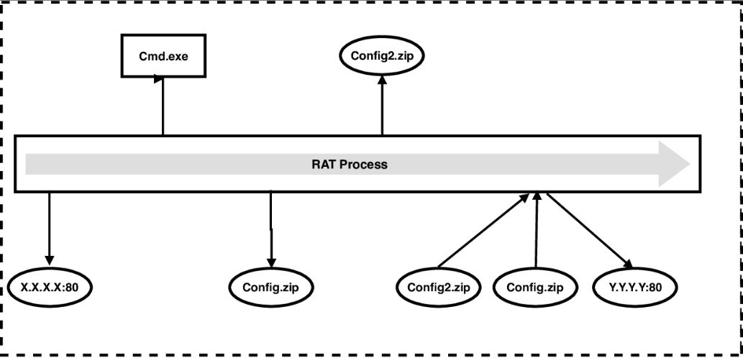
Traditional Forensic Analysis
Even if traditional forensic analysis is able to capture all artifacts left by the attack, administrators still cannot understand consequences of the attack.

Slide 6
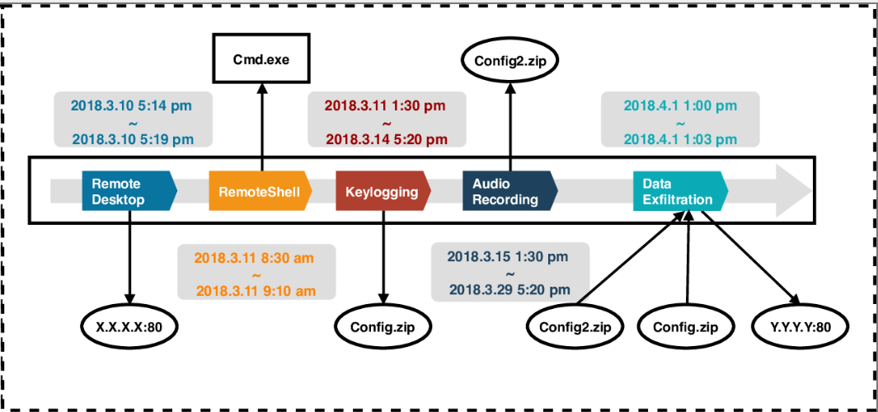
Our Method
With our semantic-aware forensic system, administrators can easily identify fine-grained semantic behaviors and understand consequences of the attack.

Slide 7
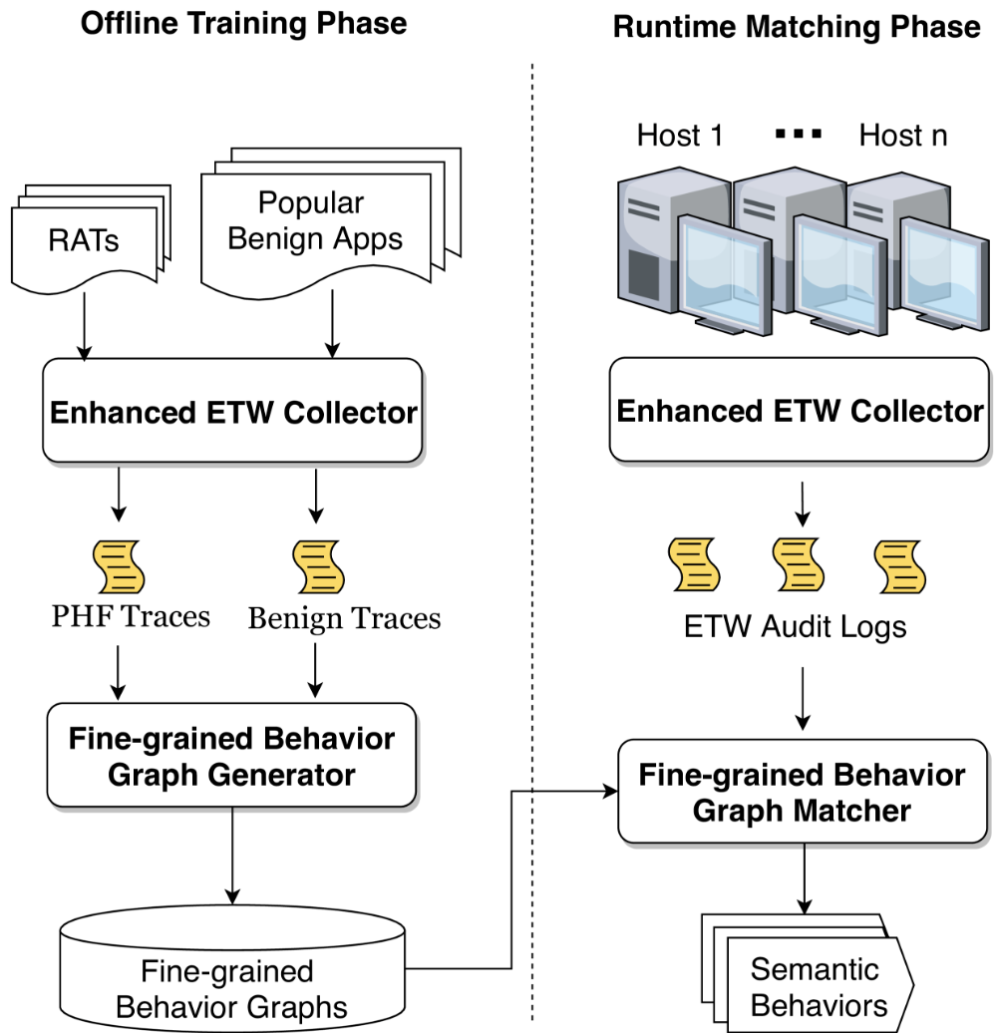
System Overview

Slide 8
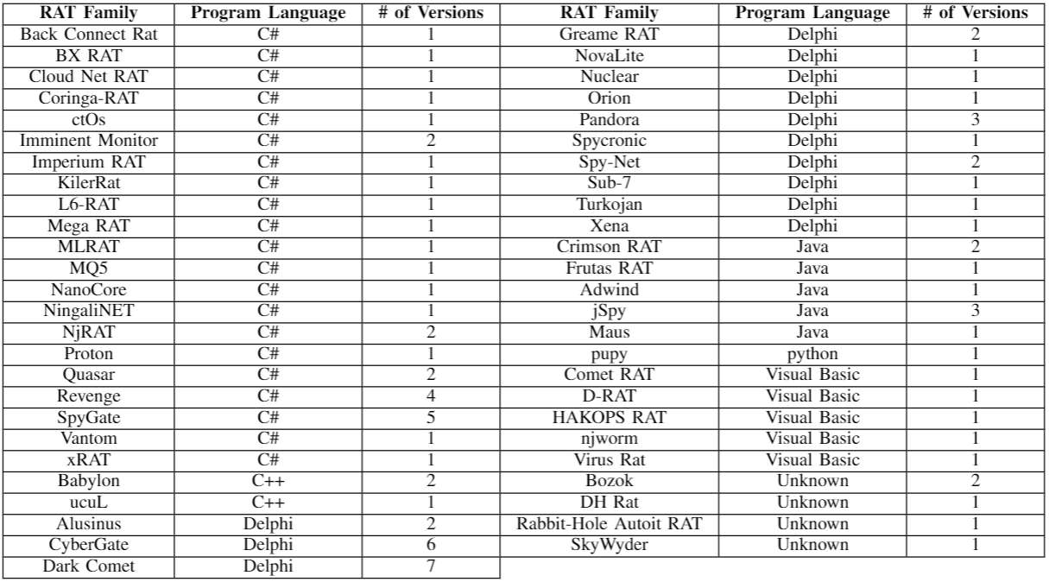
RAT Data Set

Slide 9
Fine-grained Behavior Graph Generator
Thousands of APIs
Initialization
Initialization
Core of Remote Desktop
Keylogging
GetDC
GetDeviceCaps
GetDeviceCaps
CreateCompatibleDC
CreateCompatibleBitmap
SelectBitmap
StretchBlt
NtUserGetDC
GetDeviceCaps
GetDeviceCaps
CreateCompatibleDC
CreateCompatibleBitmap
SelectBitmap
StretchBlt
Remote
Desktop
Tens of Loop …
Tens of Loop …
Audio
Recording
NtUserGetDC
GetDeviceCaps
GetDeviceCaps
CreateCompatibleDC
CreateCompatibleBitmap
SelectBitmap
StretchBlt
NtUserGetDC
GetDeviceCaps
GetDeviceCaps
CreateCompatibleDC
CreateCompatibleBitmap
SelectBitmap
StretchBlt
Remote
Shell
Send data to Server
Send data to Server

Slide 10
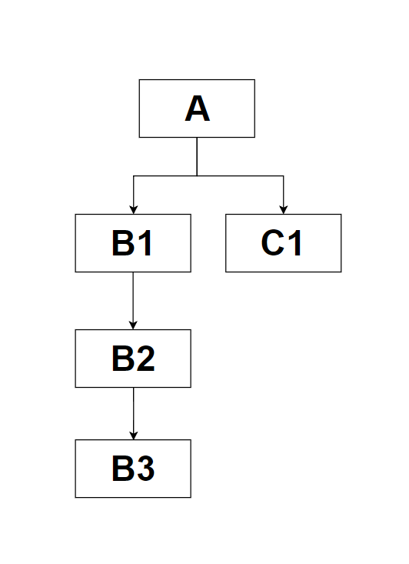
Loop Reduction Algorithm
A(){
While(){
B1()
C1()
}
}
B1(){
B2()
}
B2(){
B3()
}
A -> B1 -> B2 -> B3
A -> C1
Callstack
Tree
Observations:
If two APIs have the same callstack, these two APIs must have the same API name, and be invoked in the same line of code.
A sequence of API can be divided into three parts: Prologue, Loops, Epilogue

Slide 11
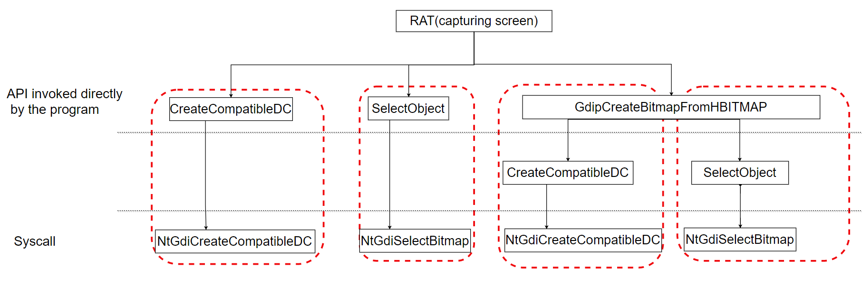
Loop Reduction Algorithm
From the perspective of syscall level, the sequence contains one loop.
Consider syscall with callstack, we can easily determine the sequence doesn’t contains loops.

Slide 12
Loop Reduction Algorithm
One Loop Example
XYZABCABCABCDEFG
Begin = XYZ
Loops = set(ABC, ABC, ABC) = set(ABC)
End = EFG
All possible sequence = Prologue + one of Loops + Epilogue
XYZ
ABC
EFG

Slide 13
Loop Reduction Algorithm
Nested Loop Example
XYZ ABCMNMN ABCMNMN EFG
Begin = XYZ
Loops = set(ABCMNMN, ABCMNMN) = set(ABCMNMN)
End = EFG
XYZ
EFG
ABCMNMN
Begin = ABC
Loops = set(MN,MN) = set(MN)
End = empty()
All possible sequence = Prologue + one of Loops + Epilogue
Recursively invoke
Loop Reduction Algorithm
for each loop
ABC
MN

Slide 14
Loop Reduction Algorithm
One Loop Example
XYZABCABCABCDEFG
Begin = XYZ
Loops = set(ABC, ABC, ABC) = set(ABC)
End = EFG
All possible sequence = Prologue + one of Loops + Epilogue
XYZ ABC EFG
XYZ
ABC
EFG

Slide 15
Loop Reduction Algorithm
Nested Loop Example
XYZ ABCMNMN ABCMNMN EFG
Begin = XYZ
Loops = set(ABCMNMN, ABCMNMN) = set(ABCMNMN)
End = EFG
ABCMNMN
Begin = ABC
Loops = set(MN,MN) = set(MN)
End = empty()
Recursively invoke
Loop Reduction Algorithm
for each loop
All possible sequence = Prologue + one of Loops + Epilogue
XYZ ABCMN EFG

Slide 16
Fine-grained Behavior Graph Matcher
Problem：Matching a labeled graph against a labeled sequence, our task is to find a partial occurrence of graph in the sequence that 1) satisfies the topological dependency constraint while 2) maximize a target function.
Step1: Convert a direct acyclic graph(DAG) into a Graph State Transition Graph.
Step2: Based on Graph State Transition Graph, the problem can be solved by Dynamic Programming algorithm.

Slide 17
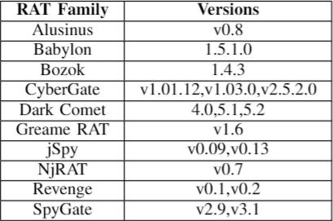
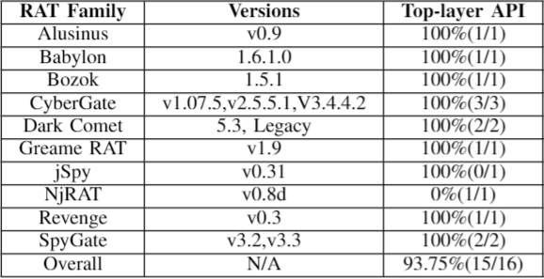
Evaluation —— True Positive
Training Set of Keylogging
Testing Set of Keylogging and TPR
TPR of other PHFs

Slide 18
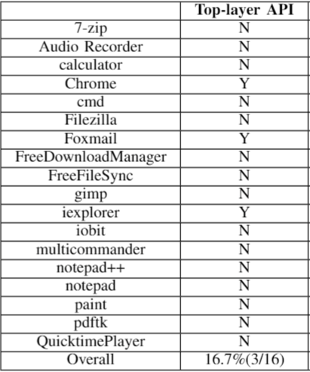
Evaluation —— False Positive
We collect traces of popular benign applications, and match behavior graphs of all PHFs against these traces.

Slide 19
Evaluation —— Runtime Overhead
CPU-bound workload. The command line option of 7-zip supports a simple benchmark, which mostly perform CPU-bound computation.
IO-bound workload. In this situation, we use 7-zip to archive 3 folders including 73 files without compression. The total size of all files are 14.7 gigabyte. This is purely IO-bound workload.
Mixed workload. In this situation, the same 14.7 gigabyte files are compressed using 7-zip. Compression and writing to disk reflect a more mixed case in which an application is performing CPU-bound computation and IO-bound tasks.
 | Baseline | Top-layer API
CPU-bound workload | 59s | 59s(0%)
IO-bound workload | 250s | 255s(2%)
Mixed workload | 165s | 168(1.8%)

Slide 20
Evaluation —— Space Overhead
To test the space overhead of out collector, we deploy our collector in two individuals' computer for several days.
One is an officer who frequently uses text editing applications (Word, Excel, PowerPoint), communication tools (Outlook and Skype) and Browsers (Chrome and Firefox).
The other is a software developer who often uses IDE (Visual Studio), Browsers (Chrome and Firefox) and command line tools (CMD and PowerShell).
 | Top-layer API
Original Data Size | 14 GB / hour
Disk size after compression | 2 MB / hour
Event Numbers | 30 Million / hour

