Slide 1
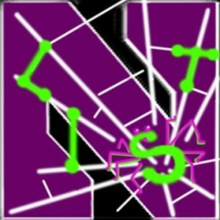
PrivacyShield: Real-time Monitoring and Detection of Android Privacy Leakage For Potential Collaboration
Yan Chen
Lab of Internet and Security Technology
Northwestern University
President, NetShield LLC

Slide 2
Self Introduction (陈焰)
2003年获加州大学伯克利分校计算机科学博士学位，现为美国西北大学电子工程与计算机科学系终生副教授, 互联网安全技术实验室主任.
2011 年入选浙江省海鸥计划加盟浙大, 特聘教授。负责浙江大学计算机学院的信息安全方向建设.
主要研究方向为网络及系统安全。
2005年获得美国能源部青年成就奖（Early CAREER Award)
2007年获得美国国防部青年学者奖（Young Investigator Award)
2004和2005年分别获得Microsoft可信计算奖（Trustworthy Computing Awards）。
研究项目获美国自然科学基金委多次资助， 并与Motorola, NEC, 华为等多家公司有项目合作并获资助。
中国互联网企业安全工作组学术委员会成员

Slide 3
Origin of PrivacyShield (1)
Multi-year investigation of security and privacy in Android smartphones
Security
Systematic evaluation of state-of-the-art Android anti-malware against transformation attacks
Apps evaluated included AVG, Symantec, Lookout, ESET, Dr. Web, Kaspersky, Trend Micro, ESTSoft (ALYac), Zoner, Webroot, and many others
Results: Found that all the studied tools found vulnerable to common transformations

Slide 4
Origin of PrivacyShield (2)
Privacy
Systematic evaluation of leakage of private data from Android apps
Studied 3,968 apps from Android Market (Google Play)
Results: Found that 25% of Google Play apps leak data
946 leak some info
844 leak phone identifiers
212 leak geographic location
Leaks to a number of ad and analytics domains
No solutions that are truly effective

Slide 5
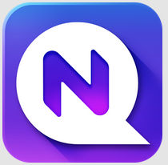
Recognition
Interest from vendors
5

Slide 6
Overview of Our Solutions
AppsPlayground (ACM CODASPY’13)
Automatic, large-scale dynamic analysis of Android apps
DroidChamelon (ACM ASIACCS’13)
Evaluation of latest Android anti-malware tools
→PrivacyShield
Solves the problem of private data leakage
Does not modify the Android platform
Alpha version release in progress

Slide 7
The Privacy Problem
Apps regularly leak private info for ad targeting and tracking
Users can (sometimes) control access to secure information, but can’t control leakage
Example 1: an app might access location to provide a legitimate service to the user, but then secretly share this information with advertisers and analytics services
True for even very popular apps
An example: Booking.com (> 5M downloads)
Example 2: malware apps may steal private data
TapSnake malware: A GPS spy in the garb of a game
Existing privacy apps only control permissions, not the flow of private data

Slide 8
PrivacyShield Solution
Principles
Give the user visibility and control over private data flow
Real-time monitoring
Download
Instrument
Reinstall
Run
Alert User
Unmodified Android Middleware
And Libraries

Slide 9
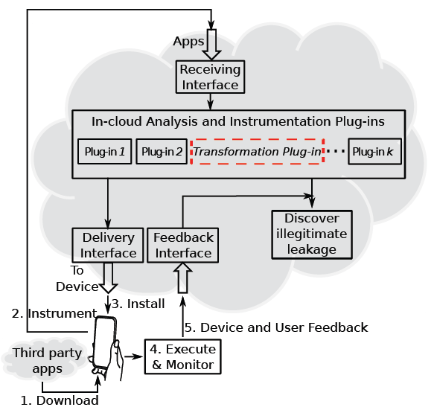
Deployment Model
By vendor or 3rd party service

Slide 10
Competitive Landscape
Segment | Approach | Example vendors
Security | Anti-virus; Privacy settings audit | AVG, BitDefender, think Android, MyPermissions, Xeudoxus, Pdroid, Trend, Lamian, PlaceMask, and others
Personal Privacy | Privacy settings audit; File “Locking” | AVG, NQMobile, Armor, Avast, Lookout, Mapwarebytes, McAfee, Trend Micro, Kaspersky, MyMobile, TrustGo, and others
Enterprise Mobile Device Management | Anti-virus; Separate user and enterprise data; Containerize apps | Samsung, Blackberry, Airwatch, Citrix, MobileIron, Symantec, McAfee, Divide, Touchdown, Kaspersky, and others
We believe PrivacyShield offers a distinct and more complete solution to data leakage
None of them except PrivacyShield can protect against the aforementioned leakage

Slide 11
Interested in Collaboration?
What do you think of this idea?
What is the demand for the solution from individuals, enterprises?
How is the solution different or similar to what's already out there?
Potential collaboration methods with NQ Mobile?
Strengthen NQ Mobile product portfolio when bundling together
Partnership: advertise each other
And more ?
Any ideas on marketing approach to reach individuals, enterprises?

