Slide 1
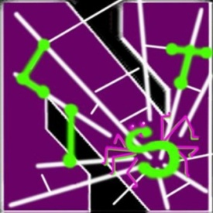
Toward a Trustworthy Android Ecosystem
Yan Chen (陈焰）
Lab of Internet and Security Technology (LIST)
Northwestern University, USA
Zhejiang University, China

Slide 2
Self Introduction
2003年获加州大学伯克利分校计算机科学博士学位，现为美国西北大学电子工程与计算机科学系终生教授, 互联网安全技术实验室主任.
2011 年入选浙江省海鸥计划加盟浙大, 特聘教授。负责浙江大学计算机学院的信息安全方向建设.
2015 年入选国家创新千人.
主要研究方向为网络及系统安全。
2005年获得美国能源部青年成就奖（Early CAREER Award)
2007年获得美国国防部青年学者奖（Young Investigator Award)
2004和2005年分别获得Microsoft可信计算奖（Trustworthy Computing Awards）。

Slide 3
Self Introduction (cont’d)
Google Scholar显示，论文总引用超过7000次，H-index指数为37.
有2项美国专利，另有6项美国专利和2项中国专利已申请
曾获SIGCOMM 2010最佳论文候选，应邀直接在ACM/IEEE ToN上出版.
在ACM/IEEE Transaction on Networking (ToN) 等顶级期刊和SIGCOMM、IEEE Symposium on Security and Privacy（Oakland）等顶级会议上发表了 100余篇论文

Slide 4
Self Introduction (cont’d)
担任 IEEE IWQoS2007、SecureComm 2009和IEEE International Conference on Communication and Networking Security (CNS)等国际会议的技术程序委员会主席
担任ACM CCS 2011的总主席及 World Wide Web (WWW) 2012的技术程序委员会副主席(分管计算机安全和隐私领域)
多次受邀在美国自然科学基金委信息科学与工程处担任评委, 并多次受邀担任美国能源部(DOE)和美国空军科研部 SBIR及STTR计划的评委
研究项目获美国自然科学基金委多次资助， 并与Motorola, NEC, 华为等多家公司有项目合作并获资助。
中国互联网企业安全工作组学术委员会成员, XCTF学术指导委员会成员。

Slide 5
Major Research Areas
Smart Phone and Embedded System Security （智能终端安全）
Web Security and Online Social Networks Security (Web 及在线社交网络安全）
Software Defined Networking and Next Generation Internet Security (软件定义网络和下一代互联网技术安全)
Advanced Persistent Threat (APT) Detection and Forensics System
  (高级持续性攻击的检测及取证系统）

Slide 6
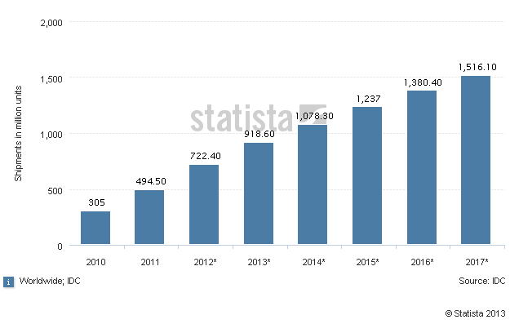
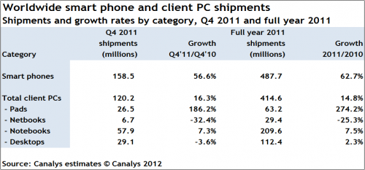
Smartphone Security
Ubiquity - Smartphones and mobile devices
  Smartphone sales already exceed PC sales
  The growth will continue
Performance better than PCs of last decade
  Samsung Galaxy S4 1.6 GHz quad core, 2 G memory

Slide 7
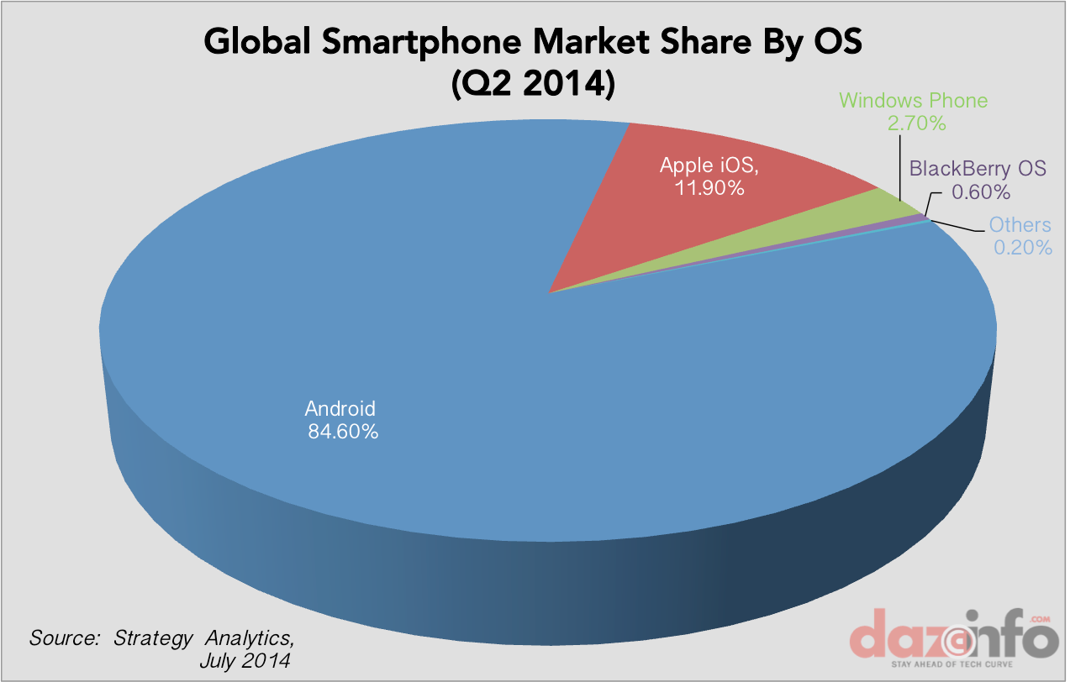
Android OS Popularity
Mobile OS Market Share, July 2014, by dazeinfo.com

Slide 8
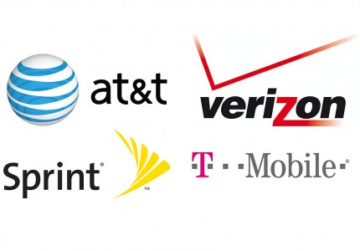






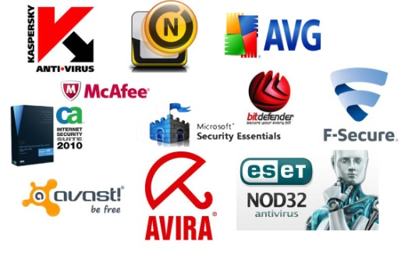

Android Ecosystem
Carriers
Vendors
Application
Stores
Applications
Devices and OS
Developers
Security Vendors
Users

Slide 9

Android Threats
Malware
  The number is increasing consistently
  Anti-malware ineffective at catching zero-day and polymorphic malware
Information Leakage
  Users often have no way to even know what info is being leaked out of their device
  Even legitimate apps leak private info though the user may not be aware
flickr.com/photos/panda_security_france/

Slide 10
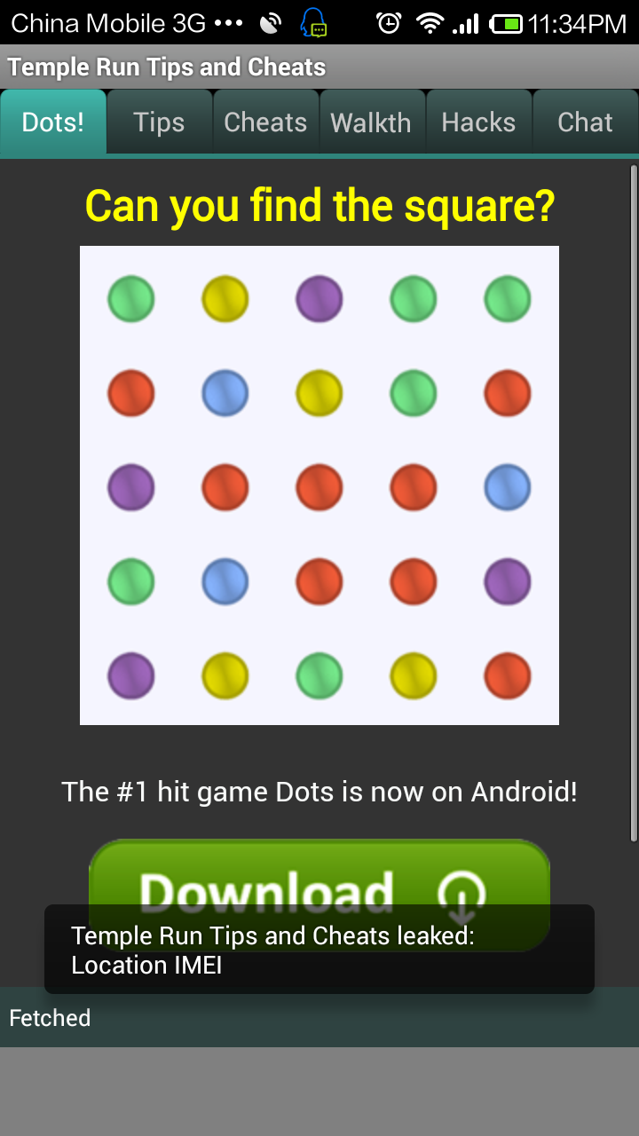
Privacy Leakage
Android permissions are insufficient
  User still does not know if some private information will be leaked
Information leakage is more dangerous than information access
  Example 1: popular apps (e.g., Angry Birds) leak location info with its developer, advertisers and analytics services
    Even doesn’t need it for its functionality!
  Example 2: malware apps may steal private data
    A camera app trojan send video recordings out of the phone

Slide 11
New Challenges & Opportunities
New operating systems
  Different design → Different threats
Different architectures and languages
  ARM (Advanced RISC Machines) vs x86
  Dalvik vs Java (on Android)
Centralized application stores
Constrained environment
  CPU, memory, battery
  User perception

Slide 12
Our Solutions
Malware detection
  Offline [AppPlayground]
  Real time, on phone [DroidChamelon, DroidNative]
    With obfuscated and native malware
  Detection of malware in ad libraries
Privacy leakage detection and prevention
  Offline [AppPlayground]
  Real time, on phone
    Consumer [PrivacyShield]
    Enterprise Mobility Management (EMM) [AppShield]
Automatic vulnerability discovery [SSLint]
Improving usability of security mechanisms [AutoCog]

Slide 13
Systems Developed
AppsPlayground [ACM CODASPY’13]
  Automatic, large-scale dynamic analysis of Android apps
  System released with hundreds of download
DroidChamelon [ACM ASIACCS’13, IEEE Transaction on Information Forensics and Security 14]
  Evaluation of latest Android anti-malware tools
  All can be evaded with transformed malware
  System released upon wide interest from media and industry

Slide 14



















Recognition
Interest from vendors
14

Slide 15

Malvertising Detection
Are some mobile advertisements malicious?
How are those ads malicious?
Any relationships with particular ad networks, app types, geographic regions

Slide 16
Systems Developed II
PrivacyShield
  Real-time information-flow tracking for privacy leakage detection
  With zero platform modification
  App released in Google play and Baidu stores
AppShield: a fine grain EMM system
SSLint [IEEE S&P ‘15]
  Automatic API misuse vulnerability discovery
AutoCog [ACM CCS ’14]
  Check whether sensitive permissions requested by apps are consistent with its natural-language description
  App released at Google play store

Slide 17
Vetting SSL Usage in Applications
Design a systematic approach to automatically detect incorrect SSL API usage vulnerabilities.
Implement SSLint, a scalable automated tool to verify SSL usage in applications.
Results (IEEE Symposium on Security and Privacy 2015)
  Automatically analyzed 22 million lines of code.
  27 previously unknown SSL/TLS vulnerable apps.
Applying it to discover other API misuse vulnerabilities

Slide 18
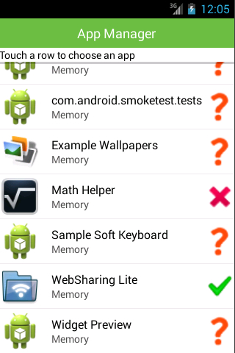
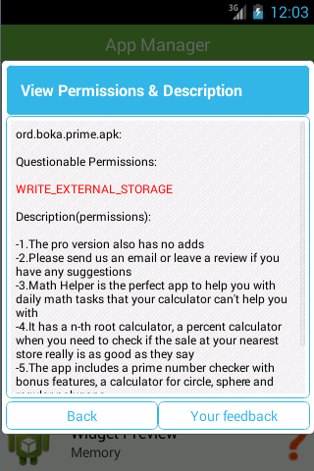
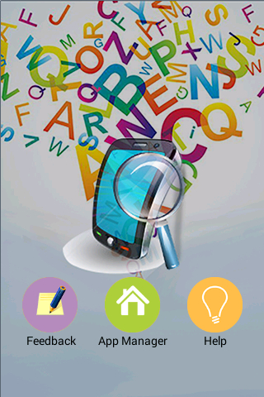
AutoCog Application
https://play.google.com/store/apps/details?id=com.version1.autocog

Slide 19
AppShield
Fine Grain Enterprise Mobility Management

Slide 20
Evolution of Mobile Solutions for Enterprise
  Mobile Device Management (MDM)
    Configuration of security policies at device-level
    Devices belong to enterprise
Mobile App Management (MAM)
  Target BYOD, apply policy controls to and provision mobile applications
  Both internally developed apps and apps that are commercially available in Google play stores
Enterprise Mobility Management (EMM)
  Consists MDM, MAM, and Mobile Content Management (MCM)
  MCM: container to securely access privileged data, app, Web.

Slide 21
Major EMM Methods
 | Developer support | OS version dependency | Device dependency | App dependency | Generality
Application rewriting | No | No | No | Partial | Full
Software development kit (SDK) | Yes | Partial | No | No | Limited
Operating System modification | No | Yes | Yes | No | Full
Generality: any application on mobile marketplaces → hardened business version
Notes:
Application rewriting
Mocana
Work on all devices, NOT on all applications
SDK
Good
Work on all applications, NOT on all versions of OS
Extra developer support
OS Modification
Bring Android to work on Android Lollipop
Dependencies on OS versions or customization
Limitation of portability

Slide 22
Comparison with Existing Systems
 | AirWatch | MOCANA | GOOD | Citrix | Android L | AppShield *
Implementation method | SDK & App rewriting | App rewriting | SDK | SDK | OS modification | App rewriting
Data location | Internal Storage | Internal Storage | Internal Storage | Internal Storage | External Storage | Internal Storage
Isolation | Sandbox | Sandbox | Sandbox | Sandbox & Encryption | DAC | Sandbox
Data sharing among business apps | Online access required | Online access required | Online access required | Local shared | Local shared | Local shared
Access control and granularity | Static | Static | Coarse Dynamic | Static | Coarse Dynamic | File-level Dynamic

Slide 23
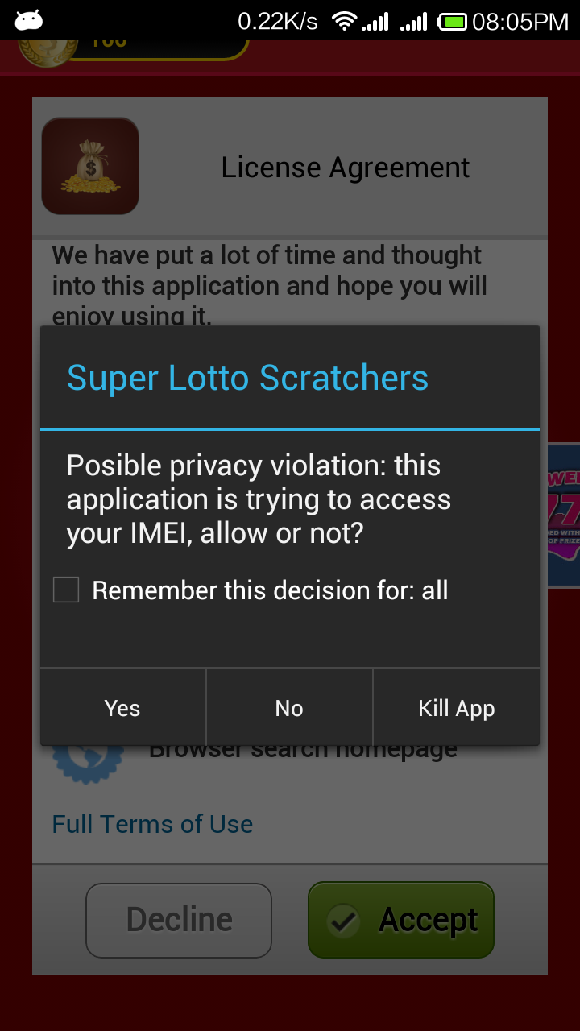
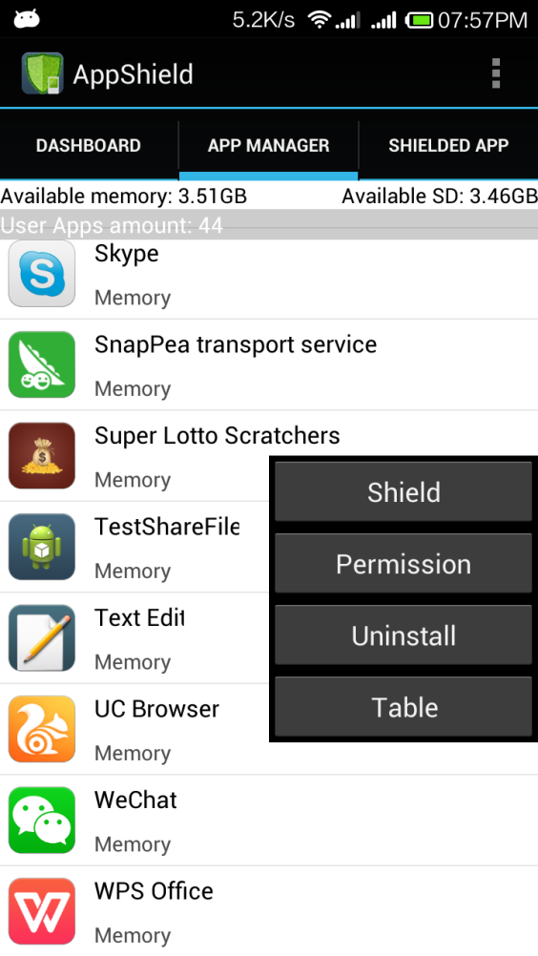
AppShield UI

Slide 24
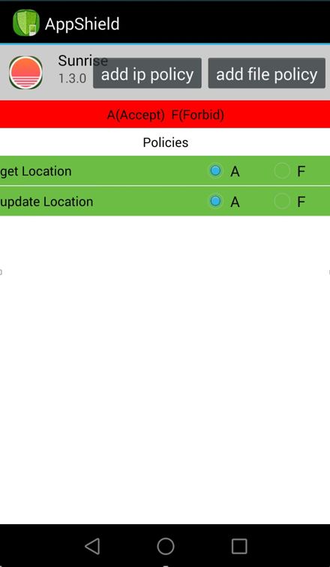
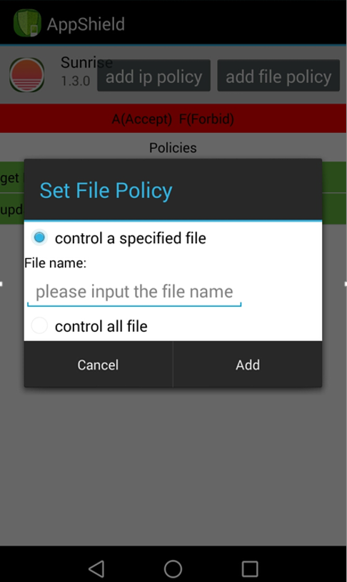
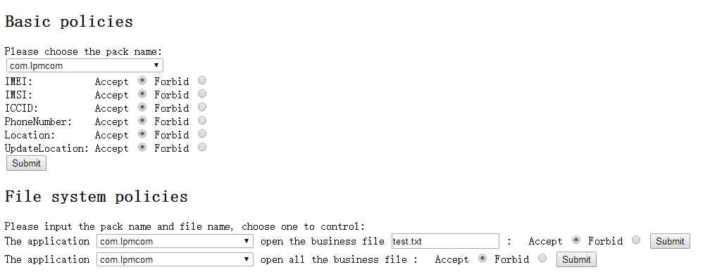
MCM Security Policy
Decision on behavior: Allow (A), Forbid (F), Popup (P)
Could change both locally and remotely in runtime
Current Policy on
  Privacy leakage
  Network access (Access IP addresses)
  Business data sharing/isolation

Slide 25
Mobile Security Research @ LIST
Malware detection
  Offline [AppPlayground]
  Real time, on phone [DroidChamelon, DroidNative]
    With obfuscated and native malware
  Detection of malware in ad libraries
Privacy leakage detection and prevention
  Offline [AppPlayground]
  Real time, on phone
    Consumer [PrivacyShield]
    Enterprise Mobility Management (EMM) [AppShield]
Automatic vulnerability discovery [SSLint]
Improving usability of security mechanisms [AutoCog]
http://list.cs.northwestern.edu/mobile/

Slide 26
Major Research Areas
Smart Phone Security and Privacy
  Malware detection
  Privacy leakage prevention
  Enterprise Mobility Management
Automatic Vulnerability Discovery
Web Security and Privacy
Software Defined Networking (SDN) Security
Advance Persistent Threat (APT) Detection and Forensics System

Slide 27
Studying Mobile Malvertising
Are some mobile advertisements malicious?
How are those ads malicious?
  Phishing
  Other social engineering
Any relationships with particular ad networks, app types, geographic regions

Slide 28
Malvertising: Methodology
Automatically run mobile apps
  AppsPlayground for automatically driving app UI
  Virtualized analysis environment for large-scale, parallel, 24x7 execution
  Preferentially trigger ads
Capture any triggered ads
Capture the redirection chain for triggered URLs
Analyze each URL in the chain for maliciousness

Slide 29
Malvertising: Methodology
Analyze the landing page further
Load in a real browser emulating a mobile agent
Click each link, download anything that can be downloaded
Scan the downloaded files for maliciousness

Slide 30
Detection Oracles
VirusTotal URL blacklists
  Google Safebrowsing, Websense, …
VirusTotal antivirus engines
  Symantec, Dr. Web, Kaspersky, Eset, …

Slide 31
Malvertising: Results
Results from running nearly 200,000 apps
Nearly 200,000 URLs scanned
170 malicious URLs
270 files downloaded
150 files are malware
~50% downloaded files are malicious
URL blacklists do not flag URLs that result in malicious downloads
Much more ad malware in Chinese market (ongoing analysis)

Slide 32
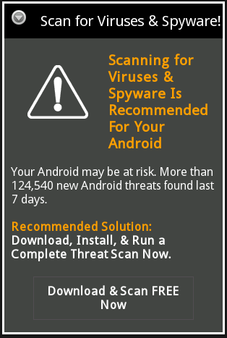
Case Study
Fake AV scam
Campaign found in multiple apps
Website design mimics Android dialog box
We detected this campaign 20 days before the site was flagged as phishing by Google and others

Slide 33
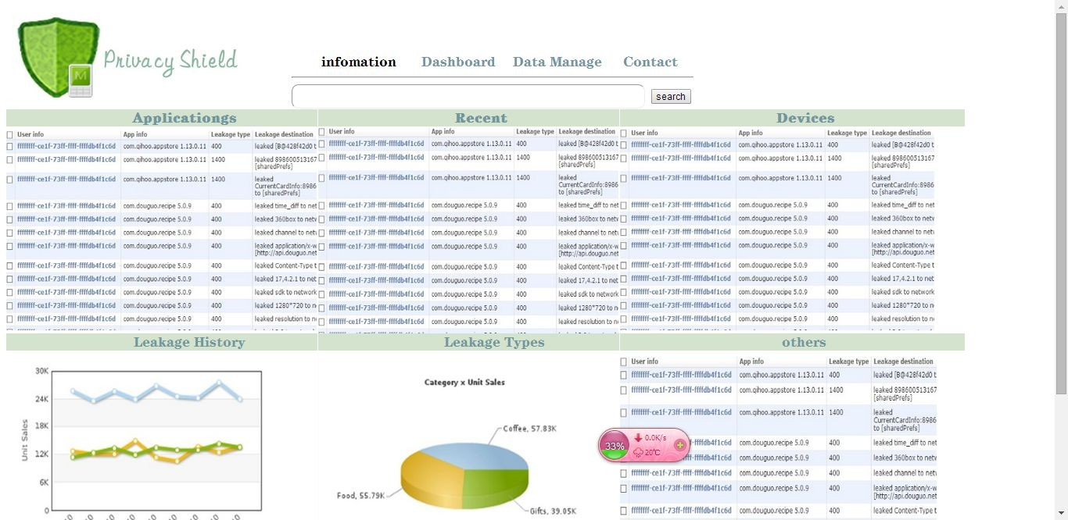
MAM Dashboard
How do apps handle data that they access
  Does it remain within the device or the enterprise?
  Is it leaked out to unknown third parties?
  Can an employee upload confidential data to a remote server
The IT administrator desires to view (and potentially block) such leakage in real time
  The IT administrator has limited control over devices now

Slide 34
Previous Solutions
Static analysis
Does not identify the conditions for the leak
TaintDroid
Requires a custom Android ROM
Unlocked device; end-user skills
Legitimate Conditions, false positives?

Slide 35
Approach: Inlined Taint-tracking
Add taint-tracking code to the app itself
Shadow locals and fields
  v has shadow variable v_{t}
  If v is derived from a private source, v_{t} is non-zero
Propagating taint across method calls
  Add additional parameters
  Return taint can be wrapped in an object passed as parameter
If tainted variable reaches a sink, alert

Slide 36
Our Approach
Give control to the user/BYOD IT administrator
Instead of modifying system, modify the suspicious app to track privacy-sensitive flows
Advantages
  No system modification
  No overhead for the rest of the system
  High configurability – easily turn off monitoring for an app or a trusted library in an app

Slide 37
Comparison
 | Static Analysis | TaintDroid | Uranine
Accuracy | Low (possibly High FP) | Good | Good
Overhead | None | Low | Acceptable
System modification | No | Yes | No
Configurability | NA | Very Low | High
Portable | NA | No | Yes

Slide 38
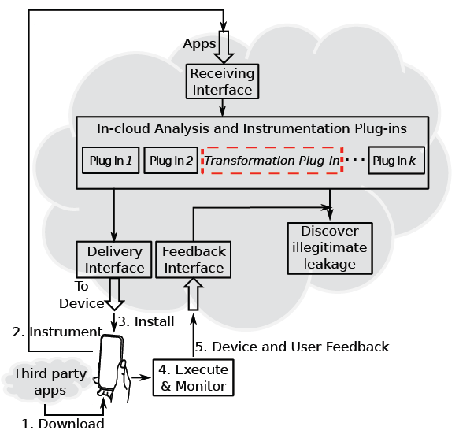
Deployment A: PrivacyShield App
By vendor or 3rd party service

Slide 39
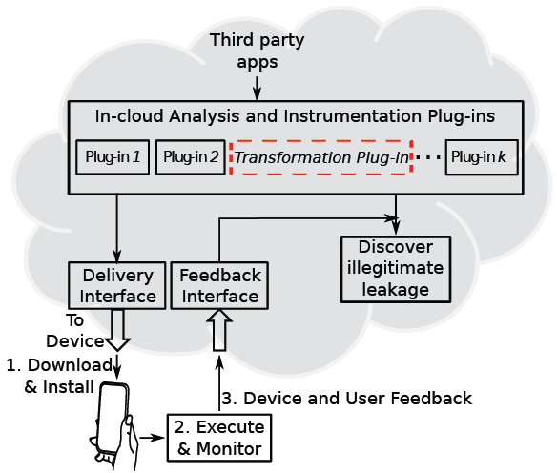
Deployment B
By Market

Slide 40
Overall Scenario
Download
Instrument
Reinstall
Run
Alert User
Unmodified Android Middleware
And Libraries

Slide 41
Challenges and Solutions
Framework code cannot be modified
  Proposed policy-based summarization of framework API
Accounting for the effects of callbacks
  Functions in app code invoked by framework code
  Proposed over-tainting techniques that guarantee zero FN
Accommodating reference semantics
  Need to taint objects rather than variables
  Proposed a hashtable with weak references to prevent interfering with garbage collection
Performance overhead
  Proposed path pruning with static analysis

Slide 42
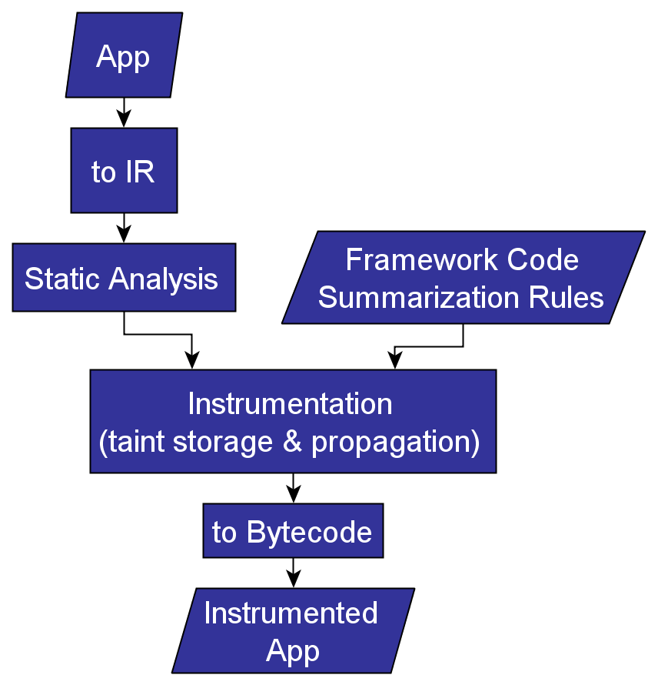
Instrumentation Workflow

Slide 43
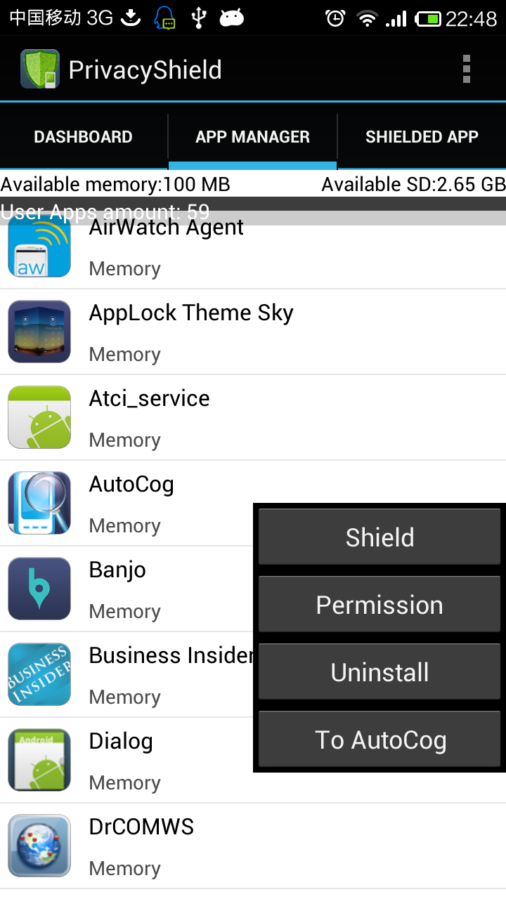
Implementation and Evaluation
Studied over 1000 apps
Results in general align with TaintDroid
Performance
  Runtime median overhead is 17%, ¾ are within 61%
  17% of apps have zero instructions instrumented. The maximum instrumentation fraction is 26%
PrivacyShield app to be released soon

Slide 44
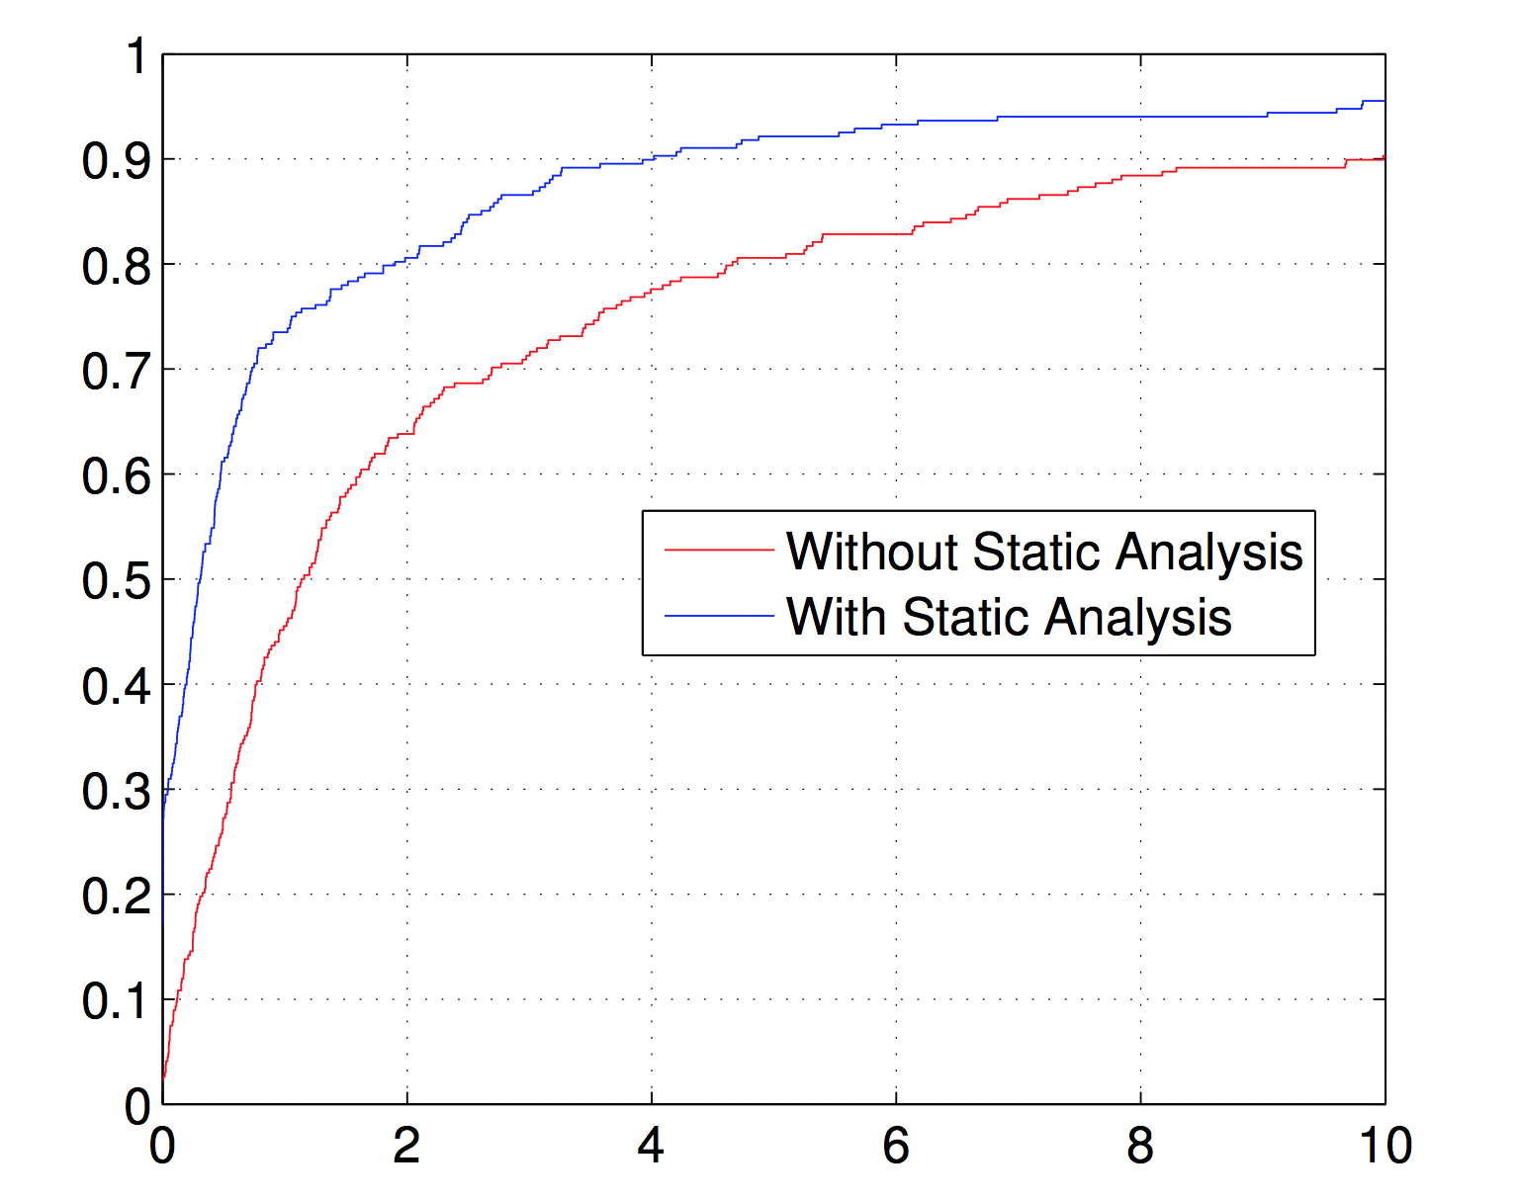
Performance Overhead

Slide 45
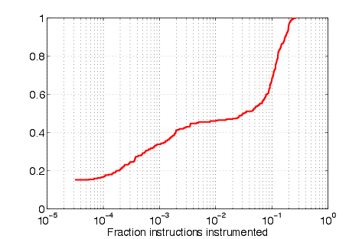
Instructions instrumented

Slide 46
Limitations
Native code not handled
Method calls by reflection may sometimes result in unsound behavior
App may refuse to run if their code is modified
  Currently, only one out of top one hundred Google Play apps did that

Slide 47
PrivacyShield Summary
A real time app monitoring system on Android without firmware modification
  Privacy leakage detection (for both personal and BYOD)
  Patching vulnerabilities
  Block popping up ads
  …
  and many others!

Slide 48
AutoCog
Measuring Description-to-permission Fidelity in Android Applications

Slide 49
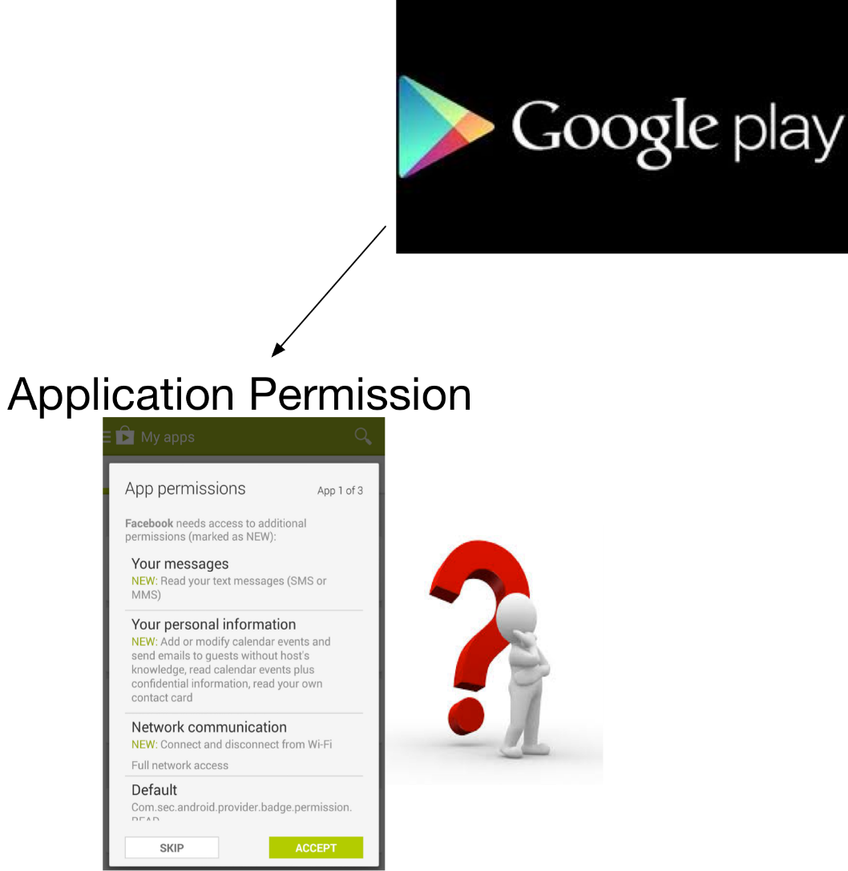
Motivation

Slide 50
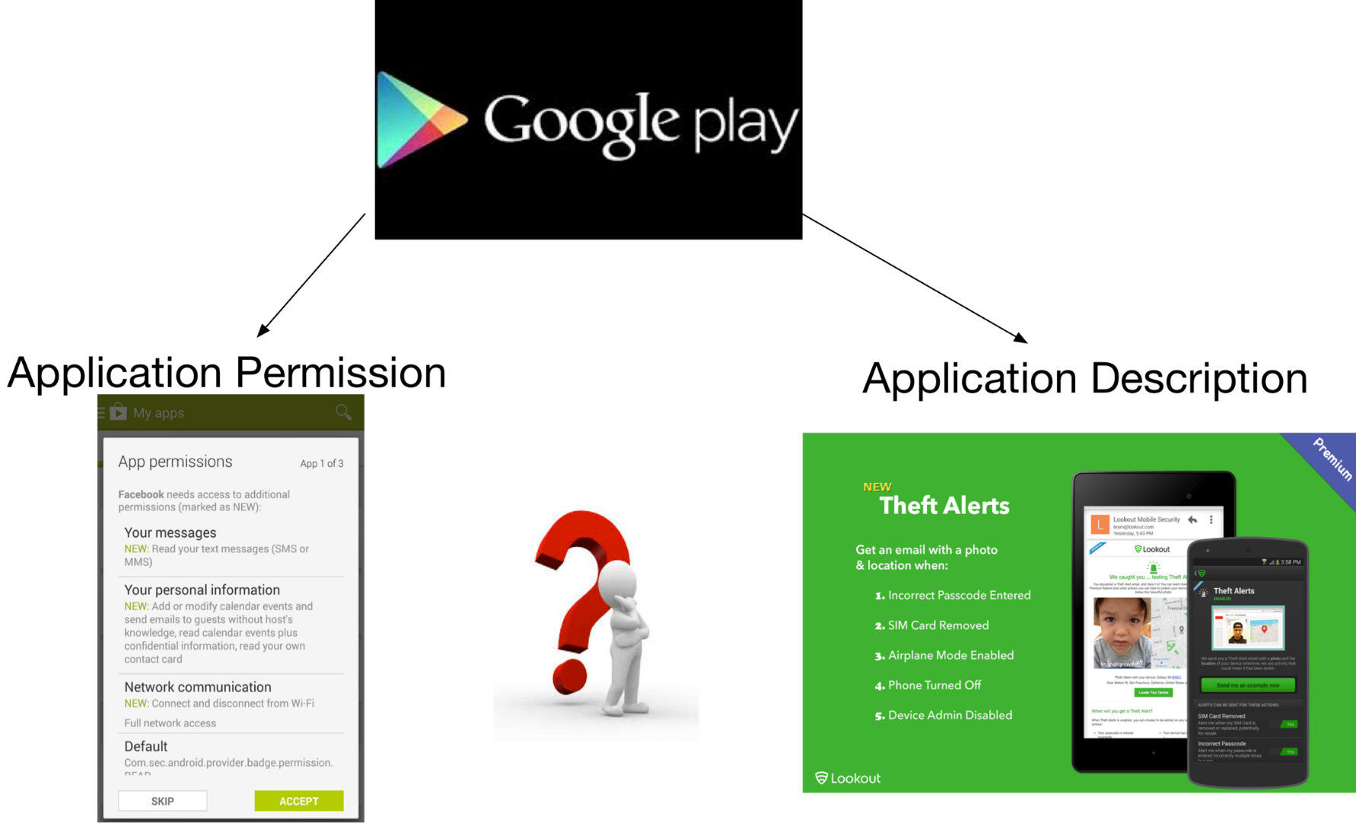
Motivation

Slide 51
Usages
  End user: understand if an application is over-privileged and risky to use
  Developer: receive an early feedback on the quality of description
    Especially on security-related aspects of the applications
  Market: Help choose more secure applications

Slide 52
Challenges
Inferring description semantics
  Similar meaning may be conveyed in a vast diversity of natural language text
  “friends”, “contact list”, “address book”
Correlating description semantics with permission semantics
  A number of functionalities described may map to the same permission
  “enable navigation”, “display map”, “find restaurant nearby”
Notes:
In the domain of smartphone contact book.

Slide 53
Contributions
Inferring description semantics
Correlating description semantics with permission semantics
  1. Leverage state-of-the-art NLP techniques
  2. Design a learning-based algorithm
Notes:
In the domain of smartphone contact book.

Slide 54
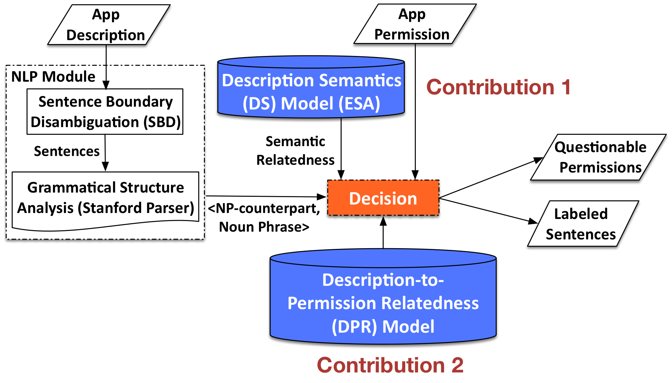
System Overview

Slide 55
DPR Model
Trained based on a large dataset of application descriptions and permissions
Noun-phrase based governor-dependent pairs with high correlation in statistics with each permission
  CAMERA: (scanner, barcode), (snap, photo);
Ontologies (based on output of Stanford Parser [2]):
  Logic dependency between verb phrase and noun phrase
  Logic dependency between noun phrases
  Noun phrase with own relationship
    (record, voice), (note, voice), (your voice) → RECORD_AUDIO
[2] R. Socher, J. Bauer, C. D. Manning, and A. Y. Ng. Parsing with compositional 11 vector grammars. In Proceedings of the ACL, 2013.

Slide 56
Samples in DPR Model
Permission | Semantic Patterns
WRITE_EXTERNAL_STORAGE | <delete, audio file>, <convert, file format>
ACCESS_FINE_LOCATION | <display, map>, <find, branch atm>, <your location>
ACCESS_COARSE_LOCATION | <set, gps navigation>, <remember, location>
GET_ACCOUNTS | <manage, account>, <integrate, facebook>
RECEIVE_BOOT_COMPLETED | <change, hd paper>, <display, notification>
CAMERA | <deposit, check>, <scanner, barcode>, <snap, photo>
READ_CONTACTS | <block, text message>, <beat, facebook friend>
RECORD_AUDIO | <send, voice message>, <note, voice>
WRITE_SETTINGS | <set, ringtone>, <enable, flight mode>
WRITE_CONTACTS | <wipe, contact list>, <secure, text message>
READ_CALENDAR | <optimize, time>, <synchronize, calendar>

Slide 57
Evaluation
Assess how AutoCog align with human readers by inferring permission from description
  Use AutoCog to infer 11 highly sensitive and most popular permissions from 1,785 applications
  Three professional human readers label the description as “good” if at least two of them could infer the target permission from the description

Slide 58
Evaluation (cont’d)
  Metrics:
Results:
  Confirm limitations of Whyper: limited semantic information, lack of associated APIs, and lack of automation
 | Precision | Recall | F-score | Accuracy
AutoCog | 92.6% | 92.0% | 92.3% | 93.2%
Whyper [3] | 85.5% | 66.5% | 74.8% | 79.9%

Slide 59
Accuracy
System | Precision (%) | Recall (%) | F-score (%) | Accuracy (%)
AutoCog | 92.6 | 92.0 | 92.3 | 93.2
Whyper | 85.5 | 66.5 | 74.8 | 79.9
Notes:
We run AutoCog and Whyper in parallel and evaluate how well they are aligning with human reader’s groundtruth.
Precision higher than whyper by 7 percentage.
Recall higher than whyper over 20 percentage.

Slide 60
Measurement
49,183 applications from Google Play
  Only 9.1% of the applications having permissions that can all be inferred from description

Slide 61
Deployment: AutoCog Application
https://play.google.com/store/apps/details?id=com.version1.autocog

Slide 62
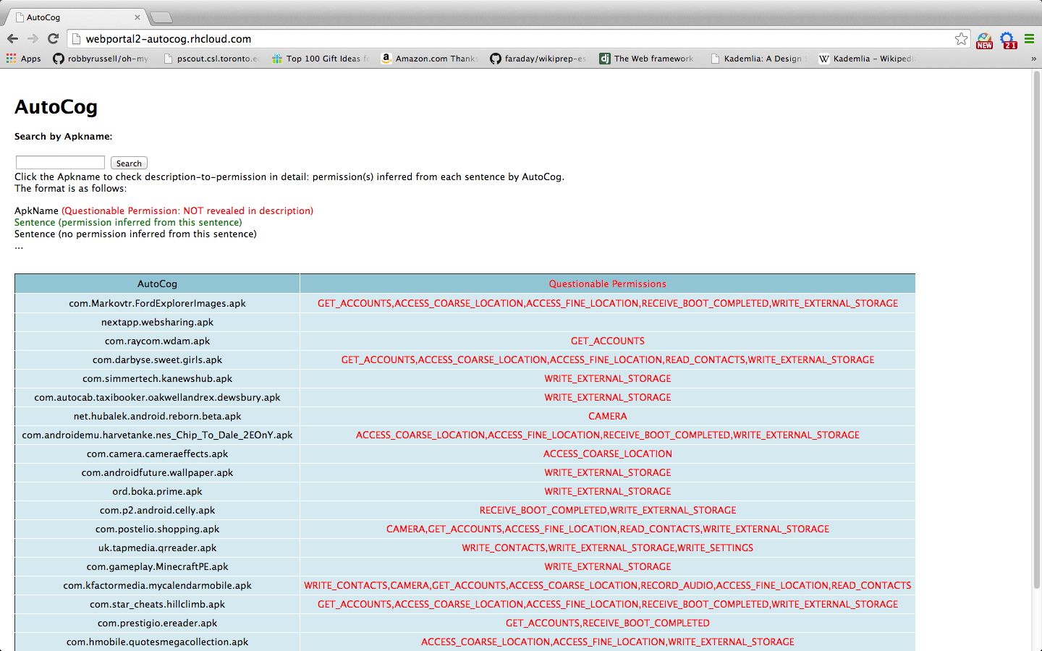
Deployment: Web Portal
http://webportal2-autocog.rhcloud.com/

Slide 63
AppsPlayground
Automatic Security Analysis of Android Applications

Slide 64
AppsPlayground
A system for offline dynamic analysis
  Includes multiple detection techniques for dynamic analysis
Challenges
  Techniques must be light-weight
  Automation requires good exploration techniques

Slide 65
Architecture
…
Event triggering
AppsPlayground
Virtualized Dynamic
Analysis Environment
Exploration Techniques
Intelligent input
Fuzzing
Kernel-level monitoring
Taint tracking
API monitoring
…
Detection Techniques
Disguise techniques

Slide 66
Architecture
…
Event triggering
AppsPlayground
Virtualized Dynamic
Analysis Environment
Exploration Techniques
Intelligent input
Fuzzing
Kernel-level monitoring
Taint tracking
API monitoring
…
Contributions
Detection Techniques
Disguise techniques

Slide 67
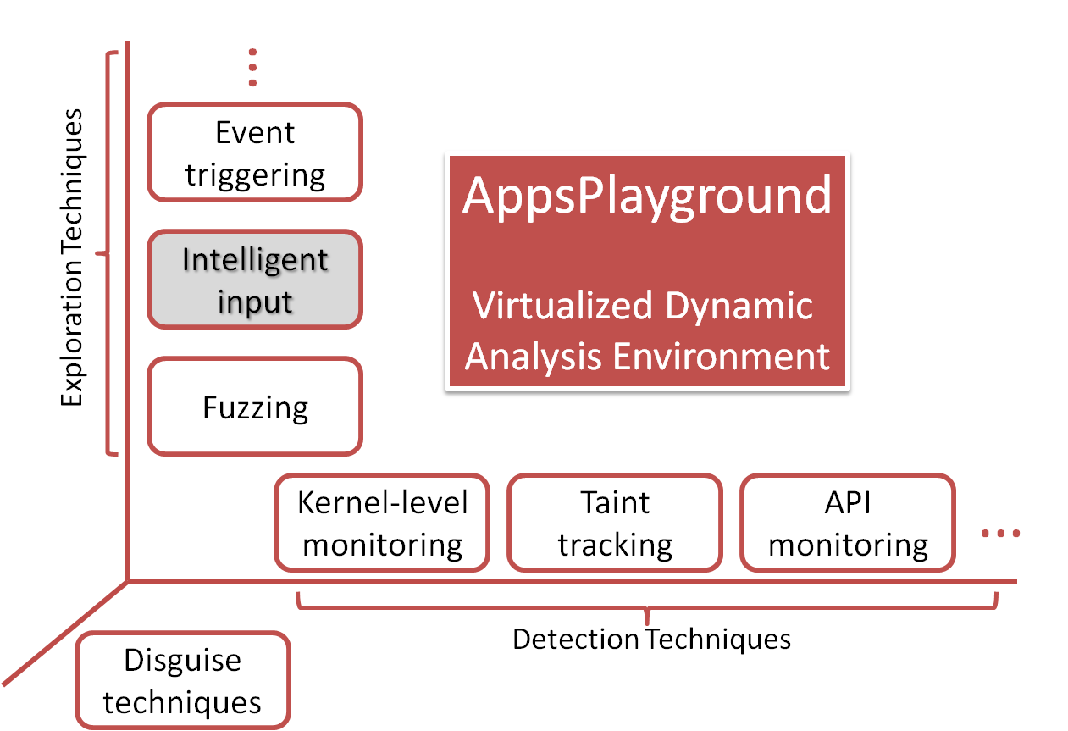
Intelligent Input
Fuzzing is good but has limitations
Another black-box GUI exploration technique
Capable of filling meaningful text by inferring surrounding context
  Automatically fill out zip codes, phone # and even login credentials
  Sometimes increases
  coverage greatly

Slide 68
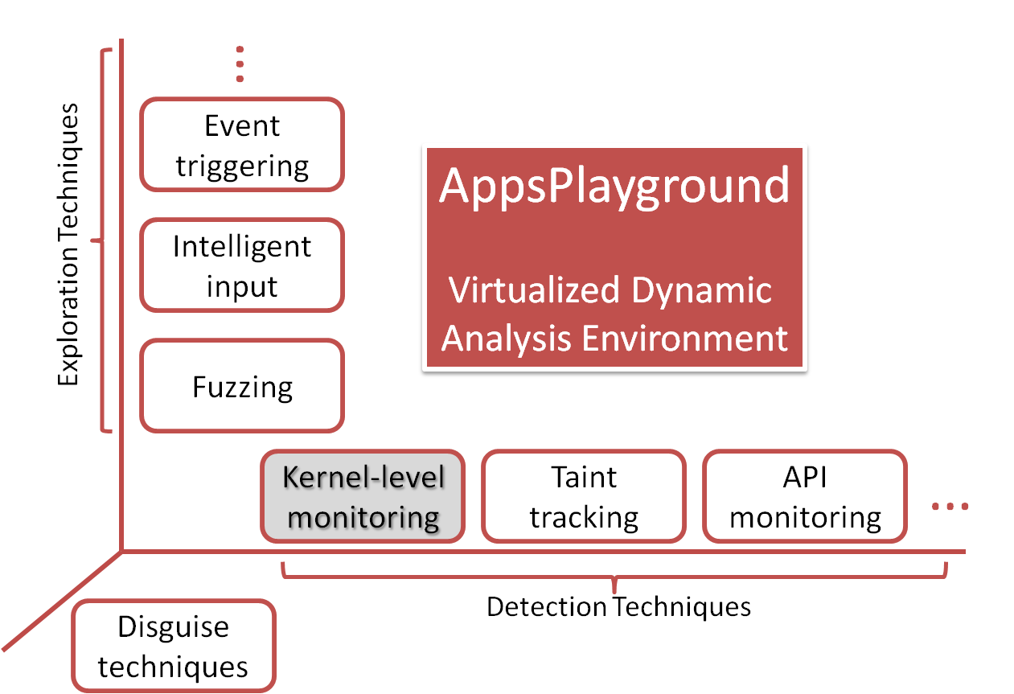
Kernel-level Monitoring
Useful for malware detection
Most root-capable malware can be logged for vulnerability conditions
Rage-against-the-cage
  Number of live processes for a user reaches a threshold
Exploid / Gingerbreak
  Netlink packets sent to
  system daemons

Slide 69
Disguise Techniques
Make the virtualized environment look like a real phone
  Phone identifiers and properties
  Data on phone, such as contacts, SMS, files
  Data from sensors like GPS
  Cannot be perfect

Slide 70
Privacy Leakage Results
AppsPlayground automates TaintDroid
Large scale measurements - 3,968 apps from Android Market (Google Play)
  946 leak some info
  844 leak phone identifiers
  212 leak geographic location
  Leaks to a number of ad and analytics domains

Slide 71
Malware Detection
Case studies on DroidDream, FakePlayer, and DroidKungfu
AppsPlayground’s detection techniques are effective at detecting malicious functionality
Exploration techniques can help discover more sophisticated malware

Slide 72
Backup for Appsplayground

Slide 73
Dynamic vs. Static
 | Dynamic Analysis | Static Analysis
Coverage | Some code not executed | Mostly sound
Accuracy | False negatives | False positives
Dynamic Aspects (reflection, dynamic loading) | Handled without additional effort | Possibly unsound for these
Execution context | Easily handled | Difficult to handle
Performance | Usually slower | Usually faster

Slide 74
Exploration Effectiveness
Measured in terms of code coverage
  33% mean code coverage
    More than double than trivial
    Black box technique
    Some code may be dead code
    Use symbolic execution in the future
Fuzzing and intelligent input both important
  Fuzzing helps when intelligent input can’t model GUI
  Intelligent input could sign up automatically for 34 different services in large scale experiments

Slide 75
Playground: Related Work
Google Bouncer
  Similar aims; closed system
DroidScope, Usenix Security’12
  Malware forensics
  Mostly manual
SmartDroid, SPSM’12
  Uses static analysis to guide dynamic exploration
  Complementary to our approach

Slide 76
DroidChameleon
Evaluating state-of-the-art Android anti-malware against transformation attacks

Slide 77
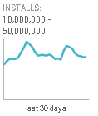

Introduction
Android malware – a real concern
Many Anti-malware offerings for Android
Many are very popular
Source: http://play.google.com/ | retrieved: 4/29/2013

Slide 78
Objective
What is the resistance of Android anti-malware against malware obfuscations?
Smartphone malware is evolving
  Encrypted exploits, encrypted C&C information, obfuscated class names, …
  Polymorphic attacks already seen in the wild
Technique: transform known malware

Slide 79
Transformations: Three Types
Trivial
No code-level changes or changes to AndroidManifest
Detectable by Static Analysis - DSA
Do not thwart detection by static analysis completely
Not detectable by Static Analysis – NSA
Capable of thwarting all static analysis based detection

Slide 80
Trivial Transformations
Repacking
  Unzip, rezip, re-sign
  Changes signing key, checksum of whole app package
Reassembling
  Disassemble bytecode, AndroidManifest, and resources and reassemble again
  Changes individual files

Slide 81
DSA Transformations
Changing package name
Identifier renaming
Data encryption
Encrypting payloads and native exploits
Call indirections
…

Slide 82
Evaluation
10 Anti-malware products evaluated
  AVG, Symantec, Lookout, ESET, Dr. Web, Kaspersky, Trend Micro, ESTSoft (ALYac), Zoner, Webroot
  Mostly million-figure installs; > 10M for three
  All fully functional
6 Malware samples used
  DroidDream, Geinimi, FakePlayer, BgServ, BaseBridge, Plankton
Last done in February 2013.

Slide 83
DroidDream Example
 | AVG | Symantec | Lookout | ESET | Dr. Web
Repack |  |  | x
Reassemble |  |  | x
Rename package | x |  | x
Encrypt Exploit (EE) |  |  | x
Rename identifiers (RI) |  | x | x
Encrypt Data (ED) |  |  | x
Call Indirection (CI) |  |  | x
RI+EE |  | x | x | x
EE+ED |  |  | x
EE+Rename Files |  |  | x
EE+CI |  |  | x |  | x

Slide 84
DroidDream Example
 | Kasp. | Trend M. | ESTSoft | Zoner | Webroot
Repack
Reassemble |  |  |  | x
Rename package |  |  | x | x
Encrypt Exploit (EE) |  |  |  | x
Rename identifiers (RI) |  |  |  | x | x
Encrypt Data (ED) |  |  |  | x
Call Indirection (CI) |  |  |  | x
RI+EE |  |  |  | x | x
EE+ED | x |  |  | x
EE+Rename Files |  | x |  | x
EE+CI |  |  |  | x

Slide 85
Findings
All the studied tools found vulnerable to common transformations
At least 43% signatures are not based on code-level artifacts
90% signatures do not require static analysis of Bytecode. Only one tool (Dr. Web) found to be using static analysis

Slide 86
Signature Evolution
Study over one year (Feb 2012 – Feb 2013)
Key finding: Anti-malware tools have evolved towards content-based signatures
Last year 45% of signatures were evaded by trivial transformations compared to 16% this year
Content-based signatures are still not sufficient

Slide 87
Solutions
Content-based Signatures are not sufficient
Analyze semantics of malware
Dynamic behavioral monitoring can help
Need platform support for that

Slide 88
Takeaways
Need to have semantics-based detection
Need to provide better platform support for anti-malware
Google and device manufacturers
Anti-malware vendors

Slide 89
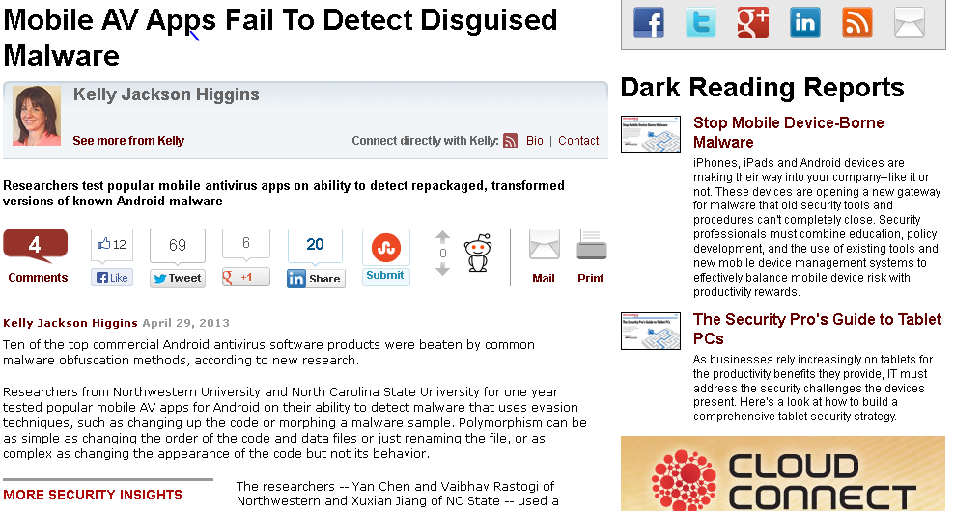
Impact
The focus of a Dark Reading article on April 29, 2013
Then featured by Information Week, The H, heise Security, Security Week, Slashdot, Help Net Security, ISS Source, EFY Times, Tech News Daily, Fudzilla, VirusFreePhone, McCormick Northwestern News, and ScienceDaily.
Contacted by Lookout, AVG and McAfee regarding transformation samples and tools

Slide 90
Conclusion
Developed a systematic framework for transforming malware
Evaluated latest popular Android anti-malware products
All products vulnerable to malware transformations

Slide 91
Previous Solutions
Static analysis: not sufficient
  It does not identify the conditions under which a leak happens.
    Such conditions may be legitimate or may not happen at all at run time
  Need real-time monitoring
TaintDroid: real-time but not usable
  Requires installing a custom Android ROM
    Not possible with some vendors
    End-user does not have the skill-set

Slide 92
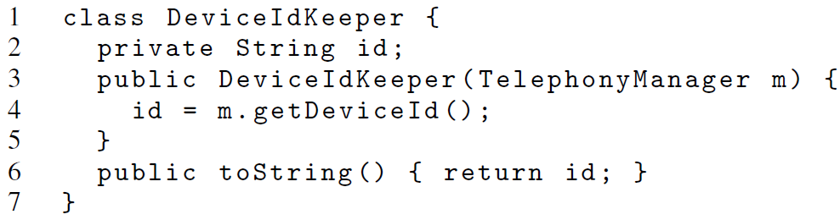
Callback Example
The toString() method may be called by a framework API and the returned string used elsewhere.

