Slide 1

Towards a Trustworthy Android Ecosystem
Yan Chen
Lab of Internet and Security Technology
Northwestern University

Slide 2
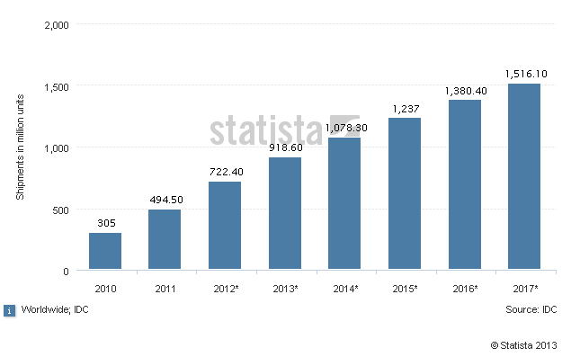
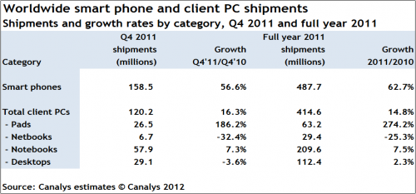
Smartphone Security
Ubiquity - Smartphones and mobile devices
  Smartphone sales already exceed PC sales
  The growth will continue
Performance better than PCs of last decade
  Samsung Galaxy S4 1.6 GHz quad core, 2 G memory

Slide 3
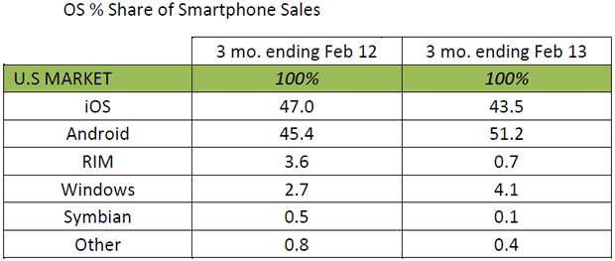
Android Dominance
Android world-wide market share ~ 70%
Android market share in US ~50%
(Credit: Kantar Worldpanel ComTech)

Slide 4

Android Threats
Malware
  The number is increasing consistently
  Anti-malware ineffective at catching zero-day and polymorphic malware
Information Leakage
  Users often have no way to even know what info is being leaked out of their device
  Even legitimate apps leak private info though the user may not be aware
flickr.com/photos/panda_security_france/

Slide 5
New Challenges
New operating systems
  Different design → Different threats
Different architecture
  ARM (Advanced RISC Machines) vs x86
  Dalvik vs Java (on Android)
Constrained environment
  CPU, memory
  Battery
  User perception

Slide 6
Problems
Malware detection
  Offline
  Real time, on phone
Privacy leakage detection
  Offline
  Real time, on phone
OS architecture or application vulnerabilities
System hardening
  Access control, ASLR, …

Slide 7
Problems
Malware detection
  Offline
  Real time, on phone
Privacy leakage detection
  Offline
  Real time, on phone
OS architecture or application vulnerabilities
System hardening
  Access control, ASLR, …

Slide 8
Our Solutions
AppsPlayground, CODASPY’13
  Automatic, large-scale dynamic analysis of Android apps
DroidChamelon, ASIACCS’13
  Evaluation of latest Android anti-malware tools
Uranine
  Real-time information-flow tracking enabled by offline static analysis
  With zero platform modification

Slide 9
AppsPlayground
Automatic Security Analysis of Android Applications

Slide 10
AppsPlayground
A system for offline dynamic analysis
  Includes multiple detection techniques for dynamic analysis
Challenges
  Techniques must be light-weight
  Automation requires good exploration techniques

Slide 11
Architecture
…
Event triggering
AppsPlayground
Virtualized Dynamic
Analysis Environment
Exploration Techniques
Intelligent input
Fuzzing
Kernel-level monitoring
Taint tracking
API monitoring
…
Detection Techniques
Disguise techniques

Slide 12
Architecture
…
Event triggering
AppsPlayground
Virtualized Dynamic
Analysis Environment
Exploration Techniques
Intelligent input
Fuzzing
Kernel-level monitoring
Taint tracking
API monitoring
…
Contributions
Detection Techniques
Disguise techniques

Slide 13
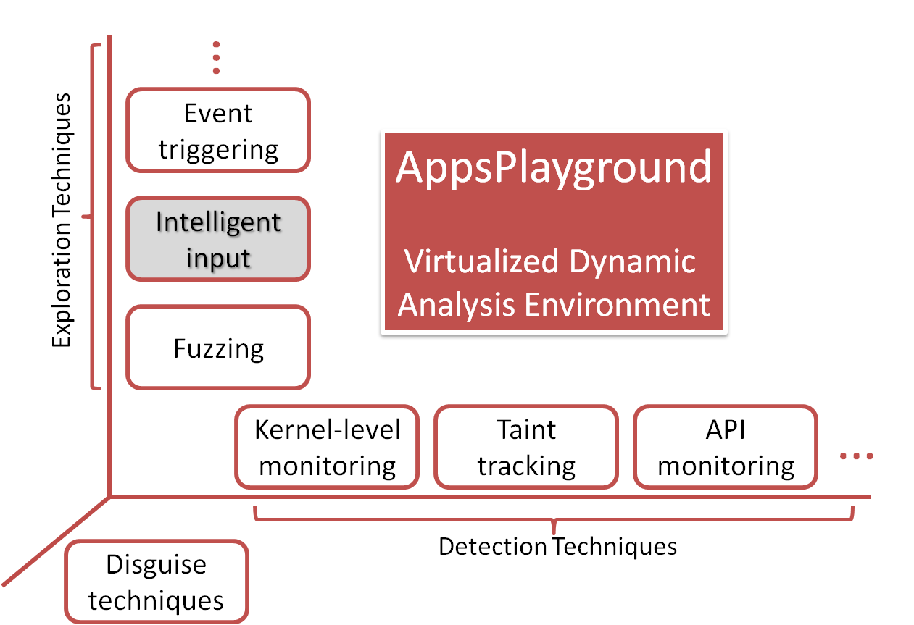
Intelligent Input
Fuzzing is good but has limitations
Another black-box GUI exploration technique
Capable of filling meaningful text by inferring surrounding context
  Automatically fill out zip codes, phone # and even login credentials
  Sometimes increases
  coverage greatly

Slide 14
Privacy Leakage Results
AppsPlayground automates TaintDroid
Large scale measurements - 3,968 apps from Android Market (Google Play)
  946 leak some info
  844 leak phone identifiers
  212 leak geographic location
  Leaks to a number of ad and analytics domains

Slide 15
Malware Detection
Case studies on DroidDream, FakePlayer, and DroidKungfu
AppsPlayground’s detection techniques are effective at detecting malicious functionality
Exploration techniques can help discover more sophisticated malware

Slide 16
DroidChameleon
Evaluating state-of-the-art Android anti-malware against transformation attacks

Slide 17
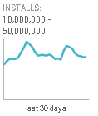

Introduction
Android malware – a real concern
Many Anti-malware offerings for Android
Many are very popular
Source: http://play.google.com/ | retrieved: 4/29/2013

Slide 18
Objective
What is the resistance of Android anti-malware against malware obfuscations?
Smartphone malware is evolving
  Encrypted exploits, encrypted C&C information, obfuscated class names, …
  Polymorphic attacks already seen in the wild
Technique: transform known malware

Slide 19
Transformations: Three Types
Trivial
No code-level changes or changes to AndroidManifest
Detectable by Static Analysis - DSA
Do not thwart detection by static analysis completely
Not detectable by Static Analysis – NSA
Capable of thwarting all static analysis based detection

Slide 20
Trivial Transformations
Repacking
  Unzip, rezip, re-sign
  Changes signing key, checksum of whole app package
Reassembling
  Disassemble bytecode, AndroidManifest, and resources and reassemble again
  Changes individual files

Slide 21
DSA Transformations
Changing package name
Identifier renaming
Data encryption
Encrypting payloads and native exploits
Call indirections
…

Slide 22
Evaluation
10 Anti-malware products evaluated
  AVG, Symantec, Lookout, ESET, Dr. Web, Kaspersky, Trend Micro, ESTSoft (ALYac), Zoner, Webroot
  Mostly million-figure installs; > 10M for three
  All fully functional
6 Malware samples used
  DroidDream, Geinimi, FakePlayer, BgServ, BaseBridge, Plankton
Last done in February 2013.

Slide 23
DroidDream Example
 | AVG | Symantec | Lookout | ESET | Dr. Web
Repack |  |  | x
Reassemble |  |  | x
Rename package | x |  | x
Encrypt Exploit (EE) |  |  | x
Rename identifiers (RI) |  | x | x
Encrypt Data (ED) |  |  | x
Call Indirection (CI) |  |  | x
RI+EE |  | x | x | x
EE+ED |  |  | x
EE+Rename Files |  |  | x
EE+CI |  |  | x |  | x

Slide 24
DroidDream Example
 | Kasp. | Trend M. | ESTSoft | Zoner | Webroot
Repack
Reassemble |  |  |  | x
Rename package |  |  | x | x
Encrypt Exploit (EE) |  |  |  | x
Rename identifiers (RI) |  |  |  | x | x
Encrypt Data (ED) |  |  |  | x
Call Indirection (CI) |  |  |  | x
RI+EE |  |  |  | x | x
EE+ED | x |  |  | x
EE+Rename Files |  | x |  | x
EE+CI |  |  |  | x

Slide 25
Findings
All the studied tools found vulnerable to common transformations
At least 43% signatures are not based on code-level artifacts
90% signatures do not require static analysis of Bytecode. Only one tool (Dr. Web) found to be using static analysis

Slide 26
Signature Evolution
Study over one year (Feb 2012 – Feb 2013)
Key finding: Anti-malware tools have evolved towards content-based signatures
Last year 45% of signatures were evaded by trivial transformations compared to 16% this year
Content-based signatures are still not sufficient

Slide 27
Solutions
Content-based Signatures are not sufficient
Analyze semantics of malware
Dynamic behavioral monitoring can help
Need platform support for that

Slide 28
Takeaways
Need to have semantics-based detection
Need to provide better platform support for anti-malware
Google and device manufacturers
Anti-malware vendors

Slide 29
Conclusion
Developed a systematic framework for transforming malware
Evaluated latest popular Android anti-malware products
All products vulnerable to malware transformations

Slide 30
Uranine
Real-time Privacy Leakage Detection without System Modification for Android

Slide 31
Motivation
Android permissions are insufficient
  User still does not know if some private information will be leaked
Information leakage is more interesting (dangerous) than information access
  E.g. a camera app may legitimately access the camera but sending video recordings out of the phone may be unacceptable to the user

Slide 32
Previous Solutions
Static analysis: not sufficient
  It does not identify the conditions under which a leak happens.
    Such conditions may be legitimate or may not happen at all at run time
  Need real-time monitoring
TaintDroid: real-time but not usable
  Requires installing a custom Android ROM
    Not possible with some vendors
    End-user does not have the skill-set

Slide 33
Our Approach
Give control to the user
Instead of modifying system, modify the suspicious app to track privacy-sensitive flows
Advantages
  No system modification
  No overhead for the rest of the system
  High configurability – easily turn off monitoring for an app or a trusted library in an app

Slide 34
Comparison
 | Static Analysis | TaintDroid | Uranine
Accuracy | Low (possibly High FP) | Good | Good
Overhead | None | Low | Acceptable
System modification | No | Yes | No
Configurability | NA | Very Low | High

Slide 35
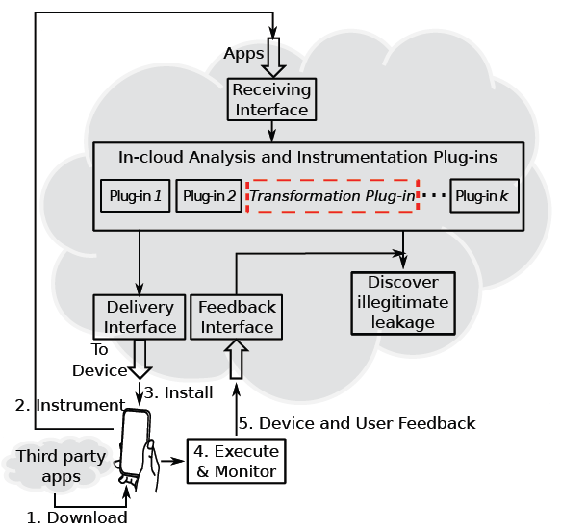
Deployment A
By vendor or 3rd party service

Slide 36
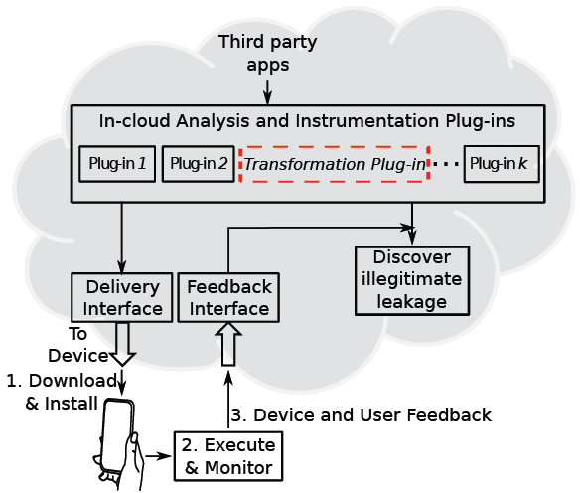
Deployment B
By Market

Slide 37
Overall Scenario
Download
Instrument
Reinstall
Run
Alert User
Unmodified Android Middleware
And Libraries

Slide 38
Challenges
Framework code cannot be modified
  Policy-based summarization of framework API
Accounting for the effects of callbacks
  Functions in app code invoked by framework code
  Over-tainting techniques guarantee zero FN

Slide 39
Challenges
Accommodating reference semantics
  Need to taint objects rather than variables
  Not interfering with garbage collection
Performance overhead
  Path pruning with static analysis

Slide 40
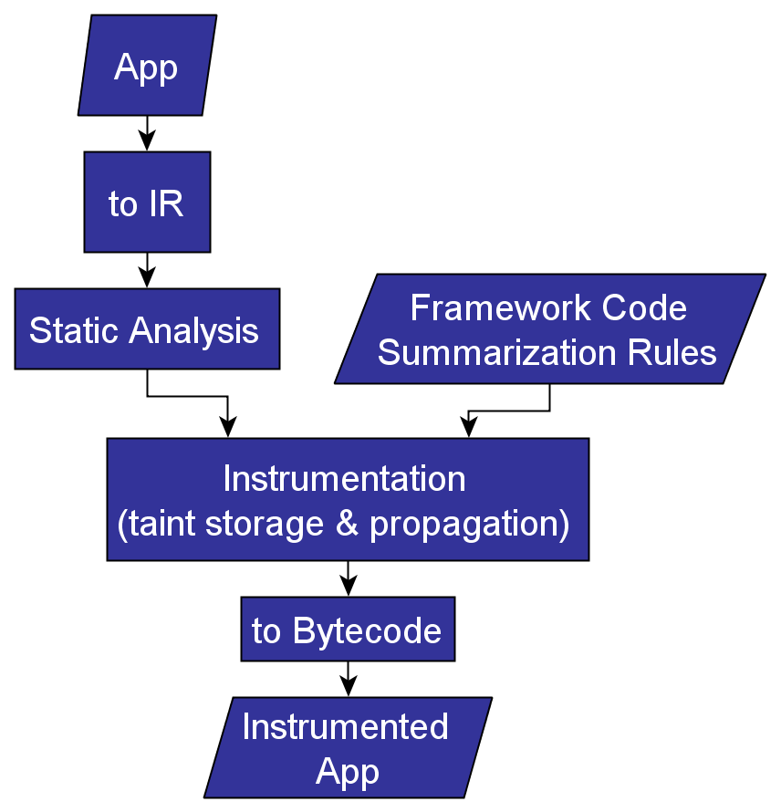
Instrumentation Workflow

Slide 41
Preliminary Results
Studied 20 apps
Results in general align with TaintDroid
Performance
  Runtime overhead is within 50% for 85% of the apps evaluated and with 100% for all apps
  Less than 20% instructions need to be instrumented in all apps evaluated

Slide 42
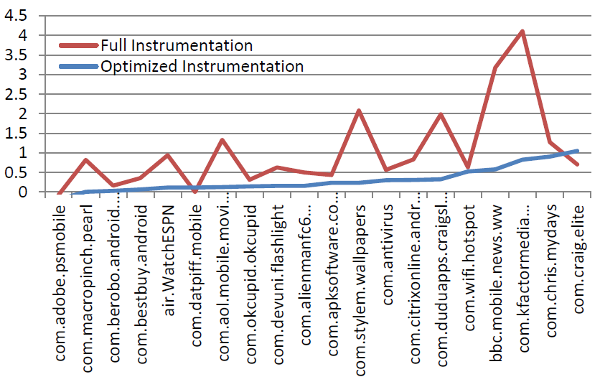
Runtime Performance

Slide 43
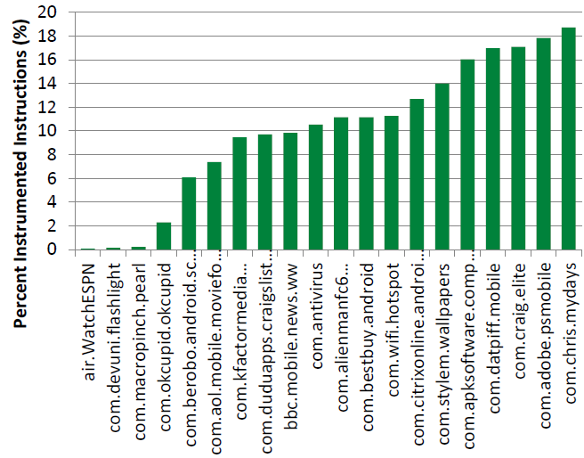
Fraction of Instructions
Instrumented

Slide 44
Limitations
Native code not handled
Method calls by reflection may sometimes result in unsound behavior
App may refuse to run if their code is modified
  Currently, only one out of top one hundred Google Play apps did that

Slide 45
Conclusion
AppsPlayground, CODASPY’13
  Detected privacy leakage on large scale
  Capable of detecting malware
DroidChamelon, ASIACCS’13
  Several popular Android anti-malware tools shown vulnerable
Uranine
  Real-time information-flow tracking with zero platform modification is possible
More info and tools
  http://list.cs.northwestern.edu/mobile/

Slide 46
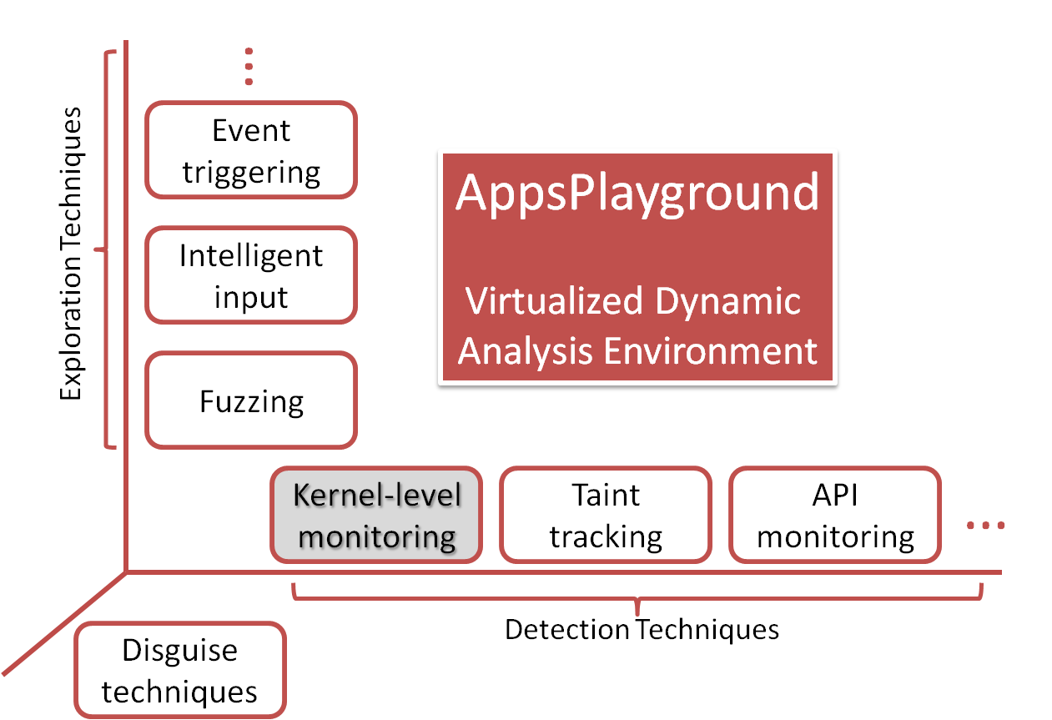
Kernel-level Monitoring
Useful for malware detection
Most root-capable malware can be logged for vulnerability conditions
Rage-against-the-cage
  Number of live processes for a user reaches a threshold
Exploid / Gingerbreak
  Netlink packets sent to
  system daemons

Slide 47
Security in Software-defined Networks
Towards A Secure Controller Platform for OpenFlow Applications

Slide 48
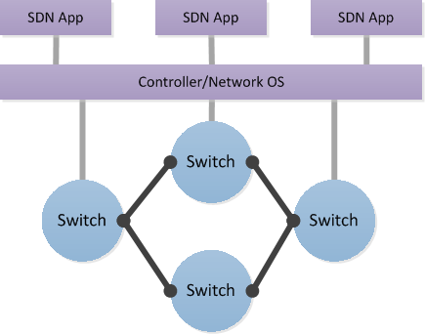
SDN Architecture
SDN apps defines routing behavior through controller
Current controllers assume full trust on apps, and do not check what apps send to switches

Slide 49
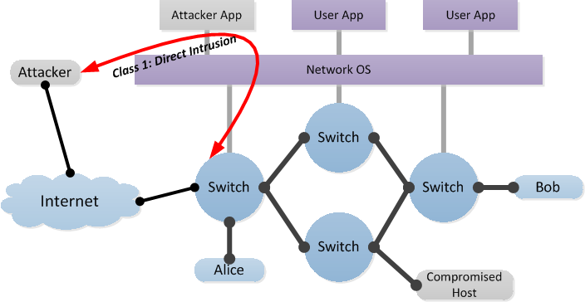
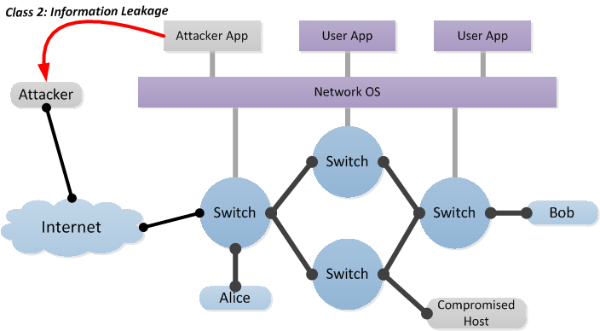
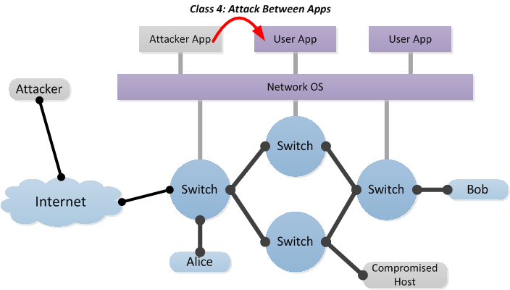
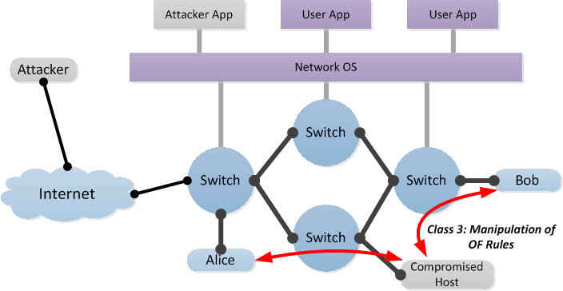
Threat Model
Two threat model
  Exploit of existing benign-but-buggy apps
  Distribution of malicious apps by attacker
Plenty of potential attacks

Slide 50
Challenges
Network resources are architecturally distinctive
  It is not obvious which resources are dangerous and which ones are safe
Controller has limited control on SDN apps
  Only controller API calls go through controller, such as flow addition and statistics query
  OS system calls do not go through controller, so apps can write whatever they want to the network, storage, etc.

Slide 51
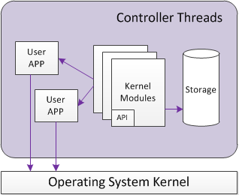
Our Approach
Permission Check + Isolation
Contributions
  Systematic Permission Set Design
  Comprehensive App Sandboxing
Original Controller
Architecture
PermOF Architecture

Slide 52
Backup

Slide 53
Smartphone Security
Lots of private data
  Contacts, messages, call logs, location
  Grayware applications, spyware applications
  TaintDroid, PiOS, etc. found many leaks
  Our independent study estimates about 1/4th of apps to be leaking
Exploits could cause user money
  Dialing and texting to premium numbers
  Malware such as FakePlayer already do this

Slide 54
Android Threats
Privacy leakage
  Users often have no way to know if there are privacy leaks
  Even legitimate apps may leak private information without informing user
Malware
  Number increasing consistently
  Need to analyze new kinds

Slide 55
Dynamic vs. Static
 | Dynamic Analysis | Static Analysis
Coverage | Some code not executed | Mostly sound
Accuracy | False negatives | False positives
Dynamic Aspects (reflection, dynamic loading) | Handled without additional effort | Possibly unsound for these
Execution context | Easily handled | Difficult to handle
Performance | Usually slower | Usually faster

Slide 56
Disguise Techniques
Make the virtualized environment look like a real phone
  Phone identifiers and properties
  Data on phone, such as contacts, SMS, files
  Data from sensors like GPS
  Cannot be perfect

Slide 57
Exploration Effectiveness
Measured in terms of code coverage
  33% mean code coverage
    More than double than trivial
    Black box technique
    Some code may be dead code
    Use symbolic execution in the future
Fuzzing and intelligent input both important
  Fuzzing helps when intelligent input can’t model GUI
  Intelligent input could sign up automatically for 34 different services in large scale experiments

Slide 58
Playground: Related Work
Google Bouncer
  Similar aims; closed system
DroidScope, Usenix Security’12
  Malware forensics
  Mostly manual
SmartDroid, SPSM’12
  Uses static analysis to guide dynamic exploration
  Complementary to our approach

Slide 59
Threat Mitigation at App level
Offline analysis
  Trustworthiness of app is known before use
  Static analysis
  Dynamic analysis
Real-time monitoring
  Often more accurate but with runtime overhead
  User has control over app’s actions in real-time

Slide 60
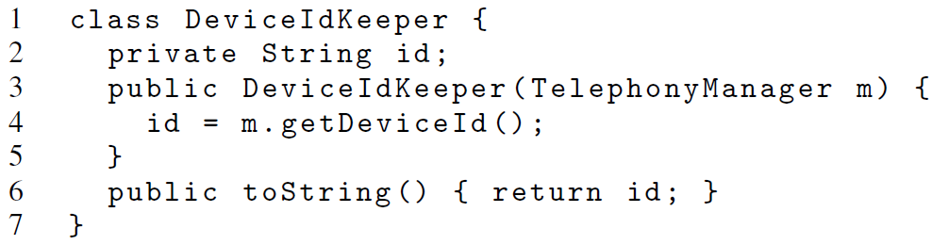
Callback Example
The toString() method may be called by a framework API and the returned string used elsewhere.

Slide 61
Potential Defenses against malicious app
Server-side Security Check by Controller Vendor
  Static analysis
  Dynamic analysis
Runtime Permission Check
  Enforce the principle of least privilege on apps
Principal Isolation
Anomaly-based Behavior Monitoring

