Slide 1
OSA: An Optical Switching Architecture for Data Center Networks with Unprecedented Flexibility
Kai Chen, Ankit Singla, Atul Singh, Kishore Ramachandran,
Lei Xu, Yueping, Zhang, Xitao Wen, Yan Chen
Northwestern University, UIUC, NEC Labs America
USENIX NSDI’12, San Jose, USA

Slide 2
A Brief Advertisement
OSA: container-size, NSDI’12
WaveCube: scalable, upcoming SIGCOMM’12

Slide 3












Big Data for Modern Applications
Scientific: 200GB of astronomy data a night
Business: 1 million customer transactions,
2.5PB of data per hour
Social network: 60 billion photos in its user
base, 25TB of log data per day
Web search: 20PB of search data per day
…
…

Slide 4
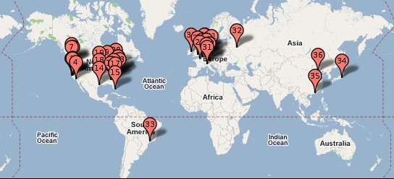
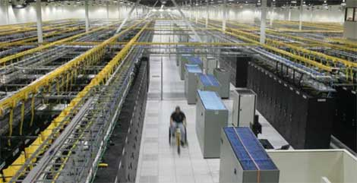
Data Center as Infrastructure
Example of Google’s 36 world wide data centers

Slide 5

Conventional DCN is Problematic
Core
switch
Serious communication bottleneck!
1:240
Considerations:
Bandwidth
Wiring complexity
Power consumption
Network cost
…
Aggregation
switch
1:5 ~ 1:20
(ToR switch)
Top-of-Rack
1:1
A DCN structure adapted from Cisco
Efficient DCN architecture is desirable, but challenging

Slide 6
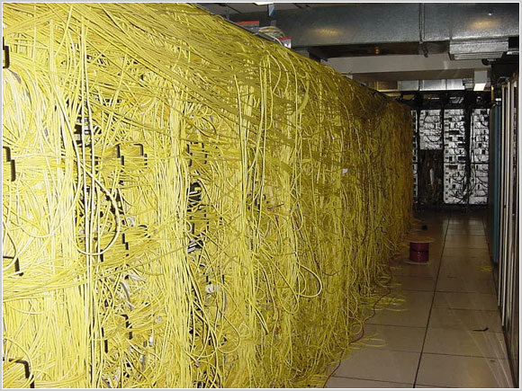



Recent Efforts and Their Problems
All-electrical
(static)
Fattree, BCube,
VL2, PortLand
[SIGCOMM’08 ’09]
CLUE
Fattree
Static over-provisioning
High bandwidth, but
high wiring complexity,
high power, high cost
BCube

Slide 7
Recent Efforts and Their Problems
All-electrical
(static)
Hybrid
electrical/optical
(semi-flexible)
Conventional electrical network
Fattree, BCube,
VL2, PortLand
[SIGCOMM’08 ’09]
c-Through, Helios
[SIGCOMM’10]
Optical links
High bandwidth, but
high wiring complexity,
high power, high cost
Reduced complexity,
power and cost, but
insufficient bandwidth
c-Through
Limited flexibility

Slide 8
Our Effort: OSA
All-electrical
(static)
Hybrid
electrical/optical
(semi-flexible)
All-optical
(high-flexible)
Insight behind OSA:
Data center traffic exhibits regionality and some stability [IMC’09] [WREN’09] [HotNets’09][IMC’10] [SIGCOMM’11][ICDCS’12]
So, we flexibly arrange bandwidth to where it is needed, instead of static over-provisioning!
Fattree, BCube,
VL2, PortLand
[SIGCOMM’08 ’09]
c-Through, Helios
[SIGCOMM’10]
OSA
High bandwidth, but
high wiring complexity,
high power, high cost
Reduced complexity,
power and cost, but
insufficient bandwidth
High bandwidth, and
low wiring complexity,
low power, low cost

Slide 9
OSA’s Flexibility: An Example
High capacity link for increased demand
H
G
Traffic demand
10
0
H
A | G | 10
B | H | 10
C | E | 10
D | F | 10
B | D | 10
C | F | 10
E
F
F
D
20
G
A
D
C
C
E
B
OSA can dynamically change its ToR topology and link capacity to adapt to the real demand, thus delivering high bandwidth without static over-provisioning!
A
B
Change
link capacity
Change topology
Demand change
H
A | G | 10
B | H | 10
C | E | 10
F | G | 20
B | D | 10
C | F | 10
D
F
G
A
C
Direct link for real demand
E
B

Slide 10
Outline of Presentation
Background and high-level idea
How OSA achieves such flexibility?
OSA architecture and optimization
Implementation and Evaluation
Summary

Slide 11
How We Achieve Such Flexibility?
Approach: identify the advantages of optical network technologies, innovatively apply them in data center networking to design a flexible architecture!

Slide 12
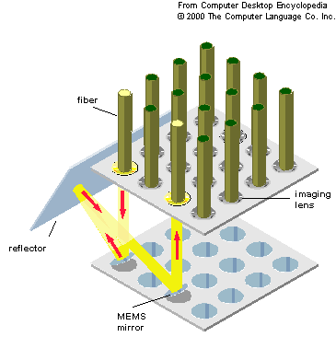
How We Achieve Such Flexibility?
Micro-Electro-Mechanical Switch
MEMS
N × N
N
fiber
N
Flexible topology
imaging lens
reflector
MEMS
mirror
MEMS
A
B
C
D
Fixed degree
A
A
D
B
D
C
C
B

Slide 13
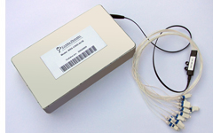
How We Achieve Such Flexibility?
Micro-Electro-Mechanical Switch
Wavelength Selective Switch
MEMS
N × N
WSS
1 × k
N
fiber
N
Flexible topology
imaging lens
reflector
MEMS
mirror
MEMS
Output 1
Wavelengths
A
B
C
D
Output 2
Fixed degree
WSS
A
A
Input
D
B
D
C
Output k
C
B

Slide 14
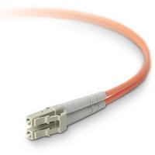
How We Achieve Such Flexibility?
Micro-Electro-Mechanical Switch
Wavelength Selective Switch
MEMS
N × N
WSS
1 × k
N
fiber
N
Other optical devices:
Flexible topology
Flexible link capacity
imaging lens
Optical fiber
WDM (DE)MUX
Coupler
Circulator
reflector
MEMS
mirror
bidirectional
MUX
DEMUX
Coupler
Fixed node capacity
100 Terabits X 1
C
MEMS
A
A
Wavelength uniqueness
A
32 port
32 port
4 port
Send
Receive
A
B
C
D
WSS
B
D
Fixed degree
Common features:
Support high bit-rate, high capacity
Power-efficient
Small and compact (except MEMS)
A
A
C
C
B
D
D
B
D
C
C
B

Slide 15
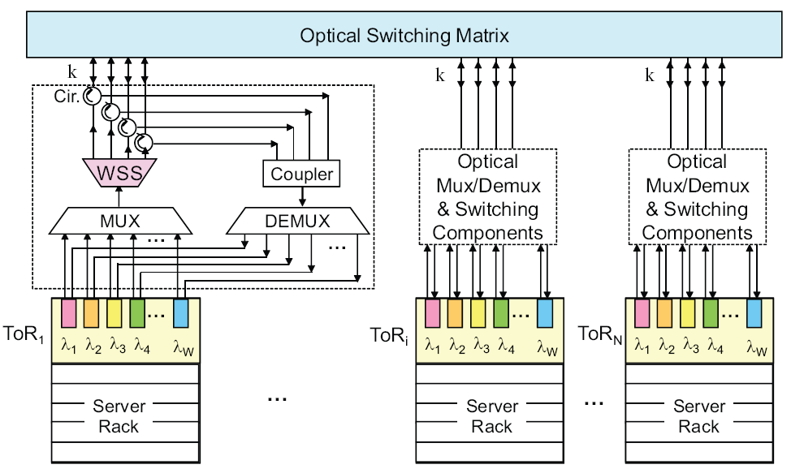
OSA Architecture Overview
Send part
Receive part
(MEMS 320 ports)
Top-of-Rack switch

Slide 16
OSA Architecture Overview
At its core
(MEMS 320 ports)
H
MEMS (320 ports)
G
H
H
E
F
F
D
F
D
Each ToR can connect to any k other ToRs
G
A
k
G
A
D
C
C
C
WSS
WSS
Each link can have flexible capacity
WSS
A
B
E
B
E
B
ToR
ToR
…
ToR
OSA can arrange any k-regular topology with flexible link capacity among the ToRs!

Slide 17
OSA Architecture Overview
At its core
Two notes about OSA:
1. Multi-hop routing for indirect ToRs
2. OSA is container-sized DCN for now
(MEMS 320 ports)
MEMS (320 ports)
k
WSS
WSS
WSS
ToR
ToR
…
ToR

Slide 18


Control Plane: Logically Centralized
OSA Manager
Optimize the network to better serve the traffic
Topology
(MEMS 320 ports)
Link capacity
Routing

Slide 19
Optimization Procedure in OSA Manager
Hedera [NSDI’10]
Maximum k-matching
1. Estimate traffic demand between ToRs
2. Assign direct link to heavy communication ToR pairs
OSA Manager

Slide 20
Maximum K-matching for Direct Links Setup
ToR demand graph
A
A
B
B
3
ToR traffic demand
1
3
4
H
2
5
H
1
C
C
 | A | B | C | D | E | F | G | H
A | -- | 3 | 0 | 5 | 2 | 0 | 0 | 1
B | 3 | -- | 4 | 0 | 0 | 3 | 0 | 1
C | 0 | 4 | -- | 2 | 1 | 1 | 4 | 1
D | 5 | 0 | 2 | -- | 1 | 0 | 1 | 3
E | 2 | 0 | 1 | 1 | -- | 4 | 0 | 4
F | 0 | 3 | 1 | 0 | 4 | -- | 3 | 0
G | 0 | 0 | 4 | 1 | 0 | 3 | -- | 3
H | 1 | 1 | 1 | 3 | 4 | 0 | 3 | --
 | A | B | C | D | E | F | G | H
A | -- | 3 | 0 | 5 | 2 | 0 | 0 | 1
B | 3 | -- | 4 | 0 | 0 | 3 | 0 | 1
C | 0 | 4 | -- | 2 | 1 | 1 | 4 | 1
D | 5 | 0 | 2 | -- | 1 | 0 | 1 | 3
E | 2 | 0 | 1 | 1 | -- | 4 | 0 | 4
F | 0 | 3 | 1 | 0 | 4 | -- | 3 | 0
G | 0 | 0 | 4 | 1 | 0 | 3 | -- | 3
H | 1 | 1 | 1 | 3 | 4 | 0 | 3 | --
3
3
1
1
2
G
4
G
1
D
D
3
4
1
F
F
4
E
E
Maximum
weighted 3-matching
Edmonds’ algorithm^{[1]}
ToR connection graph
H
G
E
F
D
C
A
B
[1] J. Edmonds, “Paths, trees and flowers”, Canad. J. of Math., 1965

Slide 21
Optimization Procedure in OSA Manager
Hedera [NSDI’10]
Maximum k-matching
Shortest path routing
1. Estimate traffic demand between ToRs
2. Assign direct link to heavy communication ToR pairs
3. Compute the routing paths
4. Compute the traffic demand on each link
5. Assign wavelengths to provision the link bandwidth
Edge-coloring theory
OSA Manager

Slide 22
Edge-coloring for Wavelength Assignment
H
G
H
G
3
4
F
3
E.g., from F’s perspective
E
E
F
4
3
4
3
2
D
C
D
C
2
5
4
A
3
B
A
B
Expected wavelength graph
Multigraph based on # of wavelengths
Wavelength assignment:
A wavelength cannot be associated with a ToR twice
Edge-coloring:
A color cannot be associated with a node twice
Vizing’s theorem^{[2]}
[2] J. Misra, et. al., “A constructive proof of Vizing’s Theorem,” Inf. Process. Lett., 1992.

Slide 23
Optimization Procedure in OSA Manager
Topology, MEMS
Routing, ToR
1. Estimate traffic demand between ToRs
2. Assign direct link to heavy communication ToR pairs
3. Compute the routing paths
4. Compute the traffic demand on each link
5. Assign wavelengths to provision the link bandwidth
Link capacity, WSS
OSA Manager

Slide 24
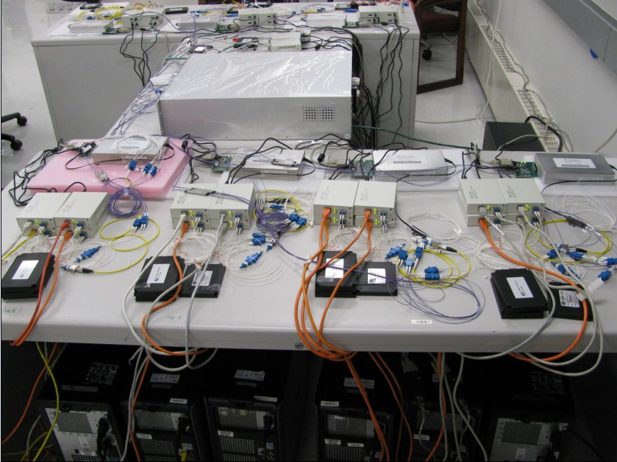
Prototype Implementation
MEMS
WSS
1 MEMS (32 ports: 16×16)
8 WSS units (1×4 ports)
8 ToRs* and 32 servers
Theoretical curve
Experiment curve
Experiment results strictly follow the expectation:
Demonstrate the feasibility of the OSA design!
*Server-emulated ToR

Slide 25
Simulation Results (2560 servers*)
OSA can be close to non-blocking
85%
90%
~100%
80%
Demonstrate the high-performance of the OSA design!
3.86X
3.1X
3.54X
3X
OSA is significantly better than hybrid
*80 ToRs (each with 32 servers) form a 4-regular graph for OSA.

Slide 26
Cost, Power & Wiring (2560 Servers)
OSA is slightly better than hybrid
OSA is significantly better than Fattree
Demonstrate OSA can potentially deliver high bandwidth in a simple, power-efficient and cost-effective way!

Slide 27
Summary
Static, “fat”
Flexible, “thin”
Fattree
Hybrid
OSA
 | Performance | Complexity | Power | Cost
Fattree | √ | X | X | X
Hybrid | X | √ | √ | √
OSA | √ | √ | √ | √
OSA is inspired by traffic regionality and stability
Sweet spot for performance, cost, power, and wiring complexity
Caveats: not intended for all-to-all, non-stable traffic
Acknowledgement: CoAdna Photonics (WSS) and Polatis (MEMS)

Slide 28
Thanks!

Slide 29
Data Center Traffic Characteristics
[IMC’09][HotNets’09]: only a few ToRs are hot and most of their traffic goes to a few other ToRs
[IMC’10]: traffic at ToRs exhibits an ON/OFF pattern
  [SIGCOMM’09]: over 90% bytes flow in elephant flows
[WREN’10]: 60% ToRs see less than 20% change in traffic volume for between 1.6-2.2 seconds
[ICDCS’12]: a production DCN traffic shows stability even on a hourly time scale
Static full bisection bandwidth between all servers at all the time is a waste of resource!

Slide 30
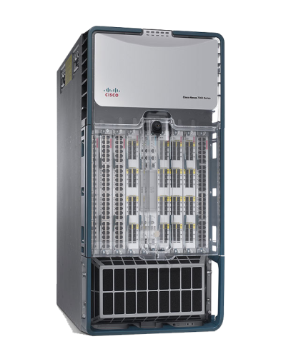
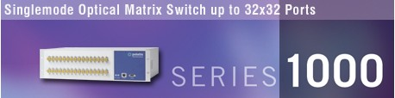
Circuit Switch vs Packet Switch
Optical Circuit Switch
circuit switching
500$/port
rate free
0.24mW/port
~10ms circuit switching latency
Electrical Packet Switch(10G)
store and forward
500$/port
10Gb/s fixed rate
12.5W/port
per-packet switching

Slide 31
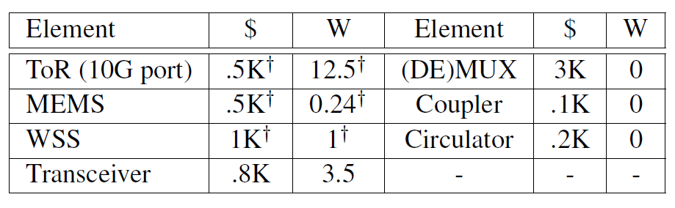
Cost and Power

Slide 32
Data Sending
(MEMS 320 ports)
Notes:
Let’s see how the data is transmitted in the network.

Slide 33
Data Receiving
(MEMS 320 ports)

Slide 34
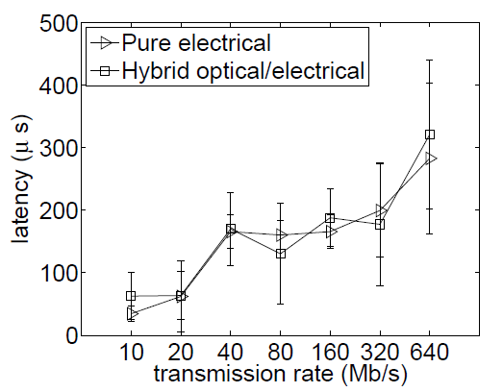
Multi-hop Routing
(MEMS 320 ports)
O-E-O
Sub-nanosecond
Notes:
Let’s see how the data is transmitted in the network.

Slide 35
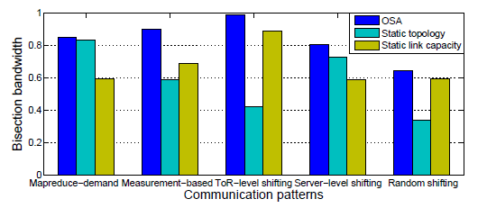
The effect of dynamic topology and link capacity

Slide 36
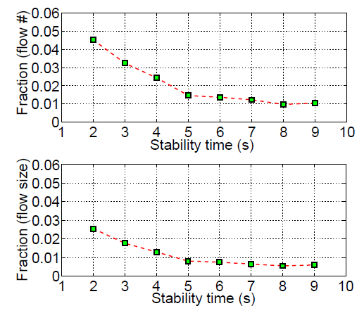
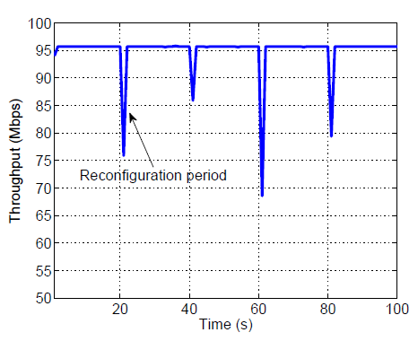
The effect of reconfiguration

