Slide 1
Abusing Browser Address Bar for Fun and Profit - An Empirical Investigation of Add-on Cross Site Scripting Attacks
Presenter: Jialong Zhang

Slide 2
Roadmap
Introduction
Background and Motivation
Experiments
Discussion
Related Work
Conclusion

Slide 3
Introduction
Add-on Cross Site Scripting (XSS) Attacks
A sentence using social engineering techniques
Javascript:codes
For Example, on April 25, 2013, over 70,000 people have been affected by one such Add-on XSS attack on tieba.baidu.com.

Slide 4
Roadmap
Introduction
Background and Motivation
Experiments
Discussion
Related Work
Conclusion

Slide 5
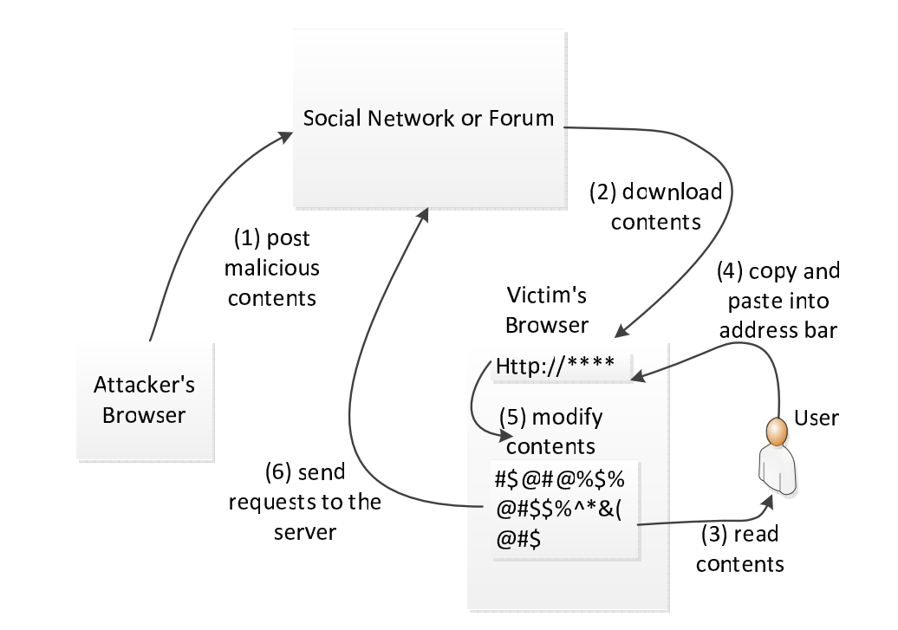
Background

Slide 6
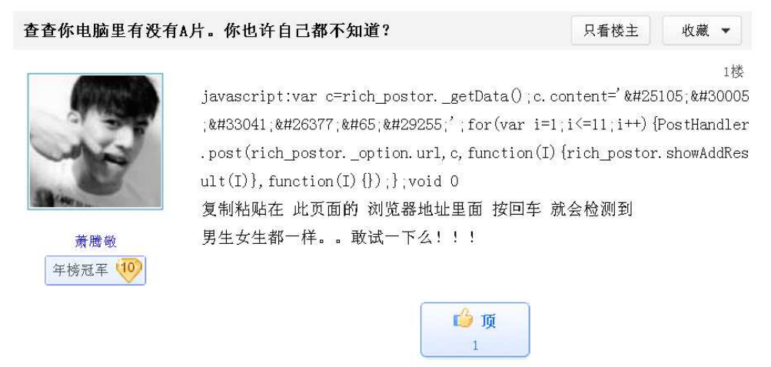
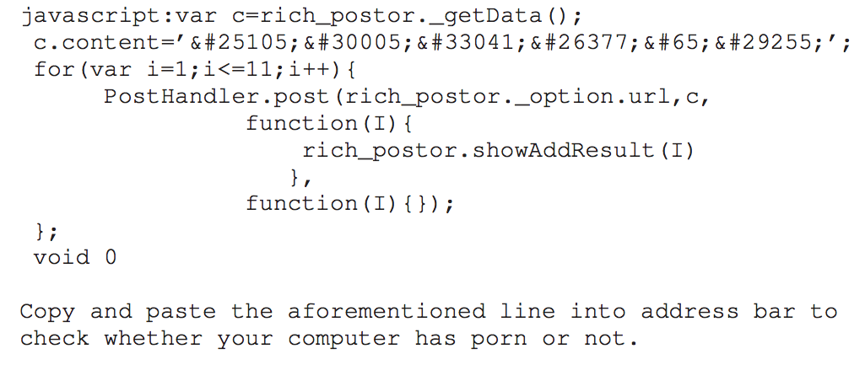
A Motivating Example

Slide 7
Roadmap
Introduction
Background and Motivation
Experiments
Discussion
Related Work
Conclusion

Slide 8
Expriments
Experiment One: Measuring Real-world Attacks
Experiment Two: User Study Using Amazon Mechanical Turks
Experiment Three: A Fake Facebook Account Test

Slide 9
Experiment One
Data Set:
Facebook: 187 million wall posts generated by roughly 3.5 million users
Twitter: 485,721 Twitter accounts with 14,401,157 tweets
Results
Facebook
Twitter
Category | Description | # of distinct samples
Malicious Behavior | Redirecting to malicious sites Redirecting to malicious videos | 40 3
Mischievous Tricks | Sending invitations to friends Keep popping up windows Alert some words | 2 1 2
Benign Behavior | Zooming images Letting images fly Discussion among technicians | 4 4 2
Total |  | 58
Category | Description | # of distinct samples
Malicious Behavior | Redirecting to malicious sites Including malicious JavaScript | 2 5
Benign Behavior | Changing Background Color Altering Textbox Color | 1 1
Total |  | 9

Slide 10
Experiment One – Discussion
Beyond Attacks in the Wild:
More Severe Damages
Stealing confidential information
Session fixation attacks
Browser Address Bar Worms
More Technique to Increase Compromising Rate
Trojan – Combining with Normal Functionality
Obfuscating JavaScript Code
So we have experiment two.

Slide 11
Roadmap
Introduction
Background and Motivation
Experiments
Experiment One
Experiment Two
Experiment Three
Discussion
Related Work
Conclusion

Slide 12
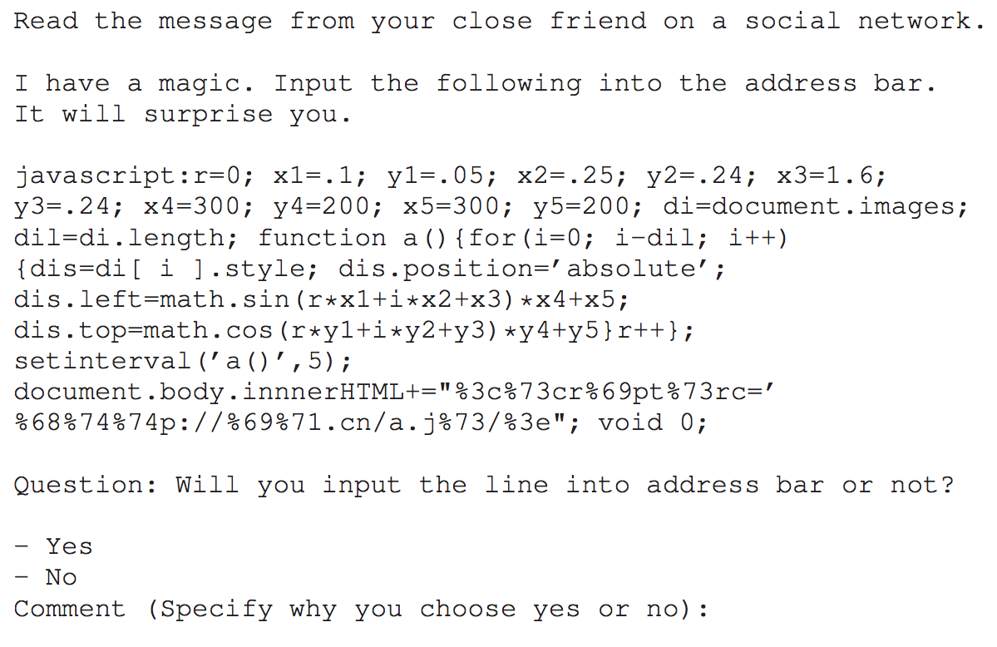
Experiment Two
Methodology
Survey format
Consent form
Demographic survey
Survey questions
Comparative survey
changing one parameter but fixing others
Question sequence randomization
Platform: Amazon Mechanical Turk

Slide 13
Experiment Two
Results
Percentage of Deceived People According to Different Factors
Percentage of Deceived People According to Age
Percentage of Deceived People According to Different Spamming Categories
Percentage of Deceived People According to Programming Experiences
Percentage of Deceived People According to Years of Using Computers
Factor | Without the factor | With the factor
Obfuscated URL | 29.4% | 38.4%
Lengthy JavaScript | 38.4% | 40.4%
Combining with Benign Behavior | 37.1% | 40.0%
Typing “JavaScript:” and then Pasting Contents | 38.2% | 20.3%

Slide 14
Experiment Two
Results
Percentage of Deceived People According to Age
Percentage of Deceived People According to Different Spamming Categories
Percentage of Deceived People According to Programming Experiences
Percentage of Deceived People According to Years of Using Computers
Age | Rate
Age <= 24 | 45.7%
25 < Age <= 30 | 39.8%
30 < Age <= 40 | 34.4%
Age > 40 | 14.0%

Slide 15
Experiment Two
Results
Percentage of Deceived People According to Different Spamming Categories
Percentage of Deceived People According to Programming Experiences
Percentage of Deceived People According to Years of Using Computers
Category | Rate
Magic (like flying images) | 38.4%
Porn (like sexy girl) | 36.3%
Family issue (like a wedding photo) | 52.7%
Free ticket | 29.2%

Slide 16
Experiment Two
Results
Percentage of Deceived People According to Programming Experiences
Percentage of Deceived People According to Years of Using Computers
Programming Experience | Rate
No | 38.4%
Yes, but only a few times | 36.3%
Yes | 52.7%

Slide 17
Experiment Two
Results
Percentage of Deceived People According to Years of Using Computers
Years of Using Computers | Rate
< 5 years | 56.7%
5 – 10 years | 41.1%
10 – 15 years | 28.0%
15 – 20 years | 24.3%

Slide 18
Roadmap
Introduction
Background and Motivation
Experiments
Experiment One
Experiment Two
Experiment Three
Discussion
Related Work
Conclusion

Slide 19
Experiment Three
Experiment setup
A fake female account on Facebook using a university email address.
By sending random invitations, the account gains 123 valid friends.
Experiment Execution
We post an add-on XSS sample.
Description: a wedding photo
JavaScript: show a wedding photo and send an request to a university web server
Result
4.9% deception rate.

Slide 20
Experiment Three
Comparing with experiment two – why is the rate much lower than the one in experiment two?
Not everyone has seen the status message.
The account is fake and thus no one knows this person.

Slide 21
Roadmap
Introduction
Background and Motivation
Experiments
Discussion
Related Work
Conclusion

Slide 22
Discussion
The motives of the participants
We state in the beginning that we will pay those participants no matter what their answers are.
Can we just disable address bar JavaScript?
There are some benign usages.
Ethics issue
No participant is actually being attacked.
We inform the participants after our survey.

Slide 23
Roadmap
Introduction
Background and Motivation
Experiments
Discussion
Related Work
Conclusion

Slide 24
Related Work
Human Censorship
Slow
Disabling Address Bar JavaScript
Dis-function of existing programs
Removing the keyword – “JavaScript”
Problem still exists (a user can input himself)
Defense on OSN Spam
High False Negative Rate

Slide 25
Roadmap
Introduction
Background and Motivation
Experiments
Discussion
Related Work
Conclusion

Slide 26
Conclusion
Add-on XSS combines social engineering and cross-site scripting.
We perform three experiments:
Real-world Experiment
Experiment using Amazon Mechanical Turks
Fake Facebook Account Experiment
Researchers and browser vendors should take actions to fight against add-on XSS attacks.

Slide 27
Thanks!
Questions?

