Slide 1
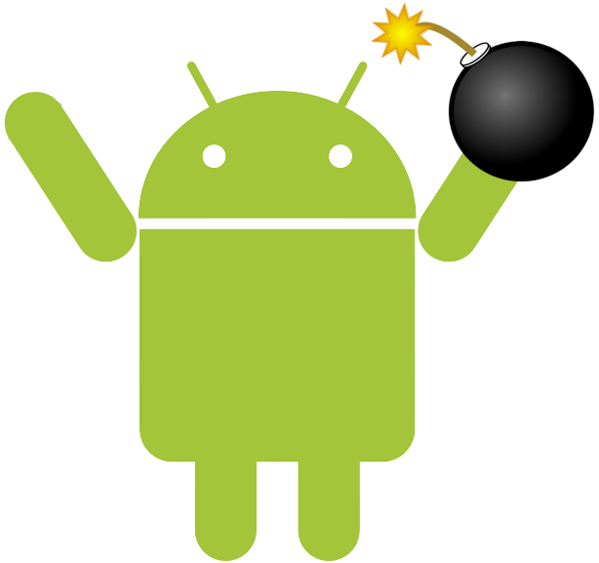
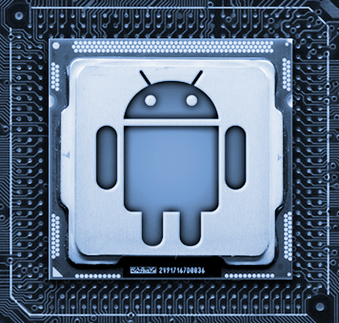
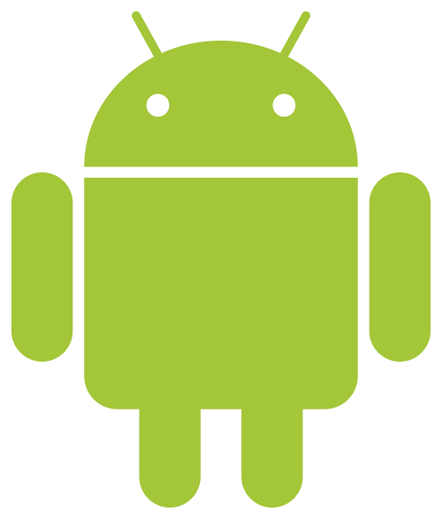
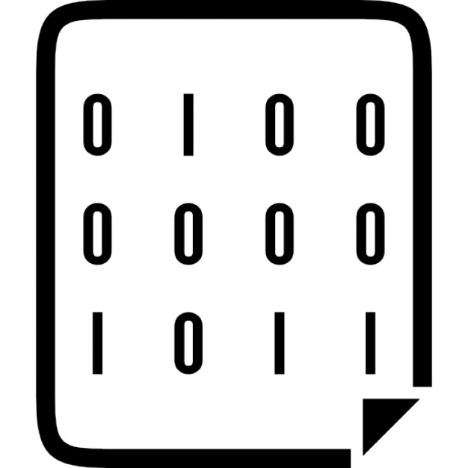
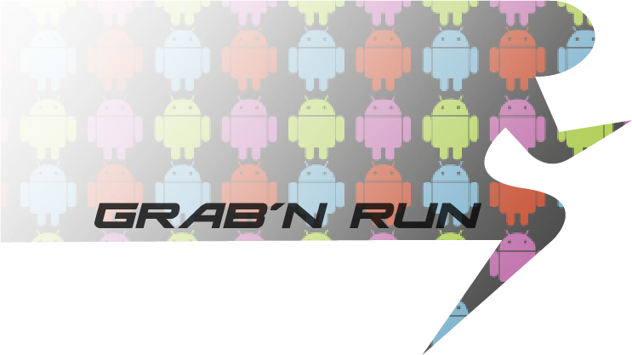
University of California, Santa Barbara
Northwestern University
Trustdroid Identifying and Mitigating Trust Violations in the Smartphone Ecosystem
Challenge:
Identifying and mitigating trust violations in the smartphone ecosystem
User – UI
User - Advertisement
User – Market
Apps – Network
Apps – OS
...
Scientific Impact:
Study and mitigate trust violations currently exploited in the wild
Identifying novel trust violations
Developing and evaluating automatic detection and mitigation solutions
Large scale measurement and analysis of apps and ad libraries
Identification
Solution:
Identification
Logic-bomb discovery
Bare-metal analysis
Java/native code interaction analysis
Intelligent dynamic analysis of apps
Mitigation
App sandboxing
Trustworthy GUI attribution
Safe code downloading
App instrumentation for policy enforcement
Broader Impact:
Scientific publications
Collaboration with vendors
Malware reported to Google, Baidu
Mobile ad analysis system adopted by Huawei
Open source releases
Android UI modifications
Grab’n run
Baredroid
Mitigation
Notes:
SaTC is a multi-disciplinary program, and PI Meeting attendees include academics, industry professionals, government representatives, and others with wide-ranging expertise. Building continuing support for the SaTC program and growing the security and privacy research community requires that we convey the essence and broader impacts of SaTC-funded research to diverse stakeholders in a clear, concise, and visual way, quantifying impacts where possible. The summary slide should be understandable by the broader security and privacy research community, including those researchers that don’t work in your specific research domain.
Use this template as a guide to ensure your slide addresses the topics identified. This slide may be used to introduce your project and/or promote the SaTC program both within and outside NSF.

