Slide 1
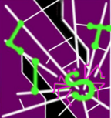
Proactive Web Security and Privacy Systems without Breaking Compatibility.
Xiang Pan
Ph.D. Candidate
Lab for Internet and Security Technology (LIST)
Northwestern University

Slide 2
Internet is not safe.
Web Security:
  Browsers have vulnerabilities (>100/year/browser).
  Websites have vulnerabilities. (e.g., gmail, icloud, facebook)
Web Privacy:
  User’s behavior on more than 90% of websites will be tracked by third-party trackers.
Notes:
New browsers vulnerabilities are discovered every weeek. Every year, there are at least a hundred vulnerabities on each browser exposed . attacker could exploit these vulnerablities and steal user information or take over the whole computer.
Moreover, many web services also have web vulnerabilities, such as XSS and sql injection vulnerabilities. Such vulnerabilities are more prevelant: Many popular apps had been found to have serious web vulnerabilitis, not to mention those services maintained and operated by smaller companies. Attacker can exploit thoese vulnerabilities to hijack user’s session and steal user’s sensitive information.
Web privacy is always contrvercial topic. Some people cared it so much and some people believe it’s the price to use free internet. But in any case, the fact is, user’s behaviors are trackered on most of the websites and user’s behaviors on differnet websites could be correlated together. If these information is leaked out, that would be a huge problem.

Slide 3
JShield: Vulnerability-based Detection Engine
JShield [ASCAC 2014] is a vulnerability based detection engine of scripts exploiting browser vulnerabilities.
  Robust to data pollution attacks and polymorphic attacks. .
  Vulnerability signature at the opcode level.
  Stateful vulnerability signatures.
Notes:
Before talking about my thesis’s problem statement, let me first briefly introcude my first PhD project.
Browser and plugins have vulnerabilities. Attacker could write malicious scripts to exploit the browser and take over the system.
When a new vulnerabilitiy is discovered, many anti-virus software engineering will write signatures to detect those malicious codes.
However, Attacker could easily write many very different kinds of exploit codes for the same vulnerability. Making tranditional signature-based detection engine very inefficient.
To address this limitation, we propose JSHield, a dynamic analysis engine. First, Jshiled automatically trigger all events to expose more codes to the detection engine. Seoncd, the signature is at opcode level and stateful. This design is based on the observation that in order for a specific vulnerability to be triggered, from op code level, all these different versions of attacking scripts have to go throught the same states. such as looking up prototype chain and get some field and then set it as null. Jshield’s stateful signature could describe such state transition using deterministic finite automaton

Slide 4
JShield: Pros and Cons
JShield works very well as a signature-based detection system:
  Deployed by Huawei, the world’s largest telecommunication equipment maker.
  Outperformed existing AV on millions of real-world malicious JS samples.
  Filed a US pattern application.
  Published ASCAC 2014.
However, JShield is a reactive security system.
  Requires prior-knowledge of existing vulnerabilities.
    New vulnerabilities are discovered every week.
  It cannot work without signatures.
    Attack has been in the wild before the signatures are ready.
Notes:
Jshield works well as a signature-based detection system.
It’s deployed by Huawei, the worlds’ largetst telcomuunicatoon equiment maker.
Before deploying JSHIeld, Huawei evluated our system using the millious of real-world malicous JS samples they collected and verified that Jshield performed better than Kasparsky.
Suffers all the limitations of reactive system.
New vulnerabilities are discovered every week!

Slide 5
Problem Statement
Proactive web security and privacy system.
Two challenges:
  [Identify Target] How to tell good/bad when you don’t know the enemy?
  [Preserve Compatibility] How to strike a balance between security/privacy and compatibility?
Notes:
Because of this limitation, when I started to think about my phd thesis, I prefer to solve security problem using proactive approach. Protecting users before before attack happens and requires no prior knowledge.
Proactive systems have two generaral challenges.
First, you don’t know the much about who the attacker is, what the malicious scripts look like,, how can you tell who is good and who is bad?
Second, proactive systems cannot describe the target, such as tracker or malicious payload, precisely. If it’s designed too aggressive, it could break the website’s functionality, but if it’s too conservative, it might be easilly bypassed by atacker.

Slide 6
Problem Statement (Cont.)
Two challenges in proactive web security:
  [Identify Target] Identify vulnerability or malicious scripts?
  [Preserve Compatibility] Preserve compatibility?
Web Security: CSPAutoGen [CCS 2016]
  Use template to describe benign script.
    Only execute benign script.
    No need to identify vulnerability.
  Transform scripts being CSP-compatible.
    Benign ones allowed, malicious ones blocked.
    No benign scripts will be blocked.
Notes:
In this thesis, I will discuss two projects in web seciruty and provacy. For web security, I will talk out CSPAutoGen, it’s published in CCS 2016. The system will protect suers against xss attacks by automatically deploy CSP on target website. CSP, which I will be discussed in detais later, will block scripts not loaded from a trusted host.
We just talked about the two challenges of proactive systems, To address the first challenge, CSPAutoGen propose a template mechanism to describe what benign script looks like.The basic idea is, as a proactive system, it doesn’t know if the site has vulnerabilities, and it doesn’t know what the malcious code liiks like, but it knows for this website, what benign scripts look like. As long as a script not matching the template, it will be blocked by CSP. In this way, if a website has xss vulnerabilities, attacker can only use it to execute benign scripts.
As for the second challenge, we propose several techniques to rewrite webpage and javascripts, ensure all JS being CSP compatible– benign ones get allowed by CSP, malicious ones blocked by CSP. In this way, all JS from the site will be propoerly executed and site’s compatibility won’t be compromised.

Slide 7
Problem Statement (Cont.)
Two challenges in proactive web privacy:
  [Identify Target] Identify tracker?
  [Preserve Compatibility] Preserve compatibility?
Web Privacy: TrackingFree [NDSS 2015]
  Partition client-side storage.
    Tracking request will carry different tokens to identify user.
    No need to know the trackers.
  Contents allocation mechanism.
    Evaluation shows compatible to most of the websites.
Notes:
For web provacy, I will discuss our paper TrackingFree and it ‘s published at NDSS 2915. It’s an anti-tracking browser defeat against web tracking. A lot of anti-tracking systems use blacklist to protect users. If a request sent to a tracker’s address, it will be blocked.
TrackingFree uses a dfferent ways, it doesn’t care about who is the tracker, but just partioning client-side storage, so all the tracking requests are still sent to trackers, but they just don’t know all these requests come from the same user because.
As for the second challenge, we propose an in-degree-bounded graph algorhm, making sure the new browser works for most of the web services.

Slide 8
RoadMap
Background & Problem Statement.
Project: CSPAutoGen: automatic CSP inferring system.
  CSP Background
  Architecture
  Design
  Evaluation
  Conclusion
Project: TrackingFree: anti-tracking browser.
Other side projects.

Slide 9
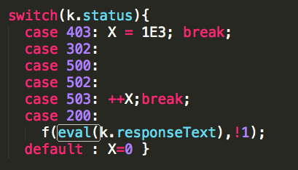
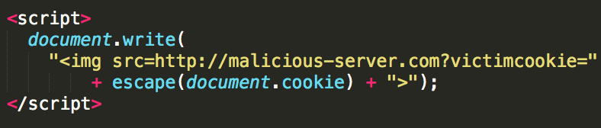
Content Security Policy (CSP)
Whitelist-based mechanism against XSS attacks.
Supported by all popular browsers.
CSP allows website developer to create a whitelist of trusted sources, and instructs the browser to only execute or render resources from those sources.
CSP disables eval and inline scripts by default.
  unsafe-inline
  unsafe-eval
Eval Script Example.
“UNSAFE”
Inline Script Example.
Notes:
Flexbile and convenient, but they might introduce more xss vulnerbailities.
Such two usages are very popular, so CSP allows developers to specify direvetives in their policiis, unsafe inline and unsafe-eval, the fomer allows eval script and the later allows inline scripts. However, just as the name suggests, these two direvetives are unsafe. Actucally, if both of them are enabled in the policy, the CSP becomes almost useless: if there is a XSS vulnerability, attacker can inject malcious payload through inline script, bypassing the CSP’s sources.

Slide 10
CSP Server Deployment Rate is Low
Website | Unsafe-inline | Unsafe-eval
facebook.com | Enabled | Enabled
twitter.com | Disabled | Enabled
yandex.ru | Enabled | Enabled
mail.ru | Enabled | Enabled
pinterest.com | Enabled | Enabled
alibaba.com | Enabled | Enabled
CSP deployment burden is high.
  Only 0.002% of Alexa Top 1M (20) websites enable CSP. [1]
  Only 0.00086% of 900,000 (8) least popular websites enable CSP. [1]
Few websites use CSP securely.
  Many specify “unsafe-inline” and “unsafe-eval”.
Alexa Top 50 Websites with CSP Deployed.
[1]. M. Weissbacher, T. Lauinger, and W. Robertson. Why is CSP Failing? Trends
and Challenges in CSP Adoption. In RAID. 2014.
Notes:
CSP relies on website developers to write secure policies for their websites. However, CSP disbales many popular but insucure usages of JS, site developers have to rewrite their web applications to make codes to be CSP-compatible. Otherwise, the csp will be either useless or the website cannot work properly.
This incurs heavy deployment burden, that’s why although CSP has been supported by all the browsers, its server deployment rate is really low. 20 out of 1 million websites enable CSP.
Moreover, even for the websites with CSP deployded, they didn’t use CSP in a secure way. This table shows the websites with CSP deployed among Alexa top 50 websites. You can see that all the six website enable unsafe-eval direvetive and 5 out of 6 enabled unsafe-inline. This just makes CSP almost useless.

Slide 11
Limitation of Existing Works
White-box approach: AutoCSP and deDacota.
  Require server modification.
Black-box approach: autoCSP.
  Serious compatibility issue.
All these works don’t support eval scripts and inline scripts generated during client-side execution.
  Use unsafe-inline and unsafe-eval.
Notes:
We expect to have a system that can automatically infer CSP for existing websites. There are three works proposed to achieve this goal. Two of them are white-box approaches and they require server modification. SO if a company’s security department would like to use these products, they have to convince the development depart to change their codes ever since. This could be a big problem for large companies.
Another balck-box approach requires work in training phase and working phase. In the training phase, it generates the model and then use the model to rewrite webpages in working phase. However, it requries all JS avaiable in the traning phase, othwesise it will break website’s functionality. However, this condition is too strong to achieve for any popular website. A lot of scripts contain data that’s related to current page’s topic or today’s date. There is no way to get those scripts in advance.
Moreover, JavaScript can dynamically generate new codes while executing. Such techniques are widely used because it can decrease the initial loading time of a page. However, all these works don’t support eval or inline scripts generated during client-side execution, so all these codes cannot be propoerly executed, unless unsafe-inline and unsafe-eval are specified, which makes CSP much less secure.

Slide 12
RoadMap
Background & Problem Statement.
Project: CSPAutoGen: automatic CSP inferring system.
  CSP Background
  Architecture
  Design
  Evaluation
  Conclusion
Project: TrackingFree: anti-tracking browser.
Other side projects.

Slide 13
Contributions
Black-box approach.
  No server modification.
  Support any server-side language.
Allow unseen, benign scripts.
Use CSP securely.
  Not specifying “unsafe-inline” or “unsafe-eval”.
Securely transform all types of JS to be CSP compatible.
  None of existing works can achieve that.
Notes:
Because of the limitation of existing systems, we propose our system, CSPAutoGen. First of all, it’s a black-box approach so no server modification is required and supports any server side language.
Second, as we just said, there are unlimited number of scripts, as a training based appraoch, CSPAutogen only require a small amount of samples in training phase, and then it can work on unseen scripts.
Third, it will deploy CSP securely, that means, the policies it generates will not include unsafe direvertives, like unsafe-inline and unsafe-eval.And the policies will not break the site’s functionalities.
Fourth, a webpage might introduce JavaScript in a variety of ways, but now matter how the JS is introduced, CSPAutoGen can transform of them codes to be CSP compatible.

Slide 14
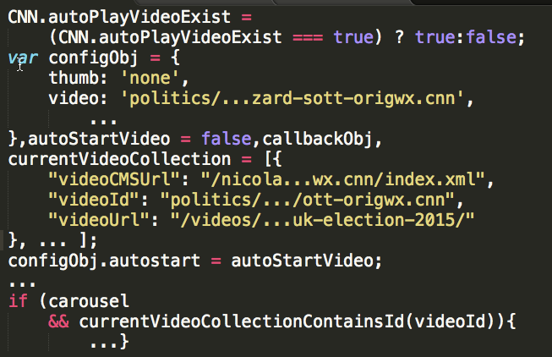
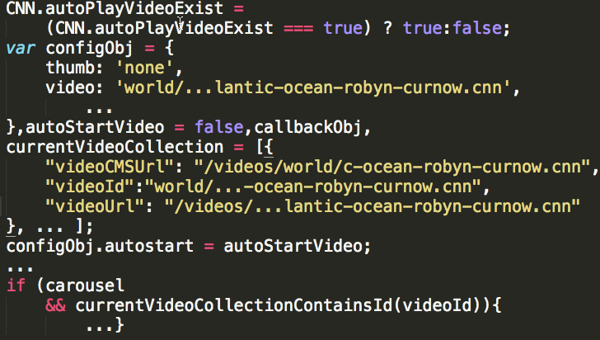
CSPAutoGen Core Idea
Code structures and logic are same.
Core Idea: build a template that infers scripts’ exact structures and types of contained data.
Data in the codes are different.
Notes:
Before going into the details, let’s first see the core idea of CSPAutoGen. When we observe the scripts from websites, we find out a lot of scripts look very similar. A further observation shows that these scripts share the same strutter, like an assignment followed by a if statement, but the embedded data is different. This makes sense because if a website has hundred thousands of different scripts, for quality and efficient, those scripts should be generated from some sort of framework or following some guidelines.
CSPAutoGen’s core idea is inferring code structure and types of contained data. Use both of them to determine if an unseen script benign or not. If benign, add the script to the site’s trusted host, which will be allowed by CSP, if malicious, the CSP will automatically disable it because the script is not from trusted host.

Slide 15



CSPAutoGen Architecture
Training
Phase:
Training templates.
Offline.
Rewriting Phase:
Rewrite webpage.
Inject CSP & library.
Web application firewall (WAF).
Runtime
Phase
Handle dynamic (eval) scripts.
Handle runtime-included scripts.
Browser.
Notes:
Here is the architecture of CSPAutoGen. It has three phases, training phase, rewetting phase and runtime phase.
Before deploying CSPAutoGen for a website, we first need to run it in training phase to train the templates for the target website. Then with the trainied templates, CSPAutoGen comes to rewriting phase. In rewriting phase, CSPAutoGen is deployed at the site’s web application firewall and rewrite all the incoming webpages. It also injects generated CSPs and a client-side library to each webpage. The library is used for runtime phase.
During rewrtting phase, not all scripts are availbel. Some codes are generated during client-side execution In runtime phase, CSPAutoGen needs to
ensure all the benign scripts among those dynamically generated codes being available during
Next, when the rewritten webpages are delivered to client-side to execute, the client-side library will make sure all dynamically generated codes can be converted to be CSP compatible.

Slide 16
CSPAutoGen Architecture
(Training Phase)
URLs with various configures.
Inline &
dynamic (eval)
scripts
Template
Generator
Template DB
Headless
Browser
Cluster
Templates
cnn.com
External scripts
src attributes
Host
Whitelist
Generator
JS Host
Whitelist
Notes:
A list of urls are obtained through the website’s test cases. Then these urls will be rendered in healdess browser cluster with various configures. During rendering, all inline and dynamic scripts are sent to template generator to build the site’s templates, which will be disucssed later; all external script’s src attributes are sent to host whitelist generator to build the site’s host whitelist. The site’s templates and host whitelist will be stored in a template database for later use.

Slide 17



CSPAutoGen Architecture
(Rewriting & Runtime Phase)
1. DOM tree observer
2. Symbolic Template
Trusted Server
Template DB
New Page:
1. No inline scripts.
2. CSP.
3. Library.
Benign Inline to External
Script: e.g, <script src=“trusted.com/a.js” …
1. Templates
2. JS Host Whitelist
CSPAutoGen Policy
Applier Engine
Original
Webpage.
User
Web server
Client Side
Server Side
Notes:
In rewriting phase, CSPAutoGen is deployed at the site’s well aplication firewall. It intercept all the outgoing webpages, match all the inline scripts against the site’s template. For benign inline scripts, it will move those scripts to a trusted server and then reimport those scripts thorugh a exteranl script tag, The new external script will be allowed by CSP because the trusted host is specified in the policies.
Then it injects policies and client-side library into the webpage and sent the webpage to client.
When the rewritten page is executed during client-side,
In rewritting phase, not all JS are avalible, so in

Slide 18
RoadMap
Background & Problem Statement.
Project: CSPAutoGen: automatic CSP inferring system.
  CSP Background
  Architecture
  Design
    Template Mechanism
    Processing Scripts based on Templates
  Evaluation
  Conclusion
Project: TrackingFree: anti-tracking browser.
Other side projects.

Slide 19
Design: Template Mechanism
/* Simplified Script */
AMPTManager.pageSlotsObj['ad_rect_btf_01'] =
fun.setTargeting('pos', ['rect_btf_01']);
AMPTManager.pageSlotsObj
['ad_rect_btf_01'] =
fun.setTargeting('pos', ['rect_btf_01']);
AMPTManager.pageSlotsObj
['ad_rect_btf_03'] =
fun.setTargeting('pos', ['rect_btf_03']);
Generalized AST
Notes:
First, let’s see CSPAutoGen’s template mechanism. The template is the key of the system: we consider all scripts matching the template as benign and the ones not matching as malicious. Based on our observation, many different JS share the same structure but contain varying data. To describe a code’s structure, the best way is abstract syntax tree.
However, AST contains not only structure, shownn as the black node, but also data, shown as red node. So we propose a new sturcure called generalized AST. It replace all data node in the AST as an abstract node and only keep the structure node, so different codes with the same structures will share the same gAST.

Slide 20
Design: Type System
AMPTManager.pageSlotsObj
['ad_rect_btf_01'] =
fun.setTargeting('pos', ['rect_btf_01']);
…
AMPTManager.pageSlotsObj
['ad_rect_btf_03'] =
fun.setTargeting('pos', ['rect_btf_03']);
The template mechanism (gAST) satisfies high matching rate, but might be abused by attackers.
CSPAutoGen Template Mechanism
=
gAST + Type System
Type:
  CONST
  NUMBER
  ENUM
  URL
  REGEXP
  GAST
[ad_rect_btf_01,
ad_rect_btf_03,
ad_rect_btf_03,
ad_rect_btf_03,
…
ad_rect_btf_01]
[pos, pos,
pos, pos,
…, pos]
Notes:
Gast can describe a script’s structure, but for better security, we also need to restrict the data contained in the script. Then we propose a type system. Here is how it works, during the training phase, we group together all scripts with the same gast, then, for each data node in each group, we infer its data type and value based on the corresponding data associated with that node. In our type system, we have six types, GAST is for expression that will appear in .
Therefore, the template mechanism is composed of gAST and type system.
To match an unknown script, we first extract its gast and check if this gast exsits in the site’s templates. If not, matching failed, otherwise, we will further detect the containde data. For each data node, we first detect if the unknow script’s data match the correponding data type in the template, if yes, then we further match if its value is accepted. For example, if the type is URL, we will determine if the unknown script’s url’s host exist in the corresponding template’s data node. Only if the unknown script passed both tests, will we consider the script as benign.

Slide 21
Design: Script Processing
JavaScript Category Modifiers:
  Inline vs External.
    <script src=“external.js”></script>
  Pre-included vs Runtime-included.
    body.appendChild(script-tag-object);
  Dynamic.
    eval(“alert(1)”);
Notes:
Next, let’s see how CSPAutoGen transform JavaScripts into CSP compatible.
To make it clear, first, I would like to intodce the following five modifiers to describe JavaScript categories. All javaScript can be descirbed using one or several of these modifiers.
Inline script refers to the scirpts that are directly embedded in the script tag, as opposed to external script that are refered though src attribute.
Pre-included script refers to the scripts that are available before user’s browser rendering the webpage. In other words, pre-included scripts are the ones availble at rewritting phase, while runtime-included refers to scripts that are generated during client-side execution.
Dynamic script refers to the scripts that are interpreted by eval and eval like functions.

Slide 22
Design: Script Processing (Cont.)
Any JavaScript can be classified as one of the following.
  Pre-included external script.
  Runtime-included external script.
  Pre-included inline script.
  Runtime-included inline script.
  Dynamic script.
Handled by CSP automatically.
CSPAutoGen is required.
Notes:
Any JavaScript can be classified as one of the following five categories. First external scripts, no matter it’s preincluded or runtime-included, it can automatically handled by CSP. That is, the the src attribute of the external script is specified in the policy, it will be allowed, otherwise, it will be blocked.
Then there are three other categories of scripts: pre-included inline script, runtime-included incline script and dynamic script. Now I will discuss how CSPAutoGen transform each of them so the benign scripts will be allowed by CSP, while the malicious ones automatically blocked. Since all scripts can fall into one of the five categories, we will say CSPAutoGen can handle all JavaScripts.

Slide 23
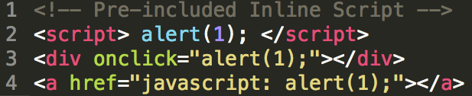


Design: Pre-included Inline Scripts
Core Idea: transform benign inline scripts to external scripts during rewriting phase.
<script src=http://domainA.csp.com/hash.js> </script>
1. Match the script against templates.
2. Put benign script to server.
3. Rewrite script tag.
Notes:
Pre-included inline script refers to the inline scripts that are availble before browser rendering. As shown in the figure, inline script can be put in the script tag, event handler and JavaScript URL scheme.
Pre-included incline scripts are available during rewritting phase. So during the rewriting phase, we match each inline script against templates, if matched, we put them into a trusted server where the script an associated url is allocated to that script. Last, we set the src attribute of the script tag as the url, transforming the inline script to external scripts. For inline event handlers and JavaScript URL scheme, they can be handled in a similar ways with two extra steps. Firtst, they need to be wrapped by a function and then this function needs to be registered as corresponding event handler.

Slide 24
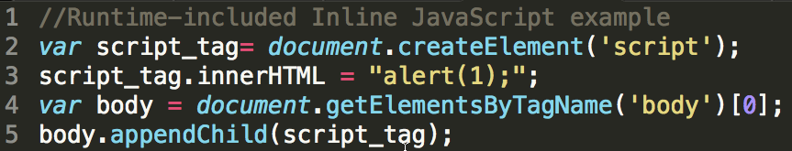
Design: Runtime-included Inline JavaScript
Core Idea: observe DOM-tree change and process new-added script tag the same way as pre-included inline script.
Notes:
CSPAutogen can handle it by observing DOM-tree change because no matter how the scripts are generated, they have to modify DOM tree before being exected by browser.
Runtime-included JavaScript are included and executed during runtime by other JavaScripts.
Here is an example, the script first create a script tag and then set inline script to the tag, after that, the tag is appended back to the page’s DOM true, when it is done, the script will be executed.
It’s Widely-used, but none existing works can handle beacause it’s not available during rewritting phase.
For such case, no matter how it is included, a script tag has to be added to the DOM tree. Therefore, the key to process runtime-inclded inline JS is by observing DOM-tree change. And whenever a new script tag is crated, we can process them in a simlar way as pre-included inline script.

Slide 25


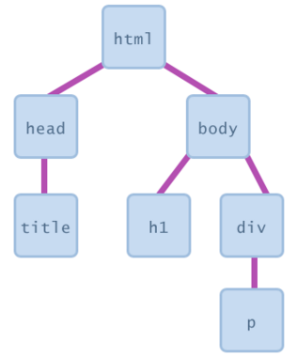
<script>
alert(1);
</script>
2. Find a new script tag with inline scripts.
1. Observe DOM tree change.
4. If matched, send the inline script to CSPAutoGen server.
3. Match the script against templates.
<script
src=“http://da.csp.com/path1”>
</script>
5. CSPAutoGen server matches and stores the JavaScript into a file accessible to outside.
7. Client-side library add a new script tag with src attribute set as the returned URL.
6. CSPAutoGen returns the script file’s URL back to client-side.
Notes:
Here is the details. During rewritting-phase, our library wil register an observer to observe the DOM tree change when the page is ready. Whenever a new script tag with inline script is detected, we will extract the inline script and use it to match against the templates. If matched, the script will be sent to the website’s trusted server. Where a url is created for this script. Then the server will returns the url back to client-side library, which will use the url to add a new exteal script tag to the DOM tree. Since the script trusted server is specified in the CSP’s whitelist, the external script will be executed.
This process is asynchronized. However, all the runime-inlucded scripts are synchronized, so it won’t break the website’s functionality.

Slide 26
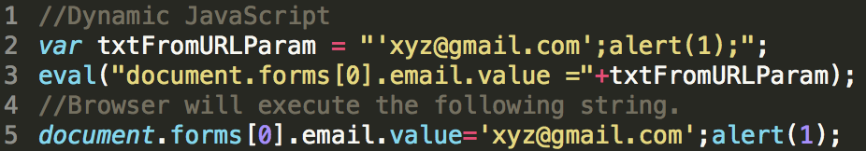
Design: Dynamics Scripts
Eval and Eval-like functions:
eval, setTimeout, setInteval and Function
Core Idea: we know benign dynamic scripts’ structures, so we can define all allowed script structures as functions and data node as functions’ parameters (symbolic template).
Notes:
The last category is dynamic scripts. Dynamic scripts refer to the codes that are generated by eval and eval like functions.
These four functions can interpret strings as JavaScript codes. This figure shows an vulnerability introduced by dynamic scripts. In line two, variable txtFromURLParam stores the strings extracted from URL’s parameters. If this string are sent to eval method for execution without proper sanitization, the malicious codes could be executed in victim’s browser.
CSP disables such usage. But these methods are frequently used in web applications and frameworks, disabling all such usages will break most of the site’s functionalities.
We need to transform all dynamic scripts to CSP-compatible, that is, still allows those benign dynamic scripts, while disables malicious ones. The core idea is, we consider a script as benign only when it pass tempate matching, that means, we know all benign scripts’strucuters. We can prepare those code structures as JavaScript functions and define them in the page in rewritting phase, during runtime-phase, we just extract target script’s data node and call corredsponding function with those data as parameters. We refer to these functions as symbolic templates.

Slide 27
eval( "AMPTManager.pageSlotsObj[’ad_ns_btf_01’] =
googletag.defineSlot(’/8663477/CNN/world/leaf’,
[[1 ,2] ,[150 ,90] ,[300 ,50] ,[300 ,100]] , ’ad_ns_btf_01 ’).
addService(googletag.pubads()).
setTargeting(’pos’, [’ns_btf_01 ’]);");
//convert gAST to JavaScript.
AMPTManager.pageSlotsObj[CSP_String] =
googletag.defineSlot(CSP_String , CSP_Array , CSP_String).
addService(googletag.pubads()).
setTargeting(CSP_String , CSP_Array);
//Symbolic template function for the gAST.
var symTemplate = function ( CSP_S1 ,CSP_S2 ,CSP_A3 ,CSP_S4 ,CSP_S5 ,CSP_A6) {
AMPTManager.pageSlotsObj[ calcNodeVal(CSP_S1) ] =
googletag.defineSlot(
calcNodeVal(CSP_S2), calcNodeVal(CSP_A3), calcNodeVal(CSP_S4) ).
addService(googletag.pubads()).
setTargeting(calcNodeVal(CSP_S5), calcNodeVal(CSP_A6)); };
Notes:
Now let’s see an example, Here is a dynamic scripts. This string will be interpreted by eval method.
We would like to execute the script only when the string pass template matching, so we must have seen its gast in training phase. When converting its gast back to script, it looks like this: All abstracted data becomes a vairable, shown in orange.
Then, we wrap these snippet of code into a function and make these data variable as the method’s varaible. Note that in JS, a data could be array and object, where an expression can be stored, in order to preserve the exeuction order, we further wrap these para,eters with a method called calcNodeVal, which will make sure the expressions’exection order is preserved.
This is the basic idea, In implementation, it’s more complicated than that because we also need to be very careful to deal with the schope chain of JavaScript. I don’t want to g into very details here.

Slide 28
Design: Dynamics Scripts (Cont.)
1. Rewrite eval and eval-like functions.
  E.g., window.eval = function(arg) {}.
  The rewritten eval function is allowed by CSP.
2. In rewritten eval function, we match the argument against the templates.
  If not matched, do nothing.
  If matched, we instantiate the symbolic template function to execute the argument as JavaScript.
Notes:
After understainng the sumbolic template mechanism, here we see how we we deal with dynamic scripts.
First, in rewtitting phase, we rewrite all dynamic scripts. Note these rewritten scripts are allowed by CSP because they cannot interpret any strings as JavaScript codes;
Then during runtime phase, when any of these eval or eval-like function called, our rewritten method will be actually invoked. In the rewritten method, we first match the argument string against the tempaltes, if matched, we instantiate the symbolic template function to execute the arguments.
Such process is synchronous, In this way, we ensure benign dynamic scripts executed, while malicious ones disabled. Note that attacker could find a variety of tricky ways to obtain the original eval method, but users are still protected because CSP diables eval from JavaScript engine levevl.

Slide 29
RoadMap
Background & Problem Statement.
Project: CSPAutoGen: automatic CSP inferring system.
  CSP Background
  Architecture
  Design
    Template Mechanism
    Processing Scripts based on Templates
  Evaluation
  Conclusion
Project: TrackingFree: anti-tracking browser.
Other side projects.

Slide 30
Evaluation:
Robustness on Unseen Webpages
Training Page : 2,000
Testing Page : 500
Template # : 262
Matching Rate:
91.6% - 100%
Median: :99.2%
Median: 99.2%
Notes:
Now let’s see its evaluation, we first would like to see the template matching rate on unseen scripts. We did this experiment on Alexa top 50 websites. For each website, we cralwed 2500 different webpages. We use 2000 of them to train templates and use the rest 500 to verify the tempalte’s mathcing rate. The rate rages from 91 percent to 100 percent, with a median value of 99 percent. Note that we did this experiement without any server collaroration, If server-side’s test cases are available, this could easily acheve 100 percent matching rate.

Slide 31
Evaluation:
Robustness Over Time.
Domain | # of Templates (01/01/16) | MR (02/01/16) | MR (03/01/16) | MR (04/01/16)
Amazon | 596 | 99.62% | 99.13% | 98.39%
CNN | 259 | 98.72% | 98.50% | 98.30%
Facebook | 53 | 99.47% | 97.90% | 95.98%
Google | 857 | 97.89% | 94.13% | 87.14%
Reddit | 49 | 97.47% | 97.01% | 89.78%
Yahoo | 295 | 99.30% | 99.05% | 94.01%
Real-word Websites
# of Training Page: 2000, # of Testing page: 2000
Notes:
Now we would like to see the robutstness of template overtime. We crawled 2000 webpages from these six websites. For each of the website, we crawled 2000 webpages on four different dates. We use the pages crawled on Januar fist to build template and then use this template to match scripts crawlled on Feb 1st, March 1st and April first. From the table, we can see, Amazon, cn Facebook maintain a high matching rate for three month. Reddit and Yahoo works fine for two month. Google needs to update evey month.
In reality, CSPAutoGen’s training engine can be deployed at the compnay’s quailty assurance side, when new function has been added and just passed the testing, the new pages or scripts should be sent to CSPAutoGen to update the template. This way, it can always maintain a high matching raete.

Slide 32
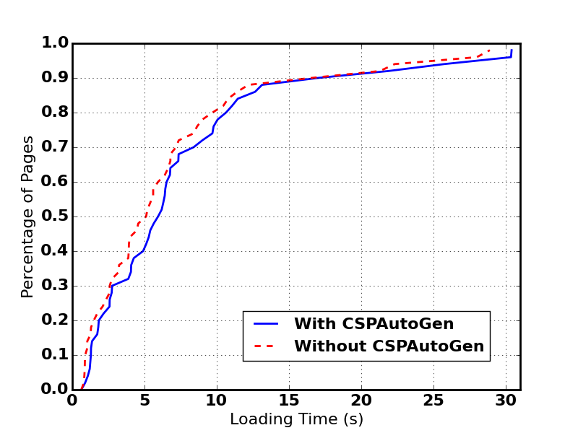
Evaluation:
Performance Overhead
Can be optimized.
Source | Min (ms) | Median (ms) | Max (ms)
DOM Tree Parsing | 1.97 | 112.62 | 1349.0
Script Transmission | 23 | 51 | 332
gAST Building | ~0 | 0.2 | 33
Template Matching | ~0 | 0.1 | 0.5
Runtime-included Script | 9 | 107 | 1419
Dynamic script | ~0 | 9 | 64
Alexa Top 50 websites.
  Median: 470ms, 9.1%.
Running asynchronously.
The Breakdown of CSPAutoGen Latency.
Notes:
Now let’s see its performance. From the table, we can see the bottle neck of the system resides in DOM tree parsing and handling runtime-included script. For the former, we can optimize it by using a more efficient parser. We currently use an python-implemented one, conveninet but slow. For runtime-inlicded script, it works asynchoursly, so affects little user experience.

Slide 33





Evaluation: Compatibility
Correctly render Alexa Top 50 Websites.
Case study on five popular websites (without CSP support) in different areas.
Email
Search Engine
Online Shopping
Online Social Network
Web Portal
Notes:
Next we would like to see its compatibility. We first render Alexa Top 50 websites with and without CSPAutoGen enabled and compare the figure difference. The results show that CSPAutoGen can correctly render these websites.
Then we choose thse five ppluar websites, and conduct extensive case studies on them. We sent email, search news, images, post a message, shared a news to my socal network and puchase some stuff from Amazon. It all works properly.

Slide 34
Conclusion
Black-box approach to deploy CSP for existing websites.
  Server modification is not required.
  Support any server language.
Securely convert ALL types of JS to be compatible with CSP.
  Including dynamic scripts and runtime-included inline scripts.
Acceptable performance overhead (9.1%) and compatible with existing websites.

Slide 35
RoadMap
Background & Problem Statement.
Project: CSPAutoGen: automatic CSP inferring system.
Project: TrackingFree: anti-tracking browser.
  Introduction & Background
  System Design
  Evaluation
  Conclusion
Other side projects.

Slide 36


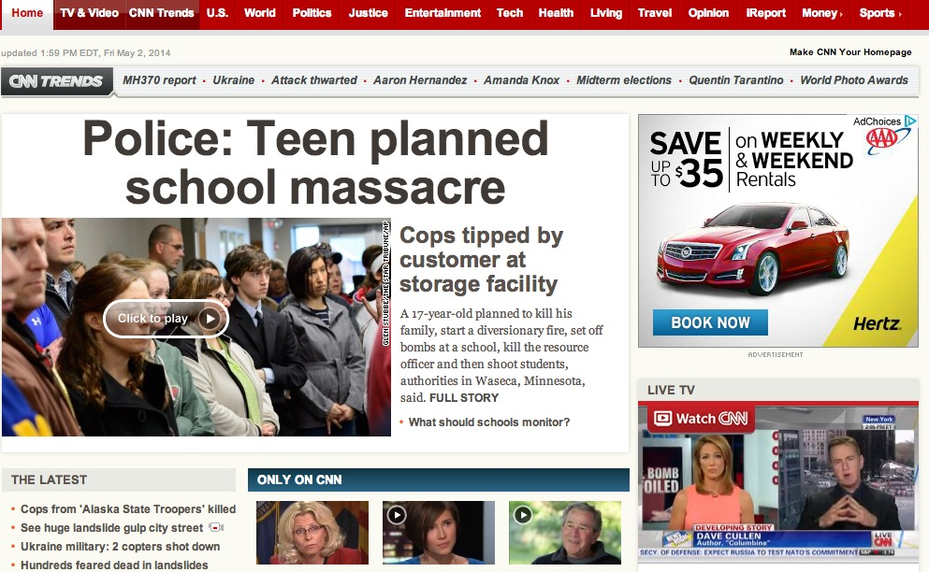
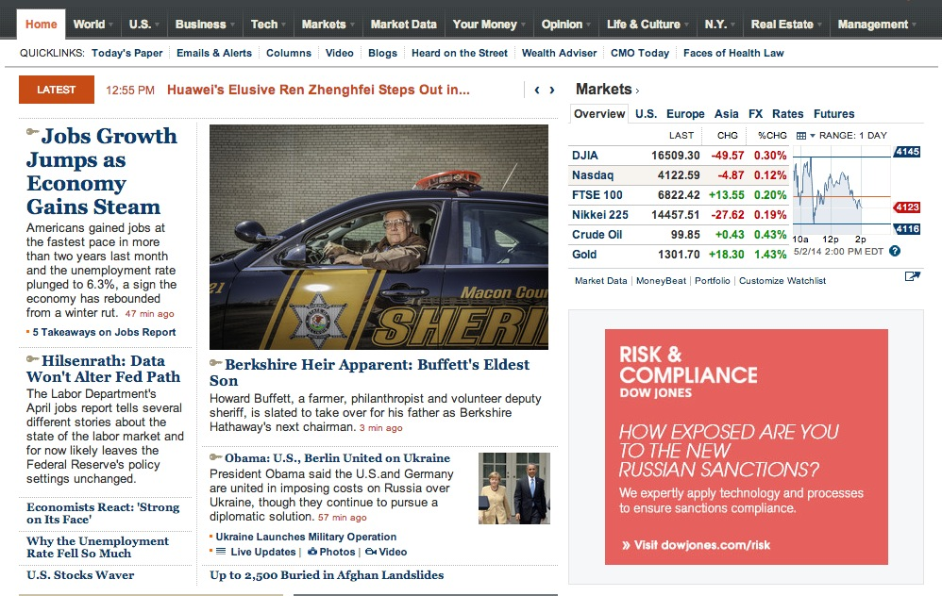
Web Tracking
User
Referer : http://online.wsj.com/
Cookie : id = 12345
Tracking server
doubleclick.net
Referer : http://www.cnn.com/
Cookie : id = 12345
Visit wsj.com
Visit cnn.com
Notes:
Now let’s first see how web tracking works.
When a user visits a website, say wsj.com, the site contains some tracking element. While rendering, user’s browser will automatically send requests to the tracking server, In this example, we will consider the tracker as doubleclick.net. In the tracking request, it contains where the request is sent from, in this case, it’s wsj.com as well as a gloally unique id the tracker associated to this user.
Then later when the user opens another webpage in cnn.com, such tracking element still exists in that page and browser will send another request to tracker. Agin, this request contains the page’s url as well as the user’s ID.
Thorugh the id, the tracker can know this user, 12345, has visited a page in wsj.com and another page in cnn.com.

Slide 37
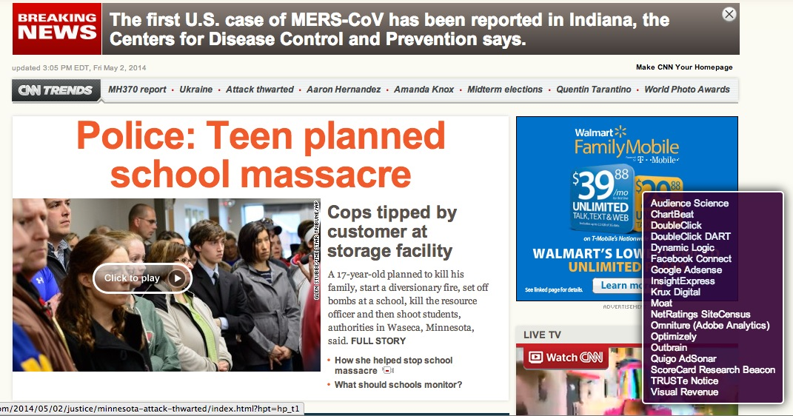
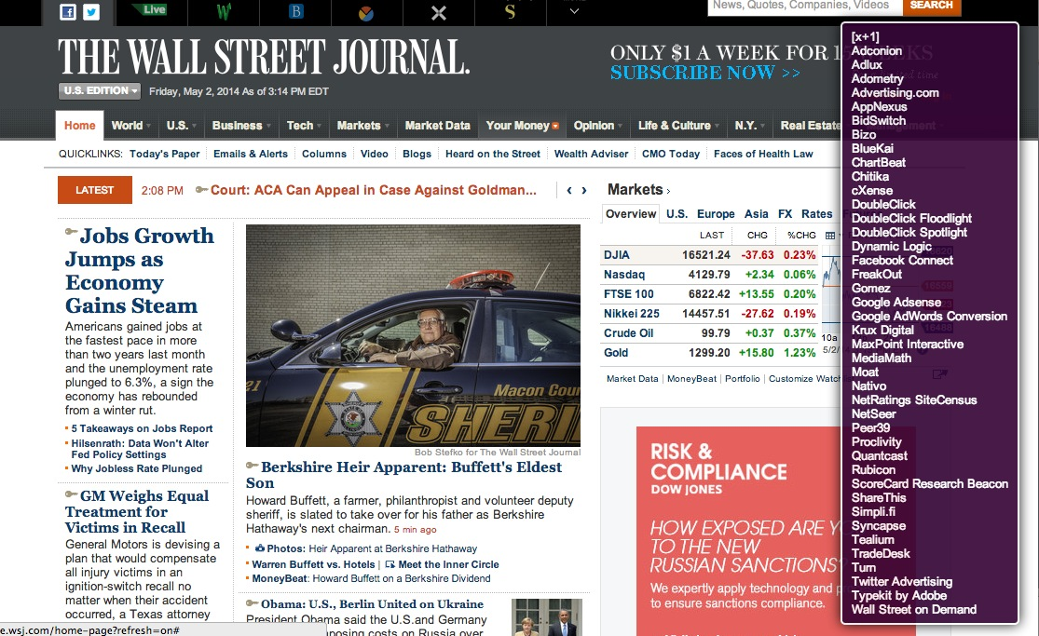
Web Tracking is Prevalent and Serious
  Prevalent
    More than 90% of Alexa Top 500 websites [Roesner, NSDI 2012].
    A web page usually has multiple tracking elements.
  Serious
    Not only browsing history, but also other sensitive information such as location, name and email, can be leaked out.
Notes:
Web tracking is prevalent. More than 90% of websites contain at least one trackers, and each site usualy contain multiple trackers. So users behaviors on cnn are watched by more than 20 parties whle on wsj, more than 40 parties.
there is no technical barrier to them associating your identity with your -- Arvind
your identity can be attached to data that was initially collected without identifying information

Slide 38
No Effective Defense Approach
Disable third-party cookie
  Many other locations to store user’s identifiers
Blacklist-based anti-tracking tools
  Priori knowledge of tracking servers
Do-Not-Track header
  No enforcement
Notes:
Existing defense approaches can be classifeid as the following categories:
Some browsers, such as safari, allows user to disable third-party cookie, which is the major storage to store the identifeir tracker associate to each user. However, there are many other locations to store the identifeir, such as plugin, HTML5 local storage, etc
Many defense appraoch use blacklist to block those requests sent to trackers listed on the list. Such appraoch requires prior knowledge of tracking servers, and it’s easier for tracker to bypass it.
Another approach is called Do-Not_tracker header, which is a header field put on http request telling the tracker that the user done’t want to be tracked. However, there is no enforcement and tracker can just ignore it compeletely.

Slide 39
TrackingFree
Goals and Challenges
Complete Anti-tracking Capability
Backward Compatibility
Affordable Performance
Referer : http://online.wsj.com/
Cookie : id = 12345
Referer : http://www.cnn.com/
Cookie : id = 24578
Core Idea : TrackingFree partitions client-side states into multiple isolation units so that the identifiers still exist but not unique any more!
Notes:
In order to address the shortcomings of existing approach, we propose TrackingFree. Its core idea is partioning client-side storage into multiple isolation units, so that identfier still exists, but not unique any more.
Let’s review preivous exmpale, in TrackingFree, the two webpages will be rendered in two different princpals, each of which has an independent sotrage, so the identifiers carried by the two requests are not the same any more. Therefore, the tracker cannot associate user’s behaviors on the two principals.

Slide 40
RoadMap
Background & Problem Statement.
Project: CSPAutoGen: automatic CSP inferring system.
Project: TrackingFree: anti-tracking browser.
  Introduction & Background
  System Design
  Evaluation
  Conclusion
Other side projects.

Slide 41
Regular Browser Architecture
Notes:
Before discussing the details of trackingfree, let’s first see a regular browser’s arichitecture. Nowadays, all web pages share the same persistent storage. Third party elements, no matter on which page they are embeded, they an access the same storage as long as meeting same-origin-policy. This is why the tracking element in wsj and cnn can access user’s id and send them to trackers.
Here is trackingfree’s architecture. It renders different domains in different principals. For each principal, it not only has independent memory space, but also indenpend persistent storage. Web elements in one principal cannot be able to access the storages of another principal. For example, both principal contains a frame belonging to online.b.com, but they can’t access the same cookie because the cookie storages are isolated, though they belong to same origin. Fundementally cuttting off the chain that trackers can correlate users hehvors on multiple principals.
Trackingfree adopt profile based isolation mechanism because its completeness and low overhead. Such mechanism is proposed by Chromium or Firefox to isolate the persistent storages belong to different users. They can guarantee that all the storages will be isolated
Different principals can’t directly communite, but they can coommunicate through the replay of the kernel. For exmaple, if mail.a.com wants to post a message to online.b.com, the principal will put the message in an IPC message and send it to kernel. After receiving the message, the kernel can check whether this message meet the privacy requirement, which we will discuss in principal communication section. If the message meets the requierement, kernel will relay the message to corresponding principals, otherwise, the message is rhtough away,
If a navigatioon is about to happen, like a new page is opened, or existing page redirect to another, the browser kernle will decide on which principal to render the new page. This content allocation mechanism is the key to strive a balance between anti-tracking capability and privacy-preserving capanility. In order to make smart decisions, TrackingFree needs to undersntand the relationships between any two principals, so the principal bacnend will maintain a graph to describe principals organization.

Slide 42
Contents Allocation Mechanism
Initial Contents Allocation
  Handles those pages that are navigated by users directly.
Derivative Contents Allocation
  Handles those pages that are generated due to the contents on other pages.
Notes:
Now let’s see how the contents allocation mechanism, Tehre are two parts: initial contents allocation and dereviative contents allocation. The former deals with those tpo frames that are navigated by users directly, such as user open a new page via address bar,
The derivative conents allocation handles those frames that are generated due to the cotents of other frames, which we refer to child frame, such as user clicks a link or the page just pops up a window.

Slide 43
Initial Contents Allocation
Notes:
IAM is simple, all pages with the same domains are put into the same principal, while pages with different domains put in different principal.
Each domain corresponds to one principal.

Slide 44
Derivative Contents Allocation
Principal Switch
  Cross-domain
  User-triggered
Principal Selection
  Maintains an in-degree-bounded graph for principals.
  The in-degree of the graph is set to two.
44
Notes:
For derivative contents allocation, we first need to device when a new page is about to rener, should we change the principal. A short answer is we only swich principal if the new page is cross-domain and triggerd by user.
Then if a principal switch is about to happen, trackingfree needs to decide the target principal. In order to achieve a good balance between anti-tracking capability and compatibility, we propose a indegree-bounded graph for princial.
Here is a principal organization graph, each node represents a principal and A directed edge from principal A to principal B exists if and only if at least one principal switch from A to B has occurred before.
P = (k+1)(c+1)
Assuming in principal 3, a new page with domain a.com is opened, TrackingFree will search will search principal 3 has ancestor with domain a.com. It found princial 1, so, the new page will be rended in principal a1. Similaly, if a page p.com is opened, it will be opened in principal 2. However, if another page b.com opend at principal 4, the new page shouldb’t be opened in principal 2 because that node’s indree already aceives 2. So instead, TrackingFree will create a new principal and set it as the principal 4’s child.
We experimentally verifiedd such design can preserve website’s functionalities, and formally proved its anti-tracking capability is still maintained.

Slide 45
RoadMap
Background & Problem Statement.
Project: CSPAutoGen: automatic CSP inferring system.
Project: TrackingFree: anti-tracking browser.
  Introduction & Background
  System Design
  Evaluation
  Conclusion
Other side projects.

Slide 46
Evaluation
Anti-tracking capability
  Formal proof
  Experiments with real world websites
Compatibility
Performance
  Latency
  Memory usage
  Disk usage

Slide 47
Formal Proof
Methodology
  Use Alloy to formally analyze TrackingFree ’s anti-tracking ability.
  Describe TrackingFree’s behaviors on an existing Alloy web model [Akhawe et al. CSF 2010].
Results
  Formally verified that trackers can correlate TrackingFree user’s activities up to three principals.
Notes:
Alloy will search the counterexample of the claim in a limited-size space. If Alloy cannot fnd the counterexmaple, we will say the claim is correct in that space.
structural modelling language

Slide 48
Anti-tracking Capability with Real World Websites
Re-implemented an in-complete but accurate tracking token detection approach [Roesner et al. NSDI 2012].
The approach is based on the observation that each tracking request must contain the user’s globally unique identifier.
Notes:
Then we exprimentally evaluate TrackingFree’s anti-tracking capability. We re-mplemented an existing approach to find tracking tokens.
The tracking token is a string in each reuqest used to uniquely identify a user. In the beigging example, the id filed is a tracking token because it can help tracker to correlate users activities on cnn and wsj.

Slide 49
Anti-tracking Capability with Real World Web Sites
Tracking Host | Prevalence (# Domains) | Tracking Token(s)
b.scorecardresearch.com | 133 | UIDR
ad.doubleclick.net | 117 | id, __gads
ib.adnxs.com | 75 | anj
p.twitter.com | 70 | __utma
cm.g.doubleclick.net | 56 | id
ad.yieldmanager.com | 52 | bx
bs.serving-sys.com | 40 | A4
cdn.api.twitter.com | 40 | __utmz
secure-us.imrworldwide.com | 38 | IMRID
adfarm.mediaplex.com | 31 | svid
Visited 2,032 valid URLs from Alexa Top 500 websites.
Gathered 647 tracking tokens.
TrackingFree eliminated all of them.
Notes:
On Alexa top 500 webstites, we found 647 trackers using a regular firefox browser. Then we repeat the work on TrackinFree browser, we found zero trackers, means TrackingFree disables all trackers.
This taken shows the top 10 prevenlent trackers we discovered.

Slide 50
Compatibility
Manually tested TrackingFree’s compatibility on 69 third-party services from Alexa Top 50 websites.
Name | Example | # Succeeded Instance | # Total Instance
Cross-site online payment | Purchase on Ebay and make payment on Paypal | 1 | 1
Cross-site content sharing | Share Youtube video to Facebook homepage | 32 | 32
Single sign-on | Using Facebook account to login Yahoo | 35 | 36
Overall Results |  | 68 | 69
Notes:
Now let’s see TrackingFree’s compatibility.
Because trackingfree might only affect the scenrio when multiple sites interacts with eachother. So we evauate TrackingFree’s compability on 69 third-party services from Top Alex 50 websites. This services include 1 cross0site online payment, 32 cross-site content sharing and 36 single sing-on servces. It only failed on instance of single sign-on service, logging pinterst using fb.
logging pinterest.com through user’s Facebook account

Slide 51
Performance
Source | Overhead
Latency | ~3%-~20%
Memory | ~25MB/principal
Disk | ~0.6MB/principal

Slide 52
TrackingFree Conclusion
TrackingFree browser completely protects users from third-party web tracking by isolating web contents.
We theoretically and experimentally proved TrackingFree’s anti-tracking capability.
TrackingFree is backward compatible with existing websites.

Slide 53
RoadMap
Background & Problem Statement.
Project: CSPAutoGen: automatic CSP inferring system.
Project: TrackingFree: anti-tracking browser.
Other side projects.

Slide 54
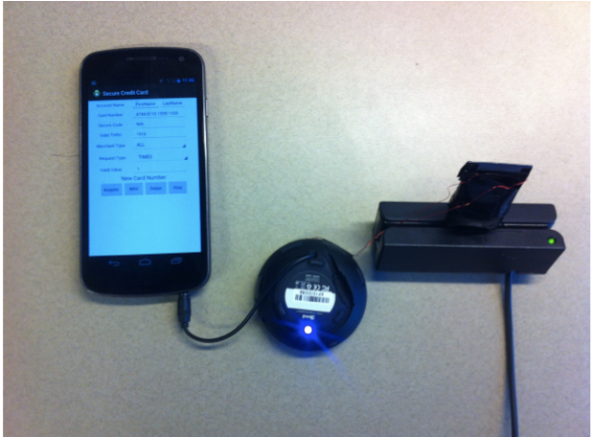

Other Side Projects
SafePay [CNS 2015]: a device that protect against credit card forgery with existing magnetic card readers. Won best paper award.
HogMap [SDN-NFV 2016]: an SDN-based distributed honeynet market place.
Are These Ads Safe [NDSS 2016]: measure if the ads in Android Apps might contain malicious contents.
Android
Solenoid
Amplifier
Card reader
Notes:
SafePay. can Magnetic credit card is not safe. SafePay is a device that can connect to the phone, fetch a disposable card number and transform that number into sound wave that can be received by existing card reader.
HogMap:It allows multiple geographically isolated honeynets and unallocated ip spaces dynamically work together to monitor and respond to malicious traffic. For example, in northwestern, we have several old machines that we would like to use them as honeypot, but we don’t have a block of unallocated IP spaces to capture suspicious traffic. Meanwhile, a research lab, SRI international, they have sufficient IP spaces but lacks of honeypot servers. So the both parties can send requests to HogMap and a distributed honeynet will be created dynamically. All triffic sent to SRI internatial will be forwared to NU to respond, and then response will be forwarded back to attacker. Both parties can access the traffic.
600K 2,423 malicious URLs • 706

Slide 55
Xiang Pan, Yinzhi Cao, Yan Chen, Shuangping Liu, Yu Zhou and Yan Chen.
CSPAutoGen: Black-box Enforcement of Content Security Policy upon Real-world Websites, (CCS 2016).
Xiang Pan, Vinod Yegneswaran, Yan Chen, Phillip Porras and Seungwon Shin
HogMap: Using SDNs to Incentivize Collaborative Security Monitoring, (SDN/NFV 2016).
Vaibhav Rastogi, Rui Shao, Yan Chen, Xiang Pan, Shihong Zou, and Ryan Riley
Are These Ads Safe: Detecting Hidden Attacks through the Mobile App-Web Interfaces, (NDSS 2016).
Yinzhi Cao, Xiang Pan and Yan Chen,
SafePay: Protecting against Credit Card Forgery with Existing Magnetic Card Readers, (CNS 2015).
Won the Best Paper Award. Featured in CCTV-America and over 30 news periodicals.
Xiang Pan, Yinzhi Cao and Yan Chen,
I Do Not Know What You Visited Last Summer - Protecting users from third-party web tracking with TrackingFree browser, (NDSS 2015).
Yinzhi Cao, Xiang Pan and Yan Chen,
JShield: Towards Real-time and Vulnerability-based Detection of Polluted Drive-by Download Attacks, (ACSAC 2014).
Adopted by Huawei Inc., the world’s largest telecommunication equipment maker.

Slide 56
Backup Slides…

Slide 57
Case study: Logging Yahoo using Facebook Account
(1). Logging
using FB
(8). Data (F)
Carried on URL
(5). Logging FB
(2). Data (Y)
Carried on URL
(4). Data (Y)
Carried on URL
(6). Data (F)
Carried on URL
(3). Data (Y)
Carried on URL
(7). Data (F)
Carried on URL
57

Slide 58
Principal Communication
Cross-domain communication is widely used, but break the isolation mechanism.
Our solution: we restrict the use of explicit communication as follows:
  Third-party elements in one principle can not explicitly communicate with other principals.
  First-party elements can only explicitly communicate with the first-party elements placed in its neighbor principals
3119
4852
6
0
Notes:
Cross-domain communication is widely used, but it break the isolation mechanism.
We

Slide 59











Problem Statement
1. Principal customization for dynamic analysis.
2. Multiple principal coordination.
3. Automatic principal policy inference.
TrackingFree: an anti-tracking browser.
NDSS, 2015
CSPAutoGen: a system inferring CSP.
CCS, 2016
JShield: a vulnerability- based detection engine.
ACSAC, 2014
Notes:
Among all the security techniques, sandbox is the most practical one. Actually, browsers are implemented as a sandbox.
Here is the design of Chrome browser. Web pages in different domain will be rendered in different sandbox, which we refer to principal. Browser kernle is running in a standalong process. So even if malcious codes are executed in one pricinapl, it’s still challenging to exploit other princpals or browser kernels.
My thesis focus on how to better utilize sandbox techniques on web security and privacy. It’s composed of three parts.. The first one studies how to customize browser sandbox to make dyanamic analysis more efficient. Our project Jshield belongs to this category. Jshield is a vulnerability-based detection engine. In this project, we first added a JS event triggering model in browser principal, so when conducting dynamic analysis, all registered events will be automatically triggered, this could expose more malcious scripts to our detection engine, which is also embedded in the web principal so malicous codes can be detected in realtime.. Second, we proposed a novel stateful signature mechanism inthe detection engine. The signiture mechanism is more robust to data-pollution attack and polymophic attacks.
In the second chapter, we study for a multi-principal browser, how to manipulate multiple principals so that the browser could acachieve good security capability without compromising compatibility. Specifically, we need to decide when new page comes, how to choose principal to render the new page. Also, if cross-principal communication is required, like one object in one page will send messages to an object in another page, how to control the communication to achieve a good balance between security and compatibility.
My work, TrackingFree, falls into this category. It’s a novel multi-principal browser that protect users from third-party web tracking attacks. Its key idea is to render web pages with different domains in different principals, fundamentally cut-off the chain that tracker can correlate users behaviors in different domains. It adopts a stronger sandbox mechanism (…) and finer-grainined allocation mechanism to achieve anti-tracking capability. The challenging part is how to preserve the compatibility without comprmising the anti-tracking capability..
The third chapter, I study automatically inferring sandbox policie. All web browsers support content security policy. The policies can instruct browsers to follow more strict security rules while rendering a webpage in principal. For exmaple, only JavaScript loaded from a trusted source can be executed. However, writing policies is not a trivil work and it has to be defined carefully: if it’s too strict, it will break the site’s functionalities.
Our third project, CSPAutoGen belongs to this category. It’s a training-based system that can automaticaly infer CSP for exsting websites. Specifically, CSPAutoGen trains so-called templates for each domain, generates CSPs based on the templates. Then in sits at the gateway of web servbers, rewrites incoming webpages on the fly to apply those generated CSPs and transform those benign but CSP-incompitible codes into CSP compatible codes, and then serves those rewritten webpages to client browsers.

Slide 60
Problem Statement
1. Principal customization for dynamic analysis.
2. Multiple principal coordination.
3. Automatic principal policy inference.
TrackingFree: an anti-tracking browser.
NDSS, 2015
CSPAutoGen: a system inferring CSP.
CCS, 2016
JShield: a vulnerability- based detection engine.
ACSAC, 2014
Notes:
Among all the security techniques, sandbox is the most practical one. Actually, browsers are implemented as a sandbox.
Here is the design of Chrome browser. Web pages in different domain will be rendered in different sandbox, which we refer to principal. Browser kernle is running in a standalong process. So even if malcious codes are executed in one pricinapl, it’s still challenging to exploit other princpals or browser kernels.
My thesis focus on how to better utilize sandbox techniques on web security and privacy. It’s composed of three parts.. The first one studies how to customize browser sandbox to make dyanamic analysis more efficient. Our project Jshield belongs to this category. Jshield is a vulnerability-based detection engine. In this project, we first added a JS event triggering model in browser principal, so when conducting dynamic analysis, all registered events will be automatically triggered, this could expose more malcious scripts to our detection engine, which is also embedded in the web principal so malicous codes can be detected in realtime.. Second, we proposed a novel stateful signature mechanism inthe detection engine. The signiture mechanism is more robust to data-pollution attack and polymophic attacks.
In the second chapter, we study for a multi-principal browser, how to manipulate multiple principals so that the browser could acachieve good security capability without compromising compatibility. Specifically, we need to decide when new page comes, how to choose principal to render the new page. Also, if cross-principal communication is required, like one object in one page will send messages to an object in another page, how to control the communication to achieve a good balance between security and compatibility.
My work, TrackingFree, falls into this category. It’s a novel multi-principal browser that protect users from third-party web tracking attacks. Its key idea is to render web pages with different domains in different principals, fundamentally cut-off the chain that tracker can correlate users behaviors in different domains. It adopts a stronger sandbox mechanism (…) and finer-grainined allocation mechanism to achieve anti-tracking capability. The challenging part is how to preserve the compatibility without comprmising the anti-tracking capability..
The third chapter, I study automatically inferring sandbox policie. All web browsers support content security policy. The policies can instruct browsers to follow more strict security rules while rendering a webpage in principal. For exmaple, only JavaScript loaded from a trusted source can be executed. However, writing policies is not a trivil work and it has to be defined carefully: if it’s too strict, it will break the site’s functionalities.
Our third project, CSPAutoGen belongs to this category. It’s a training-based system that can automaticaly infer CSP for exsting websites. Specifically, CSPAutoGen trains so-called templates for each domain, generates CSPs based on the templates. Then in sits at the gateway of web servbers, rewrites incoming webpages on the fly to apply those generated CSPs and transform those benign but CSP-incompitible codes into CSP compatible codes, and then serves those rewritten webpages to client browsers.

