Slide 1
The Multi-Principal OS Construction of the Gazelle Web Browser
Presented by Vaibhav Rastogi

Slide 2
A new protection scenario
Current browsers try to separate host system from Web
Websites evolved into web applications
Lot of private data on the web
Financial transactions
Website principals need to be protected from each another

Slide 3
Apply multi principal OS concepts
Websites as principals
Principals to be protected from each other
OS to be protected from website principals
Browser as an OS
Isolates all principals and the OS from each other
All OS functions handled by browser kernel
System call interface

Slide 4
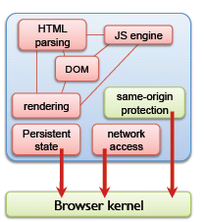
Gazelle
Browser kernel
Provide cross principal protection
Manage resources
Define principals
Based on website origins
Complete isolation of principals
any sharing is through the kernel

Slide 5
Security Model
Principals
SOP – <proto, domain, port>
Define resources
DOM and script objects, cookies, display, network communications
Make a consistent SOP
plugin content, cookies
Notes:
Apply principal model to objects
Apply to <object>, <embed>, <img> and so on

Slide 6
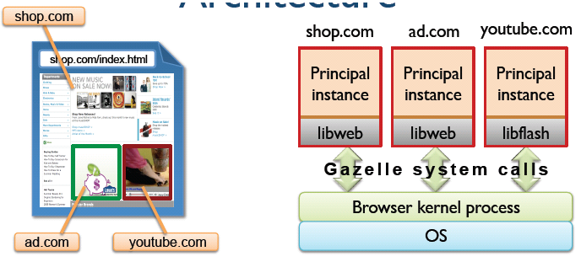
Architecture: Kernel
Browser kernel
Exclusively manage all system resources
Enforce all security policies

Slide 7
Architecture: Principals
Abstraction units
Protection
Failure containment
Resource allocation
All above units defined as SOP principals
All units implemented as OS processes

Slide 8
Architecture
A principal’s process includes all browser components
Failure containment
Efficiency
Process level sandboxing guarantees containment of memory exploits
Plugins interact with OS through browser kernel

Slide 9
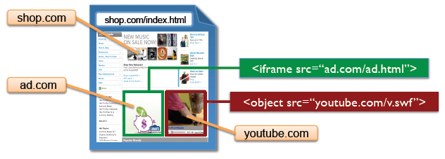
Architecture
<script>, stylesheets
Run as includers
<iframe>, <object>, <img>, <embed>
Run as providers

Slide 10
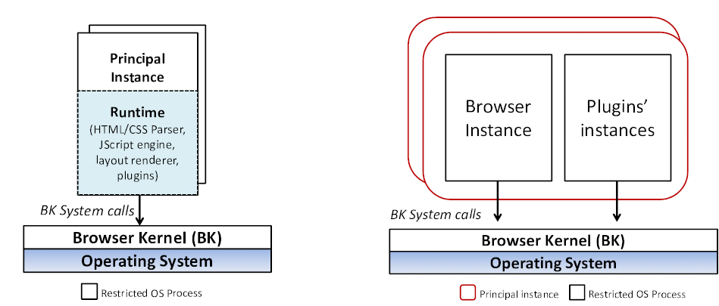
Architecture

Slide 11
Display and Events Protection
Determine display and events ownership and enforce protection
Separate rendering and display management
Traditional OSes do not handle cross principal display protection

Slide 12
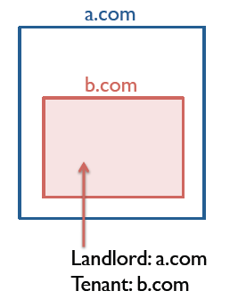
Display and Events Protection
Dual ownership
Landlord – the creator
Tenant – the resident
Landlord allocates part of display to tenant
Resources associated with display
Position, dimensions, content (pixels), location

Slide 13
Display and Events Protection
Position and dimensions
Drawing isolation
Navigation

Slide 14
Display and Events Protection
Potentially overlapping transparent cross origin overlays.
The z-axis stack
Requirement: determining if the event owner corresponds to user intent
Low fidelity determination leads to UI redressing attacks

Slide 15
Display and Events Protection
2D display delegation policy
No overdrawing allowed
Severely limited
Opaque overlay policy
Better but still has limitations

Slide 16
Security Analysis
Trusted computing base assumption
Compromise is contained
No additional capabilities may be acquired by a compromised instance
Cross origin vulnerabilities
Display vulnerabilities
Plugin vulnerabilities

Slide 17
Implementation
Browser kernel implemented in C#
Prototype utilizing the IE’s trident renderer
Compatible with IE 7
Instrument Trident to redirect resource access to browser kernel
Sandboxing implemented through interposition
No plugin support

Slide 18
Evaluation
When browsing across same origin, on par with IE and Chrome

Slide 19
Evaluation
More overhead in cross origin navigation
May be better in production version

Slide 20
Evaluation
Higher memory usage, response time
User action -> display update – roughly 77 ms

Slide 21
Comparison
Google Chrome
Site vs SOP principal
Embedded content
Plugin content
Enforcement of policies
goals

Slide 22
Comparison
OP browser
Browser components also isolated in different processes
Lot of IPC required
Failure containment absent
No display protection
Incomplete separation of OS logic

Slide 23
Limitations
Backwards compatibility
Evaluation not very convincing
Others
Display protection

Slide 24
Cross Origin JavaScript Capability Leaks
Presented by Vaibhav Rastogi

Slide 25
Cross Origin JavaScript Capability Leaks
JavaScript objects of one context should not necessarily be accessible from another
DOM and JavaScript engine have different security models
DOM – access control
JavaScript engine – object capabilites
Disparate security models lead to vulnerabilties

Slide 26
Object Capabilities
Ability to influence an object depends on ability to designate the object
Pointers obtained by
Accessing properties of accessible objects
Built in object such as the global object or Object.prototype

Slide 27
Contributions
Identify a new class of browser vulnerabilities
A dynamic tool for detecting these
Discovered several real vulnerabilities
A new defense mechanism

Slide 28
Capability Leaks
Browser bugs may cause inter context leaks
Malicious script can use the unintentionally leaked pointer to get access to the Object.prototype of the victim
Affect non vulnerable sites too

Slide 29
Detection
Compute security origin
Mark edges between objects connected with “points-to” relation
Mark cross origin edges as suspicious
Instrument set, delete
Take into account implicit pointers
Whitelist certain edges

Slide 30
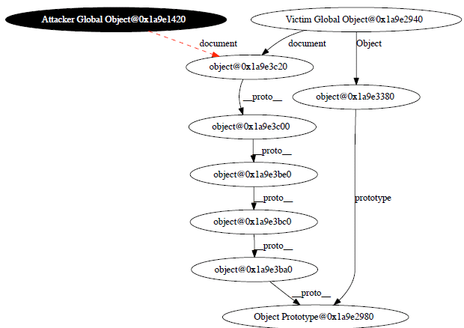
A vulnerability in WebKit

Slide 31
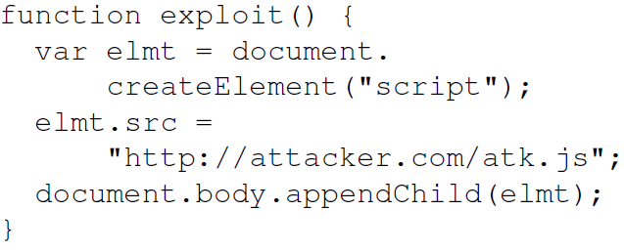
A vulnerability in WebKit
Create an iframe which has the following function

Slide 32
A vulnerability in WebKit
In parent frame store a pointer to exploit
Navigate to
Call

Slide 33
Defense
Add access control checks throughout JS engine
Addresses the mismatch in the security models
Double layer of security
Compare active and target origins to allow/deny access
Inline cache for optimization
1-2% overheads in implementation

Slide 34
Comparison with other works
FBJS, ADSafe, Caja
Restrict JavaScript and DOM API to enforce capability model on DOM
These projects target on new code which can obey such constraints
They must work in existing browsers – so cannot change the legacy browsers
The opposite is true for this paper

Slide 35
Comparison with other works
Gazelle, OP
Suspicious edges are between sandboxes
However implementations of cross origin communication APIs like PostMessage may change the situation
Unclear if such vulnerabilities exist
or is it?

Slide 36
Thanks
Credits:
http://www.usenix.org/events/sec09/tech/slides/wang.pdf
http://www.usenix.org/events/sec09/tech/slides/barth.pdf

