Slide 1
Vulnerability Analysis of Web-Based Applications
Part 1
Authors: Marco Cova, et al.
Presented by: Brett Parker and Tyler Maclean

Slide 2
Outline
Intro, Background, Trends
Technologies
Attacks
Vulnerability Analysis

Slide 3
Why web applications?
Growth of web-based applications over the years
Businesses rely on web-apps to provide service access
Web-apps are used in security-critical environments
Medical
Financial
Military

Slide 4
Why vulnerable?
Web apps are composition of various infrastructure components
Server-side
Client-side
Infrastructure developed by experienced programmers with solid security skills
Applications developed by inexperienced programmers who have little mind for security
Vulnerabilities create entry points for entire networks

Slide 5
Vulnerability analysis
web vulnerability analysis – allows one to identify security problems in web-based applications at early stages of development and deployment
Methodologies
Detection model (positive vs. negative)
Analysis technique (static vs. dynamic)

Slide 6
Why attack web apps?
Widely accessible
Interface with backend components
Web technology inexpensive
Novices develop without security in mind

Slide 7
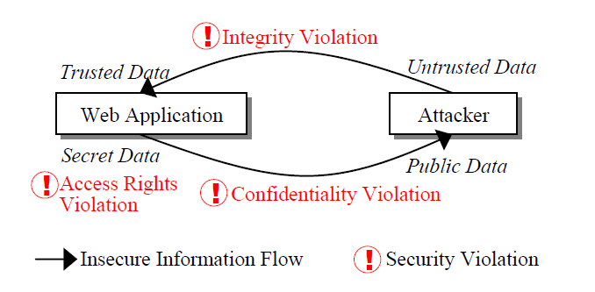
Model of web vulnerabilities

Slide 8
Trends
Symantec catalogued 1,100 new vulnerabilities in web-based applications in 2005 which represented over half the total new vulnerabilities
59% increase from previous semester
109% increase from previous year

Slide 9
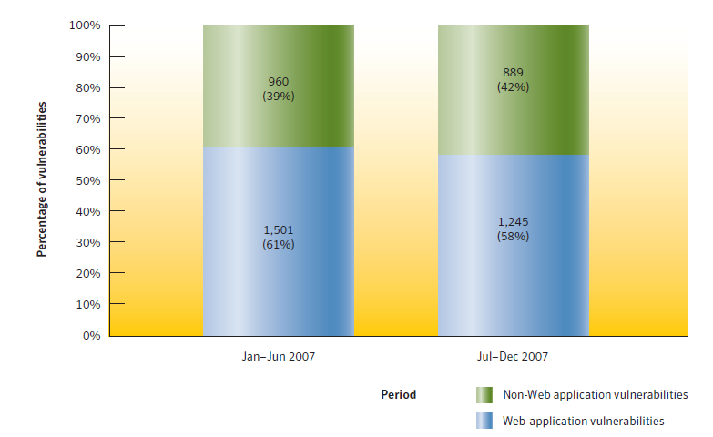
Symantec chart

Slide 10
Sources of security problems
Architectural choices
SQL injection
Trust relations
Cross site scripting (XSS)
Web protocol implementations
Response splitting
Features provided by languages
PHP eval()

Slide 11
How to prevent vulnerabilities?
Use a higher-level language
Use testing tools
Code reviews and audits
Web application firewalls

Slide 12
Outline
Intro, Background, Trends
Technologies
Attacks
Vulnerability Analysis

Slide 13
CGI Overview
“Common Gateway Interface”
Mechanism that a server can use to interact with external applications
Can be written in almost any language and run on almost any server

Slide 14
CGI Lifecycle
Server receives request for CGI program
Server creates new process to run specified application
Server passes to the application the data from the user’s request
Program runs, generates output, and passes output back to server
Server passes output back to client
CGI process quits

Slide 15
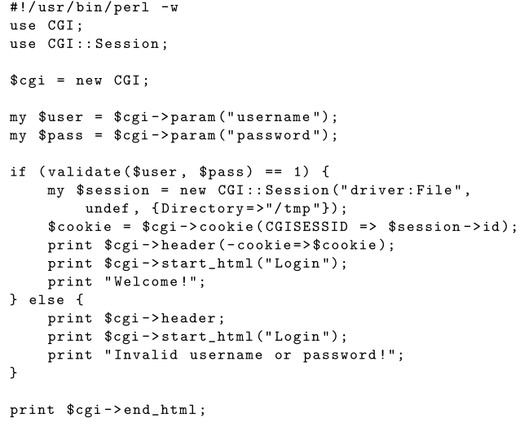
CGI Example in Perl

Slide 16
CGI Advantages/Disadvantages
Advantages
Language-independent
Programs can be written in many languages
Components can be written in different languages
Disadvantages
Significant impact on server through creation of new processes

Slide 17
CGI Improvements
FastCGI
Creates pool of processes that can be reused
API Extensions
ISAPI for Microsoft IIS
API for Apache
Uses fewer resources

Slide 18
Web application frameworks
Web server extended with frameworks used to develop web applications – “plugins”
Interpreted or compiled
Examples
PHP
Perl
Python
J2EE
ASP.NET
Java Server Pages (JSP)

Slide 19
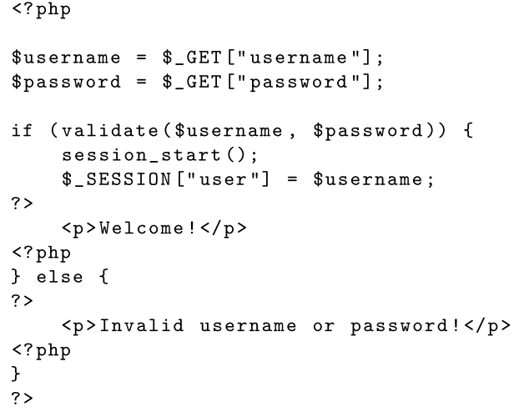
PHP example

Slide 20
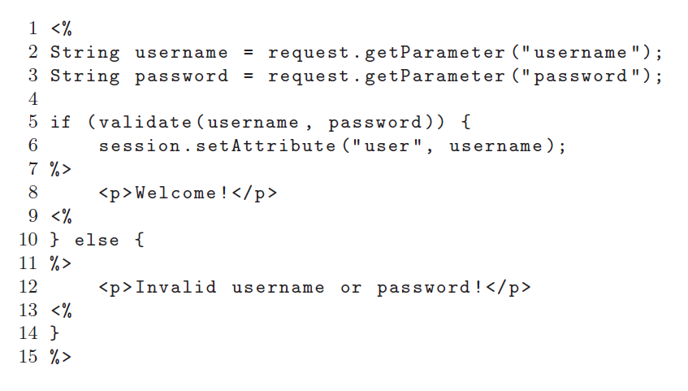
JSP example

Slide 21
Outline
Intro, Background, Trends
Technologies
Attacks
Vulnerability Analysis

Slide 22
Behavior of web apps
What can be broken?
Authentication
Authorization
Configuration
Validation

Slide 23
Interpreter injection
Some languages allow dynamic composition and interpretation of code (ex: PHP)
eval()
preg_replace()
system()
passthru()
backticks()
shell_exec()
exec()
pcntl_exec()
popen()
proc_open()

Slide 24
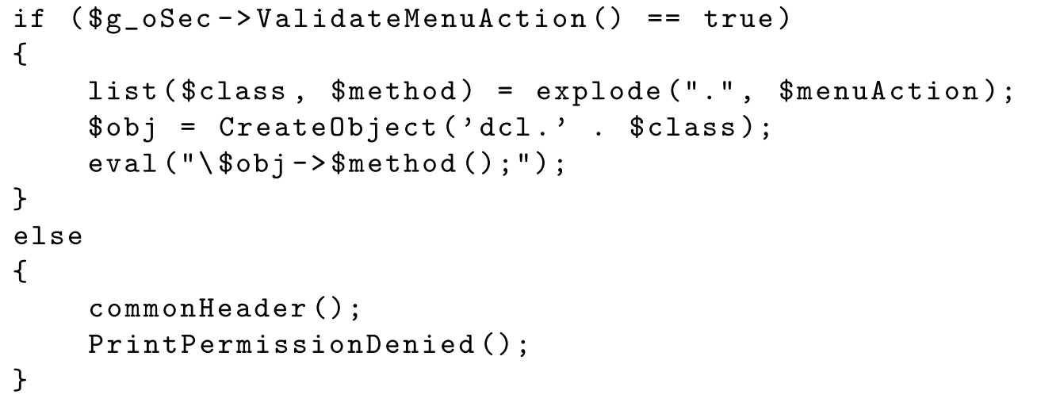
PHP eval() example

Slide 25
How to prevent?
Sanitization
Malicious user input is removed before processing
escapeshellarg()
espaceshellcmd()

Slide 26
Filename injection
Some languages allow dynamic inclusion of files from other locations, used to run other functions or present content to user
PHP allows this from remote sites!

Slide 27
PHP example
Variable “$skin” having value of “http://[attacker-site]” causes execution of “http://[attacker-site]/header.tpl”

Slide 28
Cross site scripting (XSS)
Attacker forces a client (web browser) to run attacker-supplied code (Javascript) in the context of a trusted website
TRUST ISSUE FROM BEFORE!
Browser violates same origin policy
Documents loaded from one site can only get or set the properties of documents from the same site
Allows attacker to steal private information
Bank account info
Cookies
Session information

Slide 29
3 Types of XSS
Non-persistent (reflected)
User is tricked into visiting a specially-crafter link with the malicious code embedded
When the user visits the page, the code is immediately executed (reflected) at the user
Persistent (stored)
Malicious code is stored in the vulnerable application
Later, the code is presented and executed at the user
Blogs, forums, etc.
DOM-based
Elements of the DOM data structure used maliciously

Slide 30
Another XSS example
http://www.webappsec.org/projects/articles/071105.shtml

Slide 31
XSS example

Slide 32
SQL injection
When web application uses unsanitized user data to compose queries that are later passed to database for evaluation
Attacker can
Determine structure of databases/tables
Create/delete/change users or permissions
use it expose personal information if the result of the query is later rendered in the page

Slide 33
SQL injection example

Slide 34
SQL injection example

Slide 35
Session hijacking
Most web apps use HTTP, which is statelss
But sometimes, we want to maintain a state
Shopping cart
How to maintain session state
Cookies
Server-side session data

Slide 36
Session hijacking
If client keeps session state, attacker (dishonest user) can modify state mechanism (ex: cookie, hidden field)
Price of an item in shopping cart
Prevent by using cryptographic techniques
Session fixation
Attacker sets up session and obtains session ID
Lures the victim into accessing the target application using their fixed session ID
Waits for client to perform authentication/authorization
Impersonates the session using session ID

Slide 37
Response splitting
Attacker injects header termination characters and then his own specially-crafted header
When the server generates the response, it will contain multiple copies of certain header lines (the correct one and the attacker-generated one)
Intermediate servers on the way back might interpret this response as containing two documents – the original one requested and the one crafted by the attacker
Used for web cache poisoning
Attacker inserts his own malicious code into the cache using this method

Slide 38
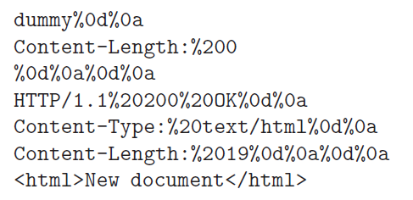
Response splitting example

Slide 39
Another response splitting example
http://projects.webappsec.org/HTTP-Response-Splitting

Slide 40
Outline
Intro, Background, Trends
Technologies
Attacks
Vulnerability Analysis

Slide 41
Vulnerability analysis
The process of assessing the security of an application through auditing of either the application’s code or the application’s behavior for possible security problems
Detection models
Negative
Positive
Analysis techniques
Static
Dynamic

Slide 42
Detection models
Negative
Model known vulnerabilities using expert knowledge
Match the models against application
Identify instances of vulnerabilities
Positive
Model “normal” or “expected” behavior using machine learning techniques
Match the models against application
Identify abnormailities

Slide 43
Analysis techniques
Static
Pre-execution techniques for predicting runtime properties of the analyzed program
Does not require application to be deployed or executed
Account for all possible inputs to the application
Have no performance impact on running application
Does not require modification of dev environment
In theory, no false negatives

Slide 44
Analysis techniques
Dynamic
Series of checks to detect vulnerabilities at runtime
Analysis done on a “live” application
Less prone to false positives
More prone to false negatives, since not all inputs are tested, and not all execution paths are exercised
Hybrid
Combination of both!
Used in practice

Slide 45
Negative detection model
Known vulnerabilities modeled, then application is checked for instances of the model
Assumption that web-specific vulnerabilities are the result of insecure data flow in application
Models attempt to identify instances where untrusted user input propagates the security-critical areas of the application without being checked/sanitized
This is called taint propagation

Slide 46
Taint propagation
User input or data is marked as “tainted” and its propagation through application is traced (statically or dynamically) to check if it reaches any security-critical areas
Models data flow as source and sink
Language extended with
tained
untainted
untaint()

Slide 47
PHP popularity
Grown tremendously over the last five years
On of the most commonly used languages on the web
1,500,000 sites using PHP in March 2000
21,000,000 sites using PHP in March 2006
Most popular Apache module

Slide 48
Static analysis
Run analysis on source code of application in attempt to determine where tainted data can reach

Slide 49
WebSSARI
One of the first works to do taint propagation analysis for finding vulnerabilities in PHP
Targets XSS, SQL injection, script injection
PHP is extended with tainted and untainted
3 user-provided files
Preconditions to sensitive function
Postconditions for sanitization functions
All possible sources of user input
If tainted data reaches security-critical area, program inserts runtime guards or sanitization routines

Slide 50
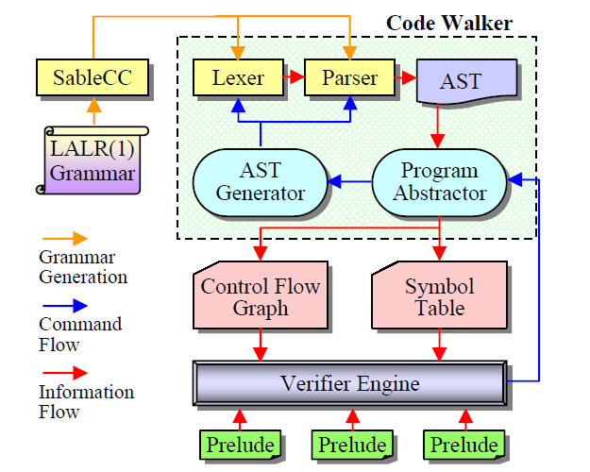
WebSSARI

Slide 51
WebSSARI weaknesses
Only intra-procedural analysis
Dynamic variables, arrays, data structures are considered tainted; reduced precision
Limited support for sanitization routines

Slide 52
Xie and Aiken
Uses symbolic execution to model the effect of statements inside flow of program using Control Flow Graphs (CFGs)
Supports inter-procedural analysis
Supports PHP arrays, common data structures, but only a limited set of them
No support for object-oriented features of PHP
Requires manual sanitization

Slide 53
Livshits and Lam
Work on Java language
Pointer analysis techniques used on bytecode-level image of the program
Uses program query language (PQL) to describe vulnerabilities to be identified
But, this requires each vulnerability to be tested by manually describing it in PQL, so unknown vulnerabilities cannot be detected

Slide 54
Livshits and Lam

Slide 55
Weaknesses of static analysis
Difficult to parse and understand flow of dynamic scripting languages (PHP)
Weakly-typed
Dynamic code inclusion
Arbitrary code evaluation
Susceptible to false positives due to over-analysis

Slide 56
Dynamic analysis
Extend interpreter or program itself to collect information as the program runs
Track and analyze tainted data as application executes

Slide 57
Perl
Taint mode
Interpreter executed with –T command-line switch ensures that no data from outside environment (user input, environment variables) can be used in security-critical functions (shell, file modification)

Slide 58
Nguyen-Tuong, et al.
Modify PHP interpreter to identify data originated from untrusted sources
Strings are tainted at granularity of single character
Tainting is propagated across function calls

Slide 59
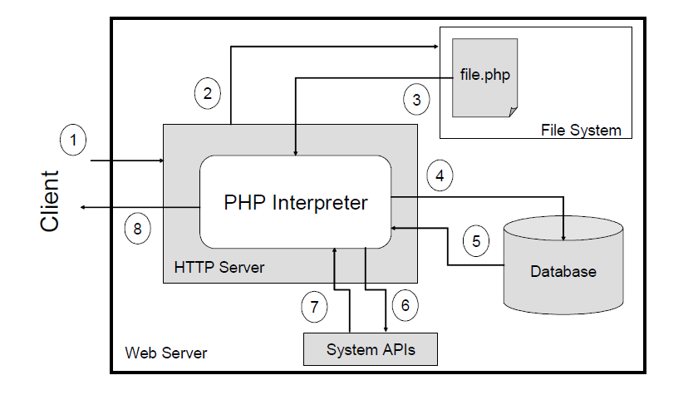
Nguyen-Tuong, et al.

Slide 60
Haldar, et al.
Java JVM extended to support propagation of taintedness for system classes
java.lang.String
java.lang.StringBuffer

Slide 61
Dynamic anlysis adv/disavd
Advantages
Modified interpreter is transparent to application
No complex analysis framework needed because all information collected comes from program execution
Disadvantages
Analysis only performed on executed paths; nothing discovered about paths not taken
Possible impact on application functionality
Can suffer from false positives and false negatives

Slide 62
Static vs. dynamic summary
Static
Precision depends highly on complexities of dynamic features in language
Dynamic
Issues of completeness of analysis
Application stability/performance overhead

Slide 63
Thanks!
Positive approaches on Wednesday!
Questions?

