Slide 1
Summary on SCRIPTGARD Automatic Context-Sensitive Sanitization for Large-Scale Legacy Web Applications
William Ng
Northwestern University
Modified slides from presentation of Prateek Saxena
UC Berkeley

Slide 2
Sanitization in WebApplication
String Img.RenderControl()
{
Write(userimg);
}
String Img.RenderControl()
{ Write(Sanitize(userimg));
}
Small-Scale Apps
Large-Scale Applications
Buggy Sanitizer
Missing Sanitization
[Pixy’06, PhpTaint’06,Cqual’04, Merlin’09,Securifly’05, PhpAspis’11, Saner’08, Bek’11]
New Sanitization Errors
[CCS’11]
SCRIPTGARD

Slide 3
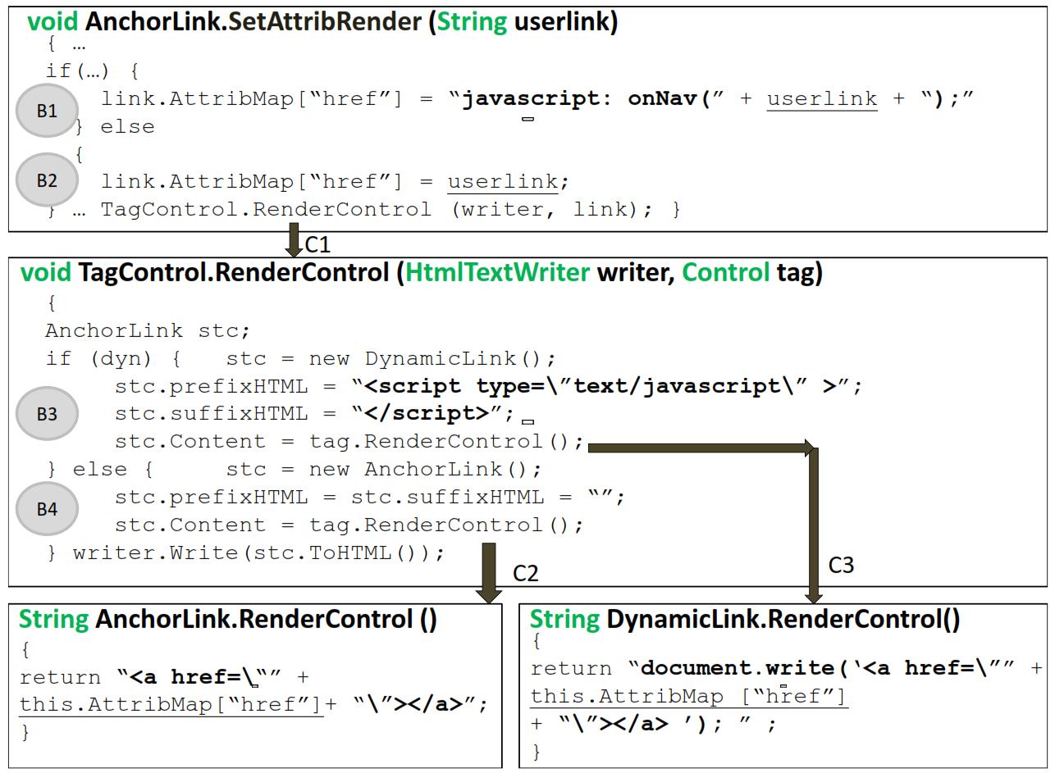
Error #1: Context-Mismatched Sanitization(CMS)

Slide 4
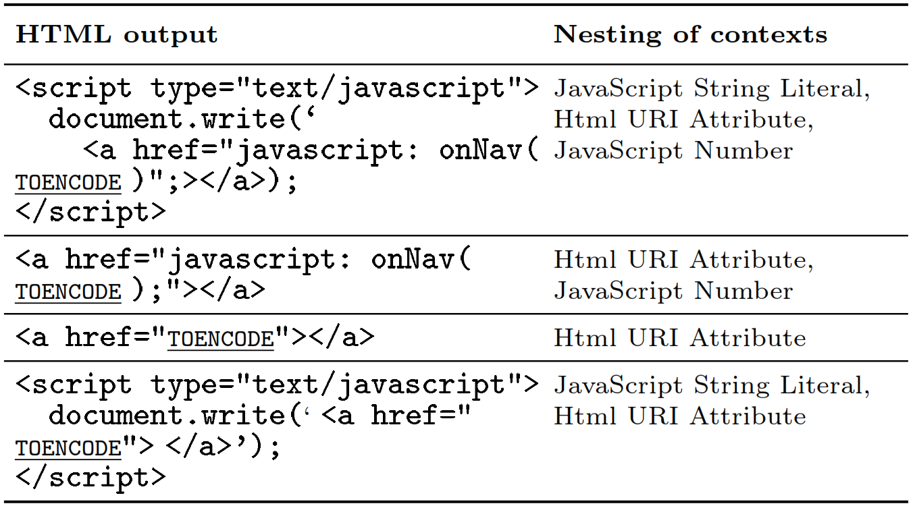
Error #1: Context-Mismatched Sanitization(CMS)

Slide 5
Why Does Context-Mismatch Happen?
San
Context is a Global
Path-Sensitive Property
But, developers select Sanitizers Locally
Output Sink

Slide 6
Error #1: Context-Mismatched Sanitization(CMS)
1,207 (4.7%) are CMS errors!

Slide 7
Error #2: Inconsistent Multiple Sanitization(IMS)
Attack Input
San 1
San 2
San 1
San 2
Safe?
Safe?
Output Sink

Slide 8
Inconsistent Multiple Sanitization(IMS): How does it happen?
EcmaScriptStringEncode – transforms all characters that can break out of JavaScript string literals (like the “ character) to Unicode encoding \u0022 for “)
HtmlAttribEncode - encodes characters (&quot; for “)
Notes:
Analysis Put nes

Slide 9
Inconsistent Multiple Sanitization(IMS): How does it happen?
Document.write(“<a href ='” + EcmaScriptStringEncode(HtmlAttribEncode( “xyz )) +”'></a>”)
Document.write(“<a href ='” + EcmaScriptStringEncode( &quotxyz) +”'></a>”)
Document.write("<a href ='" + \u0026quotxyz +“'></a>")
Document.write("<a href ='&quotxyz'></a>")
<a href =‘”xyz’></a>
Notes:
Analysis Put nes

Slide 10
Inconsistent Multiple Sanitization(IMS): How does it happen?
Document.write("<a href =‘" + HtmlAttribEncode(EcmaScriptStringEncode( “xyz )) +"’></a>")
Document.write("<a href =‘" + HtmlAttribEncode( \u0022xyz ) +“’></a>")
Document.write("<a href =‘" + \u0022xyz +“’></a>")
Document.write("<a href =‘”xyz’></a>")
Big problem if xyz is);Onclick…
Document.write(“<a href =‘“);Onclick…”></a>’)
Notes:
Analysis Put nes

Slide 11
Inconsistent Multiple Sanitization(IMS): Does it Really Happen?
285 (8%) of multiple sanitizations are errors!

Slide 12
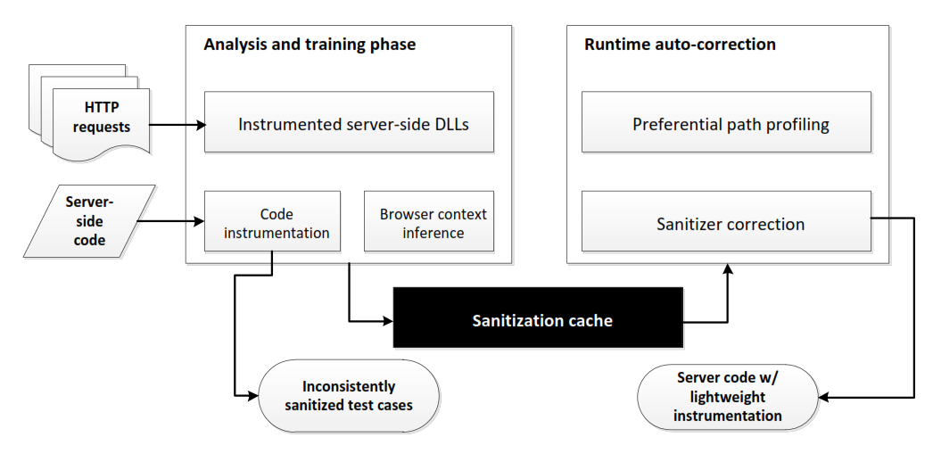
SCRIPTGARD Architecture

Slide 13
SCRIPTGARD Analysis
Trace dynamic execution of application on test inputs
Identify all untrusted data embedded in application’s output
Map application trace to static program path
Map untrusted trace to the correct sequence of sanitizer to apply
Find out which part of string needs to be sanitized through positive taint analysis
If sequence doesn’t match, it add the correct sequence to sanitization cache

Slide 14
SCRIPTGARD Analysis
Trace dynamic execution of application on test inputs
Identify all untrusted data embedded in application’s output
Map application trace to static program path
Map untrusted trace to the correct sequence of sanitizer to apply
Find out which part of string needs to be sanitized through positive taint analysis
If sequence doesn’t match, it add the correct sequence to sanitization cache

Slide 15
Positive Taint analysis
X = Untrusted input
Z = unknown source
A = safe input
Y = X
cZ = sanitize (Z)
Write(X,Y,Z,A,cZ)
Normal taint analysis kept track how the untrusted variable is used in the program, e.g. X, Y
Positive taint analysis kept track of the safe data, e.g. A and cZ
ScriptGard marks portion of server output which is not positively tainted e.g. X, Y, Z
ScriptGard also records sequence of propagator and sanitizer applied

Slide 16
SCRIPTGARD Runtime Auto-Correction
Apply the correct sanitizer sequence from the cache if analysis is done on the path
Administrator choice if analysis is not done on the path yet

Slide 17
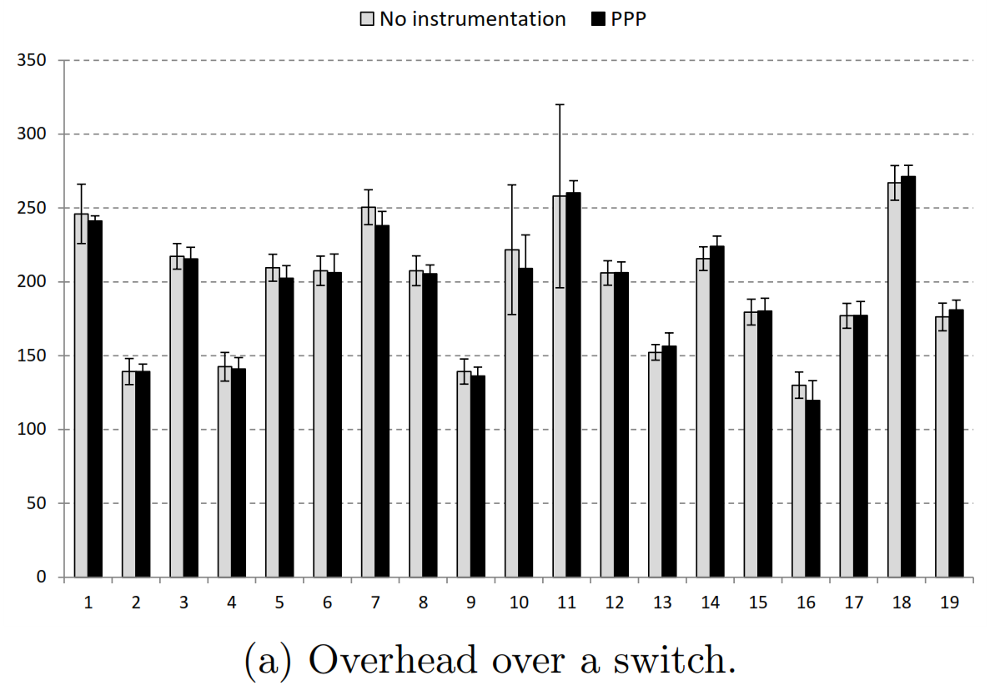
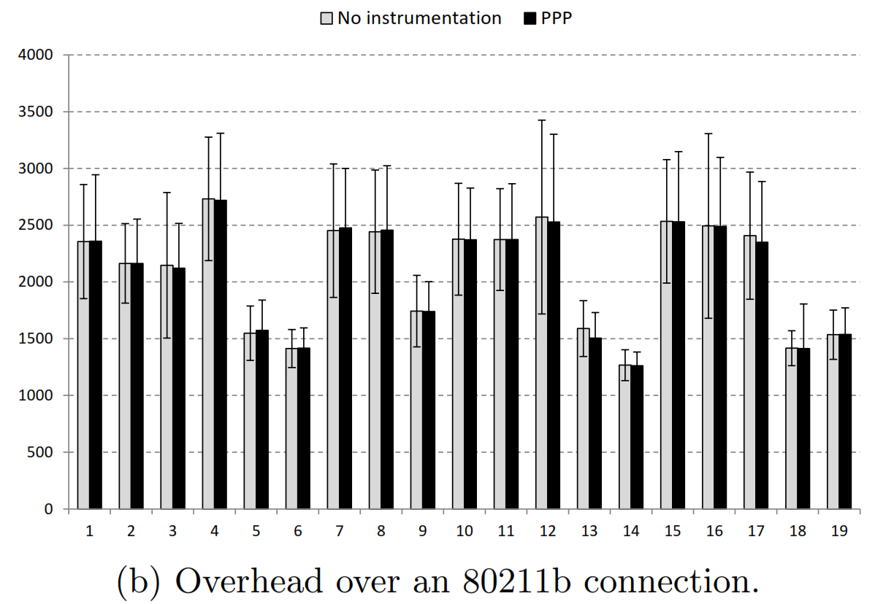
SCRIPTGARD: Performance
Time to load first byte from URL increase by more than 100 times.
Preferential path profiling can slightly reduce the overhead.

Slide 18
Questions?

