Slide 1
Mobile Privacy
Sinan Bolel and Eric Jizba
With some slides by Muhammad Naveed

Slide 2
Outline
Background and Motivation
Information Leaks through Shared Resources
Accidental Data Sharing

Slide 3
Background and Motivation
Modern Operating Systems

Slide 4
Changing use cases
Rapid development of the way smartphones are being used today
Increasingly used for even more tasks
  Phone calls, email, texting, navigation, entertainment, etc.
Notes:
Smaller and smaller apps/tasks
User-designed workflow

Slide 5
OS Modularity
In the past, tools/apps shared next to nothing
  Simple UNIX tools (i.e. grep)
  Monolithic GUI applications (i.e. MS Office)
Modern applications work together to complete larger, user-defined task
Modern OSes run each application as a unique security principal
Notes:
Now that apps ARE sharing data, they CAN
Years of research have pointed to running each app as unique security principle
Will touch on the security principal later

Slide 6




Shopping App
1
3
2
Social Networking App
Barcode Scanner App
Browser
Notes:
OS Modularity Example:
1: Scan item using barcode scanner and camera
2: Look up item using browser
3: Share the item on social network
Passing data

Slide 7
Background and Motivation
Android OS and Security
Notes:
All of the concepts apply to all the mobile Oses, but it is easier to demonstrate with only one OS
Android is the most popular

Slide 8
The Android OS
Android runs Linux kernel, defines its own application runtime
Java-based middleware API forces developers to design apps within a component framework
Four component types: activity, service, content provider, broadcast receiver.
  These provide daemon-like functionality
    Service: general purpose
    Content provider: database
    Broadcast receiver: listen for messages
Binder framework provides access control and Inter-Process Communication (IPC) between components.
  Apps use intent messages to interact with binder
  Intent filters registered to receive messages addressed to specific action strings
Notes:
activity defines UI screen

Slide 9
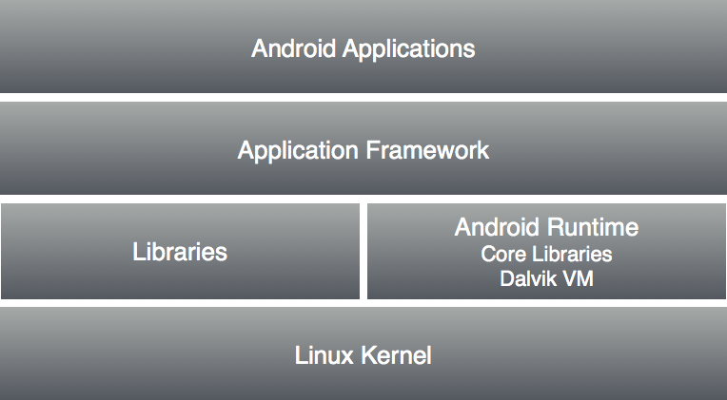
The Android OS
Notes:
activity defines UI screen

Slide 10
Android vs. Linux
Single-user
millions of apps
mobile
Multi-user
limited resource sharing
Relatively stationary

Slide 11
Android Security
OS design takes security seriously.
Built on sandbox and permission model.
  Each app is isolated from others by Linux user-based protection.
  Apps are required to explicitly ask for permissions to access the resources outside its sandbox before installation.
Compared to even desktop OSes, this security design looks good.

Slide 12
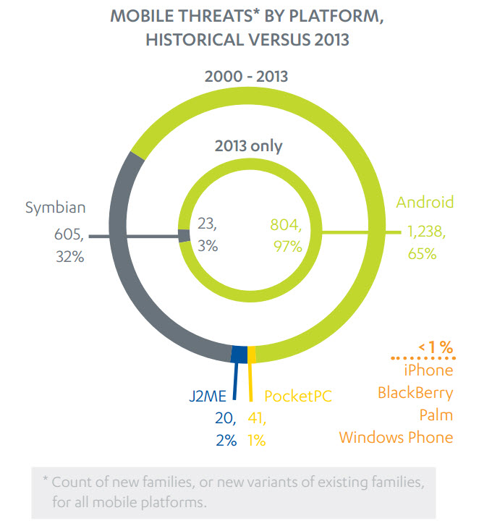
Malware on Android
Waves of Android-based malware in recent years.
Mobile Malware is mostly on Android
  2013: 87%
  Now: 97%
  Largely from unregulated third party app stores
    Middle East & Asia
  Apps in Google Play with malware: 0.1%
source: forbes.com

Slide 13
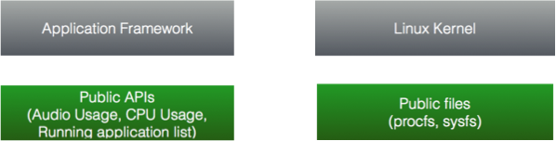
Shared Resources for Apps
The design of the OS is based on unprotected shared resources
  Including those inherited from Linux
No permissions required to access shared resources.

Slide 14
Android Shared Resources
Examples of resources available to apps without permissions:
  Per-app data usage statistics
  ARP information
  Speaker status (on or off)
Examples of resources only available with permissions:
  Camera
  Location
  Internet
Developers specify permissions in App Manifest file
Users approve permissions on install
Notes:
*Access resolution protocol
Speaker example: Lower music volume for incoming call
Debate about whether users actually pay attention to permissions

Slide 15
Information Leaks
Basic Problem

Slide 16
What are information leaks?
Most leaks caused by implementation errors
  Either in Android or within mobile apps
Prior studies focused on privacy implications of data from sensors
  e.g. motion sensor, microphone
Privacy concerns
  Background information from shared resources exposed by both the Android and Linux layers.
  What can be inferred when this info is combined with public data?

Slide 17
Information Leaks: Basic Problem
Public resources are thought to be innocuous
Malicious apps able to access sensitive data without permissions
  Stealthily collect sensitive data
  Deliver to remote server
  Analyze data and other public information (i.e. public tweets) to infer user-specific information

Slide 18
Information Leaks
Main question:
  “Assuming that Android’s security design has been faithfully implemented and apps are well protected by their developers, what can a malicious app still learn about the user’s private information without any permissions at all?”

Slide 19
Stealthiness
Sensing LCD ON/OFF status from public resources
Data can be sent using browser (without any permission), when the screen is OFF
To avoid being detected, browser can be redirected to another website (e.g. google.com) by sending an Intent
Notes:
To make the attack stealthy we exploited some more public information. LCD ON/OFF status can be easily learned from the Android public resources. BSSID is sent through browser only when the LCD is OFF. To avoid being noticed even after the attack, browser can be redirected to another website e.g. google.com and send the browser to the background.

Slide 20
Information Leaks
Main Ideas: Location Inference Attack
Notes:
BSSID along with BSSID-GPS coordinate database can be used to locate smartphone user

Slide 21
ARP Information
/proc/net/arp contains Address Resolution Protocol (ARP) information
/proc/net/arp contains BSSID (i.e. MAC address of the wireless interface) of the access point phone is connected to
ARP information wasn’t considered sensitive in original Linux design
Location privacy breach for Android due to increased mobility
Notes:
Android proc files system have a file that contains ARP information. This file stores the MAC address of the wireless interface of the Access point to which the phone is connected to.

Slide 22


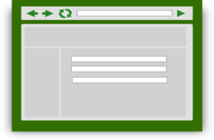
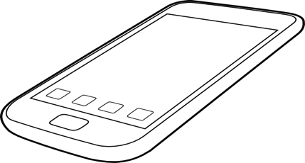

Attack
Adversary controlled web-server
App sends BSSID using browser
Running zero-permission app monitoring
/proc/net/arp
Notes:
monitor the ARP file and extract the BSSID

Slide 23

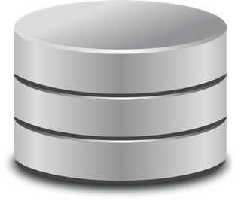


BSSID based Location Services
BSSID to GPS coordinates mapping database
1 - BSSIDs
2 - GPS Coordinates
Navizon
We used Navizon app to access the BSSID to GPS coordinates mapping database.
Notes:
BSSID based location services can be used by any Wi-Fi enabled device and works in areas where GPS have poor reception. Navizon is such a BSSID based location service, that we used in our attack. The Navizon app uses SSL to send BSSIDs seen by the phone’s wireless interface and receive the GPS coordinates.

Slide 24




BSSID based Location Services
GPS
BSSID to GPS coordinates mapping database
2
BSSID to GPS mapping
BSSID
BSSID
BSSID
1
3
BSSID
BSSID
BSSID
BSSID collection by capturing WiFi broadcast beacons
Notes:
data collection
Wi-Fi access points periodically broadcast beacons, so users can connect to the network.
These beacons contain BSSID and due to limited WiFi range can be mapped to the approx. GPS location of the access point.
Some companies have collected this data through driving streets, while some use their applications to provide location service and to collect the data as well. In this way, they aggregate large amount of BSSID to GPS location mappings in their database.

Slide 25
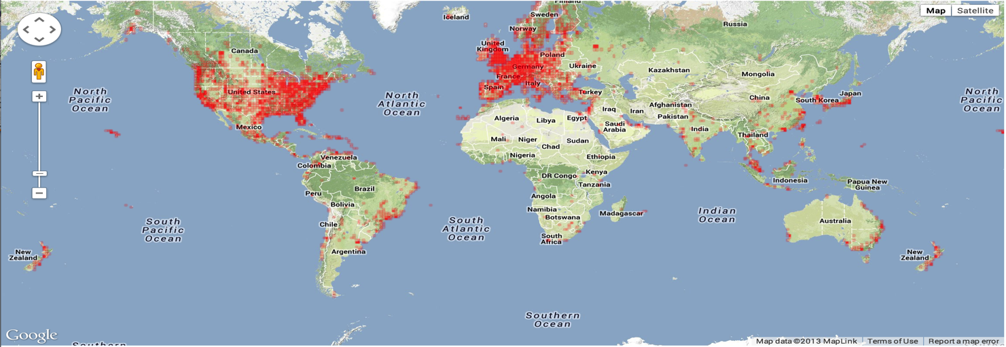
Coverage
http://www.navizon.com/navizon_coverage_wifi.htm

Slide 26




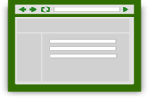
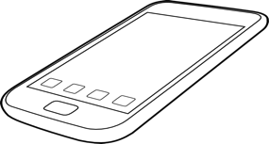



Complete Attack
App sends BSSID by sending Intent to the browser
Adversary controlled web-server
Running zero-permission app monitoring
/proc/net/arp
BSSID to GPS coordinates mapping database

Slide 27

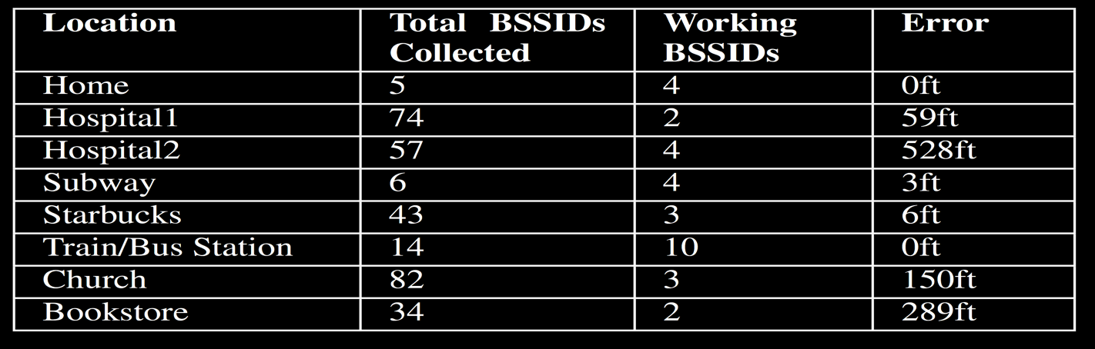
Evaluation

Slide 28
Information Leaks
Main Ideas: Driving Route Inference
Notes:
In the previous attack, we showed how to locate a user. In this attack we show how to infer the victim’s driving route by simply monitoring the speaker usage of the GPS application.

Slide 29

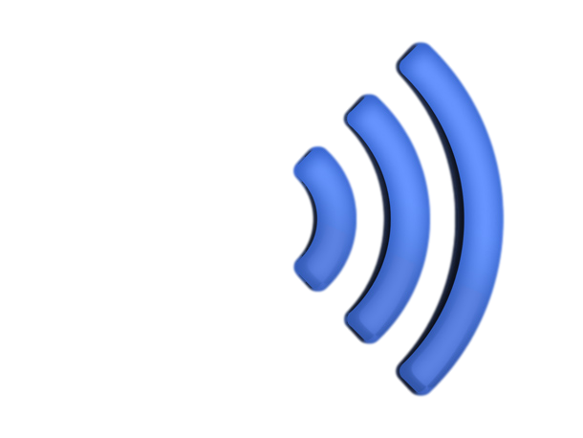
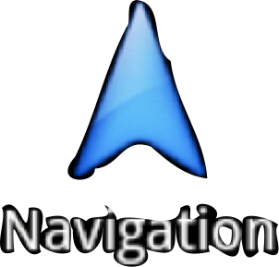
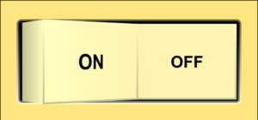
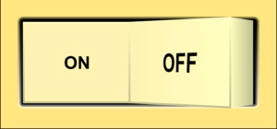
Speaker ON/OFF Status
AudioManager.isMusicActive
Notes:
Android public API AudioManager.isMusicActive
This information is used by other apps e.g. lowering music for an incoming call

Slide 30

Speaker Status Logger
Fingerprint
10ms
30ms
60ms
10ms
40ms
ON
OFF
Segment 1: Head west on W Clark St toward N Busey Ave
Segment 2: Turn left onto N Goodwin Ave
Notes:
Only log when maps are running – determine when it’s running based on process list from linux shared resources
Calls isMusic Active with sampling rate of 50 per second

Slide 31

Attack
 | (source S1, destination D1)
 | (source S3, destination D3)
 | (source S4, destination D4)
 | (source S5, destination D5)
40
70
80
50
(source S2, destination D2)
Fingerprint
10
30
60
10
40
10ms
30ms
60ms
10ms
40ms
60
30
50
10
40
10
30
60
10
10
30
90
10
40
Notes:
Assuming we have a database that maps the this speaker usage fingerprint to its corresponding route, we just need to find the route corresponding to this fingerprint in the database..
sequences are not always identical and not all speaker usage intervals can be recorded. So, we used a similarity metric similar to Jaccard Index to measure the similarity between two fingerprint sequences.
Jaccard Index measures similarity between two sample sets

Slide 32
Fingerprint Database
Creation of fingerprint database needs driving from source to destination
We used driving simulator to drive 1000 routes
Simulator takes approx. 3 mins for 15 mins drive
Scale-up strategy using text-to-speech engine
Notes:
drive simulator needs to wait for the navigation app to finish audio sentences.
Driving simulator used Mock GPS simuator

Slide 33



Drive Simulator
GPS coordinates vector for the best route
(Source Address,
Destination Address)
Notes:
Our drive simulator design is straightforward. We collected a large number of addresses and pair them up as source and destination. We used Google maps api to get GPS coordinates vector for the best route between the source and destination.

Slide 34

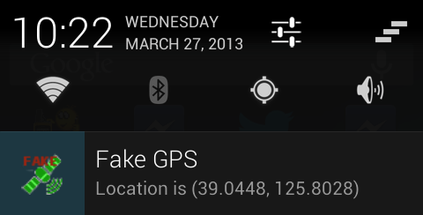


Drive Simulator
GPS coordinates vector for the best route
Notes:
We used this GPS coordinates vector as input to Android Mock GPS. Android provides mock gps functionalities for the testing of GPS based apps. This essentially simulates driving by inputing and now GPS navigation app will behave as if the user actually drive from source to destination and will play the corresponding driving instructions.

Slide 35



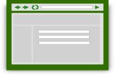


Complete Attack
Zero-permission app sends fingerprint using browser
Adversary controlled web-server
 | (source S1, destination D1)
 | (source S3, destination D3)
 | (source S4, destination D4)
 | (source S5, destination D5)
Zero-permission app fingerprints Navigation app audio usage
40
70
80
50
(source S2, destination D2)
10
30
60
10
40
60
30
50
10
40
10
30
60
10
10
30
90
10
40

Slide 36


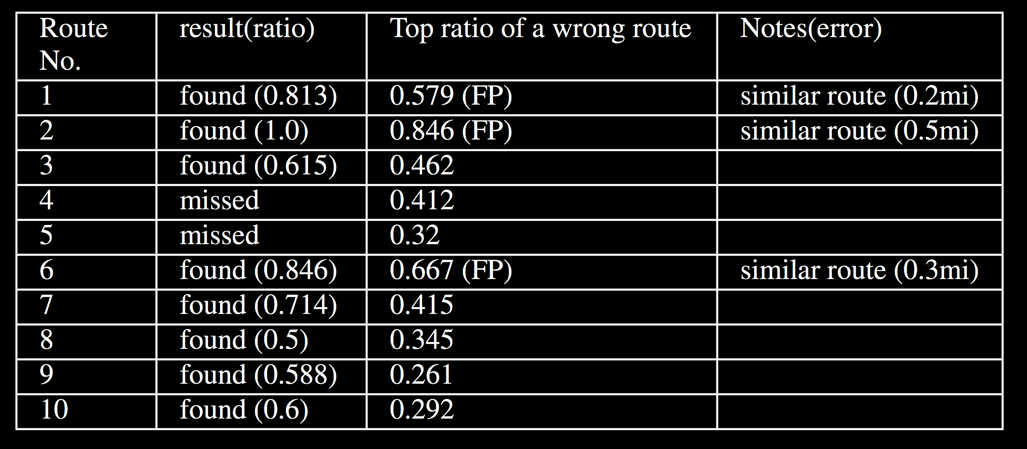
Attack Evaluation
Routes similar to actual routes
Correct routes
Notes:
3 routes found were actually false positives because a similar route with similar fingerprint vector was present in the database.

Slide 37
Information Leaks
Main Ideas: Identity Inference Attack
Notes:
In previous attacks I described how to infer victim’s location and driving route. In this attack we show how to infer the identity of the user by simply monitoring the twitter app traffic usage and twitter public API.

Slide 38

Per-app Traffic Usage
Per-app traffic usage on Android
Intentionally provided to monitor data usage of different apps

Slide 39





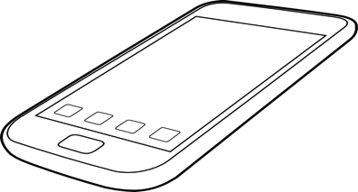

Tweet Fingerprinting
580-720B
Increments
Tweet event
Download Tweets Request
541-544B
Increments
Notes:
We used Twitter app for our identity inferences attack. Using per-app traffic usage counter we fingerprint different events for twitter app. We observed that the tweets download request packet size varies from 541-544B and tweet packet size varies from 580-720B. This means that whenever the twitter app traffic usage counter increments by 580-720B, we can reliably infer that user tweeted.

Slide 40



Attack
Timestamp 1
Timestamp 2
Timestamp 3
…
.
.
Timestamp n
Notes:
Using the cellphone local clock we record the time the tweet was sent. We record such timestamps for few of tweets. This timestamp vector creates a fingerprint that we used to identify the identity.

Slide 41


Attack
People who tweeted at Timestamp1 ± 60s
People who tweeted at Timestamp2 ± 60s
Timestamp 1
Timestamp 2
Timestamp 3
…
1
.
.
Timestamp n
+
People who tweeted at Timestamp3 ± 60s
Twitter Public Stream
Notes:
We grab all the tweets corresponding to the recorded timestamps using the Twitter public API. We used several timestamps to narrow-down the identity of the the user. Once we have enough timestamps to single out the victim we extract his identity from the tweet.

Slide 42
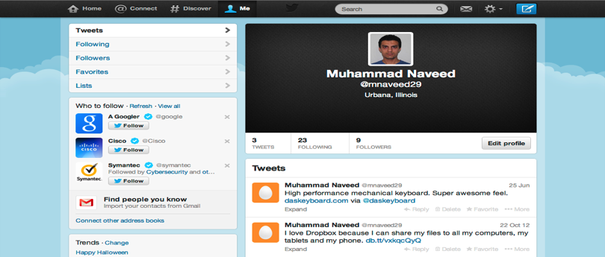

Attack
Manual analysis of approx. 4000 twitter accounts
First and last name | 79%
Location | 32%
Bio | 21%
Notes:
From twitter username we can easily find more information about the user. To study the effectiveness of our attack we manually analyzed approx. 4000 twitter accounts and observed that 70% people reveal their real first and last name, 32% reveal their location and 21% reveal their bio.

Slide 43





Identity breach is serious
Notes:
Identity breach can reveal even more sensitive information. Names of all apps is public information and can be accessed by any Android app. When the name of sensitive app is linked to the identity it can reveal private information. This can leak sensitive information about health and disease, sexual orientation, embarrassing applications etc.

Slide 44




Complete Attack
Zero-permission app sends tweet’s timestamp using browser
Adversary controlled web-server
Zero-permission app fingerprints tweet event

Slide 45

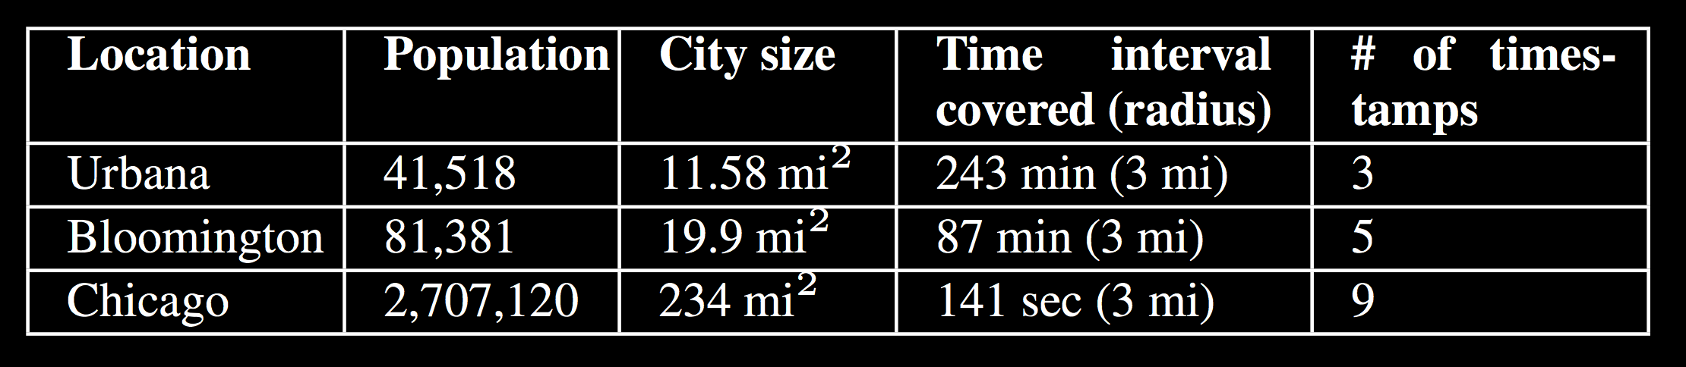
Attack Evaluation
Notes:
We found out that the number of timestamp i.e. the number of times victim needs to tweet before we can identify him or her depends upon the population of the city. For a small city like Urbana 3 tweets are enough but a densely populated city like Chicago more tweets are required.

Slide 46
Information Leaks
Main Ideas: Health and Investment

Slide 47


Input Response Size
Fingerprint selection actions in app with data-usage sequences of response
Number of responses: 204 conditions -> 32 categories
Payload size -> uniquely id all 204

Slide 48
Information Leaks
Evaluation and Results

Slide 49
Mitigation
Access to ARP file can be restricted using Linux permissions
Access to audio channel API can be restricted only to system processes when sensitive apps (e.g. navigation) is running
Hiding per-app traffic usage is challenging
Notes:
Mitigation depends upon the type of public resource. Access to ARP file can be restricted using linux permissions as its only used by system processes. Similarly, access to the audio channel API can be restricted such that only system processes can access it when sensitive apps are running. Hiding per-app traffic usage is more challenging as this information is intentionally made public and many apps uses this information to measure traffic usage of different apps.

Slide 50
Round up and Round down
3α=768B
550B
2α=512B
450B
1α=256B
0α=0B
Notes:
Instead of revealing exact packet size, rounded packet size can be used to measure app traffic usage. We can round up or round down depending upon what results in more accurate estimate.

Slide 51
Traffic Usage Data
Rounding
  Round reported packet sizes up or down
Aggregation
  Rounding strategy leaks individual packet payload size
  Aggregated traffic can be reported e.g. hourly, daily, weekly instead of per packet increments
Notes:
Instead of revealing exact packet size, rounded packet size can be used to measure app traffic usage. We can round up or round down depending upon what results in more accurate estimate.
Rounding strategy still leaks approx. packet size and in some scenarios can be used as a finger print. Aggregation provides another mitigation option. The data can be aggregated over time and reported hourly, daily or weekly to avoid finger printing.
This doesn’t affect data tracking apps because they still get the same information.

Slide 52
Fingerprint Mitigation
Naive idea: Adding a permission
  Users do not pay attention to the permissions
  Developers tend to ask more permissions than needed
Our approach: App’s specified policy for network traffic usage release
  NO_ACCESS
  ROUNDING
  AGGREGATION
  NO_PROTECTION
Notes:
A naive idea to restrict access to per-app traffic usage is to introduce another permission. Experience have showed that permissions are not very effective as users don’t pay attention to the permissions and developers tend to aks more permissions than required by the app. Our approach, allows the app to provide a policy using which it want to reveal it traffic usage to other apps. App developer can restrict access, provided noisy traffic usage, aggregated traffic usage or they an decide not to protect it in case the app is not sensitive.

Slide 53
Results
Linux design assumptions should be reevaluated for new scenarios
Android public resources can reveal much more than imagined by the Android designers
Mitigation can be challenging depending upon the utility of the public resource
Notes:
Linux based smartphone operating system design should consider new attack avenues that are not plausible for a desktop operating system.
Public resource considered harmless by Android designers can reveal lot of private information.
We showed that location, identity, disease and other information can be leaked from Android’s public resources.
Mitigation is sometimes difficult as it can affect the utility provided by the public resource.

Slide 54
Open Issues
Lots of apps built around the current security model
Fixing existing design must be done carefully to:
  avoid undermining basic functions of existing apps
  strike a balance between system utility and data protection

Slide 55
Accidental Data Sharing
and Aquifer

Slide 56
Accidental Data Sharing
Main question:
“A key challenge for modern OS security is controlling [the] user-directed workflow between apps and preventing accidental information disclosure”

Slide 57
Accidental Data Sharing
Complete sandboxing of apps not adequate.
Key challenge is controlling the user-directed workflow between apps and preventing accidental information disclosure.
  Photo of a whiteboard containing meeting notes inadvertently uploaded to a social networking site.
  Confidential document inadvertently stored on a cloud server when viewed.

Slide 58
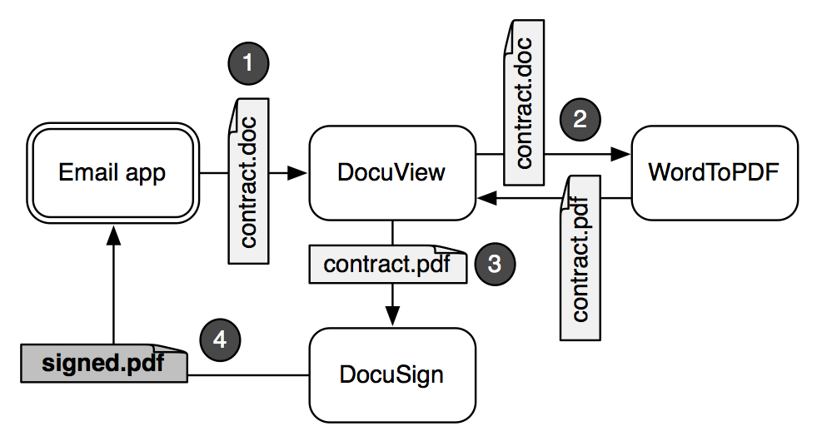
Example User Workflow

Slide 59
Data intermediary problem
User shares data (i.e. a contract) with multiple apps to accomplish the task (i.e. signing the contract)
From the Email app’s perspective, the other apps are intermediary and the app cannot trust them with sensitive data
  For now, we are only considering accidental data disclosure and not malicious apps
This problem was not exposed until application separation became prevalent

Slide 60
Aquifer Policy Restrictions
Export Restrictions
  List of apps that are allowed to send data off device
  Ex. the Email app could only list itself for the contract
Required Restrictions
  List of apps that are required to send data off device
  Ex. the docuSign could be listed to ensure any data containing a signature goes through it before being exported

Slide 61
Aquifer app survey
Surveyed top 50 free Android apps from 10 categories (500 apps total) to determine the need of Aquifer
Characteristic | Number of Apps
Data Sources | 85 (17%)
Data intermediaries | 140 (28%)
Value from Export Policy | 70 (14%)
Value from Regulate Policy | 78 (15.6%)
Notes:
Large number of data intermediary apps (more apps provide data services than data creation)...showing the prevalance of the data intermediary problem

Slide 62
Open Issues
Aquifer policy may lead to usability failures
App developers would need to consider Aquifer policy
  Ex. Notify the user when data is classified to avoid user confusion that could lead to access control violation

Slide 63
Questions?

