Slide 1
Building Android Security
Jan 2015

Slide 2
Background and Motivation

Slide 3
Background
The Android OS is based on Linux but is substantially different when dealing with application abstraction.
Android apps are commonly written in Java and then compiled into special DEX bytecode that is used by the Dalvik virtual machine.
Android also defines four types of components: activity, service, broadcast receiver and content provider.

Slide 4
The Components
Activity components are responsible for handling the user interface.
Service components act as daemons which handle background processing.
Broadcast receiver components handle asynchronous messages on the system.
Content provider components are data servers that are queried by other applications.

Slide 5
Binder & Parcels
These components communicate with each other using Binder interprocess communication (IPC).
Binder passes messages (called parcels) and also takes care of thread management.
These parcels can pass references to other binder objects as well as file descriptors.
When an app has a reference to a service component it can execute remote procedure calls (RPCs) for methods defined by that service.
Most of Android’s APIs are implemented as RPCs to defined service calls, which makes these very crucial.

Slide 6
Android Permissions
Android enforces component security using permissions and defines a core set of permissions that protect the OS resources and apps.
Third-party application developers can define new permissions that are enforced using the same mechanisms as OS permissions.
Android then places authorization hooks that correspond and are allowed to run OS service component methods.

Slide 7
The Android iOS
Consumer operating systems are undergoing many changes.
Such changes are providing new abstractions for developers working on user-applications.
Mobile operating systems are becoming more semantically rich and are simplifying the development process.

Slide 8
The Android iOS
However, these changes are forcing the designers to rethink how security is handled on their devices.
It is now a necessary for user applications to be placed under unique protection domains, rather than simply executing with the user’s authority.
Still, how and when privileges and access to the API’s should be given has been very debated.

Slide 9
The Android iOS
Android has been a main focus of research for the last few years. This is mainly attributed to it’s open source foundation and the popularity of mobile devices.
There have been more than a dozen proposals from the research community for new Android security architectures.
While these proposals have many different ideas and motivations, they most often share the same types of authorization hooks and the ASM seeks to assist with those goals.

Slide 10
Flexible and Fine-Grained Mandatory Access Control on Android for Diverse Security and Privacy Policies
USENIX Security '13
Sven Bugiel, Stephan Heuser, Ahmad-Reza Sadeghi
System Software Laboratory
Department of Computer Science and Engineering
POSTECH
2013.10.08.

Slide 11
Content
Introduction
Design
Implementation
Evaluation
Conclusion
System Software Laboratory

Slide 12
Introduction
Today, mobile devices such as smartphones and tablets are widely used in our daily lives, especially for working purposes
  Increased amount of sensitive information stored on them
The most popular and widespread smartphone operating system is Google’s Android
But, Android has been shown to be vulnerable to a number of different attacks
  Privacy violation
  Confused deputy attacks
  Collusion attacks
  Root exploits
System Software Laboratory

Slide 13
Introduction
There are various security extensions to Android’s access control framework to address particular problem sets
Almost all proposals for security extensions to Android constitute mandatory access control (MAC)
  Mechanisms for
    Establishing fine-grained access control to user’s private data
    Protecting the platform integrity
  Use the specific semantics such as policy language
But, they focused on a specific system abstraction layer
  Either at the middleware layer or the kernel layer
System Software Laboratory

Slide 14
Mandatory Access Control
Named from its historical context
Defined in the Trusted Computer System Evaluation Criteria (1983)
Hardware based security in military contexts
Recently the definition relaxed
  “Mandatory” now means “Best Effort”
  Argument is that broader definition better for general use, depth and
  flexibility
  Source: Wikipedia
System Software Laboratory

Slide 15
Introduction
Goal
  A generic and practical MAC architecture for Android-based mobile devices
    Operates on both kernel and middleware layer
    Flexible and fine-grained security access control model
    Minimized the complexity of the policy by API-oriented design of Android
FlaskDroid
  System-wide Android security framework that operates on both the middleware and kernel layer
    Uses existing security extension to Android’s access control framework
    (SE Android)
  Focused on security policy and type enforcement at middleware layer
System Software Laboratory

Slide 16
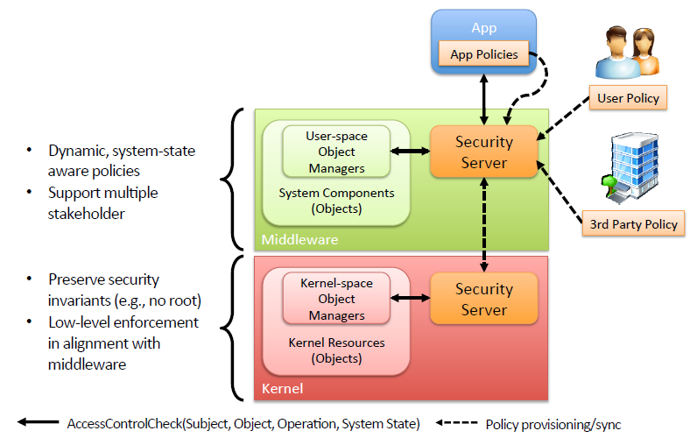
Design
* Author’s slides
FlaskDroid
System Software Laboratory

Slide 17
Recall FireDroid
For contrast, remember that FireDroid used simple ptrace based
system call interception for their approach
FireDroid and FlaskDroid don’t mention each other
Today’s primary paper also doesn’t mention FireDroid
System Software Laboratory

Slide 18
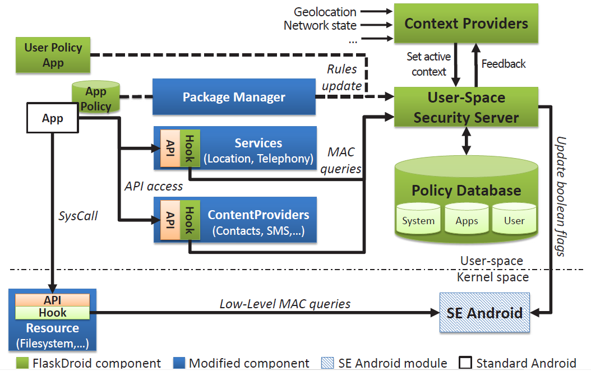
Implementation
FlaskDroid Architecture
* Paper
System Software Laboratory

Slide 19
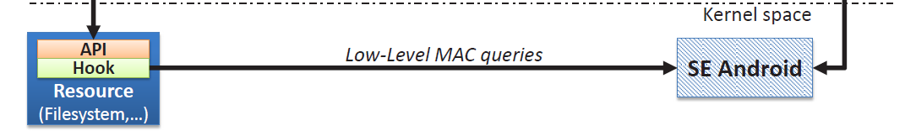
Implementation
Kernel space
  SE Android module
    Responsible for preventing
      Escalating their privileges
      Bypassing the middleware enforcement points
    Type enforcement
      Determines the access rights of the object/subject
      allow TSub TObj : CObj OC
        TSub: a set of subject types
        TObj: a set of object types
        CObj: a set of object classes
        OC: a set of operations
System Software Laboratory

Slide 20
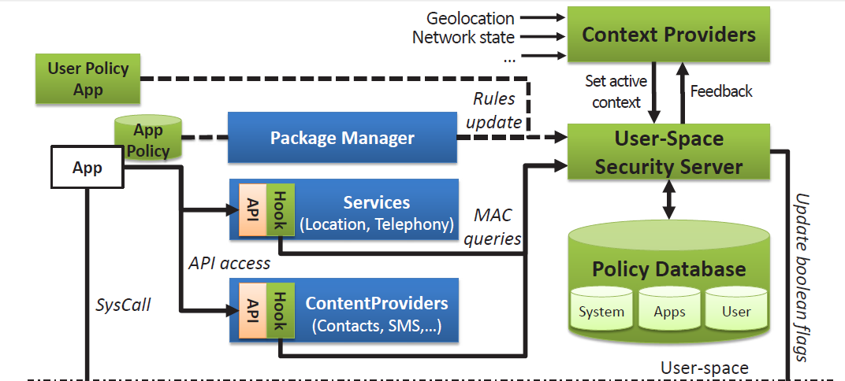
Implementation
User-space (App and middleware layer)
  User-space Security Server (USSS)
    The central policy decision point for all user-space access control decisions
    Exposes an interface to the USOMs for requesting access control decisions
System Software Laboratory

Slide 21
Implementation
User-space (App and middleware layer)
  User-space Security Server (USSS)
    Uses type enforcement for access control
    (1) the subject type (calling app), (2) the object type (callee app UID)
    (3) the object class (Intent), (4) the operation on the object (query)
System Software Laboratory
Notes:
(1) the subject type (the calling app), (2) the object type (contacts_email or the callee app UID), (3) the object class (contacts_data or Intent), and (4) the operation on the object (query)

Slide 22
Implementation
User-space (App and middleware layer)
  User-space Object Managers (USOMs)
    Middleware services and apps act as USOMs for their respective objects
      System components or 3rd party components
      136 policy enforcement points
System Software Laboratory

Slide 23
Implementation
User-space (App and middleware layer)
  User-space Object Managers (USOMs)
    PackageManagerService
      Responsible for (un)installation of application packages or finding a preferred component for doing a task at runtime
      As a USOM, assigning consolidated middleware and kernel-level app types to all apps during installation using criteria defined in the policy
System Software Laboratory

Slide 24
Implementation
User-space (App and middleware layer)
  User-space Object Managers (USOMs)
    ActivityManagerService
      Responsible for managing the stack of Activities of different apps, Activity life-cycle management and providing the Intent broadcast system
      As a USOM, labeling Activity and Intent objects and enforcing access control on them
System Software Laboratory

Slide 25
Implementation
User-space (App and middleware layer)
  User-space Object Managers (USOMs)
    Content Providers
      The primary means for apps to share data (well-defined, SQL-like interface)
      Responsible for assigning labels to the data entries they manage during insertion/creation of data and for performing access control on update, query, or deletion of entries
System Software Laboratory

Slide 26
Implementation
User-space (App and middleware layer)
  Context Providers
    Context
      The current security requirements of the device (geolocation, network state)
    Responsible for a distinct set of contexts, which it activates/deactivates in
    the USSS
System Software Laboratory

Slide 27
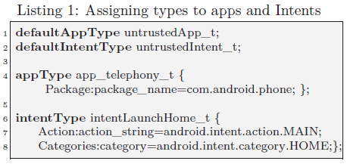
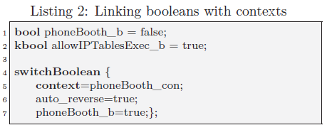
Implementation
Policy language
  Application and Intent Types
    The criteria for apps
      The application package name, the requested permissions or the developer signature
    Criteria for Intent objects
      The Intent action string, category or receiving component
  Context definitions and awareness
    an option to declare contexts to enable context-aware policies
    either activated or deactivated by a dedicated Context Provider
System Software Laboratory

Slide 28
Related Work

Slide 29
Related Work
With Firmware modification
  Require authorization hook semantics
Without firmware modification
  Repackage applications with inline reference monitors

Slide 30
Related Work
With Firmware modification
  Require authorization hook semantics
Without firmware modification
  Sometimes crashes the app; Can be circumvented
  Aurasium, AppGuard, RetroSkeleton, Dr.Android, Mr.Hide, etc.

Slide 31
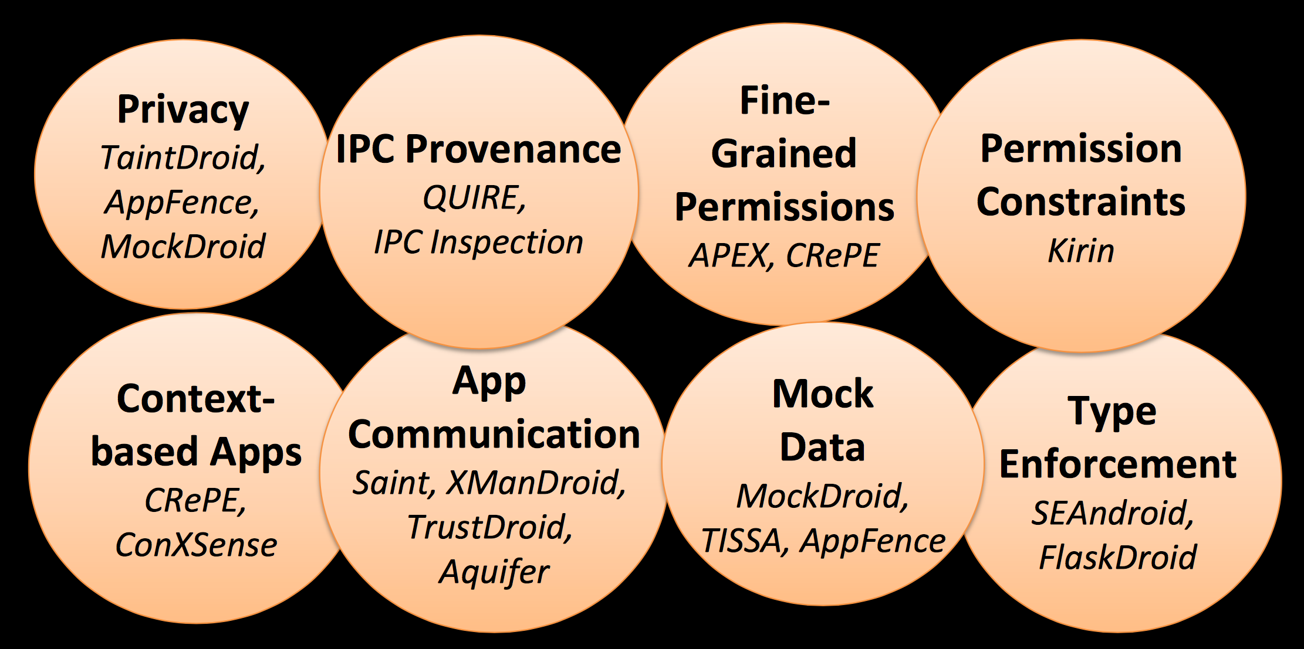
Related Work
With Firmware modification

Slide 32
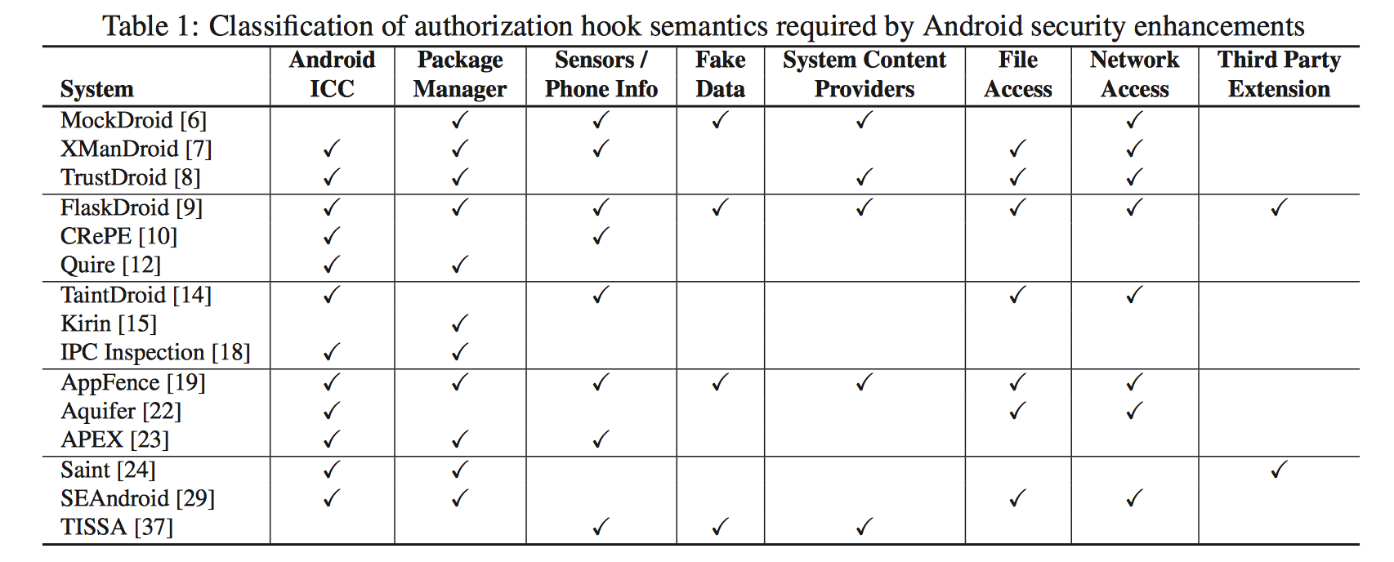
Related Work
With Firmware modification

Slide 33
Related Work
With Firmware modification
  Reference monitor interface on Linux
    LSM, TrustedBSD

Slide 34
Related Work
With Firmware modification
  Reference monitor interface on Linux
    LSM, TrustedBSD, SELinux(embedded in Android 5.0)

Slide 35
Related Work
With Firmware modification
  Reference monitor interface on Linux
    LSM, TrustedBSD, SELinux(embedded in Android 5.0)
  Reference monitor interface on Android
    Android Security Framework(ASF), FlaskDroid
    Android SE
    ASM

Slide 36
Related Work
With Firmware modification
 | ASM | Android 5.0 | Samsung Knox
data isolation | ✓ | ✓ | ✓
data sharing | ✓ |  | ✓
custom-defined permission | ✓ | ✓
mandatory access control | ✓ | ✓

Slide 37
Primary paper
https://www.usenix.org/conference/usenixsecurity14/technical-sessions/presentation/heuser

Slide 38
ASM: A Programmable Interface for Extending Android Security
Research by:
Stephan Heuser, Adwair Nadkarni,
William Enck, Ahmad-Reza Sadeghi
From NC State and TU Darmstadt
Presented by: Jayce Gaines

Slide 39
Basic Problem
Main ideas
Evaluation and results
Open issues

Slide 40
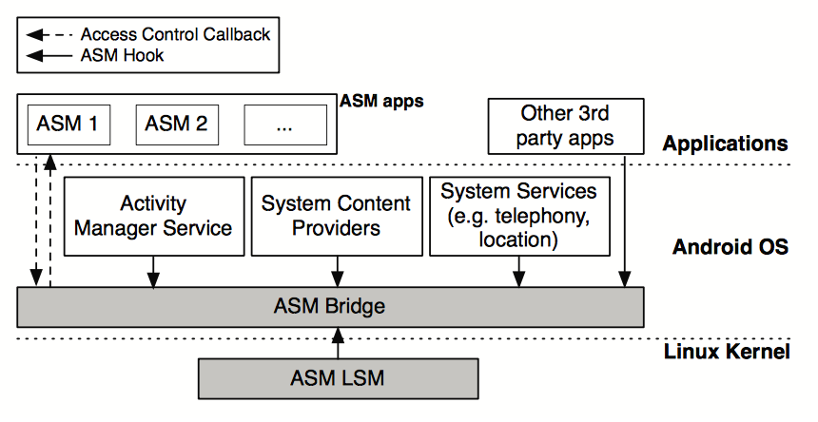
What is ASM?
ASM stands for the Android Security Modules framework.

Slide 41
What is ASM?
ASM stands for the Android Security Modules framework.
Most simply, the ASM is a framework that creates a series of “authorization hooks” that allows developers to program and define new reference modules for android.
It allows a simple interface that these developers can use to implement their applications without the need to change how the operating system is set up.

Slide 42
What ASM is About
The primary goal of ASM is to promote security extensibility and make the platform more accessible to potential security enhancements.
ASM provides a set authorization hooks for building reference monitors for Android security.
ASM is designed to replace data values in OS APIs and allow third-party applications to define new ASM hooks.

Slide 43

Contributions
Identify the authorization hook semantics for new operating systems, such as Android.
Design and implement the ASM framework.
Implement two example ASM apps for demonstration.

Slide 44
Design Goals
  G1: Create generic authorization expressibility
  G2: Ensure existing security guarantees
  G3: Protect kernel integrity
  G4: Multiple authorization modules
  G5: Minimize resource overhead
Notes:
The authors sought to design a programmable interface for building new security enhancements on the Android platform and set out to complete the following goals:
Additionally ASM assumes that the base Android OS and services are trusted and that third-party applications have complete control over their address spaces.
Any authorization hooks placed by the third-party app is untrusted.
Third-party apps are trusted to mediate their own authorization hooks and protection.

Slide 45
Design Goals (Cont.)
Generic Authorization Expressibility
  ASM provides the reference monitor interface hooks necessary to develop both prior and future security enhancements for Android.
  Not all authorization will need all hooks provided and the different hooks will be placed at different levels of authorization.
  This is so the enforcement semantics can be sufficiently maintained.

Slide 46
Design Goals (Cont.)
Ensure Existing Security Guarantees
  Android allows third parties to extend it’s framework, essentially allowing sandbox-like features.
  However, this can potentially break the built in security framework’s guarantees. To fix this ASM’s reference monitors interface hooks only allow fewer permissions and/or less file system access.
  It should be noted that by allowing more restrictions some expressibility will be lost.

Slide 47
Design Goals (Cont.)
Protect Kernel Integrity
  This is an extension of Goal 2, ensuring the existing security remains viable and true.
  Some modules will require hooks within the kernel. These are essential to providing the LSM interface to third-parties.

Slide 48
Design Goals (Cont.)
Multiple Authorization Modules
  Official support for multiple authorization modules on the platform have not been adopted and could be of great benefit for the developers.
  ASM could potentially support multiple authorization modules.
  However, allowing this requires carefully designing the architecture to address possible conflicts.

Slide 49
Design Goals (Cont.)
Minimize Resource Overhead
  ASM should be designed so that when there is no authorization module loaded, the system should have a negligible impact.
  Additionally, it is understood that not all authorization hooks will be used by the modules.
  Since some hooks contribute more overhead than others, ASM is designed so that only necessary hooks are enabled when needed and the remaining are disabled.

Slide 50
Basic Problem
Main ideas
Evaluation and results
Open issues

Slide 51
Authorization Hook Semantics
  Some prior security enhancements are as follows:
    Constraining permissions of installed apps
    Mediating communication between components
    Enforcing information control policies
    Tracking Android intent messages through applications
    Tracking privacy sensitive information
    Substitute fake information to protect user identification
    Etc.
Notes:
Many different academic and industry researchers have proposed security enhancements to the Android OS.
These enhancements, while sometimes sharing similar concepts, do not necessarily have the same motivation or design techniques.

Slide 52
Authorization Hook Semantics
We can see from the table that nearly all of the proposals modify the Activity Manager Service (AMS). This is to provide additional constraints on the Inter-Component Communication (ICC).
The Package Manager Service (PMS) is also frequently modified, many times for consistently updating permissions. Network Access and Sensors/Phone Info are also often changed by many different security implementations.
It is important to note that ASM only considers mediation at the process level. This means that applications such as TaintDroid and AppFence cannot be built on top of ASM. This, however, does not mean that it will remain the case in the future.

Slide 53
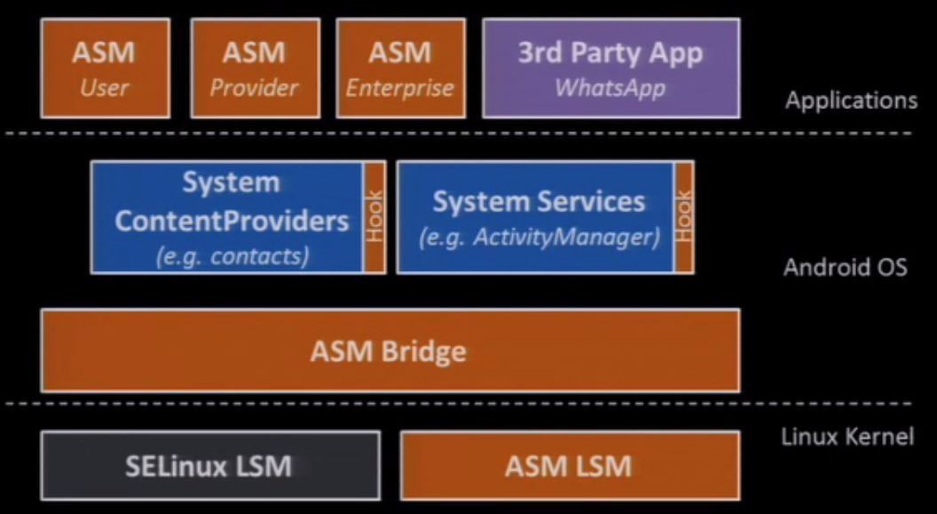
ASM Design
ASM Provides a reference monitor interface for building new monitors. This allows developers to focus on their new security enhancements, rather than placing hooks.

Slide 54
ASM Design
As shown, the ASM framework implements reference monitors as ASM apps, with each app having to register for a unique set of authorization hooks and callback.
When a protected operation is requested, ASM automatically invokes the callback in the app and grants permission to the request.
The ASM monitor interface is contained in the ASM bridge, which receives protection events from authorization hooks. The hooks only trigger if it is enabled.
  A protection event is an OS event requiring access control.

Slide 55

ASM Apps
The reference monitors themselves are built as ASM apps and developed with the same conventions and constraints as other Android apps.
The core part of an ASM application is a service component that implements the hook interface.
Procedure for building an ASM application:
  ASM App Registration
  Hook Registration
  Handling Hook Callbacks
  Registration Protection
  ASM App Deployment

Slide 56
ASM Apps Procedure
ASM App Registration:
  An ASM app must register itself with the ASM Bridge after installation. This can be done manually or can be done automatically after the install is complete.
  When the ASM bridge receives a new registration, it updates its persistent configuration.
  A reboot is required so that ASM apps receive all protection events since boot. This is important because it could impact their protection state.

Slide 57
ASM Apps Procedure
Hook Registration:
  The ASM app service component is started by ASM during the boot process. At this point, it registers for the reference monitor interface hooks in needs.
  Different hooks result in varying overhead costs, thus ASM app developers are encouraged to only register for the hooks that are necessary.
  If the ASM registers for third-party defined hooks the developer is responsible for the naming conventions of the new hooks.

Slide 58
ASM Apps Procedure
Handling Hook Callbacks:
  Once registered, an app with receive a unique callback for each corresponding protection event. The information of the callback will be hook-specific.
  The ASM app returns the access control decision to the ASM Bridge.
  ASM app developers must coordinate with the original application developer for information passed to the callback.

Slide 59
ASM Apps Procedure
Registration Protection:
  Reference monitors are granted a high amount of privileges. However, ASM doesn’t allow an ASM app to override the existing Android security protections.
  ASM must protect the ability to receive callbacks and does this using the existing Android permission model.
  By using the preconfigured permission model, it allows for easily inspected ASM apps so that its abilities can be easily identified.

Slide 60
ASM Apps Procedure
ASM App Deployment
  How the ASM permissions are granted has a significant impact on the practicality of security in the mobile device. It is known that end users do not frequently read or understand Android’s install permissions.
  This can allow malware that exploits that lack of understanding and gain ASM app privileges. This is partially mitigated by accomplishing G2.
  It can be further prevented by using an alternative deployment model; such as firmware signing keys, which prevent source code changes, or by implementing an “unknown sources” setting that would prevent non-Google certified apps from being installed.

Slide 61
ASM Bridge
The ASM Bridge provides the reference monitor interface and coordinates the protection events that occur in the authorization hooks.
The bridge has three main components:
  Per-hook activation
  Callback Timeouts
  The Master Policy
The Per-Hook Activation means that all the hooks for the ASM App start as disabled. This keeps the overhead from exceeding an unreasonable amount while the app is not loaded. The hooks are then enabled on a “by need” basis, to keep the overhead down as much as possible.
The Callback Timeouts allows the Bridge to set a time limit on the response time for protection events. If a timeout occurs, the bridge assumes access to the resource is denied.
The Master Policy is in place to prevent collisions when multiple applications are active at the same time. By default the policy is a consensus of all active ASM apps. All apps must grant an access control decision for the action to be allowed.

Slide 62

Hook Types
ASM provides a reference monitor interface for authorization hooks placed throughout the Android OS. In general they come in five different categories:
  Lifecycle Hooks
  OS Service Hooks
  OS Content Provider Hooks
  Third-Party App Hooks
  LSM Hooks

Slide 63
Lifecycle Hooks
Hooks in this category include: resolving intents, starting activities and services, binding to services, dynamic registration of broadcast receivers, and receiving broadcast intents.
This type of hook is designed to refine the list of resolved applications, based on access control policies.
Lifecycle hooks are used most often at the beginning of component’s establishment to determine intent and then to prevent the ASM from adding new apps to the list which would override the OS’s restrictions.

Slide 64
OS Service Hooks
ASM apps require mediation for OS APIs providing functionality, such as getting the geographic location of the device and taking pictures. This is the main function of the OS Service Hooks.
ASM uses Android’s AppOps subsystem to place the authorization hooks. AppOps is an Android security enhancement that could potentially be implemented as an ASM app itself.
Using AppOps, OS Service hooks support graceful enforcement. This means that, whenever possible, it will return empty data rather than throwing an exception. This keeps the application running smoothly, rather than risking volatile crashes.

Slide 65
Content Provider Hooks
Content Provider Hooks are daemons that provide a relational database interface for sharing information with other applications.
Separate hooks are required and need to be authorized for the insert, update, delete and query functions.
It is possible improve performance of certain functions such as query; however, this has resulted in increased number of function callbacks which is a trade-off. The authors state that this is something they intend to explore further in future work.

Slide 66
Third-Party Hooks
ASM has the capabilities to allow third-party Android applications to add hooks to the ASM Bridge. These hooks are useful for extending enforcement in Google’s and the device manufacturer’s applications.
Third-party hooks are identified by a unique hook name and the package name of the application.
The ASM Bridge sends messages to a special service to update the status of a hook. The third-party developer must follow the message codes exactly for proper hook management.

Slide 67
LSM Hooks
ASM apps sometimes require mediation of UNIX-level objects such as files or network sockets. By default, ASM cannot define authorization hooks for those types of objects. Instead, special hooks must be placed in the Linux Kernel.
The main consideration for ASM is how to allow its apps to interact with the LSM hooks, without overriding the security conventions already in place.
Currently, the ASM implementation uses a special ASM LSM that implements the LSM hooks and makes upcalls to the ASM Bridge. This retains the original conventions, while maintaining the performance standards of ASM.

Slide 68
Basic Problem
Main ideas
Evaluation and results
Open issues

Slide 69
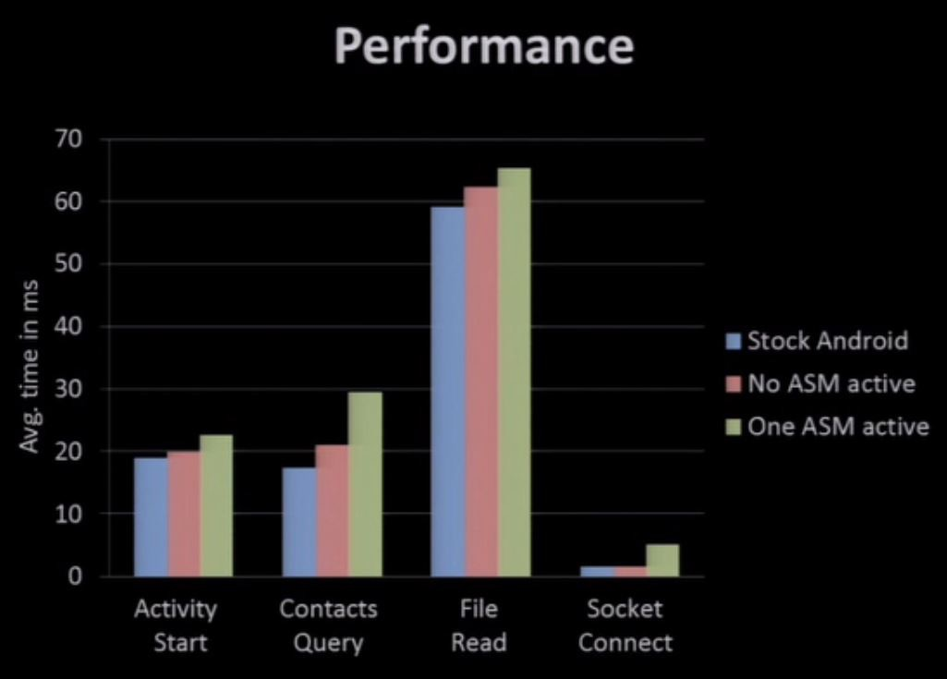
Evaluation
ASM considerably simplifies development of security modules. Additionally, ASM minimizes overhead that would normally be incurred and retains acceptable performance that does not interfere with the user.
We can also see similar results when comparing overall energy consumption when compared to the normal amount of power usage. It is almost unnoticeable.

Slide 70
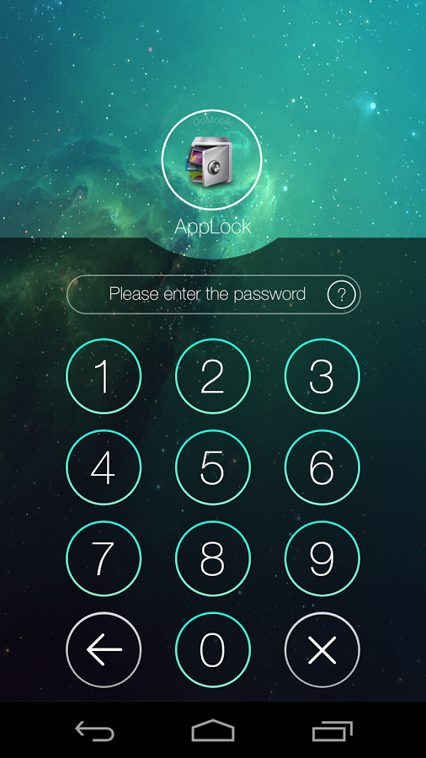
Evaluation
AppLock
If the top application is protected by AppLock’s policy, LockService overlays the current screen with a password prompt user interface.

Slide 71
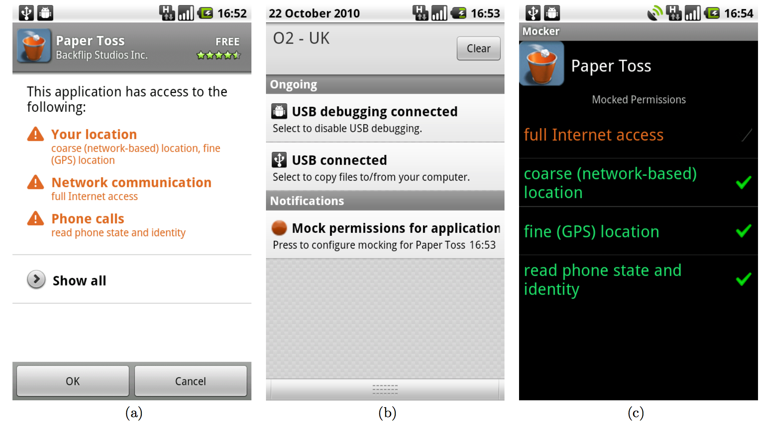
Evaluation
MockDroid
If an application is assigned a mock permission, the Android OS component will return fake information.

Slide 72
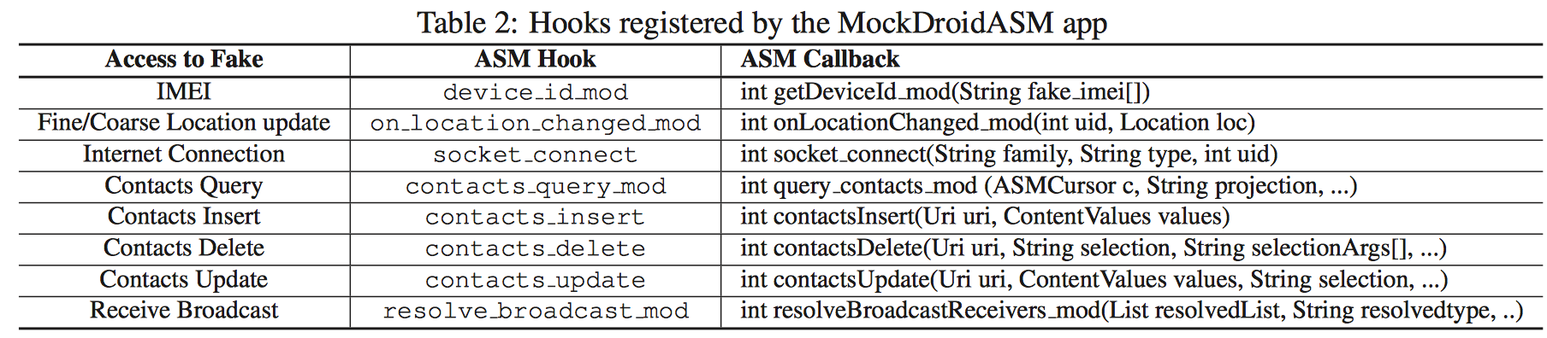
Evaluation
MockDroid

Slide 73
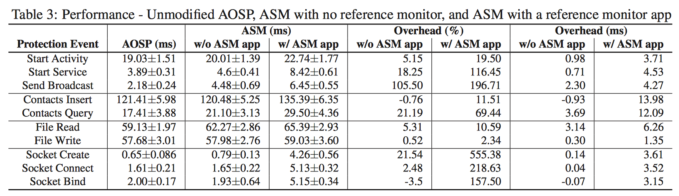
Performance

Slide 74
Basic Problem
Main ideas
Evaluation and results
Open issues

Slide 75
Open Issues
Overall, the Android Security Modules framework is similar to other reference monitor interfaces that have been proposed in the past for Linux and TrustedBSD.
ASM is important because it is one of the first solutions of its kind for Android mobile devices and can lead to unification and simpler implementation of various security enhancements.
ASM promotes the creation of additional and novel security improvements to Android, while avoiding restricting OS consumers to a specific enforcement policy.
The authors believe that if ASM were to be integrated into the core source code for Android, it could potentially allow researchers to add new reference monitors to Android devices, without requiring root access.

Slide 76
The End.

