Slide 1
FireDroid: Hardening Security in Almost-Stock Android
Giovanni Russello, Arturo Blas Jimenez, Habib Naderi, Wannes van der Mark
University of Auckland, New Zealand
Notes:
She worked on this project mainly during her summer internship at northwestern university.

Slide 2
Roadmap
Introduction
System Design
Implementation
Security Policy
Evaluation
Discussion of EMM

Slide 3
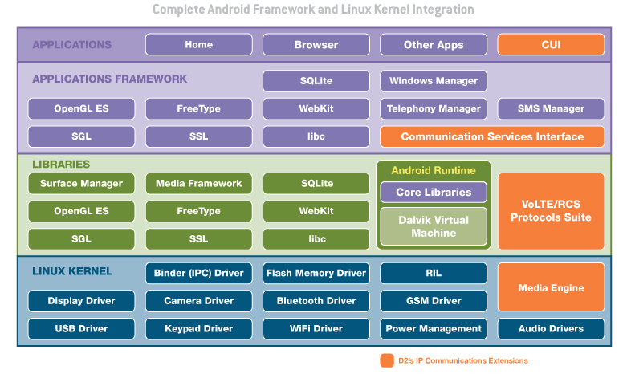
Android Framework

Slide 4
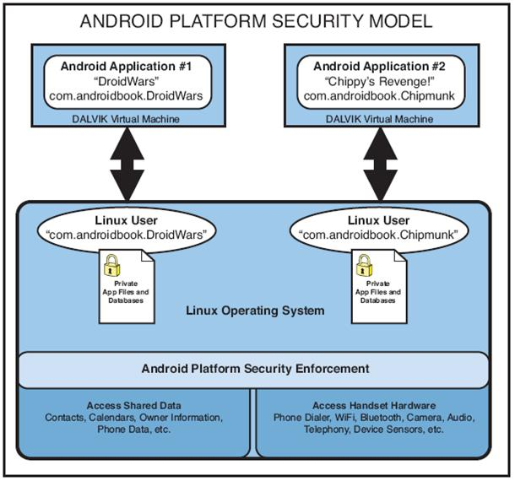
Permission System
Declares the permissions requested
Agree as all-or-nothing
upon installation
Access Control
Mechanism
similar with traditional
Linux

Slide 5
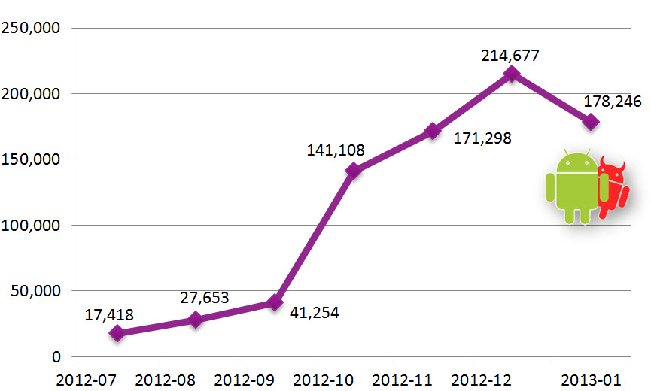
Motivation
Big market share of Android (87% worldwide, 2013)
Big number/increment of malware (97%, 2013)

Slide 6
Motivation
Rapid evolution of malware
Commercial tools fail to detect 21% of malwares
Inflexible security mechanism/policy enforcement of Android

Slide 7
Desired System
Light modification of OS
No recompilation of middleware and OS
Enforce security policies in Native Code Layer
Not rely on user

Slide 8
Roadmap
Introduction
System Design
Implementation
Security Policy
Evaluation
Discussion of EMM

Slide 9
System Design
Observation
Privacy-related depends on low-level system call
Challenge
Map high level policies to those enforced at low-level : policy language
No modification on application, middleware, Linux to interpose system calls: ptrace()
Notes:
All their privileged operations rely on system calls executed by the Linux kernel. As such, by controlling the execution of system calls it is possible to control the behaviour of applications.
Security policy for low-level operation is huge in number and error-prone. Security policy is defined by human administer
ptrace() system call for tracing applications’executions.

Slide 10
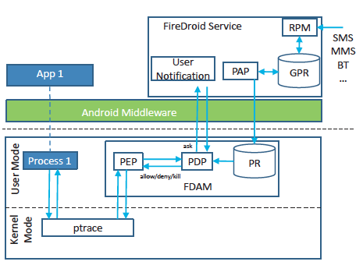
Architecture
Notes:
As shown in Figure 1, the FDAM attaches to the target process through the ptrace() system call meaning that each time the target process executes a system call, the kernel suspends the target process and notifies the FDAM. Within the FDAM, the Policy Enforcement Point (PEP) is responsible for gathering the required information from the system call executed by the target process including the parameters in the system call. The PEP forwards this information to the Policy Decision Point (PDP) that will retrieve the relevant policies from the Policy Repository (PR) within the FDAM. The PR contains policies specific to the process being monitored (more on this in Section 4). Depending on the policies, the PDP can decide to allow or deny the execution of the system call. Moreover, the policy evaluation might also return the decision to kill the target process. Another possible outcome of the policy evaluation is to inform the user and to ask her decision (either allow, deny or kill the process). To ask the user, the PDP contacts the FireDroid Service (FDS). This service is implemented as an Android application and provides to the user an interface to interact with FireDroid.
The Remote Policy Manager (RPM) component handles the remote edit/update policy requests. New policies can be sent through SMS/MMS and/or Bluetooth.

Slide 11
Roadmap
Introduction
System Design
Implementation
Security Policy
Evaluation
Discussion of EMM

Slide 12
System call interposition
ptrace() could monitor a process when the monitoring process is the parent process
Android’s Zygote process
First start on boot process
Fork all the other applications process
Notes:
Zygote process starts all the other application process. Design purpose to support quick sharing of this initializing components, context

Slide 13
System call interposition (cont’d)
Monitoring process starts earlier than Zygote
Modify the configuration file “init.rc”
Need to get the root privilege
No need to recompile the OS image (light modification)
On-the-air update disable FireDroid?
Modify init.rc
Disable ptrace()
Notes:
Modify init.rc could not happen without physical access to the device

Slide 14
System call interposition (cont’d)
Avoid side effects caused by system call interposition
Incorrectly replicating OS semantics
Race conditions
Denying system calls
Android memory sharing

Slide 15
System call interposition (cont’d)
Avoid side effects caused by system call interposition
Incorrectly replicating OS semantics
6 = socket(UDP,…)
7 = socket(TCP,…)
close(7)
dup2(6,7)
bind(7, … port 80)

Slide 16
System call interposition (cont’d)
Avoid side effects caused by system call interposition
Race condition
A: write to /tmp/foo, /tmp/bar, read tp /tmp/baz
/tmp/foo symbolic link to /tmp/bar
B: removes /tmp/foo, create a new symbolic link /tmp/foo to /tmp/baz
A get write permission to /tmp/baz
Android memory sharing
Policies on file descriptors to ashmem/ION shared memory regions
Notes:
ashmem/ION shared memory
regions

Slide 17
Security Policies
Requester Operation [param-list] on Target
[if condition] then outcome [do action]
outcome: allow, deny, kill, ask
do action: invoke functions in Android layer
Notes:
The Requester represents the process requesting the Operation to be executed on the Target
do action: modifying the returned value of Operation; interacting with application components such as broadcast receivers and content providers; sending text messages and emails; and finally logging information
Requester can be either an application or a system service (such as the Activity Manager). The Target can also be an application
or a service, but it could also represent a resource, such as a file or a content provider.

Slide 18
Roadmap
Introduction
System Design
Implementation
Security Policy
Evaluation
Discussion of EMM

Slide 19
Security Validation
Execute malware → inspect system log → set up security policies → Execute malware
Financial Charges
SMSLimit = 10
App -> numofSentSMS = 0
contact = getContact()
if (App.numOfSentSMS > SMSLimit) then ask
if (!contact.contains(destNum)) then ask
if (destNum.length <= 7) then ask
if (ask.outcome == allow) do App.numOfSentSMS++
App|PackageManager registerReceiver [intent, priority] on ActivityManager
if (intent == SMS_RECEIVED) && (priority == highest)
then allow do set (priority, LOWEST)
Notes:
A large portion of the malware samples is responsible for causing financial charges to the user. The main method used is to subscribe the user to premium-rate SMS services by sending SMS messages with special codes. The malware requires the special permission sendTextMessage to be able to send SMS messages to any numbers without notifying the user
Some premium services require the user to send a second confirmation SMS to complete the subscription process. Some malware samples (such as RougeLemon) deal with this extra check by requesting the receiveSMS permission that allows them to get any received SMS messages. The malware registers to the SMS_RECEIVED event with the highest priority either programmatically through the ActivityManager or using the manifest file (in which case the PackageManager will be used). If the malware registers with the highest priority then it will be able to hijack the notification and the user will never know that an SMS has been received.

Slide 20
Information Harvesting
App get [code] on iPhoneSubInfo
if (code == IMEI) then allow do replace(fakeIMEI) and notifyUser(imeiMessage)
if (code == IMSI) then allow do replace(fakeIMSI) and notifyUser(imsiMessage)
if (code == ICC) then allow do replace(fakeICC) and notifyUser(iccMessage)
if (code == PHONE_NUMBER) then ask
App query on ContentProvider
if (call_log/calls) then ask
if (sms/inbox || sms/sent) then deny and notifyUser(stoedsmsMessage)
Notes:
Collect device identifier or personal information to remote server

Slide 21
Vulnerabilities
RATC
Keep forking new processes
Reach the maximal number of allowed user process
Kill adb daemon
adb restarted as a root process
numOfForked = 0
delta = 10
App fork on System
if (numOfForked < userProcLimit() - delta) then deny
Notes:
Android debug bridge

Slide 22
Vulnerabilities
exploid
NETLINK message to create a user-controlled copy of the init process
Protocol set to NETLINK_KOBJECT_UEVENT
Get the root privilege
App socket [domain] on System
if (domain == PF_NETLINK) then deny
perf_event_open
Execute segment of code with negative index to the user process
App perf_event_open [attr] on System
if (attr.config < 0) then deny
Notes:
A very recent Linux kernel vulnerability [13] (affecting version 2.6.37 to 3.8.9) has been discovered that allows a process to gain root privileges in Linux kernels with the PERF_EVENTS option enabled. This vulnerability affects even kernels with SELinux enabled.
The exploit uses the perf_event_open system call to force the kernel to transfer execution to a known user-process address where malicious code will elevate the process credentials to execute a shell as root. The main problem is that the perf_event_open uses as an argument a struct where a 64-bit unsigned integer is eventually casted into a 32-bit signed integer. Any negative value will be used by the kernel as an offset for a memory address that a user program can control.

Slide 23
Performance penalty
Configuration:
HTC One X, Android 4.0.3 (Ice Cream Sandwidch), Linux 2.6.39.4 kernel
Quadrant: overall evaluation by computationally-intensive applications
BenchmarkPi: overhead in CPU
Notes:
The results are provided in Table 2. The Quadrant benchmark generates points (pts) for each of the tests (higher values indicate better performance)
while the BenchmarkPi measures the time in milliseconds (ms) to complete the computation (the lower the value the better the performance).

Slide 24
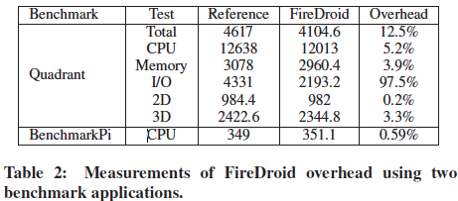
Notes:
From the results, we can see the overhead introduced by FireDroid is very low for the CPU, memory, 2D and 3D tests. Only in the I/O test, FireDroid introduces a very high overhead of 97.5%. This is explained by the fact that when files are opened, FireDroid normalises the file path which requires extra time. Also, the use of ptrace introduces a high overhead given the context switches necessary for passing the control to the FDAM

Slide 25
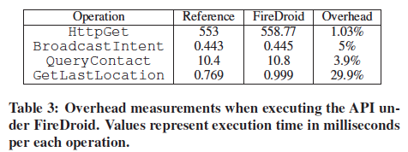
Performance penalty
Interact with other applications
Invoke Android API
Battery consumption
496 mins without Firedroid, 480 mins with Firedroid
Notes:
In more details, for the HttpGet operation the overhead is very negligible. In this case, the device was connected to the Internet using a WiFi connection and performing an HttpGet to http://www.google.com . We measured that 95% of the total execution time is due to network latency to retrieve the data from the remote server.
The rest of operations executed by the application require IPC with other processes through the Binder. This represents the worst case, since the FDAM has to extract information from the ioctl system call with the Binder to be able to evaluate the policies.
The BroadcastIntent sends an implicit intent that is captured by a service component through the sendBroadcast(intent)
method. When this operation is executed under FireDroid the running time increases by 5%. The QueryContact is performed using
the ContentResolver interface to query the id, displayed name, and phone number of each contact. Each time this operation is performed, the FDAM extracts from the ioctl system call the authority of content provider. In this case, the overhead introduced by FireDroid is 3.9%. Finally, the GetLastLocation
is executed by getting a handle to the system service responsible for the location by invoking the getSystemService method.
Afterwards, the getLastKnownLocation method is invoked using the service’s handle. When this operation is executed under FireDroid, the FDAM intercepts first the ioctl to request the service’s handle and then the system call executed for requesting the remote execution of the service’s method. Intercepting the second system call allows us to enforce filtering operations such as changing the returned value of the location with a less precise or a fake one. For performing this fine-grained level of control the overhead introduced by FireDroid is 29.9%.

Slide 26
Roadmap
Introduction
System Design
Implementation
Security Policy
Evaluation
Discussion of EMM

Slide 27
FireDroid
Pros:
Unmodified apps – any app including built-in system apps
No modification and recompilation of OS or middleware
Completely Handle Native Code
Cons:
Need root privilege of device (modify the init.rc file)
Performance penalty and battery consumption
Security policy not so flexible, only allow/deny…

Slide 28
App Rewriting + API hooking
Disassembles apps, rewrite them and hook the security-sensitive APIs to enforce behavior (e.g. open(), read())
Pros:
Much more flexible security policies (app-level granularity)
No need to root the device, no modification on OS
Handle Native Code
Cons:
Need to installed modified version of app
Not able to monitor the system/preinstalled apps

Slide 29
Thank you!
Questions?

