Slide 1
Malicious Advertisements
Boyu Ran and Ben Rothman

Slide 2
Roadmap
Background
Problem
Challenge
Related works
Reference Paper
MadTracer
Comparison between Ref. and MadTracer
Conclusions

Slide 3


Focus
Online Advertisement
Mobile Advertisement

Slide 4

Online Advertisement
Online Advertisement growing trend
  aka Online Marketing or Internet Advertising
  Use internet to deliver promotional messages to consumers
Notes:
includes email marketing, social media marketing , search engine marketing, display advertising and mobile advertising.

Slide 5
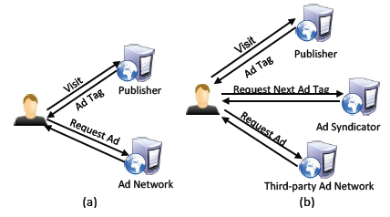
Actors in Web Advertising
publishers
advertisers
audiences
others(ex: tracker)

Slide 6
Advertising Model
Cost Per Click (CPC) / Pay Per Click (PPC)
Advertisers only pay when a user clicks the ad and is directed to the website
Cost Per Mille (CPM) / Cost Per Impression (CPI)
Advertisers pay for exposure (view) of their message to a specific audience

Slide 7

Major Types of Online Advertising
Search/Contextual
Social networks and blogs
Display

Slide 8
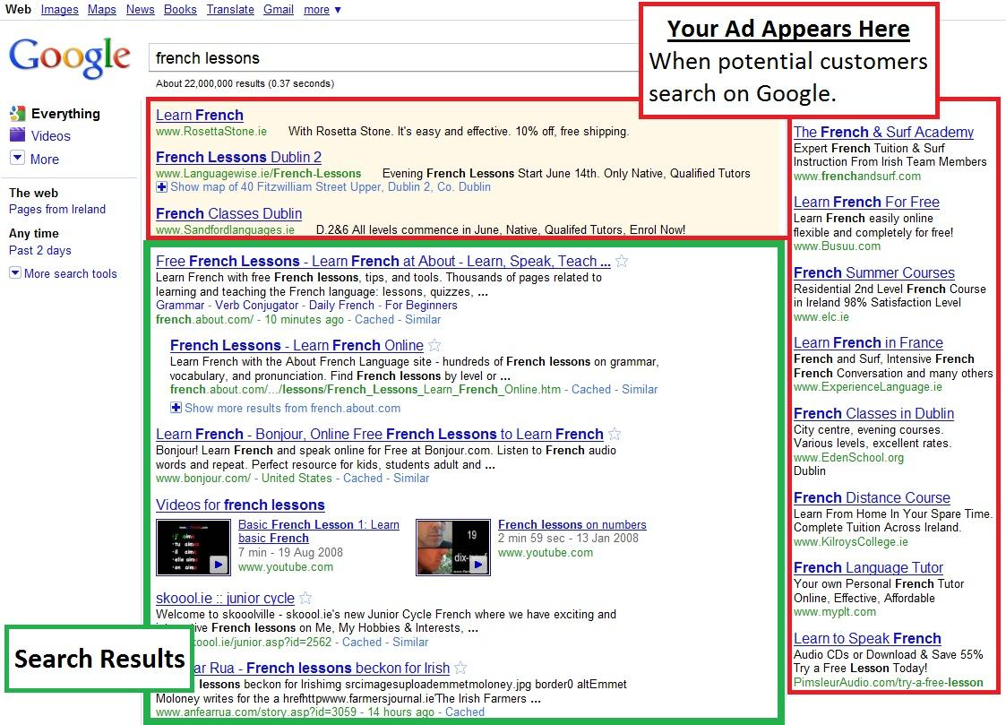
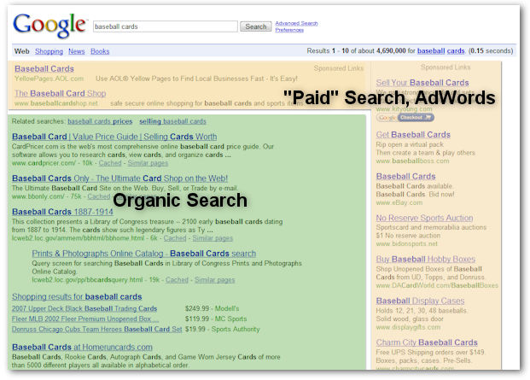
Search/Contextual Example

Slide 9
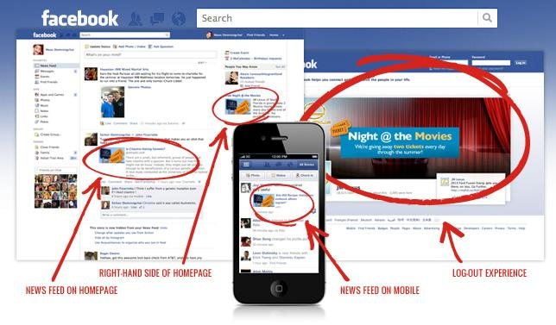
Social Networks Example

Slide 10
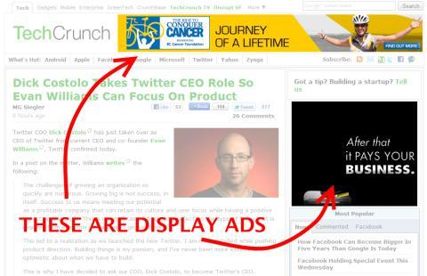
Display Ads Example

Slide 11
Comparison
 | Benefits | Drawbacks
Display | high visibility, effective behavioral and geographical targeting. | blindness
SEM(Search) | Origination | Inorganic Results
Social Media | Low Cost, Increased Visibility( push notification) | TOS limitations

Slide 12
Mobile Advertising
https://www.youtube.com/watch?v=rSRc6ICK_yU

Slide 13
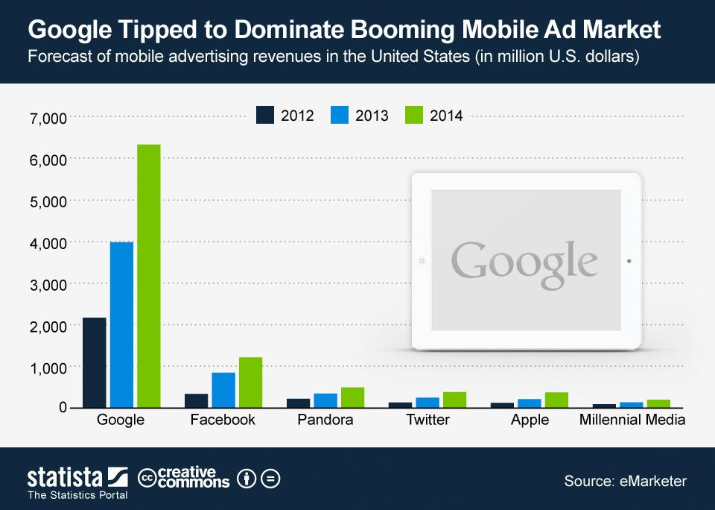
Some Statistics!

Slide 14
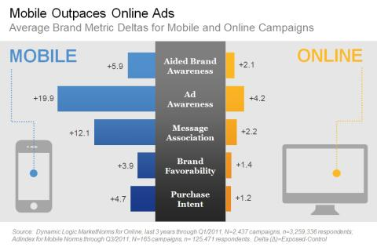
Online Ads vs Mobile Ads
Source: Dynamic Logic Market Norms for Online

Slide 15
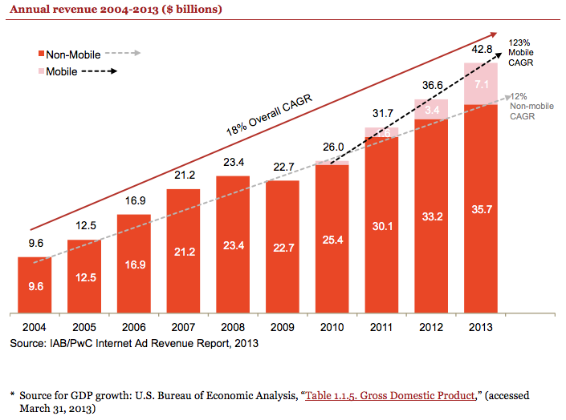
Online Ads vs Mobile Ads
Source: U.S. Bureau of Economic Analysis

Slide 16
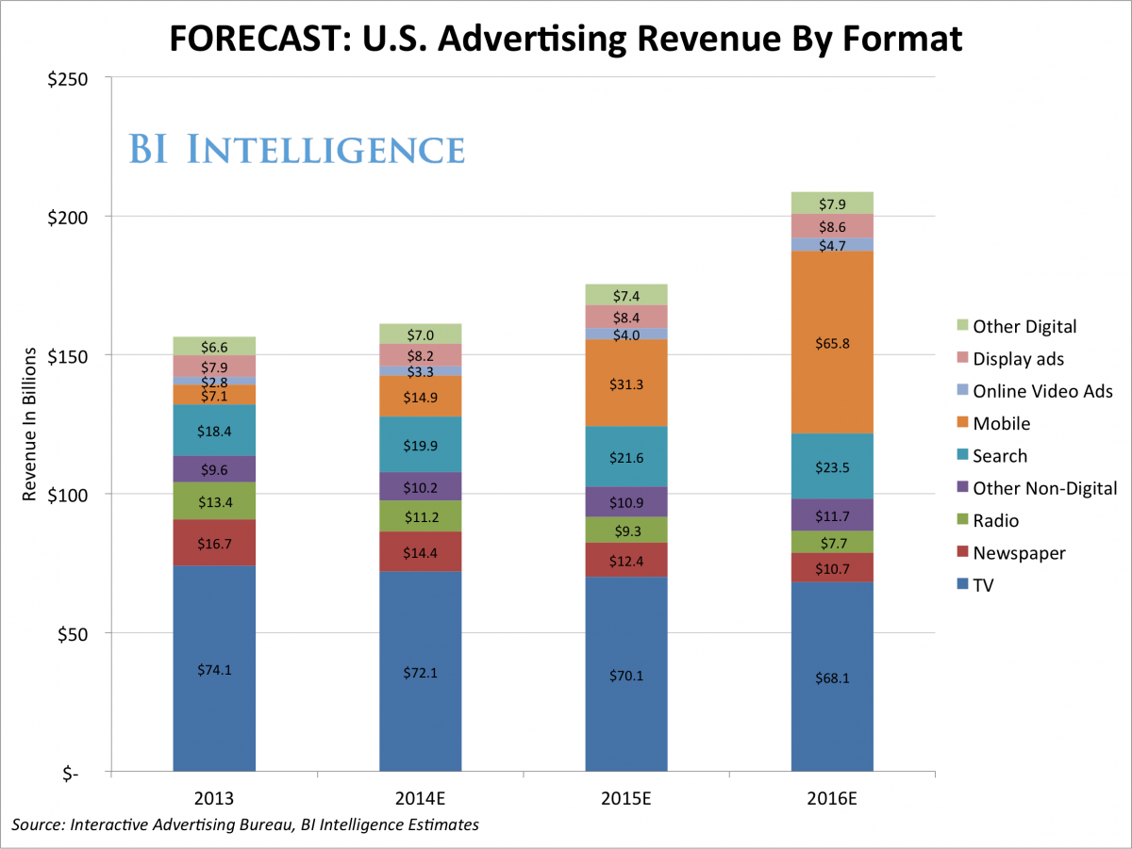
Online Ads vs Mobile Ads
Source: Interactive Advertising Bureau

Slide 17
Roadmap
Background
Problem
Challenge
Related works
Reference Paper
MadTracer
Comparison between Ref. and MadTracer
Conclusions

Slide 18

Problem
Subject to illegal usage
  drive-by downloads
  scamming (deceptive downloads)
  click-fraud (link hijacking)
Notes:
drive-by downloads - > when you visit a page, the malicious code will be downloaded in the background to your device.
scamming - > fake anti-virus
click-fraud -> a person who manually or use a script to click the add in order to increase his own ad revenue.

Slide 19
Drive-by Download Demo
https://www.youtube.com/watch?v=_cBed6-ufIQ

Slide 20
Fake Antivirus Scam Demo
https://www.youtube.com/watch?v=xxDm_sKhIBM

Slide 21
Roadmap
Background
Problem
Challenge
Related works
Reference Paper
MadTracer
Comparison between Ref. and MadTracer
Conclusions

Slide 22

Challenge
Little is known about the infrastructures used to deliver the malicious ad contents.
The partner relations of ad entities are often determined dynamically
Attackers use obfuscation of content and compromising ad networks
Malicious ads exhibit different behaviors

Slide 23
Roadmap
Background
Problem
Challenge
Related works
Reference Paper
MadTracer
Comparison between Ref. and MadTracer
Conclusions

Slide 24
Related Works (Ref Paper)
Detecting malvertisements: HTML redirection analysis (Stringhini et al. and Mekky et al.)
High-interaction honeypots (Provos et al.)
Flash-based malvertising analysis (Ford et al.)
Restricting access: AdJail, AdSandbox, AdSentry
Preventing click-hijacking (lots of related work)

Slide 25
Related Works(Primary)
previous work focus on controlling the behavior of ads in order to prevent malvertising.
Stone-Gross fraudulent activities in online ad exchange
Wang Ad distribution networks. Focus on network performance and user latency.
None of them focus on network topology for malicious ad detection

Slide 26
Roadmap
Background
Problem
Challenge
Related works
Reference Paper
MadTracer
Comparison between Ref. and MadTracer
Conclusions

Slide 27
Methodology Overview
Collect ad samples
Use oracles to identify malvertisements
Analyze trends in malvertisements

Slide 28
Methodology
Collected the contents of 673,596 ad frames from:
  Alexa top 10,000 websites
  Alexa bottom 10,000 websites
  Alexa 23,000 random websites
over 3 months
(used EasyList from AdBlock Plus to identify ads)

Slide 29
Methodology
Identify suspicious activity
  Wepawet - emulates browser, analyzes JS execution for anomaly-based detection of suspicious code
  Malware/Phishing blacklists - ads served from domains included in blacklists, used threshold of 5 blacklists to improve accuracy
  VirusTotal - if an ad tried to force the user to download a file, that file was analyzed with VirusTotal to classify file

Slide 30
Methodology
Analyze properties of malvertisements
  Are any particular ad networks used?
  Are any particular types of websites targeted?
  Does ad arbitration expose safe ad networks to malicious ads?

Slide 31
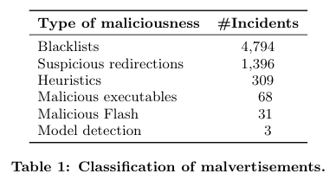
Results
6,601 malvertisements discovered, representing 1% of all ads analyzed

Slide 32
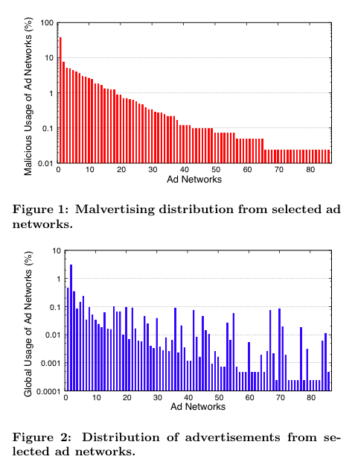
Ad Networks
No matter how sophisticated the filtering used by ad networks, malicious ads will manage to infiltrate
Some networks are better than others at prevent malvertisements relative to their popularity

Slide 33
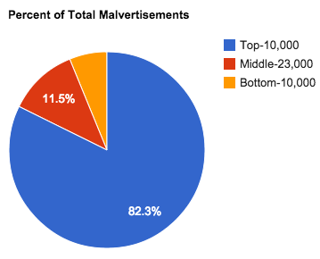
Targets
Website popularity

Slide 34
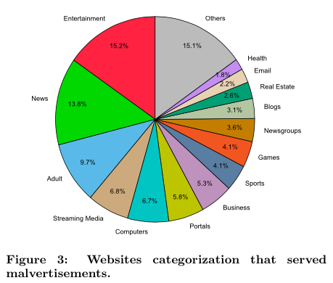
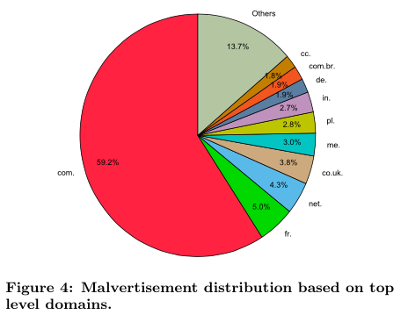
Targets
Malicious ads target mainly .com, but all categories of website

Slide 35
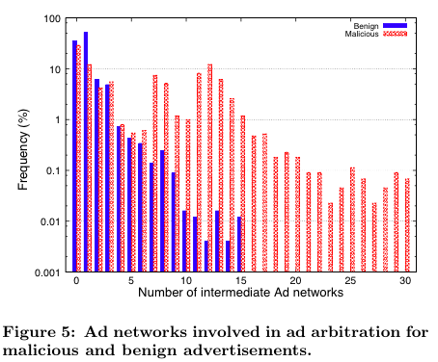
Ad Arbitration
Ad networks serving between each other make trusted ad networks vulnerable

Slide 36
Roadmap
Background
Problem
Challenge
Related works
Reference Paper
MadTracer
Comparison between Ref. and MadTracer
Conclusions

Slide 37
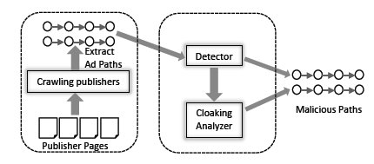
MadTracer
Two components
  first part analyze path and attributes
  second part monitor publisher’s page and study cloaking techniques

Slide 38
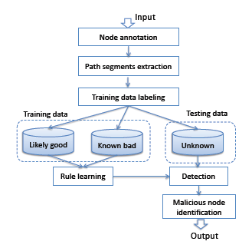
Detection Methodology
Node annotation
  node popularity, role, domain registration info, and URL properties

Slide 39
Detection Methodology
Extract path segment and select a subset of them as training data to build detection rules
  based on decision tree

Slide 40
Detection Methodology
Uses rules to match against each ad-path to be detected.
  If matched, report as Malvertising path.
  Sent to analyzer for further analysis.

Slide 41
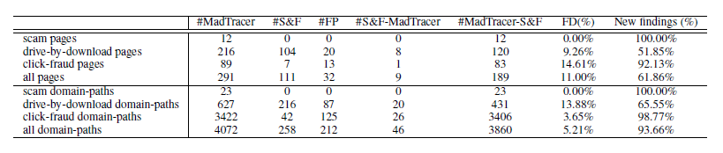
Evaluation
MadTracer works effectively against real-world malvertising activities: it caught 15 times as many malicious domain paths as Google Safe Browsing and Microsoft Forefront combined.

Slide 42
Roadmap
Background
Problem
Challenge
Related works
Reference Paper
MadTracer
Comparison between Ref. and MadTracer
Conclusions

Slide 43
Primary vs. Reference Paper
 | Primary Paper | Reference Paper
Duration of Experiment | 3-month period | 3-month period
Machine Learning | Yes | No
Scale of Experiment | Alexa’s top 90,000 web sites | Alexa top 10,000, bottom 10,000, middle 23,000
Detection Method | Google Safe-Browsing API, Microsoft Forefront, MadTracer | Anomaly JS detection, domain blacklists, and malware in download requests
Malvertising Defend Mechanism | MadTracer | (suggests using ad blocking, ad network collaboration, iframe sandboxing)

Slide 44
Web vs. Mobile Ads
 | Web Ads | Mobile Ads
Channels | web servers ( web sites) | Wifi SSID, SMS, QR Code, Contacts, Calendars, Etc.
Basis of Advertising | IP-based | Geolocation-based
Malvertising Detection Methods | dynamic analysis | static and dynamic analysis
Malvertising Defend Mechanism | MadTracer | NoInjection
Ad Serving | Client Redirects | Server Redirects

Slide 45
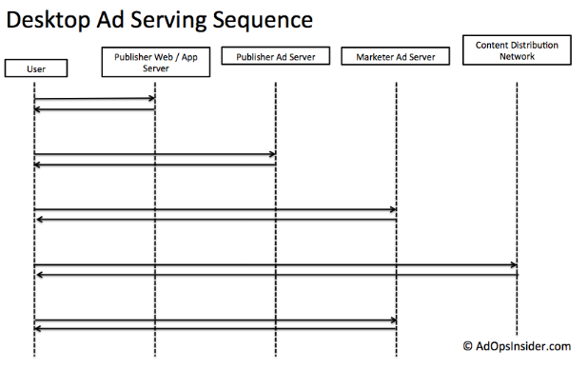
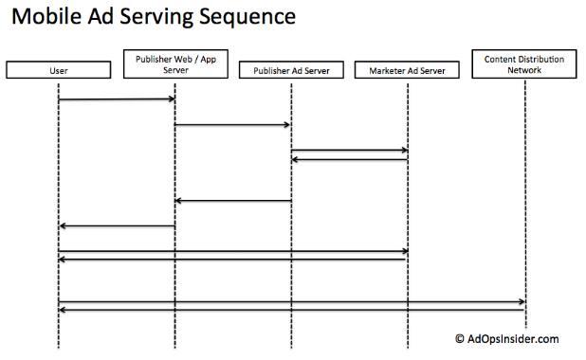
Web vs Mobile Ad Serving

Slide 46
Roadmap
Background
Problem
Challenge
Related works
Reference Paper
MadTracer
Comparison between Ref. and MadTracer
Conclusions

Slide 47
Conclusion
There are lots of attack vectors when it comes to ads, and they are a necessary risk for the economy of the web (primary and reference paper in agreement)
No single approach will be sufficient, it requires work on the part of the browser developers, ad network managers, web/app developers to reduce risk of malvertising

Slide 48
Any Questions?

