Slide 1
CoVisor: A Compositional Hypervisor for Software-Defined Networks
Xin Jin, Jennifer Gossels, Jennifer Rexford, David Walker
Princeton University

Slide 2
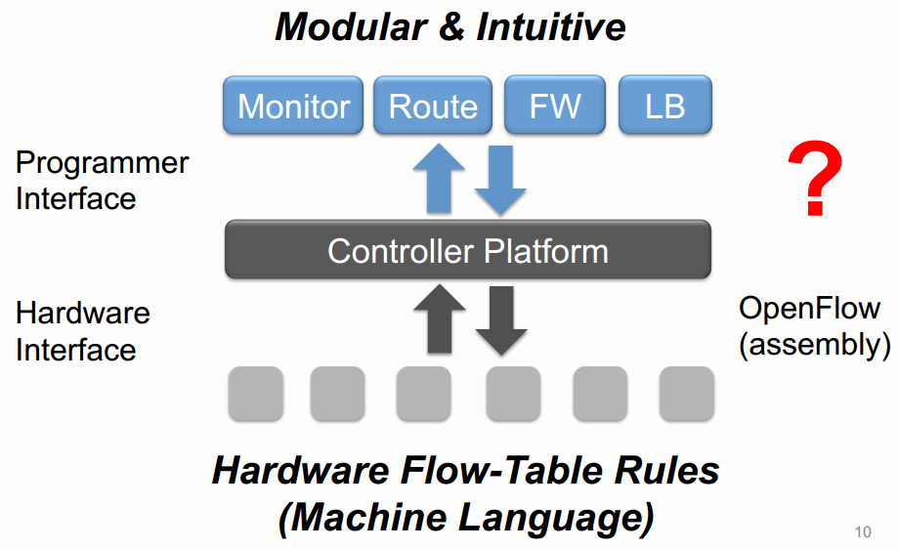
Coordinating Control-plane Modules

Slide 3
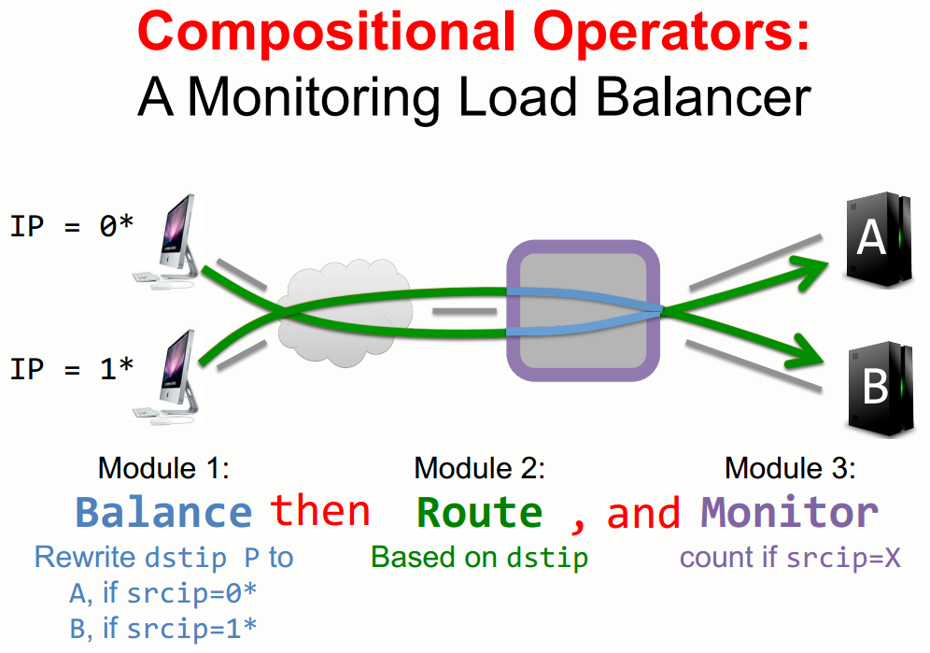

Slide 4
Compositional Network Hypervisor
Assembly of multiple controllers
  Single admin, multiple controllers
  Compose controllers with parallel, sequential or overriding
Definition of abstract topologies
  One physical switch -> many logical switches

Slide 5
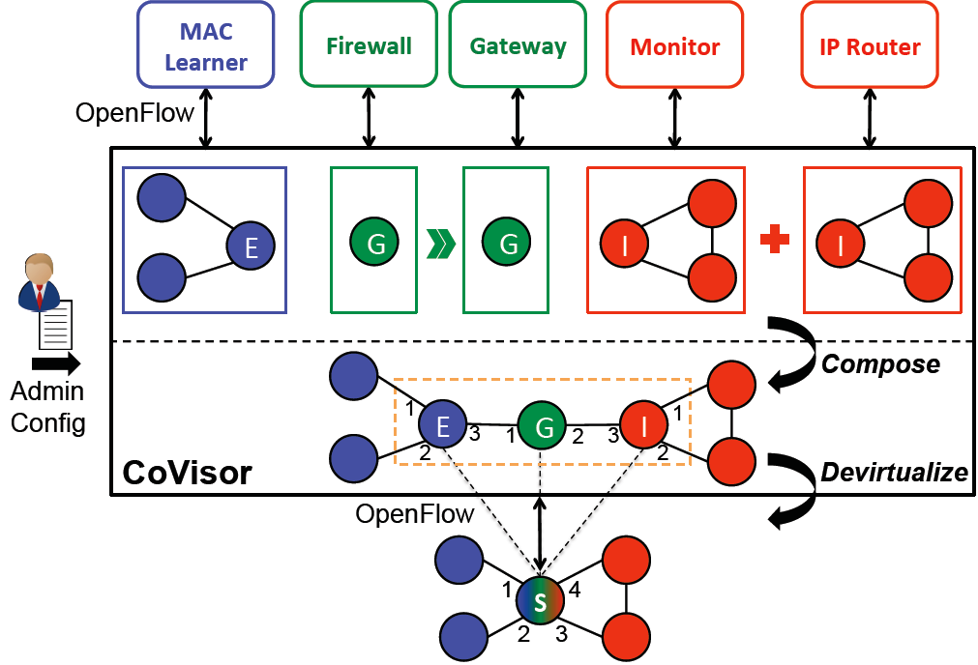
CoVisor Overview

Slide 6
Challenge
Flow table compilation efficiency

Slide 7
Solution
Incremental compilation
  Incremental priority assignment
  Advanced indexing for fast rule lookup

Slide 8
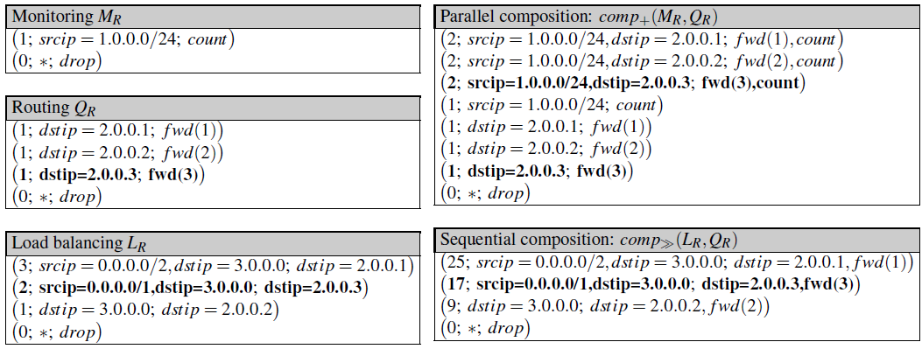
Incremental Compilation

Slide 9
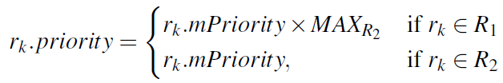
Incremental Priority Assignment
Heuristics
  Parallel:
  Sequential:
  Overriding:

Slide 10
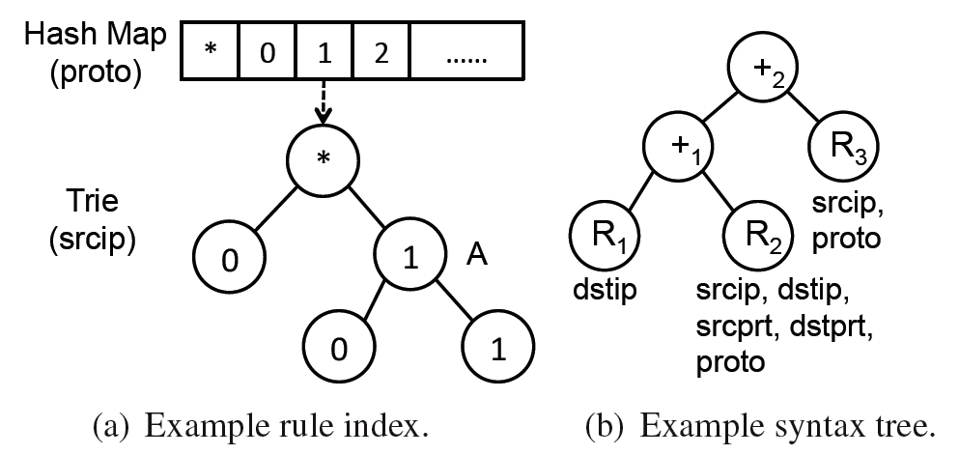
Advanced Indexing Structure
Given a target rule R_{t}, how to efficiently find the rules in a flow table that overlap with R_{t}?

Slide 11
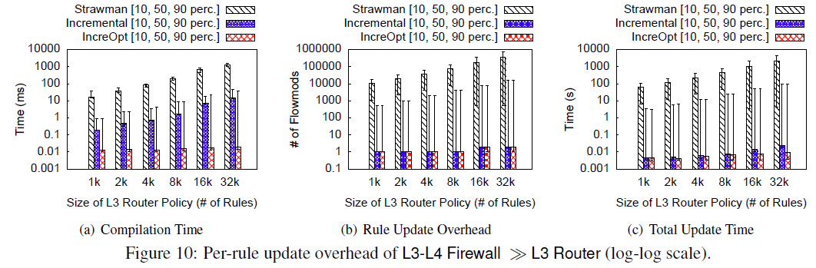
Implementation and Evaluation
Implement with 4K LOC on OpenVirteX
Simulation experiments against a strawman compiler

