Slide 1
CHEX: Statically Vetting Android Apps for Component Hijacking Vulnerability
Chao Shi
Scribed from www.cc.gatech.edu/grads/l/long/download/CHEX_CCS12.pptx

Slide 2
Systematic Detection of Capability Leaks in Stock Android Smartphones
Jacob Sherin

Slide 3
Component Hijacking Vulnerability

Slide 4
Vetting vulnerable apps in large scale
High volume of app submissions
Inexperienced developers
Large number of vulnerable apps
Accurate and scalable app vetting methods
Component hijacking vulnerability

Slide 5
Components in Android Apps
Type
Activity
Service
Broadcast Receiver
Content Provider
Mutually independent yet interactive
Secure interaction mechanism exists
People ignorance
Export Component
The component is publicly available
App1
App2
Android Framework
Notes:
Why export component, component reuse. Example, messenger app use the contact enumerator component by the contact manager app

Slide 6
Component hijacking attacks
A class of attacks that seek to
gain unauthorized access (read/write or combined)
to protected or private resources
through exported components in vulnerable apps.
The attacking app is already installed
Vulnerable apps exist on target devices

Slide 7
Component hijacking attacks
Unauthorized access to protected resources
Contact Manager App
Enumerator Service
Returns the address book upon request
Accepts unauthorized requests
READ
Enumerator
Service
Android Framework
Contacts
Notes:
Bypass the permission checking system. The malicious app has no permission for the protected resource. Data sink between the Enumerator Service and the malicious app

Slide 8
Component hijacking attacks
Unauthorized access to private resources
Contact Manager App
Setting Update Receiver
Accepts external updates
App Internal DB is not permission protected
Write to critical area
Private
Storage
Setting Update
Receiver
Android Framework
Key | Value
VoIP_Prefix | “1234”
Is_App_Lisenced | false
Notes:
The Contact Manager app is badly styled. The setting update receiver should filter the input from other apps. (SQL injection can happen.)

Slide 9
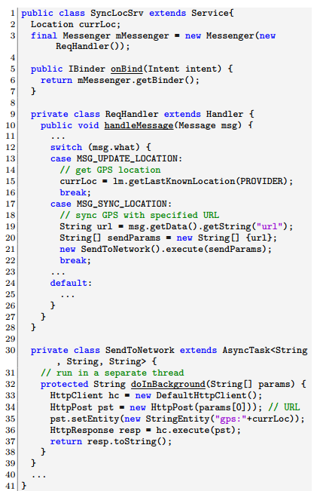
Code Example
Component Hijacking vulnerable app
Malicious app:
Ibinder binder;
/* Connect to the service */
…
/* Send message to the service */
Messenger mMessenger = new Messenger(binder)
mMessenger.send(msg);
Notes:
A Handler without santinization on the caller is really dangerous

Slide 10
Data flow view
Message
(Input Source)
GetLastLocation
(Sensitive Source)
SendParams
(Transit sink)
currLoc
(GV)
params
(Transit Source)
HTTPClient Execute
(critical sink)

Slide 11
Chain of components.
A data-flow perspective
Component hijacking ➔
read/write protected or private data via exported components
Detecting component hijacking ➔ finding “hijack-enabling flows”
App
Private
Protected
Android Framework
Notes:
A data-flow perspective, both read and write. ! Chained component hijacking flow is possible.

Slide 12
App entry points
Points where transfers the control to the app.
Start point
Callbacks
Definition: App entry points are the methods that are defined by the app and intended to be called only by the framework.
App launch points
Component lifecycle callbacks
UI event handlers
Asynchronous constructs
Others

Slide 13
Challenges
Reliably discovering all types of entry points (or event handlers) in their completeness
Soundly modeling the asynchronous invocations of entry points for analysis.
Assess the collective side-effects of individual data flows and identifying the converged flow of interest
Tracking data ﬂows across splits and components (different thread, do in the background)
Notes:
1.
2. Asynchronized, user input message
3. Combined interested data flow
4. Heap data and user input

Slide 14
More complex view
Entry Point
GetLastLocation
(Sensitive Source)
Message
(Input Source)
Handle Message
currLoc
(GV)
SendParams
(Transit sink)
Entry Point
currLoc
(GV)
params
(Transit Source)
Background,
New thread
HTTPClient Execute
(critical sink)
Notes:
Thread same memory

Slide 15
Capability Leak

Slide 16
Capability Leaks
Capability Leak: A situation where an app can gain access to a restricted API without requesting proper permission
Explicit Capability Leak: Broadening access to a restricted API by exposing it via another API
Implicit Capability Leak: Inheriting permissions from other applications

Slide 17
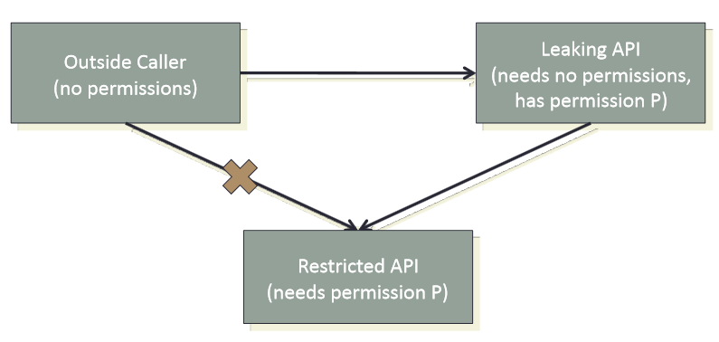
Explicit Capability Leaks

Slide 18
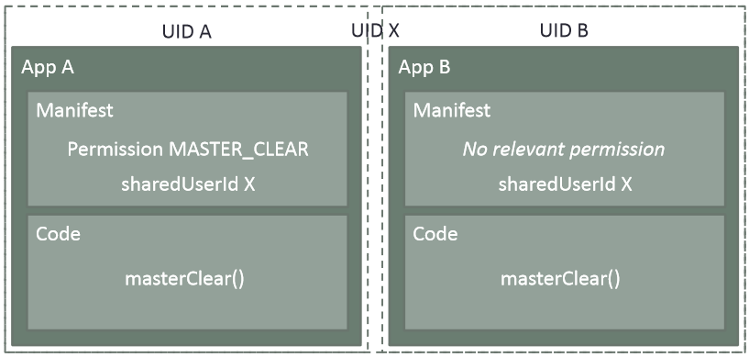
Implicit Capability Leaks
Applications don't have permissions, user identifiers (UIDs) do.

Slide 19
CHEX Design

Slide 20
Related Work Limitations
Only protected resources being checked.
No completeness in entry point discovery.
No in-depth analysis. Simply checking the usage of exported methods in the component.
No scalability methods
Only test on small set of apps.
Notes:
Remove the attacking launch point (API exposure)

Slide 21
Major Contributions
Designed a sound method which automatically discovers all types of app entry points with low false rate.
Designed a method to model the interleaved execution of the multiple entry points and track data flow between them.
Build CHEX, a in-depth, scalable, context-sensitive, flow-sensitive static app vetting tool for component hijacking vulnerabilities and tested on large set of apps.

Slide 22
Dalysis: Dalvik Analysis Framework
Parse
manifest
Meta data
Point-to analysis
Constants
Instruction translation
Abstract interpretation
SSA conversion
Call graph builder
Disassemble
bytecode
(DexLib)
Class
hierarchy
SSA IR
SDG builder
Instructions
…
Frontend
Backend
Consumes off-the-shelf Android app package (.apk)
Generates SSA IR (adopted from WALA)
Supports extensible backend for multiple types analysis tasks

Slide 23
Entry point discovery
Observation: only two ways to “register” entry points
Declaring them in the manifest file (parse manifest)
Overriding/implementing the designated interfaces
Unused methods overriding framework
Dead code
Entry points
How to distinguish?
Containing class is instantiated
Original interface is never called by app
Notes:
Onload, OnError

Slide 24
Entry point discovery
Unused methods overriding framework
Entry points
Unused methods overriding framework
Entry points

Slide 25
App splitting
Definition:
A split is a subset of the app code that is reachable from an entry point.
App
Modeling app execution by permuting split executions in all feasible orders
Why reasonable?
Most splits cannot be interleaved
Efficient pruning techniques
Android Framework
Notes:
(1)Few interleaving, most sequential. The framework invoke the start point in the main thread of the app
(2)Concurrent data flow is hard to be reproduced and is not focused here.

Slide 26
SDS and PDS
Src1
G1
Split Data-flow Summary (SDS)
Intra-split data-flows that start and end at
heap variables, sources, or sinks.
G1
Sink1
Permutation Data-flow Summary (PDS)
Linking two adjacent SDSs in a feasible permutation
Src1
G1
When permutation ends, all possible data-flows have been enumerated.
Sink1

Slide 27
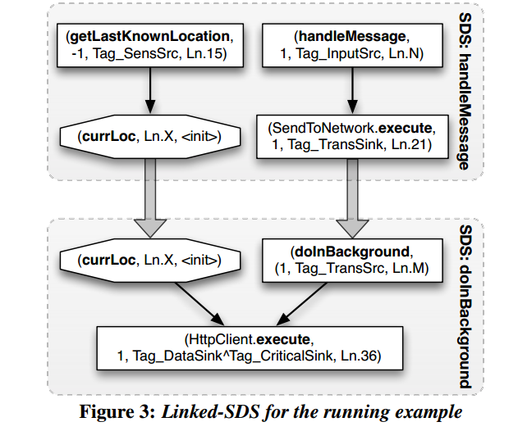
Example
Notes:
Left P1: right

Slide 28
Identifying “hijack-enabling flows”
Using descriptive policies to specify flows of interests
Sensitive source
Input
Input
Sensitive Source
…
…
…
Public Sink
Critical Sink
Critical Sink
Input-specified
sink
Notes:
Critical sink: writing related

Slide 29
Evaluations
5,486 apps from the official and alternative markets
Hardware spec: Intel Core i7-970 with 12GB RAM
Performance
Accuracy
Median processing time: 37sec
22% apps took >5min
254/5,486 flagged as vulnerable
True positive rate: 81%
Insights
50 entry points of 44 types per app
99.7% apps contain inter-split data-flows

Slide 30
Vulnerabilities found
Attack Class | Representative cases
Data Theft | Sending GPS data to URL specified by input string
Capability Leak | Input string used as hostname for socket connection
Code Injection | Input string used for raw SQL query statement Input string used as shell command
Intent Proxy | Object embedded in input used to start Activity
Data tampering | Input string submitted to server as game score

Slide 31
Discussions
False positives
False negatives
Sophisticated request validations
Infeasible split permutations
Control-flow driven hijacks
Notes:
Limitation
Future work

Slide 32
Capability Leaks

Slide 33
Detecting Capability Leaks
Android SDK gives us no tools!
Function composition
Capability leak: g(x) = f(x) + some other stuff
Intuitive Algorithm
Find interesting (dangerous) APIs (f(x))
Find new API definitions (g(x))
Link them!

Slide 34
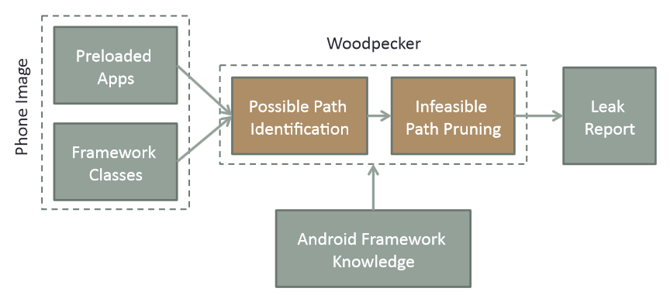
System Overview

Slide 35
Possible Path Identification
Construct a control-flow graph
Find all paths from an IPC entry point to an API of interest

Slide 36
Possible Path Identification: Challenges
Object references
Class hierarchy used to conservatively resolve references
Extensive use of callbacks
Use framework knowledge to stitch together callbacks

Slide 37
Infeasible Path Pruning
Many potential paths exist
Most are either impossible or uninteresting
Must prune these uninteresting paths
Branch conditions need an understanding of program data-flow
Explicit permission checks are “infeasible paths”
Approach: Symbolic Path Simulation

Slide 38
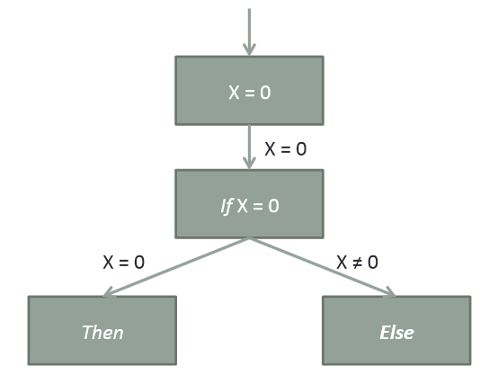
Symbolic Path Simulation

Slide 39
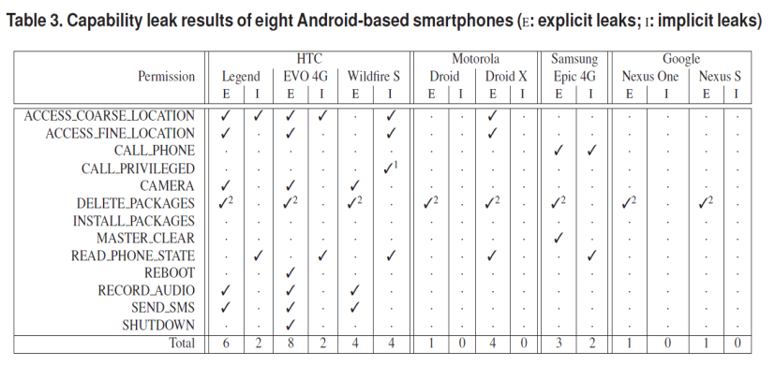
Results

Slide 40
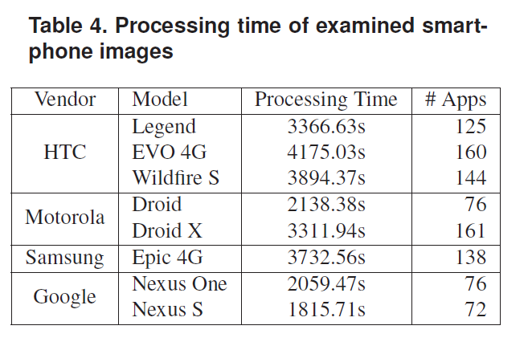
Results

Slide 41
Case Studies
Explicit Capability Leaks (Without Arguments)
Explicit Capability Leaks (With Arguments)
Implicit Capability Leaks

Slide 42
Explicit Capability Leaks (Without Arguments)
Samsung Epic 4G
Pre-loaded app, com.sec.android.app.Selective-Reset
Displays reset confirmation screen
SelectiveResetReceiver class
Listens for Android.intent.action.SELECTIVE_RESET Intent, then waits for confirmation
Starts SelectiveResetService, then listens for android.intent.action.SELECTIVE_RESET_DONE
This calls CheckInService.masterClear()

Slide 43
Explicit Capability Leaks (With Arguments)
HTC capability leaks
SEND_SMS
CALL_PHONE
RECORD_AUDIO
Similar formats
Exercised capability takes a number of arguments, certain components can be passed in Intent.

Slide 44
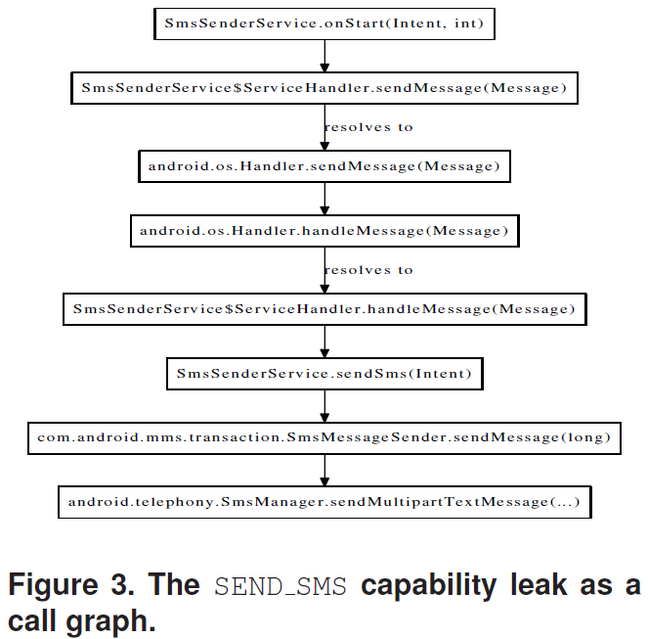
Explicit Capability Leaks (With Arguments)

Slide 45
Implicit Capability Leaks
HTC Wildfire S
Built-in MessageTab app, com.android.MessageTab
CALL_PRIVILEGED capability
It is used to manage phone's SMS messages, but for convenience allows the user to dial contacts directly through a “contact details” screen
Does not request CALL_PHONE or CALL_PRIVILEGED in its manifest
BUT! It does declare a sharedUserId attribute
android.uid.shared
Shared with several core Android apps, including com.android.htcdialer, which has both phone-dialing permissions

Slide 46
Future Work and Improvement
Handle native code in addition to Dalvik bytecode
Expand permission set, only 13 now
Chained capability leaks
App-defined permissions
Expand to include third-party user apps

