Slide 1
CONSCRIPT: Specifying and Enforcing Fine-Grained Security Policies for JavaScript in the Browser
Leo A. Meyerovich and Benjamin Livshits
Presented by Josiah Matlack and Maciek Swiech
Notes:
Josiah and Maciej

Slide 2
Background and Motivation
Webpages are a “mashup” of Javascript – on the page and in external files
  Inclusion of third party content is necessary, but untrusted
Many policies and enforcement mechanisms
  Granularity, performance, and correctness
  CONSCRIPT is high performance, low complexity
Example: eval
  Necessary evil (for JSON data)
  window.eval = function() { // safe code }
  Hiding is insufficient
  Use ConScript to advise the calls
Notes:
Maciej

Slide 3
Background and Motivation
Simple (shallow) aspect systems unable to detect all attacks
  Difficult (at best) to prove correctness
  Foiled by various prototyping attacks
Not only JavaScript but native elements must be protected and validated
  Browser functionality provided by document and window
Notes:
Maciej

Slide 4
Background and Motivation
Aspect-oriented systems
  Breakdown logic into concerns
    Cohesive area of functionality
  Grouping and encapsulation of concerns
  Cross-cutting concerns
    Cut across multiple abstractions
  Alter behavior through advice and pointcuts
    Aspects: code (and included advice)
    Pointcut: specified moment of execution
Notes:
Maciej

Slide 5
Aspect-Oriented Programming (AOP)
Complementary to OOP model, allows for simplification of code
  Cross-cutting concerns: secondary functionality that may be replicated across various classes / primary functionalities
  Advice: additional code to be applied to the model
  Point-cut: a point of application execution at which cross-cutting needs to be applied
  Aspect: the combination of the point-cut and advice
Notes:
Maciej

Slide 6
AOP Example
void transfer(Account fromAcc, Account toAcc, int amount) throws Exception {
if (fromAcc.getBalance() < amount) {
throw new InsufficientFundsException();
}
fromAcc.withdraw(amount);
toAcc.deposit(amount);
}
Security??
Notes:
Maciej

Slide 7
AOP Example (cont.)
void transfer(Account fromAcc, Account toAcc, int amount, User user, Logger logger)
throws Exception {
logger.info("Transferring money...");
if (! checkUserPermission(user)){
logger.info("User has no permission.");
throw new UnauthorizedUserException();
}
if (fromAcc.getBalance() < amount) {
logger.info("Insufficient funds.");
throw new InsufficientFundsException();
}
fromAcc.withdraw(amount);
toAcc.deposit(amount);
logger.info("Successful transaction.");
}
Now we have checks…
What if security concerns change?
Notes:
Maciej

Slide 8
AOP Example (cont.)
External interests (security checks, logging) have become tangled with the main interest of the application
Aspects can contain advice – code that is joined to specific parts of a program
Contain cross-cutting code in a central and easy to manage / reason about place
Notes:
Maciej

Slide 9
AOP Example (cont.)
aspect Logger {
void Bank.transfer(Account fromAcc, Account toAcc, int amount, User user, Logger logger) {
logger.info("Transferring money...");
}
void Bank.getMoneyBack(User user, int transactionId, Logger logger) {
logger.info("User requested money back.");
}
// other crosscutting code...
}
Notes:
Maciej

Slide 10
Basic Problem
Create a browser-based aspect system that constrains the JavaScript code that can run on a webpage by specifying security policies
  Allow policies to be set by the webpage
Notes:
Josiah
This system is aspect-oriented

Slide 11
Basic Problem (cont.)
Browser aspects
  Protect benign users by giving control to hosting site
  ConScript: browser-supported aspects
Correctness checking
  Policies are easy to get wrong
  Remedy: type system
Expressiveness
  Wide catalog of policies
Real-world evaluation
  Built into IE8 JS interpreter and well tested
Notes:
Josiah

Slide 12
Related Work
Static analysis: instituting policies as properties
  Context sensitivity in JS is prohibitively high
  Small widgets are more tractable, but large systems aren’t
  Inference is well studied
Browser tags
  Obviated need
Isolation languages
  Correctness is hard
Notes:
Josiah
JS too hard for context sensitivity, in comparison to other languages
Especially for large systems
Type system (dynamic) comes into paly
Specialized browser tags would explode in size
Policies can avoid the need
Isolation: filter and rewrite
Hard to get it completely right because of TMTOWTDI
This is easier, generalized, abstract policies
Max’s note: more abstraction could be easier? Not sure this is true. 17 policies and 969 lines seems short already
Clarify

Slide 13
Related Work (cont.)
Shallow wrapping
  Not appropriate for large APIs
  Susceptible to policy integrity attacks
Weaving aspects into the source
  Server cost too high
  Type-based pointcuts are too imprecise
  DOM API can’t be rewritten
Aspect interfaces for dynamic languages
  The around function is much simpler
  around could be modified (before, after, etc.)
Notes:
Josiah
Shallow wrapping falls prey to redefinitions and other problems
Weaving = static aspects
Not an interface, just a single delegate function

Slide 14
Related Work (cont.)
Secure aspects
  Don’t allow for behavioral modification of code
  CONSCRIPT is the opposite model
    Aspects are protected from subsequent code
    Others don’t interact with non-policy code
Notes:
Josiah
Rather than protecting the code, protect the aspect
Can’t modify behavior of code, so limited
Can’t interact with code not contained in an aspect (limits to definitions)

Slide 15
Main Ideas
around function
Deep advice: advice propagates to function root, rather than references
  Depends on the runtime and browser being uncompromised
  Avoids shallow advice (wrapping), as leaks occur
C++ interpreter
  Adds advice pointer and enabled bit to functions
Notes:
Josiah
Around: pass in a function and its arguments to aspect
Old function not called
Checking is performed
Advice designer decides what to do
Circumvents possibly vulnerable functions
Deep advice: can leak if function defined in multiple ways
Scope chain

Slide 16
heap
stack
function withBoundChecks
fish
...
...
display
...
dog
function
paint
draw
Notes:
Deep advice example

Slide 17
Main Ideas (cont.)
C++ interpreter
  Native functions are handled like user-defined (bit + pointer)
  External functions are checked for advice registration
    Hits have advice processed, misses continue normally
    Bounded lookup table
  Bless/curse: flip advice bit to enable/disable advice function
    Automatic flipping is most efficient and effective
  New scripts are sent to advice automatically
    The return string is passed to the parser
  Isolated reasoning and static analysis in the interpreter to prevent vulnerabilities through poisoning
Notes:
Josiah
Lookup table is bounded because there are a finite number of functions
Bless/curse: necessary to prevent infinite recursion
Poisoning a big issue

Slide 18
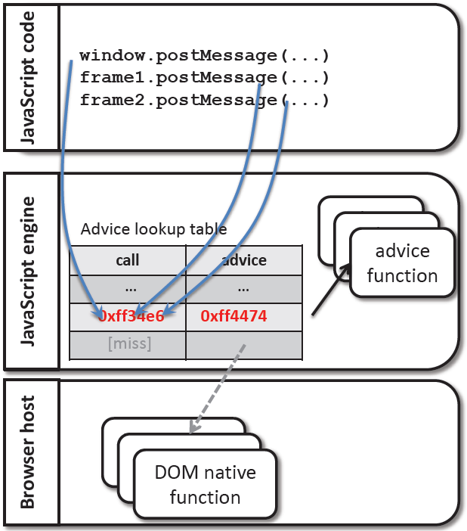
Notes:
How external functions are handled

Slide 19
Main Ideas (cont.)
Some functionality removed
  with and eval
  No caller access
Policies
  17 handwritten, 2 automatic generators
  No kernel to user flow allowed
  Functions must be known at policy invocation
  Privilege levels: u, k and o
Notes:
Josiah
Not a full feature set, but like ECMAScript 5
Not a full list of features
Privilege levels: more on that later

Slide 20
Main Ideas (cont.)
Script introduction policies
  No scripts after a certain point
  No string arguments in setInterval or setTimeout
  No inline scripts
  Tags checked for whitelisted sources
  noinlinescript tag for certain elements
Communication restrictions
  Restrict XMLHttpRequest to secure connections
  No access to cookies (http access only)
  Limit postMessage (cross-frame messages) to whitelist
  Limit cross-domain requests to a whitelist
Notes:
Josiah
All examples of policies, not all necessarily used at the same time (can be turned on/off)

Slide 21
Main Ideas (cont.)
DOM Interactions
  Prevent links from accessing cookies
  Limit the number of popup windows (or window movement)
  Disable dynamic iframe generation
  Whitelist for URL redirections
  Disable abuse of resources (modal dialogs)
API Programming Reliability Constraints
  Simple comparisons for $ operator in Jquery
  No null returns for $ operator
  Staged eval restrictions
Notes:
Josiah
As before

Slide 22
Policies: Easy to get Wrong
1.
2.
3.
4.
5.
6.
7.
8.
9.
var okOrigin={"http://www.google.com":true};
around(window.postMessage,
function (post, msg, target) {
if (!okOrigin[target]) {
throw ’err’;
} else {
return post.call(this, msg, target);
}
});
Notes:
toString redefinition at line 4
Function.prototype poisoning line 7
Object.prototype poisoning line 4
Access path integrity for function calls (uCall instead of post.call)
Reference isolation (hasProp instead of okOrigin[target])

Slide 23
Main Ideas (cont.)
Static typing system
  Use ML-like typing system to annotate privilege level of objections
  K (‘kernel’), U (‘user’), O (protected ‘object’)
  Track how information can flow
Automatic policy generation (Script#)
  Look for unused methods in training data, and blacklist errors as malicious
  Integrate with rules auto-generated from other libraries (private methods)
Notes:
Josiah
Like previous systems we’ve worked on, information flow checking
Except types are actual privilege information
(TaintDroid, for example)
Auto policy generator (Script# is one example)

Slide 24
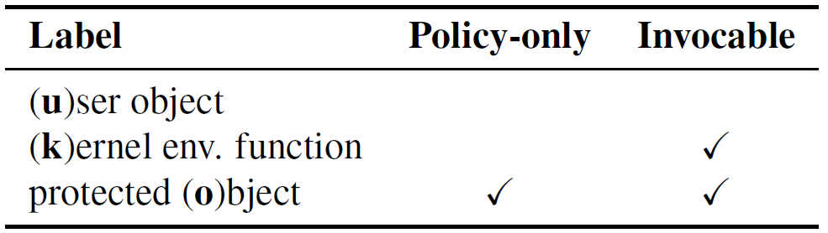
Notes:
“Is-substitutable-for lattice”

Slide 25
Evaluation and Results
969 lines of JavaScript at 60 locations
  Without boilerplate code, about 8 lines per location
Some features disabled
  arguments.callee
Performance cost is 2-3x better than others
10,000 invocations of each target function
  Advice mechanism + original function counted
  Tried on native, user-defined, and DOM functions
24 microsecond cost for environment creation
Notes:
Maciej

Slide 26
Evaluation and Results (cont.)
CPU bound
Considerably faster than the DoCoMo system
For private methods, at most 0.3% overhead
  Less than 3.5% range of error
Intrusion detection policy very small
  7% overhead with a 46% standard deviation
  No intrusion detection alarms while testing
0.7KB average file size increase
  Policy file size mostly constant, even with large source
Notes:
Maciej

Slide 27
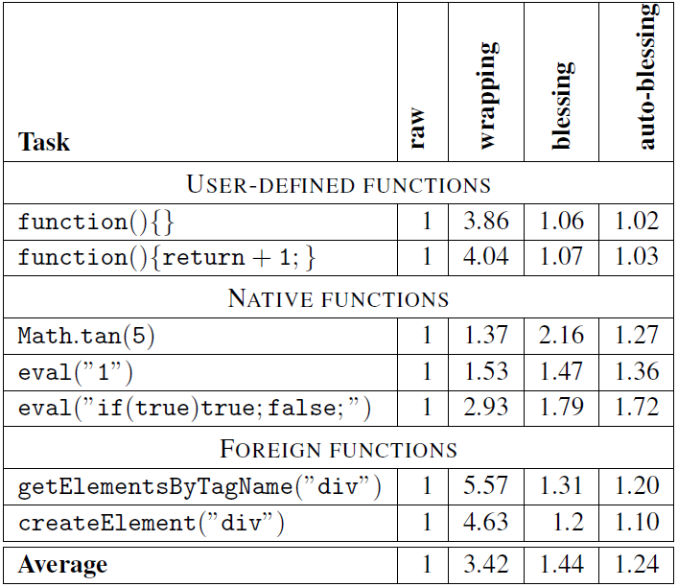
Micro Benchmarks
Notes:
Maciej

Slide 28
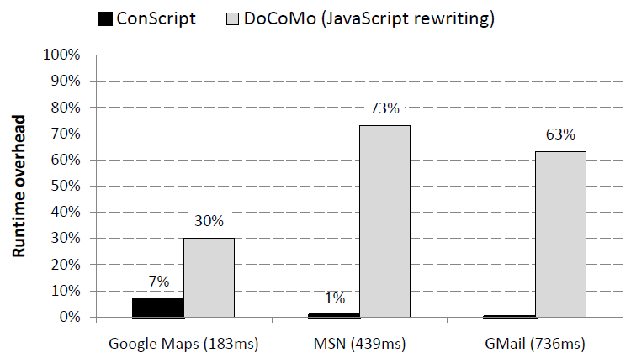
Macro Benchmarks
Notes:
Maciej

Slide 29
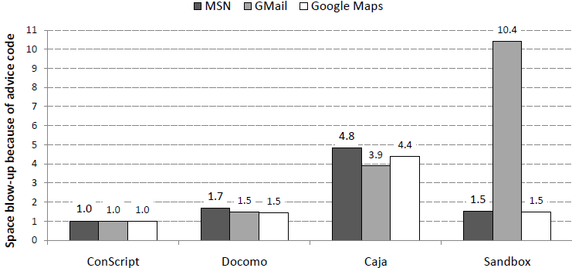
Code Size Increase
Notes:
Maciej

Slide 30
Open Issues
Library loading and static analysis
  If code is loaded before aspect registration
  Static analysis could be preferable
with and eval are missing
SetTimeout unsafe without policy enforcement
Type inference incomplete
Browser support is required
Notes:
Maciej

Slide 31
Open Issues (cont.)
Automatic policy generation
  Policies come with host page
  Attackers could use unsupported frameworks
Notes:
Maciej

Slide 32
Questions?
Notes:
Josiah and Maciej

