Slide 1
All You Ever Wanted to Know About Dynamic Taint Analysis & Forward Symbolic Execution (but might have been afraid to ask)
Edward J. Schwartz, ThanassisAvgerinos, David Brumley
Presented by: Vaibhav Rastogi

Slide 2
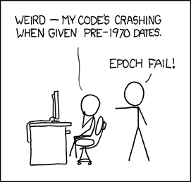
The Root of All Evil
Humans write programs
This Talk:
Computers Analyzing Programs Dynamically at Runtime

Slide 3
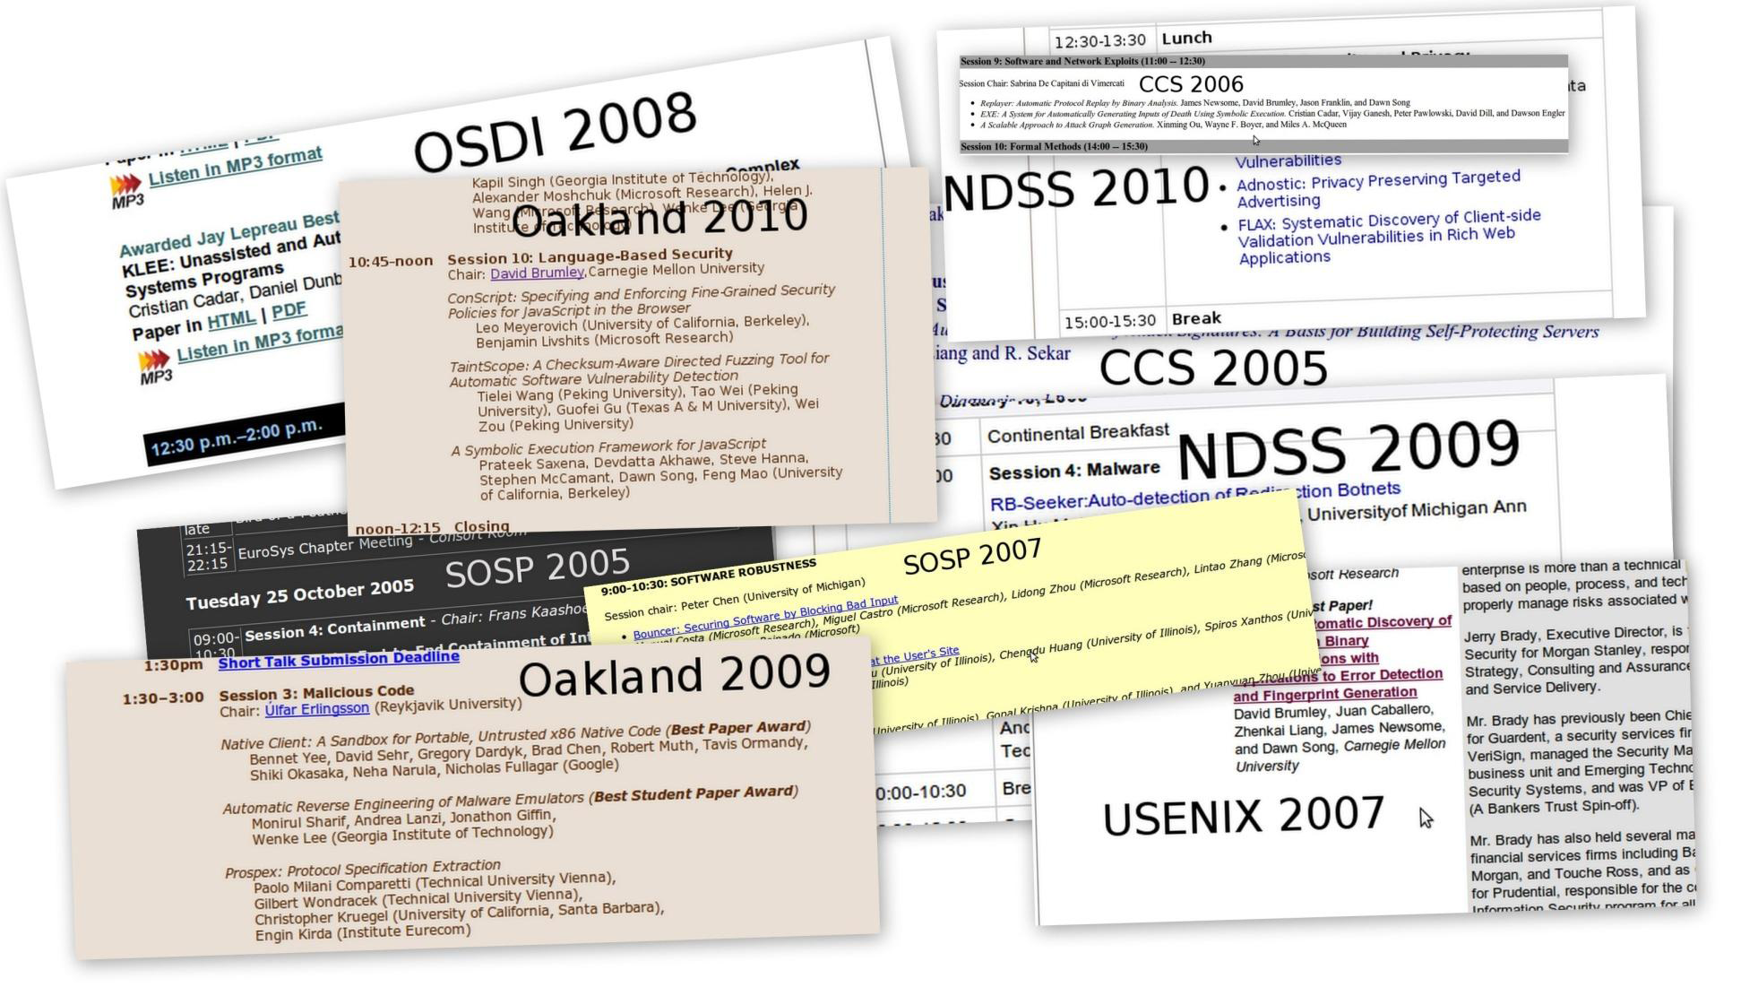
Two Essential Runtime Analyses
Malware Analysis
Vulnerability Detection
Privacy Leakage Detection
Dynamic Taint Analysis:
What values are derived from this source?
Automatic Test-case Generation
Input Filter Generation
Malware Analysis
Forward Symbolic Execution:
What input will make execution reach this line of code?

Slide 4
Contributions
Formalize English descriptions
An algorithm / operational semantics
Technical highlights, caveats, issues, and unsolved problems that are deceptively hard
Systematize recurring themes in a wealth of previous work

Slide 5
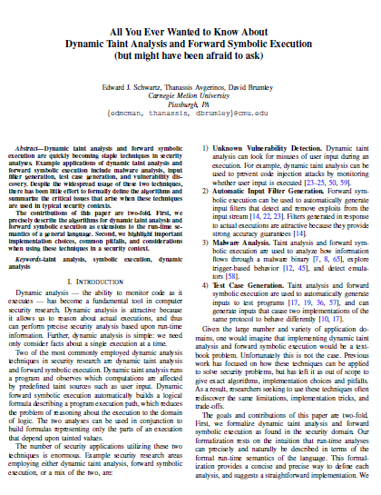
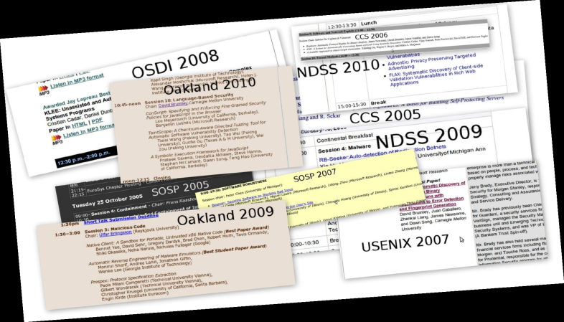
Contributions

Slide 6
Dynamic Taint Analysis
How it Works
Example Policies
Issues

Slide 7
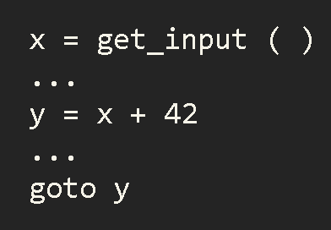
Example

Slide 8
Example
Input is tainted

Slide 9
Taint Introduction
Tainted
Untainted
x
Input is tainted

Slide 10
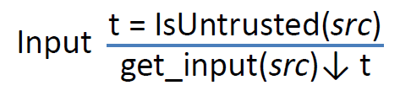
Taint Introduction
Var | Val | Taint ( T | F)
x | 7 | T

Slide 11
Taint Propagation
Tainted
Untainted
x
y
x
42
Data derived from user input is tainted

Slide 12
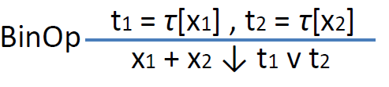
Taint Propagation
Var | Val | Taint ( T | F)
x | 7 | T
y | 49 | T

Slide 13
Taint Checking
Tainted
Untainted
x
y
x
42
y
Policy violation detected

Slide 14
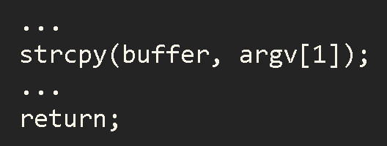
So What?
Exploit Detection
x
y
x
42
y
Tainted return address

Slide 15
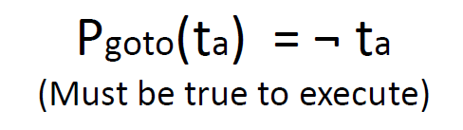
Taint Checking
Var | Val | Taint ( T | F)
x | 7 | T
y | 49 | T

Slide 16
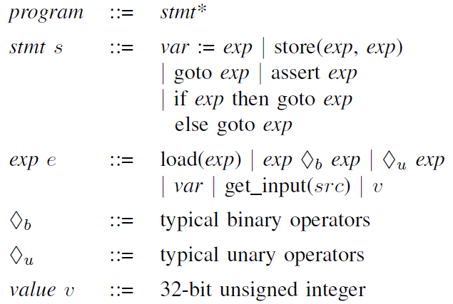
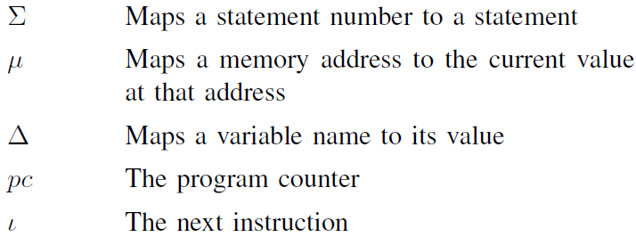
Taint Semantics in SIMPIL

Slide 17
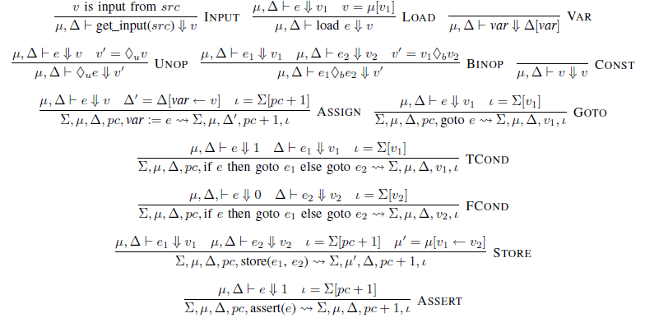
SIMPIL Operational Semantics
tl;dr

Slide 18
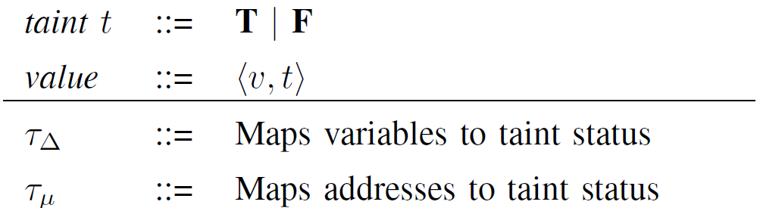
Operational Semantics for Tainting

Slide 19
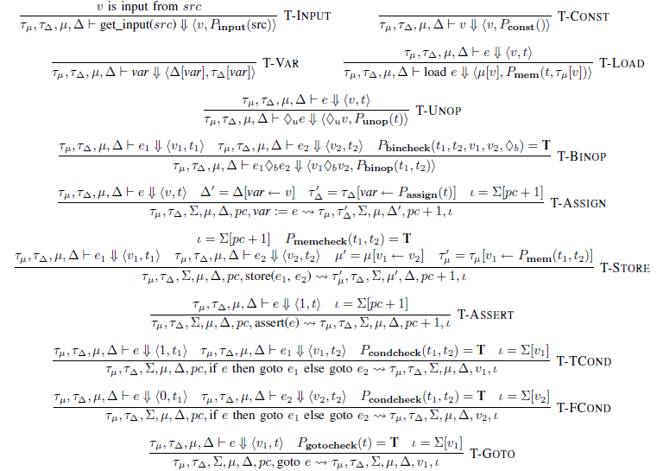
Operational Semantics for Tainting

Slide 20

Example Taint Semantics

Slide 21
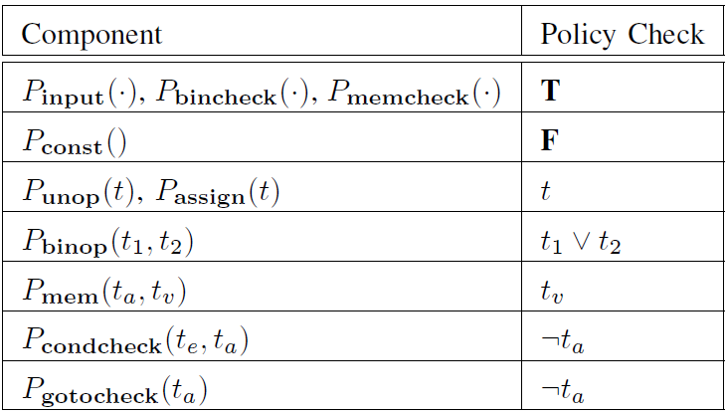
Example Taint Policy

Slide 22

Dynamic Tainting Issues
Tainted Addresses
Undertainting
Overtainting
Time of Detection vs. Time of Attack
To taint, or not to taint
Control flows discussed earlier
Sanitization
Overwritten return address detected only at return

Slide 23
Dynamic Tainting Issues
Overwritten return address detected only at return
x
y
x
42
y

Slide 24
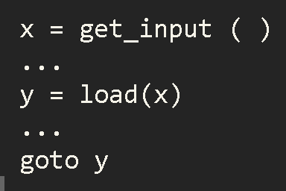
Tainted Addresses
Don’t taint y
Table indices, e.g. ,
a[i] == i
Taint y
tcpdump uses packet data to compute function pointers

Slide 25
Dilemma
Undertainting:
False Negatives
Overtainting:
False Positives

Slide 26
Forward Symbolic Execution
How it Works
Challenges
Proposed Solutions

Slide 27
Example
bad_abs(x is input)
if (x < 0)
return -x
if (x = 0x12345678)
return -x
return x

Slide 28
Example
bad_abs(x is input)
if (x < 0)
return -x
if (x = 0x12345678)
return -x
return x
2³² possible inputs
0x12345678
What input will execute this line of code?

Slide 29
Working
bad_abs(x is input)
if (x < 0)
x ≥ 0
F
T
x < 0
if (x = 0x12345678)
return -x
F
T
return x
return -x
x ≥ 0 &&
x != 0x12345678
x ≥ 0 &&
x == 0x12345678

Slide 30
Working
What input will execute this line of code?
bad_abs(x is input)
if (x < 0)
x ≥ 0
F
T
x < 0
if (x = 0x12345678)
return -x
F
T
return x
return -x
x ≥ 0 &&
x != 0x12345678
x ≥ 0 &&
x == 0x12345678

Slide 31

Operational Semantics

Slide 32


Operational Semantics

Slide 33
Challenges
Exponential Number of Paths
Symbolic Memory
System Calls

Slide 34
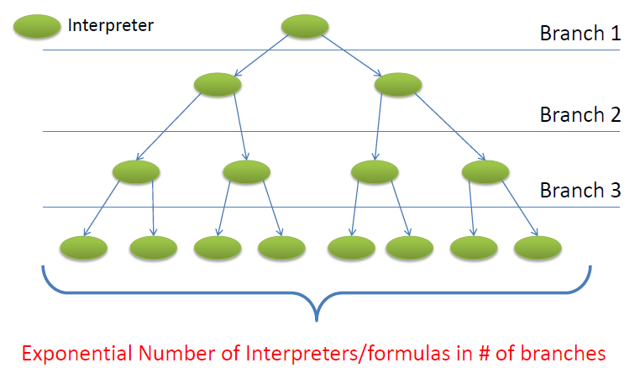
Exponential Number of Paths

Slide 35
Exploration Strategies
Bounded Depth First Search
Bounded necessary – else loops mayn’t terminate!
Random Paths
Possibly different weights to different paths
Concolic Execution
Mix symbolic and concrete execution
Make symbolic execution follow a concrete execution path

Slide 36
Symbolic memory
Example: tables
Aliasing issues
Solutions:
  Make unsound assumptions
  Let the SMT solver do the work
  Perform alias analysis
    A static analysis – may not be acceptable
Related Problem: Symbolic jumps
addr1 = get_input()
store(addr1, v)
z = load(addr2)

Slide 37
Symbolic Jumps
The pc depends on the user input
Explore jump targets found in concrete execution
Let the solver solve it
Do static analysis

Slide 38
System and Library Calls
What are effects of such calls?
Manual summarization is possible in some cases
Use results from concrete execution
  Not sound

Slide 39
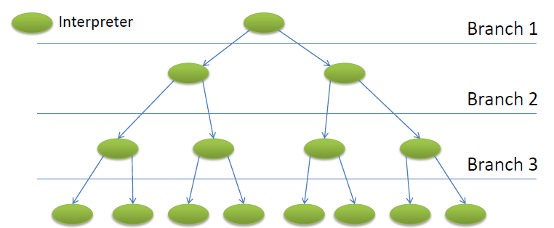
Symbolic Execution is not Easy
Exponential number of paths
Exponentially sized formulas with substitution
Solving a formula is NP-complete
s + s + s + s + s +s + s + s + s + s + s + s +s = 42

Slide 40
Conclusion
Dynamic Taint Analysis and Forward Symbolic Execution both extensively used
  A number of options explored
This talk provided
  Overview of the techniques
  Applications
  Issues and state-of-the-art solutions

