Slide 1
TAJ: Effective Taint Analysis of Web Applications
Yinzhi Cao
Reference:
http://www.cs.tau.ac.il/~omertrip/pldi09/TAJ.ppt
www.cs.cmu.edu/~soonhok/talks/20110301.pdf

Slide 2
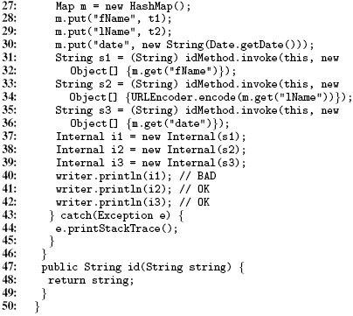
Motivating Example*
Taint Flow #1
* Inspired by Refl1 in
SecuriBench Micro

Slide 3
Motivating Example*
Taint Flow #2
Sanitizer
* Inspired by Refl1 in
SecuriBench Micro

Slide 4
Motivating Example*
Taint Flow #3
Non-tainted
* Inspired by Refl1 in
SecuriBench Micro

Slide 5
Motivating Example*
Reflection
* Inspired by Refl1 in
SecuriBench Micro

Slide 6
Several Concepts
Slicing
Thin Slicing
Hybrid Thin Slicing
Taint Analysis
Thin Slicing + Taint Analysis

Slide 7
Slicing
Boring Definition: The slice of a program with respect to program point p and variable x consists of a reduced program that computes the same sequence of values for x at p. That is, at point p the behavior of the reduced program with respect to variable x is indistinguishable from that of the original program.

Slide 8
An Example
1. x = new A();
2. z = x;
y = new B();
a = new C();
5. w = x;
6. w.f = y;
7. if (w == z) {
8. a.g = y
9. v = z.f;
10. }
1. x = new A();
2. z = x;
y = new B();
5. w = x;
6. w.f = y;
7. if (w == z) {
9. v = z.f;
10. }
Slicing for v at 9

Slide 9
Thin Slicing
Only producer statements are preserved.
Producer statements - A statement t is a producer for a seed s iff (1) s = t or (2) t writes a value to a location directly used by some other producer
Other statements: explainer statement

Slide 10
1. x = new A();
2. z = x;
y = new B();
4. w = x;
5. w.f = y;
6. if (w == z) {
7. v = z.f;
8. }
y = new B();
5. w.f = y;
7. v = z.f;
Thin Slicing seed 7

Slide 11
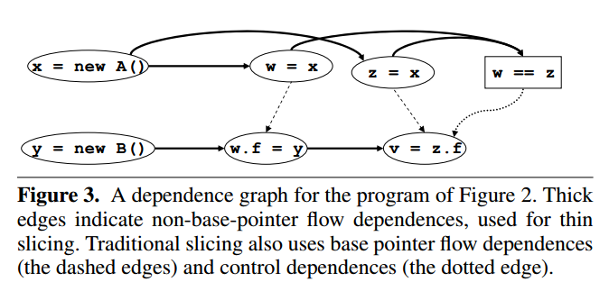
Dependence Graph

Slide 12
Two Types of Existing Thin Slicing
Context- and Flow- Insensitive Thin Slicing (Fast but inaccurate in most cases)
Context- and Flow- Sensitive Thin Slicing (Slow but accurate in most cases)

Slide 13
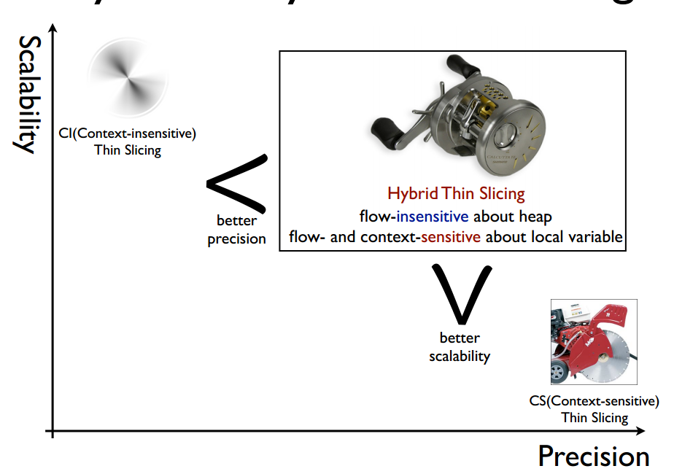
So in TAJ,
Hybrid Thin Slicing
  Flow-insensitive and Context-sensitive for the heap
  Flow- and Context-sensitive for local variables
  Fast and accurate

Slide 14
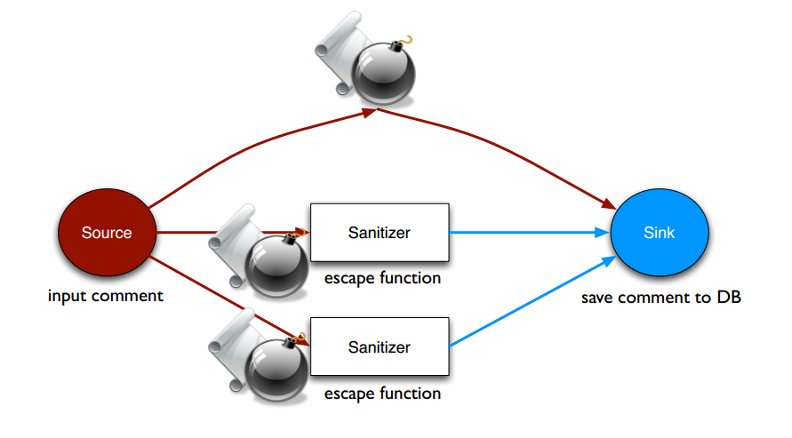
Taint Analysis

Slide 15
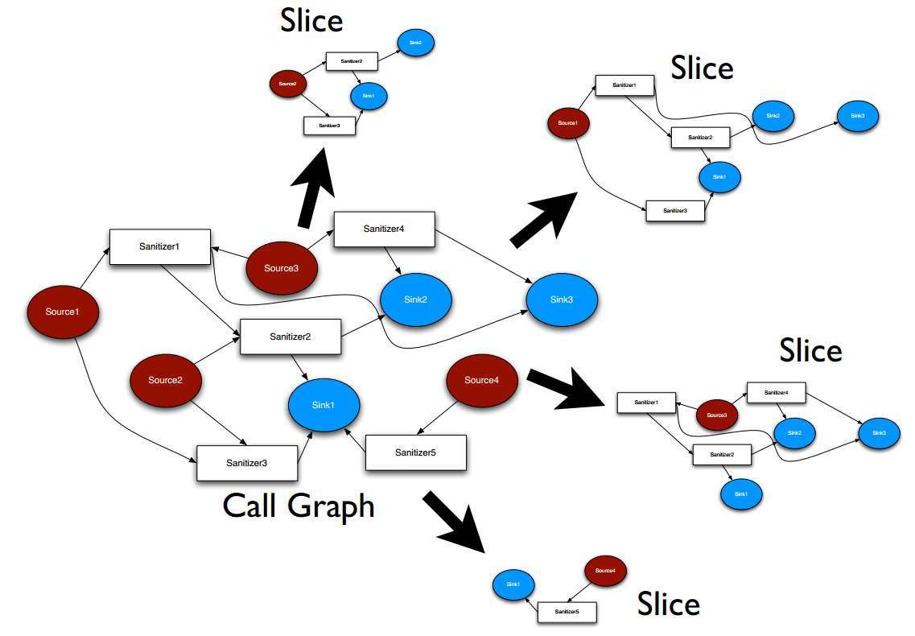
Hybrid Thin Slicing + Taint Analysis

Slide 16
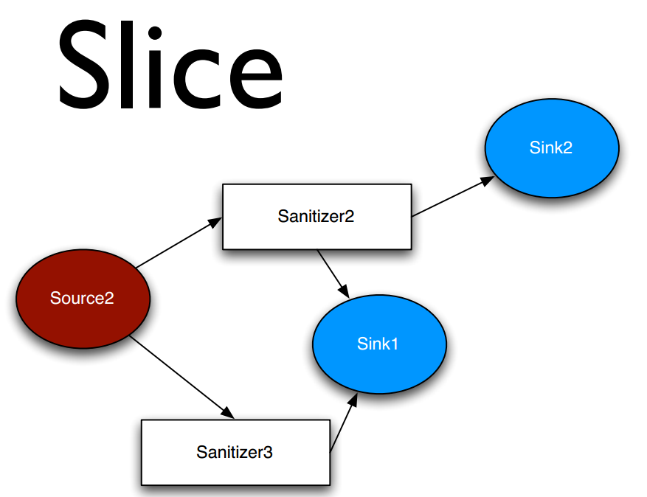

Slide 17
Note that this is forwards thin slicing instead of backwards thin slicing.

Slide 18
Several Tricks Played
Taint Carriers
Handling Exceptions
Code Reduction
Eliminating Redundant Flows
Refection APIs
Native Methods

Slide 19
Taint Carrier
private static class Internal {
private String s;
public Internal(String s) {
this.s = s;
}
public String toString() {
return s;
}
}
Internal i1 = new Internal(s1); // s1 is tainted
writer.println(i1)

Slide 20
Create a pointer analysis
So there is an edge between i1 and s
private static class Internal {
private String s;
public Internal(String s) {
this.s = s;
}
public String toString() {
return s;
}
}
Internal i1 = new Internal(s1); // s1 is tainted
writer.println(i1)

Slide 21
Handling Exceptions
protected void doGet(HttpServletRequest req,
HttpServletResponse resp) throws IOException {
try {
...
} catch (Exception e) {
resp.getWriter().println(e);
}
}

Slide 22
Problem: Exception.getMessage is the source but it is called implicitly at Exception.toString
Solution: Mark the combination println(e); as source.

Slide 23
Code Reduction
Predict behavior of some common libraries and skip tracking.
For example, URLEncoder.encode is a sanitizer.

Slide 24
Eliminating Redundant Flows
Flows are equivalent iff
  Parts under application code coincide
  Sinks corresponding to same issues type
Dramatically improves user experience (on JBoard, x25 less reports)
Sound, minimal with respect to remediation
n₁
n₂
Application
n₃
n₄
Library
n₅
n₆
n₇
n₈
n₉
n₁₀
n₁₁
Sinks with same issue type

Slide 25
Others
Reflection: Try to infer it if it is constant.
Native Methods: Hand-coded models.

Slide 26
Results
Speed:
  Hybrid thin slicing is 2.65X slower than context insensitive slicing (CI)
  Hybrid thin slicing is 29X faster than context sensitive slicing (CS)
Accuracy:
  Accuracy score: the ratio between the number of true positives and the number of true and false positives combined
  Hybrid: 0.35, CS: 0.54, CI: 0.22

Slide 27
Pixy
A flow-sensitive and context-sensitive data flow analysis for PHP.

Slide 28
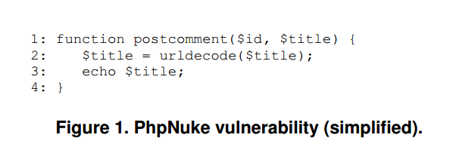
Vulnerability One

Slide 29
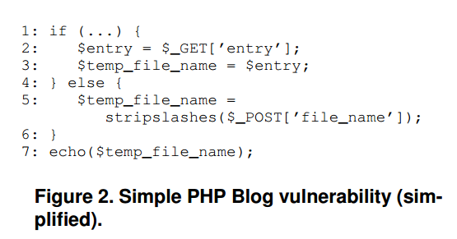
Vulnerability Two

