Slide 1
dynamic Data tainting and analysis

Slide 2
Roadmap
Background
TaintDroid
JavaScript
Conclusion

Slide 3
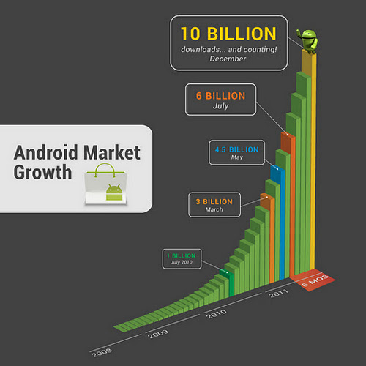
Background
In smartphone, we use third-party applications such as
- Google map, Angry bird … etc
More than 10Billion Apps
Because it’s useful.
But can you trust that
they don’t use
your privacy Data?
phoneNumber,location …
Absolutely NOT

Slide 4
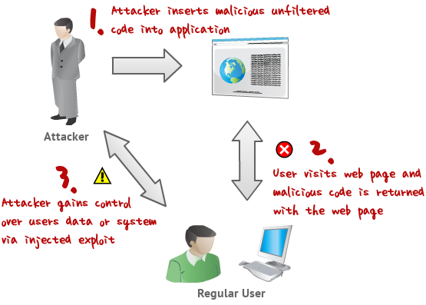
Background
Cross-Site scripting (XSS): an attack against web applications. Scripting code is injected into the application output. Executed on client-side to extract sensitive data
Extensive use of client-side scripts (mostly JavaScript)
Script code injection due to:
Lacking security awareness of the developers
Programming mistakes (financial or time constraints)
Notes:
In a cross-site scripting attack, the code that is injected into the output of the web application is under the attacker’s control. This code is executed in the user’s web browser, where it collects sensitive information that is then sent to the attacker. Because the code runs in the context of the vulnerable web site, it is not distinguishable from normal application behavior.
Allows attacker to circumvent the “same-origin” policy
The script runs on the client-side so has all the data needed
Mainly provided by saved cookies
Usually these data, once fetched, are transferred to remote servers

Slide 5
Methods for injecting malicious code
Stored XSS: stores malicious code in database records (ex. forum), when a user requests a dynamic page, the record is loaded, therefore injected
Reflected XSS: assume a search form that includes the search query to the result page. Upon clicking search => JavaScript code is sent as the query => injected response page
Notes:
In the first method, called stored XSS , the attacker persistently stores the malicious code in a resource managed by the web application, such as a database. The actual attack is carried out at a later time, when the victim requests a dynamic page that is constructed from the contents of this resource.
Example: a web-based bulletin board system
In the second method, called reflected XSS , the attack script is not persistently stored, but, instead, it is immediately “reflected” back to the user. For instance, consider a search form that includes the search query into the page with the results, but without filtering the query for scripting code. This vulnerability can be exploited, for example, by sending to the victim an email with a specially-crafted link that points to the search form and that contains the malicious JavaScript code.

Slide 6
Roadmap
Background
TaintDroid
Taint Tracking
Taint Source
TaintDroid Architecture
Application Study
Performance Evaluation
JavaScript
Conclusion

Slide 7
Dynamic Data Tainting - TaintDroid
Dynamic taint tracking system (Android)
Application in Android Market
Not verified by google
Users rarely reads or understands
General Challenge: Balance fun and utility of apps with privacy.
For this purpose, we can look inside of applications to watch how applications use privacy sensitive data.
locations, phone identifiers, microphone…
Notes:
TaintDroid is a system-wide dynamic taint tracking and analysis system capable of simultaneously tracking multiple sources of sensitive data in Android smartphone.
Applications on android market not verified by google unlike AppStore. Developers can only request coarse-grained permissions. And users rarely reads or understands the meaning of the permissions.
We want application to gain access to our valuable information, but don’t have to trust that they abuse this information.

Slide 8
Goal
General Goal : Monitor application behavior to determine when privacy sensitive information leaves the phone. - MONITOR SENSTIVIE INFORMATION
Solution : Track data with taint marking.
It’s called Taint Tracking.

Slide 9
Roadmap
Background
TaintDroid
Taint Tracking
Taint Source
TaintDroid Architecture
Application Study
Performance Evaluation
JavaScript
Conclusion

Slide 10
Taint Tracking
Scenario - You are a cowboy. You have many cows but some of them are sick and you want to trace sick cows. - How can you trace sick cows in lumberyard?
Simple Solution - Attach a tag/ring/sensor to cow to be traced - Make alarm when sick cow go out from lumberyard.
TAG
TAG
TAG
TAG
Notes:
See more details

Slide 11
Taint Tracking
Marking(TAG) particular data(COW) & Trace it.
HOW WORKS
To track privacy sensitive data -phone number..- we should attach something to data. The something is called TAG. The attachment occuring place is TAINT SOURCE.
After attachment, tracking system trace the data. we can know when the data move off from our smart phone.
When privacy sensitive data move to outside smartphone, taint tracking system makes event. The place which event happen is called TAINT SINK.
Notes:
It’s the simple process how taint tracking works
At this slide we defined three terminologies which are tag,taint source,taint sink

Slide 12
Taint Tracking
Privacy Data
Privacy data
*Data = Cow
*Taint Tag = TAG
*SmartPhone = lumberyard Network
<Application>
. . .
Data
Taint Tag
EVENT! (Message)
Data + Tag
Notes:
O.K I will explain taint tracking with simple picture.
For ease of understanding, at this context,
TaintDroid automatically labels (taints) data from privacy-sensitive sources and transitively applies labels as sensitive data propagates through program variables, files, and interprocess messages. When tainted data are transmitted over the network, or otherwise leave the system, TaintDroid logs the data’s labels, the application responsible for transmitting the data and the data’s destination.

Slide 13
Roadmap
Background
TaintDroid
Taint Tracking
Taint Source
TaintDroid Architecture
Application Study
Performance Evaluation
JavaScript
Conclusion

Slide 14
Taint Sources
Low-bandwidth sensors
Location, accelerometer
High-bandwidth sensors
Microphone, camera
Information database
Address book,

Slide 15
Taint Sources (continue…)
Device identifiers
IMEI
Network taint sink
WiFi
3G
SMS

Slide 16
Roadmap
Background
TaintDroid
Taint Tracking
Taint Source
TaintDroid Architecture
Application Study
Performance Evaluation
JavaScript
Conclusion

Slide 17
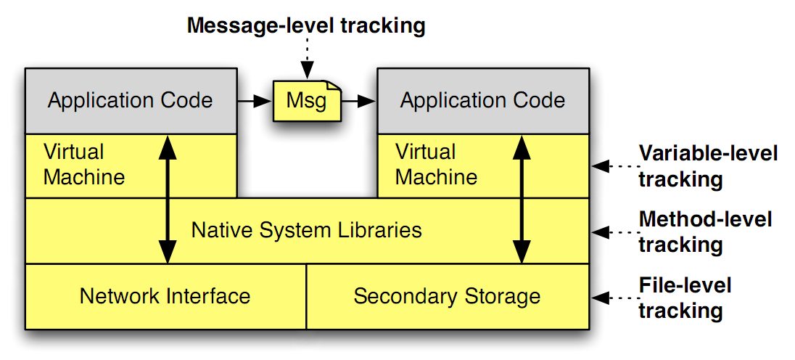
TaintDroid Architecture (tracking)
TaintDroid is a system-wide integration of taint traking into the Android platform
Variable tracking throughout Dalvik VM environment
Patches state after native method invocation
Extends tracking between applications and to storage
TaintDroid is a firmware modification, no an app
Notes:
TaintDroid has some features like these.
TaintDroid uses multi-level tracking.
Instruction level dynamic taint analysis using whole system emulation incurs high performance pernalties.
That’s why TaintDroid uses variable-level tracking throughout Dalvik VM environment.
As you know, Android architecture is like this image.
Application code is written in Java.
So android needs virtual machine to translate byte code.
Android also uses native method for high performance.
It makes it difficult to track taint tag.
Let’s talk about this later.

Slide 18
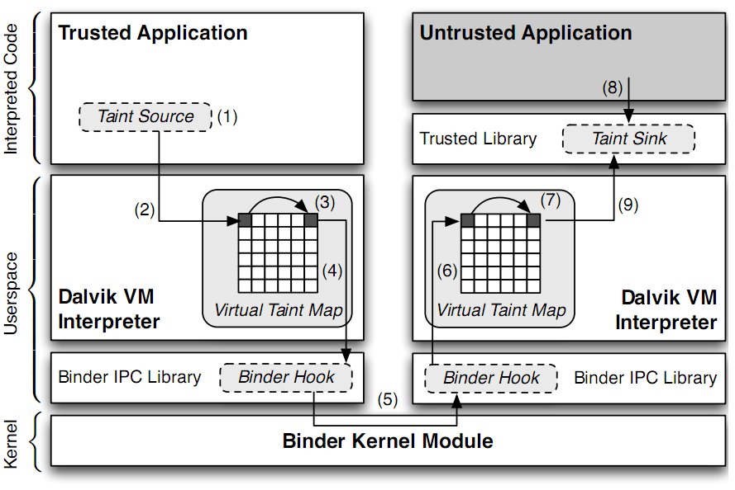
TaintDroid Architecture
Notes:
Sensitive information is ﬁrst identiﬁed at a taint source, where a taint marking indicating the information type is assigned. Dynamic taint
analysis tracks how labeled data impacts other data in a way that might leak the original sensitive information.
Finally, the impacted data is identiﬁed before it leaves the system at a taint sink (usually the network interface).
possible false positive

Slide 19
DEMO
http://appanalysis.org/demo/index.html

Slide 20
Roadmap
Background
TaintDroid
Taint Tracking
Taint Source
TaintDroid Architecture
Application Study
Performance Evaluation
JavaScript
Conclusion

Slide 21
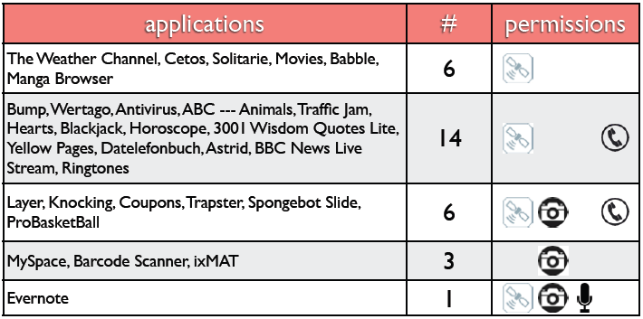
Application study
Selected 30 applications with bias on popularity and access to Internet, location, microphone, and camera
Of 105 flagged connections, only 37 clearly legitimate

Slide 22
Findings - Phone Indentifiers
7 applications sent IMEI and 2 apps sent phone info(Ph. #, IMSI*, ICC-ID) to a remote server without informing the user.
One app sent phone information every time the phone booted.
This app also transmitted phone data immediately after install, before first use.
Appeared to be sent to app developers.

Slide 23
Findings - Location
15 of the 30 applications shared physical location with an ad server
admob.com, ad,qwapi.com, ads.mobclix.com, data.flurry.com
Most traffic was plaintext(e.g.,AdMob HTTP GET):
In no case was sharing obvious to user or in EULA
...&s=a14a4a93f1e4c68&..&t=062A1CB1D476DE85
B717D9195A6722A9&d%5Bcoord%5D=47.6612278900
00006%2C-122.31589477&...

Slide 24
Findings – Summary
Of 105 ﬂagged connections, only 37 clearly legitimate
Half of the applications shared user location data with ad servers
One third of the applications exposed important phone information
No false positives with TaintDroid
Notes:
consider when as developer

Slide 25
Roadmap
Background
TaintDroid
Taint Tracking
Taint Source
TaintDroid Architecture
Application Study
Performance Evaluation
JavaScript
Conclusion

Slide 26
Macrobenchmark
App load: 3% (2ms)
Address book: (< 20 ms) 5.5% create, 18% read
Phone call: 10% (10ms)
Take picture: 29% (0.5s)

Slide 27
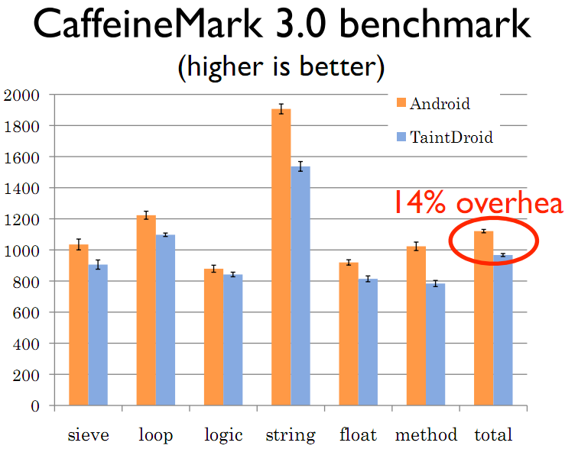
Java Microbenchmark
TaintDroid Overhead: 14%

Slide 28
IPC Microbenchmark
IPC overhead: 27%
Memory overhead: 3.5%

Slide 29
Roadmap
Background
TaintDroid
JavaScript
Taint Propagation
Static Data Tainting
Implementation
Evaluation
Conclusion

Slide 30
Paper proposed solution
Dynamic data tainting of sensitive information on the client-side during script execution
Sensitive information flow is tracked by JavaScript engine of the browser
Warning on detection
Where dynamic analysis is not effective, static analysis is called
Notes:
The optimal approach to prevent XSS attacks would be to eliminate the vulnerabilities in the affected web applications. To this end, a web application must properly validate all input, and in particular, remove malicious scripts. The problem is that many service providers do not fix their web applications in a timely way. Hence, a promising approach for protecting users against XSS attacks is to deploy the necessary security mechanisms on the client side.
The solution proposed in this paper uses dynamic data tainting. In contrast to traditional, tainting-based approaches on the server side, we taint sensitive information on the client side. The goal is to ensure that a JavaScript program can send sensitive information only to the site from which it was loaded. To this end, the information flow of sensitive data is tracked inside the JavaScript engine of the browser. Whenever an attempt to relay such information to a third party (i.e., the adversary) is detected, the user is warned and given the possibility to stop the transfer.
Unfortunately, it is not possible to detect all information flows dynamically [27]. This is a problem, because the adversary has complete freedom to craft his attack code, and, therefore, he could leverage information flows that are not covered by dynamic analysis to successfully launch XSS attacks. To address this limitation,

Slide 31
The following subjects
Dynamic Data Tainting + Static Data Tainting
Integrated as prototype implementation in Firefox
Use of web crawler for evaluation

Slide 32
Dynamic Data Tainting
Mechanisms that keep track of how sensitive data are used in the browser
Such data are marked and accessed by scripts, tracked by the system
In that case one of the following is chosen:
Log
Prevent
Exit program execution
Notes:
The goal of our protection approach is to prevent that sensitive data is sent to a third party (the adversary) without the user’s consent. To this end, we designed a mechanism that can keep track of how sensitive data is used in the browser.
Our mechanism is based on the concept of dynamic data tainting , in which sensitive data is first marked (or tainted), and then, when this data is accessed by scripts running in the web browser, its use is dynamically tracked by our system. When tainted data is about to be transferred to a third party, different kinds of actions can be taken. Examples are logging, preventing the transfer, or stopping the program with an error.

Slide 33
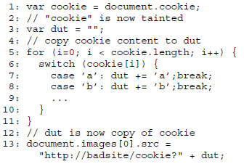
Data dependences
Assignment of a tainted value or an operation using it results a tainted value
When a variable is
stored and retrieved
to and from the Document
Object Model (DOM) tree
must retain its status
Notes:
Our taint analysis is capable of tracking data dependencies. That is, when a tainted value is assigned to another variable, this variable becomes tainted as well. Also, when any operand of an arithmetic or logic operation is tainted, the result becomes tainted. Moreover, our solution is capable of handling direct control dependencies. That is, whenever the execution of an operation depends on the value of a tainted variable (e.g., if an operation is guarded by an if branch that tests a tainted variable), the result of this operation is tainted. Figure 2 provides an example to illustrate the importance of direct control dependencies. In this example, the attacker copies the cookie from the variable cookie to the variable dut using a for-loop and a switch statement for any character in cookie . If only data dependencies were covered, the dut variable would not be tainted after the loop.
Loop
If scope
In addition to the tracking of taint information inside the JavaScript engine, tainted data stored in and retrieved from the document object model (DOM) tree [29] of the HTML page has to retain its taint status. This is required to prevent laundering attempts in which an attacker temporarily stores tainted data in a DOM tree node to clear its taint status.

Slide 34
Sensitive Data Sources
Notes:
Since this list was provided by Netscape [21], we believe it to be fairly complete

Slide 35
Interaction between JavaScript engine &browser
Notes:
In this example, the HTML page contains some embedded JavaScript code (1) that accesses the cookie of the document (which is a sensitive source).
The script is parsed and compiled into a bytecode program (2) that is then executed by the JavaScript engine.
When the engine executes the statement that attempts to obtain the cookie property from the document object (3),
it generates a call to the implementation of the document class in the browser (4).
Possible parameters of the call are converted from values understood by the JavaScript engine to those defined in the browser (5).
Then, the corresponding method in the browser, which implements the document.cookie method, is called (6).
In this method, the access to a sensitive source is recognized and the value is tainted appropriately (7).
This value is then converted into a value with a type used by the JavaScript engine (8).
This conversion has to retain the taint status of the value. Thus, the result of the operation that obtains the cookie property (variable x ) is tainted (9).

Slide 36
Roadmap
Background
TaintDroid
JavaScript
Taint Propagation
Static Data Tainting
Implementation
Evaluation
Conclusion

Slide 37
Taint Propagation
Extended the JavaScript engine to track the use of sensitive info
Extended the semantics of bytecode instructions
Can be divided into:
Assignments
Arithmetic and logic operations
Control structures and loops
Function call end eval
Notes:
JavaScript programs that are part of a web page are parsed and compiled into an internal bytecode representation. These bytecode instructions are then interpreted by the JavaScript engine. To track the use of sensitive information by JavaScript programs, we have extended the JavaScript engine. More precisely, we have extended the semantics of the bytecode instructions so that taint information is correctly propagated

Slide 38
Assignments, Arithmetic & Logic Operations
If right value of operation is tainted the left value is marked
If array element gets tainted => the whole array is marked (arr.lenth results tainted value)
Notes:
Array,
Attribute of any object
In some cases, the variable that is assigned a tainted value is not the only object that must be tainted. For example, if an element of an array is tainted, then the whole array object needs to be tainted as well. This is necessary to ensure that functions and methods that operate on the array as a whole, such as arr.length , return a tainted value.
Likewise, if a property of an object is set to a tainted value, then the whole object needs to be tainted.
Arithmetic & Logic Operations: The result is tainted if one of the used operands is tainted.

Slide 39
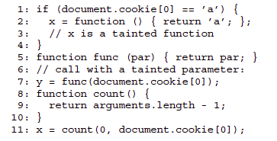
Function Calls and eval
Function is tainted if:
Defined in a tainted scope
Called with tainted actual arguments
Eval is tainted is:
Called in tainted scope
Its parameters are tainted
Note: in eval, its argument is tainted as JavaScript program so every operation in this program is tainted
Notes:
The eval function is special because its argument is treated as a JavaScript program and executed. If eval is called in a tainted scope or if its parameter is tainted, a scope around the executed program is generated, and we conservatively taint every operation in this program.

Slide 40
Document Object Model (DOM) tree
Taint info mush not be lost while storing and loading DOM nodes
Notes:
An attacker could attempt to remove the taint status of a data element by temporarily storing it in a node of the DOM tree and retrieving it later (see Figure 6). To prevent laundering of data through the DOM tree, taint information must not get lost when leaving the JavaScript engine. To this end, the object that implements a DOM node is tainted every time a JavaScript program stores a tainted value into this node. When the node is accessed later, the returned value is tainted.

Slide 41
Roadmap
Background
TaintDroid
JavaScript
Taint Propagation
Static Data Tainting
Implementation
Evaluation
Conclusion

Slide 42
Static Data Tainting
Dynamic data tainting:
Efficient and precise
Cannot detect all kinds of control dependences
Indirect control dependences => static analysis
All possible paths in a scope need to be examined
All variables that could receive a new value on any program path within a tainted scope, is tainted
Notes:
A hybrid analysis are precision and efficiency. It is a well-known fact that dynamic analysis generates more precise results than static analysis, which suffers from the conceptual limitation of undecidability. Besides, precise static analysis techniques are computationally expensive. This might be irrelevant for static security analyses performed by application developers before the deployment of the application. However, in real-time settings, dynamic analysis techniques are more suitable. By switching to a relatively fast type of static analysis only at those points where it is necessary, we combine the best of both approaches.

Slide 43
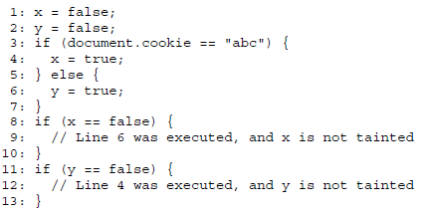
Static Data Tainting
Example problem:
Notes:
For example, consider the attack script shown in Figure 7. This script exploits an indirect control dependency. On Lines 1 and 2, the variables x and y are both initialized to false . On Line 3, the attacker tests the user’s cookie for a specific value. First, let us assume that the attacker was lucky, and that the user’s cookie indeed holds the tested value abc . In this case, Line 4 is executed, setting x to true . At the same time, our modified JavaScript engine taints x . Variable y keeps its false value, since the assignment on Line 6 is not executed. Also, y does not get tainted:
Even though the generated scope covers both branches of the if construct (Lines 3 to 7), dynamic tainting occurs only along the branch that is actually executed. Since y has not been modified, this means further that the condition on y (Line 11) evaluates to true. As y is not tainted, no tainted scope is generated for this if construct, and the attacker is free to issue a request at this point in the program, carrying the information that the cookie holds the exact value abc .

Slide 44
Linear Static Taint Analysis
For every branch in the control flow that depends on tainted value
=> static analyze, All values are tainted as long as
they change value in the scope
Difficulty: Requires info about the possible stack-contents
Notes:
This static analysis must make sure that all variables that are assigned values (no matter whether these values are tainted or not) inside such a scope are also tainted.
For instance, in the previous example from Figure 7, this would mean that both x and y are tainted, independent of the actual branch that is executed. This makes it impossible for an attacker to extract information about sensitive values without triggering an XSS alert prompt. To this end, we perform a simple, but effective linear static pass through the bytecode of the tainted scope. Since it is irrelevant for the analysis whether a variable is assigned a tainted or an untainted value, it is not necessary to employ a flow-sensitive analysis that understands the actual control flow. All that matters is whether a variable is modified or not.
If a function call or an eval statement is encountered, the JavaScript engine is switched into a special conservative mode where every subsequent executed instruction is considered as being part of a tainted scope. The reason is that a precise interprocedural analysis would be prohibitively expensive in a real-time browser setting. By switching into a conservative mode, we prevent these additional costs, and at the same time, provide security for the user.
One difficulty for a linear static analysis is that the instructions responsible for setting object properties (and array elements) do not specify the target object (or array) as immediate arguments because of the stack-based nature of the JavaScript interpreter. Instead, these instructions retrieve their target from the stack. As a result, in order to determine the target of an assignment to an object property, static analysis requires information about the possible stack contents at that point in the program.

Slide 45
Stack Analysis
To determine for every program point which elements the stack contains
Simulate the effect of an operation on the real stack by modifying an abstract stack
Notes:
The purpose of stack analysis is to determine, for every program point in the analyzed scope, which elements the stack may contain. To achieve this, we employ a flow-sensitive, intraprocedural data flow analysis [2]. For each analyzed operation, we simulate the effects of this operation on the real stack by modifying an abstract stack accordingly.
For instance, the false opcode is modeled by pushing an element on the abstract stack that represents a boolean value. Note that it is not necessary to track the exact boolean value, it is sufficient to know that there is some boolean value on the stack. For objects and arrays, however, the stack content is modeled in more detail, so that it is possible to determine the target objects (and arrays) of assignment instructions.

Slide 46
Roadmap
Background
TaintDroid
JavaScript
Taint Propagation
Static Data Tainting
Implementation
Evaluation
Conclusion

Slide 47
Data Transmission
Until now no actions to prevent leakage is made, only to notify
Leakage to attacker site
Changing the location of the current web page by setting “document.location”
Changing the source of an image in the website
Automatically submitting a form in the web page
Using special objects, such as XMLHttpRequest
Notes:
For a cross-site scripting attack to be successful, the gathered data needs to be transferred to a site that is under the attacker’s control. That is, the tainted data has to be transferred to a third party. This transfer can be achieved using a variety of methods. Some examples include:

Slide 48
Implementation
The prototype extends Mozilla Firefox 1.03pre
Tainted data objects are contained in:
JavaScript engine (SpiderMonkey)
Modified the data structures in both parts to hold the tainting flag
Notes:
There are two different parts in the web browser that can contain tainted data objects. One part is the JavaScript engine, which is called Spider-Monkey [18]. Here, variables, functions, scopes, and objects can be tainted as a result of sensitive data that is processed by JavaScript programs. The other part is the implementation of the DOM tree (e.g., location.href ). To store the additional tainting information, we modified data structures in both parts of the browser.
Every time a JavaScript program attempts to transfer sensitive data, a check is performed to determine whether the host from which the document is loaded and the host to which sensitive data is sent are from different domains.

Slide 49
Roadmap
Background
TaintDroid
JavaScript
Taint Propagation
Static Data Tainting
Implementation
Evaluation
Conclusion

Slide 50
Evaluation
Initial tests where against exploitation of small XSS vulnerabilities (known from the past to the group member of the paper)
Tested against intentionally vulnerable web applications (phpBB 2.0.18, myBB 1.0.2, WebCal 3.04)
The extended browser was manually used by the authors daily (negligible overhead)
Many warnings were about attempts to transfer sensitive info across domain borders (statistics sites & user traces)
Notes:
To evaluate our system, we took several complementary approaches. The most immediate step, which was conducted during the development phase of our prototype, was to perform a wide range of functionality tests by exploiting a variety of small XSS vulnerabilities.
In addition to tests with XSS attacks that were designed internally, we verified that our system was also suitable for defending against real-world exploits. To this end, we installed vulnerable versions of the following popular open-source web applications: phpBB 2.0.18 [25], myBB 1.0.2 [9], andWebCal 3.04 [17]. Then, we launched reported XSS attacks [1, 4, 5] against each of these applications.
Apart from defending against XSS attacks, in order to be useful in practice a protection scheme must be efficient and not bother its users with countless false warnings. To evaluate these aspects, we conducted both manual and automatic tests. For the manual tests, the modified browser was used by the authors for web surfing on a daily basis. Compared to the amount of processing necessary to fetch and render web pages, the overhead of our extended JavaScript engine is negligible.
Interestingly, although these alerts were not the result of XSS attacks, they correctly warned about attempts to transfer sensitive information across domain borders. These information transfers were caused by scripts from companies that provide web site statistics or that perform user tracking

Slide 51
Evaluation: manually
Depends on the users right decisions about connection attempts
Policies were created
By default a black-list is included to the browser
User can freely edit that list
The default configuration is reasonable and sage alternative for technically unsophisticated users
Notes:
This way, the user is given the chance to decide whether she regards the collection of this information as a violation of her privacy. Of course, in this mode of operation, the level of protection provided by our system ultimately depends on the user’s right decisions about the connection attempts. In addition, our prototype permits to conveniently define persistent policies so that the user has to decide for a particular destination domain only once.

Slide 52
Evaluation: automatically
Web crawling engine created based on Firefox
Capable of interpreting JavaScript code
Any form found is filled and submitted (typing into forms recreation)
JavaScript events (on-click) are supported
Notes:
The manual testing showed that our approach is effective and efficient, but we wanted to test our solution on a more extensive set of data. Therefore, to obtain a comprehensive amount of test data, we enhanced the Firefox browser with a web crawling engine. Using this crawler, we were able to automatically visit a large number of pages and determine a more representative estimate of incorrect warning prompts that a user can expect when browsing.
Moreover, to simulate user behavior and trigger JavaScript that is only activated when input is typed into form elements, the crawler fills out all encountered web forms and submits them.
Finally, another important aspect is the triggering of JavaScript events. Many web pages contain JavaScript code that is executed in association with specific user actions (such as onclick or onmouseover ).

Slide 53
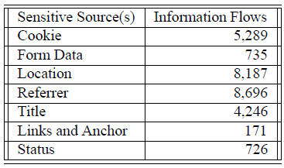
Evaluation: web crawler results
Visited 1,033,000 unique sites =>
88,589(8.585%) triggered XSS
When applying results to the
top 30 domains the number is
reduced to 13,964 (1.35%)
If we become less restricted of what is considered “sensitive data” (info only stored in cookies) => narrow down to 5,289 cookie transferring to less-known tracking sites
Notes:
After a closer inspection of these warnings, it turned out that a majority of them were caused by attempted connections to only a few destination domains. Showed in the table in next slide
When providing rules (deny or accept) for only these top 30 domains, it is possible to reduce the number of alert prompts to 13,964 (1.35%).
For instance, this could be achieved by shipping the enhanced browser with a built-in list of these domains, and by denying the transfer of sensitive information to these domains by default
Sensitive information transferred to the remaining domains (not Top-30).
A further reduction of the number of alert prompts can be achieved by being less restrictive about what kind of data is considered to be sensitive.
Usually, the sole information that has to be protected in order to foil XSS attacks is information stored in cookies.

Slide 54
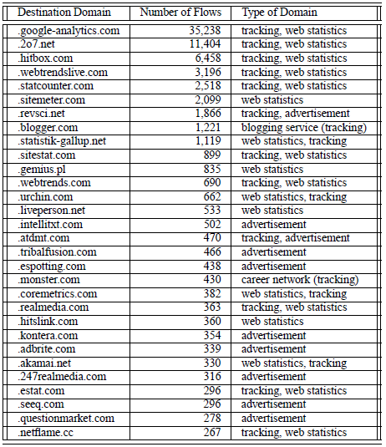
Evaluation: web crawler results

Slide 55
False positive
Low rate
Most common false positives:
Transferring cookies within the boundaries of acompany
Due to conservative tainting approach (Sites that want to confirm that cookies are enabled)
Notes:
Another group of warnings were "semantic” false positives, in the sense that even though cookie information was transferred to a different domain, it was not transferred across company borders. For instance, we observed an exchange of sensitive data between cnn.net and cnn.com . In a less obvious case, data transfer took place between the domains discover.com and unitedstreaming.com , which turned out to belong to the same company.
For example, some pages use JavaScript to check whether the browser allows cookies to be set. To this end, the script first stores some string into a cookie and immediately reads it back. Then, a check is made to determine whether the value was successfully stored. Because the cookie is considered sensitive, this check opens a tainted scope. As we want to prevent information leaks that exploit indirect control flows, all values written in this scope have to be tainted. When one of these values is later used in a cross-domain connection, a warning is raised.

Slide 56
Roadmap
Background
TaintDroid
JavaScript
Conclusion

Slide 57
Conclusion (XSS)
XSS is one of the most frequent vulnerabilities in modern web applications
Many service providers are either not willing or not able to provide sufficient protection to their users
Client-side protection is a better solution
By modifying a web browser they managed to detect (and stop if needed) leakage of sensitive data

Slide 58
Conclusion (TaintDroid)
TaintDroid provides efficient, system-wide, dynamic taint tracking and analysis for Android
TaintDroid is intergrated four granularities of taint propagation(variable-level, message-level, method-level, and file-level) to achieve a 14% performance overhead.
20 of the 30 studied applications share information in a way that was not expected.

Slide 59
Comparison
Taint Tracking
TaintDroid: Only dynamic
JavaScript: Hybrid Dynamic + Static
For the leakage in indirect control dependencies
Modification
TaintDroid: Android OS
JavaScript: JavaScript engine, DOM Tree

Slide 60
Question?

