Slide 1
PiOS: Detecting Privacy Leaks in iOS Applications
Manuel Egele, Christopher Kruegel, Engin Kirda, and Giovanni Vigna
Presented by Josiah Matlack
Notes:
Josiah

Slide 2
Basic Problem
Privacy leak detector for iOS applications
1407 applications surveyed
Official App Store and Cydia (BigBoss)
No technical limitation of app access to data
Flow-sensitive, context-sensitive, static analysis of app binaries
Notes:
Privacy leak: any event in which iOS app reads sensitive data from device and sends it to a third party without consent
User should be given choice to accept/deny
Paper does not consider unnecessary data, only privilege
No enumeration of sensitive functions/data from Apple
Use of spyphone app (which aims to prove this)
825 vs 582 for breakdown of apps
Cydia store is not encrypted, unlike App Store
Stress that there is no actual technical limitation of data access
Imperfect scheme to begin with
Especially with jailbreak (turns out not to matter, surprisingly)
No source code available, have to use binaries

Slide 3
Why build PiOS?
Mobile phone market has exploded
Smartphones are PCs
Smartphones are ubiquitous
Smartphones store personal data
iOS is a huge part of this market
Well-defined vetting for Android
Not so for iOS
Main goal: finding privacy leaks
Also attempt to discern vetting process
Notes:
Mobile phones are basically computers
Calls and texts, games, email, web,
Ubiquitous: 300 million devices sold in second quarter of 2010
World population in 10 years
Personal data: GPS, address book, photos, etc.
Market: 70-20 worldwide, 50-40 in US
Android: Transparent information access requests
Apple’s only protection is the developer agreement
Scrutiny before accepting third-party application
Process not fully known
Goal is to find leaks of private information
Additionally, discern some details about Apple’s vetting process (the authors don’t go into this much)

Slide 4
Stats from eMarketer.
Source: http://infographiclist.com/2011/10/16/smartphone-trends-opportunities-for-marketers-infographic/
Notes:
To note: growth of smartphone usage

Slide 5
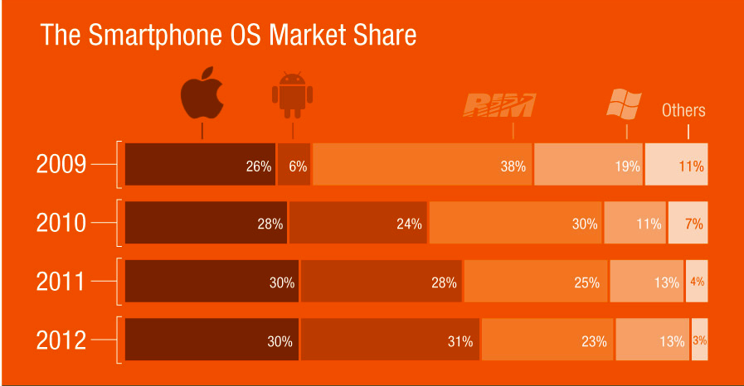
Stats from eMarketer.
Source: http://infographiclist.com/2011/10/16/smartphone-trends-opportunities-for-marketers-infographic/
Notes:
To note: market share of iOS is huge (if not growing)

Slide 6
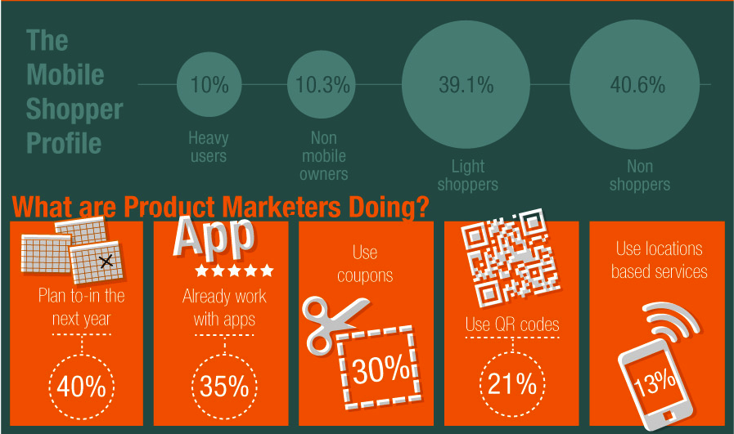
Stats from eMarketer.
Source: http://infographiclist.com/2011/10/16/smartphone-trends-opportunities-for-marketers-infographic/
Notes:
To note: app usage

Slide 7
Motivation
GET http://vl.storm8.com/points.php?version=1.52&udid=0e4e5eb4df5b0db8f947f8ad49aaec361552041c&pf=62DE49A7A5A6241858B9768783EC3EAF&fpts=10&pnum=0414%20610%20500&model=iPhone&$
Notes:
What the Storm8 applications were doing before the ban
Plain, unencrypted text (although URL encoded)
Serious security risks associated with phone number resolution

Slide 8
Other Goals
Quickly analyze large bodies of apps
Building control flow graphs (CFGs)
License agreement says little
Notes:
Quickly and efficiently categorize the security of a large number of applications
The architecture of Objective-C makes it very difficult to create CFGs
Another goal/problem domain for the researchers
License agreement is inconsequential in determining what constitutes a security flaw

Slide 9
The PiOS System
Problems with Objective-C
Functions are usually object methods
Funneled through single dispatch (send message)
Difficult to create CFG
Protocols: interface
Categories: aspects
Dispatcher
Heuristic: if the user interrupts the source-to-sink flow of sensitive data, assume this interrupt is the necessary warning dialog or prompt
Notes:
Authors describe several problems with the language itself that make static analysis more difficult
Contrast with, say, JavaScript
Vtables: dispatcher used instead
Aspects are like calling an after() method in lisp
Dispatcher: objc_msgSend function
Receives parameters, pointers to receiver and selector
Traverses class hierarchy, starting at receiver, trying to locate method (going up to superclasses)
Can be implemented in class, superclass, or category previously applied to either
If not found, object does not respond to the selector

Slide 10
Example
NSMutableString *v;
v = [[NSMutableString alloc] initWithString : @’’Hello’’]
__text:00002668 30 49 LDR R1, =off_3154
__text:0000266A 31 48 LDR R0, =off_31A0
__text:0000266C 0C 68 LDR R4, [R1]
__text:0000266E 00 68 LDR R0, [R0]
__text:00002670 21 46 MOV R1, R4
__text:00002672 00 F0 32 E9 BLX _objc_msgSend ; NSMutableString alloc
__text:00002676 2F 49 LDR R1, =off_3190
__text:00002678 2F 4A LDR R2, =cfstr_Hello
__text:0000267A 09 68 LDR R1, [R1]
__text:0000267C 00 F0 2C E9 BLX _objc_msgSend
; NSMutableString initWithString:
Notes:
Calls allocation method in NSMutableString
R0 gets a pointer to the class (second line fixed address off_31A0, then dereferenced in fourth line)
R1 gets pointer to the selector (first line fixed address of_3154, then dereferenced in third line)
Dynamic linker patches in the final addresses at runtime, but these are fixed
Directly resolved during static analysis and associated with class and methods
BLX (branch w/link exchange) calls the dispatcher (objc_msgSend) with result of alloc (the address of the string) in R0
initWithString then called, which is not static but an instance method, so it doesn’t have a static address
Address is stored in R0
R1 loaded with selector, R2 with string pointer
BLX calls objc_msgSend again
PiOS annotates the receiver R0 and selector R1 on this and all other call sites

Slide 11
Implementation of PiOS
Step 1: Reconstruct the CFG
Step 2: Bypass Apple’s signing
Step 3: Check the CFG for source->sink flows
Step 4: Determine the reachability of flows
Output reachable flows, and paths with no data flow
Notes:
Use jailbreak attempt to bypass the signing
Use debugger to launch app
Set breakpoint at program entry
Dump memory region containing decrypted code
Attempt to reconstruct class hierarchy and inheritance relationships between classes
Disassemble with IDA Pro
No actual targets of calls, only the dynamic dispatch function
Then, backward slice to identify the arguments and types of input parameters to the dispatch routine
This resolves the target of calls with good accuracy (82% correspondence of class and method)
Paths with no data flow are manually analyzed

Slide 12
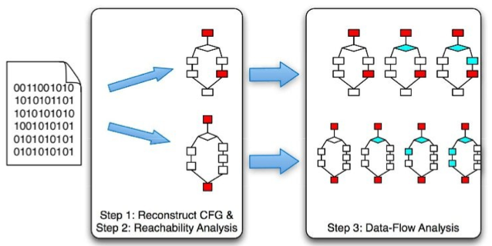

Slide 13
Mach-O Binary File Format
Metadata
Dynamically linked
Cryptographic routines
Allows class and superclass types
List of implemented methods and instance variables
iOS SDK gives the APIs of external libraries
Notes:
Mach-O fills in the gaps left by disassembly
Metadata
Dynamic linking to external code
Includes cryptographic signatures and encrypted binaries

Slide 14
More Implementation Details
Backward slicing
Forward constant propagation
Check if class and method match previous information
Once the target is resolved, add to the CFG
Notes:
Backward slicing
Go backward until the definition of a variable, beginning of a function, or use static definition to find R0, R1, etc
Once determined, use forward constant propagation
Address not necessarily important, but type is (certain types are vulnerable)
For external methods, use the header
For id types (all non-external), examine the call sites that invoke that method, and try to resolve parameter types by backward slicing and constant propagation
Build up a database of this information
For non-basic types (objects), derive the type using R0 at the end of the call
Forward constant propagation propagates types as well
If there is only one class that implements a selector, than type can be reasoned

Slide 15
Finding Leaks
100 basic block limit
User interface event trick
Determine reachability
Forward propagate information
Challenges
No method bodies
Variable number of arguments
Notes:
User interface event hack: because these events are reported by sending messages to delegate objects that contain their non-app source code, there are no edges in the CFG for this link, so there is no potential for a security leak
Conversely, all links are by default insecure
However, the existence of a path does not guarantee flow (and thus, a leak)
Determine reachability, then broadcast information from sources (enhances precision)
No method bodies: if one argument is tainted, method is tainted
Variable number of arguments: statically determine format strings and count args
Look for NULL on stack (end of args), upper bound = 20

Slide 16
Sources
Address book (ABAddressBookCreate)
GPS coordinates
UID
Photo gallery
E-mail accounts
Wifi connection information
Phone history and call information
Youtube app
Notes:
GPS is explicitly granted
UID: all apps have access
Youtube app: watched videos and searches
Safari settings/history
Keyboard cache (no passwords)
Bunch of other stuff

Slide 17
Sinks
Operations that can transmit information over the network
NSURLConnection class
14 total sinks identified
Notes:
Sneaky hack: some functions (initWithContentsOfURL in NSString) can bring in network information without explicit network traffic permissions
Sinks not listed by authors

Slide 18
Evaluation
4156612 calls to the dispatch function
Corresponding class and method found for 82%
All external libraries trigger the UID leak
Usually for advertisements
Sometimes for tracking libraries
656 applications (55%) have ads or tracking libraries
Whitelisted for convenience
Notes:
Success only if inferred class exists in the class hierarchy, and the selector denotes a method that is implemented by the class, or its ancestors in the hierarchy.
Resolved regardless of external or internal call
Danger: linking UID with other information (FB, Google account, etc.)
Solution: Combine the app with the UID for another unique ID
3877/???? (“overwhelming majority”, but no number)

Slide 19
Results
205 vulnerable applications
96 of 656 aforementioned apps have core vulnerabilities
3877 of accessed sources correspond to UID (in 195 apps)
36 apps have GPS vulnerabilities
At 104 locations
5 apps have address book vulnerabilities
At 18 locations
One app has Safari/photo storage vulnerabilities
Notes:
Address book: Gowalla, Twittericki
Clear information at first launch: FB
Initiation required: XibGameEngine, FastAddContacts

Slide 20
Results (cont.)
172 of 205 applications actually leak data
27 false negatives
Cydia not discernably worse
Challenges
Custom storing functions
Nested data structures
Resolution of object types
JSON libraries
Alias pointers, exception handlers, and format strings
Known vulnerabilities detected
Notes:
False negatives: due to hard static analysis
Cydia is interesting to note: the manual vetting process seems to have no effect
Good quality apps? Or bad quality vetting? Both?
Dictionary within dictionary
Resolution of type hard with user-defined objects
Exceptions didn’t fire
Known vulnerability: Vampires Live (Storm8)

Slide 21
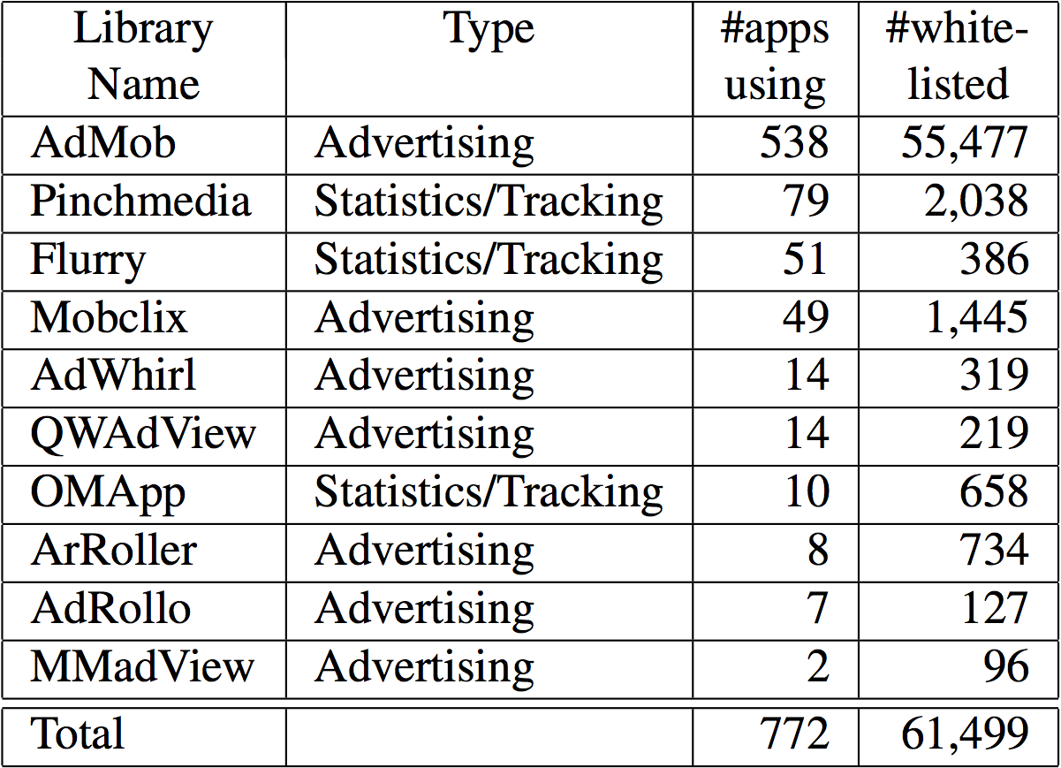

Slide 22
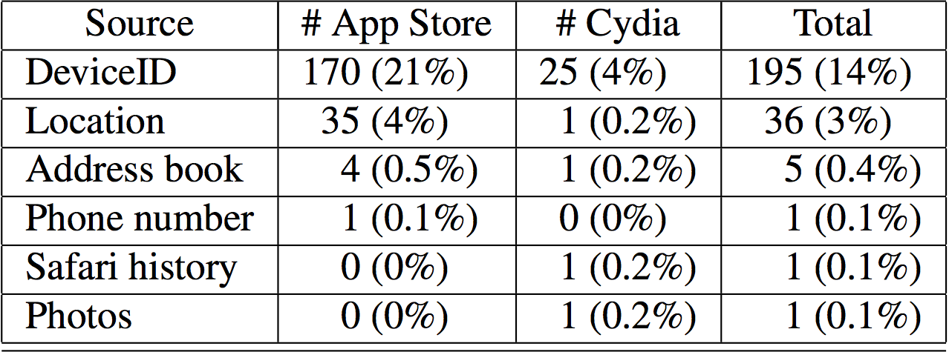

Slide 23
Open Issues
Static analysis not always possible
Non-generic aggregate types
Non-Objective-C code
Notes:
Hard to reason about types since they aren’t generic
JSON, other libraries (Trigger.io?)

Slide 24
Related Work
Builds upon slicing (TAJ, Pixy, etc.)
Static analysis
Use of class hierarchy
Pixy, TaintDroid
New fields
ARM processors
Binaries rather than source code
Objective-C analysis
Notes:
TAJ uses static analysis and slicing as well, as do others we’ve discussed
TaintDroid is dynamic (agreed with findings, though (advertising, external libraries, etc.))
Binaries isn’t new, has been done in C++, but not Objective-C

Slide 25
AndroidLeaks: Automatically Detecting Potential Privacy Leakus In Android Applications on a Large Scale
By Clint Gibler, Jonathan Crussell,
Jeremy Erickson, and Hao Chen
Presented by Maciej Swiech
Notes:
Josiah

Slide 26
Background
Android has highest market share of any mobile operating system
Most Android markets allow applications to be published without any verification
Count on self-regulating system of rankings and user reporting of malicious content

Slide 27
Android Applications
Application run inside sandboxed Dalvik VM
Application must request access to privileged information
Presented to user at install-time
But...

Slide 28
Android Applications
Permissions only tell user what kind of information can be accessed
NOT how it is used!

Slide 29
AndroidLeaks
Leverages on Watson Libraries for Analysis to create call graph of application
Use graph to perform reachability analysis
Context- and flow-sensitive

Slide 30
Major Contributions
AndroidLeaks – static analysis framework
Set of mappings between Android API and necessary permissions
Security analysis of 24,350 Android applications
Implement taint-aware slicing for Android callbacks
Compare prevalence of ad libraries and data leakage

Slide 31
Android Permissions
XML Manifest
Cannot install with only a subset of requested permissions
Cannot further restrict permissions
e.g. certain URL's for INTERNET

Slide 32
Threat Model
Any transfer of personal information off phone
No distinction between user-expected and malicious behavior
Semantic classification left for future work

Slide 33
Analysis Scope
No in-app private information considered
Consider only leaks in application code
Kernel, Dalvik, SDK = trusted
No native code analysis
Only 7% of applications in native code
Still need to call Java API

Slide 34
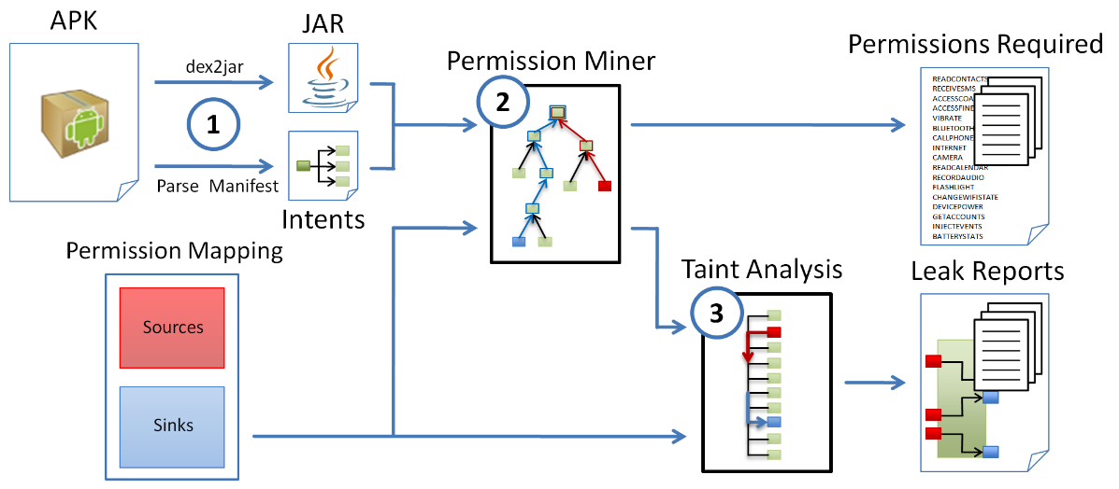
AndroidLeaks Architecture

Slide 35
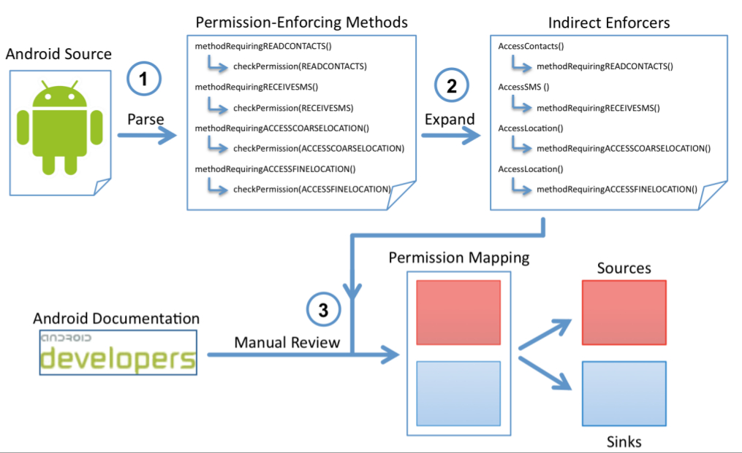
Permission Mapping

Slide 36
Permission Mapping
Source := method for accessing personal information
GPS location, phone number, etc
Sink := method to transmit information off-device
HTTP request

Slide 37
Permission Mapping
Statically analyze permission dependencies in Android framework
Context.enforcePermission(String, int, int
Class methods analyzed by mining
Permission checks propagated up a recursive abstract call-stack
Additional permissions manually mapped
INTERNET, WRITE_EXTERNAL_STORAGE

Slide 38
AndroidLeaks
DEX translate to JAR with ded or dex2jar
Call graph built using WALA
Source and Sink using methods classified
Dataflow analysis to determine paths from source to sink

Slide 39
Taint Analysis - callbacks
WALA ==> context-sensitive SDG
At each iteration, compute forward slice of tainted data
Initially populated by sensitive return data
Analyze slice for tainted sink paramaters

Slide 40
Taint Aware Slicing
Taint all objects whose constructor parameters are tainted
Taint entire collections if any tainted object is added to them.
Taint whole objects which have tainted data stored inside them.

Slide 41
Evaluation
Evaluated 25,976 Android applications
Android Market and 3rd party markets
1,626 required no permissions, 24,350 left
7,414 applications contained leaks
Entire analysis completed in 30 hours

Slide 42
Evaluation

Slide 43
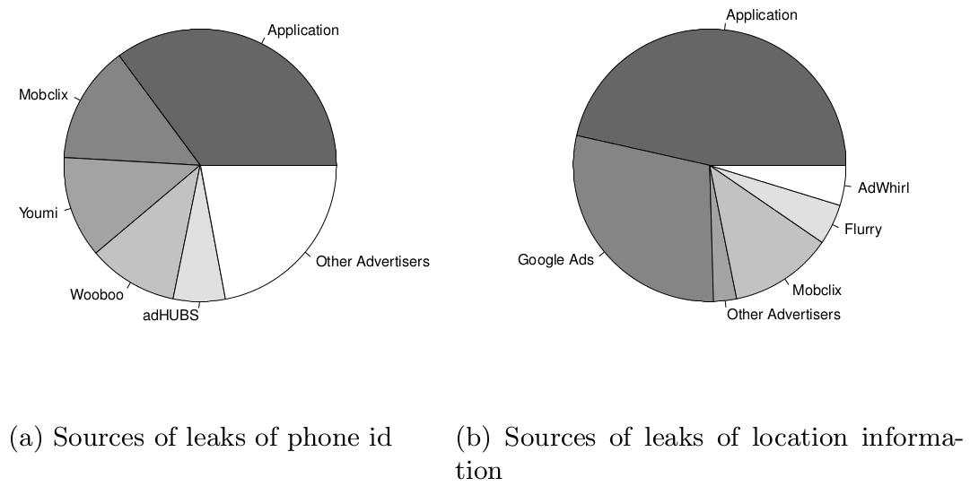
Leak sources

Slide 44
Results
Nearly all ad-code has privacy leaks
Surprising?
Tool for automated privacy leak detection
Scalabale

Slide 45
Questions and Discussion

