Slide 1
Aurasium: Practical Policy Enforcement for Android Applications
R. Xu, H. Saidi and R. Anderson

Slide 2
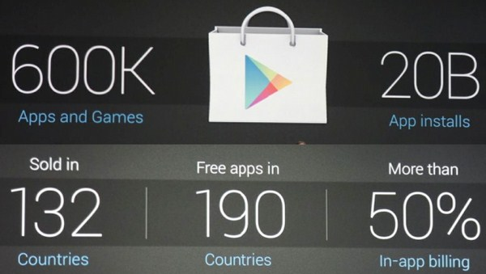
Goal
Address the multiple threats posed by malicious applications on Android

Slide 3
Introduction to Android
Security Features
  Process Isolation
  Linux user/group permission
  App requests permission to OS functionalities
    Most checked in remote end i.e. system services
    A few (Internet, Camera) checked in Kernel, as special user group

Slide 4
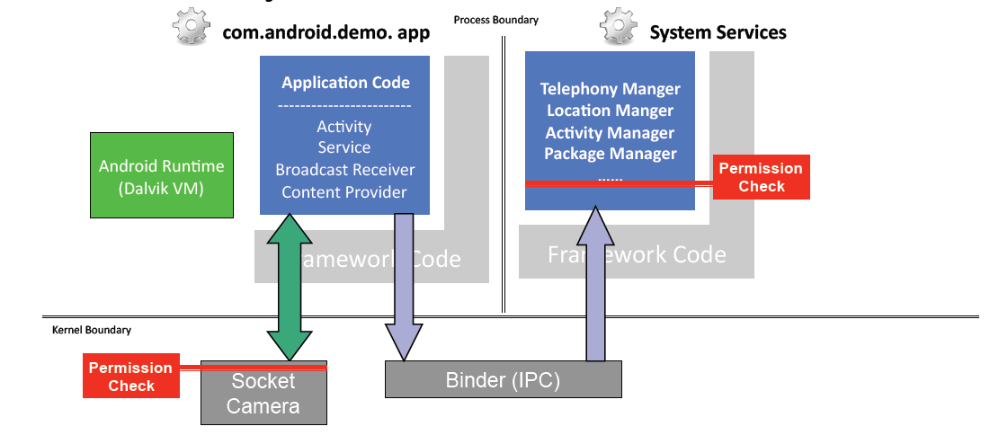
Introduction to Android

Slide 5
Malicious Android Apps
Abuse permissions:
  Permissions are granted for as long as an App is installed on a device
  No restrictions on how often resources and data are accessed
Access and transmit private data
Access to malicious remote servers
Application-level privilege escalation
  Confused deputy attacks

Slide 6
Motivation & Related work
App vetting: Google’s Bouncer
  40% decrease in malware
  Ineffective once App installed on the device
Static/dynamic analysis
  Code coverage – dynamic
  Performance penalty – static
  Hard to assert the malicious behavior
OS Modification: insert monitoring modules at key interfaces (TaintDroid, Quire)
Virtualization (L4Android)
  Require modification to the OS
  Scalability

Slide 7
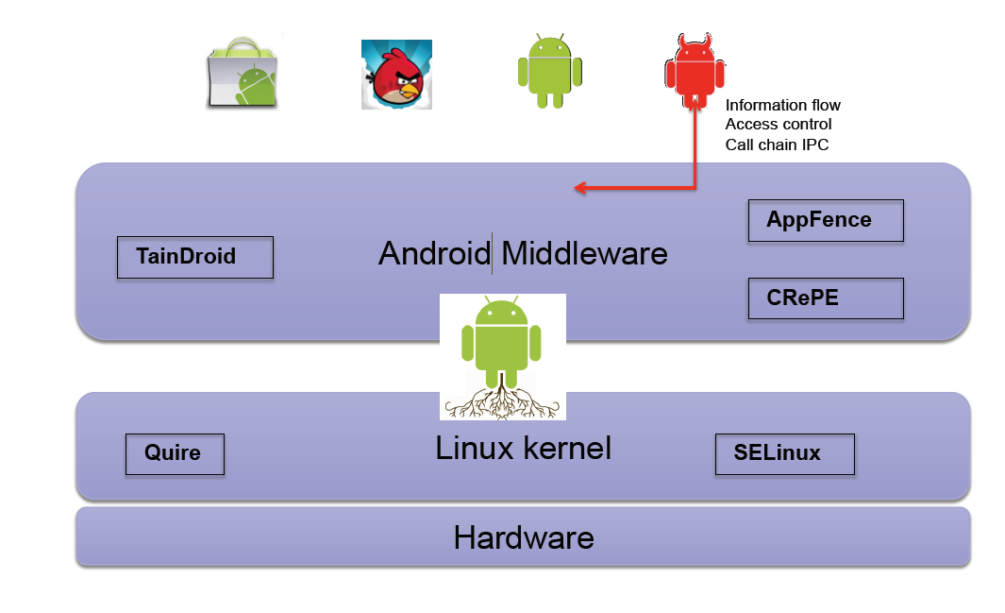
Related Approaches

Slide 8
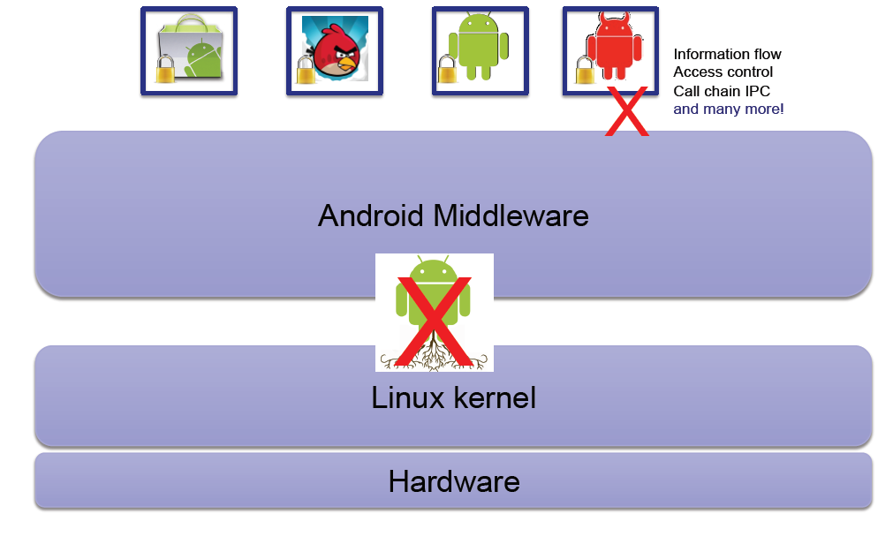
Solution: Aurasium
Repackage Apps to intercept all Interactions with the OS

Slide 9
Problems
Please list three major methods to detect/prevent application’s malicious behavior:
  Static/dynamic analysis
  OS modification
  Virtualization

Slide 10
Aurasium Internals
Problems to Solve
  Introducing alien code to repackage arbitrary application
  Reliably and completely intercepting application privacy access behavior
  Policy policies

Slide 11
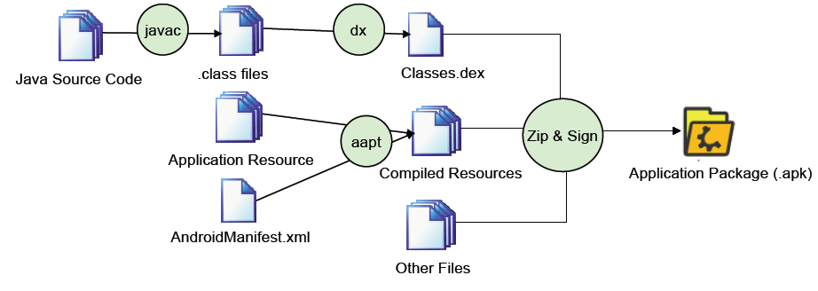
Aurasium Internals
How to add code to existing applications
  Android application building and packaging process

Slide 12
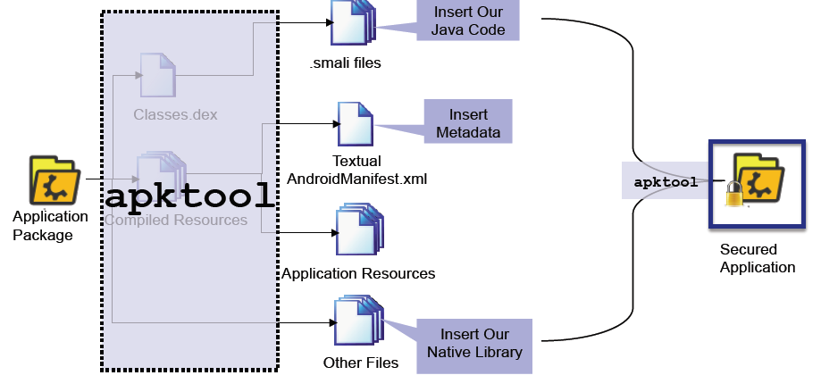
Aurasium Internals
How to add code to existing applications
  apktool

Slide 13
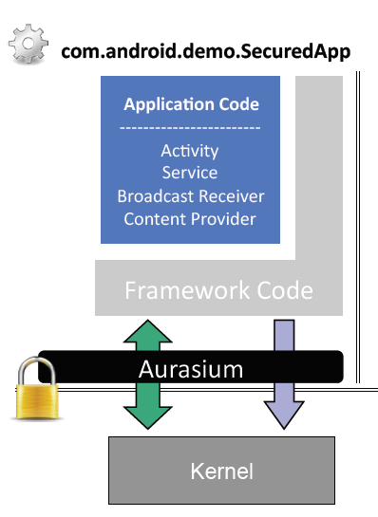
Enforcing Security & Privacy Policy
Aurasium way
  Per-application basis
  No need to root phone and flash
  firmware
  Almost non-bypassable

Slide 14
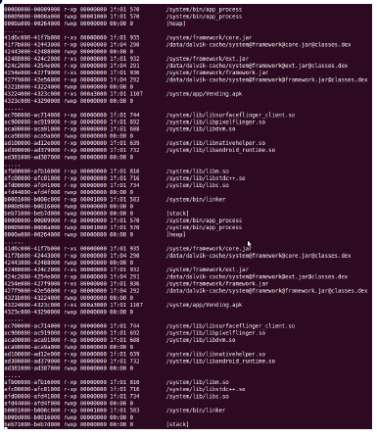
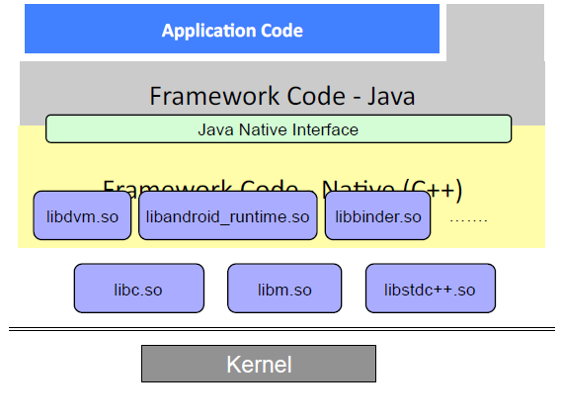
Aurasium Internals
How to Intercept
  A closer look at app process

Slide 15
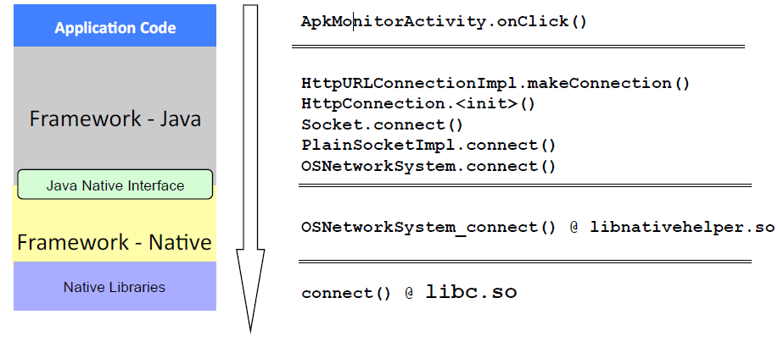
Aurasium Internals
How to Intercept
  Example: Socket Connection

Slide 16
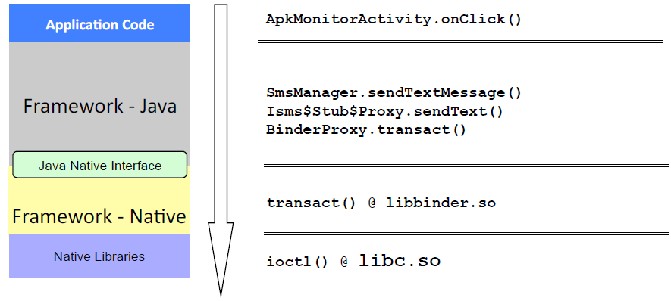
Aurasium Internals
How to Intercept
  Example: Send SMS

Slide 17
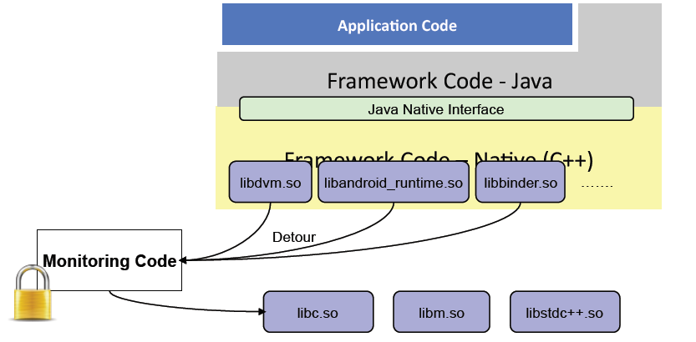
Aurasium Internals
How to Intercept
  Intercept at lowest boundary – libc.so

Slide 18
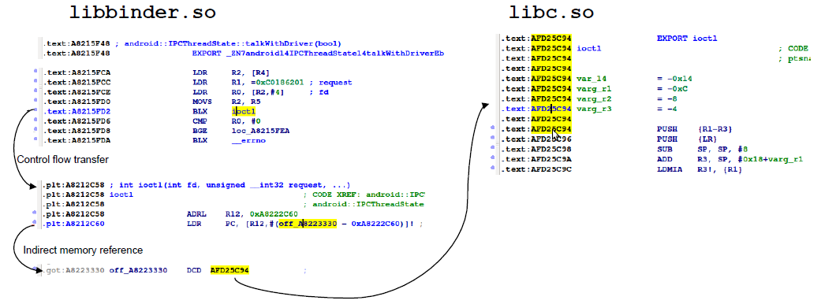
Aurasium Internals
How to Intercept
  Look closer at library calls - dynamic linking

Slide 19
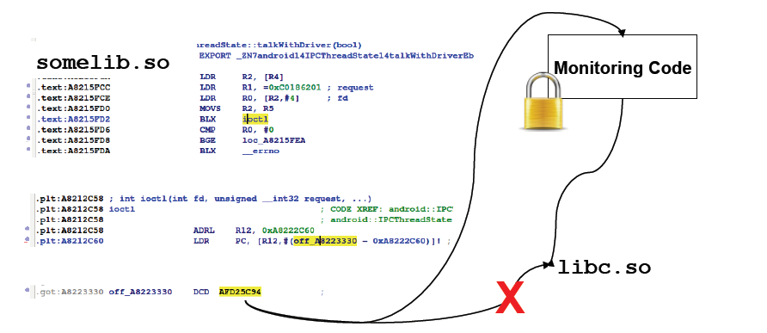
Aurasium Internals
How to Intercept
  Key: Dynamically linked shared object file
  Essence: Redo dynamic linking with pointers to our detour code.

Slide 20
Aurasium Internals
How to Intercept
  Implemented in native code
  Almost non-bypassable
    Java code cannot modify arbitrary memory
    Java code cannot issue syscall directly
    Attempts to load native code is monitored
      dlopen()

Slide 21
What can you do with Aurasium?
Total visibility into the interactions of an App with the OS and other Apps
Internet connections
  connect()
IPC Binder communications
  ioctl()
File system manipulations
  write(), read()
Access to resources
  Ioctl(), read, write()
Process management
  fork(), execvp()

Slide 22
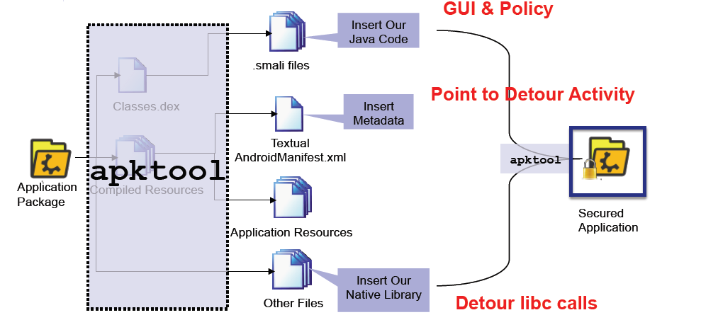
Aurasium Internals
How to add code to existing applications
  Inevitably destroy original signature
    In Android, signature = authorship
  Individual app not a problem

Slide 23
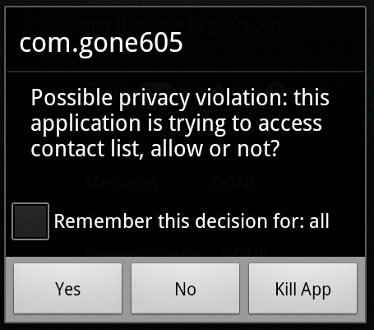
Evaluation

Slide 24
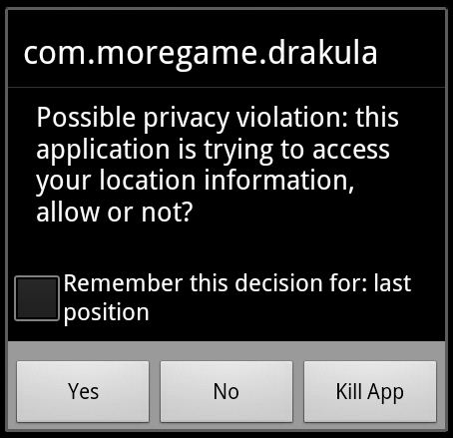
Evaluation

Slide 25
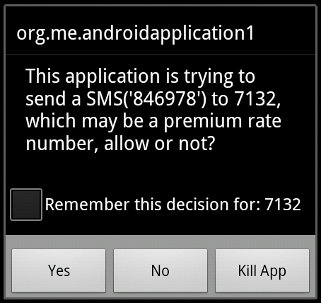
Evaluation

Slide 26
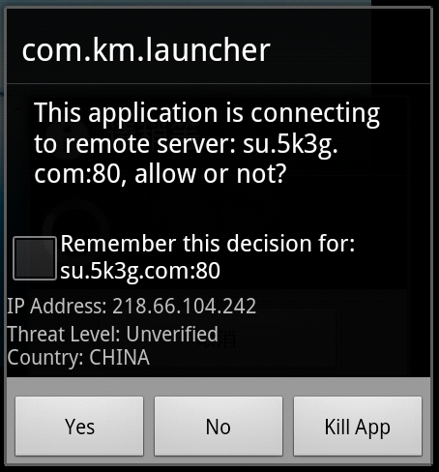
Evaluation

Slide 27
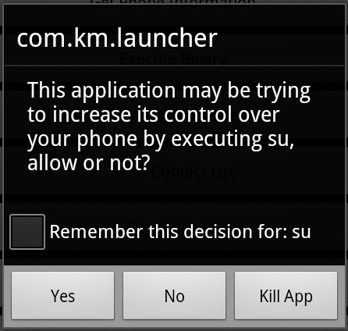
Evaluation

Slide 28
Evaluation
Tested on Real-world Apps
  3491 apps from third-party application store.
  1260 malware corpus from Android Genome.
  Results
    Repackaging:
      3476/3491 succeed (99.6%/99.8%)
      Failure mode: apktool/baksmali assembly crashes
    Device runs
      Nexus S under Monkey – UI Exerciser in SDK
      Intercept calls from all of 3189 runnable application

Slide 29
Problem
List the system calls related with:
  IPC
    ioctl()
  File operation
    read(), write()
  Process management
    fork(), execvp()

Slide 30
Limitations
99.9% is not 100% (even larger failure percentage now)
  Rely on robustness of apktool
  Manual edit of Apps as a workaround
Native code can potentially bypass Aurasium:
  Already seen examples of native code in the wild that is capable of doing so, explicitly use static linking

Slide 31
Conclusion
New approach to Android security/privacy
Per-app basis, no need to root phone
Tested against many real world apps
Have certain limitations

Slide 32

The End

Slide 33
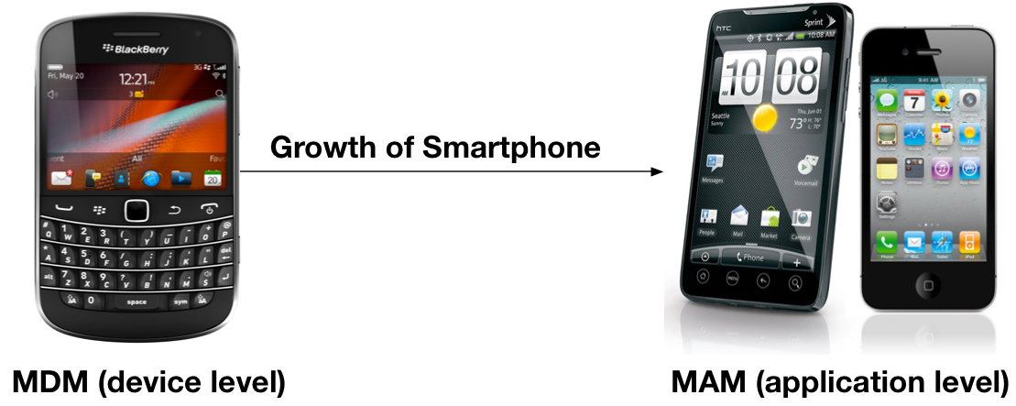
Background
Evolution of Enterprise Mobile Management (EMM)

Slide 34
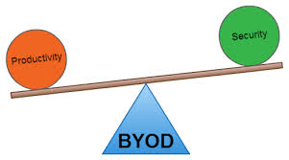
Background (cont’d)
Tradeoff: productivity v.s. security

Slide 35
Major methods
  Application rewriting
    Mocana
    Work on all devices, NOT on all applications
  SDK
    Good
    Work on all applications, NOT on all devices
    Extra developer support
  OS Modification
    Bring Android to work on Android Lollipop
    Dependencies on OS versions or customization
    Limitation of portability

Slide 36
Android Segmentation

Slide 37
Desired System
Generality
  Any application on mobile marketplaces → hardened business version
Data isolation/sharing
Completeness
  Stealthy channels: reflection, native code, dynamic load
Flexibility
  Dynamic & remote access policy update
Portability
  No modifications (dependencies) on OS
Cross-platform
  Proxy-based data access mechanism demo on iOS

Slide 38
Challenges
Lack of OS support
  Existing Android storage mechanism supports either data sharing or data isolation alone
Diversity of data access behavior
  Native code, Java reflection, Dynamic loading
Performance penalty
  Popular resource virtualization-based solutions have the scalability issue

Slide 39
System Overview
How to use:
  Shield the application to get the business version of application
  Applications on device are divided into two sets: business and personal

Slide 40
Features
  Proxy-based data access mechanism
  Privileged data leakage detection/prevention

Slide 41
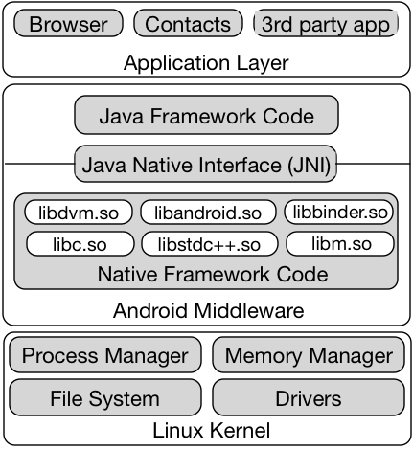
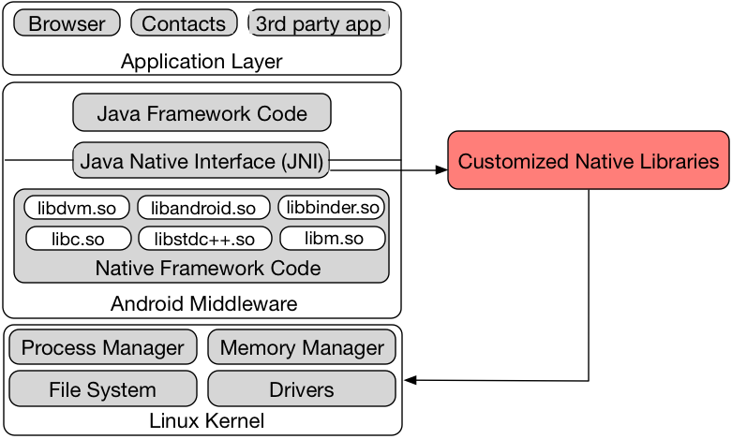
System Call Hooking

Slide 42
AppShield Architecture
3
8
7
9
4
6
12
13
11
10
5
14
1
2

Slide 43
Data Sharing/isolation
Privileged data kept in internal storage, private access mode owned by AppShield
Data access by other applications go through public storage with the virtual file path
Business application’s access redirect to the true file → sharing
Personal application cannot access the private internal storage→ isolation

Slide 44

Data Sharing/isolation (cont’d)
No access to privileged data
AppShield
Personal Application
Access
Access
Business application
Business application

