Slide 1
Mobile App Monetization: Understanding the Advertising Ecosystem
Vaibhav Rastogi

Slide 2
Outline
Advertising overview
Discovering ad networks
Popularity: rank correlations
Popularity: power law
Usage diversity
Malvertising

Slide 3
Outline
Advertising overview
Discovering ad networks
Popularity: rank correlations
Popularity: power law
Usage diversity
Malvertising

Slide 4
Advertising Overview

Slide 5
Advertising Overview
Publishers – show ads to users
Advertisers – the brand owners that wish to advertise

Slide 6
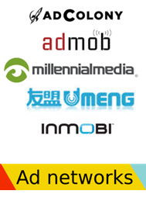
Advertising Overview: Ad networks
Also called aggregators
Link advertisers to publishers
Buy ad space from publishers; sell to advertisers
Sophisticated algorithms for
Targeting
Inventory management

Slide 7
Advertising Overview: Ad networks
Ad networks may interface with each other
Syndication
One ad network asks another to fill ad space
Ad exchange
Real time auction of ad inventory
Bidding from many ad networks for many ad spaces

Slide 8
Payment Models
Impressions
Clicks
Conversions
Installs

Slide 9
Mobile In-app Advertising
Mobile apps show ads
Ad networks provide glue code that apps can embed and communicate with ad servers
Ad library
Ad libraries identify ad networks

Slide 10
Outline
Advertising overview
Discovering ad networks
Popularity: rank correlations
Popularity: power law
Usage diversity
Malvertising

Slide 11
Discovering Ad Networks
Find Ad libraries
Typically have their own Java packages e.g., com.google.ads
Disassemble the app and get Java packages

Slide 12
Discovering Ad Networks: Approach 1
Find frequent packages
Ad networks included in many apps so their packages will be frequent
So are some other packages, e.g., Apache libs, game development libs,…

Slide 13
Discovering Ad Networks: Approach 2
Ad functionality is different from the main app functionality
Break the app into different components based on some code characteristics
Inheritance, function calls, field relationships…
Cluster components from multiple apps together
Some of the top clusters will be ads

Slide 14
Discovering Ad Networks: Results
Dataset
492,534 apps from Google Play
422,505 apps from 4 Chinese stores: 91, Anzhi, AppChina, Mumayi
Discovered a total of 201 ad networks

Slide 15
Outline
Advertising overview
Discovering ad networks
Popularity: rank correlations
Popularity: power law
Usage diversity
Malvertising

Slide 16
Popularity
Number of different metrics
Number of apps
Number of developers
Number of total downloads across all apps
Average number of downloads

Slide 17
Popularity

Slide 18
Popularity
Popularity depends on metric
Different metrics may have low correlation

Slide 19
Popularity: Applications vs. Developers

Slide 20
Popularity: Applications vs. Avg Downloads

Slide 21
Popularity: Rank Correlations
Kendall’s rank correlation coefficient
Measures similarity between two rankings
Apps vs. developers: 0.89
Apps vs. downloads: 0.72
Apps vs. avg. downloads: 0.30

Slide 22
Popularity: Why the Difference?
Successful apps use different ad networks
Do ad networks play a role in making an app successful?
Some ad networks may be used successfully by a few apps only

Slide 23
Case Study: Vungle
Video ads
Notes:
http://vungle.com/wp-content/themes/vungle-dist/vid/vungle-monetize.mp4

Slide 24
Popularity: Why the Difference?
Successful apps use different ad networks
Do ad networks play a role in making an app successful?
Some ad networks may be used successfully by a few apps only
Will these metrics better align ever in the future?

Slide 25
Outline
Advertising overview
Discovering ad networks
Popularity: rank correlations
Popularity: power law
Usage diversity
Malvertising

Slide 26
Popularity: Power Law
Observed in many natural distributions
E.g., Number of cities with more than a certain population size
Long tail, Pareto distribution, Zipf’s law, 80-20 rule
Popularity ranking of ad networks should be a power law

Slide 27
Popularity: Power Law
Verifying power law
Log-log plot should be a straight line

Slide 28
Popularity: Power Law

Slide 29
Popularity: Power Law
Why not a straight line
Information filtering:
Developers do not know about the less-popular ad libraries
Consequences
How will the number of ad networks change?
Consolidation by merging; closing business
Will we move closer to a power law?

Slide 30
Outline
Advertising overview
Discovering ad networks
Popularity: rank correlations
Popularity: power law
Usage diversity
Malvertising

Slide 31
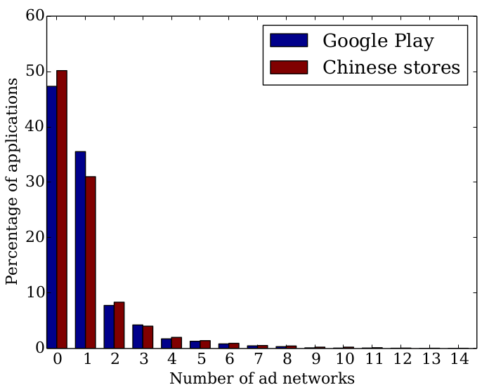
Usage Diversity
Apps sometimes have multiple ad networks

Slide 32
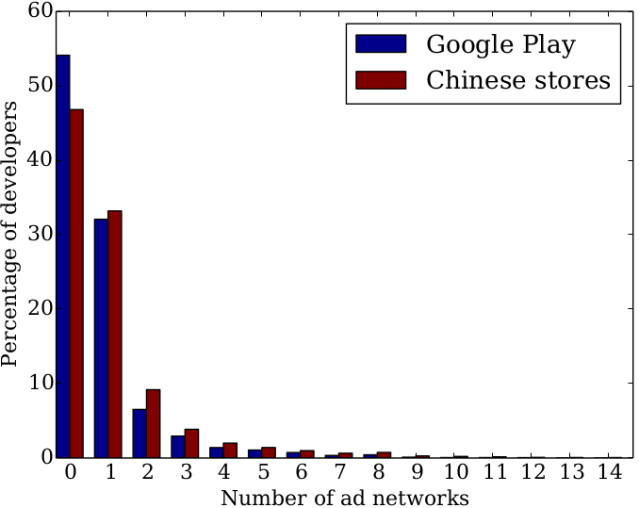
Usage Diversity
Similar results for developers

Slide 33
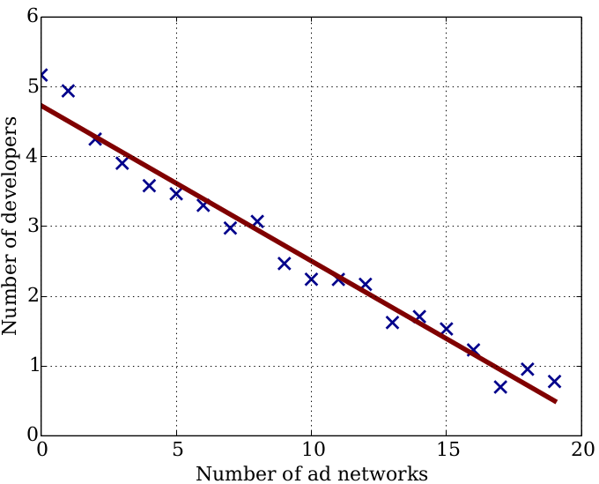
Usage Diversity
These are exponential decays: verified by a semi-log plot

Slide 34
Usage Diversity: Consistency
Are developers consistent in usage of ad libraries across their applications?
70% developers are fully consistent – use the same ad libraries across all applications
Small inconsistencies in majority of rest of the cases

Slide 35
Usage Diversity: Consistency
Use whatever is most profitable to you, and use it across all apps
Possible reasons for inconsistency
Apps for different demographics / with different functionality
Develops may choose to keep some apps ads-free
Testing different ad networks

Slide 36
Outline
Advertising overview
Discovering ad networks
Popularity: rank correlations
Popularity: power law
Usage diversity
Malvertising

Slide 37
Malvertising
Are some mobile advertisements malicious?
How are those ads malicious?
Phishing
Other social engineering
Any relationships with particular ad networks, app types, geographic regions

Slide 38
Malvertising: Methodology
Automatically run mobile apps
Use Android Emulator
AppsPlayground for automatically driving app UI
Capture any triggered ads
Analyze triggered ad URLs for maliciousness
Download content from the triggered URLs and scan them with antiviruses

Slide 39
Malvertising: Preliminary Results
Over 100,000 URLs scanned
250 files downloaded
140 malicious URLs
120 files are malware
~50% downloaded files are malicious
URL blacklists do not flag URLs that result in malicious downloads

Slide 40
Case Study
Fake AV scam
Campaign found in multiple apps
Website design mimics Android dialog box
We detected this campaign 20 days before the site was flagged as phishing by Google and others

