Slide 1
Automatic Mobile App Generation
Yang Hu and Sophia Lou

Slide 2
Different Types of Apps
Web App
only HTML5 code
Native App
native languages, Objective C/Java
Hybrid App
HTML5 code with native features
Notes:
Web App- Apps that use only HTML5 code (HTML, CSS, and Javascript) and no native device features or APIs.
Native App- Apps are typically written in the native language of the device/platform operating system: Android* Dalvik* Java*, iOS* Objective C, Windows* 8 Phone & Windows* Store C++ or C#. Each platform provides a different toolset for their native app developers including the materials needed for app store submission. These apps are installed directly onto the phone and can work, in most cases, with no Internet connectivity.
Hybrid App- Apps where significant parts are written in HTML, but it uses native device features, such as a camera or accelerometer, and use device APIs in an HTML5 wrapper.

Slide 3
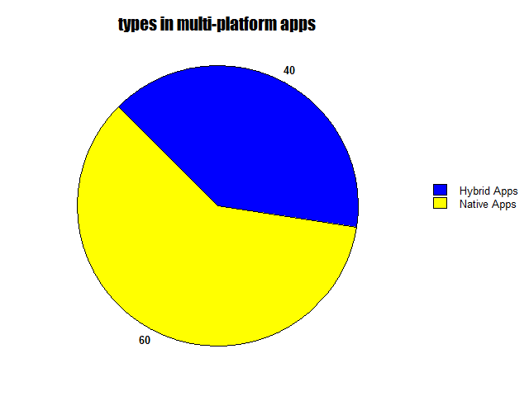
Kendo UI Survey, 2013
Notes:
A survey of 5,000 developers revealed that when developing apps for multiple platforms, HTML was the technology of choice for the majority (41%); this compares with 36% the year before. 40% of developers also admitted that they started building a native app only to realise that HTML5 would meet their needs.

Slide 4
Web Apps
Hybrid Apps
PhoneGap framework
Coding demo

Slide 5
HTML Strengths
Cross Platform Compatibility
The same HTML5 app works on different mobile operating systems
iOS, Android, Windows, Blackberry…
Guarantee of the same interface for every operating system
The cost of development is more lower for each operating system
Better suited to emerging markets such as Africa where the market tends to have a more diverse range of devices.

Slide 6
HTML Strengths
Cross Platform Compatibility
The same HTML5 app works on different mobile operating systems
iOS, Android, Windows, Blackberry…
Guarantee of the same interface for every operating system
The cost of development is more lower for each operating system
Better suited to emerging markets such as Africa where the market tends to have a more diverse range of devices.

Slide 7
Remote Updates are Automatic
Only the latest version of the app will be seen
Developers don’t have to provide support for multiple versions of the app
Users don’t have to manually update the app
Faster access to user analytics information
Weather and shopping apps
Access from the web without having to download the app
Additional decrease in development cost
Don’t need to share revenue with companies that build and maintain app stores

Slide 8
Problems
The implementation is far from uniform.
Implementation varies from browser to browser and from mobile platform to mobile platform. This widespread fragmentation makes it difficult for software developers to know which part of HTML5 they can use.
Slow response and lag
HTML5 apps can be afflicted by slowness and work erratically when a data connection is not available or is intermittent.
Access to native features (camera, GPS, notifications)

Slide 9
Distribution- app store access and user base
Different User UI Expectations
Has a different user feel than the native apps that many users now expect
Initial development time
involved process of testing in multiple devices, and operating systems and the bug fixes involved.
Lacking features
Lack Digital Rights Management needed for multimedia services
Doesn’t support background processing
Missing secure storage and notifications outside of applications

Slide 10
Security Problems
Code injection attacks
vulnerable to XSS and code injection attacks
nature of web framework
can be avoided by filtering and random token
Fracking
untrusted web content would be able to reach local resources on device

Slide 11
Native Apps
Native apps
Preinstall programs (apps) such as address books, calendars and calculators appeared first on mobile devices.
Play games and load social networks quickly
better suited to take advantage of the inherent hardware and software offerings exclusively available on each operating system and device such as camera, GPS, accelerometer etc.,
App submission and Distribution
Easier to submit for approval, validation and distribution
UI Controls
Pinch, Zoom, Tap, Pull, Slide and multi-touch control
Graphics and Animation Support
Offline Access

Slide 12
From HTML5 to Native
Before- mobile website (m.facebook.com) was wrapped in code to run on iOS and Android hardware
Able to send updates to the app multiple times a day to fix problems
Support of many devices (7,000+ devices)
HTML5 app still exists on some platforms including Windows Phone, BlackBerry, and Android
After- change to Native development
App opens faster, without a lag
Scrolling is smoother
Photos are uploaded instantly

Slide 13
Before- mobile website (m.facebook.com) was wrapped in code to run on iOS and Android hardware
more and more people are spending more time in the app, and the app is running out of memory.
trying to get some of the animations — the spinners and the way they work — getting that smoothness, we felt like we needed native to really do that well.
One is tooling support — having a debugger that actually works, performance tools that tell you where the memory is running out.

Slide 14
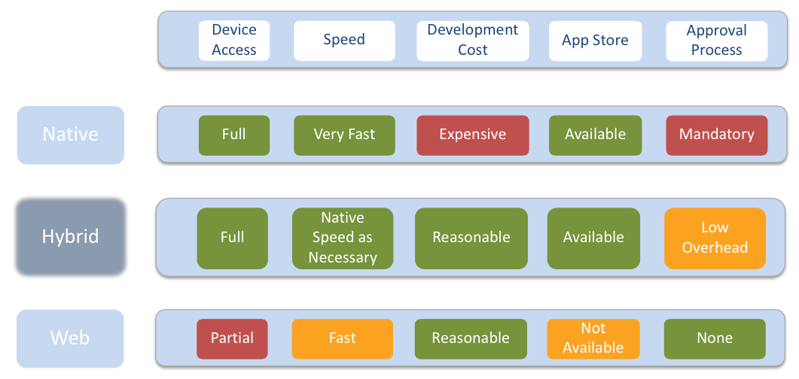
Comparison on development

Slide 15
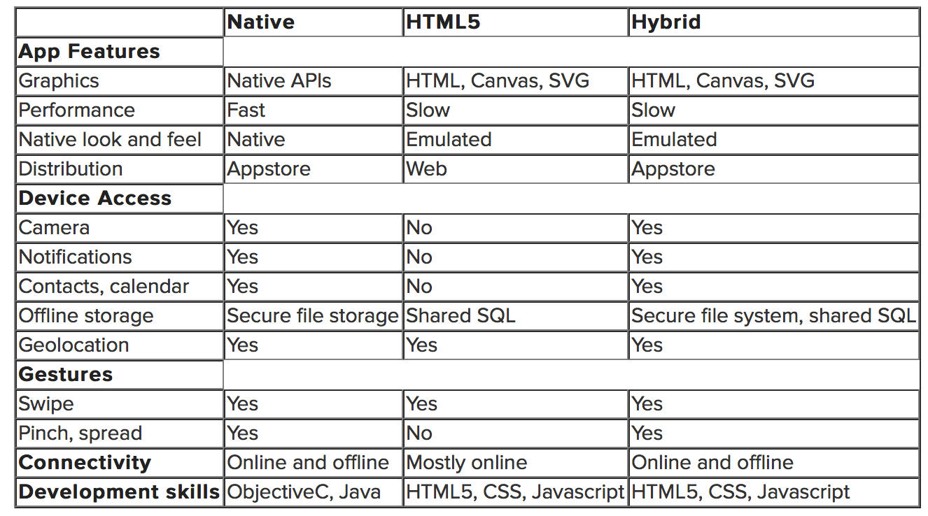
Comparison on features

Slide 16
Web Apps
Hybrid Apps
PhoneGap framework
Coding demo

Slide 17
Hybrid Apps
Often offer a good trade-off between the ease of developing HTML5 apps and the performance of native apps.
Generally, hybrid apps are built using web technologies such as HTML, CSS and JavaScript and then ‘wrapped’ in a native container. The popular PhoneGap framework does this and has been used for a number of popular apps
By 2016, 50% of mobile apps will be hybrid

Slide 18
Architecture of a hybrid app
Native container
Creates instance of UIWebView android.webkit.WebView / etc.
Navigates to main html file
Implements listener/handler for requests coming from JS code Activates
JS code when necessary
HTML5/CSS3/JS code:
Implements UI and app logic
Activates native handlers through OS-specific mechanism (custom URL scheme)
Receives responses through JS handlers

Slide 19
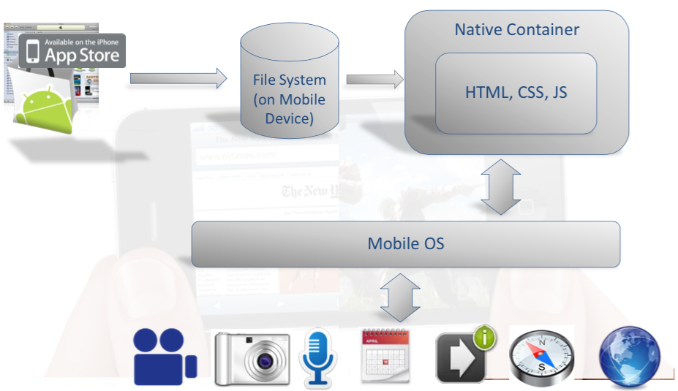
Hybrid Apps

Slide 20
Strengths
Cross-Platform Support
Lower Development Costs
Hybrid Apps help achieve the look and feel of the native apps as well as the functionality at lower development costs by taking advantage of the platform specific frameworks to reduce the time and resources required to build these apps.
Device Access
Hybrid apps offer full-integration with the various UI controls available on devices such as pinch, touch and zoom and features such as camera, geo-location, contact list, file upload, accelerometer.
Access to App Store
Hybrid Apps, like native apps can be submitted to the app stores for approval and distribution, enabling reach a larger audience.

Slide 21
Successful Hybrid Apps
Netflix is a great example because they handle their UI across devices
in HTML (mobile, web and Playstation 3) but also combine it with native technologies for e.g. video playback.

Slide 22
Twitter has been very successful in using HTML5, CSS3 and JavaScript to make hybrid applications that run fast and that feel as smooth as a native app.
The whole point of using HTML5 is to keep users constantly updated on their friends and followers
Unlike Facebook, Twitter’s use of multiple coding has made for a better, smoother app than either a native app or an HTML5-only app could deliver.

Slide 23
Hybrid Cons
Slower Performance
Limited Graphical support for heavy graphics and animation
Revenue Loss

Slide 24
Choosing your Tradeoffs
Business Goals
Target users and their preferences
Budget Constraints
User Interface (UI) controls
App Store Accessibility
Graphics Support
Speed and seamless operation
Access to hardware/software features native to a device/operating system
Web Connectivity
Development Skills

Slide 25
Quiz
 | Performance | Data storage | Development Skills | Complicated Gestures | Distribution
Web Apps | Slow | Shared SQL | HTML, Javascript, CSS | No | Web
Hybrid Apps
Native Apps | Fast | Secure local storage | Objective-C/ Java | Yes | App store

Slide 26
Web Apps
Hybrid Apps
PhoneGap framework
Coding demo

Slide 27
Development Hybrid Apps:
Phone Gap
Requirement
node JS
Xcode or Visual Studio
http://phonegap.com/install/

Slide 28
Architecture of a hybrid app PhoneGap – Open Source Framework
The de-facto standard for hybrid app development
Now in transition into becoming “Apache Callback”
Provides:
A template implementation for the native container
Implementation of the JS<->Native bridge for 6 mobile OSs
OS-independent JS APIs for activating device functions

Slide 29
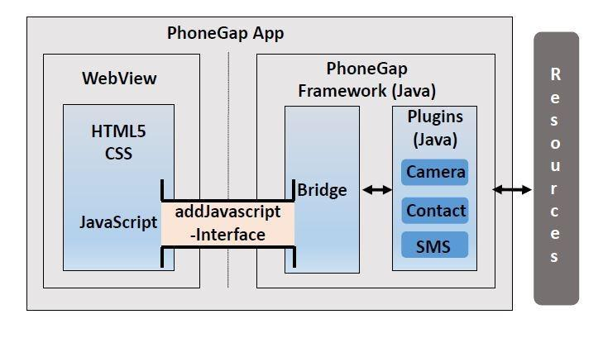
PhoneGap Architecture

Slide 30
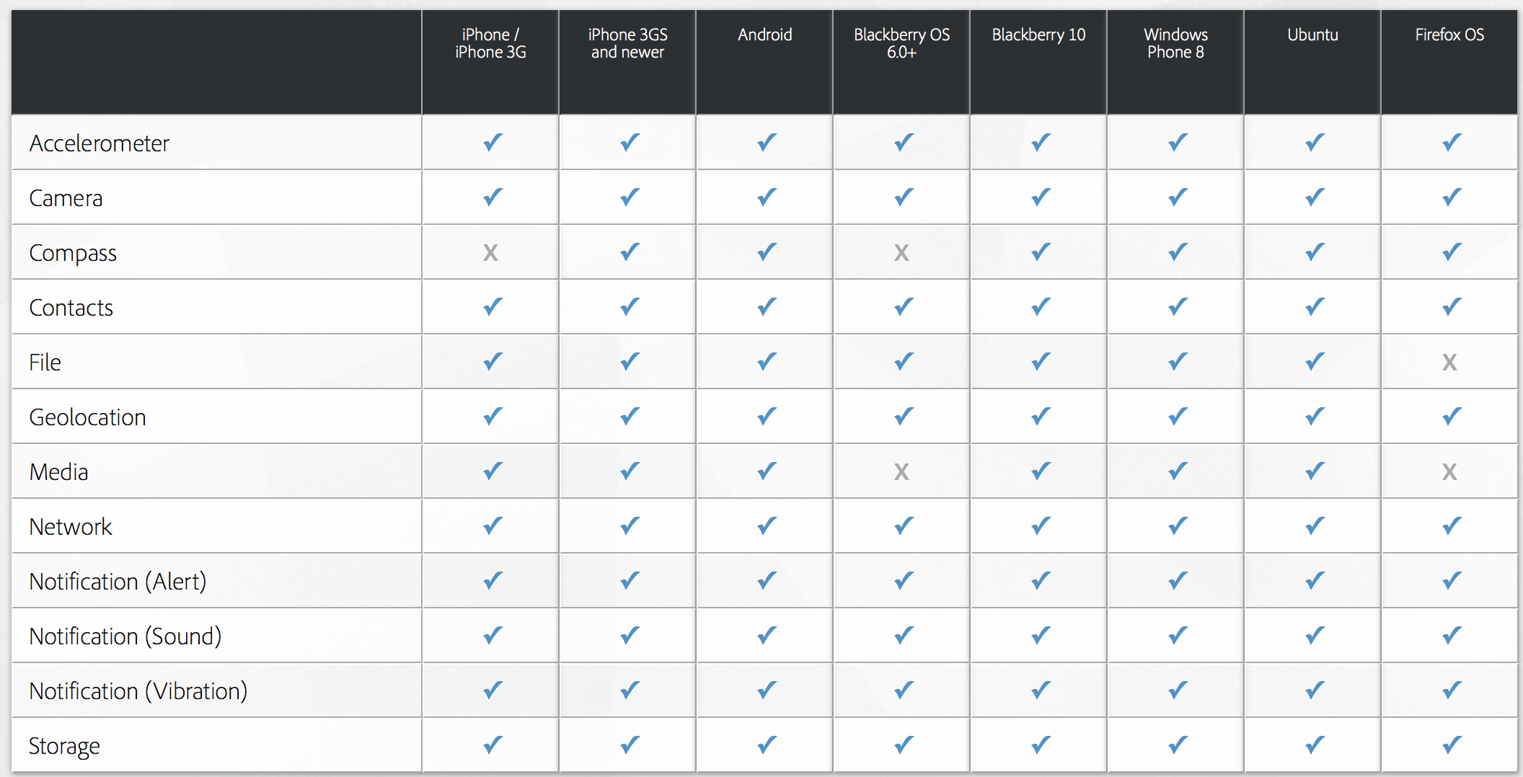
PhoneGap Architecture

Slide 31
PhoneGap architecture
Advantage:
Can be easily ported between different platforms
Device
Accelerometer
Camera
Compass
Contacts
File
Geolocation
Notification
…
HTML
CSS
JavaScript
addJavascriptInterface()
Disadvantage:
Need to build the bridge between JavaScript and native resources
WebView
PhoneGap

Slide 32
Web Apps
Hybrid Apps
PhoneGap framework
Coding demo

Slide 33
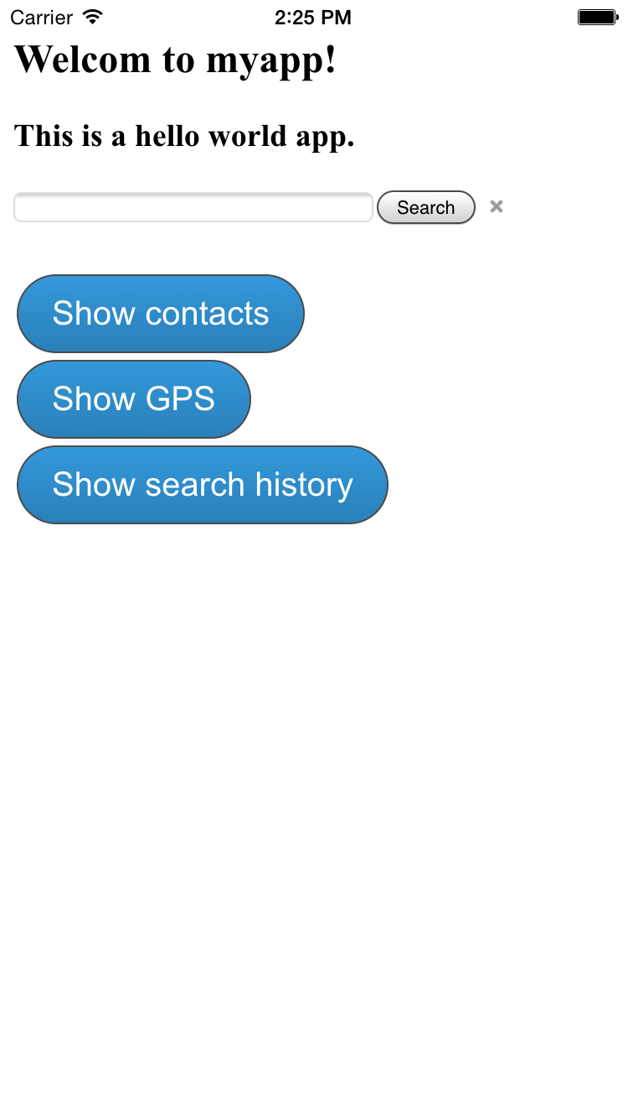
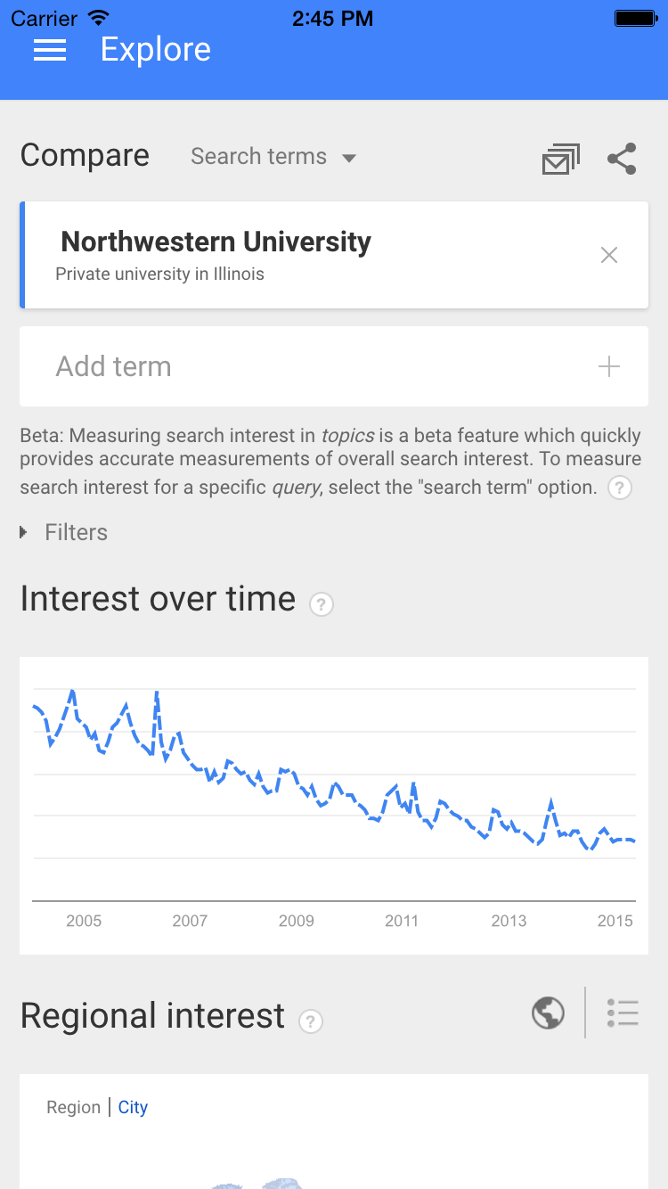
Phone Gap Demo

Slide 34
Backups

Slide 35
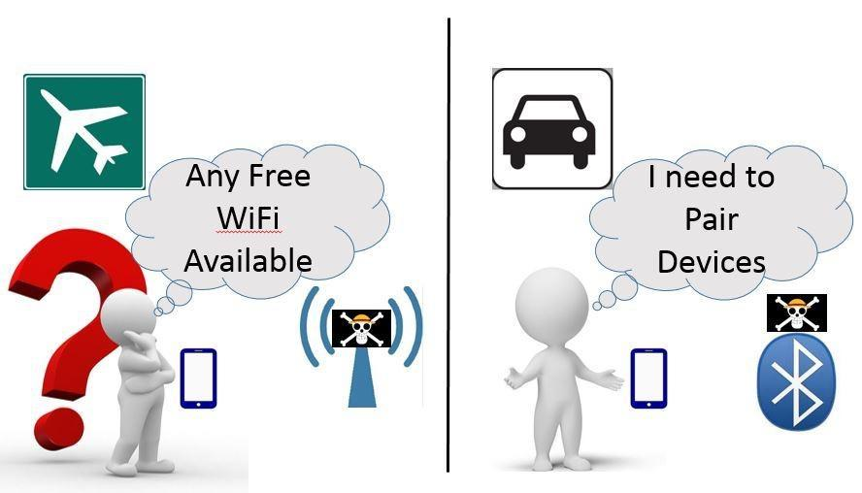
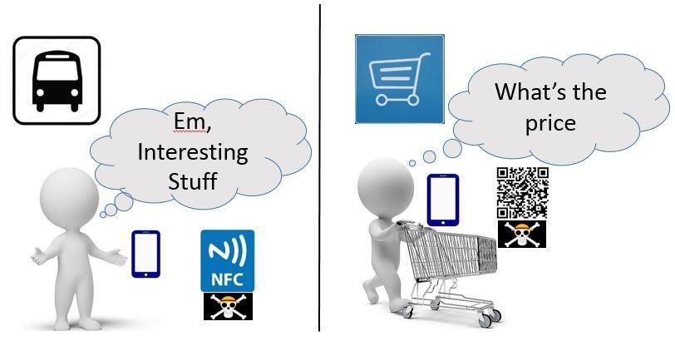
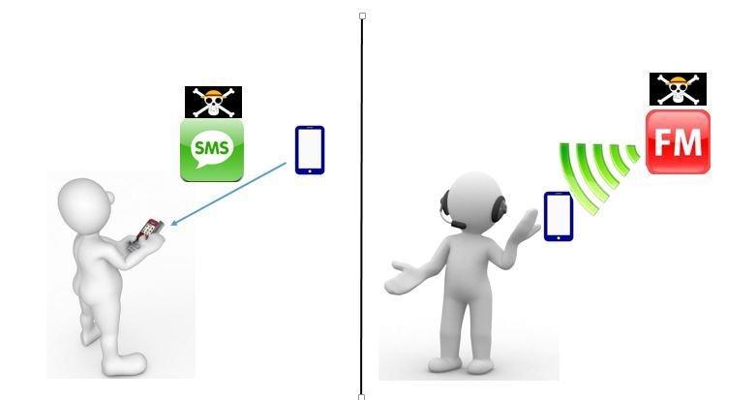
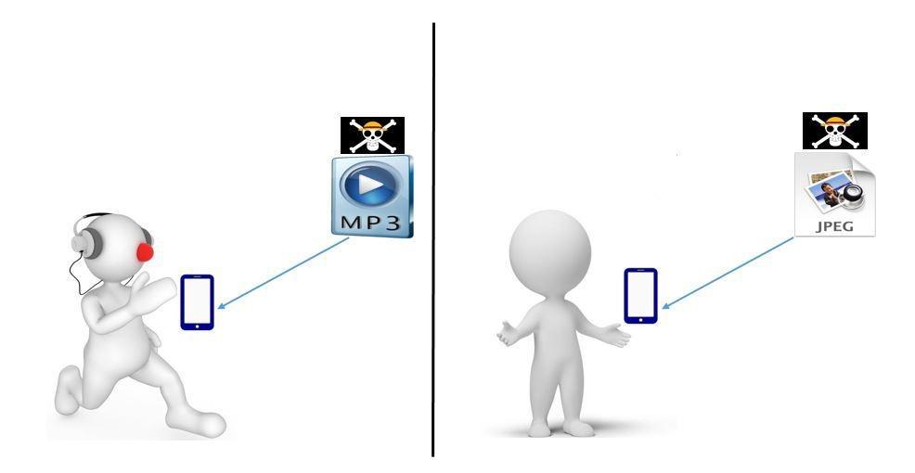
(a)
(b)
(c)
(d)
(e)
(f)
(g)
(h)

Slide 36
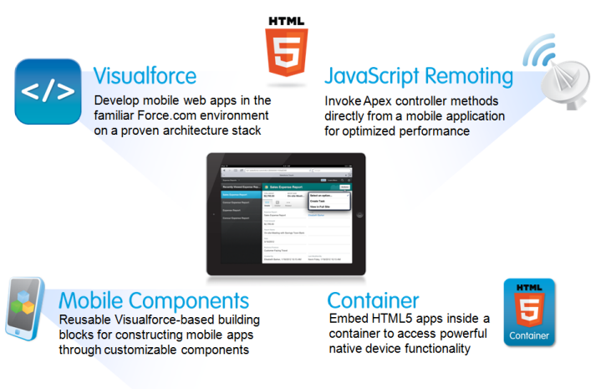
HTML5-based Mobile App
Hybrid apps

Slide 37
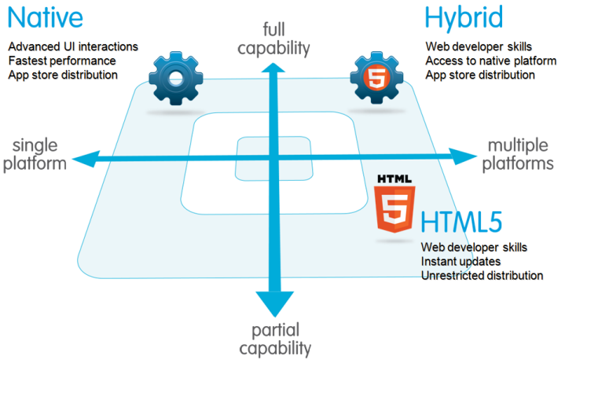
Overview of HTML5-based Mobile App

