Slide 1
iOS 8 for MDM/EMM
Greg Elliott
Shiv Chandra Kumar

Slide 2
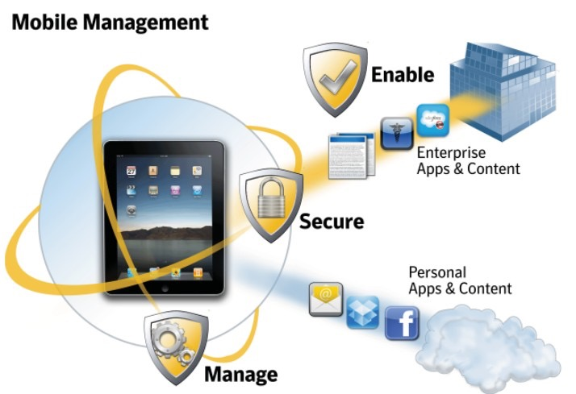
MDM(Mobile Device Mangement)

Slide 3
(Mobile Device Management (MDM)
Hardware and application inventory
Configuration of security policies
password policy, device encryption, WiFi settings, detection of jailbroken devices and so forth
Execution of actions such as partial or remote wipe, remote lock, device location mapping and passcode clearing
Devices often belong to the enterprise, not really BYOD

Slide 4
Mobile App Management (MAM)
Target BYOD, apply policy controls to and provision mobile applications
both internally developed apps
apps that are commercially available in stores such as the Apple App Store and Google Play
Two common implementations
API wrapping
Use of a software development kit (SDK)

Slide 5
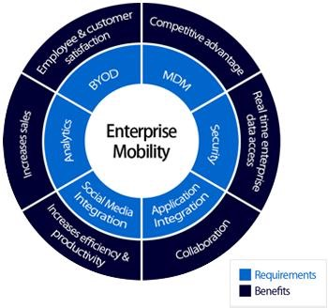
EMM(Enterprise Mobility Management)

Slide 6
Enterprise Mobility Management (EMM)
EMM consists of MDM, MAM and Mobile Content Management (MCM)
A secure mobile container to access applications, the web and corporate intranet, emails, contacts and calendars
Secure content collaboration to enable viewing, editing and syncing of content in a secure environment
Seamless enterprise access that can integrate with existing enterprise systems and mobilize applications or content on the corporate network
Always on VPN, virtual desktop interface (VDI)

Slide 7
iOS 8 for EMM
Enable productivity
Manage corporate data
Deliver seamless security
unlock new opportunities through apps

Slide 8
How it does this Generally
existing technologies:
managed accounts
managed apps
managed open-in
per-app VPN
new iOS8 technologies:
managed document providers
managed domains
managed books and PDFs
managed keyboards

Slide 9
Managed Document Providers
allow third party productivity apps to open documents from various cloud services
can be managed by IT so that only managed apps can interact with them
IT can manage workflows and maintain security without intruding on the user experience

Slide 10
Managed Domains
specific URLs and subdomains can be managed
can manage what apps can open documents that
are downloaded from enterprise domains using Safari

Slide 11
Managed Keyboards
only appear in managed apps
prevent unmanaged keyboard from appearing on top of managed apps

Slide 12
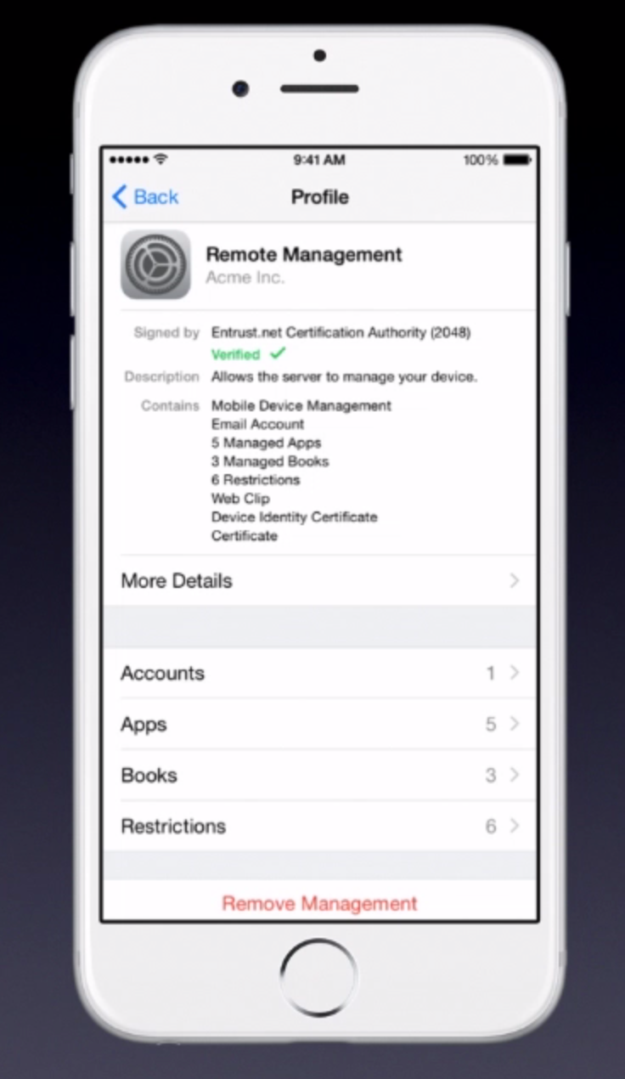
Enhanced Management UI
shows MDM settings to users in one place
essential in BYOD where transparency is important

Slide 13
Other Features
books and pdfs can be automatically pushed to users with MDM
only open with managed apps and shared with managed accounts
can also be removed remotely
Enhanced Management UI
shows MDM settings to users in one place
essential in BYOD where transparency is important
iOS 8 adds new ways to set a device name, clear restrictions and password

Slide 14
Security: Touch Id
protects login to phone and user data
unlocks keychain items
identifies successful matches
protects fingerprint data

Slide 15
Cryptography
expands data protection
use user’s password and the hardware of their device to develop strong password key
creates powerful, additional layer of cryptography
protect certain apps on the disk
greater control over mail security
external email address marking

Slide 16
Always-on VPN
tunnel all IP traffic back to the organization
give full control of device traffic
default tunneling protocol IKEv2 secures data transmission with encryption
requires device supervision, which can be configured on any device with MDM using apple configurator
requires no user interaction

Slide 17
Powerful productivity features
Time-Saving Features in Mail
Interact with colleagues with Calendar
App Extension(Extend Business Workflows)
Seamlessly connect Devices

Slide 18
Time-Saving Features in Mails
Quick swipe gesture
Jump between drafts and inbox
Intelligent suggestions
Auto reply in Exchange
Thread notification

Slide 19
Interact with Colleagues in Calendar
Free/Busy lookup
Private appointments
Mail meeting attendees
Respond from calendar
Custom repeating events

Slide 20
App extension
Most visible change
Gives third party app Developers a way to interact with inbuilt apps
Entirely new business workflow can be created between apps
Security and integrity is maintained across the apps

Slide 21
Types of Extensions
Document Providers
Custom Actions
Third-Party Keyboards
Widgets

Slide 22
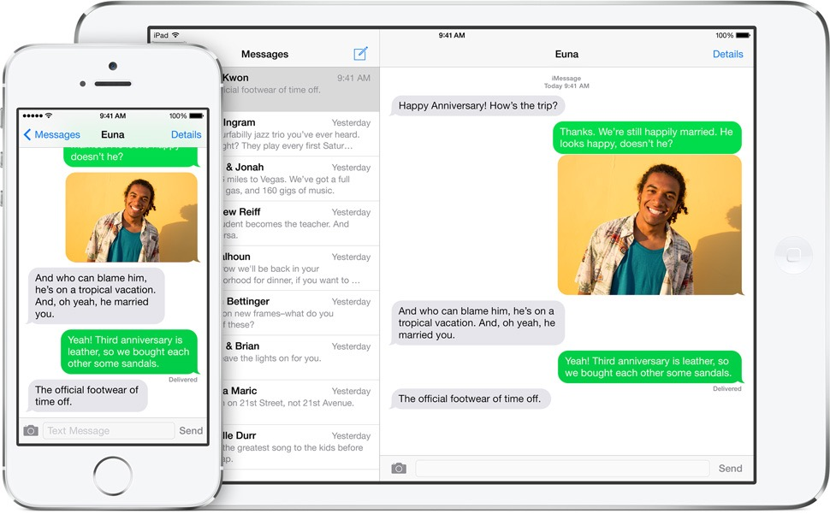
Seamlessly connect devices
Handoff
Make and answer phone calls
Instant Hotspot

Slide 23
Tips App
Details of old/new features of iOS 8
Content in the app updates automatically

Slide 24
Apple Financial Services
http://salesresources.apple.com/go/webinars/ios8forbusiness/410/?eventOrder=4,5,7,6,2,3,1

Slide 25
Procuring App Store Apps

Slide 26
Difference between Android and iOS 8
they both enhance security for MDM usage, especially through the use of cryptography
Android uses smart lock that uses facial recognition; iOS uses touch id for locking the device
they both standardize the interface for managing remote devices and configuring MDM
they both separate work and personal environments on mobile device: Android does this using Managed Profiles, iOS does this using Managed Apps

Slide 27
True/False Quiz
Managed Document Providers, Managed Domains, and Managed Keyboards are all new technologies in iOS 8 that support MDM.
Managed Books and PDFs can be opened by any app on an iOS device.
iOS 8 increases the transparency of MDM by showing the MDM settings to users in one place
MDM is a part of EMM

Slide 28
Thank You!

