Slide 1
Android Obfuscation
Wangjun Hong, Zhengyang Qu,
Northwestern University, IL, US,
Notes:
She worked on this project mainly during her summer internship at northwestern university.

Slide 2
Outline
Introduction
Reverse Engineering Techniques
Design & Implementation
Results
Comparison

Slide 3
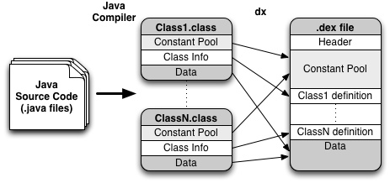
Android App compilation

Slide 4
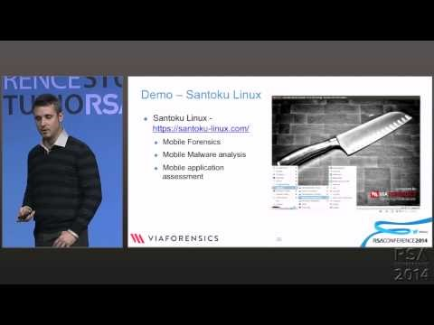
Reverse engineering
Android Apps
Reverse Engineering Talk

Slide 5
What to benefit from reverse engineering?
Inject ad-lib, repackage
Steal the intelligence property
Manipulate the execution of application
  User privacy collection, Financial loss…
Cheat the game

Slide 6
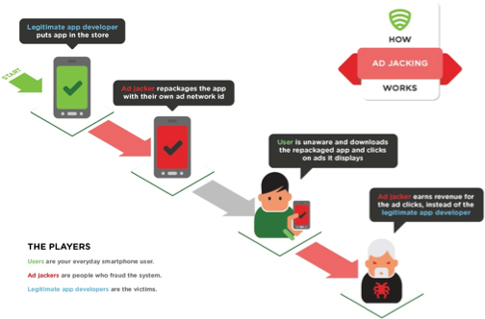
What to benefit from reverse engineering?
Inject ad-lib, repackage

Slide 7
Usage of Anti-reverse engineering techniques
Developers:
  Protect their private property
  Harden the security of users
Malware authors:
  Prevent the malware from being detected and analyzed

Slide 8
Lots of Products
ProGuard: free Java class obfuscator
DexGuard: the professional version of ProGuard
Ijiami, bangcle: two Chinese business that focus on obfuscation
Notes:
Add more: logos, features

Slide 9
Outline
Introduction
Reverse Engineering Techniques
Design & Implementation
Results
Comparison

Slide 10
List of Obfuscation Techniques
Lexical Obfuscation
Anti-debug
Tamper Detection
Anti-decompiling
Bytecode Encryption
Dynamic Loading
Reflection

Slide 11
Lexical Obfuscation
Package, class, method, variable, parameter names kept in the bytecode
Extracting lexical information helps human understand algorithm and recover the java code

Slide 12
Example
package com.helloworld
public class OperationUtil {
……
}
package a.a
public class A{
……
}
=>
Notes:
Using the same identifier over and over again in all classes and for all parameters at least once makes differentiation very demanding for any human analyst.
To increase the complexity, overloading is used to make the
differentiation of the methods even harder.

Slide 13
Random/Non-alpha
Identifier name
public final class CcoCIcI{
private static final byte[] COcocOlo;
private static boolean CcoCIcI;
private static BluetoothAdapter IoOoOIOI;
…
}
package 你{
public class 音{
public void 你() {}
public void 你(int ){}
}
}
Notes:
Trojan mentioned earlier makes use of a different approach that names classes and static
variables by only using permutations of the characters o, c, i and l.Hard to memorize and differentiate.
The illegibility of non-alphabetical characters enhancing this technique. But not only analysts are affected. Any software unable to deal with foreign characters
will most likely produce errors or crash.

Slide 14
Anti-debug
Stop execution when find debugger connected
if (android.os.Debug.isDebuggerConnected()){
android.os.Process.killProcess(android.os.Process.myPid());
}
Stop execution when running in emulator
  Validate device identifer
  IMEI, Phone number, voice mail numer, SIM serial number, subscriber ID, brand, device, model…
Notes:
The application stops its execution if the presence of a debugger is detected. This can be checked at the start of the application or regularly for instance at the beginning of each important method.
They explore their runtime environment before they start their actual application routines.

Slide 15
Tamper Detection
Validate the size of certain files or the file modification time stamps
Hash values/checksums of code blocks, classes or the whole program
Verify the signature of the apk file
It will detect in runtime to see the integrity of Android app, and if it has been modified, developer can take some corresponding actions like terminate the app.
Notes:
In order to detect any manipulation of the application a mechanism that verifies the integrity of the application can be implemented. The check can be executed at the start of the application or before certain methods are called.

Slide 16
Background on Anti-decompiling
Java decompiling: dex2jar + JAD
Dex2jar: using this can convert the .dex files to jar (.class)
JAD(Java Decompiler): convert .class to .java
De-compilation flow chart
Dex2Jar
JAD
Dex Files
jar
Java
Notes:
To prevent the decompilation of Java/Dalvik bytecode to Java source code, language constructs only valid in bytecode can be used
This gap between the different languages can be exploited by injecing different goto statements
into the bytecode.
In order for microprocessors to be able to execute statements of higher level programming languages,
they need to be translated by using the unconditional jump instruction goto.
Figure 4.1 shows a series of instructions that should never be executed. Because of the nested calls it is hard to detect the loop created with the goto statements. If the analyzer is not aware of such constructs it could either get stuck in the loop itself, crash or produce defective code.

Slide 17
Anti-decompiling
Java decompiling: dex2jar + JAD
Damage the dex.class
Goto not available in Java
:label_1
goto :label_3
:label_2
goto :label_4
:label_3
goto :label_2
:label_4
goto :label_2
Notes:
To prevent the decompilation of Java/Dalvik bytecode to Java source code, language constructs only valid in bytecode can be used
This gap between the different languages can be exploited by injecing different goto statements
into the bytecode.
In order for microprocessors to be able to execute statements of higher level programming languages,
they need to be translated by using the unconditional jump instruction goto.
Figure 4.1 shows a series of instructions that should never be executed. Because of the nested calls it is hard to detect the loop created with the goto statements. If the analyzer is not aware of such constructs it could either get stuck in the loop itself, crash or produce defective code.

Slide 18
Crack the apktool
What is apktool?
A reverse engineering tool, which can convert Android apps to .smali files, and can recompile .smali files to apk after some modification.
Android primary framework of APK
  Packaged with dirs: lib, res, assets
  Rename res -> R
  Change the structure of APK that could not be captured by apktool
Notes:
APKTool is a commonly used APK decompile tool, it can be said that 99% of the market can decompile APK out with it. XML style, configuration, page file will be fully decompiled out. How to prevent apktool? We should start with the APKTool origin, APKTool is provided by the GOOGLE APK compiler tools, so completely based on the construction of Android primary framework of APK are easily crack, anti compiled catalogues are including lib, res, assets. By changing the contents frame like this, can let the failure of APKTool, the latest QQ decompile fail. See through decompression, QQ software including lib, R, assets directory, META-INF and so on, the main difference is the directory name res became R, concrete is operated by what way.

Slide 19
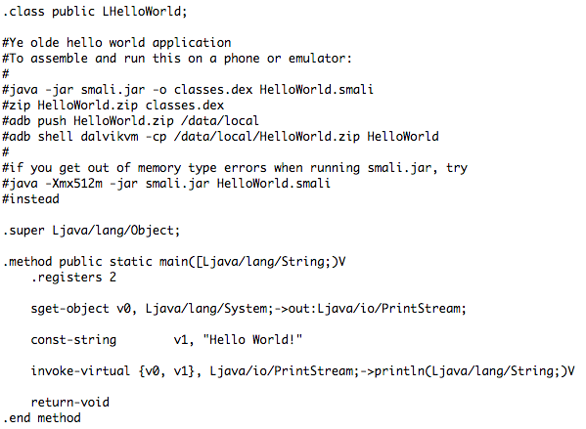
Smali Sample

Slide 20
Bytecode Encryption
Data represented only in encrypted version within the code
Have a paired function for the purpose decryption
Very diverse, hard to find a general, automatic detection method
Notes:
Obfuscators achieve encryption by introducing new methods to decrypt data represented only in encrypted form within the code. This data can represent everything from an integer to a full-blown file archive 1 containing one or more class files. Also dictionaries are possible that contain most of the strings used in the application.
We locate some fixed patterns for some commerial bytocode encryptions tools.

Slide 21
Dynamic Loading
Dynamically load dex.class in the runtime
Dex file stored as
  Additional file within the apk file
  Download from a remote source (not able to be handled by static analysis)
  Within the class, using a byte array
See example at bangcle soon
APK Wrapper
Find target dex file
Dynamic Loading
Notes:
A method can be used in Android by using a custom class loader. It needs
to make use of the ”DexFile” [11] class that is part of the Android API. For the class loader
to be able to load code, it needs to be in the form of a dex file.

Slide 22
Native Code
Android Linux Kernel
Native Development Kit (NDK), package parts of application written by C/C++
Invoked with Java Native Interface (JNI)
Packaged in .so lib, hard to reverse engineering
Might have purposes other than just obfuscation, such as performance
Notes:
With the Native Development Kit (NDK) parts of an application can be written in the
programming languages C and C++. This is possible because of Androids architecture that
is based on a Linux kernel. Using the Java Native Interface (JNI), native code can be called
from within the JVM.

Slide 23
Reflection
Inspection of classes, interfaces, fields, and methods at runtime
Modify private members at runtime
Hard for static analysis
Crypto cryptModule = new Crypto();
privateKey = cryptModule.getPrivateKey();
Object reflectedClassInstance = Class.forName(“de.tum.secureApp.Crypto”).newInstance();
Method methodToReflect = reflectedClassInstance.getClass().getMethod(“getPrivateKey”);
Object invokeResult = methodToReflect.invoke(reflectedClassINstance);
Notes:
Reflection is an obfuscation techniqe of the data obfuscation. It is a powerful feature, typically used to extend applications with external features, to browse classes, for debugging and in test tools. But it can also be used to obfuscate applications.
https://www.youtube.com/watch?v=ciDjI5EXew0

Slide 24
To Summarize
Lexical Obfuscation
Anti-debug
Tamper Detection
Anti-decompiling
Bytecode Encryption
Dynamic Loading
Reflection

Slide 25
Outline
Introduction
Reverse Engineering Techniques
Obfuscation Detection: Design & Implementation
Results
Comparison

Slide 26
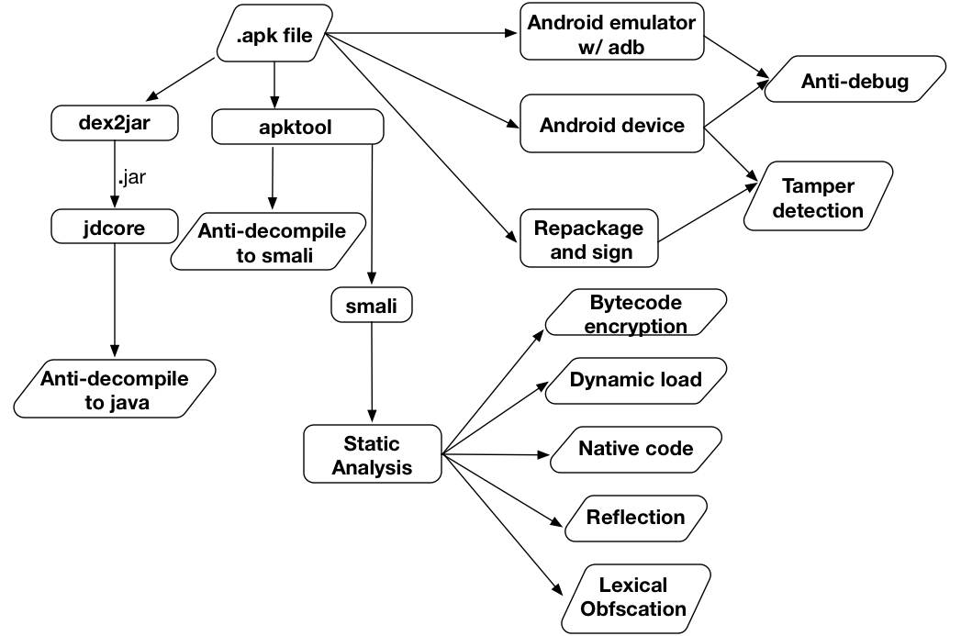
Framework

Slide 27
Lexical Obfuscation Detection
Parse the class name, super class name, field name, method name, source name from smali files
Construct a dictionary by db from wikiperdia
Check if a identifier contains meaning words length larger than 1

Slide 28
Anti-debug Detection
Run the application automatically on real device and emulator
Check if the app only crashes on emulator

Slide 29
Detection of Tamper Detection
Repackage and sign the application with our signature
Run the resigned version and original version in parallel
Check if only the resigned version crash

Slide 30
Anti Decompilation Detection
Check if the application could be decompiled to smali by using apktool
Check if the application could be decompiled to java by using dex2jar + jdcore

Slide 31
Other Detection Methods
Native code
  Packaged .so file
Dynamic Loading
  “DexClassLoader”
  “DexFile”
Java Reflection
  Ljava/lang/reflect/Method
Bytecode encryption
  Check if dex.class is packaged
  Check the existence of Activities in AndroidManifest,xml

Slide 32
Real examples
Real instance of using bangcle as the obfuscation tool

Slide 33
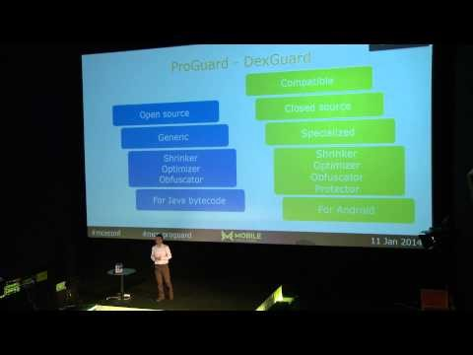
ProGuard

Slide 34
Comparison
Techniques | Intention | Ease of use | Popularity | Ease of reverse engineering | Prevent injection | Commerical/developer
Lexical | Pure | Easy | High | Middle | No | Proguard
Native | Various | Middle | Middle | Middle | No | developer
Dynamic Loading | Various | Middle | Middle | Middle | No | developer
Reflection | Various | Easy | High | Easy | No | developer
Anti-decom | Pure | Middle | Low | Difficult | Yes | Dexguard
Anti-debug | Pure | Easy | Low, rarely | Easy | No | developer
Tamper detection | Pure | Easy | Low, rarely | Easy | Yes | developer
Bytecode-encryption | Pure | Difficult | Low | Difficult | Yes | Ijiami, bangcle

Slide 35
In Summary
What obfuscation methods are generally used in the Android Reverse Engineering?

Slide 36
Exercise
Write an Android application which use the anti-debug technique.
Hint: Try to find debugger connection or the IMEI, phone number etc. of the device.

Slide 37
Thank you!
Questions?
http://list.cs.northwestern.edu/mobile/

