Slide 1
Defending: Taxonomy of Botnet Threats
Presented by GTR version M

Slide 2
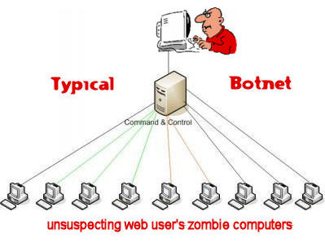
Taxonomy of Botnet Threats
Overview & Background
Taxonomy
Attacking Behavior
Command and Control (C&C)
Rallying Mechanisms
Communication Protocols
Evasion Techniques
Other Observable Activities

Slide 3
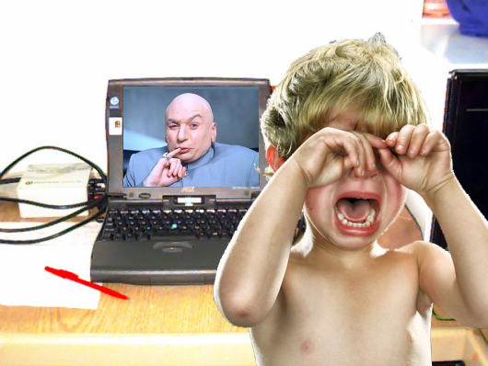
Overview and Background
World of Botnets
What is a Botnet?
What is a Bot?
What is a Botmaster?
How they control others?

Slide 4
Foundations of Botnets
How they started
Who controls them
How they infiltrate
Current status of bots

Slide 5
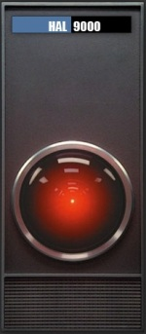
Taxonomy
Characteristics of botnets
Techniques of detection
Category of taxonomy

Slide 6
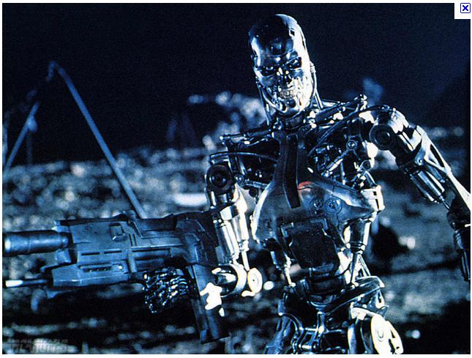
Attacking Behavior
Infecting new hosts
Stealing sensitive information
Phishing and spam proxy
DDoS (Distributed Denial of Service) Attack

Slide 7
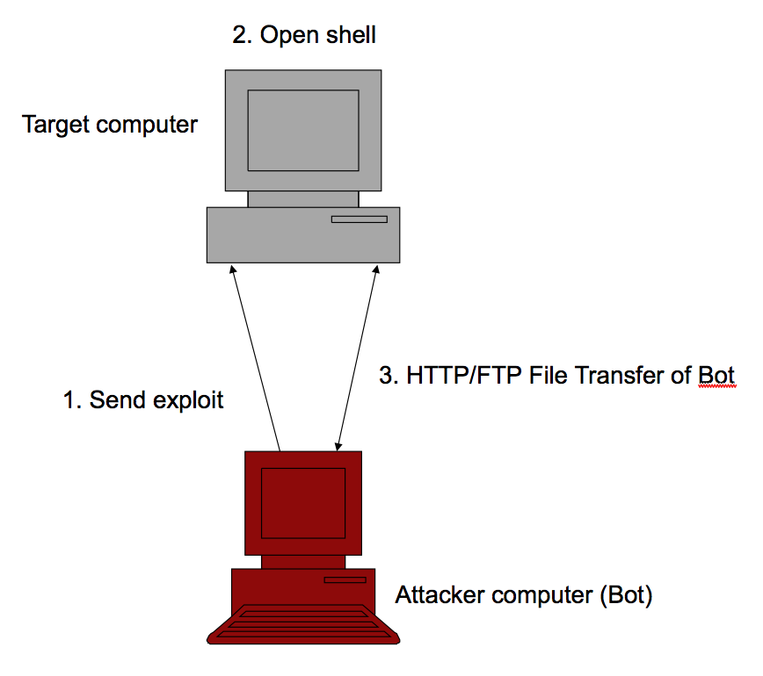
Command and Control (C&C)
Three Models:
Centralized C&C Model
P2P-Based C&C Model
Random C&C Model

Slide 8
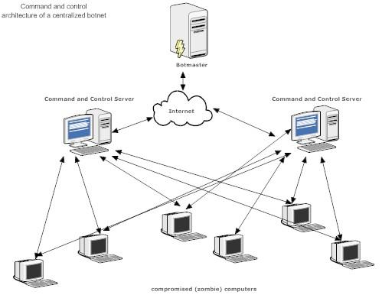
Centralized Model
Pros:
password protected to prevent eavesdropping
simple to implement or customize
easy for Botmaster to control
Cons:
C&C server is crucial for most conversations to happen
weakest link; destroy server, destroy Botnet

Slide 9
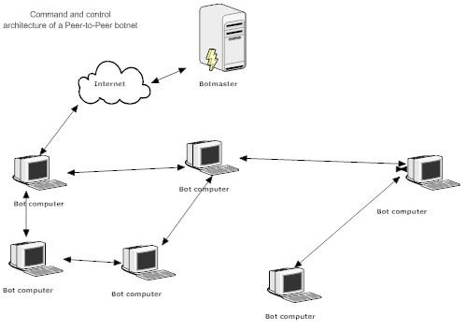
P2P Model
Pros:
harder to discover and destroy
does not depend on few selected servers
destroying single or few bots won't lead to destruction of an entire bonnet
harder to defend against
more robust than centralized
Cons:
small user groups, 10-50 users
no guarantee of msg delivery and propagation latency
harder to coordinate than centralized
used to attack a small number of target host

Slide 10
P2P Model
Pros:
harder to discover and destroy
does not depend on few selected servers
destroying single or few bots won't lead to destruction of an entire bonnet
harder to defend against
more robust than centralized
Cons:
small user groups, 10-50 users
no guarantee of msg delivery and propagation latency
harder to coordinate than centralized
used to attack a small number of target host

Slide 11
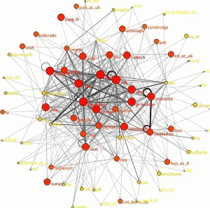
Random Model
Pros:
easy to implement and highly resilient to discovery and destruction
bots won't actively contact other bots or botmasters
bots would listen to incoming connections from its botmaster
botmaster scans internet to discover its bots, then issue command to bot
Cons:
has scalability problem and difficult to be used for large scale, coordinated attacks

Slide 12
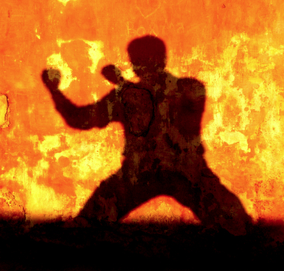
Rallying Mechanisms
Hard coded IP address
Dynamic DNS Domain name
Distributed DNS Service

Slide 13
Hard coded IP Address
IP address of C&C server is hard coded into the binary at the bot.
C&C server can be easily detected and communication channel can be easily blocked.
Not much used by current bots.

Slide 14
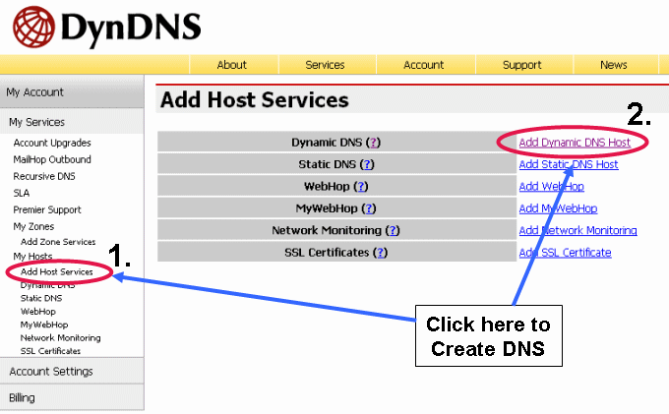
Dynamic DNS Domain name
Hard-coded domains assigned by dynamical DNS providers.
If connection fails, the bot performs DNS queries to obtain the new C&C address for redirection.
Detection harder when botmaster randomly changes the location.

Slide 15
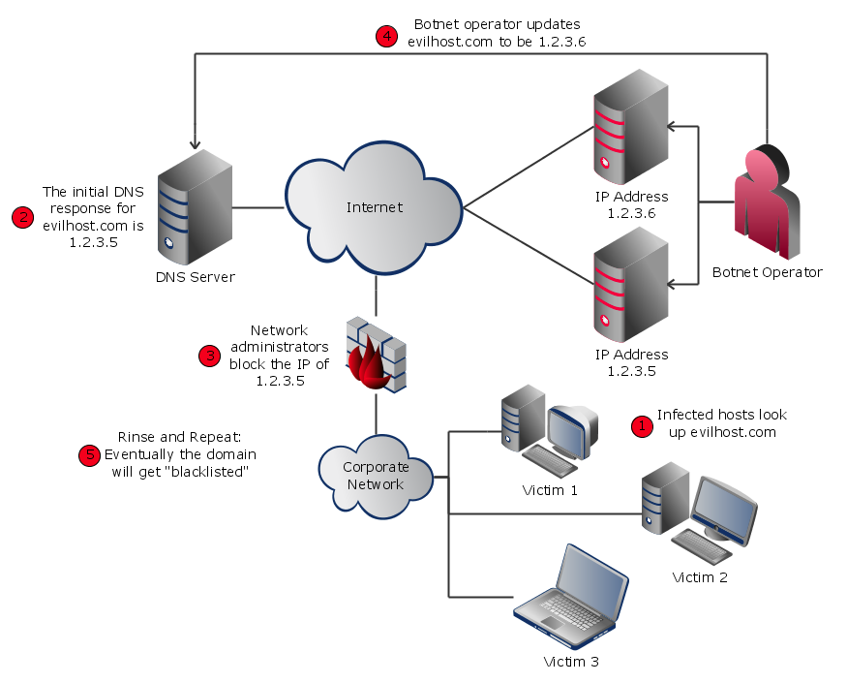
Distributed DNS Service
Botnets run own DNS service out of reach of authorities.
Bots use the DNS addresses to resolve the C&C servers.
Use high port numbers to avoid detection by security devices and gateways.
Hardest to detect & destroy.

Slide 16
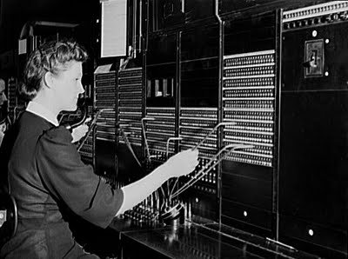
Communication Protocols
Determine the origins of a botnet attack and the software being used.
Allow researchers to decode conversations happening between the bots and the masters .
There are two main Communication Protocols used for bot attacks:
IRC
HTTP

Slide 17
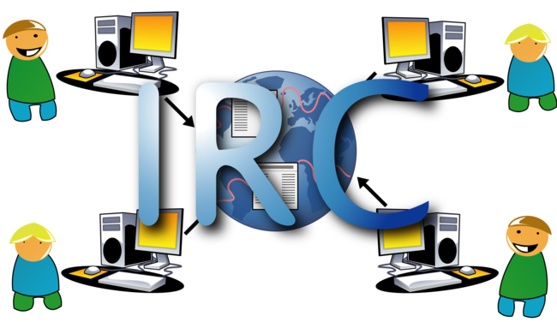
IRC Protocol
Mainly designed for group communication but can also handle private messages between two people.
Inbound vs Outbound IRC traffic.
Firewalls can be configured to block IRC traffic in corporate environments.

Slide 18
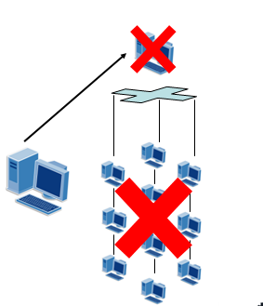
IRC Protocol
It suffers from a major drawback of using a
Centralized Server.

Slide 19
HTTP Protocol
Strength:
HTTP makes botnets harder to detect.
Firewalls block IRC ports but not HTTP.
Weakness:
It can still can be detected using appropriate filters.
Bot HTTP Traffic is different from normal traffic.

Slide 20
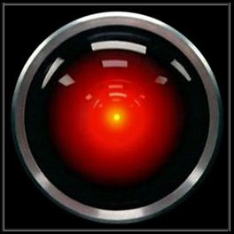
Evasion and Detection

Slide 21
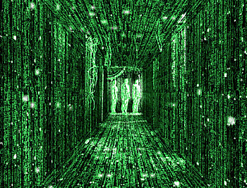
Evasion and Detection
Understand the problem:
There is no clear distinction between viruses, worms, and bots
Worms are viruses since they compromise hosts
Early viruses propagated via file replication
Bots are advanced worms/viruses since they propagate via hosts

Slide 22
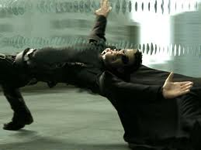
Evasion Techniques
From Signature-based Detection
Executable Packers - unpacking code, then transferring control to code
Rootkits - apps that gain access to a PC, then stay hidden until needed
Protocol evasion techniques - such as exploiting differences in how an OS interacts with a protocol such as TCP

Slide 23
Evasion Techniques
From Anomaly-based detection systems
Modified communication protocols: IRC, HTTP, VoIP
Utilize encryption to hide communications
Alternative channels: TCP, ICMP or IPv6 tunneling
SKYPE and/or IM are a matter of time

Slide 24
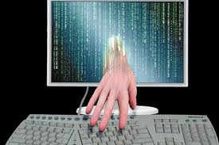
Effective Detection Alternative
Combination of Techniques:
Detect connections to C&C centers
Monitor for Communication Traffic
Monitor for Anomalous Behavior

Slide 25
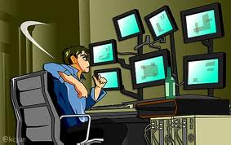
Combating Botnets focusing on Detectable Behavior
Global Correlation Behavior
Network-based Behavior
Host-Based Behavior

Slide 26
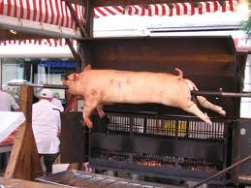
Global Correlated Behavior
Commonalities across different Botnet implementations:
Detect DNS changes for C&C host
Large numbers of DNS queries
BONUS: Operation Bot Roast I - The FBI's program to go after botnet creators, because the problem has become an issue of national security.

Slide 27
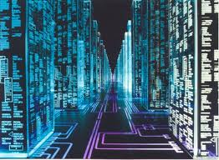
Network Behaviors
Observable Communications:
Monitor IRC & HTTP traffic to servers that don't require these protocols
IRC traffic that is not “human readable”
DNS queries (lookups for C&C controllers)
Frequency changes in IP for DNS lookups
Long idle periods followed by very rapid responses
Very bursty traffic patterns
Attack Traffic:
Denial of Service: TCP SYN packets (invalid source)
Internal system(s) sending phishing emails

Slide 28
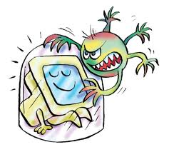
Host-based Behaviors
Detectable activity on an infected host:
Disabled Anti-virus
Large numbers of updates to system registry
Specific system/library call sequences

Slide 29
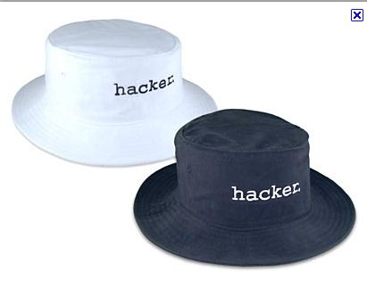
Conclusion
Stopping botnets is not easy.
Their decentralized nature, their use of unsuspecting systems makes it difficult to counter.
Instead, defending requires some unearthing to find the source of the problem.
That digging becomes admittedly harder and harder as botmasters become smarter and wilier.

Slide 30
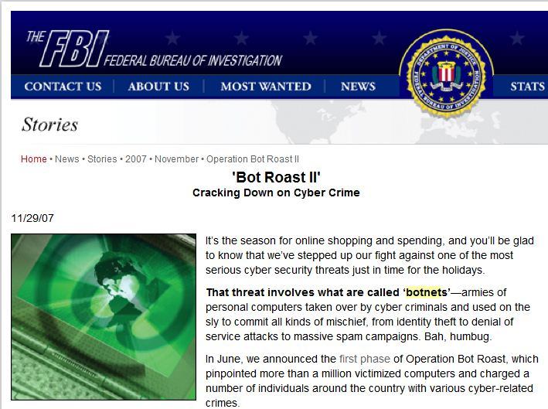
FBI Warning!

Slide 31
THANK YOU

