Slide 1
Wireless Network Security
Team MAGIC
Michael Gong
Jake Kreider
Chris Lugo
Kwame Osafoh-Kintanka

Slide 2
Why wireless?
Wifi, which is short for wireless fi … something, allows your computer to connect to the Internet using magic.
-Motel 6 commercial

Slide 3
… but it comes at a price
Wireless networks present security risks far above and beyond traditional wired networks
Ad-hoc networks
ARP poisoning
Rogue access points
Evil twins
Wired/wireless bridging
War driving
Compromised clients
Spectrum DoS
Traffic cracking
IP leakage
Man-in-the-middle
DHCP spoofing
Grizzly bears
Eavesdropping
MAC spoofing
Packet-based DoS

Slide 4
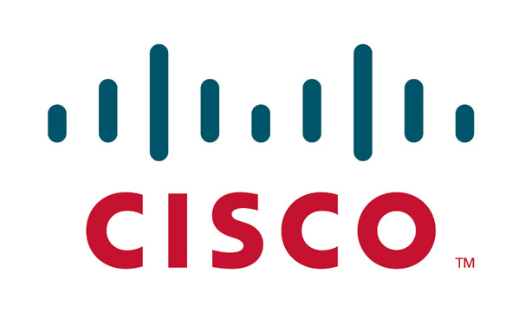
Cisco Wireless Network Solution
The Cisco Wireless Solution Architecture integrates existing Cisco networks with a robust, secure suite of wireless products.
Agenda:
The Cisco Wireless Network Architecture
Cisco Unified Wireless Network, CSA, Cisco NAC, firewalls, Cisco IPS, and CS-MARS
Common wireless threats
How Cisco Wireless Security protects against them

Slide 5
Today’s wireless network

Slide 6
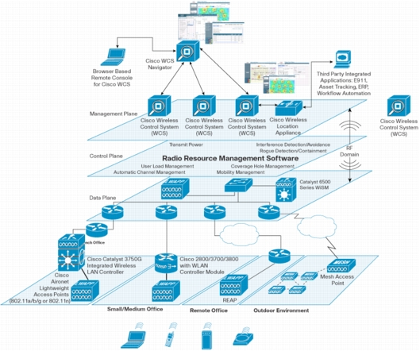
Cisco Unified Wireless Network
CUWN extends the Cisco network portfolio with wireless-specific solutions for
Security
Deployment
Management
Control issues

Slide 7
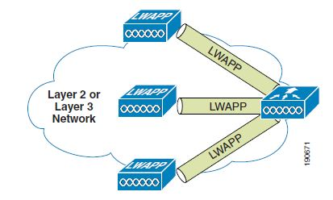
CUWN Architecture
Centralized operation and management with Wireless LAN Controller (WLC)
Simplified lightweight wireless access point operation (LWAP)
Traffic tunneled from LWAP to WLC
Consistent policy configuration and enforcement

Slide 8
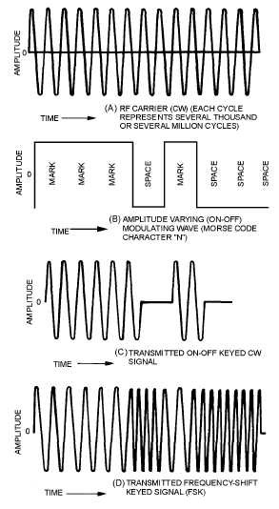
CUWN Security
Integrated and extended solutions
Wireless intrusion prevention
Rogue access point detection & mitigation
Access control
Traffic encryption
User authentication
RF interference & DoS protection
Wireless vulnerability monitoring
Infrastructure hardening

Slide 9
CSA – Cisco Security Agent
Full featured agent-based endpoint protection
Two components:
Managed client - Cisco Security Agent
Single point of configuration - Cisco Management Center

Slide 10
CSA - Purpose

Slide 11
CSA – Wireless Perspective

Slide 12
CSA – Combined Wireless Features
General CSA features
Zero-day virus protection
Control of sensitive data
Provide integrity checking before allowing full network access
Policy management and activity reporting
CSA Mobility features
Able to block access to unauthorized or ad-hoc networks
Can force VPN in unsecured environments
Stop unauthorized wireless-to-wired network bridging

Slide 13
Cisco Network Admission Control (NAC)
Determines the users, their machines, and their roles
Grant access to network based on level of security compliance
Interrogation and remediation of noncompliant devices
Audits for security compliance

Slide 14
Cisco NAC Architecture

Slide 15
Cisco NAC Features
Client identification
Access via Active Directory, Clean Access Agent, or even web form
Compliance auditing
Non-compliant or vulnerable devices through network scans or Clean Access Agent
Policy enforcement
Quarantine access and provide notification to users of vulnerabilities
Wireless integration
Both in-band and out-of-band between VLAN and WLAN

Slide 16
Cisco Firewall Purpose
Common first level of defense in the network & security infrastructure
Compare corporate policies about user network access rights with the connection information surrounding each access attempt
WLAN separation with firewall to limit access to sensitive data and protect from data loss
Firewall segmentation is often required for regulatory compliance
PCI
SOX
HIPAA
GLBA

Slide 17
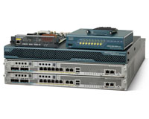
Cisco Firewall Features
Integrated approach
WLC with
Firewall Services Modules
Adaptive Security Appliance
Layer 3 routed Mode
Layer 2 bridged Mode
Support for virtual contexts to expand FWSM/ASA capabilities and further segment traffic
Multiple contexts are similar to having multiple standalone devices. Most features are supported in multiple context mode

Slide 18
Cisco IPS
Designed to accurately identify, classify and stop malicious traffic
Worms, spyware, adware, network viruses which is achieved through detailed traffic inspection
Collaboration of IPS & WLC simplifies and automates threat detection & mitigation
Institute a host block upon detection of malicious traffic
WLC enforcement to the AP to curtail traffic at the source

Slide 19
CS-MARS
Simplified, centralized management plane
Native support for CUWN components
SNMP based integration into WLC & WCS

Slide 20
Wireless Security Threats

Slide 21
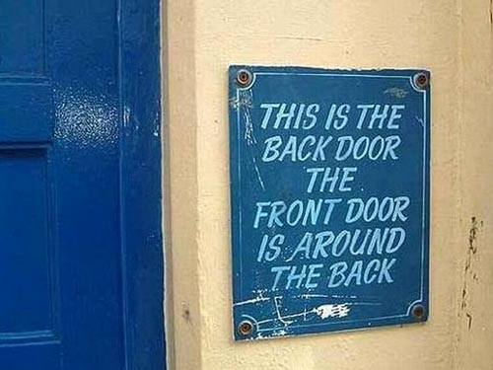
Rogue Access Points
Rogue Access Points refer to unauthorized access points setup in a corporate network
Two varieties:
Added for intentionally malicious behavior
Added by an employee not following policy
Either case needs to be prevented

Slide 22
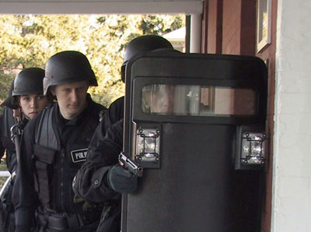
Rogue Access Points - Protection
Cisco Wireless Unified Network security can:
Detect Rogue AP’s
Determine if they are on the network
Quarantine and report
CS-MARS notification and reporting
Locate rogue AP’s

Slide 23
Cisco Rogue AP Mapping

Slide 24
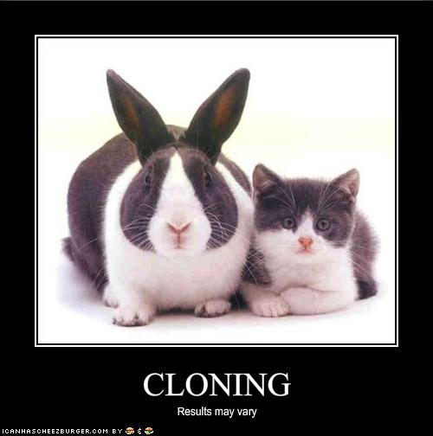
Evil Twins
Evil Twins, also known as Hacker Access Points, are malicious AP’s setup to disguise as legitimate ones
Users will likely not realize they are not connecting to the intended AP
Once connected, they can fall victim to multiple exploits, such as man-in-the-middle attacks.

Slide 25
Evil Twins - Protection
The Cisco Security Agent (CSA) can protect against Evil Twins.
It can ensure it is connecting to a company-owned access point.
If off-premise, it can force the user to use VPN.
Additionally, rogue AP’s on campus can be detected.
The network can even bring down the rogue AP using wireless de-auth packets (a loose form of DoS).

Slide 26
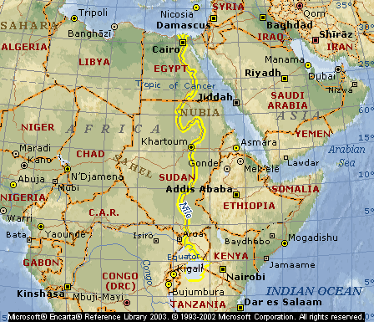
Wireless DoS
Wireless networks are subject to two forms of DoS:
Traditional (packet-based)
RF-based (“Jamming”)
Cisco uses Management Frame Protection to guard against certain packet-based attacks
Cisco WIPS uses dynamic radio resource management to help guard against jamming attacks

Slide 27
Traffic Cracking
But we’re secure….
MAC Authentication
WEP
WPA
Close but not even on the network
Cisco WCS
Layer 1/2/3 protection
Cisco MARS
Detection

Slide 28
Cracking the protection

Slide 29
Compromised Clients
Wifi Threat | Security Concern | CSA Feature
Ad-hoc Connections | Wide-open connections Unencrypted Unauthenticated Insecure | Pre-defined ad-hoc policy
Concurrent wired/wifi connection | Contamenating secure wired environment | Concurrent wired/wifi pre-defined policy Disable wifi traffic if wired detected
Access to unsecured wifi | May lack authentication / encryption Risk of traffic cracking, rogue network devices | Location based policies Restrict allowed SSIDs Enforce stronger security policies

Slide 30
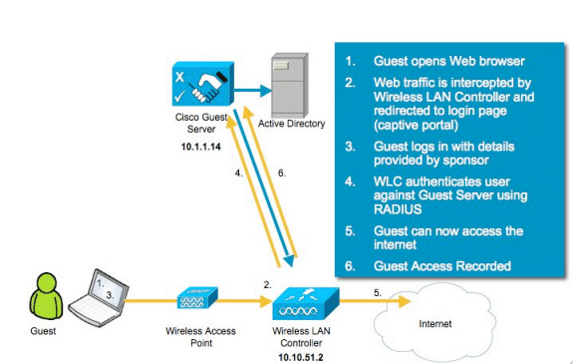
Guest Wireless
Let them on but don’t let them on… Cisco WCS

Slide 31
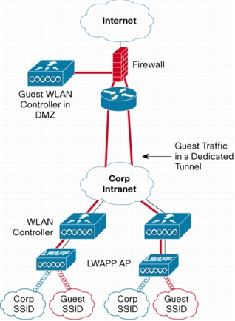
Guest Wifi with Benefits
Network segmentation
Policy management
Guest traffic monitoring
Customizable access portals

Slide 32
Conclusion
Present unparalleled threats
The Cisco Unified Wireless Network Solution provides the best defense against these threats

