Slide 1
How to infiltrate the Cisco protected wireless network, or taking candy from a baby
FROM
RICHARD RODRIGUES
JOHN ANIMALU
FELIX SHULMAN
THE HONORARY MEMBERS OF THE Intercontinental Group

Slide 2
Goal
Penetrate the Wireless network protected by Cisco security suite
Listen to the secure traffic and steal valuable information
Laugh at the Cisco security professionals while retiring young and wealthy in Russia

Slide 3
Basic Flaws
To penetrate the WLAN, it is important to know the flaws.
The entire Cisco security suite is required. The problem with this is the price.
No mention of various authentication methods to the WLAN. Examples are 802.1x with IAS, Protected EAP (PEAP) with EAP-TLS .
Unified solution means a security breach on the wired network would likely compromise the WLAN

Slide 4
Price
Cisco Security agent – (Starter bundle – 1server with 10 desktops) - $2,027
NAC Appliance (3315) - $15,530
Cisco Firewall (ASA 5520) - $5,440
Cisco IPS (IPS 4240) - $8,103
CS-MARS (MARS 110R) - $37,153
Total - $68,253
Not included – Cisco WAP, WLC, POE Switches/Power injectors, SmartNet
This is a very costly solution

Slide 5
First Step
We have to learn our enemy: get all available documentation about the Cisco wireless security: installation, development, any other documentation, known issues and weaknesses

Slide 6
Plan for the attack
Following vulnerabilities were find during our research:
WPA wireless migration feature vulnerability
OTAP feature vulnerability

Slide 7
Bypassing the firewall
Firewall – get on the company’s premises as a guest or for the “interview” and access the WLAN directly

Slide 8
WEP vs. WPA
WEP
The same IV (initialization vector) can be used more than once. This feature makes WEP very vulnerable, especially to collision-based attacks.
With IV of 24 bits, you only have about 16.7 million of possible combinations.
Masters keys, instead of temporary keys, are directly used.

Slide 9
WEP vs. WPA
WPA
Length of IV (initialization vector) is now 48, comparing to WEP’s 24. This gives you over 500 trillion possible key combinations.
IV has much better protection with better encryption methods. This is prevention of reuse of IV keys.
Master keys are never directly used.

Slide 10
Wireless Security penetration
Security misconfiguration: Leaving a WPA wireless migration feature (WEP to WPA) enabled might lead to the security breach .
Force the access point to issue WEP broadcast packets, which are used to crack the encryption key and gain access to the network
Use Aircrack-ng tool to launch the active attack
AirMonitor
AirSend
Notes:
The basic principle of an active attack consists in sending packets to the WEP network to increase the traffic and so to speed up the WEP key cracking. The problem is that packets that are not WEP encrypted with the right key are ignored by the access point and the clients. To overcome this problem one can take advantage of one of the numerous WEP weaknesses, packet replaying. WEP does not add any timestamp, MAC (Message Authentication Code) or whatever to recognise a replayed packet. The same ethernet packet is converted always into the same WEP packet (if the same IV is used, but this one is not part of the ethernet data), so you can inject a previously seen packet and no one will notice it.

Slide 11
OTAP(Over-the-Air-Provisioning)
Process used for the wireless controller discovery during the initialization of the Wireless Local Access Point
WLAN Controller – device that provides real-time communication between Cisco Aironet access points, the Cisco Wireless Control System (WCS), and the Cisco Mobility Services Engine
Notes:
The OTAP process begins when the LAP momentarily brings the radio interfaces up before the Discovery phase and scans the different RF channels that listen for RRM neighbor packets.
When the LAP moves into the Discovery phase, it sends discovery requests through its primary interface to each of the controllers in the lists based on how it learned about them. For the controllers that are learned through OTAP, the LAP sends the controller a Discovery Request packet with the OTAP bit set.

Slide 12
Wireless Security penetration
Enabled OTAP (Over-the-Air-Provisioning) service allows the sniffing of the network details from existing network traffic thanks to unencrypted multicast frames or sky-jack Cisco equipment every time an access point is connected to the network with the OTAP
All new Cisco access points introduced in a network will first scan and listen for multicast broadcasts in the WLAN to determine the location of its nearest controller. We will introduce our device as a controller, and get an access to a WLAN

Slide 13
Organize Passive Attacks on Wireless Networks
As a “controller” device, we will be able to launch the following passive attack:
Eavesdropping
Capture network traffic for analysis using easily available tools, such as Network Monitor in Microsoft products, or TCPdump in Linux-based products, or AirSnort
Passive attacks are stealthy and difficult to detect

Slide 14
Monitoring - Response
The system is only as good as the users who have been trained to use it. “People” are the weakest link.
Need “strong” education, frequent mock-exercises and practice-runs.
Need to be always one-step better than the bad-guys and a simple CCNA certification does not cut it.
Notes:
As Jibran mentioned last week ..

Slide 15
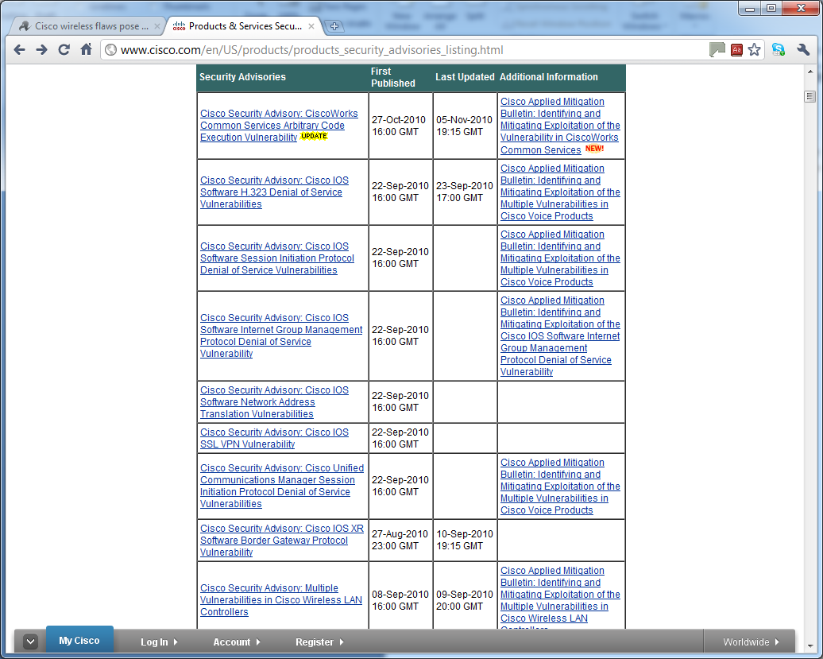
New CISCO Advisories …
Notes:
Security researchers demo Cisco Wi-Fi flaws - ZD Net, 16 April, 2010 08:56
Two generations of Cisco wireless LAN equipment contain a range of vulnerabilities
The 'Hacking Cisco Enterprise WLANs' presentation demonstrated attacks aimed at Cisco's first generation equipment Cisco Structured Wireless Aware Network (SWAN)
Possible to launch denial of service attacks and to sniff encrypted traffic on SWAN by exploiting weaknesses in Cisco's Wireless LAN Context Control Protocol (WLCCP)
SWAN access points transfer keys between them to facilitate roaming.
LEAP — the authentication protocol used in Cisco's equipment — was weak, meaning that the cryptography used to hide the keys could be broken.
In addition, attacks could be made against SWAN wireless components, including the insertion of rogue access points, the removal of physical components from the network, or attacks via the management interfaces.
Attacks also demonstrated against third generation Cisco Unified Wireless Network (CUWN) equipment.
Slide Notes: Rey urged enterprises to ensure management access to their wireless network was restricted. "They must take special care of isolating and restricting management access. This is the Achilles heel," he said.
The security researcher said that Cisco is not the only vendor grappling with these issues. "All of these [vendors'] solutions have skeletons in the closet," he said. "This is not so much about Cisco bashing."

Slide 16
What is next?
FTP stolen data to a server in Russia and enjoy your retirement
Notes:
So if you are not careful and ever-vigilant ..

Slide 17
QUESTIONS/CLOSING
Questions??
Thanks for listening!!

