Slide 1
!! Are we under attack !!
Personal Consumer devices continue to invade *Corporate enterprise – just wanting to plug in*
Mobile Device Management
Notes:
Brian
Notes:
Class question??
How many people have smart phones, tablets, or PC that connect to a corporate network?
What is the impact? How can Mobile Device Management help?

Slide 2
Overview
Northwestern University Graduate Team – Praxiteles. 2012
How It Got Here
Where It’s Going
The main devices for corporate productivity used to be the desktop or laptop computer.
RIM’s BlackBerry opened the door for smartphones as business tools.
Employees began bringing their own non-BlackBerry devices into work, and demanding that they be able to connect them with corporate resources
Mobile device management as a hub for managing a variety of corporate and personal
Security is a focus of most MDM vendors.
Mobile devices are increasingly application platforms.
Mobile technology will continue to change rapidly
We must continue to focus on solutions that offer us Enforced Passwords, Device Wipe, Remote Lock, Audit trail/logging, Jailbreak detection, Software Distribution with Application downloading, updating and verification support, external memory blocking and configuration change history.
Notes:
Brian
How it Got Here:
The IT department could deploy and maintain tight control over computers and the applications installed on them. - IT continued to maintain control by issuing corporate-owned BlackBerry smartphones, and managing them from the central hub of BES. BES could no longer be the hub for managing this variety of devices. Third-party mobile device management solutions were created to fill this gap.
Where is it going:
devices from one management interface. A hub is no longer enough. Vendors are rushing to implement features that go above and beyond the native capabilities of the devices and enterprise ActiveSync integration.
When both corporate data and personal data reside side by side on consumer devices, a balance between maintaining security and keeping personal data personal is needed.
MDM solutions will no longer manage only devices, but the applications installed on them.
; MDM vendors need to not only support today’s devices, but adapt to manage the unexpected challenges of tomorrow.

Slide 3
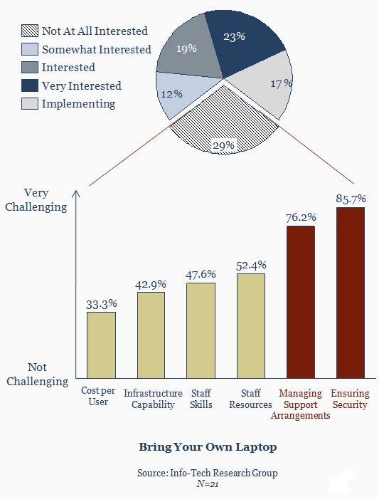
Bring Your Own Device is seen to be complex, expensive, and dangerous especially for Data Security
If employees are using their own devices, legitimate questions include:
How can IT protect the corporate data from corruption, misuse, or theft?
How can efficient use of company-owned applications be supported on a device with non-standard configuration?
How can the employee install a needed application even when their device uses a different operating system or operating system version?
Who is responsible for taking care of his or her asset;
How can the organization protect centrally located data if it can’t ensure that a device is properly secured?
19%
23%
Notes:
Brian
In traditional distributed processing, employee applications and data are installed on company owned and managed devices such as PCs.
Management of these assets enables the organization to support the efficient use of the applications and protect the data from loss, damage, or theft.
And if company owned (or licensed) software and data is on the device, won’t the device owner logically expect the organization to provide support?

Slide 4
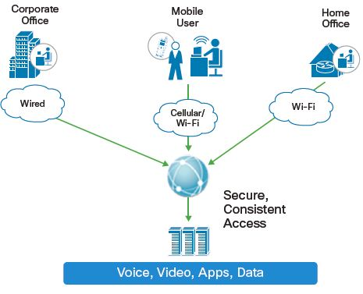
Bring Your Own Device Opportunity
Notes:
Nathan

Slide 5
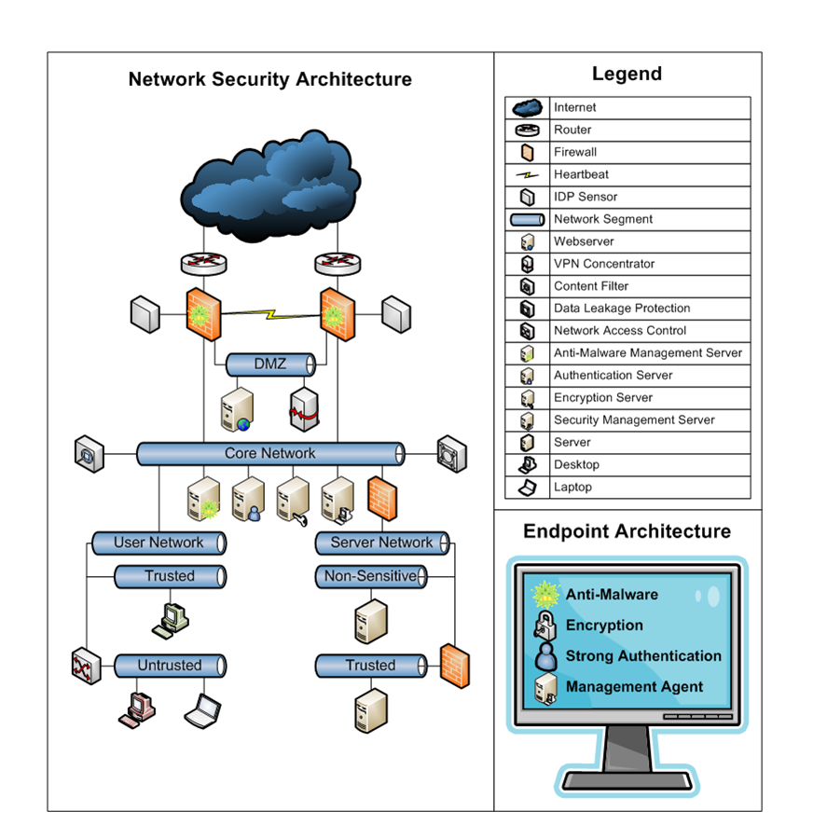
Typical Network Security Architecture
Security Network Architecture
Typical Components
Gateway firewalls
Dual gateway firewalls
Internal firewalls
Gateway anti-malware
Endpoint anti-malware
Dual Internet connections
Segmented networks
Tiered networks
Virtual Private Networks (VPN)
Intrusion detection & prevention
Content filtering
Data Leakage Protection (DLP)
Network Access Control (NAC)
Endpoint encryption
Enhanced authentication
Security management technologies
Risk Tolerance: Low
Presence of Sensitive Data: Yes
Remote Users: Yes
Hours of Operation: 24/7
Online Business: Yes
Notes:
Nathan
Organizations that requires a high level of security protection. Endpoints should be protected with anti-malware and strong authentication and encryption should be used on laptops and sensitive servers.
The organization require a granularly segmented network to create security zones and since the organization is an online business, dual Internet connections and firewalls are needed to mitigate website and network downtime.
DLP is recommended in the organization to protect sensitive data from loss or theft. Content Filtering is also recommended as it will ensure that no unauthorized websites or other materials are viewed from company endpoints.
NAC should be implemented to protect static endpoints on the network. The organization should ensure that An IDP system should be used to prevent unauthorized or malicious access to data.
Finally, a Management System should be used to properly track, monitor and maintain security systems.

Slide 6
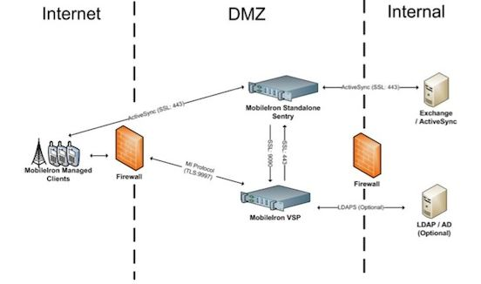
Bring Your Own Device – Mobile Security
Notes:
Nathan

Slide 7
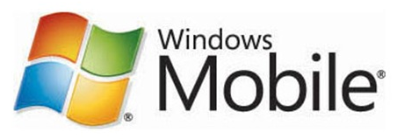
Next-Gen Multi-OS Mobile Device Management
iPhone/iPad
Android
Blackberry
Windows Mobile
Symbian
Enterprise Services
Real-Time Smartphone Inventory Dashboard – Multi-OS
Advanced Security & Management
Configure, Secure & Manage Smartphone & iPad (OTA)
Application Mgmt & Distribution
Real-time inventory, In-house App Store
Generate Actionable Alerts based on Policy
SIM change, Intl roaming,…
Employee Owned phone
Data boundary, Self Governance,…
Notes:
Nathan

Slide 8
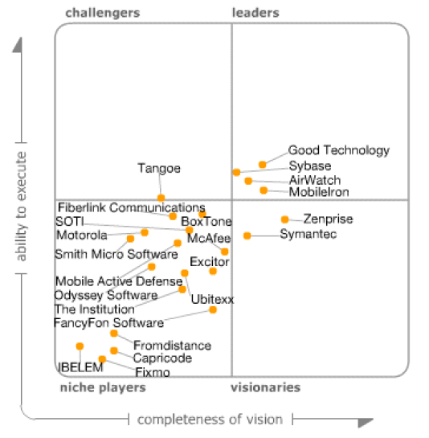
Competitive Outlook

Slide 9
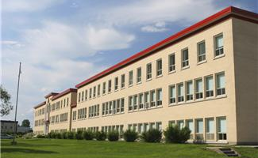
Solution Three Services of MobileIron Virtual Smartphone Platform
Control Chaos
(IT)
Control Cost
(Telecom)
Expand Experience
(User)
Secure and manage mobile devices, data, and apps
Reduce wireless bills thru visibility into usage and quality
Deliver new services and move accountability to the user
Enterprise
End-User
Advanced Management
Mobile Activity Intelligence
MyPhone@Work
Device management
Security
Access control
Enterprise data boundary (selective wipe, privacy)
Remote control
Enterprise app store
Activity analysis (voice, SMS, data traffic)
Int’l roaming monitor
Service quality analysis
Alerts and actions
Activity and quality
Privacy controls
Enterprise app store
Self-management
Virtual Smartphone Platform
Smartphone Mission Control
Proactive Business Intelligence
Cooperative Mobility
Notes:
Todd

Slide 10
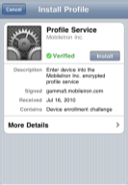
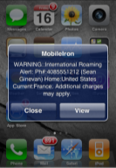
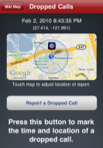
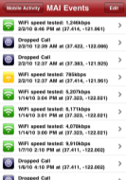
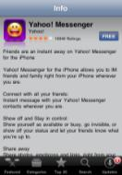
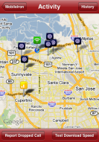
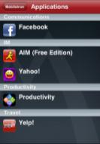
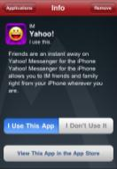
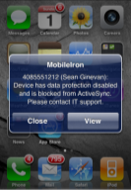
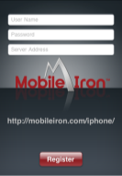
MobileIron iPhone, iPad & iPod Services
Secure at Scale
Manage Apps
Control Cost
Integrate iPhone into IT Operations
Provision at scale
Configure and secure devices
Obtain real-time inventory
Determine operational & security state of devices
Revoke enterprise resources and settings
Manage Enterprise Apps End-to-End
Gain real-time visibility into installed apps (iOS 4)
Recommend App Store applications to end-users
Distribute in-house applications over-the-air (iOS 4)
Manage Enterprise Apps End-to-End
Determine which devices are internationally roaming (iOS 4)
Generate alerts based on IT policy
Measure and record connection quality and speed (Cellular and Wi-Fi)
Report performance and dropped calls on map
Notes:
Todd

Slide 11
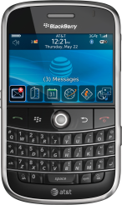
MobileIron Blackberry Value-Added Services
Advanced Troubleshooting
Control Cost and Quality
Employee Self-Governance
Advanced Help Desk & App Mgmt tools
Provision at scale
Configure and secure devices
Obtain real-time inventory
Determine operational & security state of devices
Revoke enterprise resources and settings
Real-time Business Intelligence
Activity analysis (voice, SMS, data traffic)
Generate alerts based on Telecom policy (minutes usage and International roaming)
Report performance and dropped calls on map
Billing plan integration
Employee Self-Portal
Employee Self-registration
Up-to-date view of usage by end user
Enterprise App Store
SMS search and history
Enterprise sociograph
Find-my-phone mapping
Notes:
Todd

Slide 12
MobileIron Full MDM Services for WinMO, & Symbian
Smartphone Mission Control
Control Cost & Quality
Employee Self-governance
Next-Gen Mobile Device Management
Device Management
Remote Control/Access to Blackberry
Visibility & Control over Active-Sync devices
Generate alerts based on IT Policy (SIM change)
Gain real-time visibility into installed apps
Distribute in-house applications over-the-air
Ability to Selectively Wipe contents
Virus scanning connector
Real-time Business Intelligence
Activity analysis (voice, SMS, data traffic)
Generate alerts based on Telecom policy (minutes usage and International roaming)
Report performance on map
Billing plan integration
Employee
Self-Portal
Employee Self-registration
Up-to-date view of usage by end user
Enterprise App Store
SMS search and history
Enterprise sociograph
Find-my-phone mapping
* Release pending
Notes:
Todd

Slide 13
Bring Your Own Device Security Controls
Notes:
Todd

Slide 14
Cost Analysis
Start-up and Termination Savings
IT Action and Operation
User Action and incident
Telecom Usage
Bring Your Own Device

Slide 15
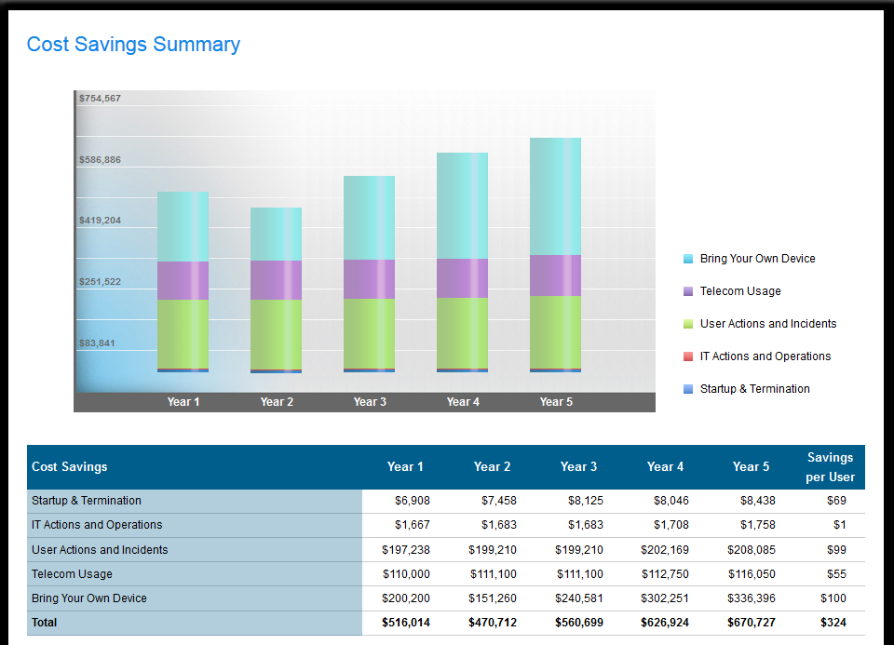
Notes:
Erildo

Slide 16
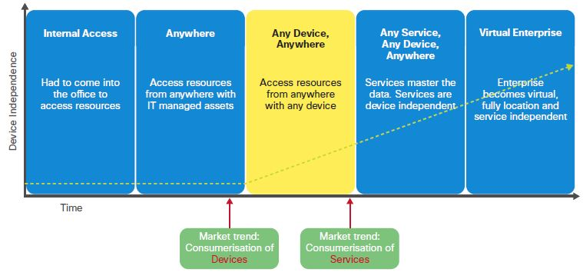
What Does It All Mean?
Notes:
Erildo

Slide 17
Would you like to see a demonstration:
Questions
Amit??
Notes:
Erildo

