Slide 1
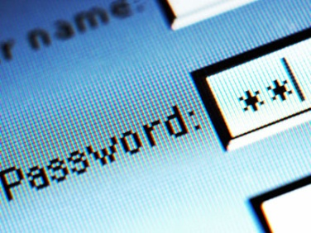
Authentication through Password Protection
Team: SuperBad Cats
MSIT 458 – Dr. Chen

Slide 2
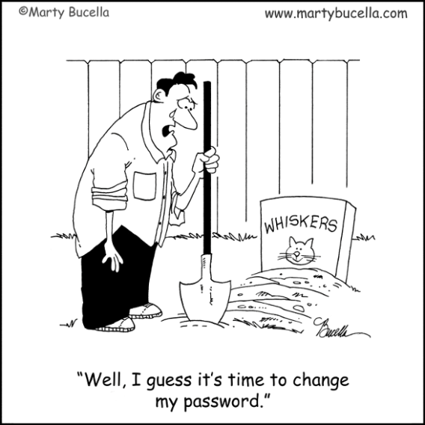
Background to the Problem:
Companies require password protection on many important systems within their company
Various systems may have differing password requirements
Requiring users to create and recall different passwords for different systems
Various systems may be used only sparingly by certain users
Users may forget their password after a period of non-use
Companies often require a new password after a given period of time
Requiring users to create and recall different passwords for different systems

Slide 3
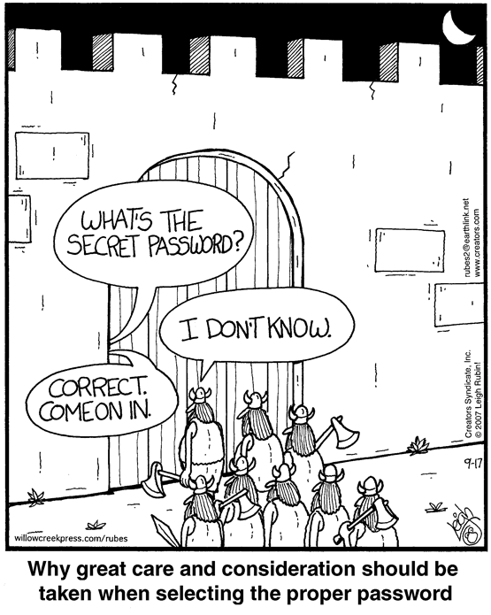
Password Reset User Support:
Call support (authenticity and validation)
Time Spent on Resets
Quantity of Resets per Year
Cost per call
Why they call
Web-based password reset
(setup by users with challenge questions)
Confidentiality
Authenticity
Integrity
Availability

Slide 4
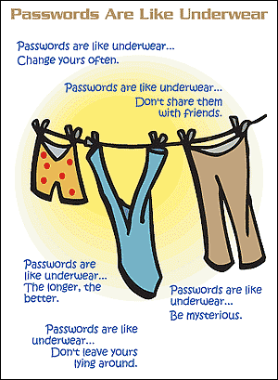
Problem:
In Summary:
Maintaining multiple passwords for a single user to access necessary systems results in excessive work time lost and cost to the company
Too many passwords
Can’t remember passwords
Too complex
Too easy
Can't remember answers to challenge questions
Don't know the password complexity rules

Slide 5
Password Complexity: Sample Company
Enforce password history 24 passwords remembered
Maximum password age 90 days
Minimum password age 1 days
Minimum password length 8 characters
Password Dictionary Blacklist "%Company Name%”
Password must meet complexity requirements Enabled (see below)
Complexity Requirements:
Not contain the user's account name or parts of the user's full name that exceed two consecutive characters
Be at least eight characters in length
Contain characters from three of the following four categories:
English uppercase characters (A through Z)
English lowercase characters (a through z)
Base 10 digits (0 through 9)
Non-alphabetic characters (for example, !, $, #, %)
Complexity requirements are enforced when passwords are created or changed.

Slide 6
Potential Solutions:
Identity Management Software
Examples: Forefront Identity Mgr, Novell Identity Mgmt Solution, Oracle Identity Mgr
Leverage Global Active Directory (GAD)
Active Directory Federation Services (ADFS)
Password Synchronization
Password Change Notification Service (PCNS)
Single Sign On
Pass Threw Authentication (Handshake), Kerberos, NTLM, SAML 2.0, Cloud Identity
Other Options
RSA Token, Biometric, Near Field Communication (NFC), RFID (Proxy), Retina, Social Media (Ex: Facebook)

Slide 7
Authentication through Password Protection
Team: SuperBad Cats
MSIT 458 – Dr. Chen

